Slide 1
Welcome to the Accumen Show!!
All Employee 2015 Annual
Compliance Training
Module 2 - Privacy & Security
HIPAA
Dana Simonds
Chief Compliance
& Privacy Officer
Matt Webb
IT Manager &
Information
Security Officer
© 2016 Accumen. Proprietary & Confidential. Materials may not be copied or distributed.

Slide 2
Agenda – HIPAA Privacy & Security
What is HIPAA and PHI?
Policies - Where are they?
HIPAA Overview
7 Privacy Policies & Review
Call or Don’t Call?
10 Security Policies & Review
Top Ten HIPAA Takeaways
Email Encryption
Accumen AlertLine
© 2016 Accumen. Proprietary & Confidential. Materials may not be copied or distributed.

Slide 3
What is HIPAA?
What is HIPAA: Federal Privacy and Security laws established to protect the privacy and security of a persons’ Protected Health Information ‘PHI’.
Who does is apply to: Covered Entity, Clearinghouse, payors, Business Associates.
Covered Entity: Providers of health care services: hospital, physician, laboratory, radiology, pharmacy, clinic, etc.
Business Associate: Accumen, consulting firm, law firm, IT vendor, EHR Vendor, billing provider, audit firm, etc. (Anyone a covered entity or Business Associate contracts for services with who has access to PHI).
Subcontractor Business Associate: Anyone Accumen contracts with to perform services who has access to PHI.
Accumen’s HIPAA Policies and Procedures are enterprise wide. Privacy & Security Policies apply to all of Accumen’s systems and interactions with confidential information, written, oral, electronic.
© 2016 Accumen. Proprietary & Confidential. Materials may not be copied or distributed.
Notes:
Need Dana to help fill in

Slide 4
What is Protected Health Information “PHI”?
PHI is any information relating to a person’s health status, treatment or payment for health services which may identify the individual.
PHI includes ORAL, WRITTEN, and ELECTRONIC records and communications.
If you use patient information that contains these identifiers, you are working with PHI and must abide by HIPPA protections
Patient Name Address Social Security or Medicare Number CPT or Diagnosis Procedure Name Email address | Geographic subdivisions smaller than a state Phone, fax, medical record, health plan, beneficiary, accession, requisition, account, or license numbers, etc. | All dates (birthdate, admission date, date of service, death, etc.) Device identifiers and serial numbers URLs & IP addresses Biometrics Images
© 2016 Accumen. Proprietary & Confidential. Materials may not be copied or distributed.

Slide 5
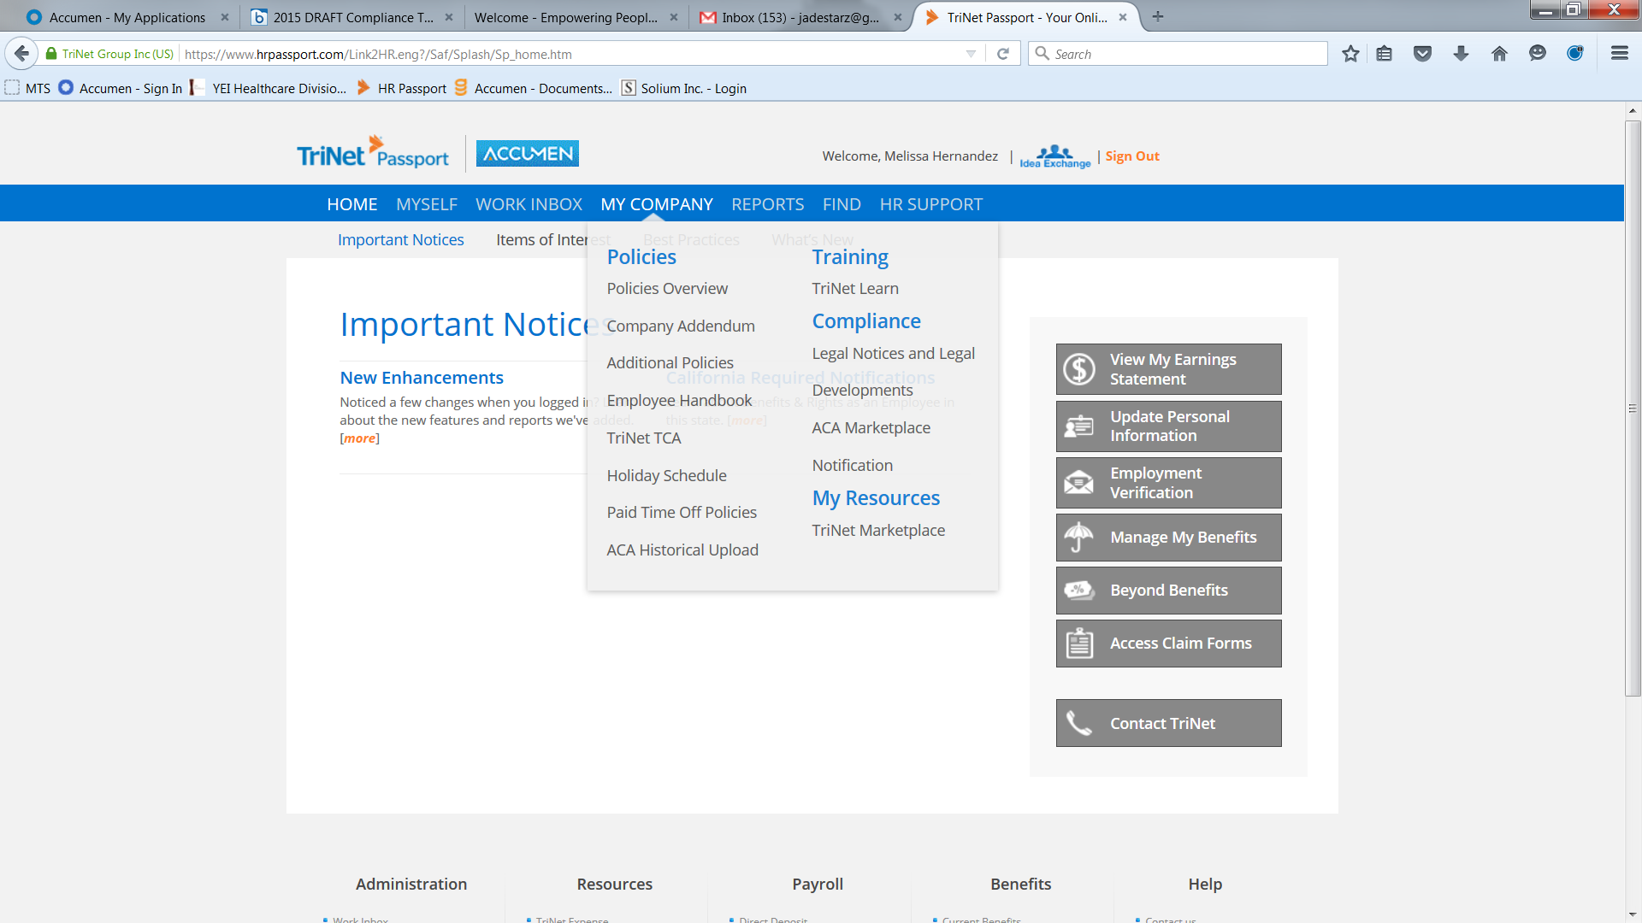
Policies & Procedures – Where are they located?
Accumen Policies & Procedures are available on TriNet HR Passport. Navigate to the My Company tab and select Additional Policies.
© 2016 Accumen. Proprietary & Confidential. Materials may not be copied or distributed.
Notes:
MELISSA: FIX

Slide 6
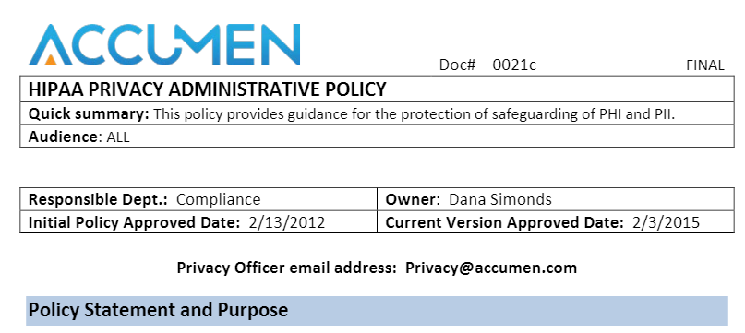
Policies and Procedures
This training session will touch on highlights in each policy. Refer to the policy for a full explanation. If you have questions on interpretation, please contact the Compliance or Security Officer listed below. We are here to help!
Dana Simonds
Chief Compliance & Privacy Officer
dsimonds@accumen.com
O: 858-207-3960 or C: 817-372-7923
Matt Webb
Security Officer
mwebb@accumen.com
O: 858-997-2099 or C: 858-518-1472

Slide 7
HIPAA Overview
Accumen has a designated Chief Compliance and Privacy Officer, Dana Simonds, who is responsible for developing, implementing, and enforcing policies and procedures to protect the privacy and security of patient health information. This role also manages HIPAA complaints and investigations. Matt Webb is Accumen’s Security Officer and is responsible for the execution and use of security measures to protect ePHI.
Understanding HIPAA and your responsibility in safeguarding patient protected health information is part of your role as an Accumen employee. If you have questions after viewing this presentation, please contact Dana. You may also submit questions or issues anonymously to Accumen’s AlertLine by calling 1-855-727-6720 or visiting www.accumen.ethicspoint.com.
Dana Simonds
Chief Compliance & Privacy Officer
dsimonds@accumen.com
O: 858-207-3960 or C: 817-372-7923
Matt Webb
Security Officer
mwebb@accumen.com
O: 858-997-2099 or C: 858-518-1472
Notes:
DELETE

Slide 8
HIPAA Privacy Policy 0021c
HIPAA Administrative Policy | 0021c
Covered entities and business associates are required by federal law to develop and implement policy and procedures that meet federal and state standards protecting PHI from unauthorized or inappropriate use or disclosure.
Privacy Policies
Privacy Officer
The company has a designated a Chief Compliance and Privacy Officer, Dana Simonds, who is responsible for developing, implementing and enforcing policies and procedures to protect the privacy and security of patient health information.
Administrative Requirements
Training - New employee orientation within 30 days, all employee annual re-training, specialized training as deemed appropriate shall be conducted.
Concerns - Privacy Officer is responsible for investigating and mitigating HIPAA concerns, complaints, breaches.
Sanctions - Violations of Company Privacy and Security policies constitute grounds for discipline up to termination.
© 2016 Accumen. Proprietary & Confidential. Materials may not be copied or distributed.

Slide 9
HIPAA Privacy Policy 0022c
HIPAA Acceptable Uses of PHI by Company | 0022c
Accumen, as vendor or service provider to our clients is only authorized to use PHI for health care operations as described in our client business associate agreement.
Privacy Policies
Permitted Uses
To deliver contracted services to client, for example: Service line optimization, supply chain management, outreach program management, technology solutions, and data aggregation, etc.
Prohibited Uses
Marketing
Fundraising
Sale of PHI
© 2016 Accumen. Proprietary & Confidential. Materials may not be copied or distributed.

Slide 10
HIPAA Privacy Policy 0023c
HIPAA Access, Amendment, and Accounting of Disclosures | 0023c
Patients have rights to access a copy, request amendments and or request a copy of certain disclosures made about their PHI.
Privacy Policies
Responding to Requests by Patients
Generally speaking, Accumen does not maintain the official patient record. The hospital or laboratory client maintains the official patient record.
If Accumen provides call center or patient service center management function, Accumen will follow the Client’s policy to manage patient requests.
Forward all other patient record requests to Accumen’s Privacy Officer.
© 2016 Accumen. Proprietary & Confidential. Materials may not be copied or distributed.

Slide 11
HIPAA Privacy Policy 0024c
HIPAA-PHI Incident Investigation and Breach Reporting Policy | 0024c
A Breach or Unauthorized access of PHI must be reported to Accumen’s client by the Accumen Privacy Officer within two business days of discovery. A substantiated breach is reported to Office of Civil Rights.
Privacy Policies
PHI Incident
If PHI has been inappropriately accessed, used or disclosed you must immediately report to Accumen’s Privacy Officer.
4 Factor Analysis
Emails containing PHI sent or intercepted by non-intended party.
Privacy Officer will investigate and analyze the incident, document findings and determine next steps.
Examples of a Breach
The type of information inappropriately used or disclosed;
The characteristics of the recipient of the information;
Whether the PHI was actually acquired or viewed; and/or,
The ability to mitigate the inappropriate disclosure.
Faxing PHI to wrong party (will consult with hospital policy).
PHI disposed in regular trash container.
Lost or missing computer/phone must be reported immediately.
Looking at patient records without a business needs (friends, family, self).
© 2016 Accumen. Proprietary & Confidential. Materials may not be copied or distributed.

Slide 12
HIPAA Privacy Policy 0025c
HIPAA Business Associate Agreement Policy | 0025c
Accumen must enter into a Business Associate (BAA) Agreement with clients or vendors if Accumen has access to, will disclose, create or receive PHI.
Privacy Policies
Process
All legal agreements, including BAA’s executed by Accumen must be routed through the legal department prior to signature.
Standard Form BAA
Accumen’s paralegal maintains current standard form BAA
Prior to routing to legal, determine if Accumen will either access or allow a vendor to access PHI in the delivery of services. If yes, a Business Associate Agreement (BAA) is mandatory.
Consult with the Privacy Officer or Legal Dept. with questions on negotiating a BAA.
BAA’s will include security requirements, as appropriate.
© 2016 Accumen. Proprietary & Confidential. Materials may not be copied or distributed.

Slide 13
HIPAA Privacy Policy 0026c
HIPAA De-Identification Policy | 0026c
Information that is considered PHI can be de-identified and no long subject to the HIPAA laws. HIPAA rules to de-identify data is specific and requires Privacy Officer approval to qualify as De-identified.
Privacy Policies
The Law
HIPAA permits the creation of “de-identified information” –information that has been stripped of any elements that may identify the individual.
Process
PHI may be appropriately de-identified in one of two methods: (1) in a manner a person with knowledge of and experience with generally accepted statistical & scientific principles and methods; or (2) according to the safe harbor method as outlined in the HIPAA Privacy Regulation but only if Company staff has first confirmed such information cannot be used to re-identify the individual.
PHI that has been appropriately de-identified is not subject to the protection requirements of the HIPAA Privacy Regulation.
This policy lists all the identifiers that must be stripped from PHI for de-identification.
Under select circumstances, the Company may assign a code or other means of identification to allow the re-identification of de-identified info.
© 2016 Accumen. Proprietary & Confidential. Materials may not be copied or distributed.
Notes:
Access to and disclosure of PHI – in all forms (oral, written, and/or electronic) – should be limited to the minimum amount necessary to carry out the task at hand.

Slide 14
HIPAA Privacy Policy 0027c
HIPAA Minimum Necessary Policy | 0027c
Access to and disclosure of PHI – in all forms (oral, written, and/or electronic) – should be limited to the minimum amount necessary to carry out the task at hand.
Privacy Policies
Process
When required, access to PHI and PII must be accessed from an Accumen IT and Security compliant device.
PHI and PII will not be stored, or transmitted from or to, personal, or other, non-compliance devices.
Questions or uncertainty regarding compliance should be directed to Accumen’s Privacy Officer.
The Company will make reasonable efforts to limit access to PHI to the minimum amount necessary.
Employees and other workforce members will not access, use or disclose PHI or PII unless necessary for them to perform their job responsibilities.
© 2016 Accumen. Proprietary & Confidential. Materials may not be copied or distributed.

Slide 15
Privacy Policy Review
0021c – Privacy Administration: Accumen and employees are required by law to comply with HIPAA rules and regulations. Dana Simonds is your Chief Compliance and Privacy Officer. This policy covers training, concerns and sanctions for non compliance.
0022c – Acceptable Uses of PHI: Accumen is authorized to use PHI for health care operations as described in our Business Associate Agreement with hospital/laboratory client.
Privacy Policies
0023c – Access, Amend, and Accounting for Disclosures: Patients have rights to their records. Accumen is not the official record holder. Forward all patient record requests to the Compliance and Privacy Officer.
0024c – PHI Incident Investigation and Breach Reporting Policy: If PHI has been inappropriately access, used or disclosed, you must report it to Compliance immediately.
0025c – Business Associate Agreement: Accumen vendors/contractors who have access to PHI must enter into a Business Associate Agreement with Accumen.
0026 – De-identification: Patient information that has been stripped of all identifiers may be classified as “de-identified” and not subject to HIPAA regulation. It is very hard to meet this requirement, submit all requests to qualify as de-identified to Compliance Officer.
0027c – Minimum Necessary: HIPAA requires you to limit the amount of PHI you need to do your job to the minimum amount necessary.
© 2016 Accumen. Proprietary & Confidential. Materials may not be copied or distributed.
Notes:
DANA TO USE THIS SLIDE TO SUBSTITUTE ITEMS TO MATT’S TOP TEN SLIDE

Slide 16
The Accumen Show: Call or Don’t Call?
IT’S NOW TIME FOR:
The Accumen Show!
CALL or DON’T CALL?
© 2016 Accumen. Proprietary & Confidential. Materials may not be copied or distributed.
Notes:
DANA TO FILL IN

Slide 17
John was telling Beverly how he met his deadline by temporarily sharing his password to the patient information system with an associate so he could help with his project. He has since changed his password.
Should John or Beverly call to report this incident?
Call?
Don’t Call?
© 2016 Accumen. Proprietary & Confidential. Materials may not be copied or distributed.
Notes:
DANA TO FILL IN

Slide 18
ANSWER
Answer:
Yes, John must call the Compliance and Privacy Officer, Dana Simonds or Accumen’s AlertLine at 1-855-727-6720. Compliance will determine if other changes or reporting is necessary.
Sharing passwords is a violation of HIPAA Password Management Policy 0018.
© 2016 Accumen. Proprietary & Confidential. Materials may not be copied or distributed.

Slide 19
HIPAA Security Policy 0010c
HIPAA Physical Safeguards Policy | 0010c
Physical access to electronic information systems and their housing facilities will be limited to those with proper authorization. Access control will be issued per the procedures in this policy.
Policies
Safeguard DO’s
Delete PHI from information systems after you have used it and when it is no longer necessary to use or store.
Use only Company-provided, encrypted thumb drives.
Have IT wipe clean all thumb drives and any other disposable media before properly disposing.
Use privacy screens when viewing ePHI on your computer.
Ensure any and all of your visitors sign-in when visiting the office.
Safeguard DON’Ts
Do not bring hardware or software onto Company premises without Security Officer approval.
Do not overload electrical circuits. Ask our Security Officer for additional surge protectors or outlet access if needed.
Notes:
Ensure any and all of your visitors sign-in when visiting the office.

Slide 20
HIPAA Security Policy 0011c
HIPAA Security Incident Reporting & Response Policy | 0011c
Incident reports concerning Accumen security policies and procedures, or Accumen’s compliance with such policies and procedures, should be made to Accumen’s CCO. The CCO will lead an investigation and will work with HR and General Counsel for conclusion.
Policies
Employees
Report concerns to the CCO, Dana Simonds, via verbal, written, or electronic communication.
CCO
Will promptly investigate incident reports.
This policy contains a form which may be used to report possible HIPAA incidents.
Will work to mitigate any possible harmful effects of the security incident.
Will create and record written findings, including information on any violation(s) and further action(s).
May impose or recommend sanctions and/or civil or criminal penalties for incidents of severe non-compliance.

Slide 21
HIPAA Security Policy 0012c
HIPAA Information Access Management Policy | 0012c
A representative of the IT Dept. will oversee User IDs & passwords, as well as User access to ePHI, Confidential Information, and other sensitive data, as necessary.
Policies
Access Authorization
All employee User ID’s & passwords will be uniquely assigned.
Access Monitoring
All systems used to maintain or transmit ePHI, Confidential Information, or other sensitive data will have access logging capabilities. These logs will be periodically reviewed.
New employees will be granted access via a New Hire Form; a copy of the form is attached to this policy.
Change requests for existing employees need to be submitted to Accumen’s IT Dept. and need to include manager approval.
Access requests to client information & systems should be coordinated through the applicable Client Account Lead.
Company-adopted web-based systems will disconnect after 4 hours of inactivity

Slide 22
HIPAA Security Policy 0013c
HIPAA IT Contingency Plan Policy | 0013c
Accumen has a policy and plan in place for data backup, disaster recovery, and emergency mode operation as well as periodic testing periods of each.
Policies
Administrative Details
Accumen has assessed the criticality, vulnerability, and security of its programs and information, and has devised an IT contingency policy and plan from such assessment(s).
ePHI will be routinely backed-up, per this policy.
Accumen has measures in place to restore lost data in the event of a fire, vandalism, natural disaster, or system failure.
The Security Officer or Compliance Officer will activate emergency mode operations when necessary.
As no ePHI is stored solely at Accumen’s offices, employees will not be granted access to the Company’s offices should any of the aforementioned events occur.
The contingency plan will be tested on a regular basis and revised as necessary.

Slide 23
HIPAA Security Policy 0014c
HIPAA IT Risk Management Policy | 0014c
Accumen’s IT Department will work to identify and mitigate risks to ePHI other data.
Policies
Risk Management & Security
Accumen will annually perform a HIPAA risk assessment.
Review & Evaluation
All IT security, network and server systems will be monitored in real-time to reduce risk to the availability and integrity of Accumen’s ePHI.
The Security Officer and CCO will maintain risk assessment and security evaluation results, and will work together to address any security issues.
Accumen, and its employees, will take reasonable and appropriate measures to protect ePHI against accidental, incidental, or intentional unauthorized modification, disclosure or destruction.
Accumen data processing resources should not be altered, destroyed, or disrupted without direct authorization.
The Security Officer will periodically review such monitoring & auditing logs, and will report any security incident(s) and information systems suspicious activity.
Accumen will annually evaluate its risk management & security policies.

Slide 24
HIPAA Security Policy 0015c
HIPAA Workforce Security Clearance Policy | 0015c
Each individual with access to ePHI must be aware of the appropriate security measures to reduce the risk of improper access, use or disclosure. They also must have appropriate clearances to access such information.
Policies
Authorization & Clearance
Accumen’s Security Officer, or a designee, will assign and oversee access to ePHI and/or the locations it resides.
Awareness & Training
Accumen will train system users, including management, in security awareness. Such training will include: periodic security reminders; malicious software protection; log-in monitoring and reporting; and password management procedures.
Access levels will be determined through several measures, including the minimum necessary policy, reference checks, and user’s identity and role-need to access ePHI.
Accumen’s Security Officer will ensure that all requirements of this policy are satisfied.

Slide 25
HIPAA Security Policy 0016c
HIPAA Access Termination Policy | 0016c
To ensure the integrity of ePHI and other confidential information, Accumen will terminate access to company information systems and facilities when an employee, (sub-)contractor, or associate leaves the company.
Policies
Information System Access
The Hiring Manager must immediately submit a User Termination Form upon the expiration of a person’s or company’s engagement with Accumen. The User Termination Form is attached to this policy.
Physical Access
The Hiring Manager or Human Resources will be responsible for collecting the following items from the departing person or company: all issued keys; building access pass(es); employee ID’s/access badges; and computer equipment.
Accumen’s IT Department will remove the person or company from all Access Lists, including office access, computer and application access, e-mail, phone system(s), and web applications.
The Security Officer will maintain a list of all employees’ access levels.

Slide 26
HIPAA Security Policy 0018c
HIPAA Password Management Policy | 0018c
To ensure the integrity of ePHI and other confidential information, Accumen will implement procedures for creating, changing, and safeguarding passwords.
Policies
Password DO’s
Choose passwords with a minimum of six (6) characters, some of which should be numbers and some of which should be letters.
Password DON’Ts
Do not use passwords that contain: any descriptive characteristic of the User (i.e. anything associated with the User’s name or initials, job function, address, telephone number(s), license plate, social security number, etc.).
Change passwords on a periodic basis, or as authorized and/or requested by Accumen.
Change passwords if: they have been, or are suspected to have been, accessed by someone other than the user; or, the user’s account has been accessed or infiltrated, or suspicion of unauthorized access or infiltration.
Do not use consecutive letters or numbers in your password(s).
Do not use the same password for multiple resources.
Do not write down or store your password(s) in the vicinity of your computer, and do not share your passwords with anyone else.
© 2016 Accumen. Proprietary & Confidential. Materials may not be copied or distributed.
Notes:
Choose passwords with a minimum of six (6) characters, some of which should be numbers and some of which should be letters.
Passwords should be changed on a periodic basis, or as authorized and/or requested by Accumen.
Passwords must be changed if: they have been, or are suspected to have been, accessed by someone other than the user; or, the user’s account has been accessed or infiltrated, or suspicion of unauthorized access or infiltration.

Slide 27
HIPAA Security Policy 0019c
HIPAA Computer Usage Policy | 0019c
Accumen defines acceptable use of company computers (tablets, laptops, desktops, servers), storage media, internet and electronic communications.
Policies
Computer Usage & Storage Media
Data created on Company computers is the property of the Company. Computers must be in a secure location. See IT for locking cables. Report stolen/lost computers immediately. Report security concerns (phishing, malware) to Security Officer immediately. Contact the Security Officer to install unapproved software.
Electronic Communication & Internet
Emails containing PHI or PII must be encrypted. Use “encrypt: in the subject line of your Accumen email.
The Company reserves the right to monitor Internet/Intranet usage.
Unencrypted removable media is not permitted. Contact the Security Officer for encrypted thumb drives. Used only Company provided cloud based storage media.
Never transmit PHI while connected to an unsecure network (an unsecure network does not require you to put in a password to access internet).
Electronic communication systems (email, instant messaging, Box.com, etc.) are for conducting Accumen business. Use your Company email for all business conducted on behalf of the Company.

Slide 28
HIPAA Security Policy 0020c
HIPAA Information Security Administration Policy | 0020c
Accumen has implemented policies and procedures – for all employees and (sub-)contractors – to govern the usage of Accumen computers, storage media, electronic communications, ePHI, and internet services.
Policies
Security Officer
The company has a designated a Security Officer, Matt Webb, who is responsible for developing, implementing and enforcing policies and procedures to protect the privacy and security of ePHI.
Administrative Requirements
Training - New employee orientation within 30 days, all employee annual re-training, specialized training as deemed appropriate shall be conducted.
Concerns - Security Officer and CCO are responsible for investigating and mitigating HIPAA concerns, complaints, breaches.
Sanctions - Violations of Company Privacy and Security policies constitute grounds for discipline, up to termination.

Slide 29
Review-Key Security Policy Points
0010c – Physical Safeguards: Only authorized employees or contracted workforce consultants will be granted access to our electronic information systems
0011c – Incident Reporting & Response: Immediately report security concerns to the Compliance or Security Officer. A form is attached to this policy.
Policies
0012c – Information Access Management: Access is granted or changed with the New Hire Form attached to this policy. Notify IT immediately if a contractor or employee leaves the organization. Access to client IT systems is coordinated through the Client Account Lead.
0013c – IT Contingency Plan: Accumen has back up plans in place to restore data in the event of a disaster or system failure
0014c – Risk Management: Accumen performs an annual risk assessment to identify and document changes to our business processes that involve PHI.
© 2016 Accumen. Proprietary & Confidential. Materials may not be copied or distributed.

Slide 30
Review-Key Security Policy Points
0015c – Workforce Security Clearance: Accumen’s Security Officer assigns your access to information systems. You are responsible for attending training, reading policies and following Information Security Reminders.
0017c – Computer Access Termination: Hiring manager must immediately submit the User Termination form attached to this policy or located in Manager Tool Box in Box.com upon expiration of an employee or sub-contractors engagement with Accumen.
Policies
0018c – Password Management: Passwords must have a minimum of 6 alpha/numerical characters. Periodically change your password. Do not share passwords.
0019c – Computer Usage: Encrypt email with any PHI elements by using encrypt: in the subject line of your email. Review this policy in detail, it provides you with a list of do’s and don'ts when using a computer to access Company information systems.
0020c – Security Administration: This policy deals administrative requirements to implement, training, address concerns, sanction offenders and manage the security requirements under the HIPAA Program.
© 2016 Accumen. Proprietary & Confidential. Materials may not be copied or distributed.

Slide 31
© 2016 Accumen. Proprietary & Confidential. Materials may not be copied or distributed.

Slide 32
HIPAA Top Ten Takeaways!
User ID’s and passwords are uniquely assigned – Never Share your password.
Delete ePHI when no longer needed and ensure removable media is wiped clean.
Report concerns to the Compliance and/or Security Officer.
Keep an eye out for periodic reminders regarding tips and training on information security.
Hiring managers must notify IT immediately if a person or company are no longer engaged with Accumen so that access can be revoked effectively.
Emails with PHI MUST be encrypted – encrypt: in the subject line.
Do not transmit PHI on an unsecured internet connection.
Report suspicious (malware/phishing) emails/computer activity to the Security Officer.
Sign your visitors into San Diego office.
Secure your computer, use privacy screens in public, dispose of PHI in shredder bins
Notes:
DANA TO UPDATE

Slide 33
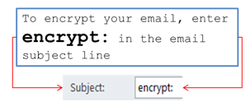
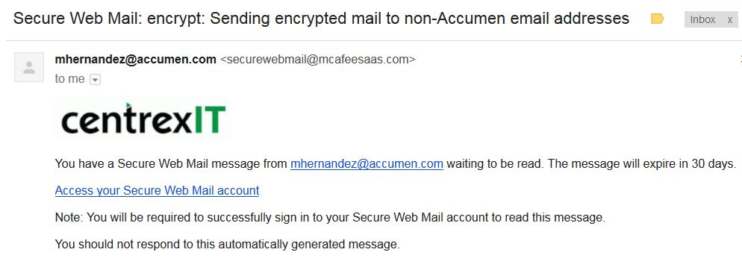
Email Encryption
We’d like to take a moment to share this SECURITY REMINDER with you regarding the sending of email to non-Accumen email addresses (any email address that does not end in @accumen.com).
When sending emails to non-Accumen email addresses, it is important to ENCRYPT each and every email if it contains suspected or actual confidential information, personally identifiable information (PII), or protected health information (PHI). Please see the below instructions and informational pictures on how to send encrypted emails from your Accumen email address to a non-Accumen email address.
The email link will direct email recipients to an encryption console where the recipient can download and view the encrypted message. If it is the recipients first time accessing the encryption console, they will need to create a free account to view the encrypted message(s).

Slide 34
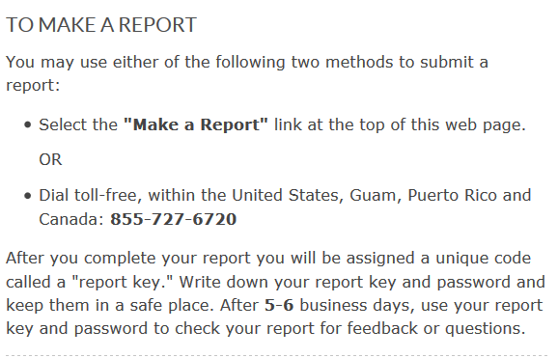
Compliance Hotline
Accumen is a company with strong values of responsibility and integrity. We strive to conduct all business matters pursuant to the highest ethical, business and legal standards.
We want our employees, clients and customers to feel comfortable expressing concerns, including activities that may involve violation of applicable laws and regulations, criminal conduct, environmental, health or safety incidents, and violations of Accumen’s policies.
In situations where you prefer to place an anonymous report you are encouraged to use Accumen AlertLine, hosted by a third party provider, EthicsPoint. The information you provide will be sent to us by EthicsPoint on a totally confidential and anonymous basis if you should choose. You have our guarantee that your comments will be heard.
If you are an Accumen employee and have a Human Resource issue please contact HR Passport.
If you would like to contact a representative of Accumen directly please feel free to contact Dana Simonds, Chief Compliance Officer, via telephone at 858-207-3960.
Notes:
Delete

Slide 35
Quiz Time
Exit Instructions
We hope this course has been informative and helpful.
Please proceed to take the
“Compliance Modules 1 & 2 Quiz”.
Dana Simonds
Chief Compliance & Privacy Officer
dsimonds@accumen.com
O: 858-207-3960 or C: 817-372-7923
Matt Webb
Security Officer
mwebb@accumen.com
O: 858-997-2099 or C: 858-518-1472

