Slide 1
Welcome to the Accumen Show!!
All Employee Annual
Compliance Training
Module 1 Corporate Compliance
Presented By:
Dana Simonds
Chief Compliance & Privacy Officer
© 2016 Accumen. Proprietary & Confidential. Materials may not be copied or distributed.

Slide 2
The Compliance Program
Objective of Accumen’s Compliance Program
To prevent, detect and address conduct that does not conform to the laws, regulations and policies that impact our business and the clients we serve.
You play a key role in promoting an organizational culture at Accumen that is consistent with our Mission, Vision, and Core Values, and promotes conduct conforming with our policies, federal and state laws.
Understanding and following the program reduces risks and penalties on both an organization and individual level.
© 2016 Accumen. Proprietary & Confidential. Materials may not be copied or distributed.

Slide 3
Agenda
Agenda
What makes Accumen great-You Do!
Compliance Code of Conduct
Ethical Dilemma?
Conflict of Interest
AlertLine
Fraud & Abuse
Policies & Procedures
© 2016 Accumen. Proprietary & Confidential. Materials may not be copied or distributed.

Slide 4
What Makes Accumen Great? – You Do!
We Profoundly impact Healthcare
Mission
Vision
Core Values
Code of Conduct
Accumen Way
Compilance Culture
I want to work here!
Notes:
If I had sum up our compliance philosophy, I would say we here at Accumen believe in cultivating strong values and integrity in all that we do. Our mission, vision, core values, code of conduct, and the Accumen Way reflect those beliefs and point team members in supporting our mission to profoundly impact healthcare.

Slide 5
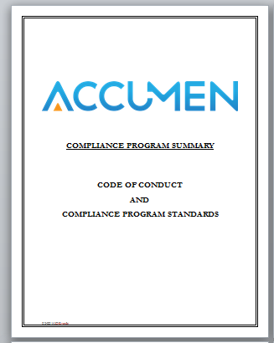
Accumen Compliance Code of Conduct
Accumen’s Compliance Code of Conduct is a navigations tool to help employees understand our requirements and expectations for ethical business conduct in the health care industry.
Code of Conduct Standards:
Honest, ethical and legal conduct
Cooperate with compliance program
Raise questions, concerns or violations to the Chief Compliance Officer, or use
Accumen AlertLine – Duty to report concerns
No retaliation or intimidation for reporting or raising issues
Perform appropriate background checks
Accurate record keeping
Conflict of Interest issues
Personnel may not be involved in gifts or benefits that influence business decisions
Appropriate test referrals
Ethical marketing activities
Compliance with patient privacy & security (HIPAA) standards
Safeguard Accumen’s and our clients’ confidential and proprietary information, including business plans, marketing strategy, financial data, etc.
Notes:
A cornerstone of our compliance program, the code of conduct helps Accumen team members understand our requirements and expectations for ethical business in the health care industry. Some examples of our Code of Conduct standards include: conducting ourselves in a honest, ethical and legal manner; raising questions or concerns to me, your Chief Compliance Officer; or, if you prefer, you can take advantage of Accumen’s Alert Line. The key message here is that you raise the concern, as we all have an express duty to report concerns; remember there is no retaliation or intimidation for reporting or raising issues in good faith; and, conflict of interest issues, such as arranging for business transactions between our clients – and it goes without saying, that personnel cannot be involved with gifts or inducements that are intended to influence business decisions.

Slide 6
Code of Conduct - Honest, Ethical and Legal Conduct
Accumen’s Code of Conduct is designed to guide our business decisions in the right direction.
Accumen’s Core Value of Integrity guides us to adhere to the highest ethical compliance and personal standards as the foundation of our business practices.
If faced with an ethical dilemma in the workplace, consult the Code for guidance, a member of management or the compliance officer. You can also use this list for a quick check.
If you are doing “what is right” you will be able to answer yes to the following questions:
Am I being truthful?
Am I acting fairly?
Is it consistent with laws, regulations and Accumen’s policies?
Am I acting in the best interests of Accumen and our client?
Would I be proud to tell someone about my actions?
Would I be comfortable seeing it in the media?
© 2016 Accumen. Proprietary & Confidential. Materials may not be copied or distributed.
Notes:
Let’s explore further how to conduct ourselves in an honest, ethical, and legal manner. If faced with an ethical dilemma, consult the Code, a member of management, or me for guidance. You can also use the quick check list on this slide. For example, ask yourself, “am I being truthful and acting fairly? Is my action consistent with laws, regulations, and Accumen’s policies or do I need clarification? Am I acting in the best interest of Accumen and our client? And, finally, would I be proud to tell someone about my actions or be comfortable seeing it in the media?”

Slide 7
Code of Conduct – AlertLine and Duty to Report
All employees have an obligation to report any actual or suspected violation, committed by self or another, of the Code of Conduct, Accumen policies and procedures, and/or federal and state laws.
Remember:
It’s never to late to report a problem
Reporting suspected violations is not an
act of disloyalty
Accumen has a non-retaliation policy
Reporting Options:
Contact the Compliance Officer directly at dsimonds@accumen.com or call 858-207-3960 office or 817-372-7923 cell.
OR, if you would like to remain anonymous, you may access a web site or speak to an operator to report your concern with Ethicspoint at:
www.accumen.ethicspoint.com or call toll free: 1-877-727-6720.

Slide 8
Code of Conduct – Conflict of Interest
The first step to avoiding a conflict of interest is to IDENTIFY one.
A conflict of interest can occur any time we have a financial or some other
interest outside the company that could in some way impair our fairness and impartiality on the job.
Examples of a potential Conflict of Interest:
You have a personal relationship or you are related to a family member of a vendor you are negotiating a contract for
2nd job that may interfere with your work
You have ownership or stock with a vendor/client
Accepting a valuable gift from a vendor
Unique to Accumen: If you are negotiating a contract between 2 or more clients. (CONTACT THE
COMPLIANCE OFFICER PRIOR TO NEGOTIATING).
What is the next step?
DISCLOSE the conflict to your
manager, HR or Compliance Officer.
© 2016 Accumen. Proprietary & Confidential. Materials may not be copied or distributed.

Slide 9
The Accumen Show: Call or Don’t Call?
IT’S NOW TIME FOR:
The Accumen Show!
CALL or DON’T CALL?
© 2016 Accumen. Proprietary & Confidential. Materials may not be copied or distributed.

Slide 10
John and Jane are discussing a potential reference lab contract between an Accumen and a Chi Client.
They are not sure if this particular arrangement would qualify as a conflict of interest.
Should John… (Call or Not Call the Compliance AlertLine?
CALL
NOT CALL
© 2016 Accumen. Proprietary & Confidential. Materials may not be copied or distributed.

Slide 11
ANSWER
Should John call the Accumen AlertLine?
Answer:
Yes, John should call the Accumen AlertLine because … [Reporting the poor practice will bring the practice to the Company’s attention and allow Accumen the opportunity for correction.]
© 2016 Accumen. Proprietary & Confidential. Materials may not be copied or distributed.
Notes:
Need Dana to help fill in

Slide 12
Healthcare Fraud and Abuse
Growing problem in US healthcare
Most providers and contractors are well-intentioned; however, in 2014 the government recovered $5.7 billion in healthcare fraud cases. Fraud persists because some people think it is easy money-with minimal risk.
Consequently, poor business practices that go undetected by the organization, but discovered by the government, will be prosecuted to the fullest extent under applicable Fraud and Abuse laws.
The health systems we serve are committed to fighting fraud and abuse
What is fraud and abuse?
FRAUD | ABUSE
Making false statements or representations of material facts to obtain some benefit or payment for which no entitlement would otherwise exist. | Abuse describes practices that: Result in unnecessary costs Are not medically necessary Are not professionally recognized standards, and Are not fairly priced

Slide 13
Examples of Fraud and Abuse
Kickbacks: Cash for referrals, free rent or below FMV rent for medical office space, free clerical staff, excessive compensation for medical directorships, anything of value in exchange for referrals.
Self-Referrals: When a provider refers themselves or a partner provider to perform a service, usually for a financial incentive.
Service Unbundling or Fragmentation: Billing for multiple procedures separately that should have been billed together in a bundle in order to forgo the bundled rate and increase profit.
Up-coding: Typically submitting a claim for a service more severe than the actual service provided. For example, submitting a claim for a broken ankle when the patient was only treated for a sprained ankle.
Cloning: Using an EHR system to automatically generate a more detailed patient observation profile by copying from another patient’s file with similar symptoms to appear as if a more thorough examination was done.
Phantom Billing: Billing for goods or services never delivered or performed.
Repeat Billing: Billing twice for the same procedure, supplies, or medications.
Keystroke Mistake: Entering incorrect codes, resulting in significant overcharges or in some cases an undercharge.
Cancelled Service: When a lab test is ordered in the Lab Information System and then canceled later but is still charged through the billing system.
Standard of Care: Billing for services in which the provider failed to meet quality standards of care and provide preventative actions to safeguard patient’s health.
Unnecessary Treatment: When a provider performs unnecessary tests in order to bill for them.
© 2016 Accumen. Proprietary & Confidential. Materials may not be copied or distributed.

Slide 14
Federal Health Care Fraud and Abuse-Laws
Anti-Kickback Statue – Federal/Criminal Statute
Applies to all medical professionals (Including Accumen)
Prohibits giving items of value in exchange for the purpose of inducing referrals of services reimbursed by the
federal government health care program
Penalties: Felony Offense punishable by fines or up to 5 yrs. Imprisonment
EXAMPLE: Outreach Program giving something of value to a physician to induce them to use a hospital laboratory
False Claims Act - Federal Law
Covers fraudulent claims to any federal or state funded contract or program-typically by Providers
Whistleblower provision allows private citizens to join in on behalf of government and share in up to 25% of rewards.
Requires hospitals/physicians to refund Medicare/Medicaid overpayments within 60 days of identification of overpayment
Penalties: $5,500 - $11,000 per claim, up to 3 x damages
EXAMPLE: Hospital billing for something they did not do (Interface or Computer error, human error, etc.)
STARK Physician Self Referral Law – Civil Statute
Prohibits a physician from referring laboratory services payable by Medicare to an entity they have a financial relationship with
Law allows for certain business arrangements if it complies with parameters of an approved Exception
Penalties: Exclusion from Medicare, %50,000 - $100,000 fine
Example: Labs who pay physicians above fair market value for rental of office space for a draw station
Federal Laws

Slide 15
Health Care Fraud and Abuse-Laws
State Laws
State Anti-Kickback and False Claims Laws
Many states have equally if not more restrictive laws
CA has broader Anti Mark Up and Anti Kickback Statutes
CA Medi-Cal has its own prohibitions
CA Direct Billing Provision
CA Privacy laws are more restrictive than HIPAA
© 2016 Accumen. Proprietary & Confidential. Materials may not be copied or distributed.

Slide 16
HIPAA Overview
Business Associates
Accumen is a Business Associate to our clients (such as ACL and Sharp), and under federal HIPAA legislation, CA Privacy Laws, and Accumen’s policies we are required to safeguard patients’ protected health information.
Business Associates are permitted to handle PHI for purposes as permitted in their Business Associate Agreement, generally related to healthcare operations, treatment, or payment.
When in doubt ask your Compliance & Privacy Officer.
Overview
In 1996, Congress enacted the Health Insurance Portability and Accountability Act (HIPAA), which requires the adoption of federal PRIVACY and SECURITY protections of individually identifiable health information. HIPAA is a federal law.
The Privacy Rule
The Privacy Rule provides comprehensive federal protection and creates minimum standards for the privacy and confidentiality of protected health information (PHI).
The Security Rule
The Security Rule requires the implementation of administrative, physical and technical safeguards to protect health information.
The Accumen Show
© 2016 Accumen. Proprietary & Confidential. Materials may not be copied or distributed.

Slide 17
The Accumen Show: Deal or No Deal?
IT’S NOW TIME FOR:
The Accumen Show!
DEAL or NO DEAL?
© 2016 Accumen. Proprietary & Confidential. Materials may not be copied or distributed.

Slide 18
Lisa, you have done such a great job with our account I would like to give you a gift to the Ritz spa as a thank you.
That sounds like a nice gesture. How should I respond to this offer?
Should Lisa say…
DEAL
NO DEAL
© 2016 Accumen. Proprietary & Confidential. Materials may not be copied or distributed.

Slide 19
ANSWER
Should Lisa accept the gift basket?
Answer:
NO DEAL. At Accumen, we believe in providing the best service to all clients. That’s why we have a policy that would not allow Lisa to take the gift basket. Lisa can thank the client for his appreciation and thoughtfulness. By not accepting the gift basket, Lisa keeps the Company clear of any signs or accusations of impropriety and personally demonstrates a Company and industry best practice.
© 2016 Accumen. Proprietary & Confidential. Materials may not be copied or distributed.

Slide 20
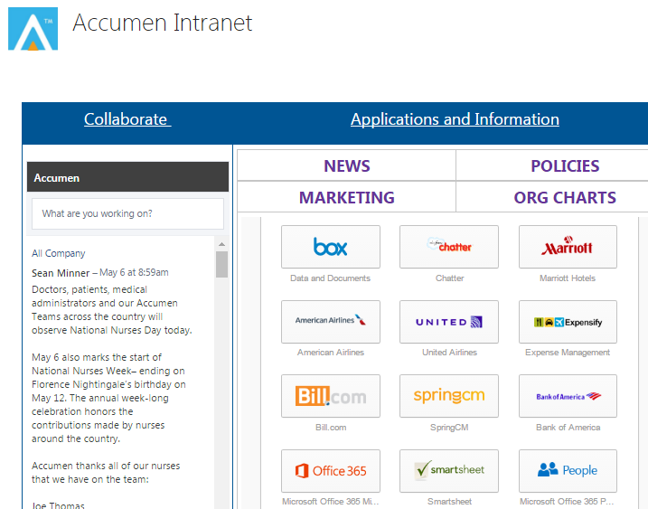
Policies & Procedures – Where are they located? 2st place
Here
© 2016 Accumen. Proprietary & Confidential. Materials may not be copied or distributed.

Slide 21
Quiz Time
Exit Instructions
We hope this course has been informative and helpful.
Please proceed to take the
Compliance Quiz.
Dana Simonds
Chief Compliance & Privacy Officer
dsimonds@accumen.com
O: 858-207-3960 or C: 817-372-7923
Melissa Hernandez
Corporate Paralegal
mhernandez@accumen.com
O: 858-207-4983 or C: 626-393-2249

