Slide 1
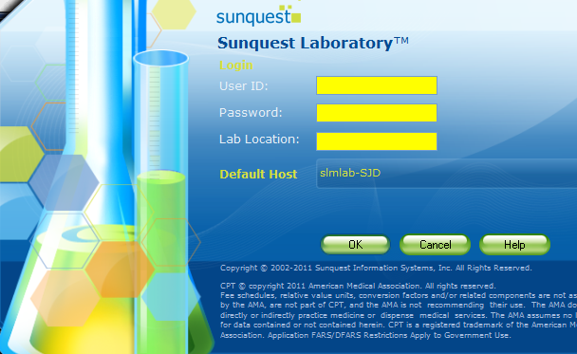
Cancelling Tests in Sunquest with proper documentation

Slide 2
The chief complaint of Physicians/RN's regarding the Lab is that we cancel or reschedule their orders without notifying them. More importantly, the safety and care of our patients can be negatively impacted. We cannot control auto cancellations in Sunquest when orders are released from Epic incorrectly, however, we can monitor and hold ourselves accountable for being diligent in proper notification and documentation.
Please call the Unit prior to cancelling orders and enter the name of the person you spoke with and date/time of call. If cancelling as a DUP, free text in the duplicate accession number (preferred) or time of the other order (DUP-;H12345 or DUP-;1100). When adding on to a previous order (CPREV), it is usually ok to do so without calling IF the add on is being done within a reasonable time frame (~8hours) and the specimen stability is acceptable.

Slide 3
Log in to Sunquest GUI and open the General Laboratory Icon.

Slide 4
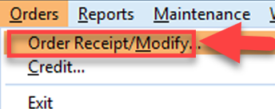
Click on Orders, then Order Receipt/Modify.

Slide 5
Highlight the test(s), then click on Credit

Slide 6
Select Remove Results for Credit Mode (IMPORTANT: use only if no parameters of the test have been reported!)
Highlight test and then click on Select

Slide 7
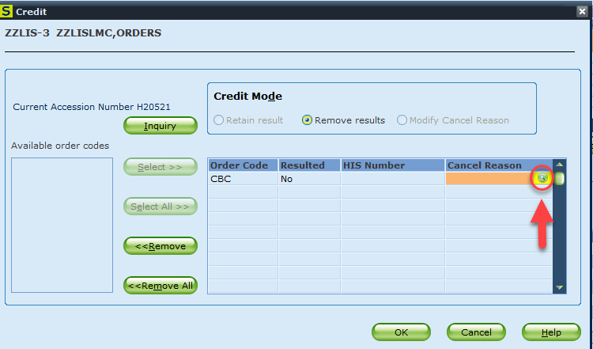
Click on the Search icon

Slide 8
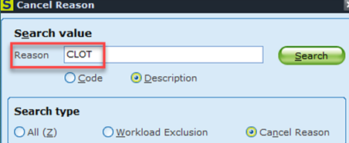
Enter the cancellation code. You do not need to click on Search unless you want to search for the code.

Slide 9
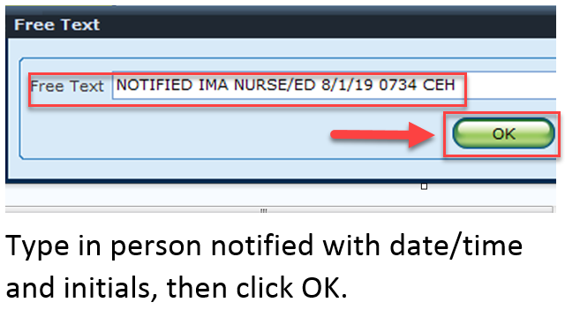

Slide 10
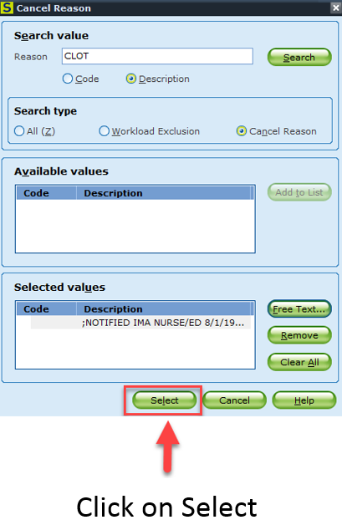

Slide 11
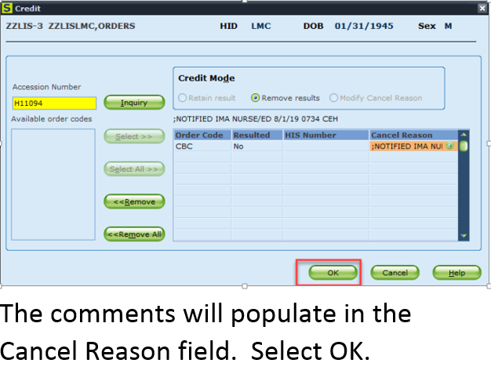

Slide 12
Thank you for all you do!!!

