Slide 1
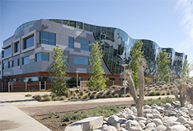
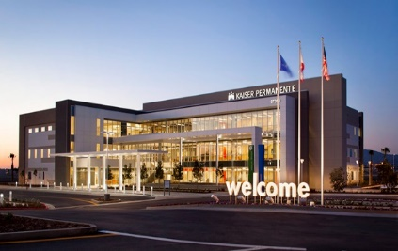
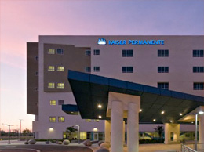
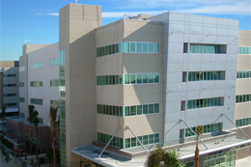
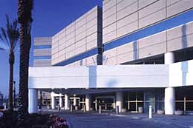
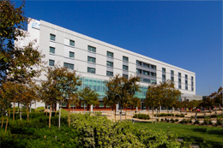
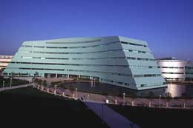
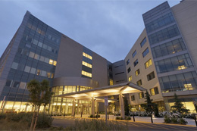
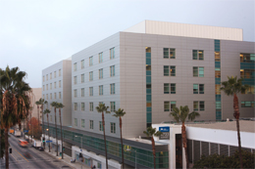
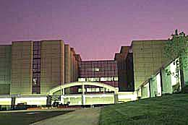
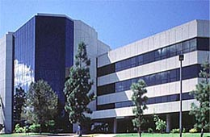
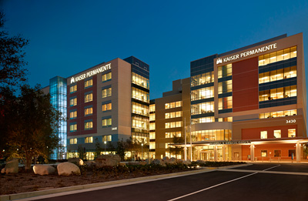
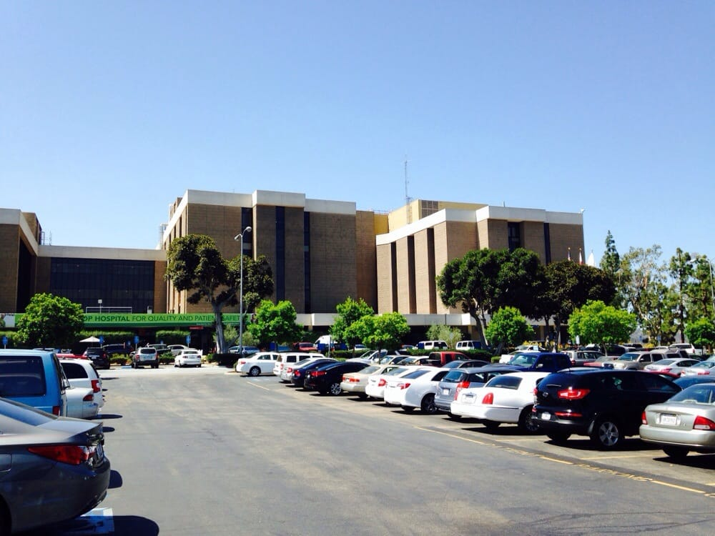
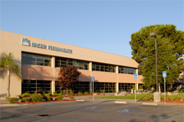
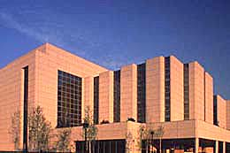
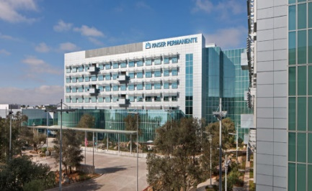
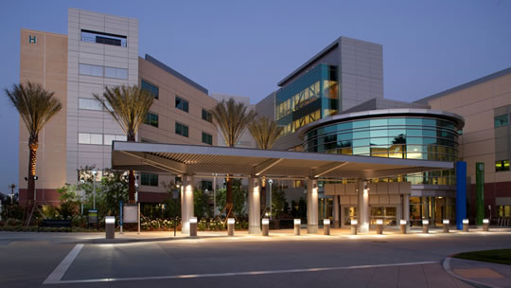
Regional
Pre-Analytical
Processes Inservice
ANTELOPE VALLEY
MORENO VALLEY MED CTR
DOWNEY
WEST L.A.
FONTANA
PANORAMA CITY
BALDWIN PARK
OC-IRVINE
LAMC
WOODLAND HILLS
Agnes Bautista
ADA, Ancillary Services, RRL-CH
4/12/19
SOUTH BAY
OC-ANAHEIM
ZION
BAKERSFIELD
RIVERSIDE
SAN DIEGO
ONTARIO

Slide 2
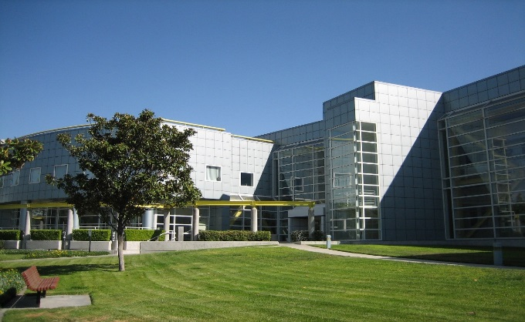
medical centers – SHERMAN WAY rrl
SOUTH BAY/ HC | ANTELOPE VALLEY
WEST L.A. | BAKERSFIELD
LAMC | PANORAMA CITY
WOODLAND HILLS

Slide 3
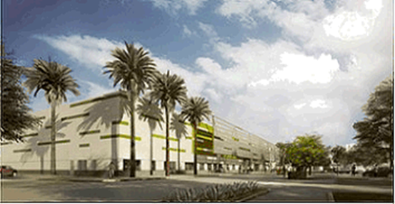
medical centers – chino hills rrl
FONTANA | IRVINE
ONTARIO | DOWNEY
RIVERSIDE | SAN DIEGO
BALDWIN PARK | ANAHEIM
MORENO VALLEY

Slide 4
SPECIMEN FLOW FOR SCAL
RELAYS
SW RRL
AV
BAK
SB
LA
PC
WH
WLA
CH RRL
ANA
BP
SD Zion
DOW
FON
IRV
ONT
RIV
MVMC
FLOW CYTOMETRY [LAMC]
Direct Route
Direct Route
GENETICS
[Electronics Pl]
Direct Route
Direct Route

Slide 5
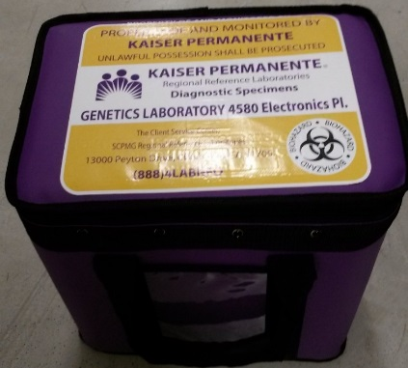
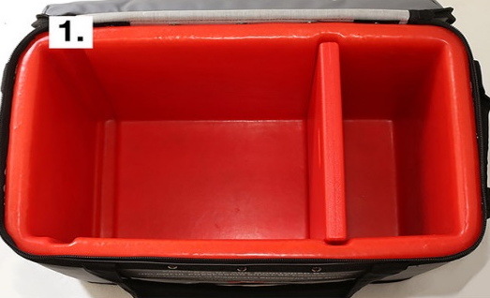
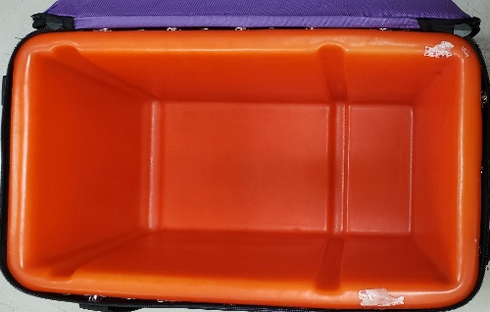
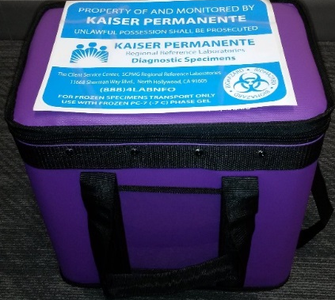
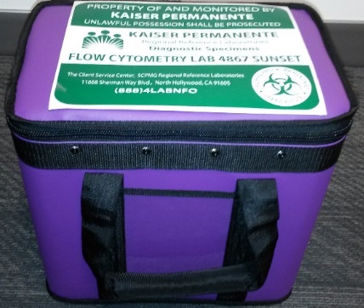
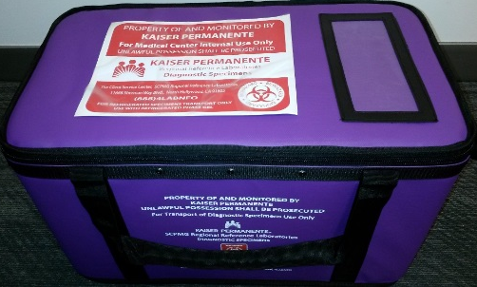
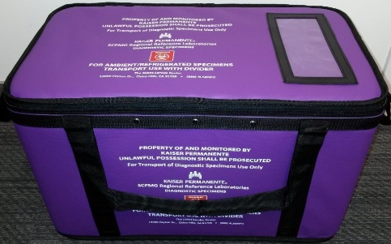
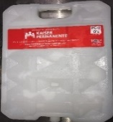
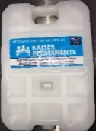

BLUE
LABEL
TOTE
CHINO HILLS
PURPLE TOTES
AMBIENT
RED
LABEL
TOTE
NO LABEL
TOTE
GREEN
LABEL
BT/FLOW CYTOMETRY TOTE
YELLOW
LABEL
GENETICS
TOTE
AMBIENT
REFRIGERATED
AMBIENT
FROZEN
AMBIENT
REFRIGERATED

Slide 6
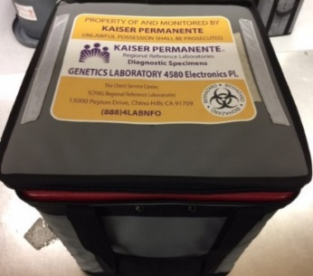
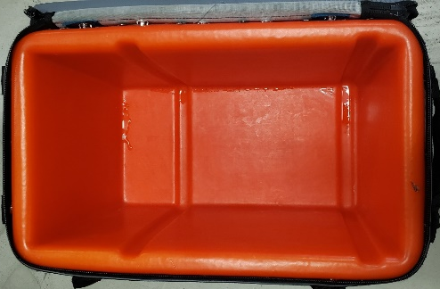
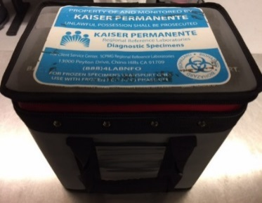
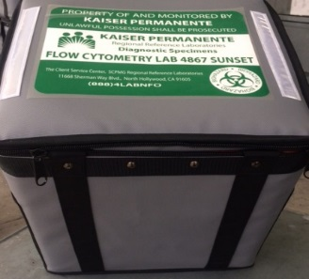
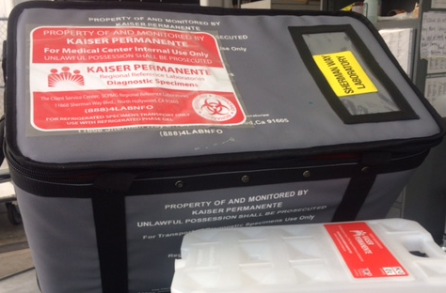
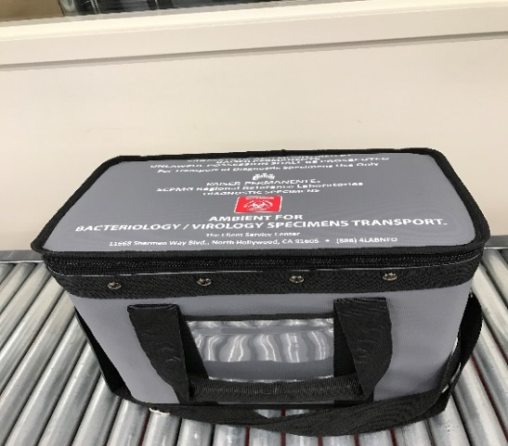
BLUE
LABEL
TOTE
SHERMAN WAY
GREY TOTES
RED
LABEL
TOTE
NO LABEL
TOTE
GREEN
LABEL
BT/FLOW CYTOMETRY TOTE
YELLOW
LABEL
GENETICS
TOTE
AMBIENT
REFRIGERATED
AMBIENT
FROZEN
AMBIENT
REFRIGERATED

Slide 7
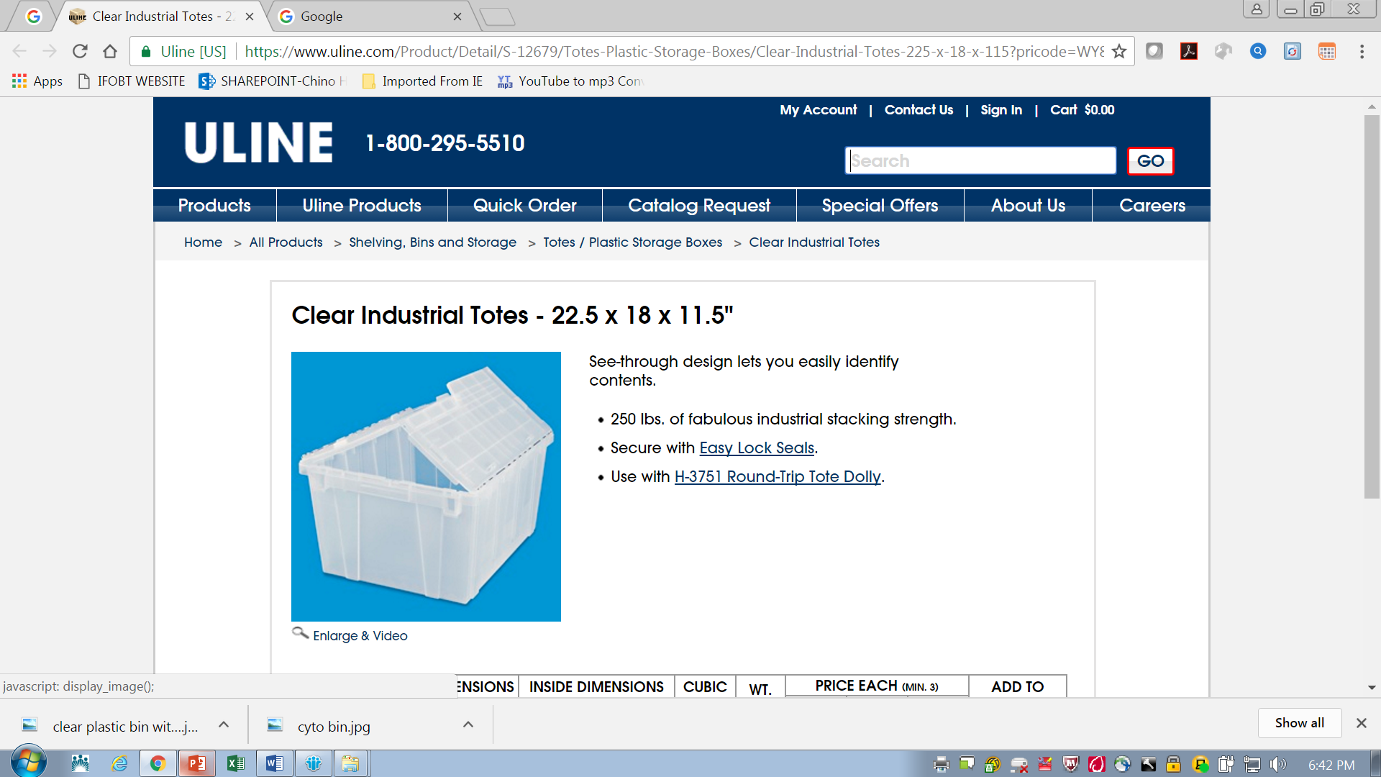
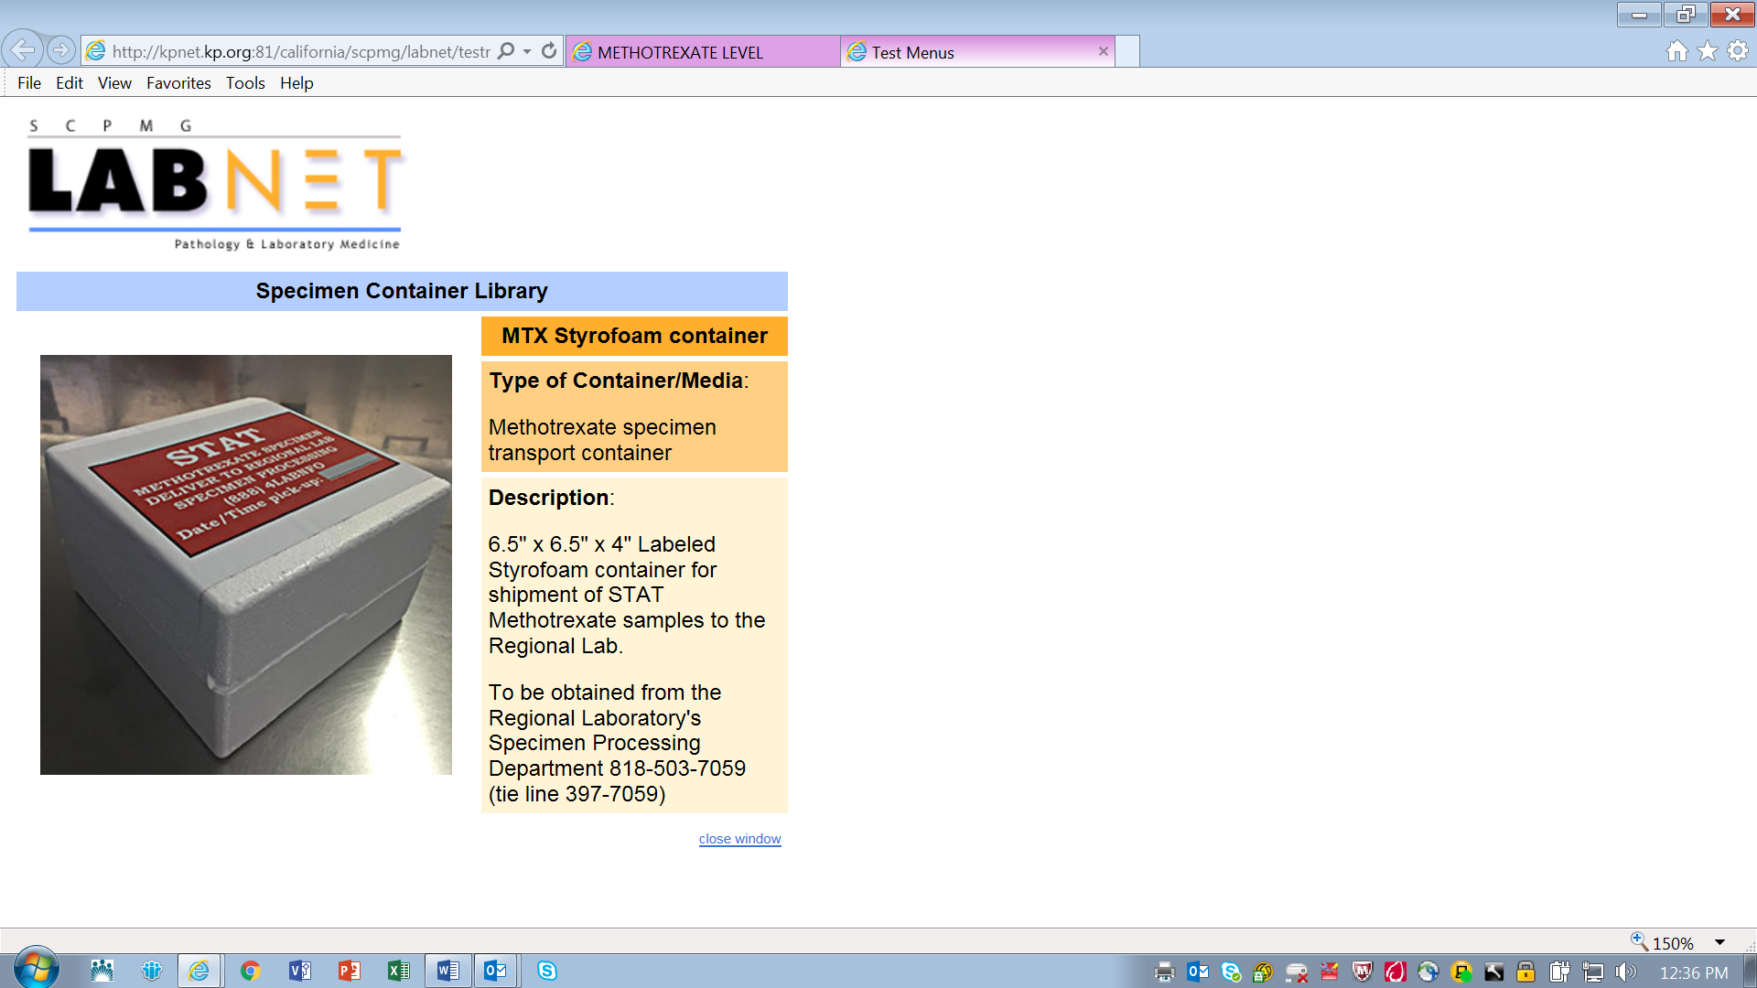
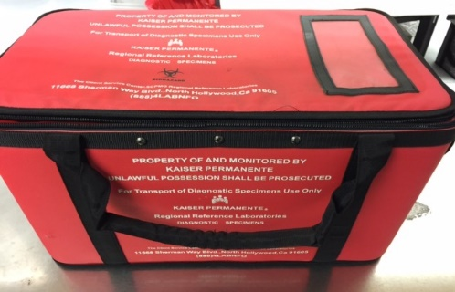
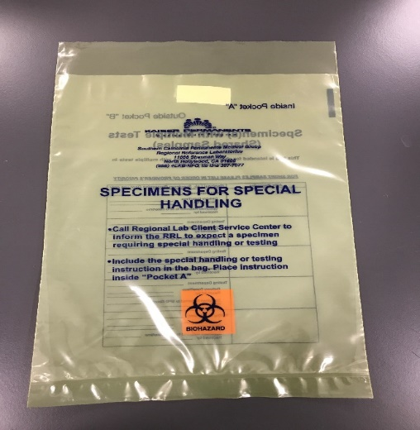
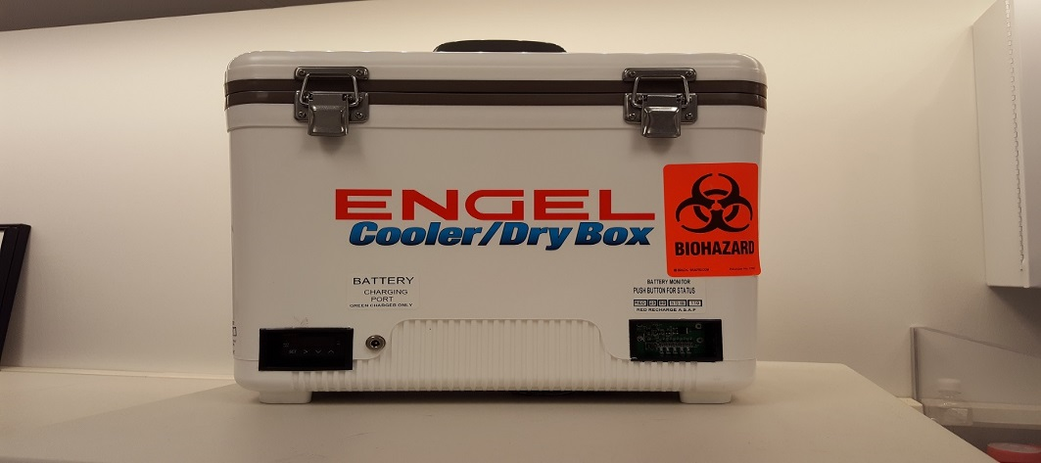
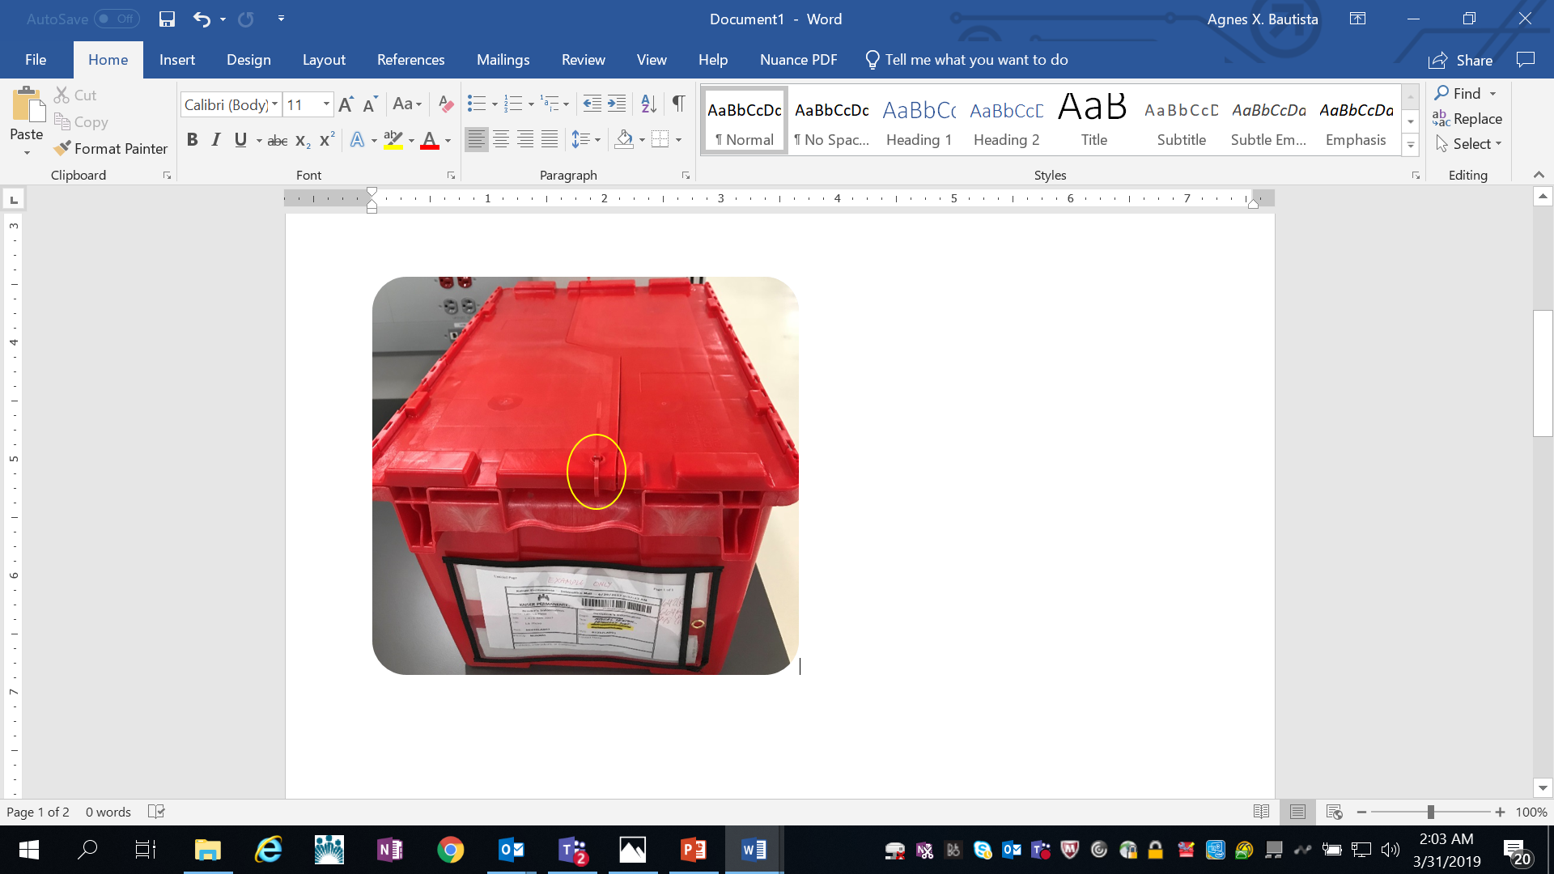
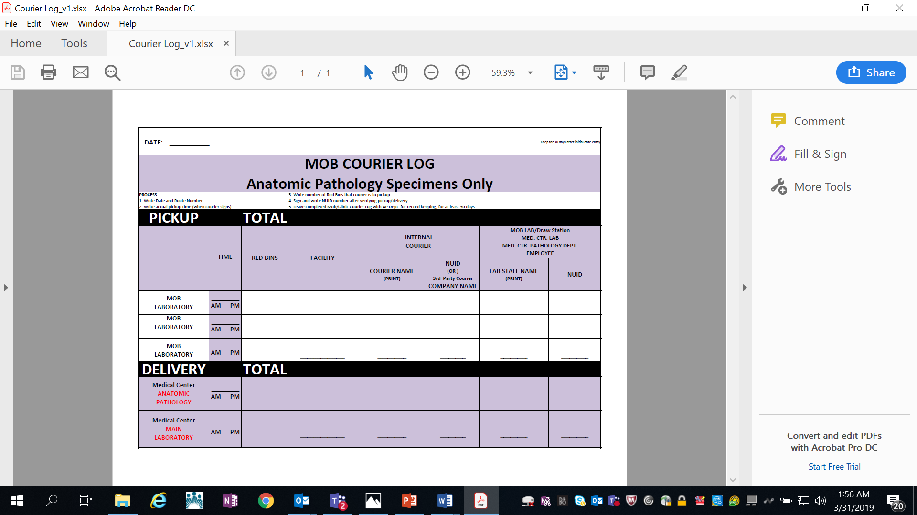
METHOTREXATE
STYROFOAM BOX
STAT
COMMON
TOTES/BINS/CONTAINERS
MEDICAL CENTER INTERNAL TOTES
NEVER DELIVER TO RRL
INCUBATOR CARRIER
TOTE
CYTOLOGY
CLEAR WHITE BINS
RED TOTES
CP
YELLOW BAG
RED BINS
AP

Slide 8

Incubator carrier tote
PURPOSE
To provide a controlled temperature environment
(33-37º C) for optimal growth of fastidious organisms on plated…
Respiratory Cultures
Sterile Site Cultures
Low Volume Urine Cultures
REPAIRS
Send to RRL-SW/Lab Technology Services (LTS)
Label “TO” and “FROM”
Indicate if it’s for…
- Repair
- Replacement
- Additional Chargers
- Additional Power supplies
- Additional Incubator Carrier Totes
Email requests to Alan Dosa /Keith Lawson for approval

Slide 9
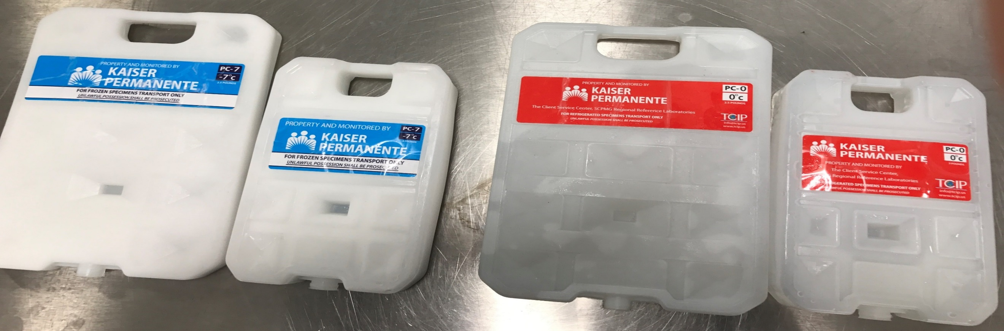
PCM - Coolants
(Phase Change Material)
FROZEN
BLUE LABEL
0º to -7º C
24 hrs.
REFRIGERATED
RED LABEL
2-8º C
24 hrs.

Slide 10
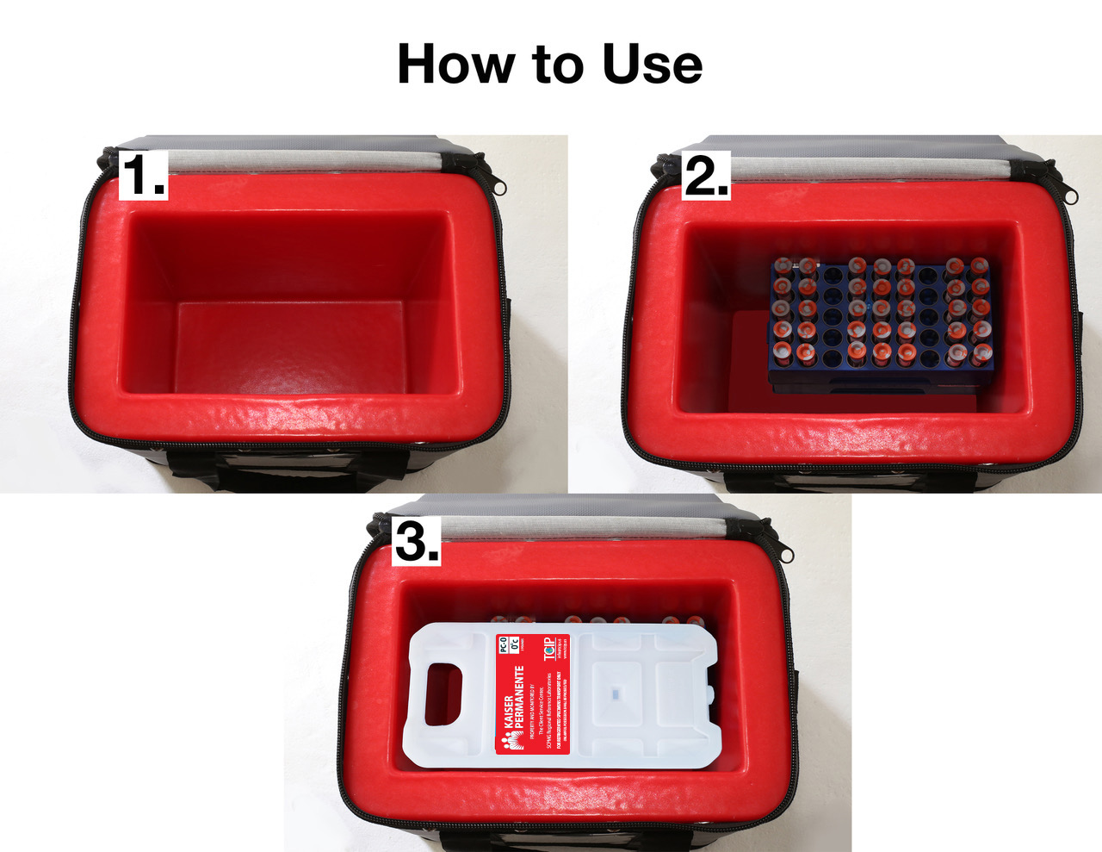
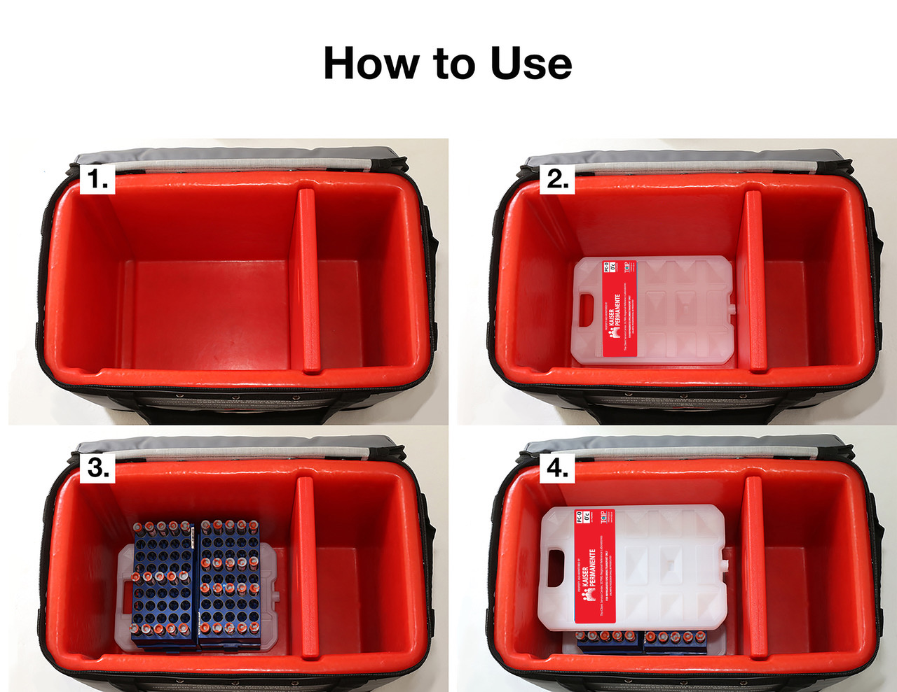
PACKING - REFRIGERATED SAMPLES
SMALL TOTE
SMALL PCM (Red)
LARGE TOTE
LARGE PCM (Red)

Slide 11
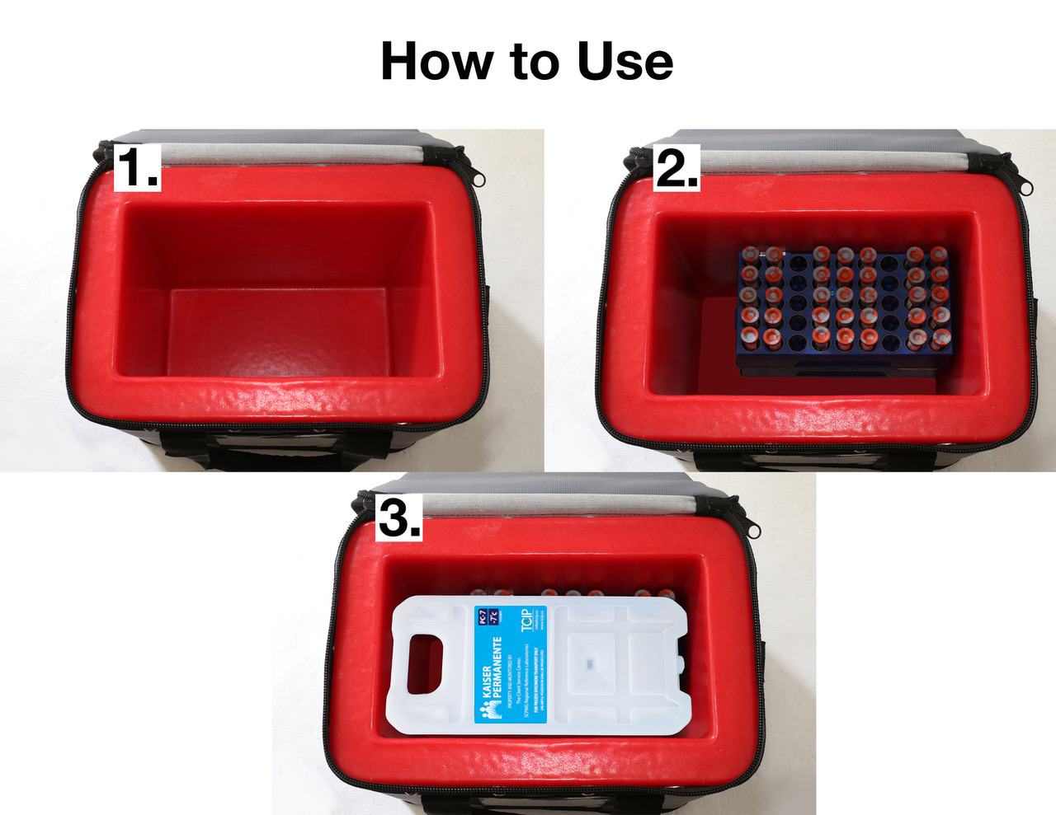
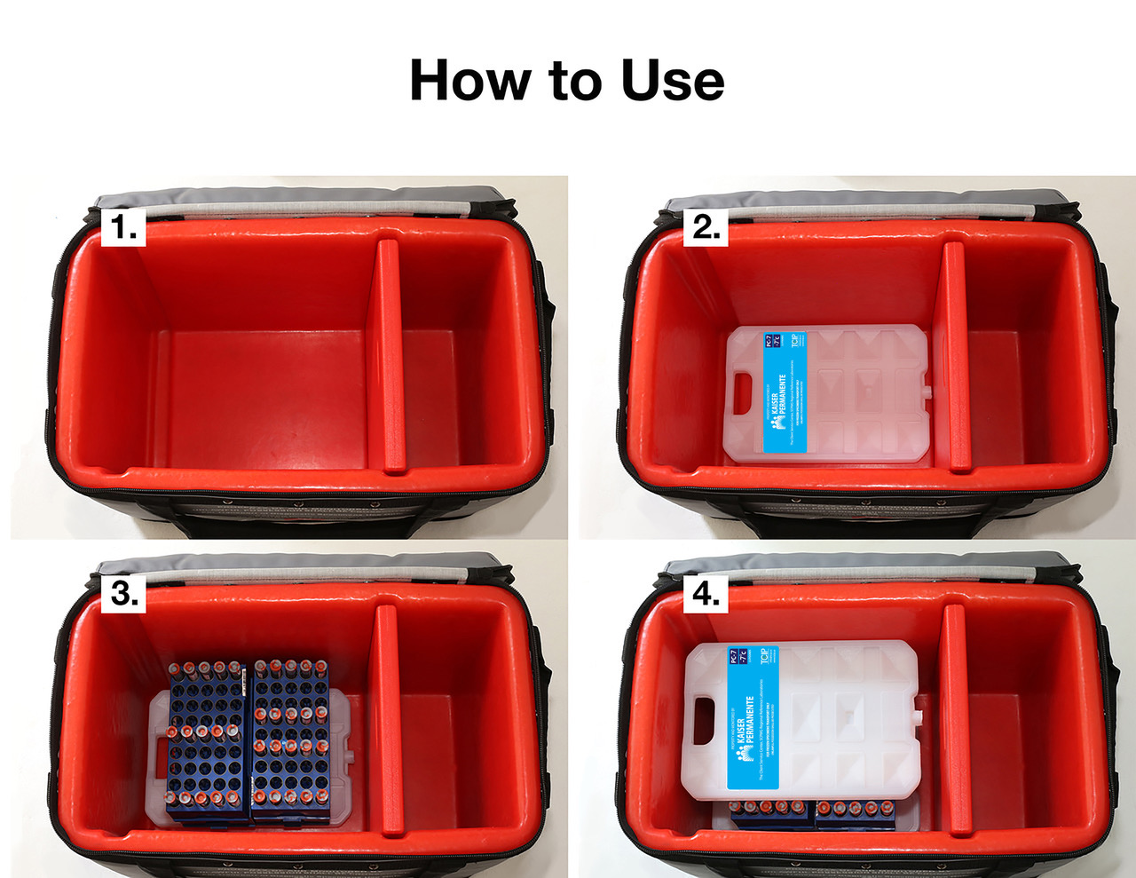
PACKING - FROZEN SAMPLES
SMALL TOTE
SMALL PCM (Blue)
LARGE TOTE
LARGE PCMs (Blue)

Slide 12
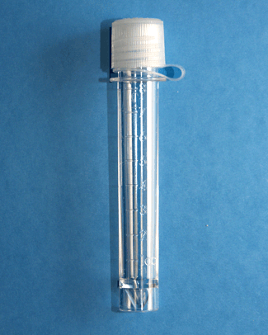
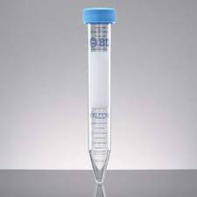
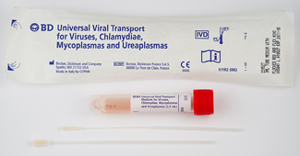
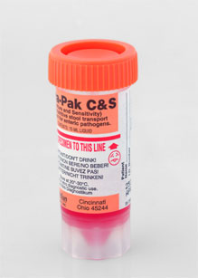








VISUAL SORTS
CLOSTRIDIUM
DIFFICILE
FALCON
TUBE
UTM
PAP SMEAR/HPV
ENTERIC PCR
O & P
HSV/EV PCR
DAU
OR
BORDETELLA
PERTUSSIS
IFOBT
MICROTAINER BULLETS

Slide 13















BLUE RACKS
DO NOT RACK
THE FOLLOWING SAMPLES:
- Visual Sorts Containers
- Microtainer Bullets
- Urine Cultures
- Eswabs
FOL
PHI
ACTH
COAG
HIV-
MONOGRAM
CBC
HBA1C
MICRO-
ALBUMIN
PCT
Refrigerated
LEAD
AMBER
ALIQ.
CLEAR
ALIQ.
LAV5
GWH3
PST4
TAN3
RRL-CH
MTX
DRUGS
IMMUNO-
SUPRESSANTS
ELECTRO-
LYTES
CHEM
ABO
RH
ZINC
ALC
CTGCU
CTGCS
Refrigerated
ALC
RRL-SW
APTIMA
GENPROBE
APTIMA
GENPROBE
RED7
GLD6
PINK6
K2 EDTA
ROY7
GY7

Slide 14







Bacteriology ambient
POR-A-CUL
TISSUES/
SPUTUM
RRL-CH
URINE
CULTURE
ESWAB
THIO
BLOOD
CULTURES
CSF
CULTURE
RRL-SW

Slide 15






FROZEN
BLUE LABELED TOTES
PHI
Prostate Health Index
Spin/Aliquot/Freeze
ACTH
Spin/Aliquot/Freeze
COAG
Spin/Aliquot/Freeze
MONOGRAM HIV TESTS
Spin/Freeze
RRL-CH
RRL-SW

Slide 16









CYTOLOGY
CLEAR PLASTIC BINS
NON-GYN
CYTOLOGY
FNA
NON-GYN
CYTOLOGY
BODY FLUIDS
FLUIDS
CLEAR
PLASTIC
BINS
GYN
CYTOLOGY
PAP SMEARS

Slide 17




RRL-CH
BT/FLOW CYTOMETRY
GREEN LABELED TOTES
SAMPLE STABILITY
48 hrs.
(Ambient)
TESTING
CUT-OFF
2:30pm
# SAMPLES
PER DAY
30-40
TYPES OF SAMPLES
Bone Marrow
Blood
Body Fluids
GREEN
LABEL
AMBIENT
COURIER
DIRECT ROUTES
DEPART ARRIVE
CRL LAMC
WEEKDAY
6:00am 6:55am
12:45pm 1:40pm
WEEKENDS
6:00am 6:55am
10:45am 11:45am
DEPART ARRIVE
SWL LAMC
WEEKDAY
6:30am 7:00am
4:35pm 5:25pm
WEEKENDS
6:45am 7:15am
RRL-SW

Slide 18







BONE MARROW COLLECTION KIT
GENETICS
YELLOW LABELED TOTES
NUMBER OF SAMPLES/DAY
200
BONE MARROW DAY
20
SAMPLE STABILITY
24 hrs
(most)
OTHER
GENETIC SAMPLES
COURIER
DIRECT ROUTES
DEPART ARRIVE
CRL GENETIC
WEEKDAY
10:30am 11:30am
3:40pm 4:40pm
WEEKENDS
6:00am 7:15am
3:15pm 3:55pm
DEPART ARRIVE
SWL GENETIC
WEEKDAY
6:30am 6:50am
11:40am 12:00pm
2:15pm 2:35pm
7:20pm 7:45pm
10:15pm 10:45pm
WEEKENDS
6:10am 6:30am
11:45am 12:15pm
AMBIENT
REFRIGERATED
RRL-CH
AMBIENT
REFRIGERATED
RRL-SW

Slide 19




CASSETTES
HISTOLOGY
TOTES/CONTAINERS
RRL-CH
RRL-SW
TISSUE BLOCKS

Slide 20


Slide 21





ctgc
IMPORTANT: CTGC samples MUST be in BLUE RACKS to prevent contamination
CTGCU
(urine)
CTGCS
(swab)
SEND TO RRL
- IN BLUE RACKS
- DO NOT PIERCE FOIL CAP
- DO NOT WRITE ON FOIL CAP

Slide 22


Quantiferon
TB Gold Plus
All 4 tubes fill volume within the black mark (0.8 to 1.2mL)
Do not send to RRL if above or below the black mark
Shake tubes firmly (up/down motion) 10 times
Keep at Room Temperature (22°C ± 5°C)
Deliver to RRL within 16 hours from collection time

Slide 23

Boric acid
GREY TOP TUBE
URINE CULTURES
MINIMUM VOLUME IS:
3.0 ml.
NOTE
In the event the transferred urine falls below the 3.0 mL minimum fill line in the boric acid test tube, immediately (within 24 hrs., refrigerated) plate urine from the boric acid test tube on to agar plates.
Urine volume less than 3.0 ml.
MUST be plated on agar plates

Slide 24

eswab
ESWAB
One Cerner Barcode Label per specimen
Do not cover Cerner Barcode Label
CERNER BARCODE LABEL
Medical Center Collection Label

Slide 25




BLOOD CULTURES
PREPARATION
COLLECTION
LABELING
ADULTS: 5 - 10 mL
PEDIATRICS: 1 - 2 mL
Blood Culture bottle fill mark
Green arrow - 10 mL
Red arrow - 5 mL
Blue arrow - Uninoculated
MUST be vertical & visible
CERNER barcode label is on TOP
MATCH & PAIR bottles together with Rubberband or Biohazard Bag
PEEL plastic top
Disinfect top with 70% ALCOHOL prior to inoculation
Allow alcohol to AIR DRY for 1 min.
INOCULATE blood culture bottles

Slide 26

IFOBT
Proper Labeling

Slide 27

YELLOW BAG
SHARED SAMPLES
SHORT SAMPLES
SPECIAL HANDLING
INPATIENT
BACTERIOLOGY SAMPLES

Slide 28

METHOTREXATE (MTX)
“STAT”

Slide 29

RACK SAMPLES
Use BLUE RACKS when sending samples to Regional Lab
Unracked samples can lead to delayed TAT
IMPORTANT: CTGC samples MUST be in BLUE RACKS to prevent contamination

Slide 30

UNSPUN SAMPLES
UNSPUN SPECIMENS CAN LEAD TO
DELAYED TAT & TEST CANCELLATIONS
REMEMBER TO:
1. INVERT 5x
2. CLOT 30 min.
3. SPIN 10 min.

Slide 31





WRITING ON ACESSION LABELS
ACCEPTABLE
NOT ACCEPTABLE
✓ NO MARKS OF ANY KIND
✓ OK TO WRITE DIRECTLY BELOW ACCESSION NUMBER
* NO WRITING, MARKS, OR STAMPS IN AREAS SHOWN

Slide 32

MISDIRECTED SPECIMENS
INVESTIGATE - Regional Labs, Medical Centers, Couriers
EMAIL - Information to Medical Centers/Couriers
RETURN - Specimen back to Med. Ctr. in Styrofoam w/big red label

Slide 33

PACTRAC
ONE PACTRAC - per one container
DO NOT - copy or duplicate
DO NOT - re-use

Slide 34

SUPPLY REQUEST FORM
https://sites.sp.kp.org/teams/labsc/loc/rrl/csc/Lists/SupplyRequestForm/Item/newifs.aspx

Slide 35

LABNET
http://kpnet.kp.org:81/california/scpmg/labnet/index.htm
Search for Test Information
  Temperature Stability
  Processing Instructions
  Collection Container
  Technical Bulletins
Courier Schedules
  Create PacTrac

Slide 36
GROUP MAILBOX
SCAL-RRL-Ancillary-ITS-Support@kp.org
PURPOSE
Provide direct communication in reporting and addressing all Courier related...
                Issues
                Questions
                Comments
                Suggestions
                Concern
                SUPPORTED BY
        Integrated Transportation System (ITS)/Regional Couriers
        RRL-NH, Ancillary Services Team (aka: Specimen Processing Dept.)
        RRL-CH, Ancillary Services Team

Slide 37
Thank you!
Life is Good
at Chino Hills
It’s a Great Day
at Sherman Way

