Slide 1
7
The Cardiovascular and Lymphatic Systems
Notes:
*

Slide 2
Media Directory
Slide 12 Chambers of the Heart Animation
Slide 27 Head and Neck Circulatory System Animation
Slide 28 Abdominal Circulatory System Animation
Slide 29 Upper Extremity Circulatory System Animation
Slide 38 Capillary Pressure Animation
Slide 72 Lymphatic System Animation

Slide 3
Chapter Objectives
Define the functions of the cardiovascular and lymphatic systems.
Identify and describe the structures and functions of the heart.
List pathologic conditions and common laboratory tests associated with the cardiovascular and lymphatic systems.
continued on next slide

Slide 4
Chapter Objectives
Trace the flow of blood through the cardiovascular system.
Describe the properties of arterial blood, venous blood, and capillary blood.
Identify and describe the cellular and noncellular components of blood.
continued on next slide

Slide 5
Chapter Objectives
Describe the differences and similarities between whole blood, serum, and plasma.
Locate and name the veins most commonly used for phlebotomy procedures.
Define hemostasis and describe the basic process of coagulation and fibrinolysis.

Slide 6
The Cardiovascular System
Functions
Transports H₂O, nutrients, electrolytes, hormones, enzymes, antibodies, cells, and gases to all cells
Defense
Coagulation process
Helps control body temperature

Slide 7
Table 7–1 The Cardiovascular System: Structures and Functions
continued on next slide

Slide 8
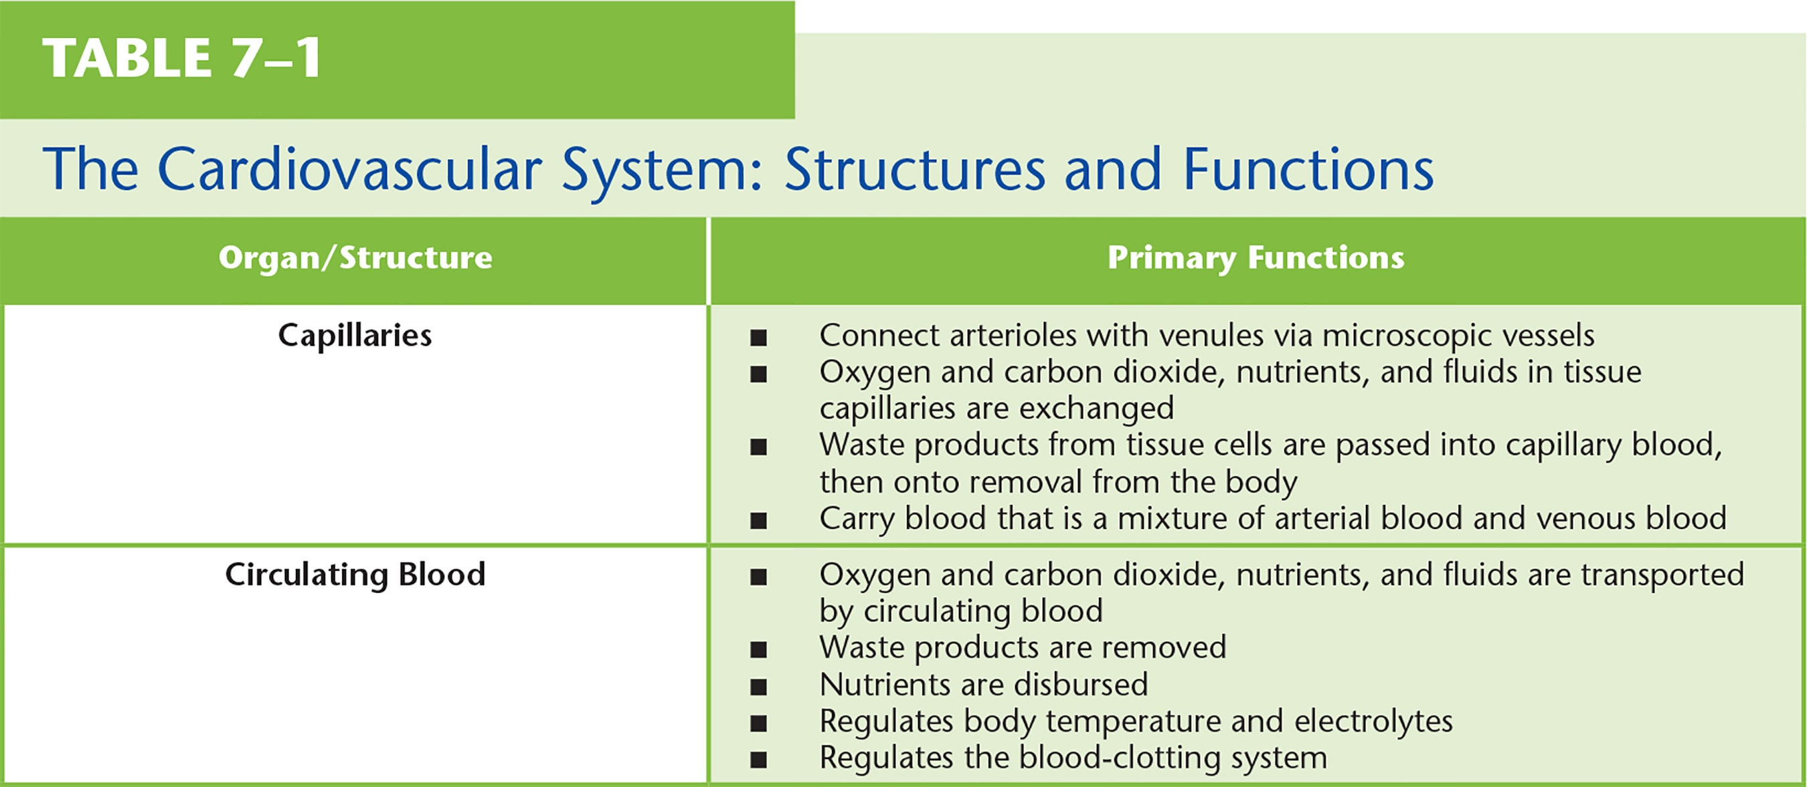
Table 7–1 (continued) The Cardiovascular System: Structures and Functions

Slide 9
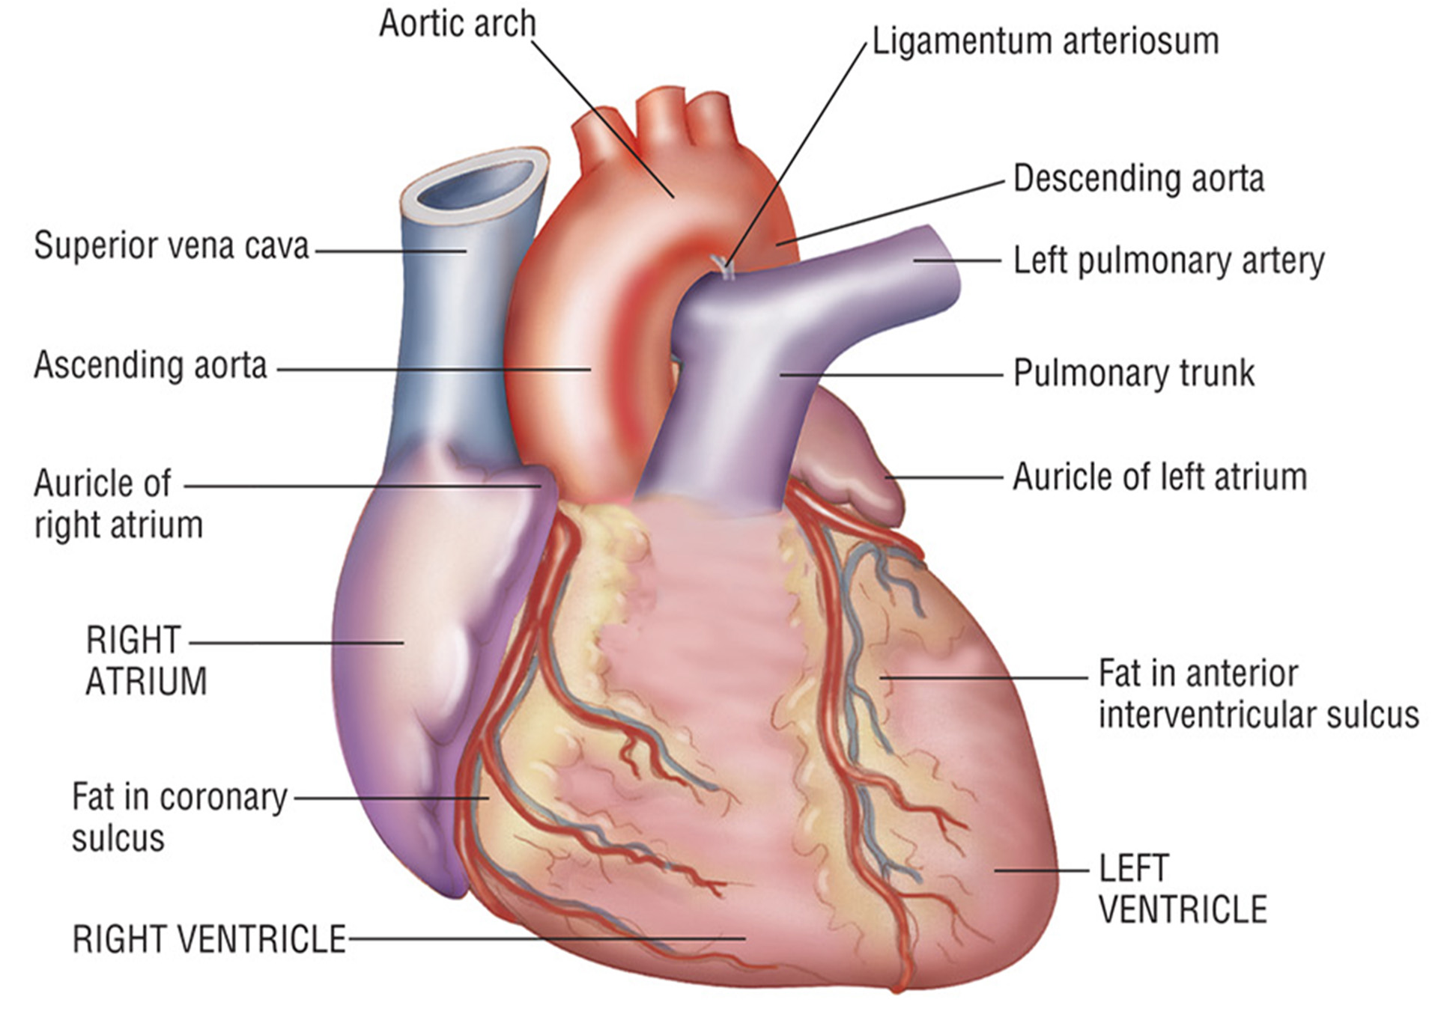
Figure 7–1 Superficial Anatomy of the Heart
continued on next slide

Slide 10
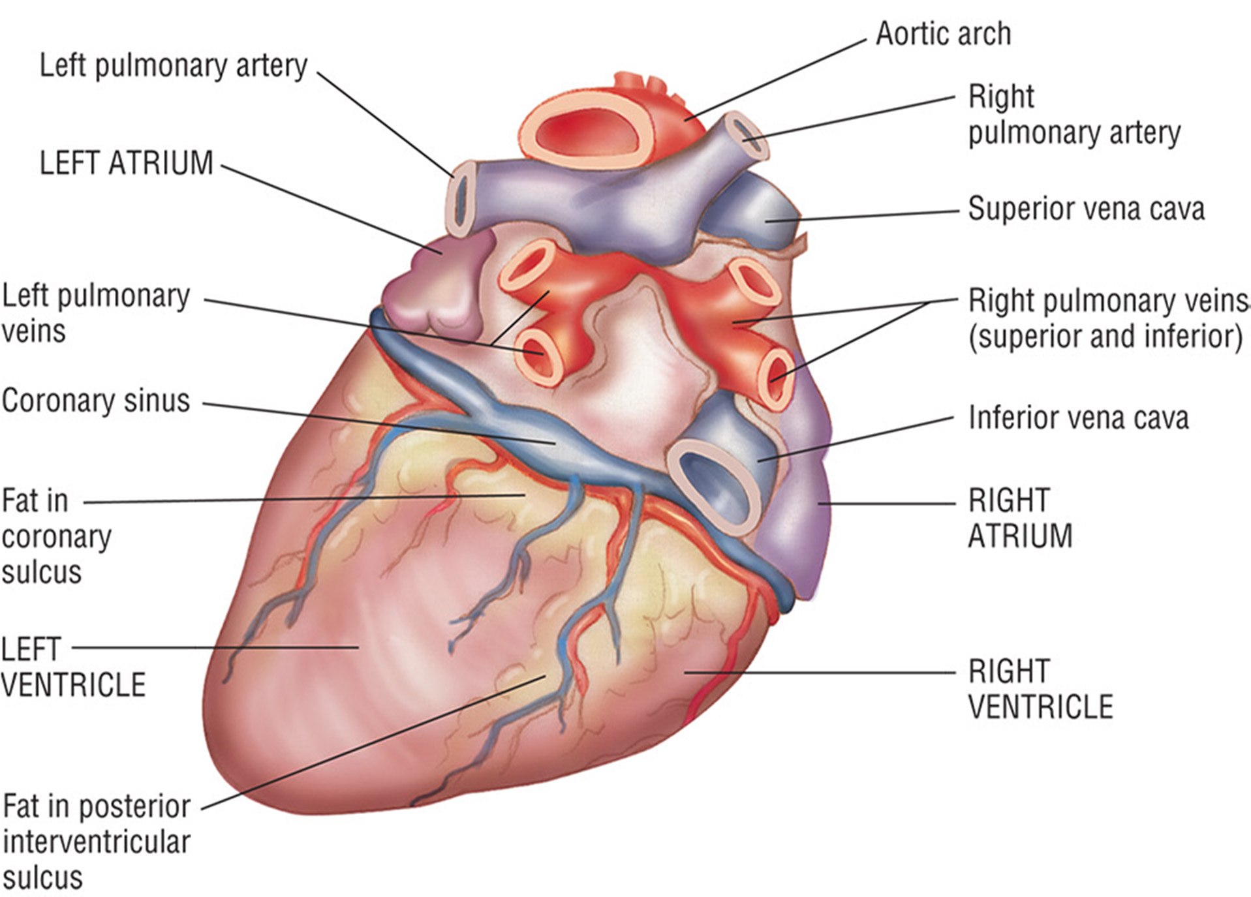
Figure 7–1 (continued) Superficial Anatomy of the Heart

Slide 11
The Heart
Muscular organ, size of a fist
Located left of midline in thoracic cavity
Four chambers
Two atria, two ventricles separated by the interatrial and interventricular septum (wall)
Valves located between each atrium and ventricle so blood flows in only one direction, preventing backflow

Slide 12
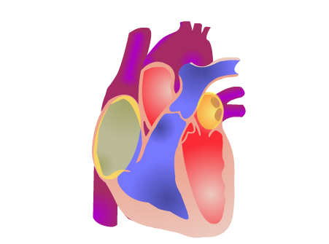
Chambers of the Heart Animation
Click on the screenshot to view an animation showing the chambers of the heart.
Click again to pause the animation.
Return to Directory
Notes:
The four chambers of the heart alternate between contraction and relaxation in a concerted fashion. This pattern is called the cardiac cycle. During the cardiac cycle, the heart chambers beat cyclically to enable a coordinated flow of blood.

Slide 13
The Heart
Bloodflow through the Heart
Right (R) atrium of the heart receives blood from two large veins:
Superior vena cava
Brings blood from the head, neck, arms, and chest
Inferior vena cava
Carries O₂-poor blood from the rest of the trunk and the legs
continued on next slide

Slide 14
The Heart
Bloodflow through the Heart
When blood enters the right atrium, it passes through right atrioventricular, or tricuspid valve, into the right ventricle.
When blood exits right ventricle, it begins the pulmonary circuit to the right and left pulmonary arteries.

Slide 15
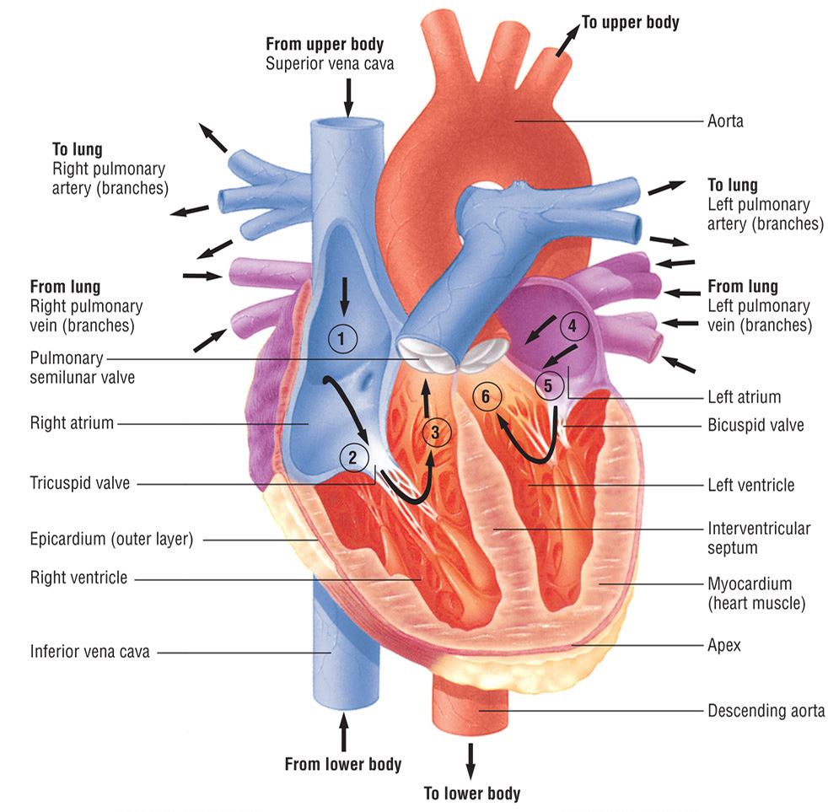
Figure 7–2 Internal Anatomy of the Heart and Path of Blood Flow
continued on next slide

Slide 16
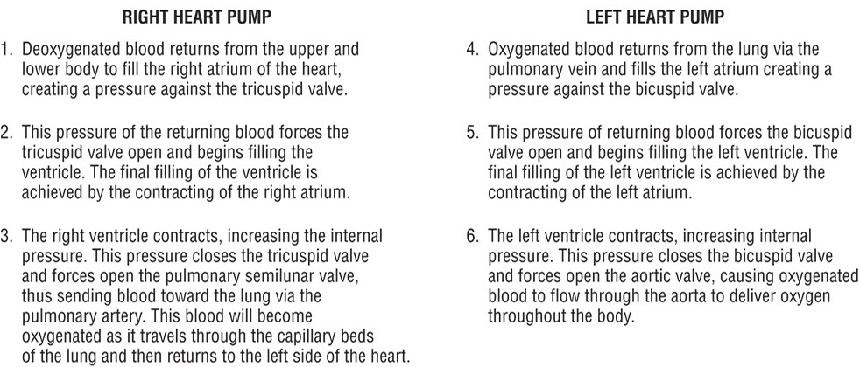
Figure 7–2 (continued) Internal Anatomy of the Heart and Path of Blood Flow

Slide 17
The Heart
The Pulmonary Circuit
Carries deoxygenated blood.
Vessels branch into smaller arterioles and capillaries within the lungs, where gas exchange occurs (O₂ is picked up, and CO₂ is released).
From the respiratory capillaries, blood flows into the L and R pulmonary veins and then into the left atrium.
continued on next slide

Slide 18
The Heart
The Pulmonary Circuit
Blood flows through mitral valve into L ventricle.
Blood exits L ventricle, then it passes through the aortic semilunar valve and into the ascending aorta to the systemic circuit.
The systemic circuit carries blood to the tissues of the body.

Slide 19
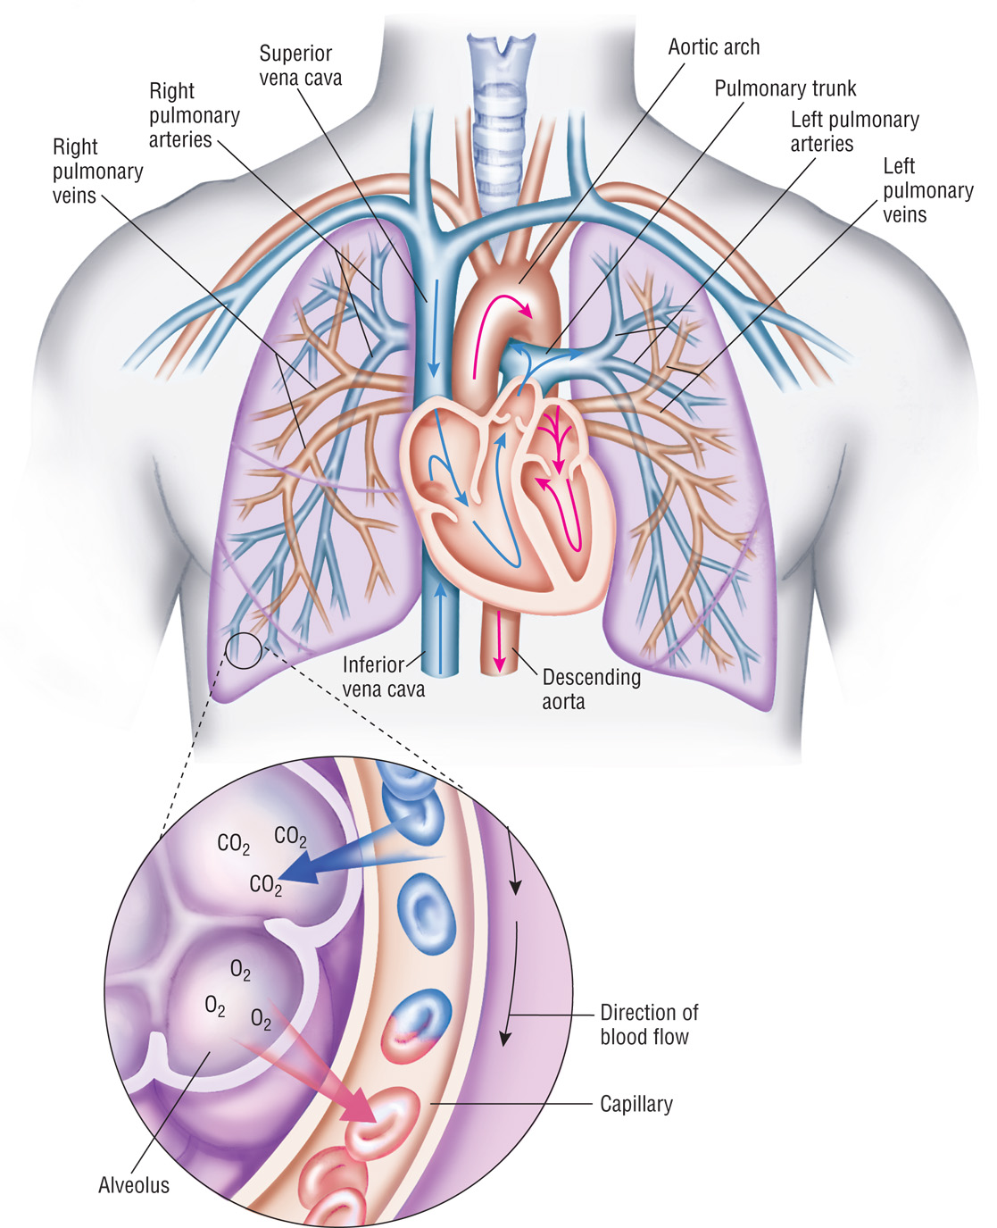
Figure 7–3 The Pulmonary Circuit in the Cardiovascular System

Slide 20
Circulating Blood
Essential to homeostasis
Provides nutrients chemical substances to all cells in the body
Gas exchange takes place in blood (oxygen and carbon dioxide)

Slide 21
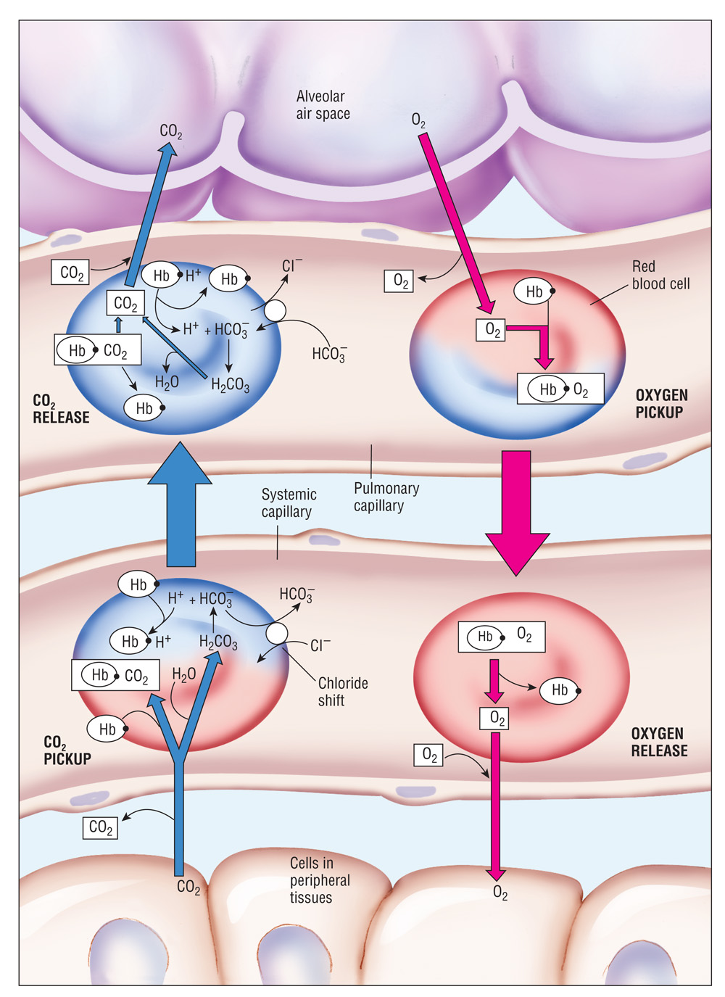
Figure 7–4 Exchange of Gases in Systemic and Pulmonary Capillaries

Slide 22
The Vessels and Circulation
Arteries
Veins
Capillaries

Slide 23
The Vessels and Circulation
Arteries
Highly oxygenated arteries carry blood away from the heart (efferent vessels).
Branch into smaller vessels called arterioles
Have thick elastic walls to resist pressure, have pulse
Carry oxygenated blood

Slide 24
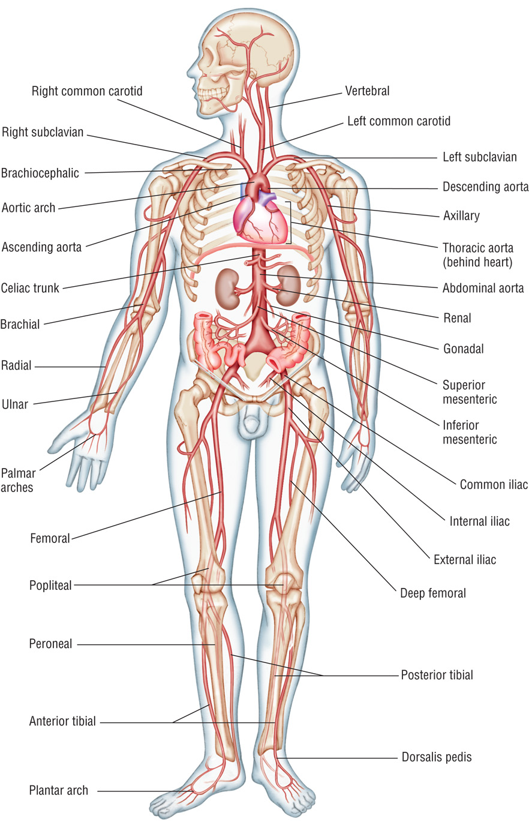
Figure 7–5 The Arterial System

Slide 25
The Vessels and Circulation
Veins
Carry blood toward the heart
All veins (except the pulmonary veins) contain deoxygenated blood.
Have thinner walls than arteries
Veins in the antecubital area of the forearm are most commonly used for venipuncture.

Slide 26
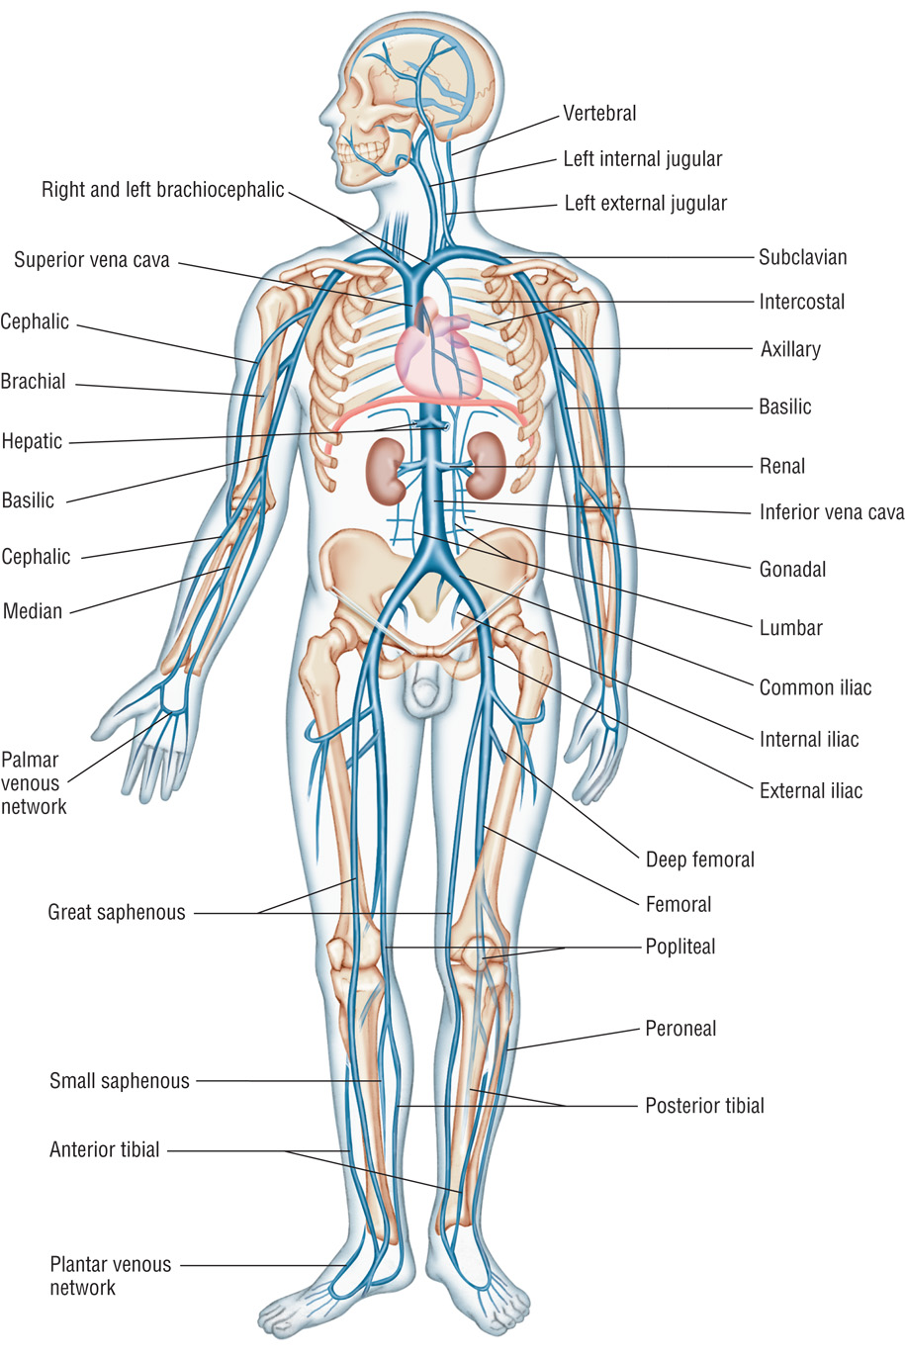
Figure 7–6 The Venous System

Slide 27
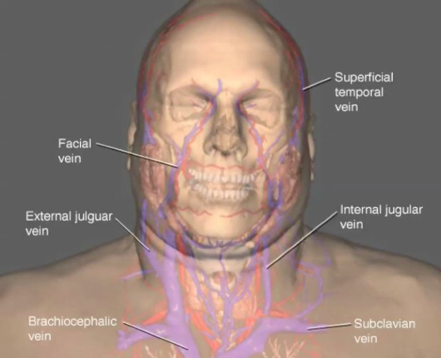
Head and Neck Circulatory System Animation
Click on the screenshot to view an animation showing the circulatory system of the head and neck. The animation may require a moment to begin. Click again to pause the animation.
Return to Directory
Notes:
There is no audio for this video/animation.

Slide 28
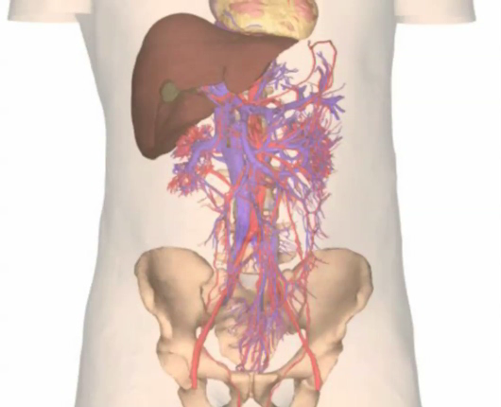
Abdominal Circulatory System Animation
Click on the screenshot to view an animation depicting the circulatory system of the abdomen. The animation may require a moment to begin. Click again to pause the video.
Return to Directory
Notes:
There is no audio for this video/animation.

Slide 29
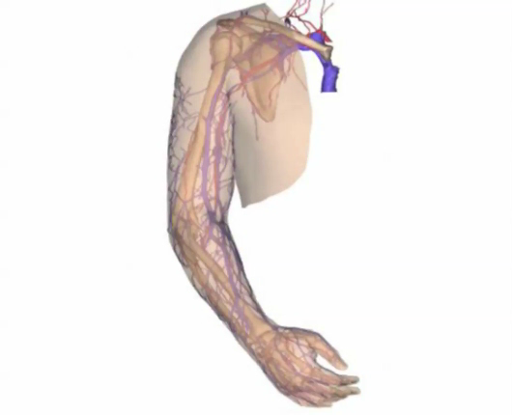
Upper Extremity Circulatory System Animation
Click on the screenshot to view an animation depicting circulation of the arm.
The animation may require a moment to begin. Click again to pause the video.
Return to Directory
Notes:
There is no audio for this video/animation.

Slide 30
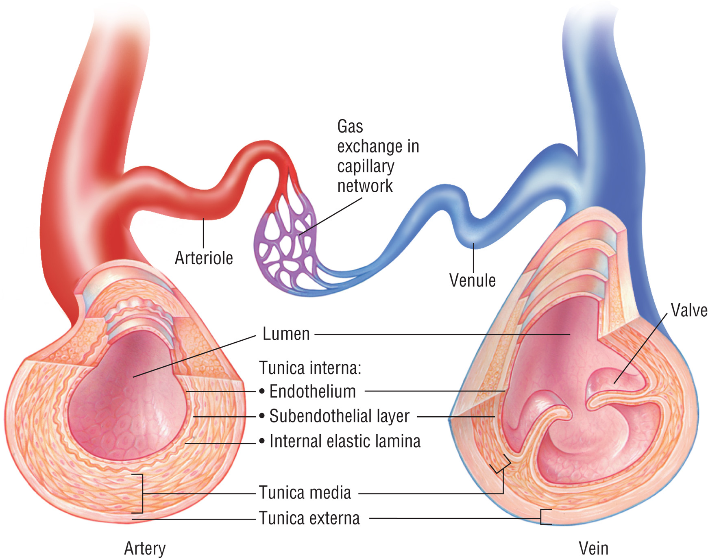
Figure 7–7 The Capillary Connection

Slide 31
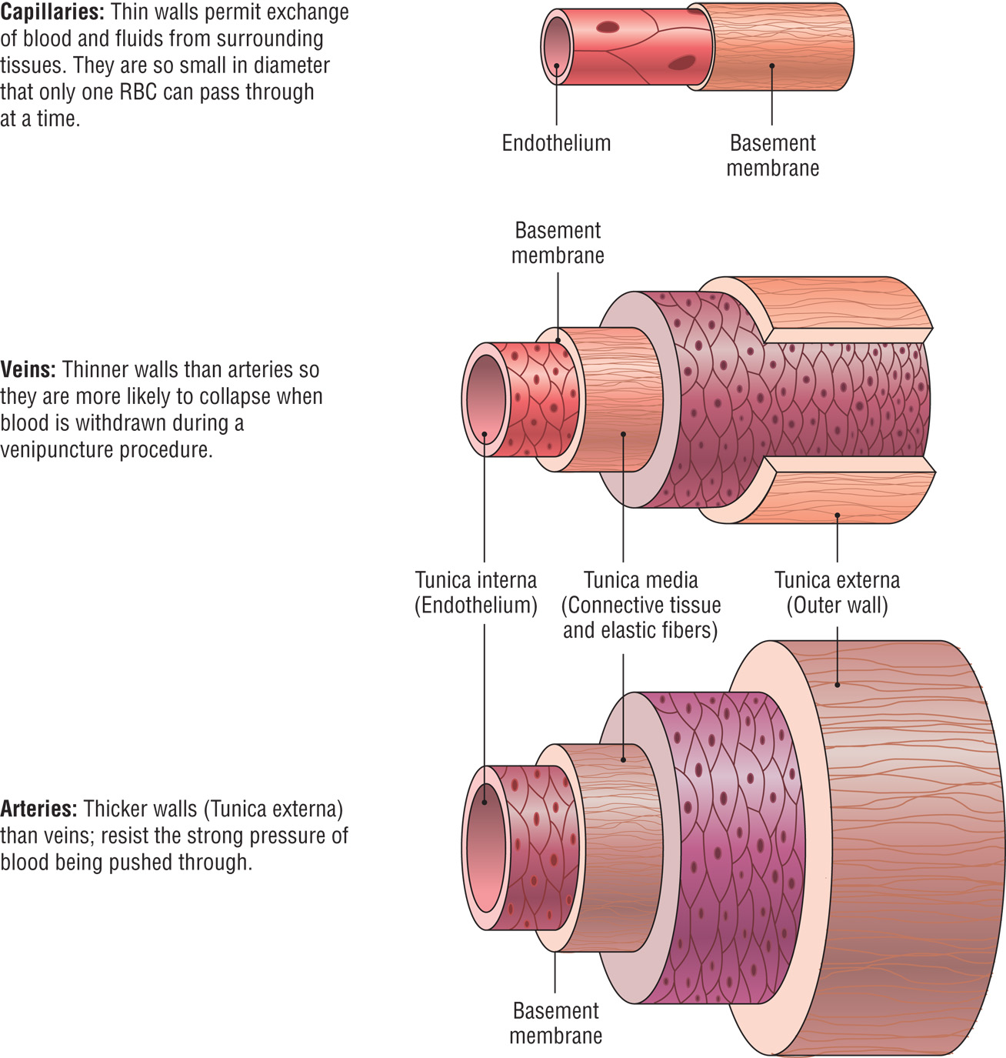
Figure 7–8 Anatomic Comparison of Arteries, Veins, and Capillaries

Slide 32
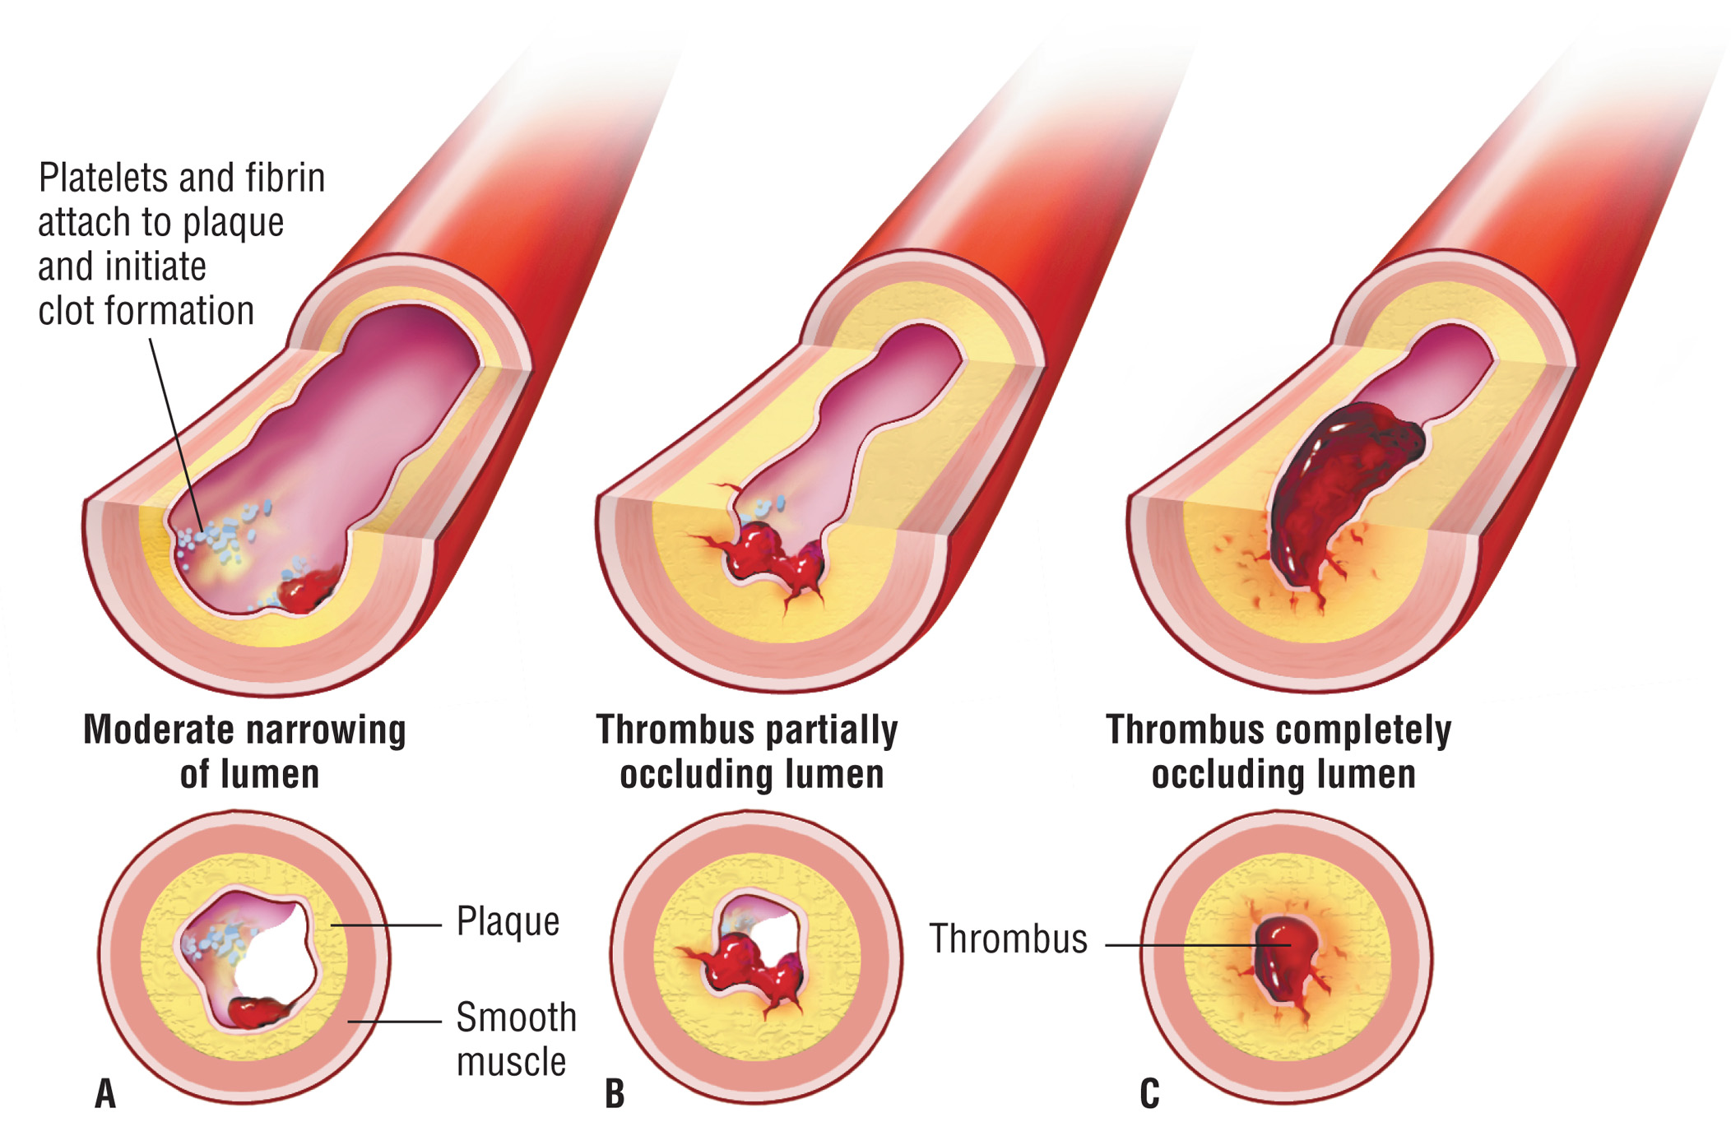
Figure 7–9 Thrombus Formation in an Atherosclerotic Vessel

Slide 33
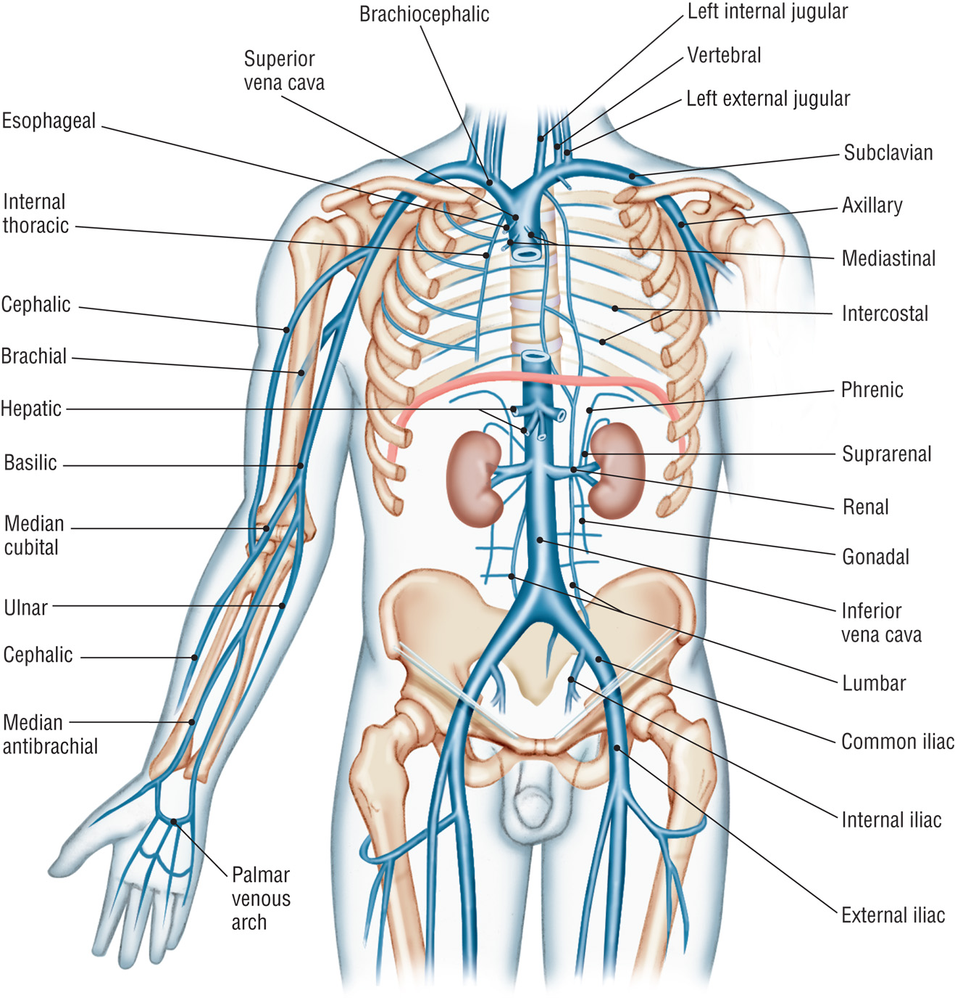
Figure 7–10 Venous System of the Upper Torso and Arm

Slide 34
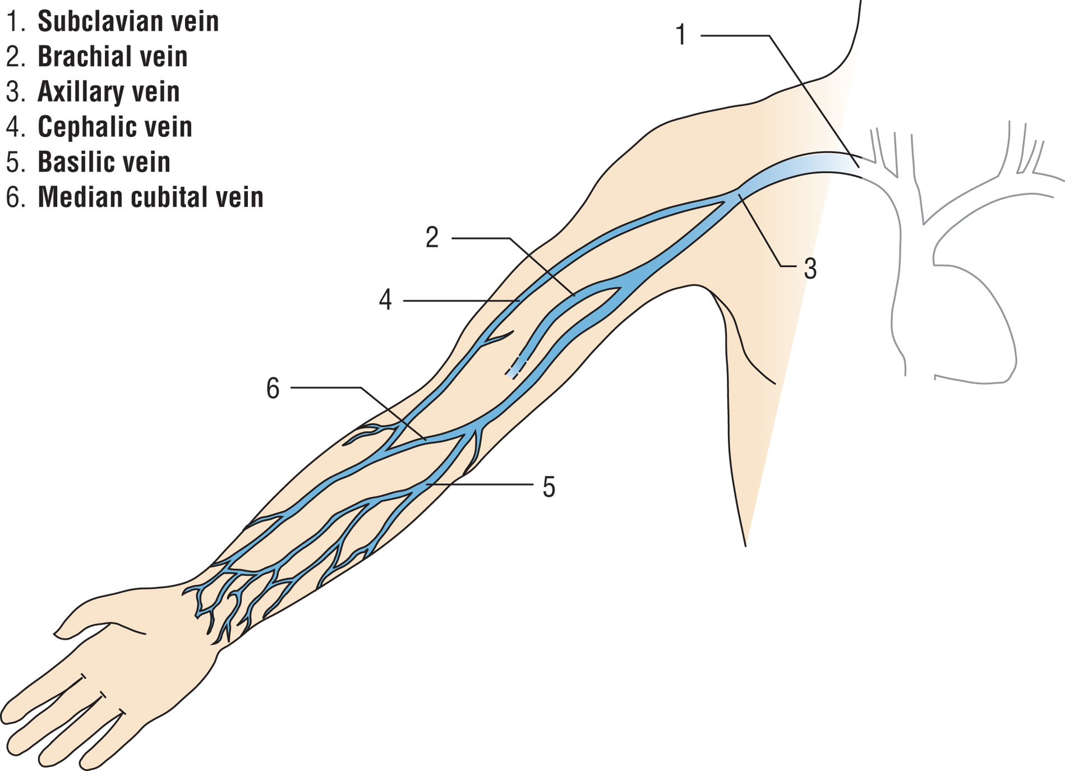
Figure 7–11 Major Arm Veins

Slide 35
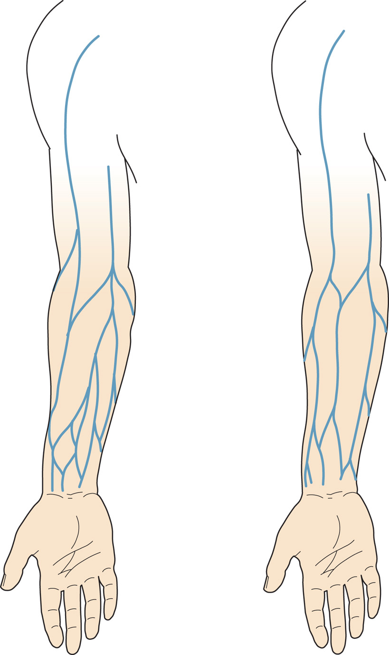
Figure 7–12 Variations in Venous Patterns

Slide 36
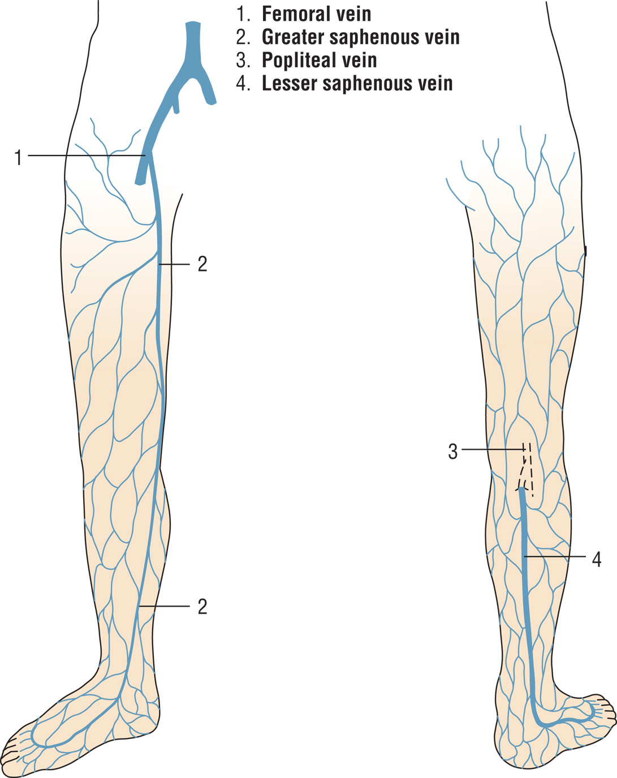
Figure 7–13 Major Leg Veins

Slide 37
Capillaries
Microscopic vessels linking arterioles and venules
May be so small in diameter as to allow only one blood cell to pass through at a time
Gas exchange (O₂ and CO₂) and other molecules between blood and tissues

Slide 38
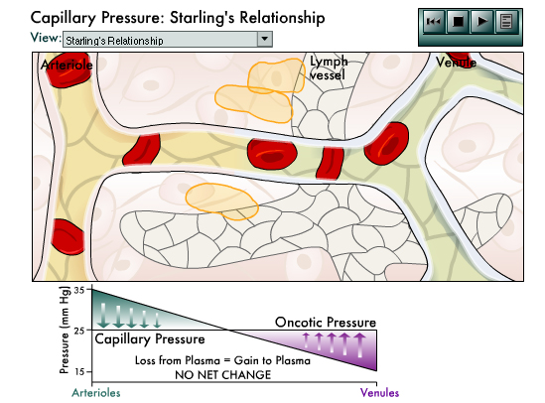
Capillary Pressure Animation
Click on the screenshot to see an animation depicting capillary pressure.
Click again to pause the video.
Return to Directory
Notes:
If you move your cursor along the capillary from the arteriolar end to the venule end, you will see the resultant pressure gradient at that point in the capillary and be able to relate that to net flow of fluid in or out of the capillary. Vasodilation reduces the pressure drop across the arterials, so that capillary pressure is closer to the arterial pressure. The venus pressure may remain unchanged. The net result is a greater length of capillary where fluid leaves the plasma and a reduced length for it to return.
This imbalance results in a net loss of fluid from the plasma. The result is an increase of the interstitial fluid in this tissue. If this increase continued, it would result in edema.
When the central blood pressure decreases, the pressure at the capillaries usually decreases. Most vascular beds will initiate reflex efforts to maintain the central blood pressure, via arteriolar vasoconstriction. This further reduces the pressure at the arteriolar end of the capillary. The decrease in hydrostatic pressure results in a decreased length of capillary, where fluid is lost from the plasma, and an increase in the length where fluid returns. This results in a net gain of fluid to the plasma. If this occurs over most of the body's vascular beds, there is an auto transfusion that helps to compensate for plasma loss during hemorrhagic shock.
When cardiac function is compromised, it cannot pump blood as effectively, so venous pressure rises. This elevation in venous pressure is seen in the capillaries. This rising venous pressure decreases the length of capillary where fluid is reabsorbed into the plasma. This results in a net loss of fluid from the plasma to ISF. The resulting edema can be seen in the swollen ankles and other tissues that are symptomatic of congestive heart failure.
When the plasma does not contain sufficient protein or the interstitial fluids contain too much, then the difference in oncotic pressure falls from 25 millimeters of mercury to less than 20. This results in a net increase in the length of the capillary where hydrostatic pressure exceeds oncotic pressure, which leads to edema.
This imbalance explains the Kwashiorkor of children with severe protein malnourishment from peritoneal edema. In burns, when capillaries are damaged, more plasma proteins leak into the interstitium, resulting in a decrease of the oncotic pressure difference and edema.

Slide 39
Types of External Bleeding
Arterial
Bright red, quick, spurts, harder to control bleeding
Venous
Darker red, steady flow, stop bleeding with gentle pressure
Capillary
Slow and even, stops easily with slight pressure

Slide 40
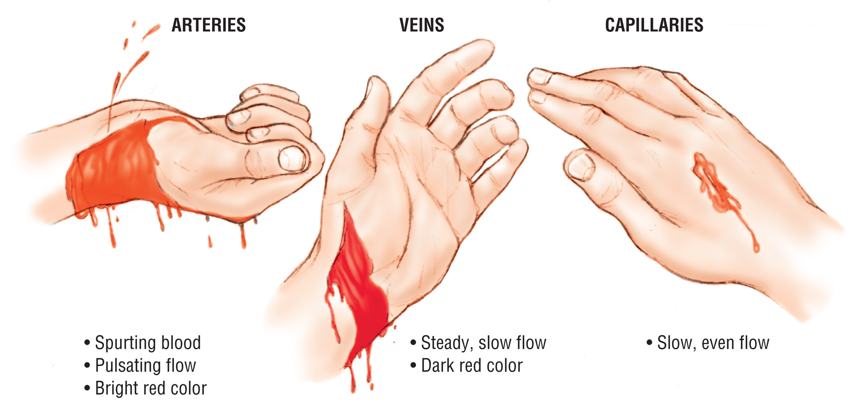
Figure 7–14 Types of External Bleeding

Slide 41
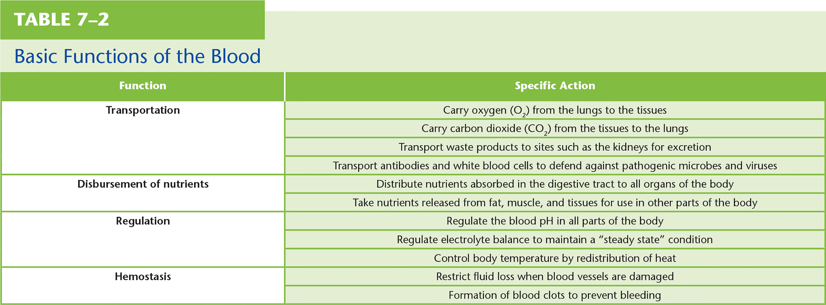
Table 7–2 Basic Functions of the Blood

Slide 42
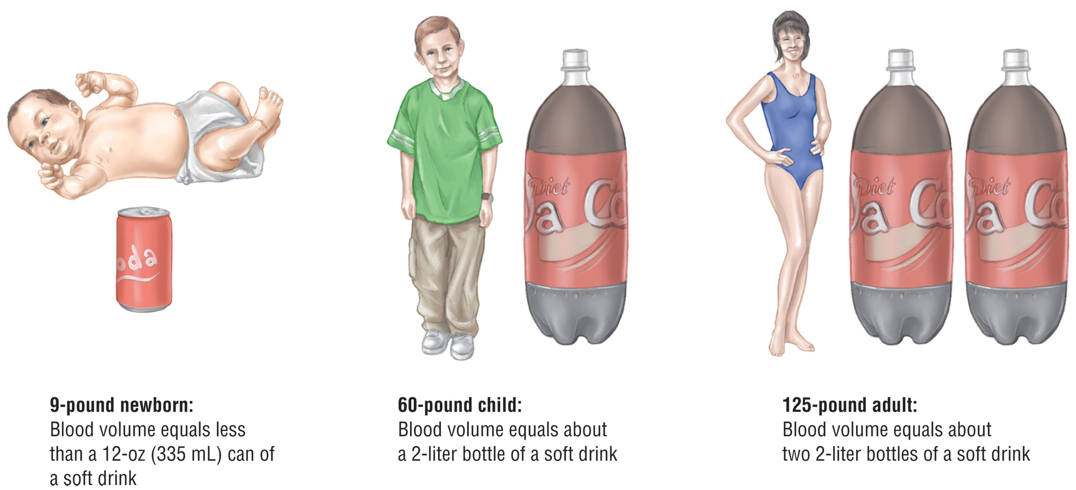
Figure 7–15 Comparison of Infant, Child, and Adolescent/Adult Blood Volumes

Slide 43
The Blood
Composed mostly of water
Contains blood cells
Also contains solutes
Lipids and glucose, proteins, fibrinogen, electrolytes, etc.
Blood can be collected with an additive to prevent clotting, or it can be allowed to clot.

Slide 44
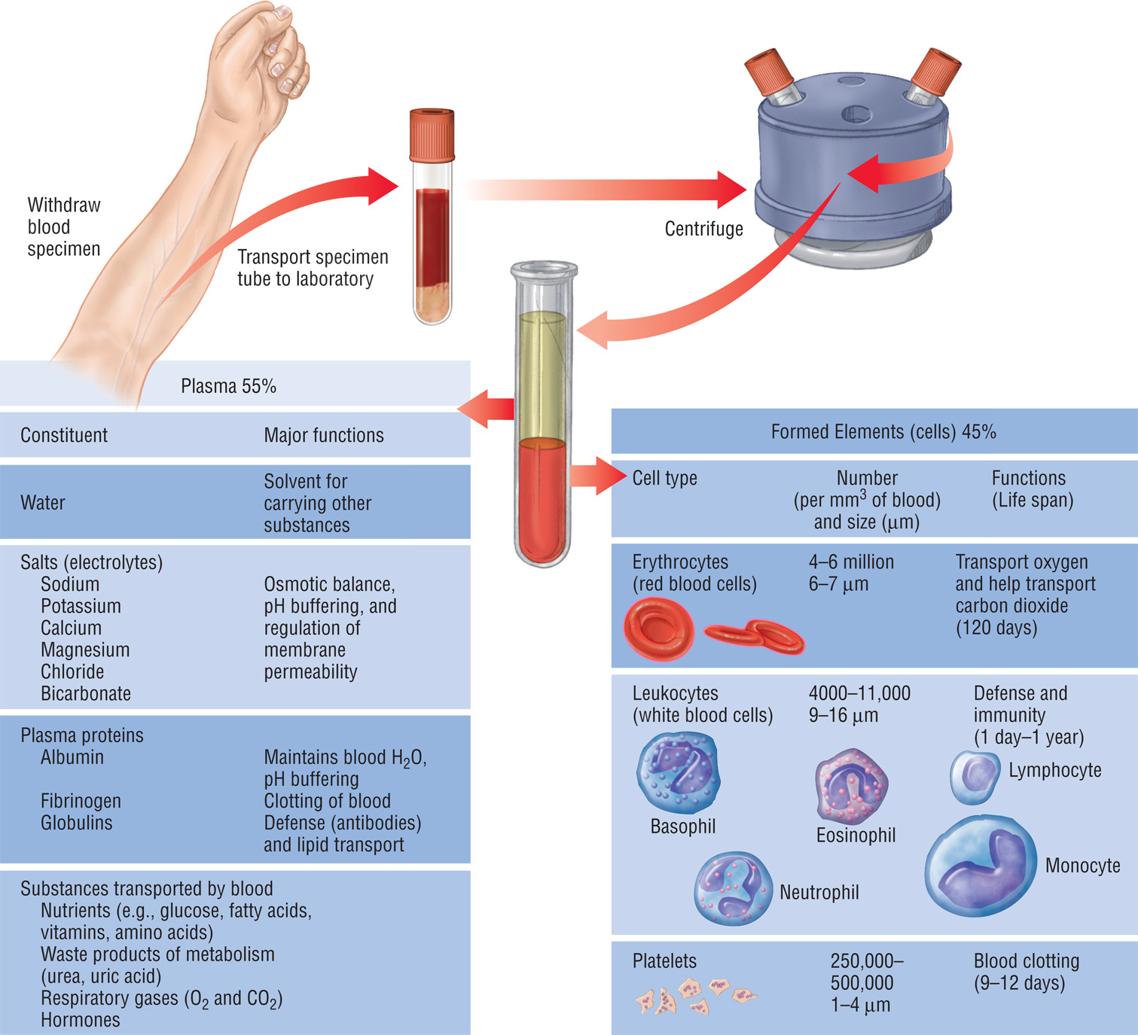
Figure 7–17 Basic Composition and Functions of Blood

Slide 45
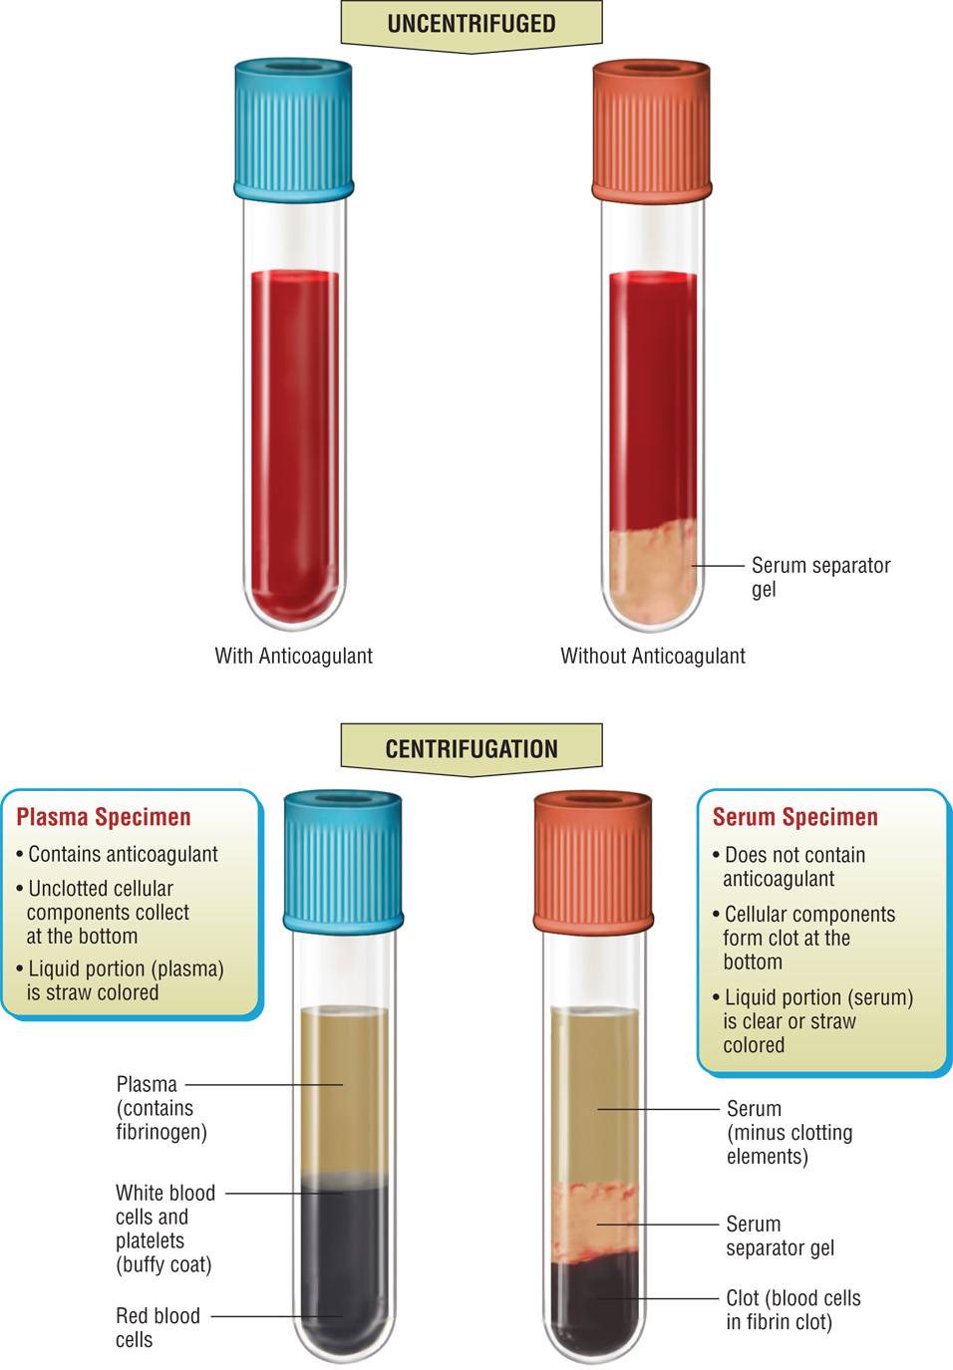
Figure 7–18 Blood Specimens with and without Anticoagulants before and after Centrifugation

Slide 46
The Blood
Erythrocytes/Red Blood Cells (RBCs)
Biconcave disk shape
Flexible shape allows passage through narrow capillaries and provides maximum surface area for O₂ and CO₂ exchange.
Life span is about 120 days in circulating blood.

Slide 47
The Blood
ABO Blood Group System
Four types based on RBCs
A, B, AB, or O
Type O is most common type followed by A, B, and AB.
Differences in blood types are due to presence or absence of protein molecules called antigens and antibodies.

Slide 48
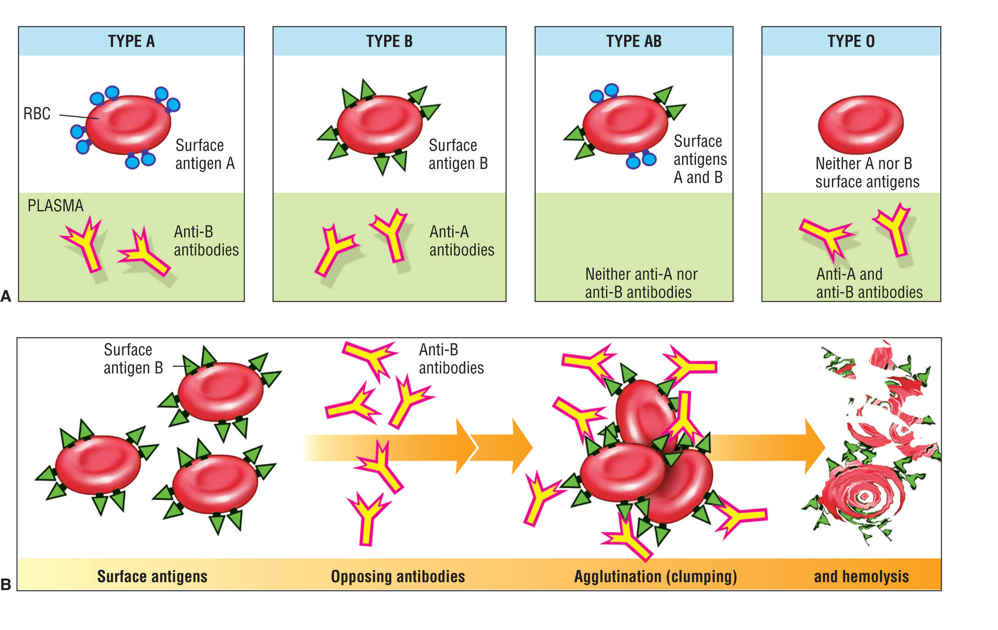
Figure 7–22 Blood Typing and Cross Reactions

Slide 49
Blood Transfusions
Can be life-saving
Cross-match testing:
Between donor and patient recipient
Detects compatibility and/or cross-reactions

Slide 50
Blood Transfusions
If patient or donor is misidentified, serious complications may result:
Wrong transfusion
Hemolysis, agglutination, organ damage, death

Slide 51
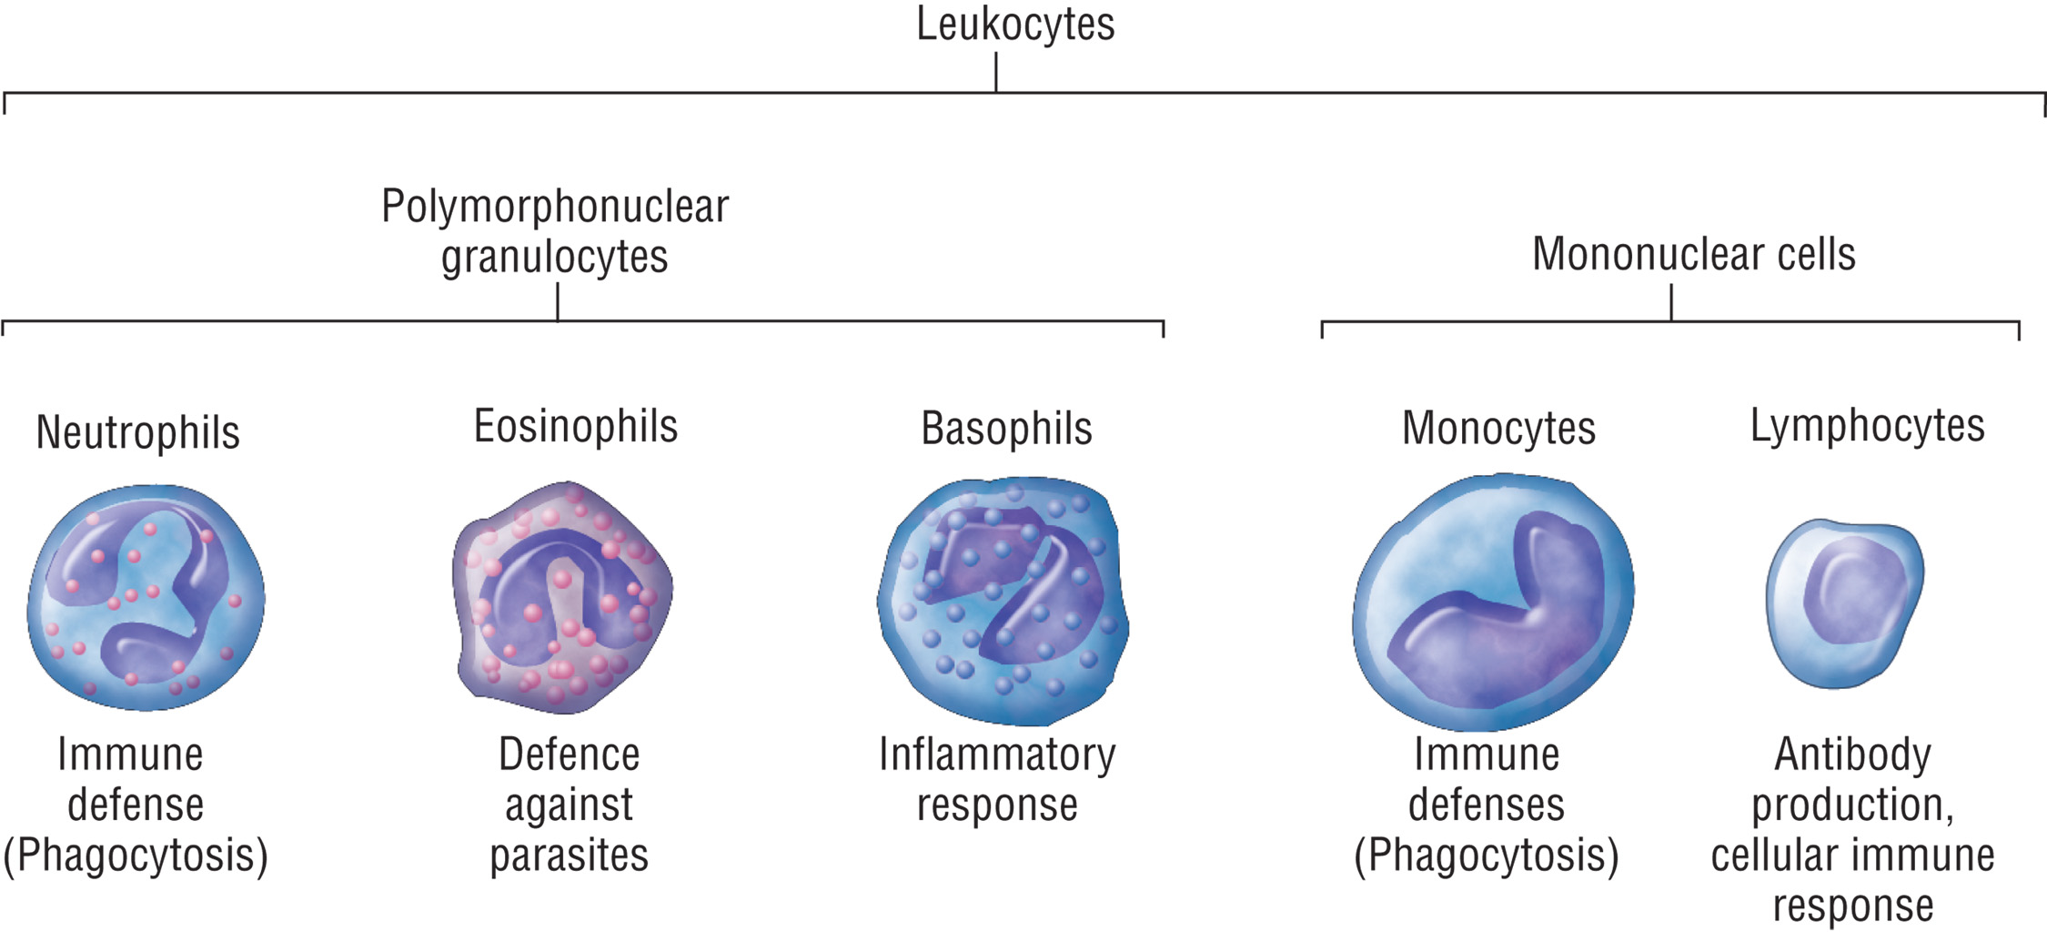
Figure 7–19 Morphology and Functions of White Blood Cells

Slide 52
Table 7–3 Blood Groups and Compatibilities

Slide 53
The Blood
Leukocytes/White Blood Cells (WBCs)
Two groups differ in color, size, shape, and nucleus:
Granular (granules in the cytoplasm)
Agranular (without cytoplasmic granules)
Part of the body's defense mechanism
continued on next slide

Slide 54
The Blood
Leukocytes/White Blood Cells (WBCs)
Formed in bone marrow and lymphatic tissues
Types
Neutrophils, basophils, eosinophils, lymphocytes, monocytes

Slide 55
The Blood
Thrombocytes or Platelets
Smaller than other blood cells
Aid in clotting process by forming a temporary patch or plug to slow blood loss, and contracting after the blood clot has formed.
Life span is 9 to 12 days

Slide 56
The Blood
Plasma
The liquid portion of the blood
Anticoagulated; does not clot
Blood cells are suspended in plasma.
Plasma is composed of water and solutes.

Slide 57
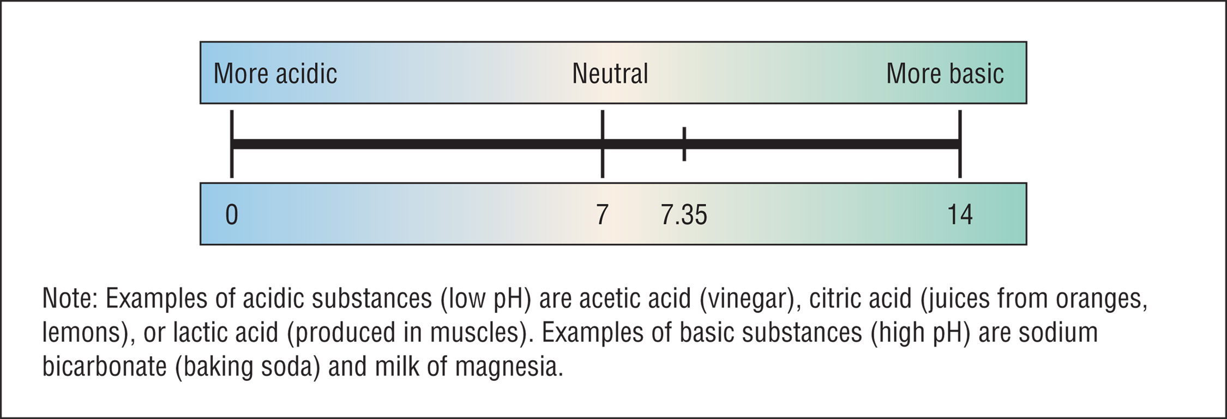
Figure 7–23 The pH Scale

Slide 58
Hemostasis and Coagulation
How does blood know when to clot and when to stay in the liquid state?
Hemostasis
Complex processes that allow the body to control bleeding while still maintaining circulating blood in the liquid state

Slide 59
Hemostasis and Coagulation
Phases in the Clotting Response
Vascular/vasoconstriction
Platelet phase
Coagulation phase
Release of clotting factors to form clot
Clot retraction
Fibrinolysis
Vessel is repaired, clot begins to dissolve

Slide 60
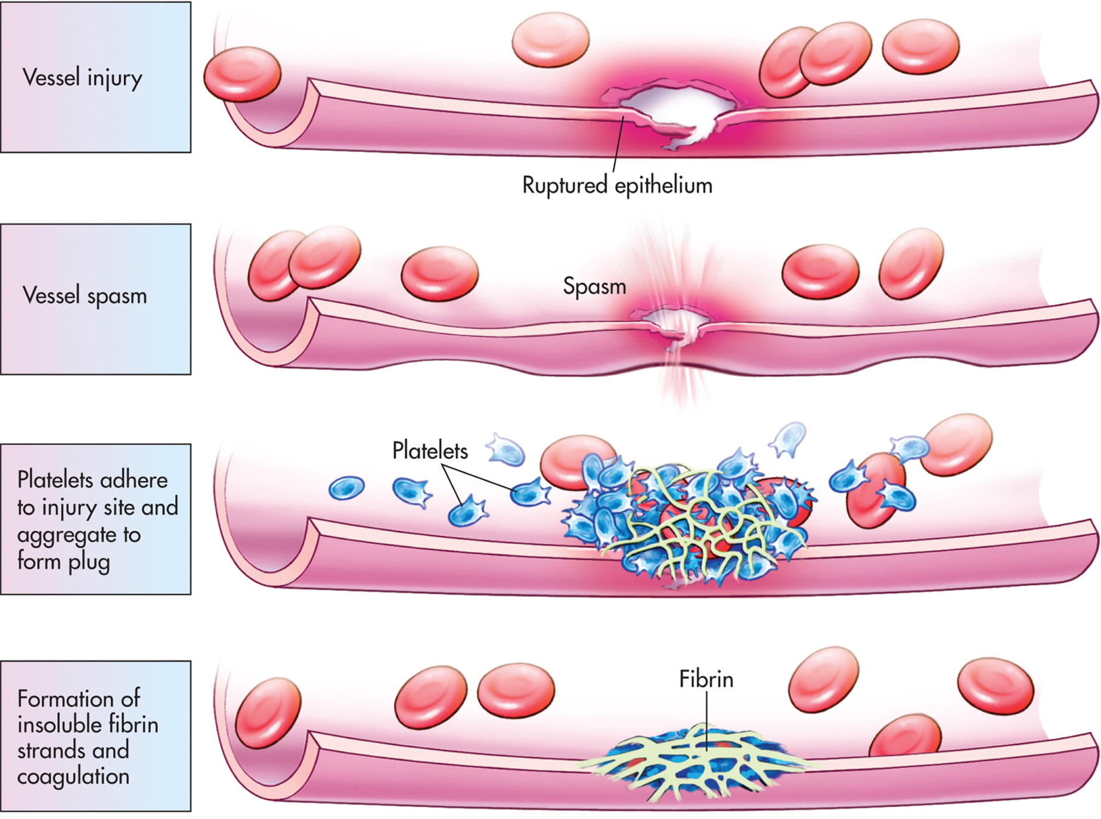
Figure 7–25 Hemostasis Overview

Slide 61
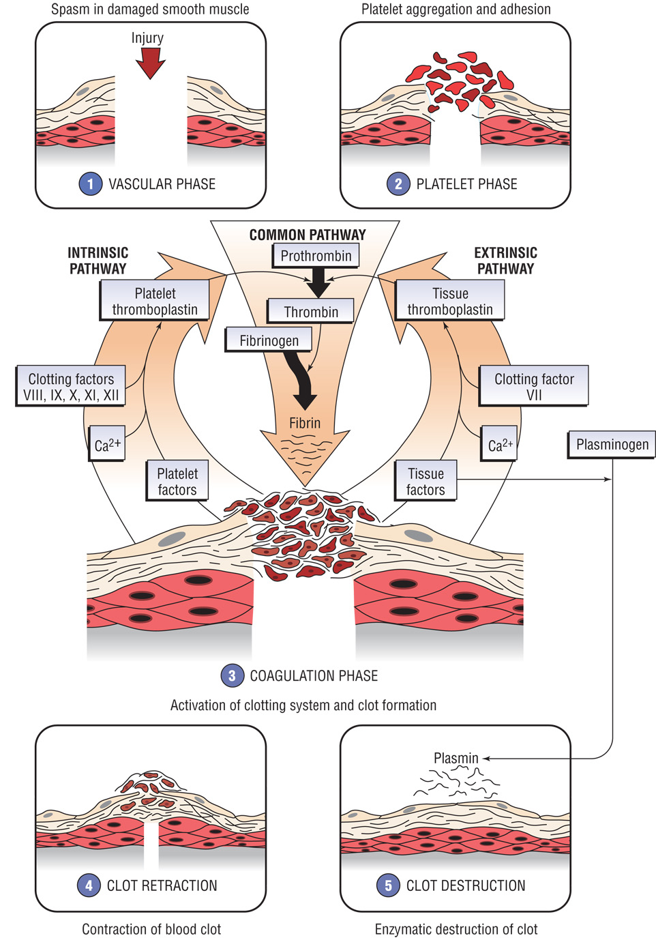
Figure 7–26 Details of the Hemostatic or Blood Clotting Process

Slide 62
Hemostasis and Coagulation
Coagulation Issues that Impact Phlebotomy
Drugs such as aspirin, heparin, and Coumadin (warfarin), suppress clotting, so patients may bleed more or bruise more easily.
Disseminated intravascular coagulation (DIC), emboli, thrombi, etc.

Slide 63
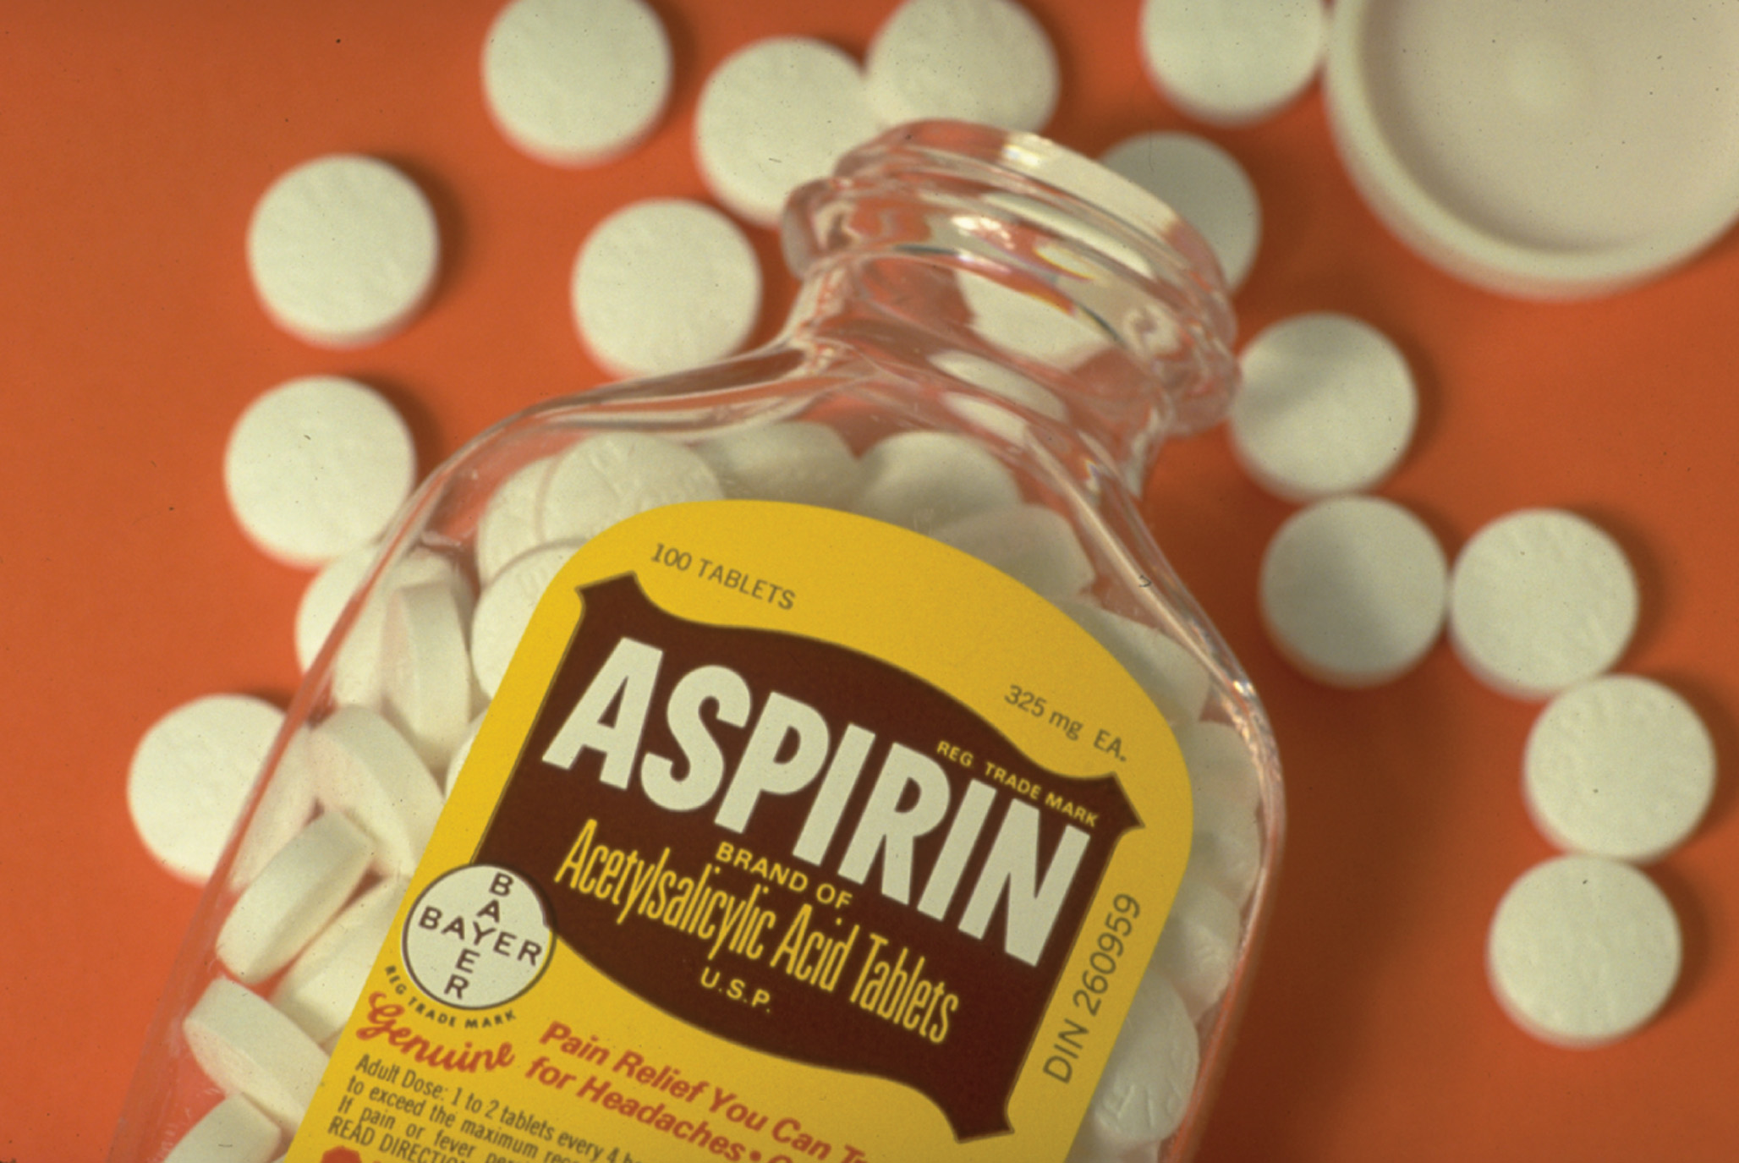
Figure 7–27 Medications and Bleeding

Slide 64
Disorders of the Cardiovascular System
Heart
Congestive heart failure, valve problems
Vessel problems
Atherosclerosis, cerebral vascular accident (CVA) or stroke, ischemia, aneurysm, hemorrhage

Slide 65
Disorders of the Cardiovascular System
Blood
Polycythemia
Anemia
Leukemia
Hemostasis problems
Hemophilia, embolus, thrombus, disseminated intravascular coagulation (DIC)

Slide 66
Table 7–7 Common Drugs for the Cardiovascular System

Slide 67
Figure 7–28 Hematologic Conditions A. Traumatic hematoma. B. Vein hemorrhage. Courtesy Jason L. Smith, MD.

Slide 68
Laboratory Tests of the Cardiovascular System
Clinical Hematology Laboratory
RBCs, number, morphology, and hemoglobin content
Morphology and number of platelets and WBCs
Bone marrow
Coagulation Laboratory
Platelet function and coagulation factors
continued on next slide

Slide 69
Laboratory Tests of the Cardiovascular System
Immunohematology or Blood Banking Laboratory
Blood types and cross-matches
Clinical Chemistry Laboratory
Serum and plasma constituents

Slide 70
Lymphatic System
Components
Lymph
Lymphocytes
Lymph vessels
Lymph nodes
Tonsils
Spleen
Bone marrow
Thymus gland

Slide 71
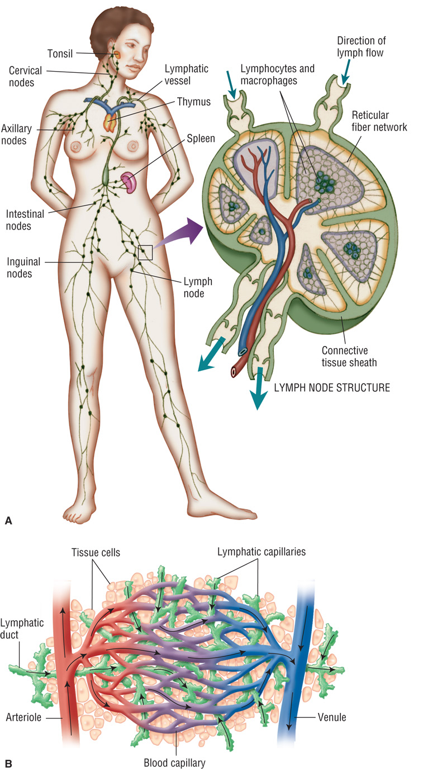
Figure 7–29 Lymphatic System

Slide 72
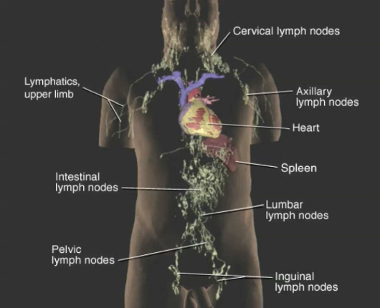
Lymphatic System Animation
Click on the screenshot to view an animation showing the lymphatic system.
The animation may require a moment to begin. Click again to pause the animation.
Return to Directory
Notes:
There is no audio for this video/animation.

Slide 73
Lymphatic System
Maintains fluid balance in tissues by filtration.
Defense against disease.
Absorbs fats and other substances from digestion.
Closely entwined with the circulatory system.
continued on next slide

Slide 74
Lymphatic System
Approximately 30 L. of lymph fluid pass from blood to tissue spaces each day.
If lymph nodes are removed, body cannot remove fluids efficiently, so patients may have localized fluid retention.

Slide 75
Disorders of the Lymphatic System
Tumors (such as lymphoma and Hodgkin's disease)
Immune disorders
Infectious processes

Slide 76
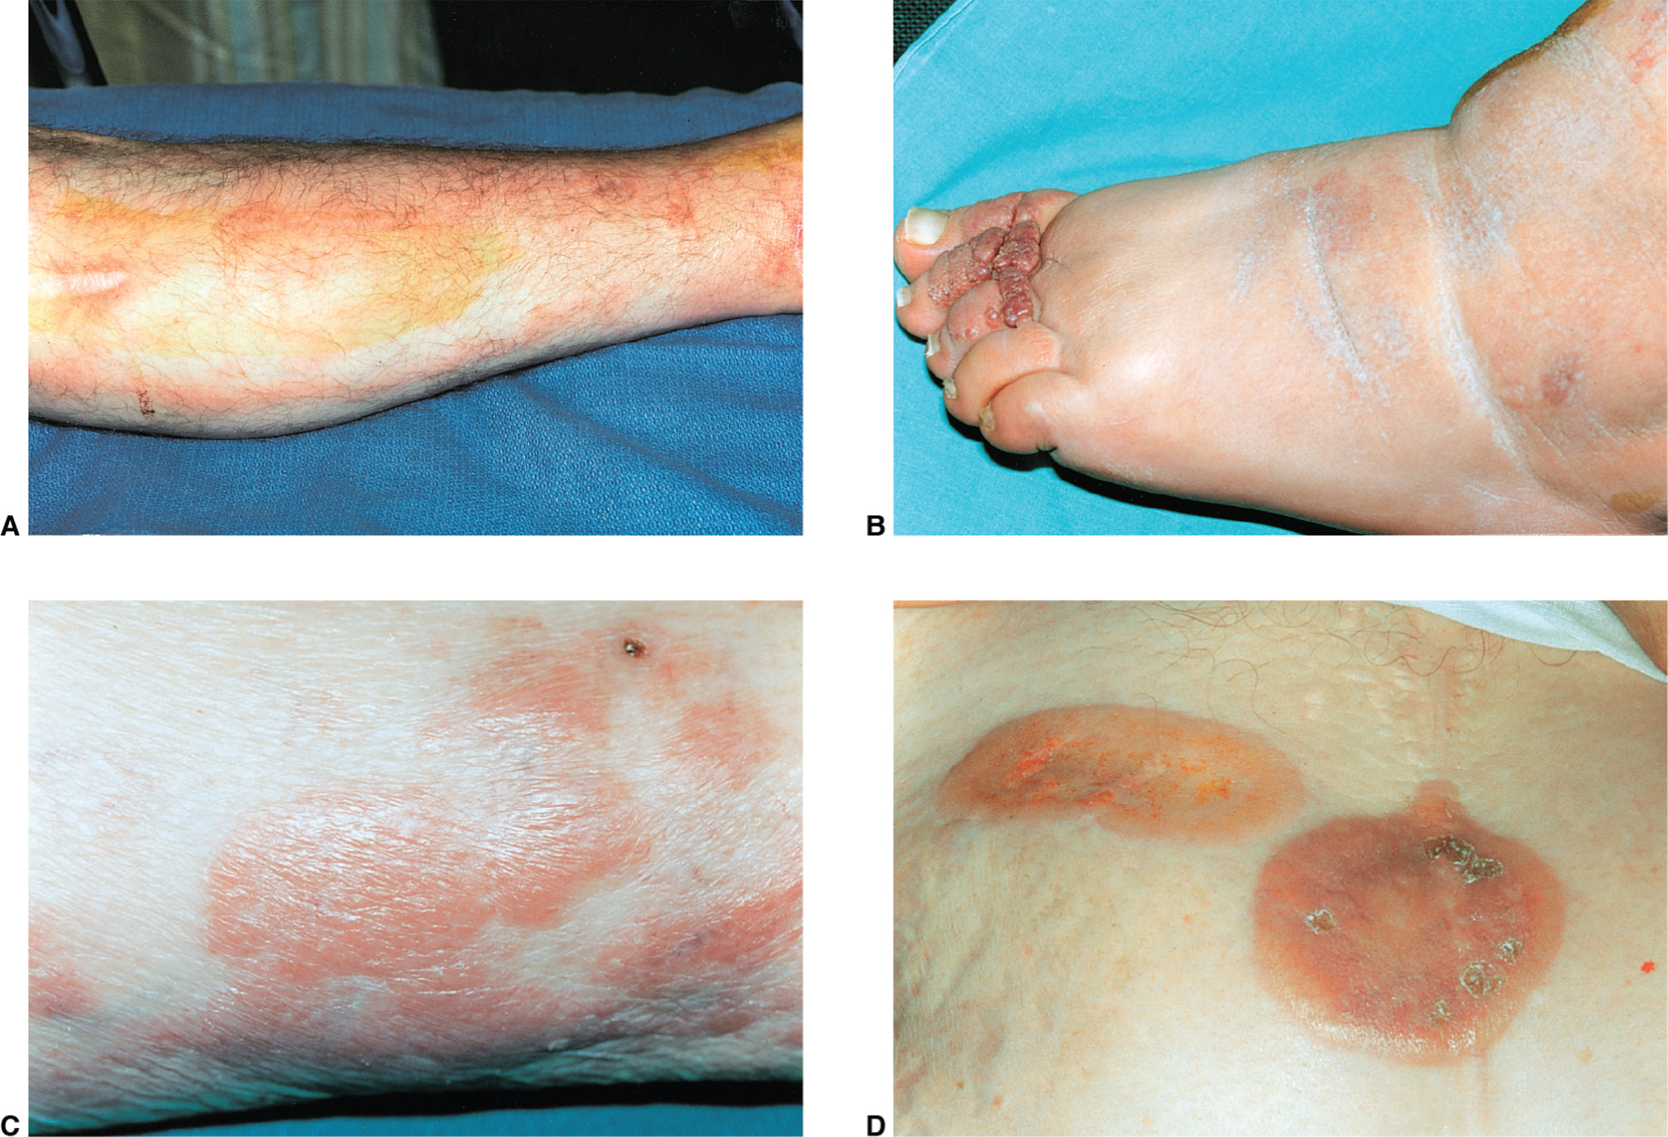
Figure 7–30 Disorders of the Lymphatic System A. Lymphangitis, or inflammation of the lymphatic vessels. B. Chronic lymphedema, accumulation of lymph fluid in the interstitial or tissue spaces. C. Lymphoma. D. Cutaneous T-cell lymphoma. Courtesy Jason L. Smith, MD.

Slide 77
Lymphatic System Laboratory Tests
Blood samples
Bone marrow
Lymph nodes are often surgically removed or aspirated so that cells can be analyzed and/or cultures performed.
Analysis of markers on the surface of the cellular material.

Slide 78
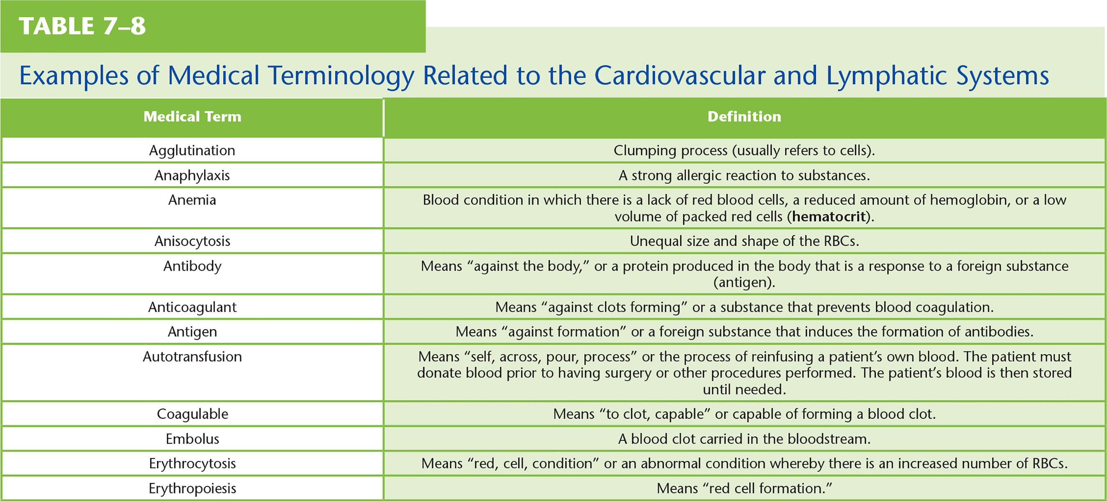
Table 7–8 Examples of Medical Terminology Related to the Cardiovascular and Lymphatic Systems1
continued on next slide

Slide 79
Table 7–8 (continued) Examples of Medical Terminology Related to the Cardiovascular and Lymphatic Systems1
continued on next slide

Slide 80
Table 7–8 (continued) Examples of Medical Terminology Related to the Cardiovascular and Lymphatic Systems1

