Slide 1
Quality control in the laboratory
by: Anastasia augustine, Mlt (ascp)
Kathy miller, MLT (ASCP)
Rama kamasani, mlt (AMT)
Cora curre, MLT(ASCP)^{CM}, Lab manager
March 2013

Slide 2
What is Quality Control?
Quality Control is the process of testing materials that have a known value or concentration prior to running and resulting patient tests.
It is performed to ensure that test results produced in the laboratory are ACCURATE.

Slide 3
Running Controls checks for the following:
Test System Failures
Environmental conditions
Reagent and Kit Storage
Operator performance

Slide 4
Why do we do QC?
Quality Control specimens are examined on a regular schedule to verify accurate test results.
To get accurate test results you must run your QC, evaluate your QC results, and document in the QC logs.
Regulatory requirements dictate that each test system must be monitored for accuracy and precision on a regular basis.
Quality Control is done to verify operator performance.
When test results are questionable, QC is performed.

Slide 5
How do we do QC?
QC ranges are found in the manufacturer’s package inserts for each test.
It is vital you choose the correct ranges for the test method.
New test kits or instruments are validated before use to ensure accuracy.
Consult each test procedure for specific instructions.

Slide 6
Two Types of QC
QUALITATIVE-Positive/Negative
Hemoccult
KOH
Mono
Pregnancy
Strep
QUANTITATIVE-Numeric Result
Glucose
Hemoglobin A1c
Hemoglobin
Prothrombin Time
Urinalysis

Slide 7
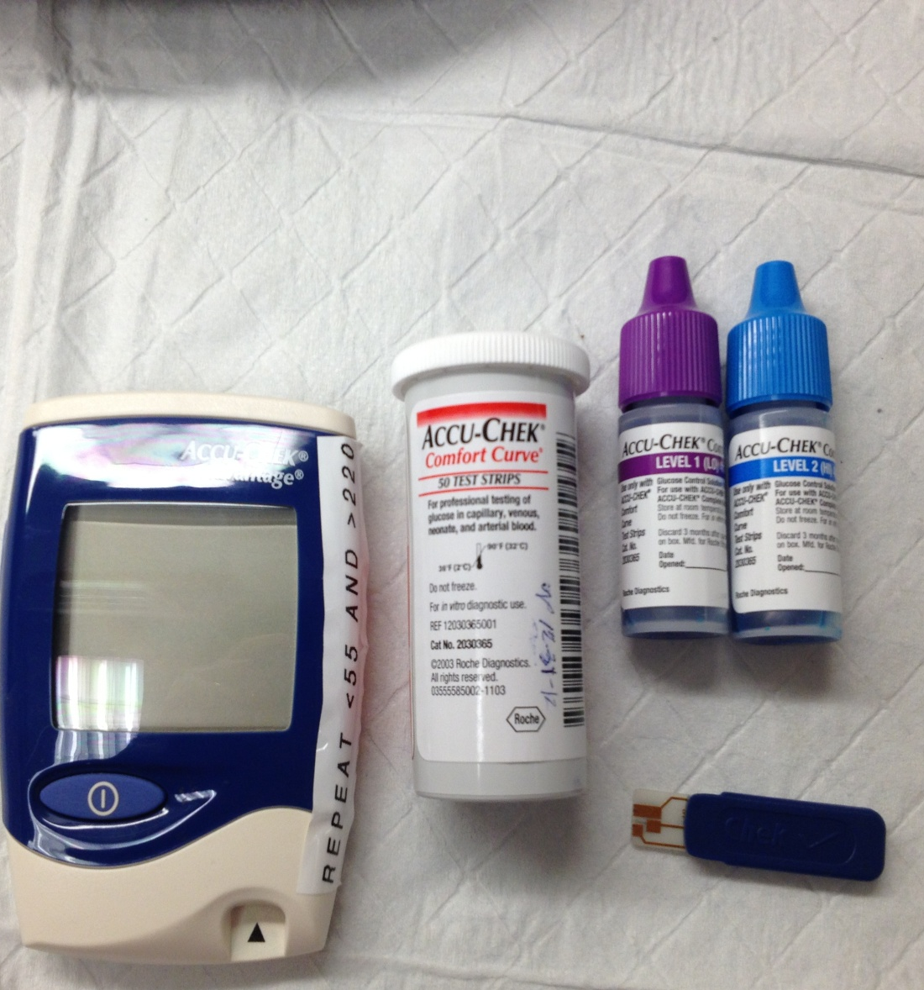
Glucose-Advantage
Low and High controls are run
  Weekly
  When a new vial of strips is opened.
  Chek strip is run once each day of testing.
After opening, the controls expire in 3 months.
The test strips are stable until the expiration date on the vial.
Chek Strip

Slide 8
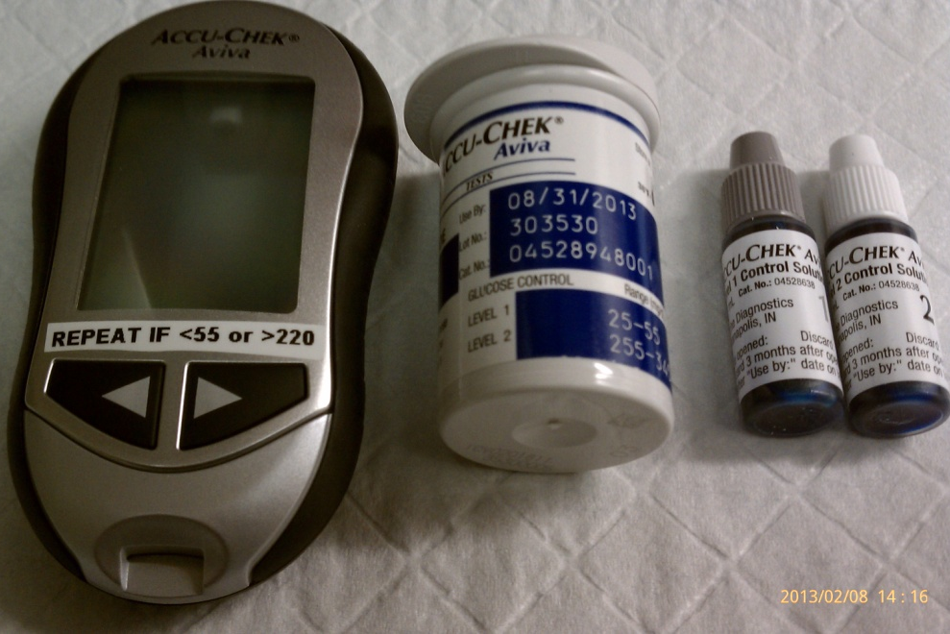
Glucose-aviva
Low and High controls are run
  Weekly
  When a new vial of strips is opened.
After opening, the controls expire in 3 months.
The test strips are stable until the expiration date on the vial.

Slide 9
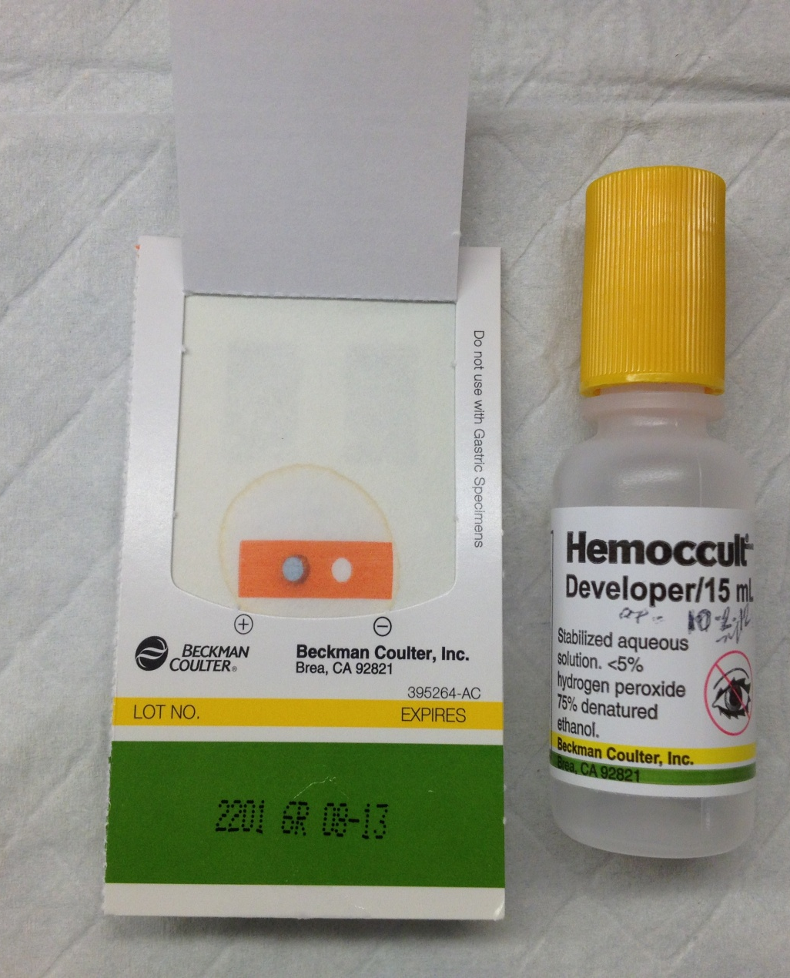
Hemoccult
Controls are run
The internal positive and negative controls must be done and the proper reaction seen on each patient card.
Check developer for expiration date.
Check test cards for expiration date before running test.

Slide 10
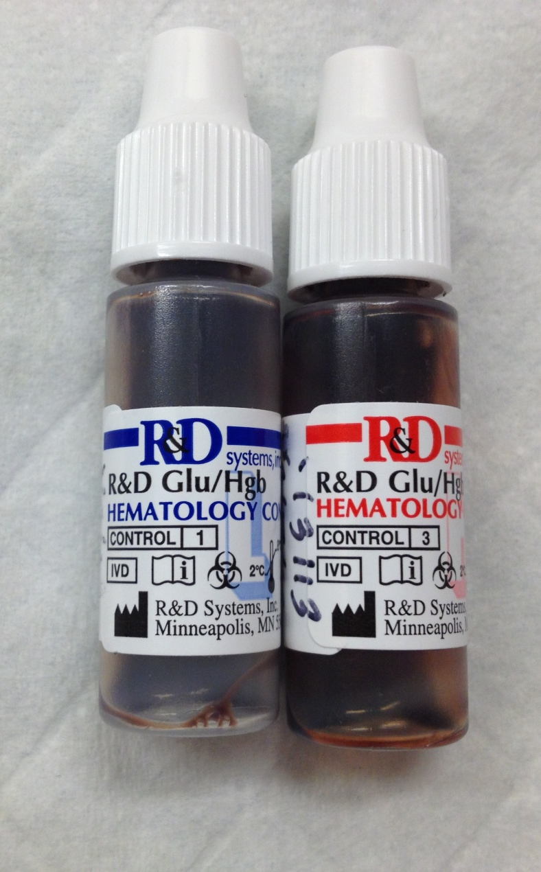
Hemoglobin
Low and High controls are run
Each day of patient testing
When a new bottle of test cuvettes are opened.
Note the SELFTEST result when starting the machine up.
  After controls are opened they expire within 1 month
  After cuvette bottles are opened they expire within 3 months.
  Controls and cuvettes can also expire as stated on the vials.

Slide 11
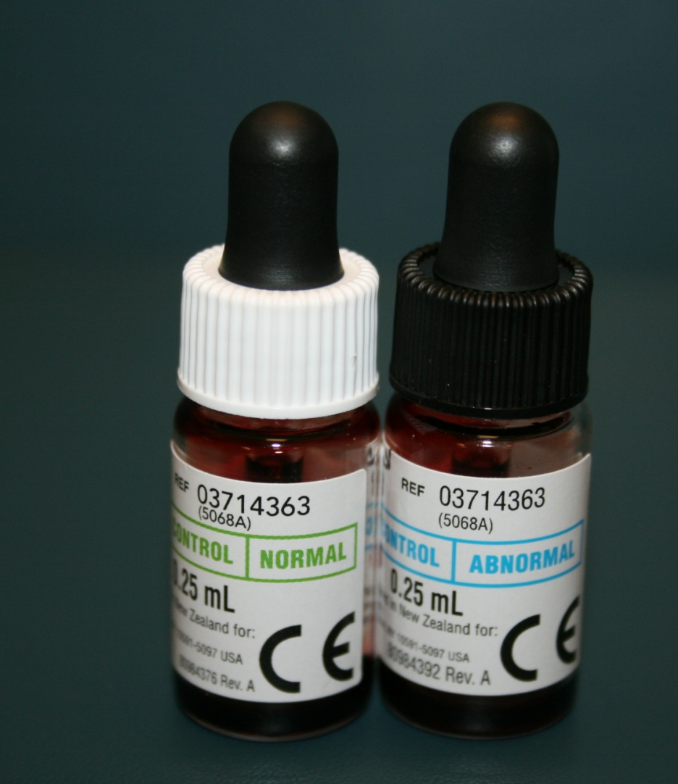
Hemoglobin A1c
Normal and Abnormal Controls are run
Weekly
When a new shipment or Lot # of reagent cartridges are opened
The optical test is run quarterly or when prompted by the machine.
Controls expire within 3 months after being made up.
Reagent kits expire in 3 months at room temperature or until the expiration date if kept refrigerated.

Slide 12
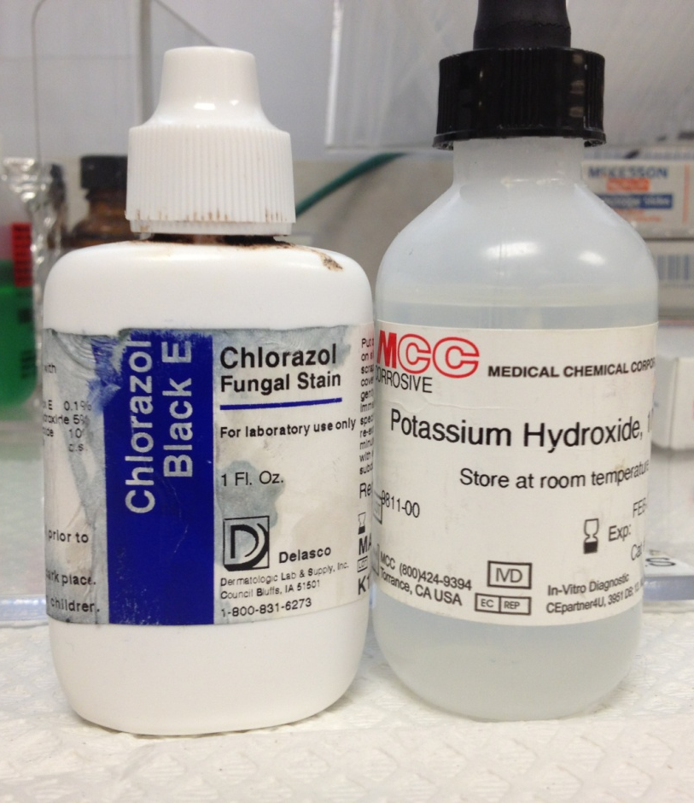
KOH/Chlorazol black e stain
Check the stains weekly for contamination.
KOH expires 2 months after opening.
Chlorazol Black E expires as stated on the vial.

Slide 13
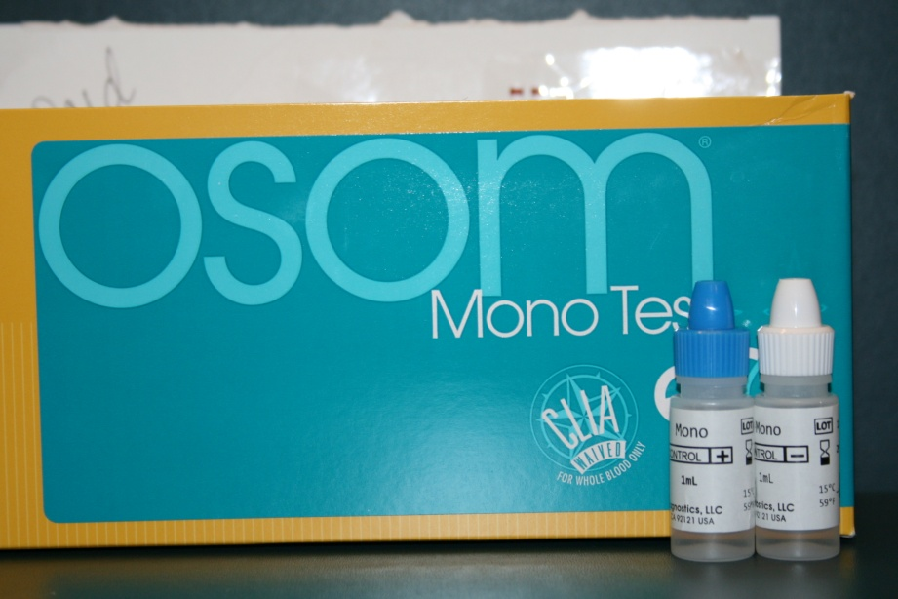
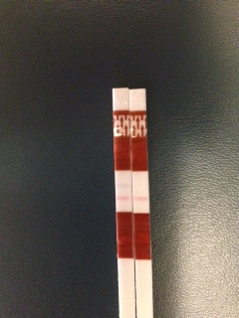
mONO
Positive and Negative controls are run
When a new kit is opened
You must observe the internal control on each test strip.
NEG
POS
Internal Control
Internal Control

Slide 14
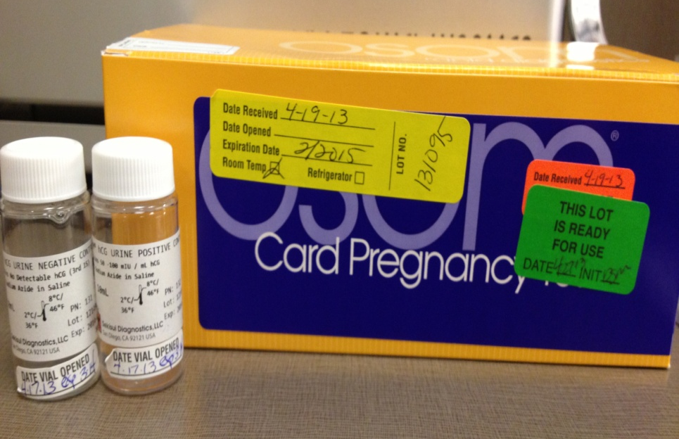
Pregnancy- Osom card
Positive and Negative controls are run
When a new kit is opened
You must observe the internal control on each test cartridge.
Controls are stable in the refrigerator until the expiration date on the bottle.
Run only Negative and Positive-I toss out Positive-II in the biohazard container.

Slide 15
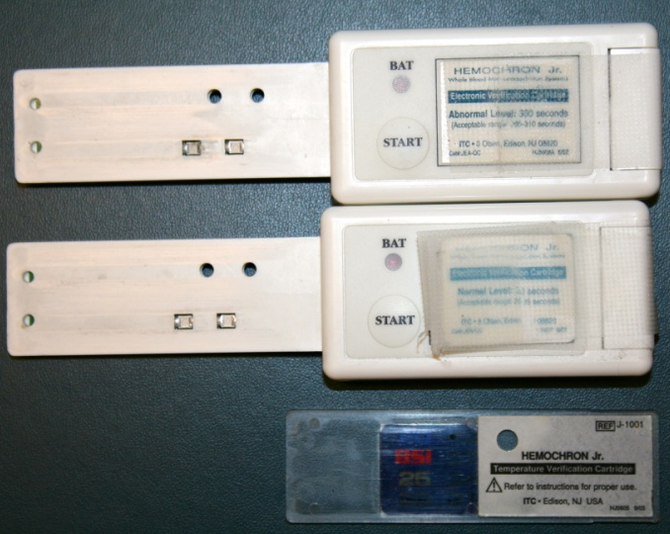
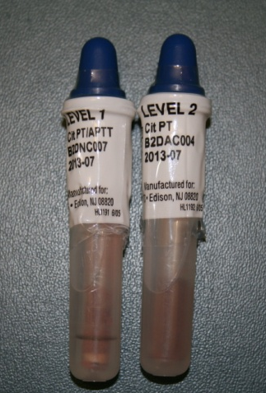
Prothrombin Time
*Moderate Complexity Test*
Liquid normal and abnormal controls are run (LQC)
When a new box is opened
New shipment is received
New lot # opened
Prompted by the machine
Electronic controls (EQC) must be run every 8 hours.
Temperature verification (TQC) must be run once each day of testing.
Controls are stable until the expiration date if refrigerated
Unopened controls are stable at room temperature for 1 month
Once opened, the box of cuvettes expire in 3 months at room temperature or by the expiration date if kept refrigerated.
Level 1 and level 2 controls are validated every time a new lot # is opened.
Please consult with MLT on this procedure
New control ranges must be entered into computer software and downloaded into the instrument.
Please consult with MLT on this procedure

Slide 16
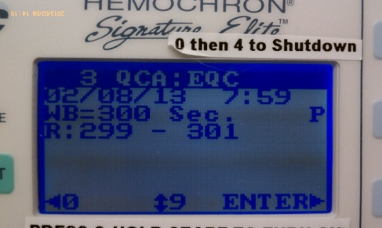
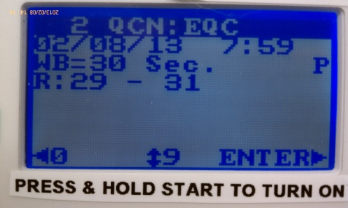
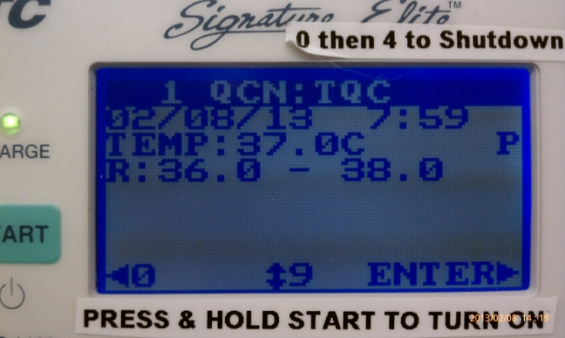
Prothrombin Time-Elite
*Moderate Complexity Test*
Liquid normal and abnormal controls are run (LQC)
When a new box is opened
New shipment is received
New lot # opened
Prompted by the machine
Electronic controls (EQC) are run automatically every 8 hours by the instrument.
Temperature verification (TQC) is automatically run once each day of testing.
Controls are stable until the expiration date if refrigerated
Unopened controls are stable at room temperature for 1 month
Once opened the box of cuvettes expire in 3 months at room temperature or by the expiration date if kept refrigerated.
Level 1 and level 2 controls are validated every time a new lot # is opened.
Please consult with MLT on this procedure
New control ranges must be entered into computer software and downloaded into the instrument.
Please consult with MLT on this procedure

Slide 17
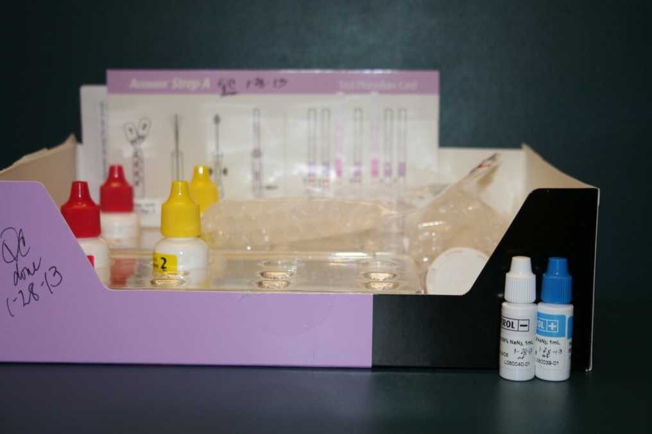
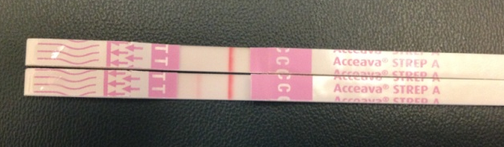
Rapid Strep
Positive and Negative controls are run
When a new bottle of test strips are opened and new reagents opened-twice per kit.
You must observe the internal control on each test strip.
Once the bottle of strips is opened they expire within 1 year or as stated on the outside of the kit whichever comes first.
NEG
POS
Internal Control

Slide 18
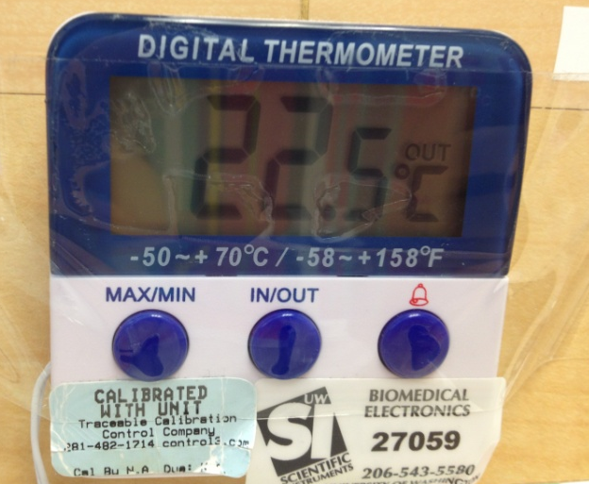
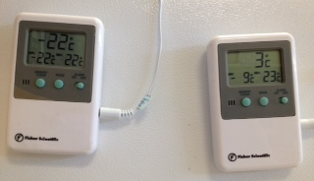
Temperatures
Temperatures are recorded for the following areas in the lab daily:
Refrigerator (2-6°C.)
Freezer (-10 to -24°C.)
(-10 to -30°C.) Northgate
Room Temperature (20-25°C.)

Slide 19
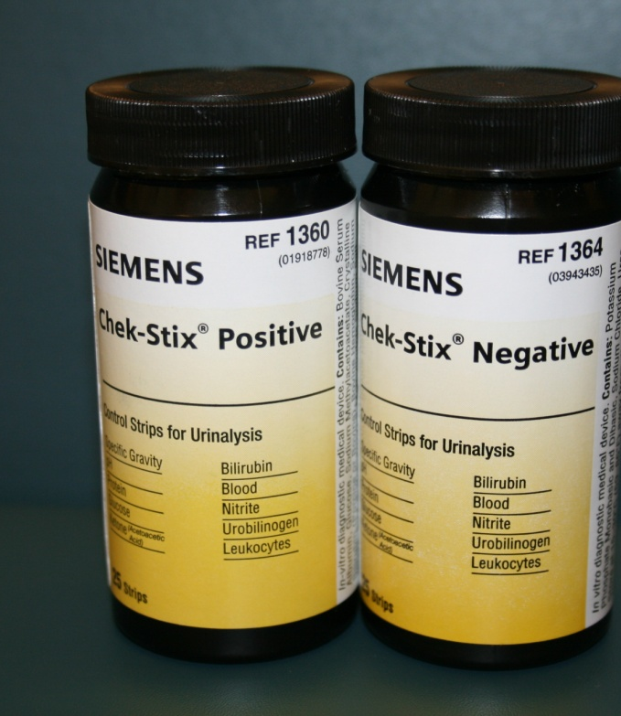
Urinalysis
Positive and Negative controls are run
Weekly
When a new vial of strips is opened
When a new lot # of strips is opened
Prepared controls are stable for 8 hours stored at room temp except bilirubin which is stable for 3 hours.

Slide 20
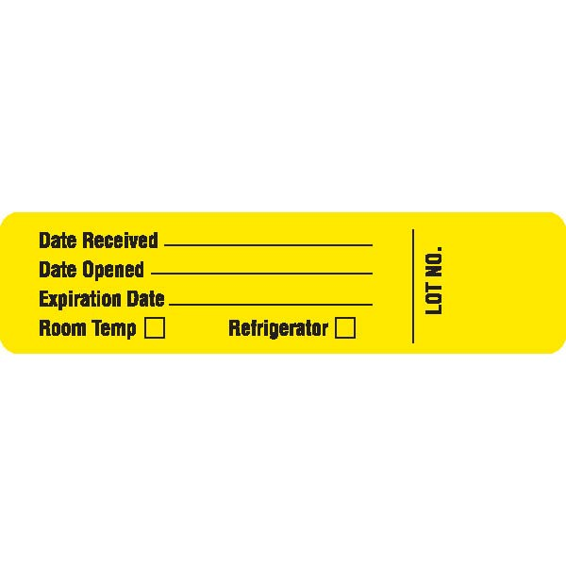
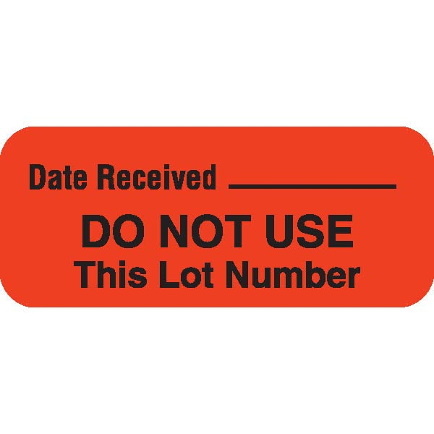
Labels for Test Kits and Controls
Kits/Cuvettes/Vials | Controls
Upon receipt Fill out the date received and temperature storage requirements | NOT USED
Kits/Cuvettes/Vials | Controls
Upon receipt Place over the opening of the box so it’s visible to everyone | Upon receipt for Protime controls if they are different lot numbers and need to be validated.

Slide 21
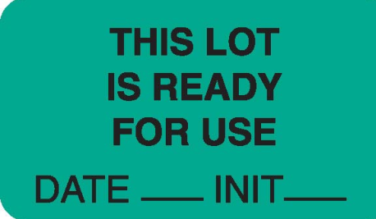

Labels for Test Kits and Controls
Kits/Cuvettes/Vials | Controls
After a new shipment of kits/cuvettes/vials has been checked with controls | Apply this label on all controls upon receipt with the exception of a new lot number of Protime controls. The lot is checked to see if a validation has been done on them first. After that is confirmed or a validation is done then this label is applied.
Kits/Cuvettes/Vials | Controls
After the new kits have been checked with controls, apply this label over the existing larger yellow label on the kit. | Apply this label on all controls after they are opened and validated (if needed).

Slide 22
Sources of error-Why is my QC out?
Specimen Collection
ERROR | SOLUTION
QNS (Quantity Not Sufficient) | Fill all tubes to indicated fill line
Contamination of Specimen | Follow all lab procedures for proper specimen collection. Collect venipuncture specimen using correct “order of draw” to reduce anticoagulant contamination.
Specimen Deterioration | Follow the laboratory and manufacturer’s insert for specimen stability.
Improper Collection/Handling | Check the UWMC Lab Test Catalog for collection guidelines and the lab procedure for proper specimen handling (room temp, refrigerated, frozen)

Slide 23
Sources of error-Why is my QC out?
Lab and Environmental
ERROR | SOLUTION
Electrical Power Failure and Surges | Check the instruments manufacturer’s instructions for electrical requirements
Improper Centrifugation | Verify that the centrifuge is running at the proper speed and time.
Low Batteries | Replace batteries when needed or when electrical issues are apparent
Improper Storage of Test Kits and Reagents | Follow package inserts for proper storage. Keep test cartridges in the foil pouches until ready to run test. Keep all test strips in with their desiccant. Do not handle test strips on reaction areas.

Slide 24
Sources of error-Why is my QC out?
Reagents
ERROR | SOLUTION
Out of Date-expired | Check expiration dates on all reagents including date opened and date expires
Wrong Kit and Lot Numbers | Check QC log sheets for the current lot number and control ranges. Check and scan current calibration card (DCA). Do not interchange components from different kit lots. Do not use after expiration date! Check the vial code (glucose).
Reagent Preparation | Make sure the reagent was made up correctly.
Operator/Testing Personnel
ERROR | SOLUTION
Training | Verify that lab staff have been trained for testing, have documentation and can locate the UWNC lab procedures and the UWMC Lab online Test Catalog.
Controls are out | Repeat the control Use new controls and repeat testing If controls are still out use new test cartridge, strip, or kit and repeat test. If still out new operator repeats. If still out send test to UWMC Lab and consult with MLT or Lab Manager

Slide 25
Questions?
Contact information
Contact the MLT in each UWNC Lab for questions or contact the Laboratory Manager
Cora Curre, MLT(ASCP)^{CM}
206-520-1331
currec@uwpn.org

