Slide 1
Quality control in the laboratory
by:
Kathy miller, MLT (ASCP)
Rama kamasani, mlt (amt)
Melissa Dofelmier, MLT(ASCP)^{CM} , Lab Technical coordinator
Cora curre, MLT(ASCP)^{CM}, Lab manager
January 2016

Slide 2
What is Quality Control?
Quality Control is the process of testing materials that have a known value or concentration prior to running and resulting patient tests.
It is performed to ensure that test results produced in the laboratory are ACCURATE.

Slide 3
Running Controls checks for the following:
Test System Failures
Environmental conditions
Reagent and Kit Storage
Operator performance

Slide 4
Why do we do QC?
Quality Control specimens are examined on a regular schedule to verify accurate test results.
To get accurate test results you must run your QC, evaluate your QC results, and document in the QC logs.
Regulatory requirements dictate that each test system must be monitored for accuracy and precision on a regular basis.
Quality Control is done to verify operator performance.
When test results are questionable, QC is performed.

Slide 5
How do we do QC?
QC ranges are found in the manufacturer’s package inserts for each test.
It is vital you choose the correct ranges for the test method.
New test kits or instruments are validated before use to ensure accuracy.
Consult each test procedure for specific instructions.

Slide 6
Two Types of QC
QUALITATIVE-Positive/Negative
Influenza
KOH
Mono
Pregnancy
Strep
QUANTITATIVE-Numeric Result
Glucose
Hemoglobin A1c
Hemoglobin
Prothrombin Time
Urinalysis

Slide 7
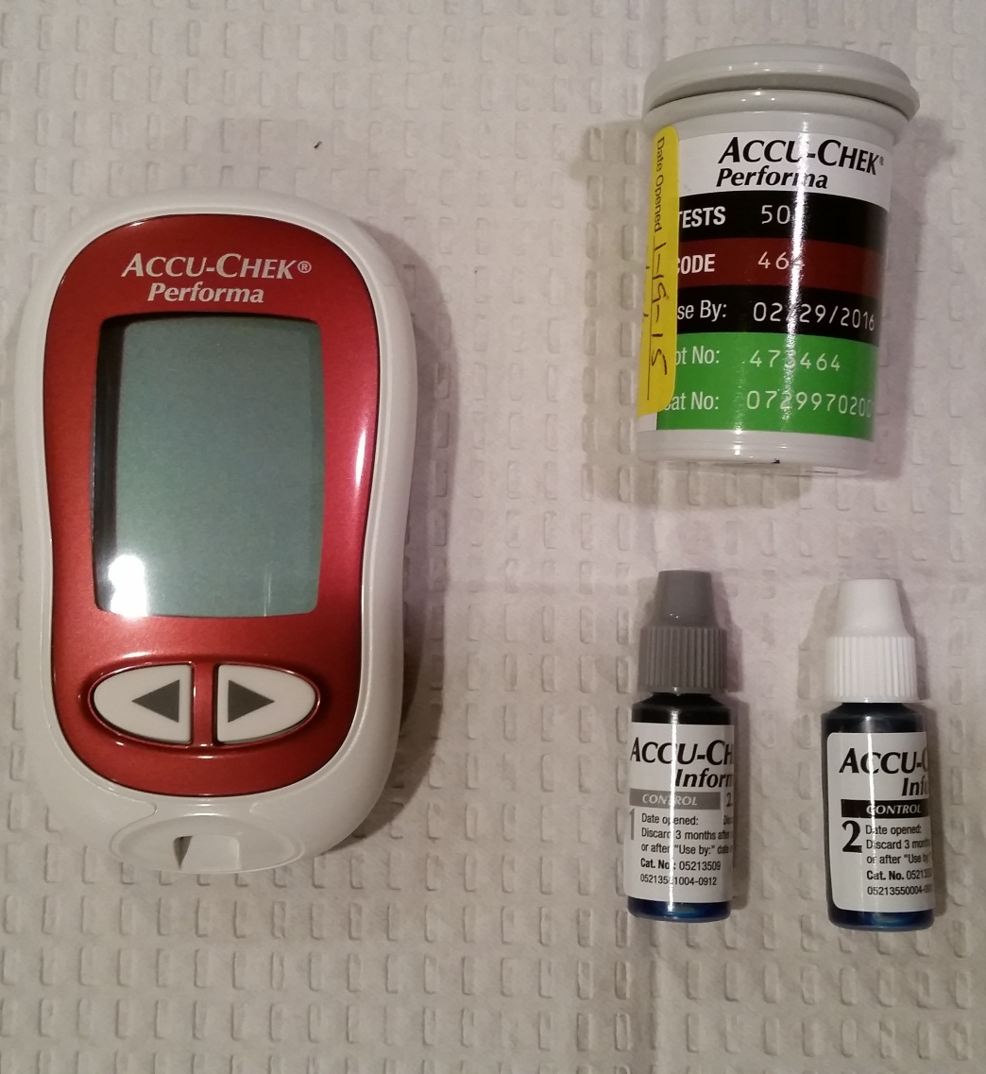
Glucose-performa
Level 1 (Low) and Level 2 (High) controls are run
  Weekly
  When a new vial of strips is opened.
After opening, the controls expire in 3 months.
The test strips are stable until the expiration date on the vial.
Chek Strip

Slide 8
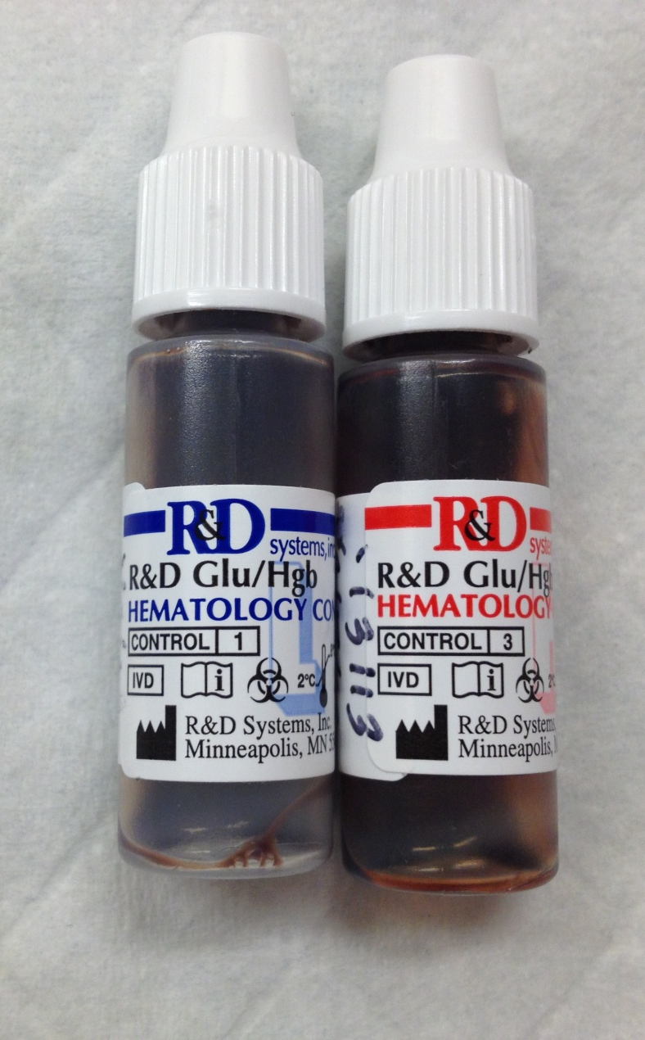
Hemoglobin
Low and High controls are run
Each day of patient testing
When a new bottle of test cuvettes are opened.
Note the SELFTEST result when starting the machine up.
  After controls are opened they expire within 1 month
  After cuvette bottles are opened they expire within 3 months.
  Controls and cuvettes can also expire as stated on the vials.

Slide 9
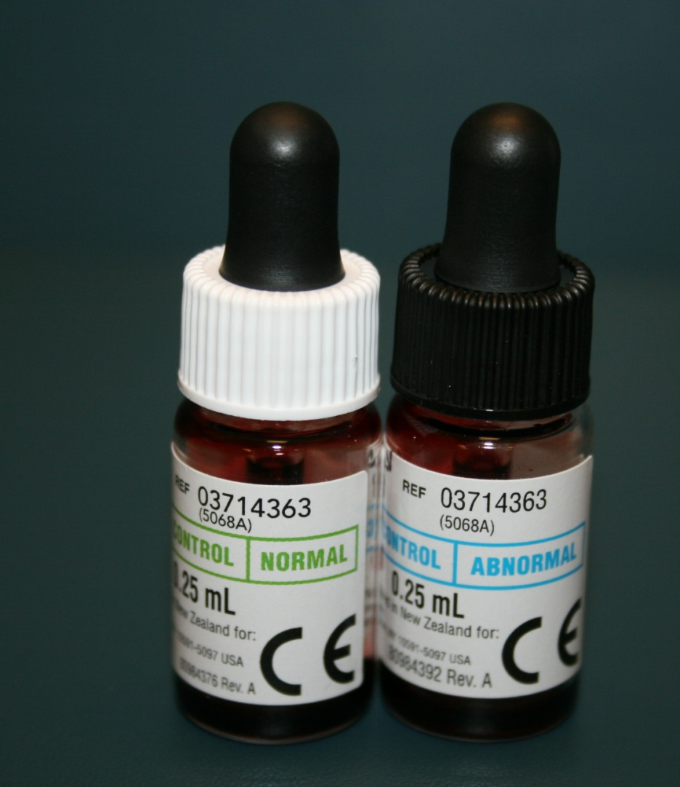
Hemoglobin A1c
Normal and Abnormal Controls are run
Weekly
When a new shipment or Lot # of reagent cartridges are opened
The optical test is run quarterly or when prompted by the machine.
Controls expire within 3 months after being made up.
Reagent kits expire in 3 months at room temperature or until the expiration date if kept refrigerated.

Slide 10
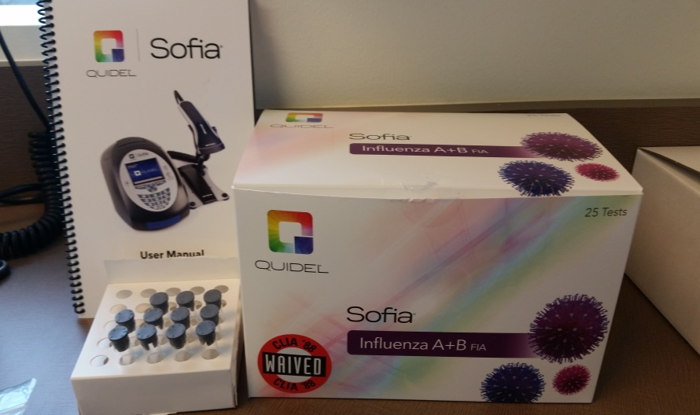
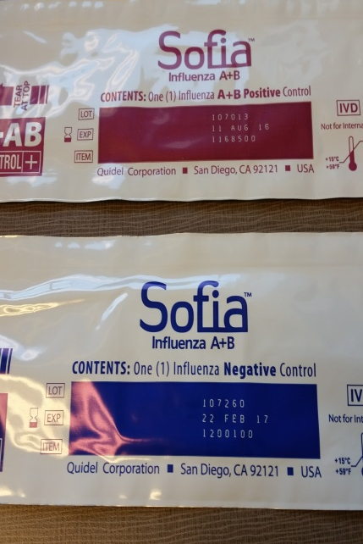
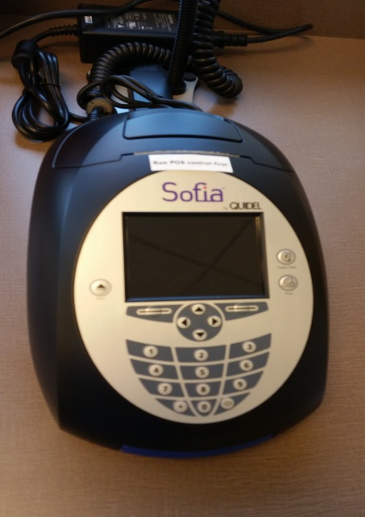
Influenza a+B
Positive and Negative controls are run
When a new kit is opened
You must verify that the built-in procedural control passed for each test cassette.
  Calibration check is run every 30 days of operation

Slide 11
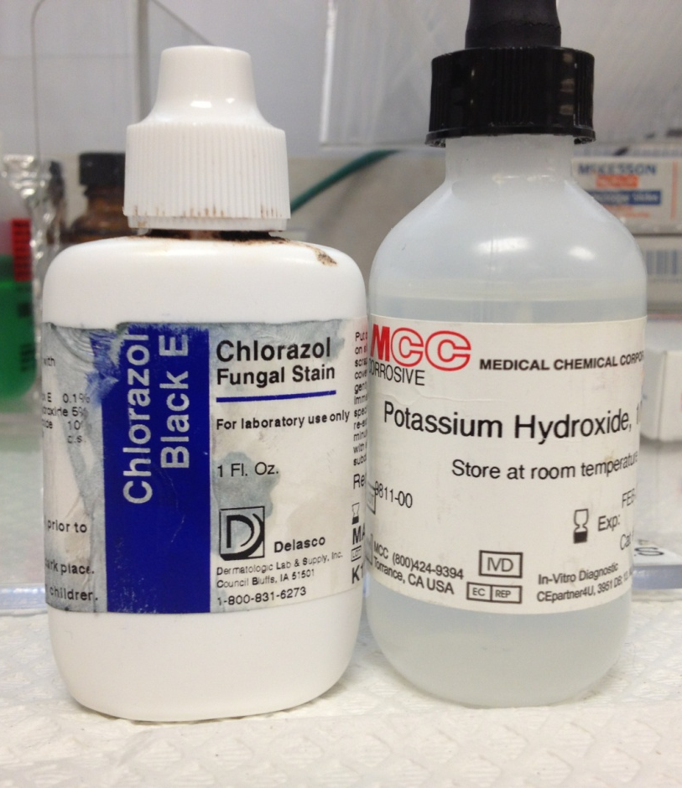
KOH/Chlorazol black e stain
Check the stains weekly for contamination.
KOH expires 2 months after opening.
Chlorazol Black E expires as stated on the vial.

Slide 12
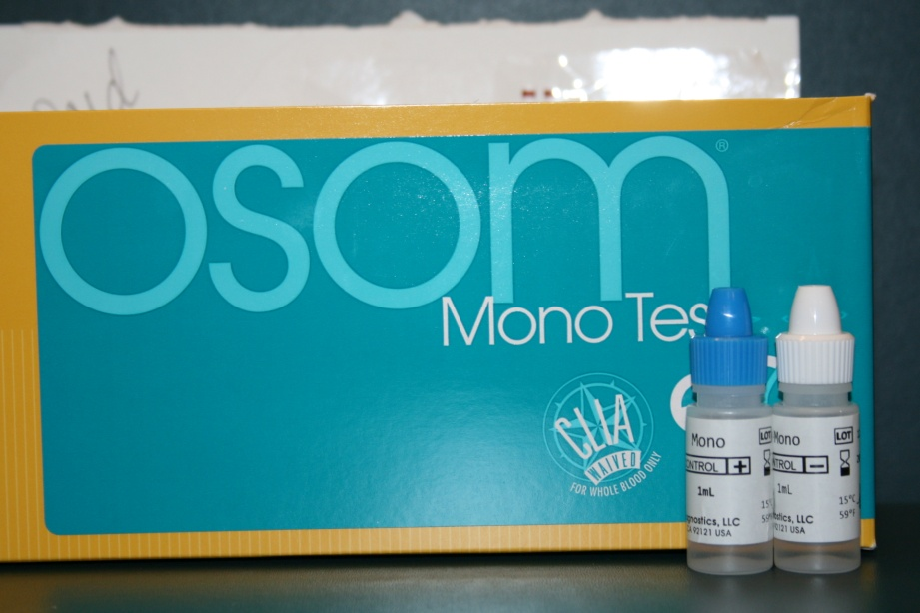
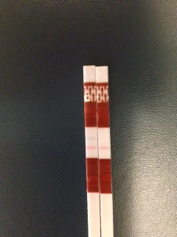
mONO
Positive and Negative controls are run
When a new kit is opened
You must observe the internal control on each test strip.
NEG
POS
Internal Control
Internal Control

Slide 13
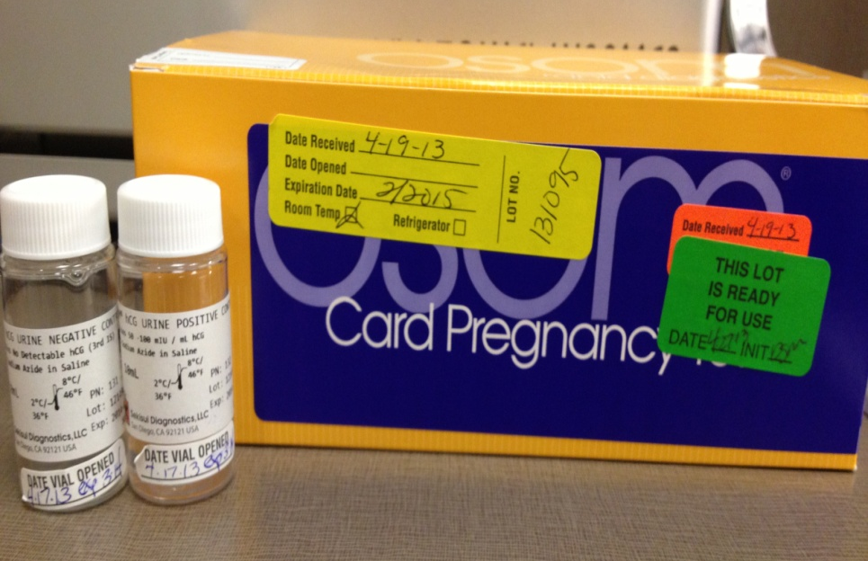
Pregnancy- Osom card
Positive and Negative controls are run
When a new kit is opened
You must observe the internal control on each test cartridge.
Controls are stable in the refrigerator until the expiration date on the bottle.

Slide 14
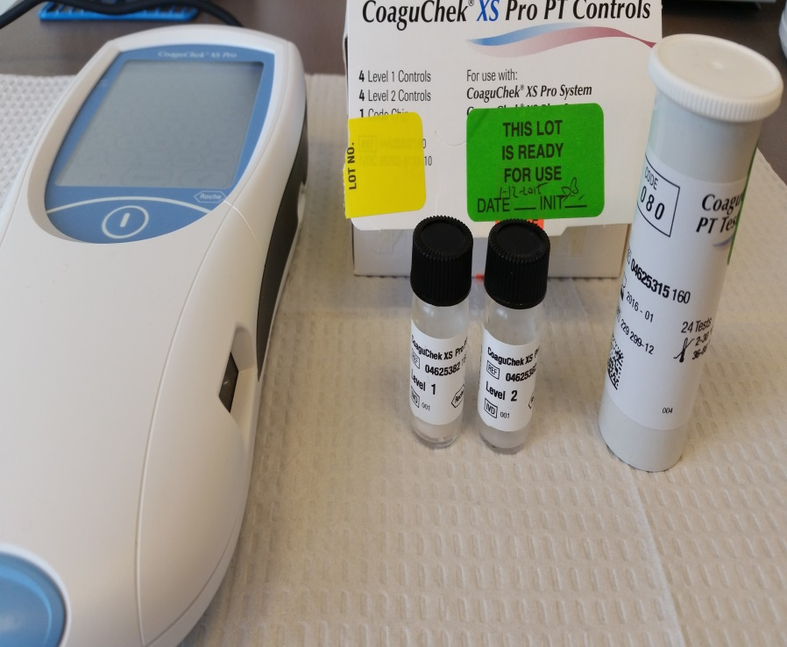
Prothrombin Time-XS PRO
-
*Moderate Complexity Test*
CoaguChek XS PRO
Level 1 (normal) and Level 2 (abnormal ) controls are run
When a new vial of strips is opened
New shipment is received
New lot # opened
Electronic built-in quality control must be noted with every test strip (QC √)
Controls are stable until the expiration date if refrigerated
Once controls are reconstituted, they are stable for 30 minutes.
Once opened, the vial of strips expire on the date noted on the vial.
Level 1 and level 2 controls are validated every time a new lot # is opened.
Please consult with CLT Lead for this procedure

Slide 15
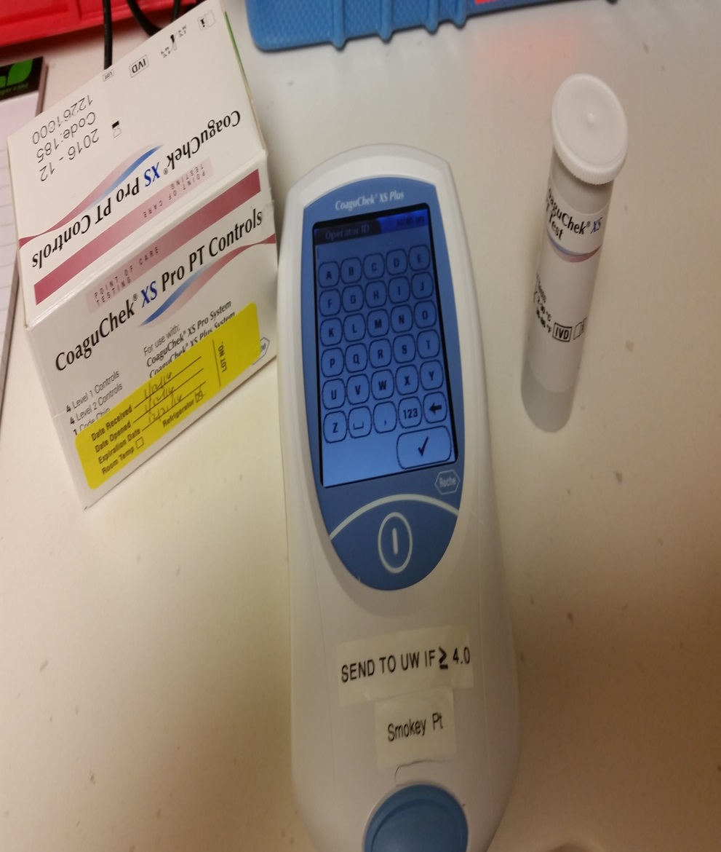
Prothrombin Time-xs plus
*Waived Test*
CoaguChek XS-PLUS
Level 1 (normal) and Level 2 (abnormal ) controls are run
When a new vial of strips is opened
New shipment is received
New lot # opened
Electronic built-in quality control must be noted with every test strip (QC √)
Controls are stable until the expiration date if refrigerated
Once controls are reconstituted, they are stable for 30 minutes.
Once opened, the vial of strips expire on the date noted on the vial.
Level 1 and level 2 controls are validated every time a new lot # is opened.
Please consult with CLT Lead for this procedure

Slide 16
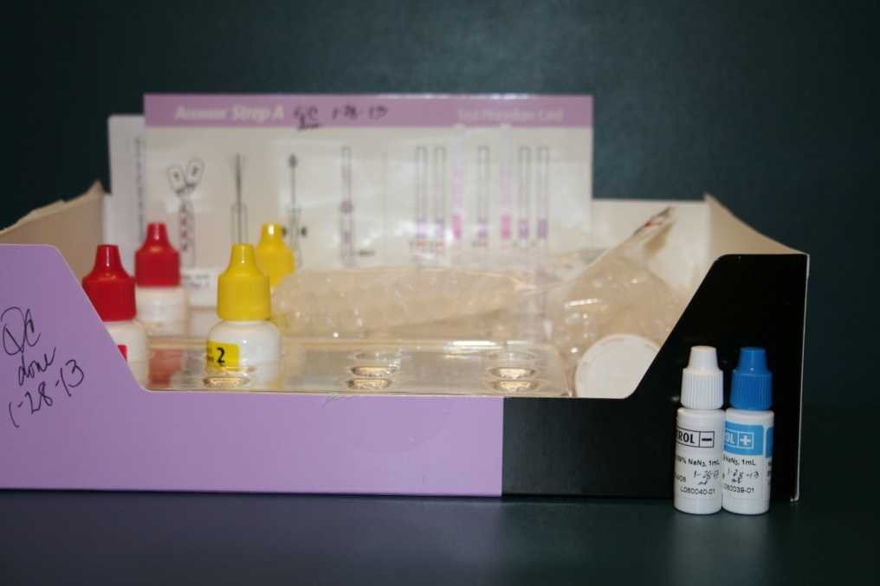
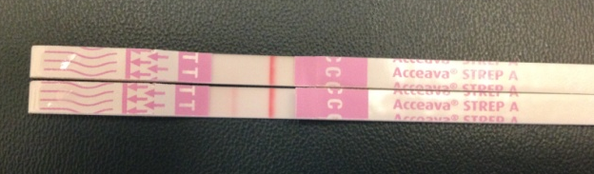
Rapid Strep
Positive and Negative controls are run
When a new bottle of test strips are opened and new reagents opened-twice per kit.
You must observe the internal control on each test strip.
Once the bottle of strips is opened they expire within 1 year or as stated on the outside of the kit whichever comes first.
NEG
POS
Internal Control

Slide 17
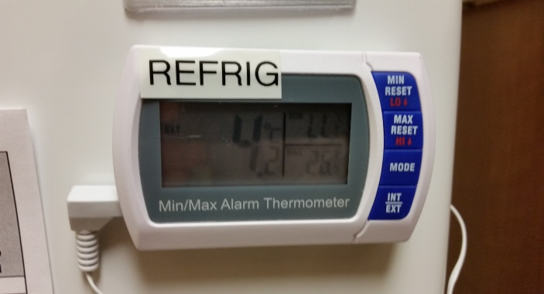
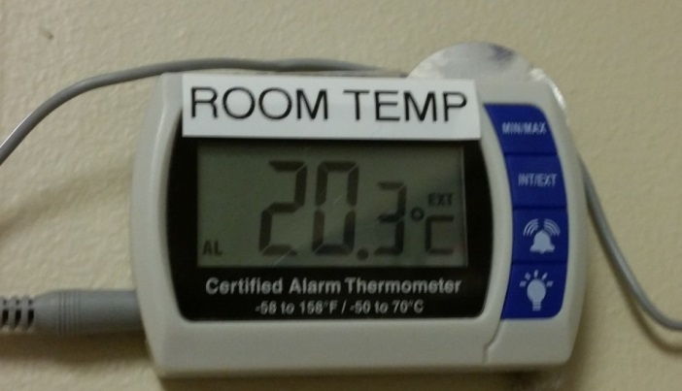
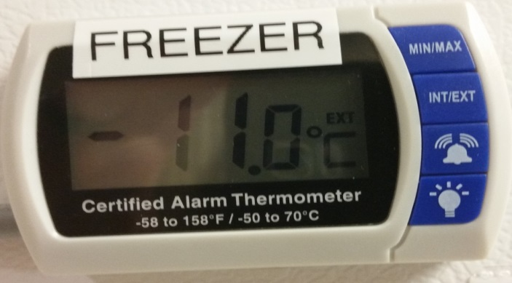
Temperatures
Temperatures are recorded for the following areas in the lab daily:
Refrigerator (2-6°C.)
Freezer (-10 to -24°C.)
(-10 to -30°C.) Northgate and Olympia
Room Temperature (15-25°C.)

Slide 18
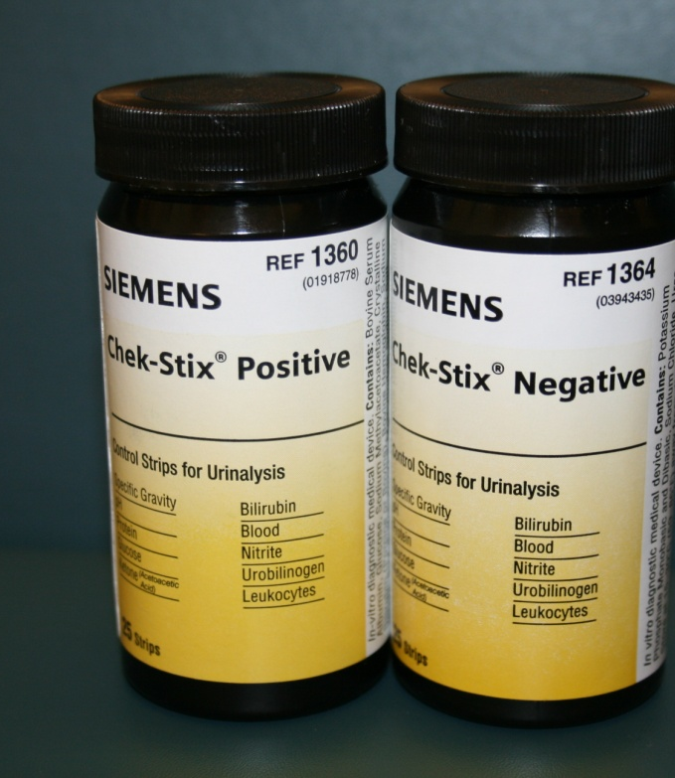
Urinalysis
Positive and Negative controls are run
Weekly
When a new vial of strips is opened
When a new lot # of strips is opened
Prepared controls are stable for 8 hours stored at room temp except bilirubin which is stable for 3 hours.

Slide 19
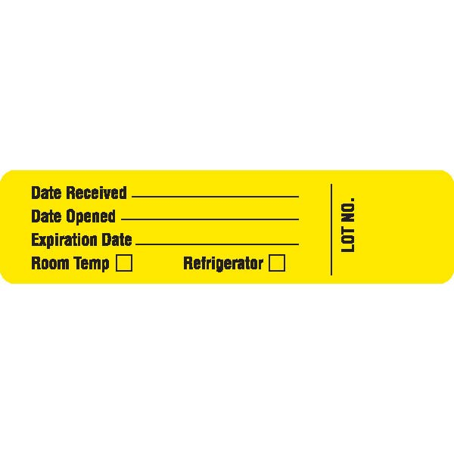
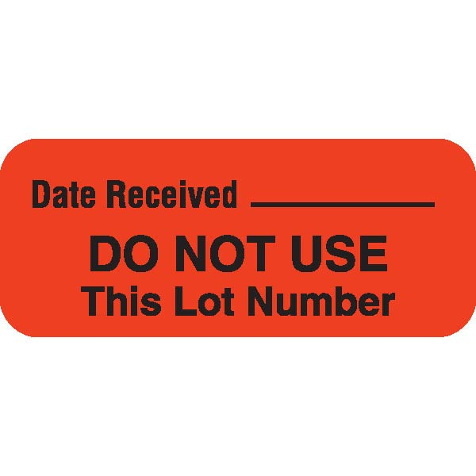
Labels for Test Kits and Controls
Kits/Cuvettes/Vials | Controls
Upon receipt Fill out the date received and temperature storage requirements | NOT USED
Kits/Cuvettes/Vials | Controls
Upon receipt Place over the opening of the box so it’s visible to everyone | NOT USED

Slide 20
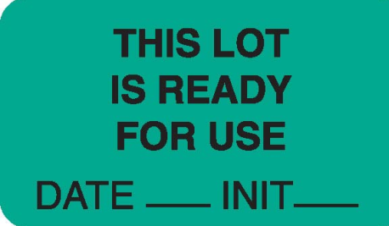

Labels for Test Kits and Controls
Kits/Cuvettes/Vials | Controls
After a new shipment of kits/cuvettes/vials has been checked with controls | Apply this label on all controls upon receipt
Kits/Cuvettes/Vials | Controls
After the new kits have been checked with controls, apply this label over the existing larger yellow label on the kit. | Apply this label on all controls after they are opened.

Slide 21
Sources of error-Why is my QC out?
Specimen Collection
ERROR | SOLUTION
QNS (Quantity Not Sufficient) | Fill all tubes to indicated fill line
Contamination of Specimen | Follow all lab procedures for proper specimen collection. Collect venipuncture specimen using correct “order of draw” to reduce anticoagulant contamination.
Specimen Deterioration | Follow the laboratory and manufacturer’s insert for specimen stability.
Improper Collection/Handling | Check the UWMC Lab Test Catalog for collection guidelines and the lab procedure for proper specimen handling (room temp, refrigerated, frozen)

Slide 22
Sources of error-Why is my QC out?
Lab and Environmental
ERROR | SOLUTION
Electrical Power Failure and Surges | Check the instruments manufacturer’s instructions for electrical requirements
Improper Centrifugation | Verify that the centrifuge is running at the proper speed and time.
Low Batteries | Replace batteries when needed or when electrical issues are apparent
Improper Storage of Test Kits and Reagents | Follow package inserts for proper storage. Keep test cartridges in the foil pouches until ready to run test. Keep all test strips in with their desiccant. Do not handle test strips on reaction areas.

Slide 23
Sources of error-Why is my QC out?
Reagents
ERROR | SOLUTION
Out of Date-expired | Check expiration dates on all reagents including date opened and date expires
Wrong Kit and Lot Numbers | Check QC log sheets for the current lot number and control ranges. Check and scan current calibration card (DCA). Do not interchange components from different kit lots. Do not use after expiration date! Check the vial code (glucose).
Reagent Preparation | Make sure the reagent was made up correctly.
Operator/Testing Personnel
ERROR | SOLUTION
Training | Verify that lab staff have been trained for testing, have documentation and can locate the UWNC lab procedures and the UWMC Lab online Test Catalog.
Controls are out | Repeat the control Use new controls and repeat testing If controls are still out use new test cartridge, strip, or kit and repeat test. If still out new operator repeats. If still out send test to UWMC Lab and consult with CLT Lead or Lab Manager

Slide 24
Questions?
Contact information
Contact the CLT Lead in each UWNC Lab for questions or contact the Laboratory Manager
Cora Curre, MLT(ASCP)^{CM}
206-520-1331
currec@uwpn.org

