Slide 1



Urine Pregnancy testing
Osom Ultra hcg combo test
In-service

Slide 2

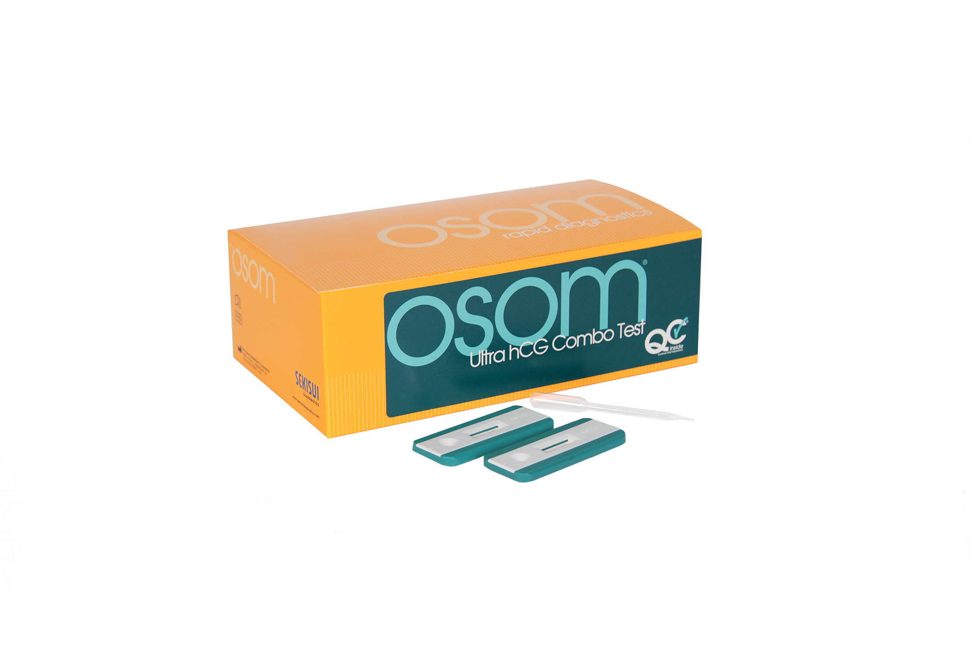

New kit – new procedure
Procedure & Additional Considerations
Internal Quality Control & External Quality Control
Negative and Positive Examples
Invalid Test examples
Take the test.

Slide 3

Procedure
OSOM Ultra HCG Combo Test Procedure
Specimen Collection: Urine collected in a clean dry urine cup. Specimen must be labeled at minimum with the patient’s name and DOB according to SCH policy.
Test procedure:
Step 1: Remove a cassette from the pouch and label it with patient’s demographics
Step 2: Draw urine into pipette provided in the pouch.
Step 3: Holding the dropper in the vertical position, add 3 free falling drops to the Sample Well (S)
Note: do not touch the end of the dropper to the membrane in the sample well.
Step 4: Read the results at 3-5 minutes. DO NOT READ RESULTS AFTER 5 MINUTES.
Interpretation of results (see slide 6 for examples):
Positive - Two pinkish to purple lines, one at the Test Position (T) and at the Control Position (C)
Note: A specimen containing a detectable level of hCG will generate a pinkish-purple line at the Test Position within 3-5 minutes. The time required to generate the line is dependent on the hCG concentration in the sample. Some positive results can be read in a early as one minute. To be interpreted as positive, the line in the Test Position (T) should be clearly distinguishable from the background color of the membrane.
Negative – Only one light to dark pinkish-purple line, at the Control Position (C). Do not read before 5 minutes
invalid – The test is invalid if NO Control Line forms. A distinct colored line at the Control Position(C) should always appear.
Note: If there is no distinct pinkish-purple line visible at the Control Position the test is invalid. Repeat test with a new test cassette. If the test is still invalid, send patient to lab for blood test.

Slide 4
Additional Considerations
OSOM Ultra HCG Combo Test Procedure (continued)
Test is only performed on Urine Samples in the Emergency Department, Surgical Services, Primary Care, CWH and Express Care.
The OSOM Ultra hCG Combo Test is capable of detecting hCG levels of 25 mIU/mL. HCG levels in normal early pregnant women vary and hCG levels often exceed 100 mIU/mL by the first day of the missed menstrual period. The test is usually capable of detecting hCG by the first day of the missed period.
Urine samples collected after consumption of large quantities of fluids may contain a lower hCG concentration. Very dilute urine can produce a false negative result. Repeat testing may be required to confirm suspected pregnancy.
The main laboratory is the backup method of testing for all locations.
There must be a green label on the box stating it’s ready for patient use.
This Lot Ready for use.

Slide 5
Internal QC
OSOM Ultra HCG Combo Test Procedure continued
Expanse Mnemonic: POC Urine Pregnancy
Meditech - Nursing Intervention Mnemonic: POC Urine
OSOM Ultra Combo Test cassette has built-in procedural controls.
The Control Line is an internal positive procedural control. The pinkish-purple Control line should appear at the (C) position which indicates the conjugate-color indicator is reactive. This is considered an internal positive procedural control.
Clearing of the background in the Result Window is considered an additional procedural control by providing a distinct readable result. This is considered an internal negative procedural control.
Entering Results in EMR:
The patient results (Positive or Negative) as well as the following internal quality control monitors must be completed when entering results into Meditech or Expanse.
Line at (C) √
Background Clear √

Slide 6
External QC
Urine Quality Control Kit: Quantimetrix Urine QC, Levels 1 & 2
SCMG Primary Care: QC each new lot number, untrained operator, new shipment same lot number, questionable patient results or integrity of the kit.
SCMG – CWH: QC each kit, untrained operator, questionable patient results or integrity of the kit.
SCMG – Express Care: QC each new lot number (Number multiple boxes of the same lot number sequential i.e. 1/3, 2/3, 3/3 etc.), untrained operator, new shipment same lot number, questionable patient results or integrity of the kit.
Hospital Based Departments: Point of Care Coordinator will perform external QC upon receipt of kits, every 30 days, and with each new untrained operators.

Slide 7
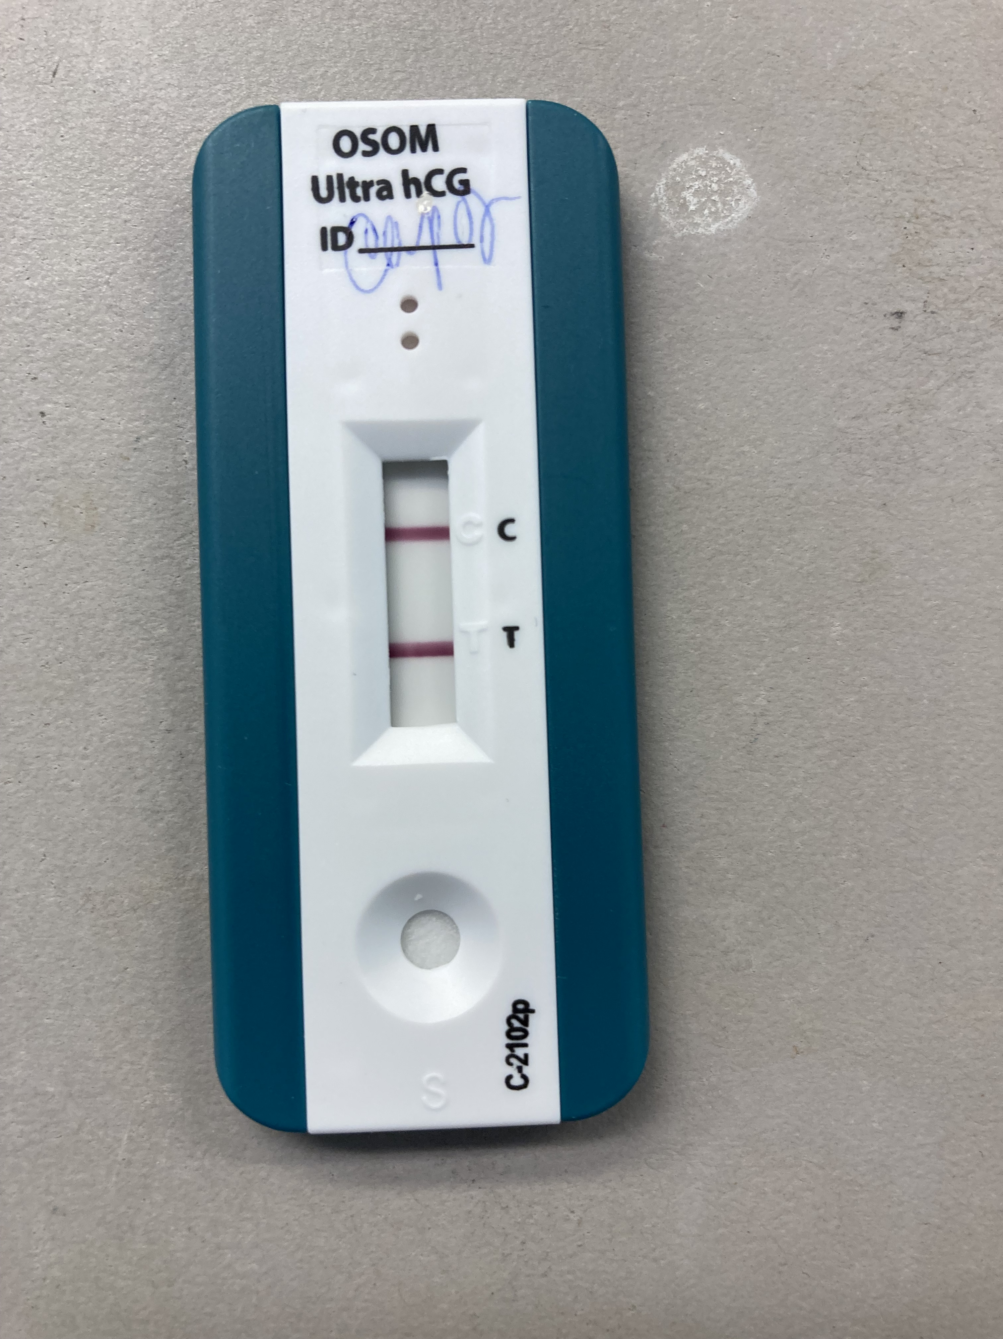
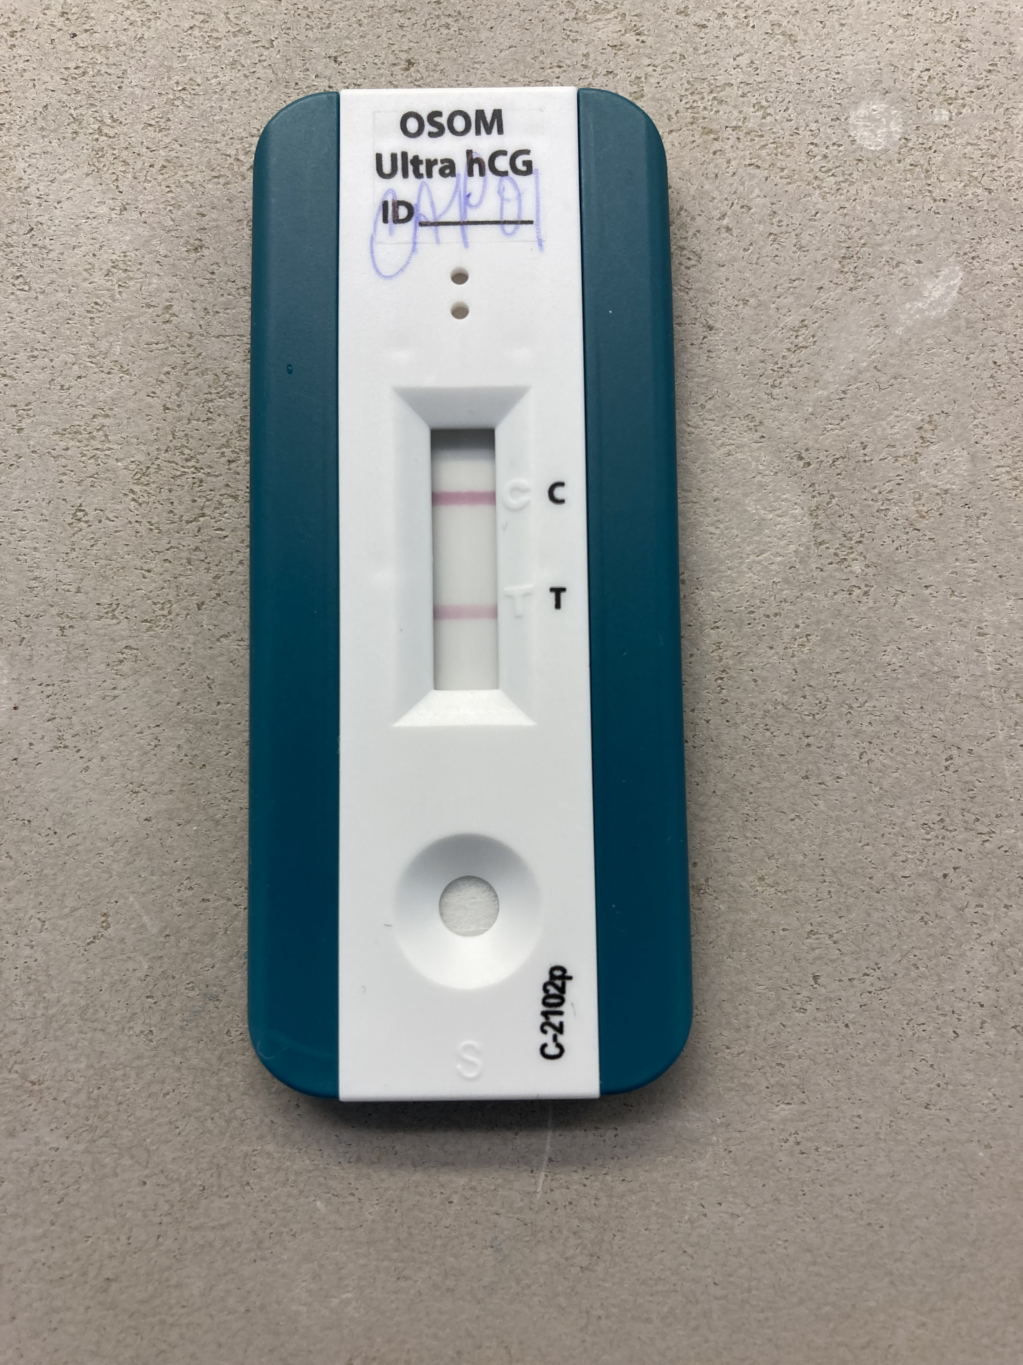
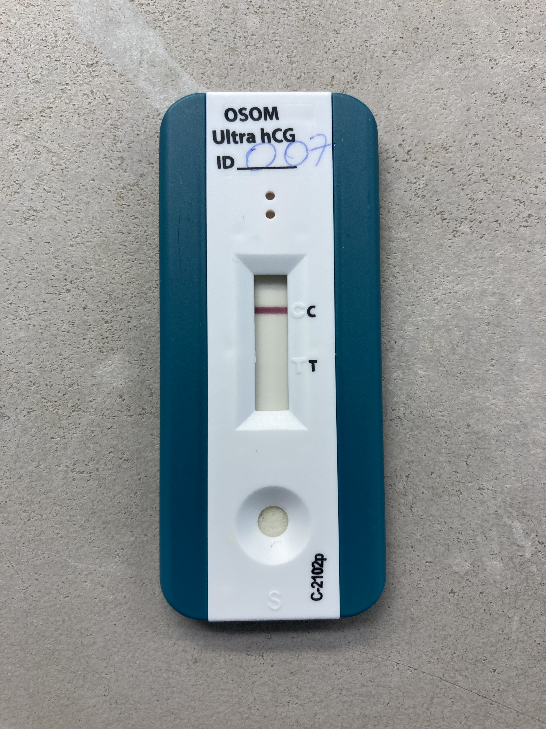
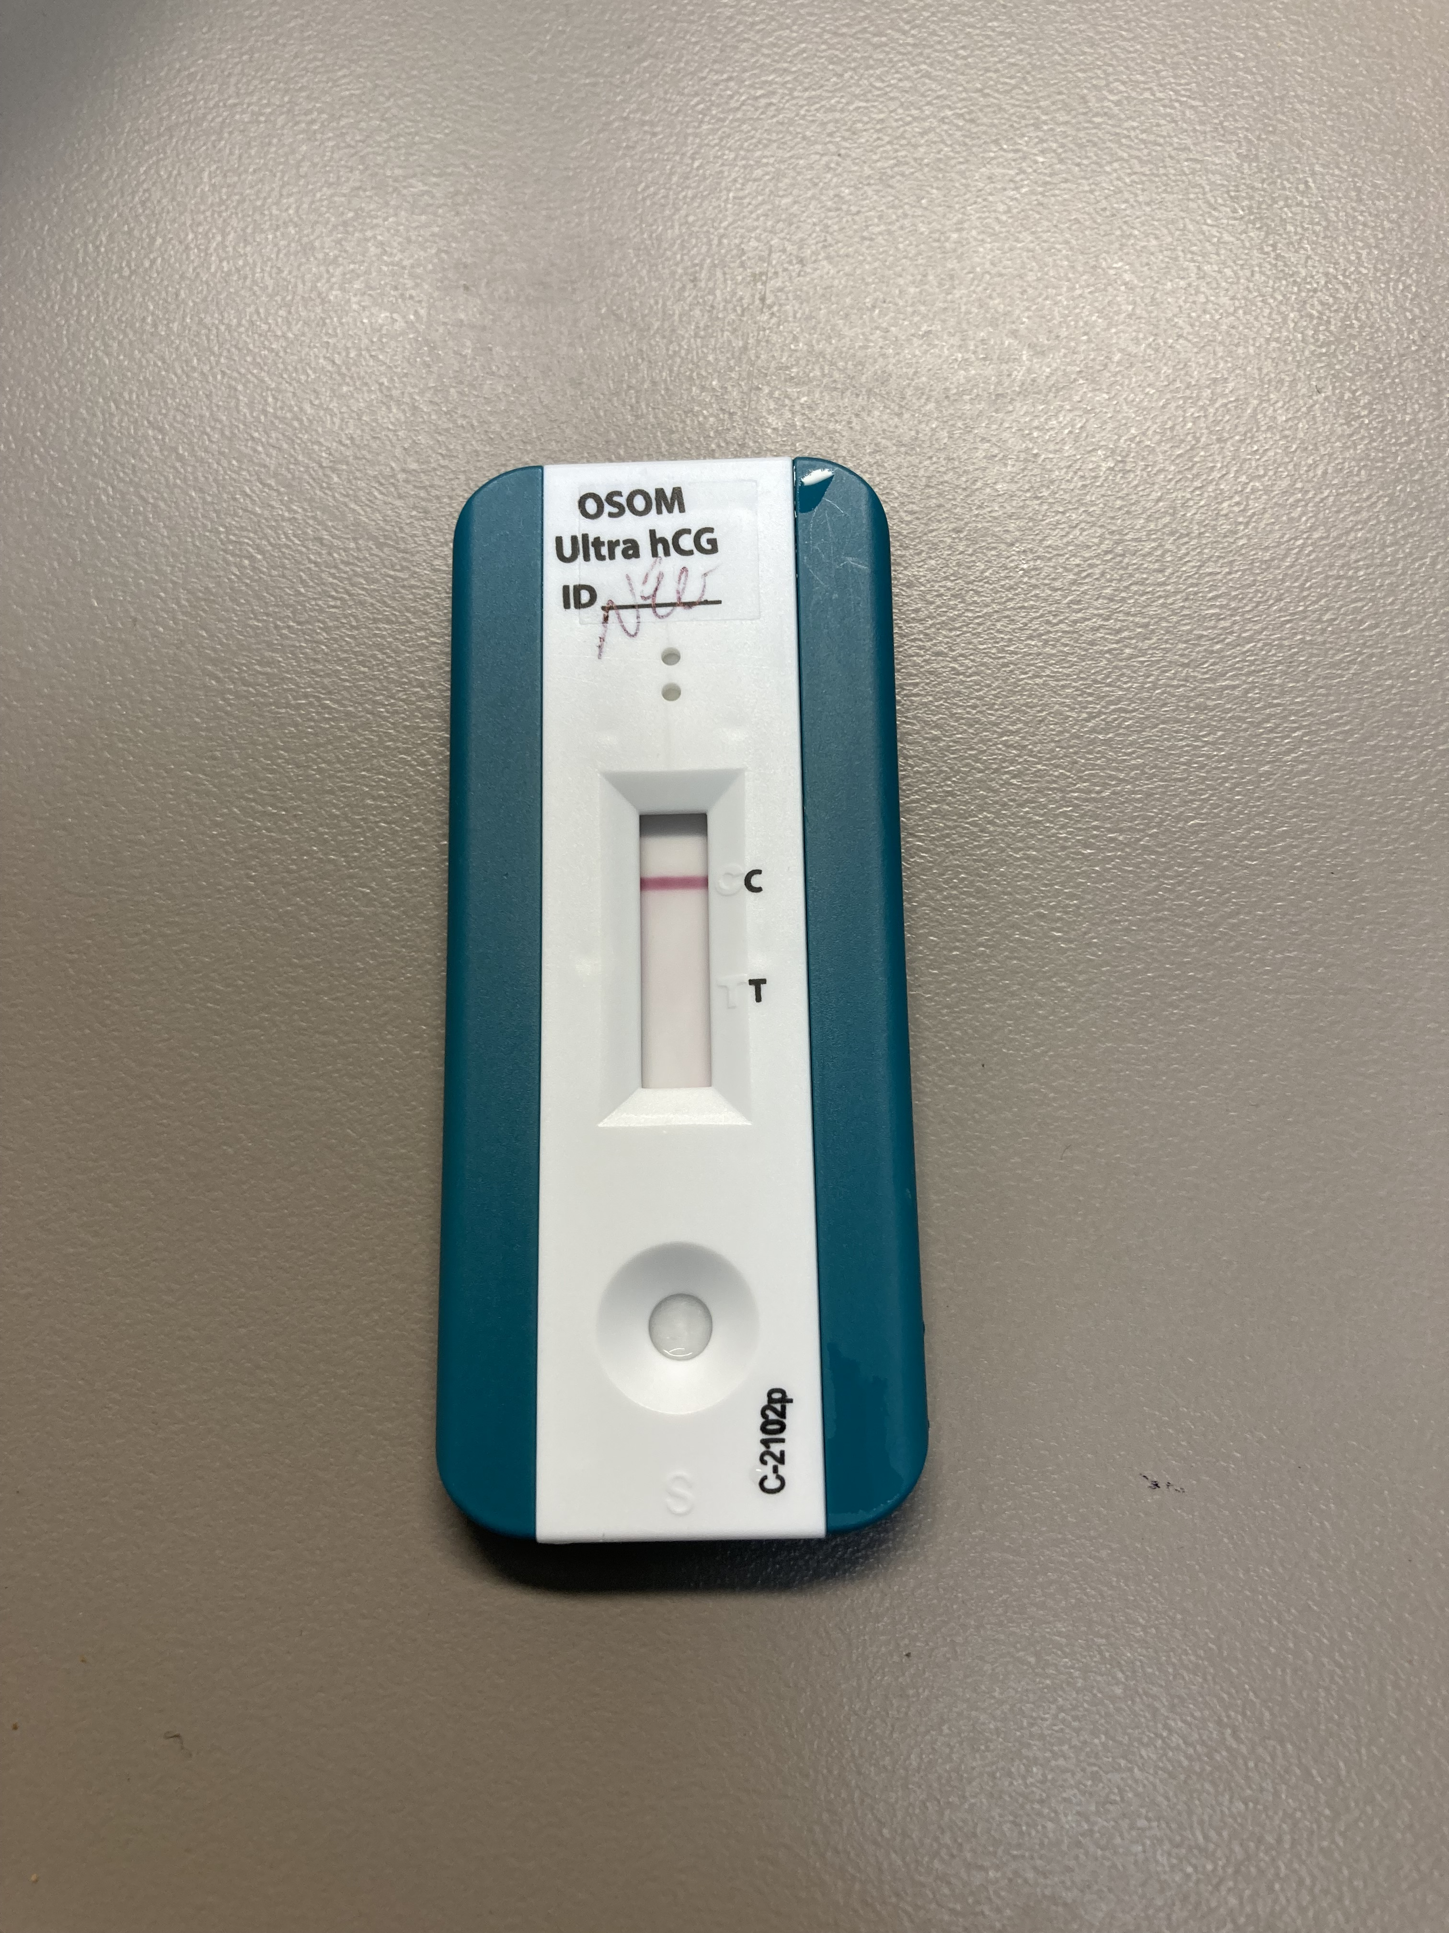
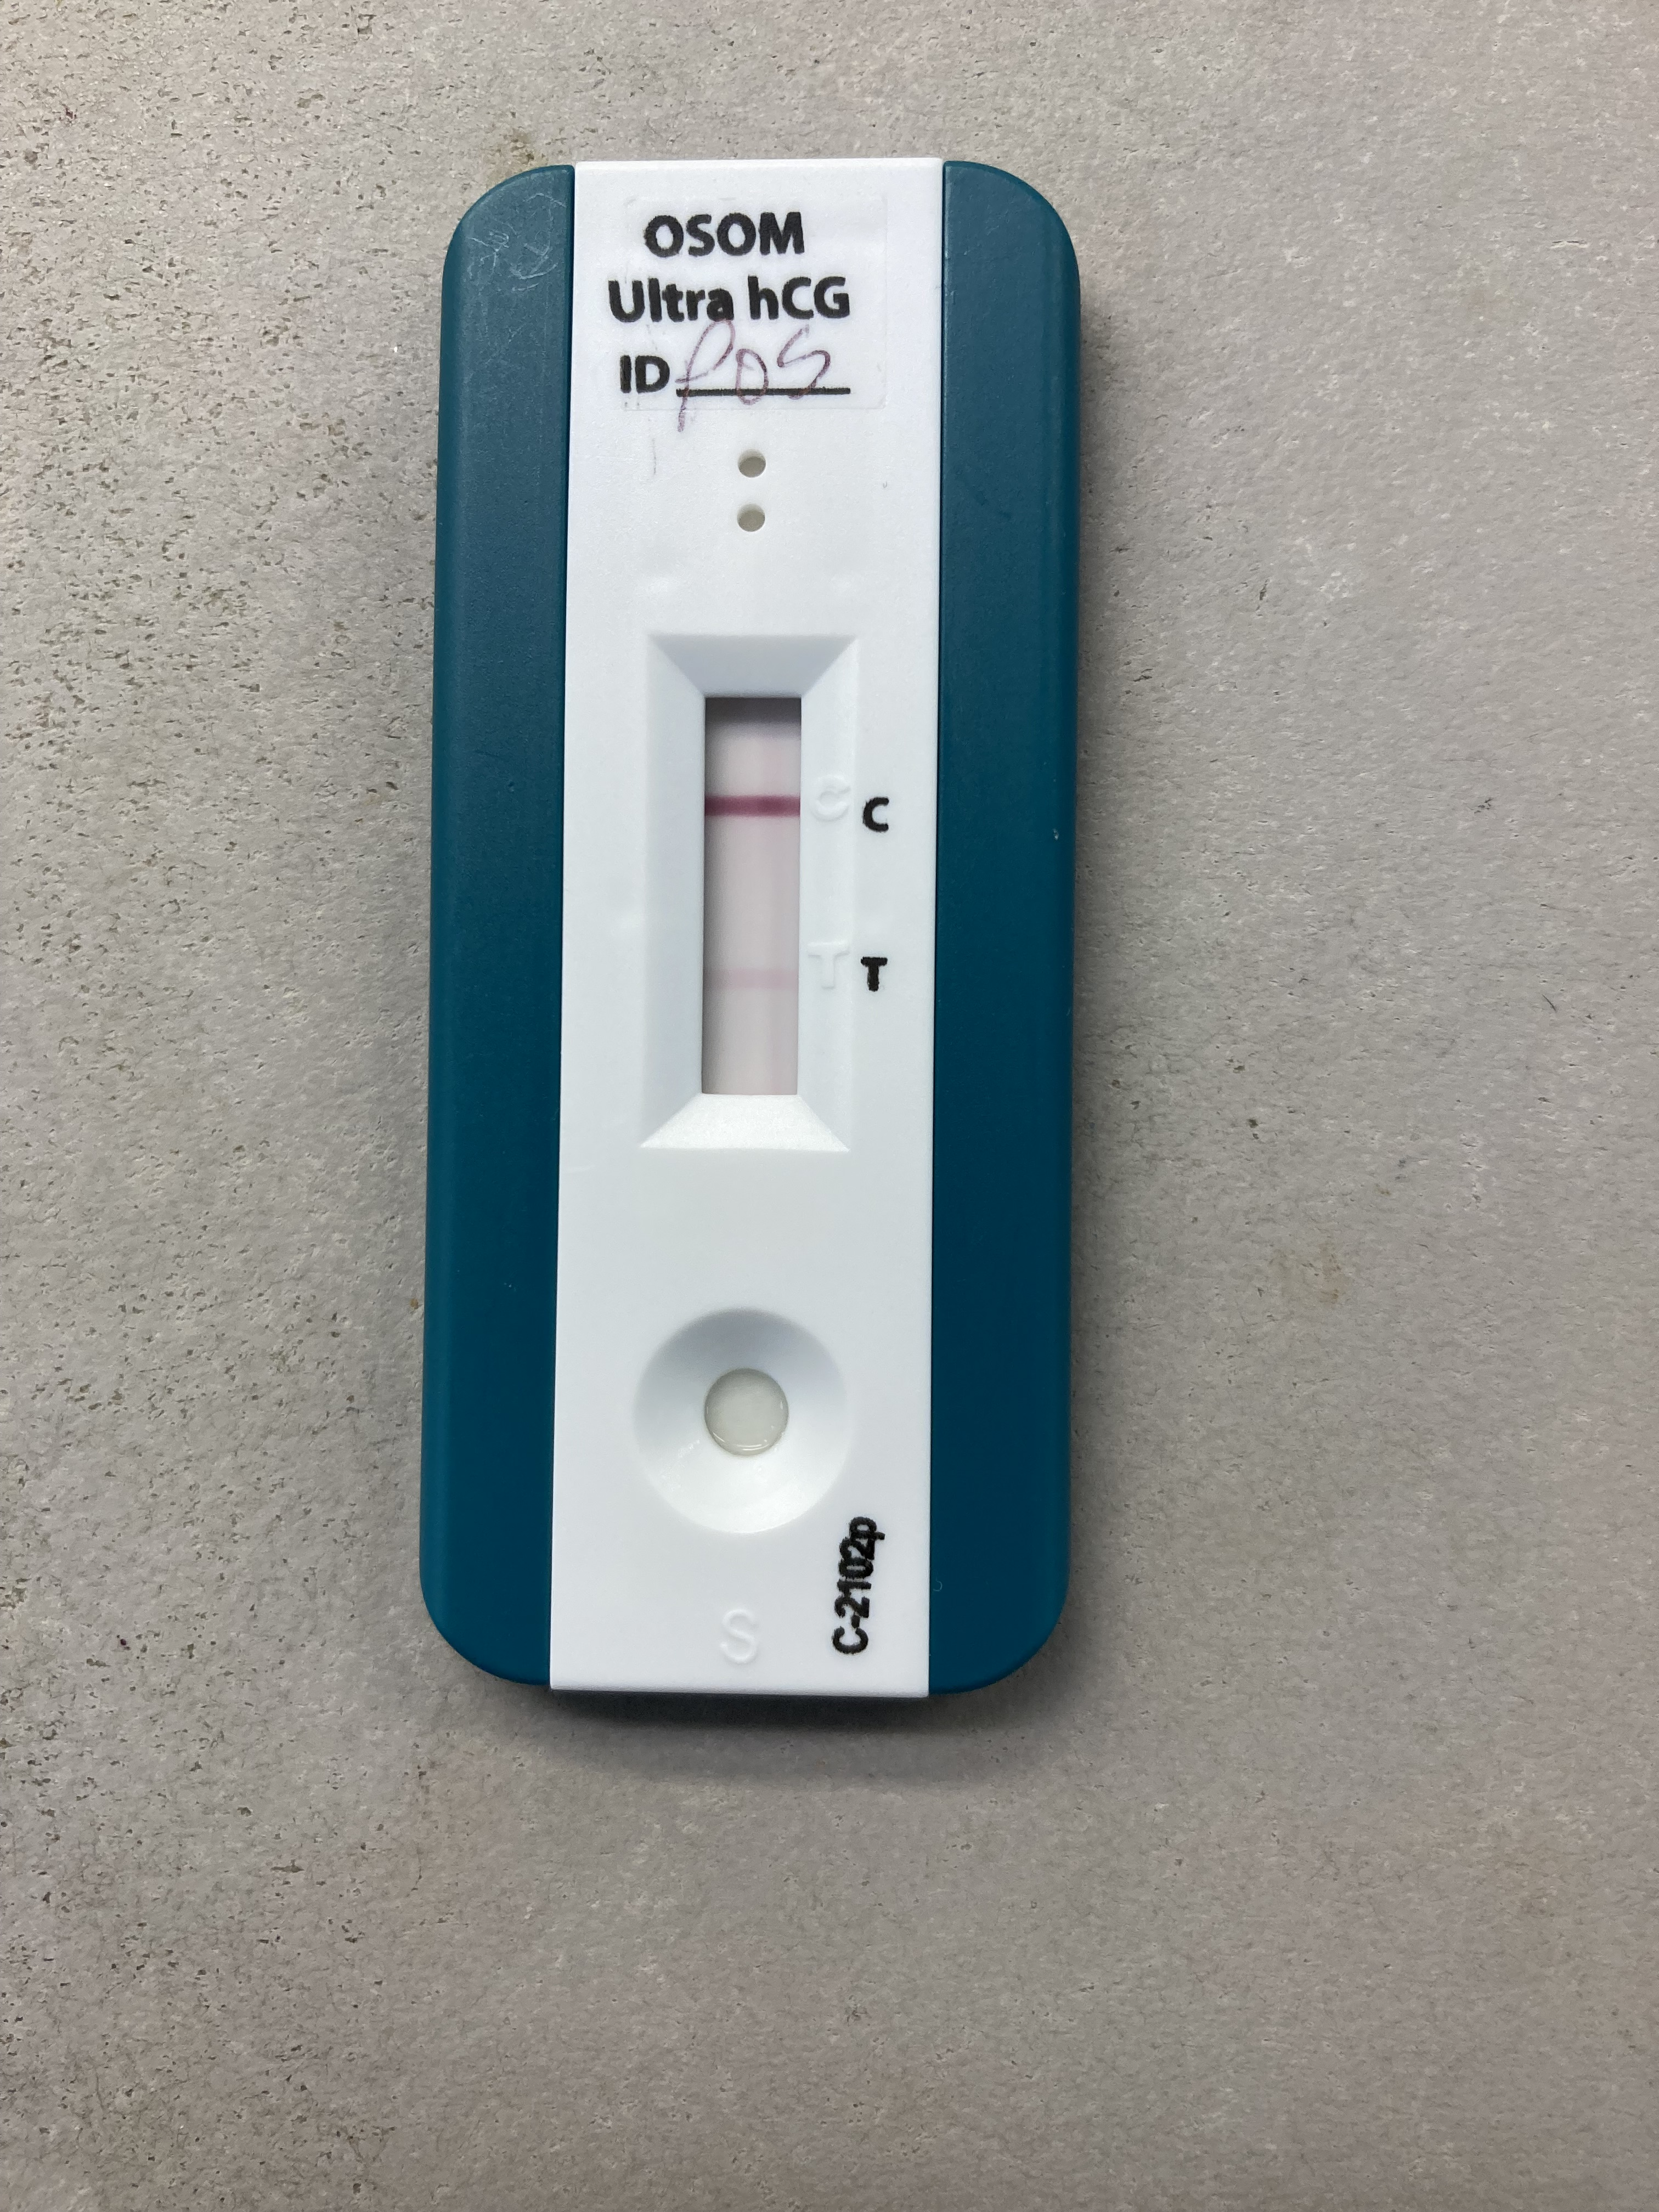
negative positive
Result results

Slide 8


INVALID TESTS
Invalid test results should be repeated on a new cassette. If test repeats invalid, perform the positive control to confirm kit is performing correctly.
In order to get a valid pregnancy test, one should order a qualitative hCG blood test or ß-hCG quantitative blood test.

Slide 9
Take the test in RAls
Taking the test in RALS
Please review the attached video
The first 3 questions related to the video will be answered in the RALS application.
  Question 1 – what is the result shown for the Quality Control Sample
  Question 2 – what is the result shown for the Quality Control Sample.
  Question 3 - What is the expiration listed on the box of Urine pregnancy tests.
  The rest of the questions will be related to procedure and quality assurance.

Slide 10


Successful Testing
Collect & Label Specimen
Perform test according to manufactures' directions
Enter into Emr including internal QC monitors

