Slide 1
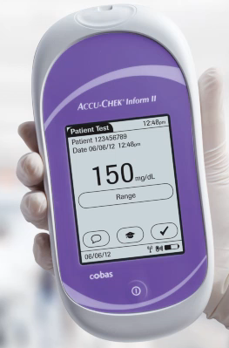
Accu-Chek
Inform II

Slide 2
OUTLINE
Meter Overview & Supplies
Operator and Patient ID Entry
Quality Controls (QC)
Safety Precautions
Specimen Collection
Patient testing
Results and Result Reporting
Limitations and Interferents
Cleaning and Disinfecting
Procedure

Slide 3
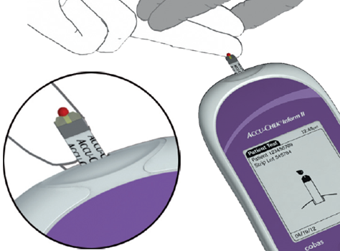
Inform II Meter Highlights
Results are accurate and precise
0.6 microliter test sample
Fast 5 second test time
30-600 mg/dL assay range

Slide 4
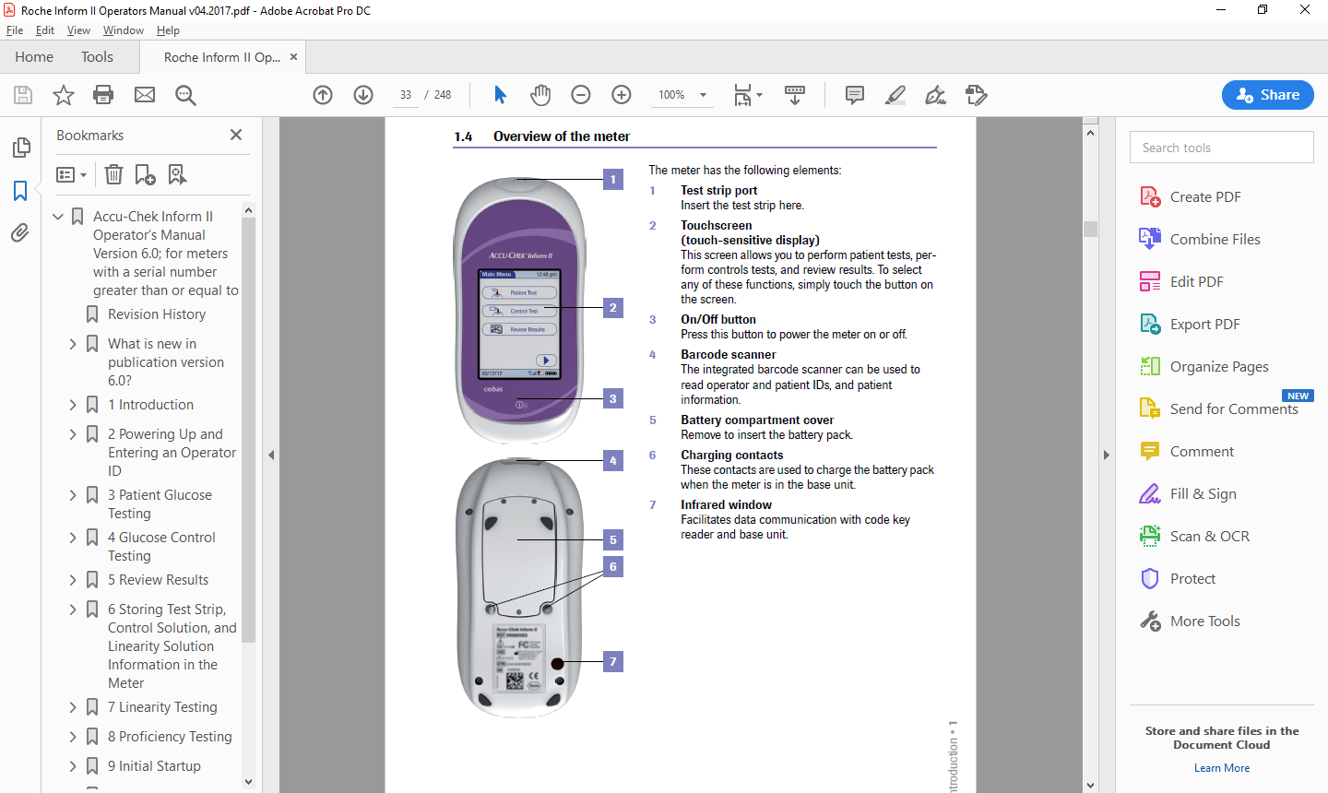
Meter Overview
1 Test strip port
2 Touch screen- sealed, easy to clean
3 On/Off button
4 Barcode Scanner
5 Battery Compartment
6 Charging contacts
7 Infrared window- for communicating with base units (keep clean)

Slide 5
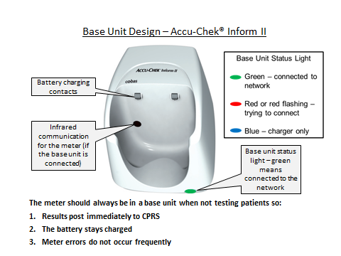
Base Unit Overview

Slide 6
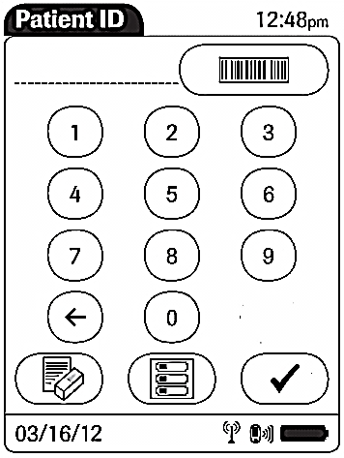
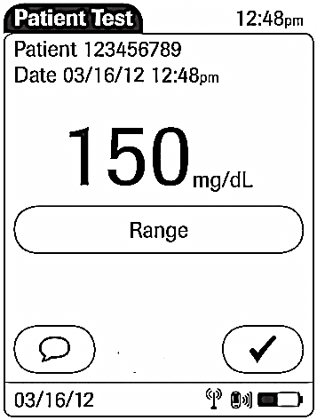
Navigating Meter
To display “Menu” use menu icon button on the screen.
To “Scan” use barcode icon button.
In most screens, to “Forward” to next screen use check mark icon on the screen.
To apply “Comments” use comment icon button.

Slide 7
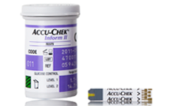
Test Strip Storage
Store at Room Temperature (heat & humidity sensitive)
Keep lid tightly closed when not in use
DO NOT put test strip bottle in pockets
Only take out the number of
strips you need for testing
Strips can be used until the
expiration date printed on bottle
DO NOT relabel bottle or discard after 3 months
Run QC each 24 hours of use before testing patients.
Run QC on EVERY NEWLY Opened Strip Bottle

Slide 8

Common Joint Commission Citation
Quality Control (QC) material not labeled with opened and new expiration dates

Slide 9
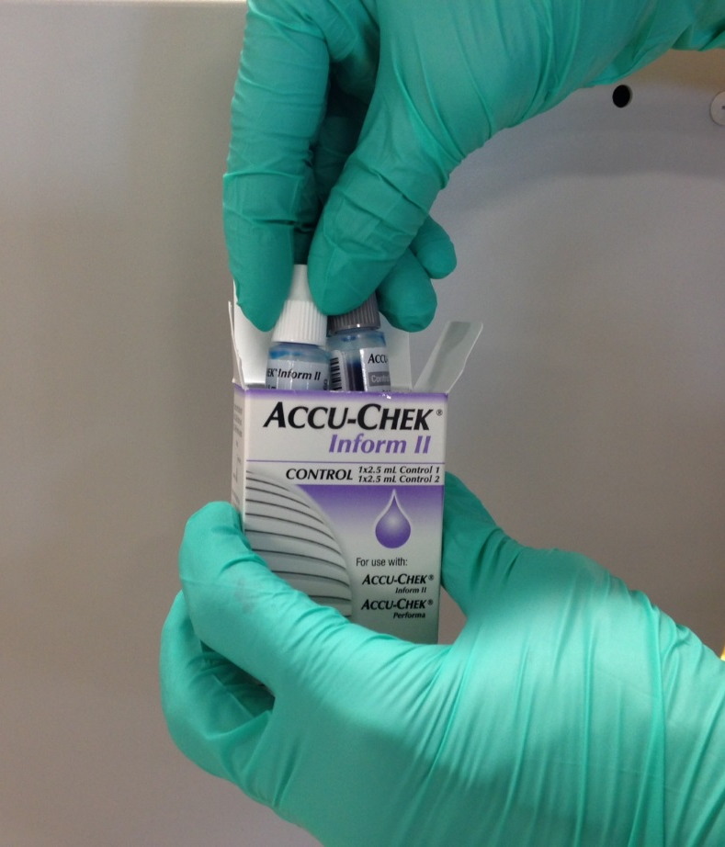
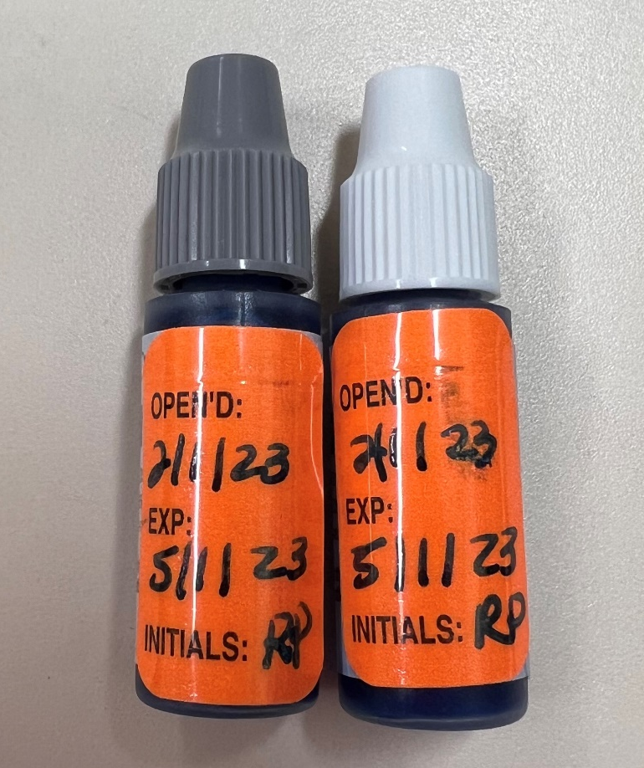
Label QC Bottles
*When opening a new box of QC, label bottles with Open Date AND 3 month Expiration Date
*Label bottles with Month, Day & Year (MM/DD/YY)

Slide 10
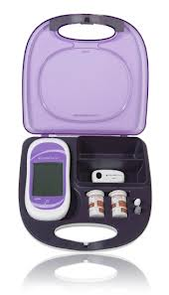
Additional Supplies
Accessory Box—Not available at all testing sites.
  Skin preparation pad (Alcohol)
  Lancet device
  Gauze pads
  Requests for replacement boxes should be called to Ancillary Testing,
  Gloves

Slide 11

Operator Inform ID Entry
OPERATOR LOG-IN
Each operator is given his/her own unique log in code following initial training.
Initial training is online. After confirmation of training, barcode will be emailed to you.
DO NOT give your code out to anyone (other nursing staff, students, providers, etc.) – you are liable and will be held responsible if borrower makes a mistake, as it is your name attached to the result in the patient’s chart

Slide 12
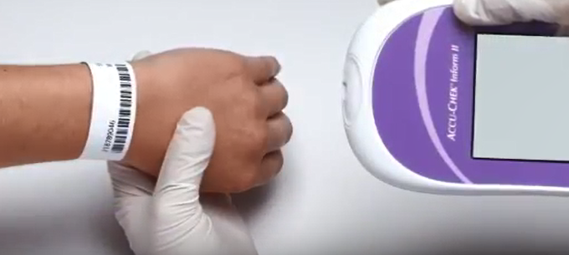
Patient ID Entry
BEFORE testing verify correct patient with 2 unique identifiers
Always SCAN armband when possible: more accurate, faster, minimal risk of invalid ID entry
  When scanning, hold meter 4-6 inches away from barcode
If barcode won’t scan, print a new armband
If armband still won’t scan or the patient does not have an armband, enter patient’s 9 digit ID manually
VERIFY correct patient
ID is shown on screen
BEFORE performing
the test.

Slide 13
Patient ID Entry
USE OF “FAKE” OR EMERGENCY ID
Use of “fake” patient IDs are NOT acceptable. Operators using random ID numbers (all zeros, 12345…, etc.) for patient testing will be counseled and may be removed from the testing system if abuse continues.
Emergency ID “999-99-9999” may be used in Emergency situations only. Immediately after testing with this ID, you must follow-up with the Ancillary Testing Office and provide updated patient ID and details of emergency for documentation. No follow-up will be considered improper testing and may result in retraining and/or glucometer lockout.
It is REQUIRED that operators contact the Ancillary Testing office when the emergency ID is used. Ext 7232. Phone is only covered 7am to 3:300pm M-F.
Notes:
Emergency ID line and required changed to red.

Slide 14
Unauthorized Meter Use
EMPLOYEE TESTING
Employee self-testing or testing of another employee is NOT Acceptable except via Occupational Health.
All tests performed here in the health care center, with facility equipment, must be associated with a doctor’s order. If you have a diabetic condition or feel ill, please visit employee health so that the testing can be ordered by a provider

Slide 15

Performing Quality Controls
Control specimens must be analyzed by personnel who routinely perform patient testing
  This does not imply that every operator or shift must perform QC daily; perform QC at the required frequencies (i.e. 1 time per day) and rotate among testing personnel. Each person doing patient testing must run QC at least once per year.
Always perform QC with the meter on a flat surface to prevent QC solutions from entering the strip port

Slide 16
Performing Quality Controls
QC testing must be performed:
Each day (24 hours) of patient testing with two levels of QC
When a new bottle of test strips is opened
If the lid is left open on the bottle of test strips
If the Inform meter has been dropped or when you want to check the performance of the system
When the test strips or control solutions have been exposed to heat, humidity or cold

Slide 17
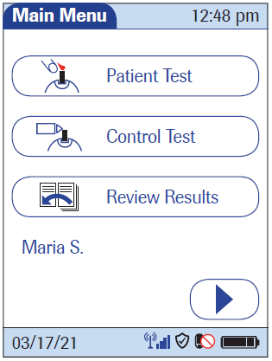
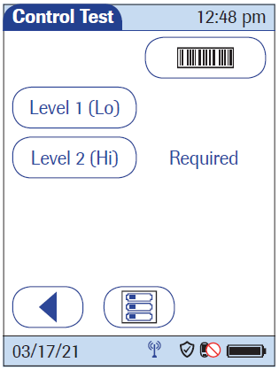
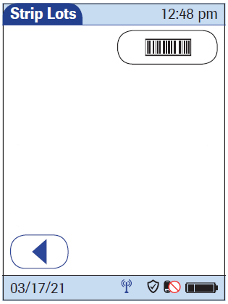
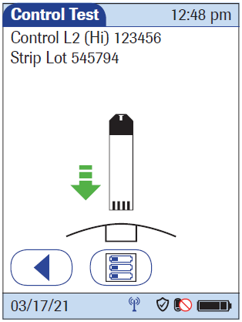
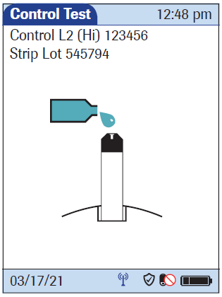
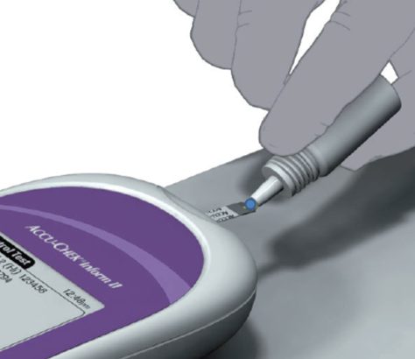
Screens Observed Running Controls
DO NOT
add sample until dropper appears.
Main Menu
Scan Control Bottle
Scan Strip Bottle
Insert Strip
Apply Sample
Squeeze small drop
of QC solution; keep the meter level to prevent solution from entering the test strip port area.
Apply to the front edge of the
yellow area and fill the yellow window – DO NOT ATTEMPT TO PLACE SAMPLE ON THE TOP OF THE STRIP.
Notes:
Scan operator ID, select Quality Control, Scan QC bottle, Scan strip bottle, then screens above.

Slide 18
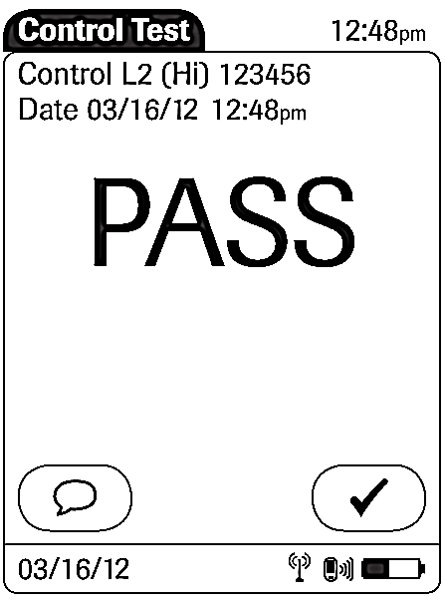
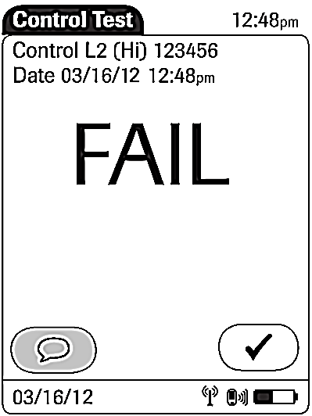
Quality Control Results
If QC fails, you must enter a comment. The comment icon will be flashing. You will not be able to proceed until you add a comment.
If QC passes, you must still attach comments.
Notes:
18

Slide 19
Comments
Up to 3 comments can be attached to each result.
Daily usually with QC the comments indicating that the temperature and humidity are in range should be attached to the results. The thermometer-hygrometer should be next to the base unit.
The “Cleaned Meter” should be attached to all results where the meter is cleaned. HINT: clean and disinfect every time.

Slide 20
QC Failure Troubleshooting Steps
  Verify controls are not expired
  Verify low control (L1) has not been substituted for the high control (L2) and vice versa
  Repeat out of range control
  Replace controls and repeat
  Replace strips and repeat
  If still unresolved, contact Ancillary Testing Dept, ext. 7232 to troubleshoot or exchange the meter.

Slide 21
Unit Will Not Charge
Check to see if it has been set all the way done in the base. The contact points are small.
If it is all the way down and does not partially charge within an hour contact the Ancillary Testing Coordinator. The battery has probably reached the maximum number of charges.
A new meter will be sent to your location.
If you are at the main campus, you may bring the meter to the lab and exchange it for another.
ATC will determine the problem, usually a bad battery.

Slide 22
Base Unit
Base units and ports are configured together.
Base Units are not “Plug and Play”. Changing out a base unit requires Biomed and technical support from the interface software provider.
Do not attempt to borrow a base unit from another location and connect to your port. The software will not recognize it at your location.
You may carry your meter to another base unit to download.

Slide 23
Safety Precautions
Observe Standard Safety Precautions (including wearing of gloves, proper disposal of contaminated material, no food or drink in testing area, etc.)
Adhere to safe work practices (including no manual recapping of needles)
Adhere to biohazard safety precautions when disposing of test material
Patient home-use meters may NOT be used for diagnosis or treatment provided by VA employees. This includes continuous monitor meters.
Adhere to the patient contact precautions for isolation patients
  Take only what you need in the room for testing.
Notes:
Isolation protocol line at bottom added.

Slide 24
Specimen Collection
Primary sample type used is capillary (fingerstick). Venous and arterial are also acceptable.
Only lithium heparin, sodium heparin, or EDTA anticoagulants may be used. No other anticoagulants should be used.
Care should be taken when samples are collected from indwelling lines. Make sure lines are flushed properly to avoid contamination from the line.
Rule of Thumb: A result is only as good as the specimen used to obtain that result

Slide 25

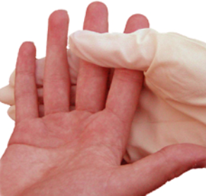
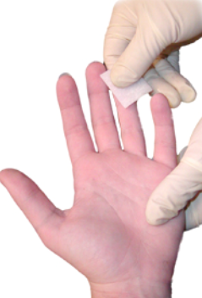

How to Properly Collect a Fingerstick Sample
1. SELECT THE FINGER SITE
Select the side of the fingertip that has not been lanced recently.
Each test should be performed from a new skin puncture. The middle or ring finger is preferred. Do Not use an old puncture site.
2. DISINFECT THE PUNCTURE SITE
Hands must be clean. Wash hands with soap & water or cleanse the puncture site with alcohol pad. Let the site dry completely before puncturing.
Alcohol or other skin preparation ingredients may interfere with the glucose test chemistry and cause a falsely elevated reading.
3. OBTAIN ADEQUATE BLOOD FROM THE PUNCTURE SITE
Hold the puncture site downward and gently apply intermittent pressure to the surrounding tissue. Strong repetitive pressure (milking) should not be applied; it may cause tissue-fluid contamination.

Slide 26
Patient Testing
Enter your operator ID and press √
Select “Patient Test”
Scan strip bottle barcode
Enter the patient’s 9-digit ID by scanning armband
When prompted insert strip
Keeping meter horizontal, apply a drop of blood to the front edge (yellow dosing area) of the test strip. Blood will be pulled into the test strip. The meter beeps and measurement begins.
NOTE: Do not place the meter on bed or bedding
Once the test is completed, the result displays
Enter at least the CLEANED METER comment.
Dispose of strip, clean and disinfect meter, and replace in base unit

Slide 27
Isolation Areas
While outside isolation rooms:
Dress in appropriate PPE
Gather glucometer supplies for testing
Turn on glucometer, enter operator ID and scan test strip lot barcode printed on strip bottle
Remove strip from vial and immediately recap vial. (Only take the number of strips you need to perform testing.) Leave strip bottle outside of isolation room.
After entering room:
Within 3 minutes, scan/enter patient ID into meter and perform glucose testing

Slide 28
How do glucometer results get to CPRS?
You must place the meter in the base unit to send results to CPRS and to charge the battery. Turn off the meter prior to placing in base unit. Each location has only 1 download station. There may be other charging stations. The download station has 2 cables coming out the back.
Approximately 5 minutes after docking the meter, patient results should appear in CPRS under the “Labs” tab
Exceptions and delays to this process do occur when:
        The “Invalid, will repeat” comment was used
        Incorrect patient ID was entered
        Patient does not have an applicable admission or encounter at the time of test performance
        For outpatients, a primary care provider is not assigned or current or the meter is docked after the encounter is closed.
        For inpatients, a primary or attending provider is not assigned or current

Slide 29
Meter Comments
Once a patient test result is displayed, you will be given the option to enter a comment. There are 7 comments available to you:
PROCESS ERROR– this comment should only be used when you feel there has been an error in testing and you DO NOT want the test results to be uploaded into the patient’s record in CPRS
WASH PT HAND REPEAT- used if you suspect there is sugar contamination that was not cleaned off.
LAB DRAW-results indicated need fot lab backup.

Slide 30
Meter comments continued
Notified RN– abnormal/critical results
CLEANED METER—should be done EVERY TIME
Temp 3-42 C
Humidity 10-90
Temperature and humidity meters are found next to the base station.

Slide 31
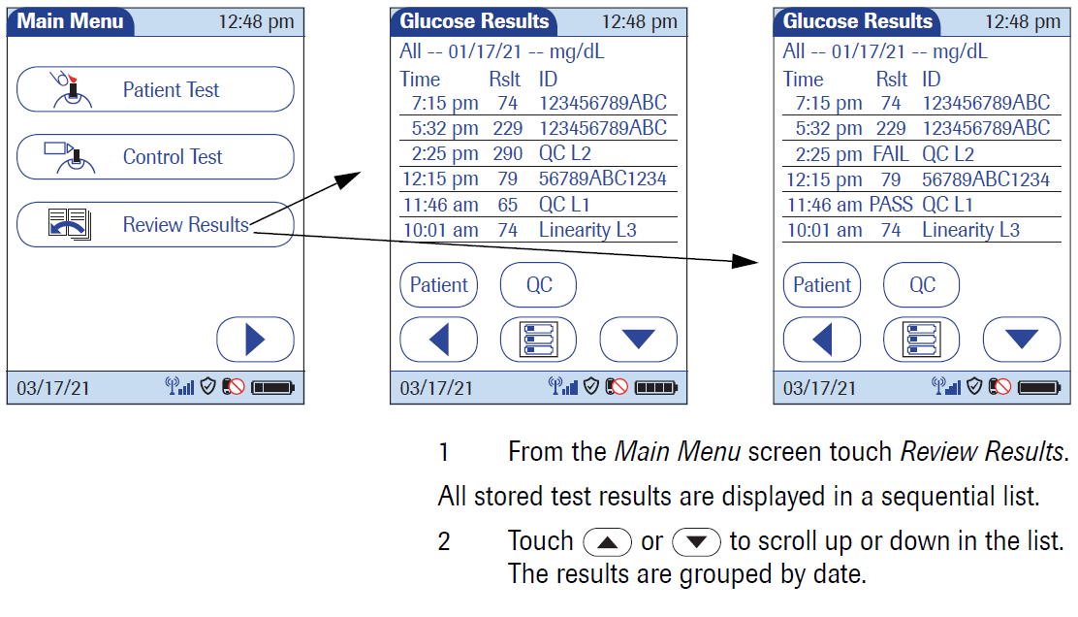
Review Results
If you need to review a result prior to entry into CPRS or during downtime:

Slide 32
Common Joint Commission Citation
Documentation notifying provider of Critical Result not completed or missing required information

Slide 33
Critical Value Documentation for Glucose
Critical Values include results <55 or >450 mg/dL
Includes “HI” and “LO” results
PER Joint Commission, VA, and CAP Regulations:
Critical values MUST be IMMEDIATELY communicated to the provider assigned to the patient
Acceptable providers include physicians, dentists, nurse practitioners, clinical pharmacists, physician assistants, and registered nurses engaged in the provision of care and/or treatment of the patient.
This verbal or phone communication of the critical value(s) to the provider must be documented in a “Critical Glucose POC Test Result” note in CPRS.

Slide 34
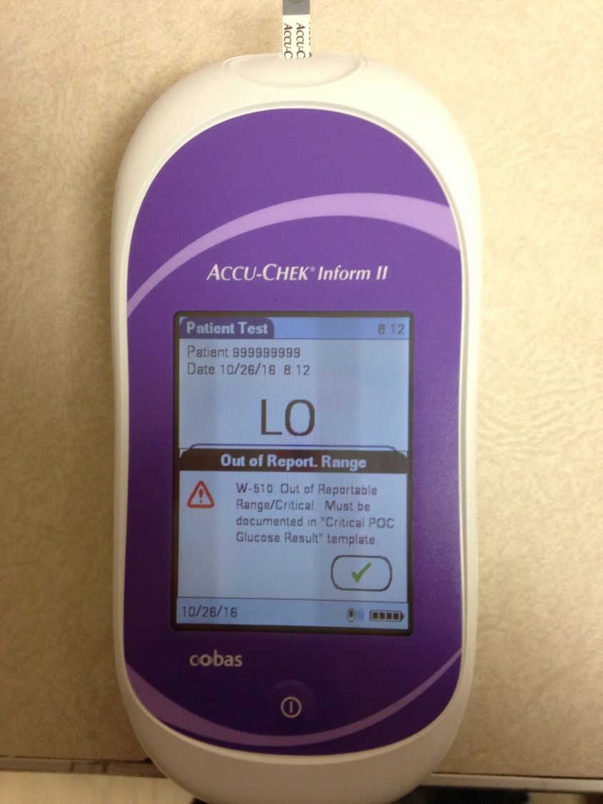
Critical Results, <55 or >450
Reminder box pops up on meter when there is a critical result and note is required

Slide 35
Extreme Patient Results
Any result less than 30 mg/dL will show as “LO” on your glucometer
Any result greater than 600 mg/dL will show as “HI” on your glucometer
To obtain a numerical result for these patients, specimen should be sent to the main laboratory
These results are considered Critical Values and should be treated as such.

Slide 36
Questionable Results
If a patient is experiencing symptoms that are not consistent with the blood glucose result obtained, it is recommended you:
  Repeat the test following procedures as described or send a green-top tube to the lab for confirmation PRIOR to treatment
  Notify provider of concerns
  Repeat controls to verify correct meter function.
  Consider equipment LIMITATIONS AND INTERFERENCES

Slide 37
Limitations & Interferents
The AccuChek meter cannot be utilized in any patient defined as “critically ill”
WTVAHCS, for the purpose of glucose point-of-care testing, has definesd critically ill as.
Mean Arterial Pressure (MAP) of <65mmHg
Use of IV vasopressors to maintain blood pressure such as dopamine.
at the time of the whole blood glucose draw or finger stick.
For these patients, a venous or arterial sample must be drawn and sent to the clinical lab for glucose measurement by traditional methodology.

Slide 38
Limitations & Interferents
Sample type:
There are significant differences between venous, capillary (fingerstick), and arterial blood glucose levels, with the venous glucose level tending to be the lowest of these three sources. These differences may be even greater depending on time elapsed since the individual has consumed food, etc. Such differences may be as much as 70 mg/dL. Unusual sample sites for capillary puncture, such as forearm, ear lobe, etc. may NOT be used for glucose testing, as even bigger differences may occur.

Slide 39
Limitations & Interferents
Shock or peripheral perfusion problems
When a patient is in shock and/or has peripheral perfusion problems, these differences are even greater. (Blood loss from trauma could be one cause). The normal processes by which glucose and other substances are distributed throughout the system are impaired. Capillary samples should not be used for these patients.

Slide 40
Limitations & Interferents
Diabetic ketoacidosis (DKA):
When a patient has a very high blood glucose (hyperglycemic-hyperosmolar state, ketotic or non-ketotic), the usual ways glucose moves between red cells and plasma, and between venous and capillary spaces, are changed. Capillary samples should not be used for these patients. Even a venous sample tested on a glucose meter may be unreliable.

Slide 41
Limitations & Interferents
Time delay between POC test and draw of Clinical Laboratory specimen:
A person’s glucose level is continuously changing. In addition, treatment (insulin, orange juice, food, exercise, etc.) may have been administered between collection of the two samples.
Hematocrit should be between 10 and 65% for testing on this meter.

Slide 42
Limitations & Interferents
Specific interferences may cause false overestimation of glucose results:
Triglycerides >1800 mg/dL
Galactose >15 mg/dL
Ascorbic acid >3 mg/dL
Maltose does NOT interfere with this test method

Slide 43
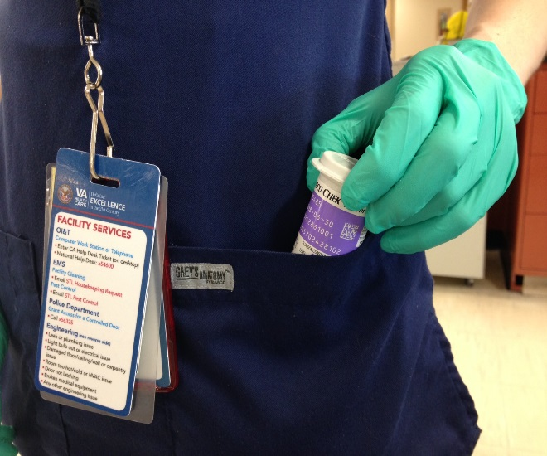
Common & Preventable Test Errors
Patient’s hands Not Clean
Alcohol Not Completely Dry
Incorrect/Invalid Patient ID Entered
Storing Test Strips Incorrectly
QC Bottle Dating - Unlabeled/Unreadable
Ignoring Test Interferences & Limitations
Good Specimen = Good Result

Slide 44
Common Joint Commission Citation
Not properly disinfecting meter after testing

Slide 45
Cleaning & Disinfecting Meters
Cleaning vs. Disinfecting
CLEANING - removes germs, dirt, and impurities from surfaces or objects. This process does not necessarily kill germs, but by removing them, it lowers their numbers and the risk of spreading infection.
DISINFECTING - kills germs on surfaces or objects. Disinfecting works by using chemicals to kill germs on surfaces or objects. (Super Sani-Cloth, Sani-Cloth, Dispatch Bleach Wipe, etc)
Alcohol swabs are acceptable for cleaning, but not for disinfecting meters between patients
It is best to use 2 of the above wipes, 1 for cleaning and 1 for disinfection. It is acceptable to use alcohol for cleaning followed by 1 of the above disinfecting wipes.

Slide 46
Cleaning/Disinfecting Meters
To ensure patient safety and meet FDA requirements, our glucometer policy requires meters to be cleaned and disinfected after each patient use.
Current hospital approved wipes include:
Super-Sani Cloth: 2-minute contact time.
Sani Cloth: 3-minute contact time
CaviWipes 2 minute contact
Dispatch Bleach Wipe: 3-minute contact time for use with C. Difficile patients.

Slide 47
Cleaning/Disinfecting Meters
Always wear gloves
Make sure meter is powered off and place on a level surface to ensure that NO liquid enters the test strip port
Remove a hospital approved wipe from its packaging and squeeze out excess solution
To clean, gently wipe the outside of the meter and carefully wipe around the test strip port area and then wipe dry with a tissue.
Then disinfect meter, gently wipe the outside of the meter and carefully wipe around the test strip port area.
After appropriate contact time, wipe meter dry with gauze or soft cloth. Do not leave wet, as this can damage the screen and possibly the meter.

Slide 48
Meter Maintenance
Other than cleaning, no maintenance is required.
If you have a meter that is malfunctioning or damaged, please contact the Ancillary Testing Department, ext. 7232 as soon as possible. You may also email Elizabeth Treece or send an IM.
DO NOT put in a work order
DO NOT place stickers or tape on the meters. The adhesive can harbor bacteria.

Slide 49
Proficiency & Competency
Competency verification is required after initial training, prior to patient testing, and annually. Six month and Annual competency is verified by a medtraining.org quiz and quality control/proficiency test performance.
Proficiency testing (PT) is required by the VA and accreditation agencies. PT includes performing the test on blind samples, which are evaluated 2-3 times per year. All trained operators are responsible for performing PT as requested by the laboratory.

Slide 50

Test your knowledge
Take the initial training as assigned. It is moving to medtraining.org and will be this PowerPoint and an exam
Run controls on glucometer with instructor
You must have your own barcode to get credit for this

Slide 51
Credits
Training developed at St. Louis VAHCS.
Modified for use at West Texas VAHCS.

