Slide 1
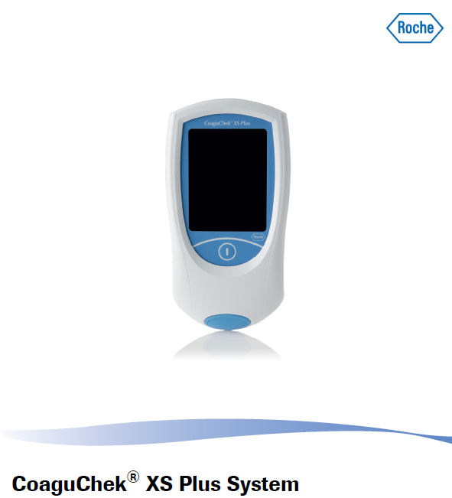

Slide 2
This training was developed for West Texas V A Health Care System By Elizabeth Treece BSMT(ASCP), MS
There are 3 parts.
This is part 2.
Part 1 is reading and acknowledging the policy.
Part 3 is the exam attached to this PowerPoint.
All parts are located at Medtraining.org.

Slide 3
Roche Coaguchek
Waived testing for PT/INR.
Sample is fingerstick blood drop only applied within 15 seconds of fingerstick.
Sample size 8 µL. Do not add more if first application too small.
Result display can be set for INR or PT/INR
Operator must be trained in use.
Meter must be on a level surface during testing.
Do not move meter during testing.
Repeat testing requires a fresh fingerstick.

Slide 4
Base Unit
Coaguchek in base unit
Contacts for charging and data transfer
Clips to hold meter in place

Slide 5
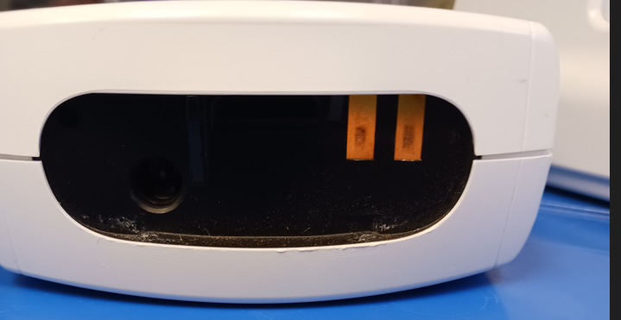
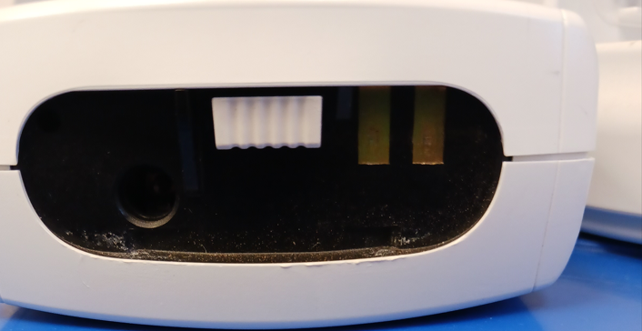
Charging contacts
End of meter that goes into base unit
Chips are lot specific. Be sure you are using the correct chip
Code chip in place

Slide 6
Contents of the box of test strips
Code chip is lot specific. Note number matches side of bottle. S indicates it is a strip code chip.
Code

Slide 7
CONTROLS
Number on the chip matches number on both levels of controls.
C on the chip indicates control

Slide 8
Supplies
Gloves
Lancets-auto-disabling single use
Alcohol wipes
Bleach wipes
Gauze/bandages
Biohazard container
Coaguchek strips
Coagucheck controls
Scissors

Slide 9
Controls
Controls are refrigerated.
Each box has a code chip.
Place code chip in chip slot when first starting the control lot.
Controls are run monthly.
The meter will lock if controls are not run.
If the meter has locked for controls it will only unlock if control test is selected.
Controls must be reconstituted with the diluent pipet.

Slide 10
Controls continued
Open control vial and remove stopper.
Take diluent pipet and hold with bulb down.
Shake all the diluent into the bulb.
Cut the end of the pipet off with scissors.
Add the entire content of the bulb to the vial. Save pipet.
Wait 1 minute. Swirl contents gently to mix.
Run control. Use the pipet to dispense on to strip.
Run both levels of controls. Do not mix up pipets.

Slide 11
Verify Date and Time on Meter
Time
Before proceeding with testing verify that the meter is still displaying the correct date and time.
The meter does not receive date and time through the interface. If the base unit lost power or the meter was not placed in the base over night it may not have the correct date and time.
Date

Slide 12
Set Date and Time
Make sure the date and time are correct before running a patient.
If the meter lost power it will automatically request date and time. Follow screen instructions to set.
If the time has changed you will need to go into SETUP to set the correct date and time.

Slide 13
Operator ID screen appears after power on
At this screen enter your user ID.
Your ID is your VISTA DUZ number and attaches your name to the result.
Do not share your ID or use someone else’s.

Slide 14
Run a sample
Main menu after entering user ID.
Select patient test or control test
To run patient sample select Patient Test

Slide 15
Running a sample continued
Enter the patient ID.
Current Patient ID is the SS#
After entering the ID check that the number is correct.
Press the green

Slide 16
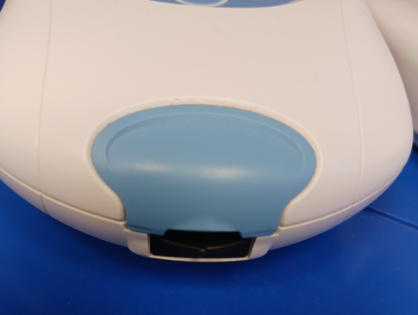
Running a sample continued
Verify the patient ID at the top.
Verify your ID.
Insert strip in smooth rapid motion. Arrows on strip go into instrument.

Slide 17
Insert strip and wait for countdown to start
Blood or control goes here once countdown starts. You will have 180 seconds to apply sample.

Slide 18
Notice top of screen indicates whether you are running controls or patients
Control
Patient with P-ID below

Slide 19
Once you have results
Enter comments. You have 3 available:
Clean meter– Indicating you cleaned the metereach use.
Time Verify—You checked the time and either set it or accepted it.
Temp 15-32 C– Indicates the room temp is acceptable for testing.
Select all comments that apply.

Slide 20
RESULTS
Meter can be set to display INR only or INR with PT
If needed results can be recalled here

Slide 21
Problems?
Contact the Ancillary Testing Coordinator at ext 7232

