Slide 1
Strep Screen
Quidel QuickVue Dipstick
Elizabeth Treece MS MT(ASCP)

Slide 2
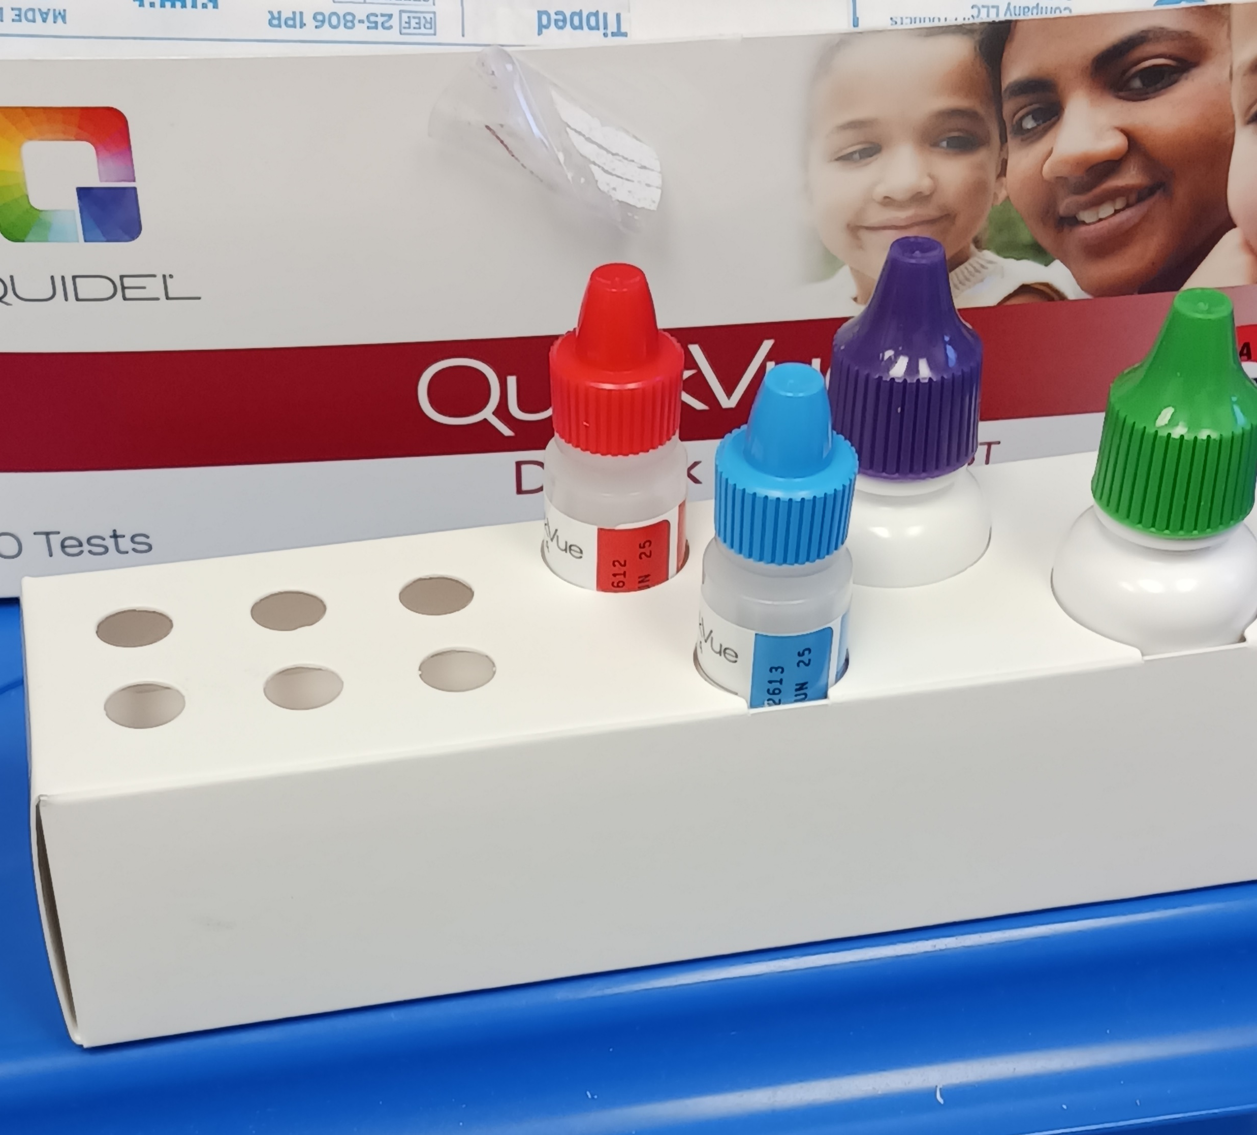
Kit Contains collection swabs, tubes, rack, liquid positive control, liquid negative control

Slide 3
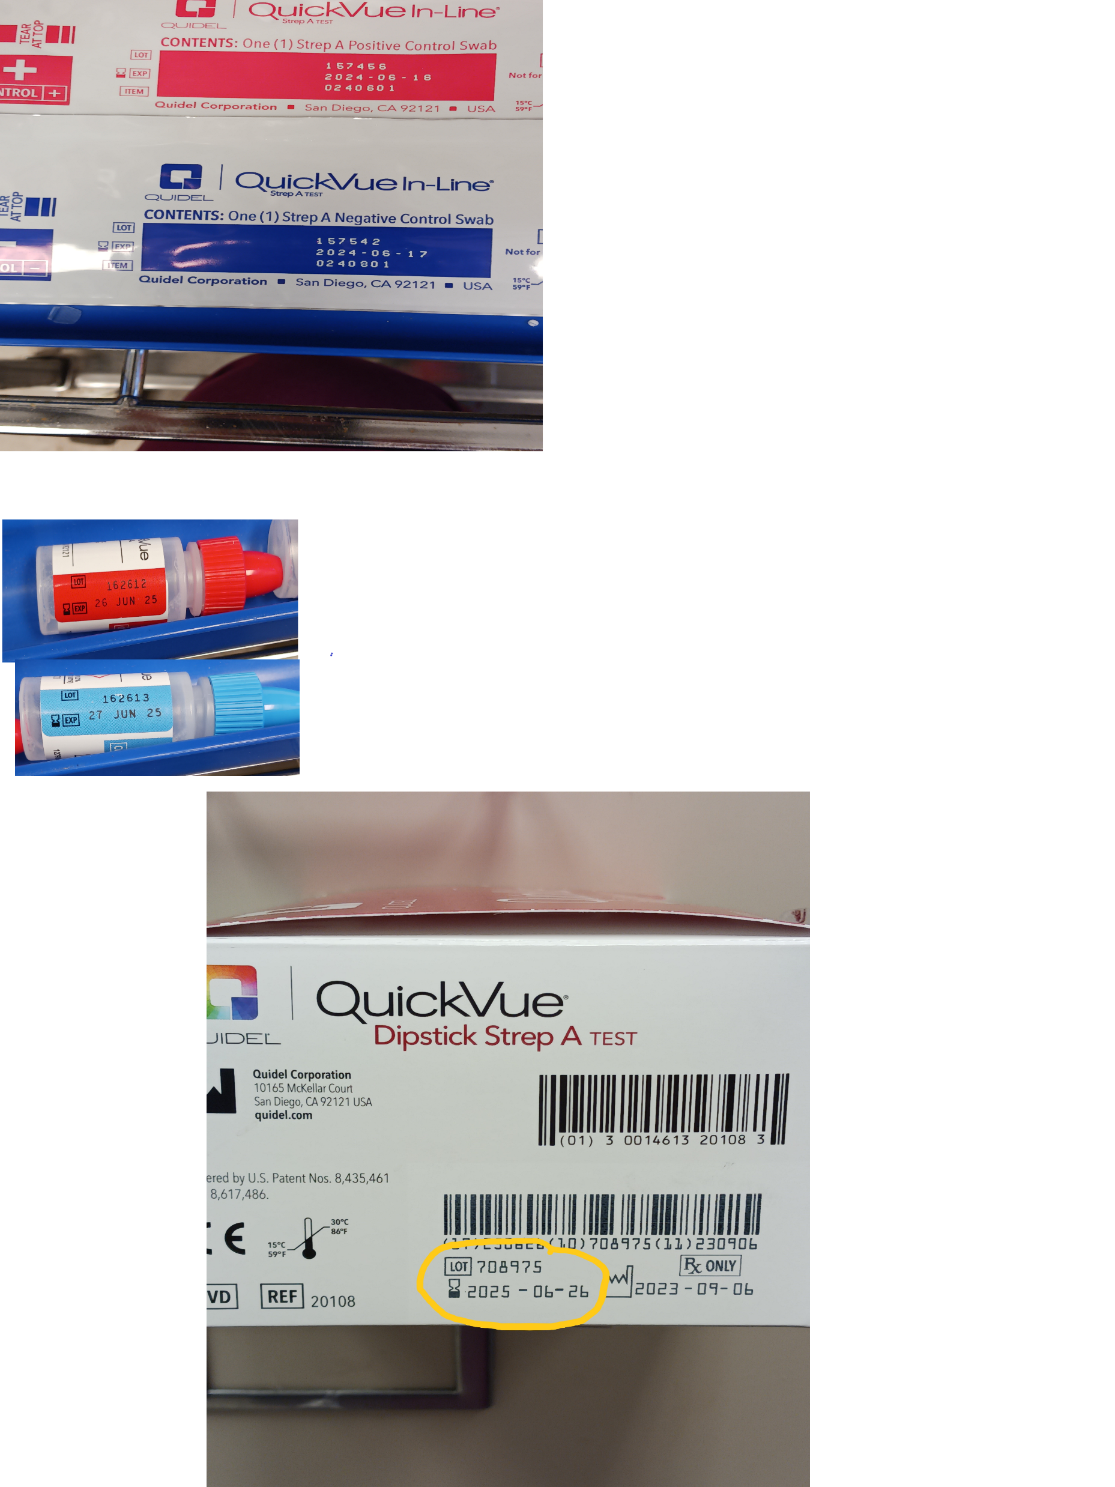
Where to find lot numbers.
Please note that control swabs are optional items and may not be available.

Slide 4
Controls
Controls must be run:
By each new operator
For each new shipment
For each new lot number in each shipment
If you ask for a new kit and it is the same lot as the lot kit this is a new shipment. Controls are required.
You may use the liquid controls in the kit or the swabs.

Slide 5
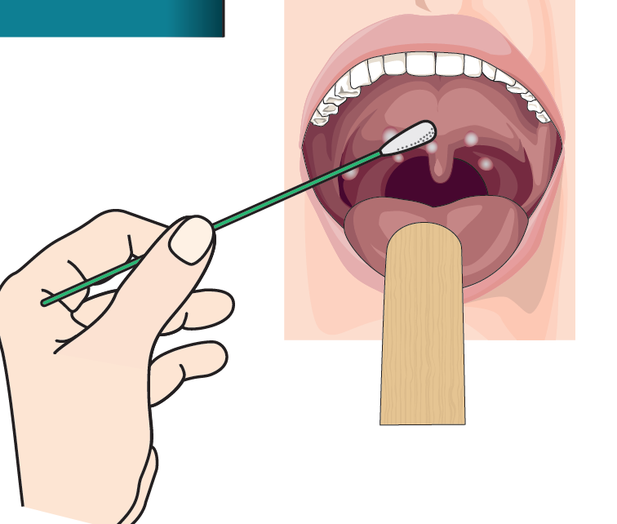
Collect sample Get Strep swab and Culture swab
For Culture use the standard blue cap swab.
Procedure for collecting throat swabs is available in notebook with collection manual.

Slide 6
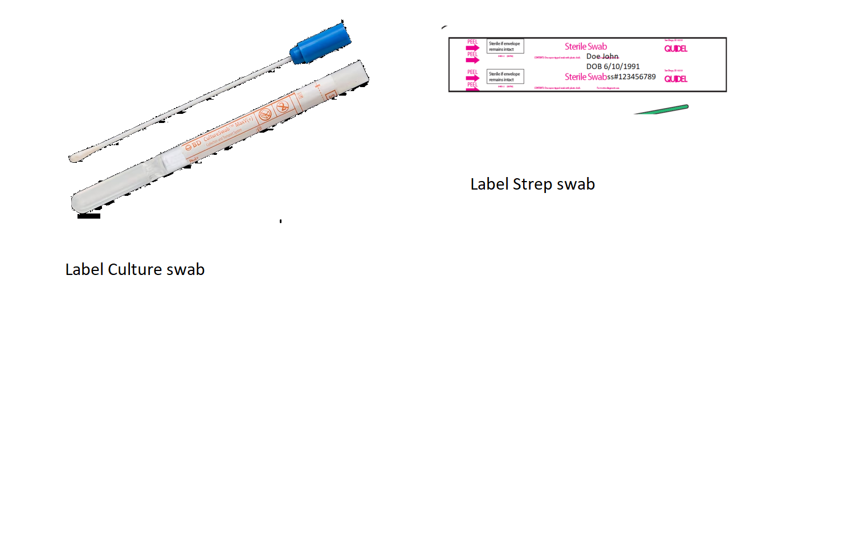
Label Swab wrapper and culture swab

Slide 7
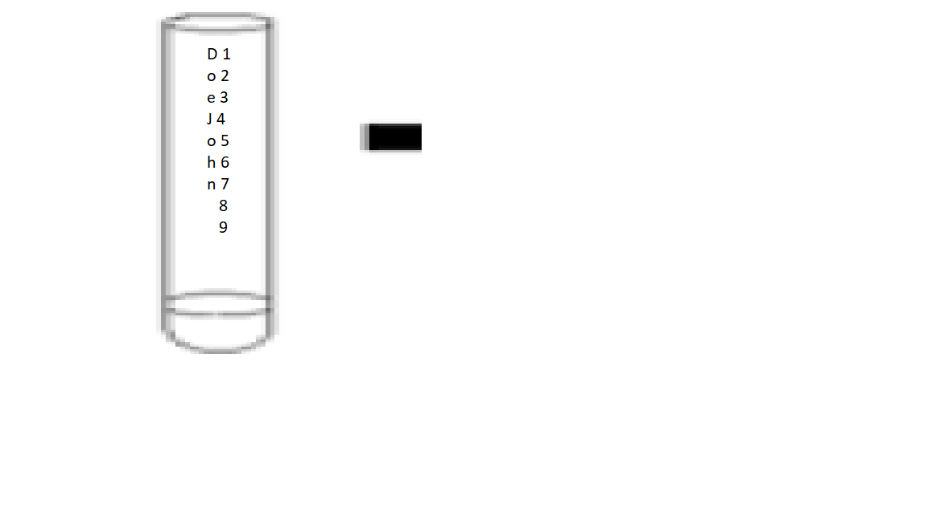
Prepare Tube for Testing
Label Tube

Slide 8
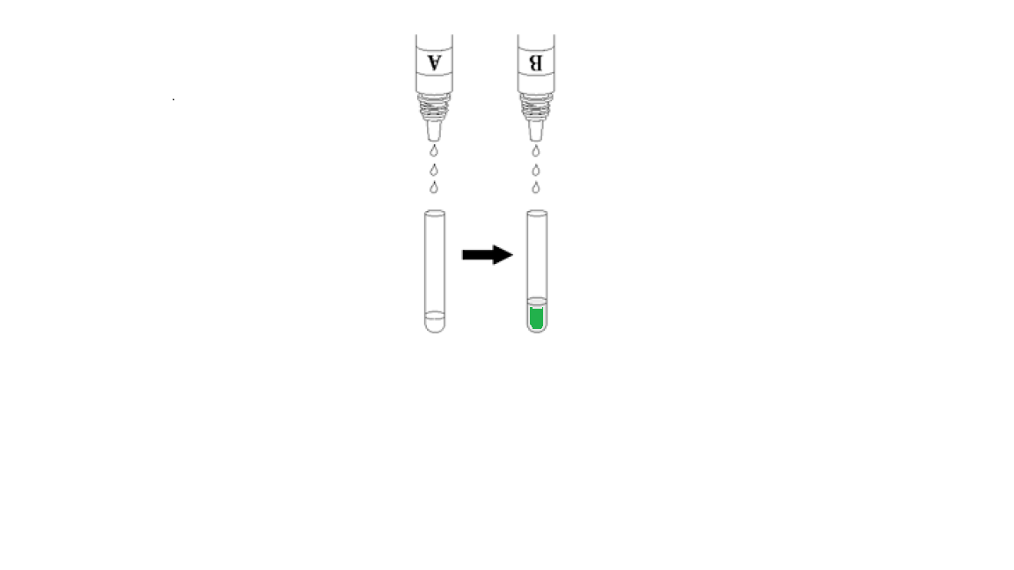
Add Reagents
If reagent B is green before adding to A, discard kit.

Slide 9
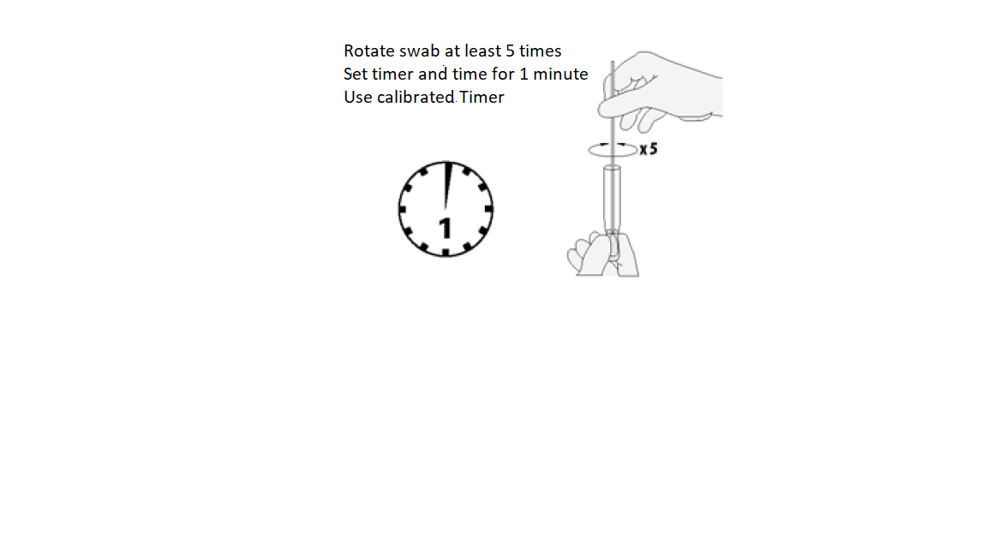
Add Swab. Squeeze bottom of tube to compress swab

Slide 10
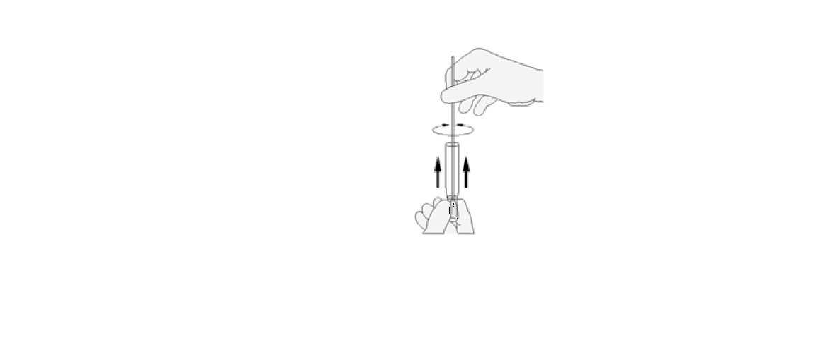
Express all liquid from Swab

Slide 11
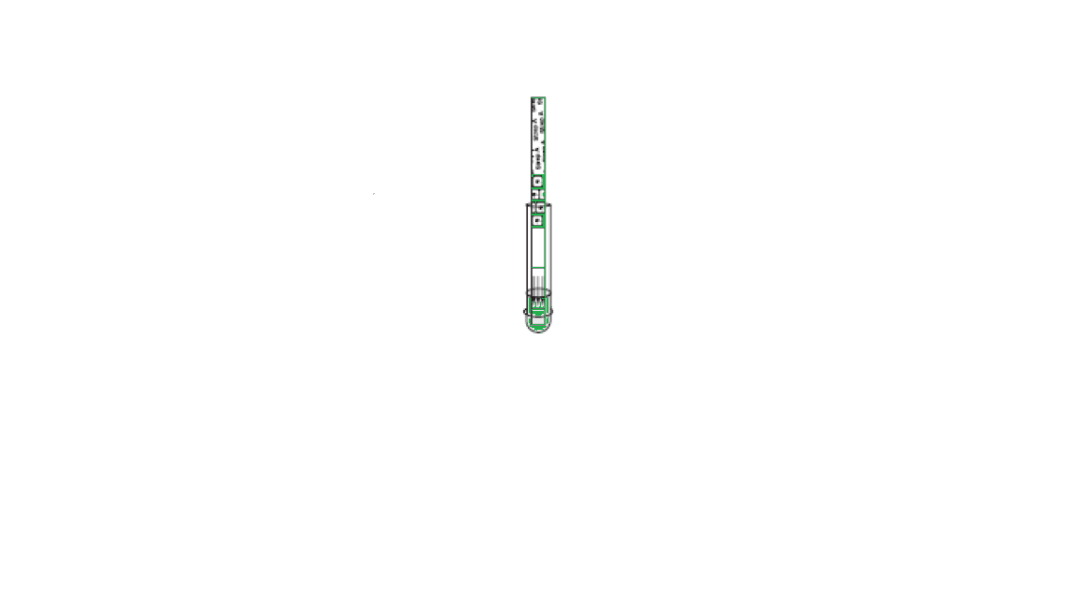
Open and Add Dipstick. Do not open dipstick ahead of time.
Use a calibrated timer
Time for 5 minutes
Do not touch the tube or dipstick.
If control line and patient line show up in under 5 minutes you may report a positive.
Negative results require the full 5 minutes.

Slide 12
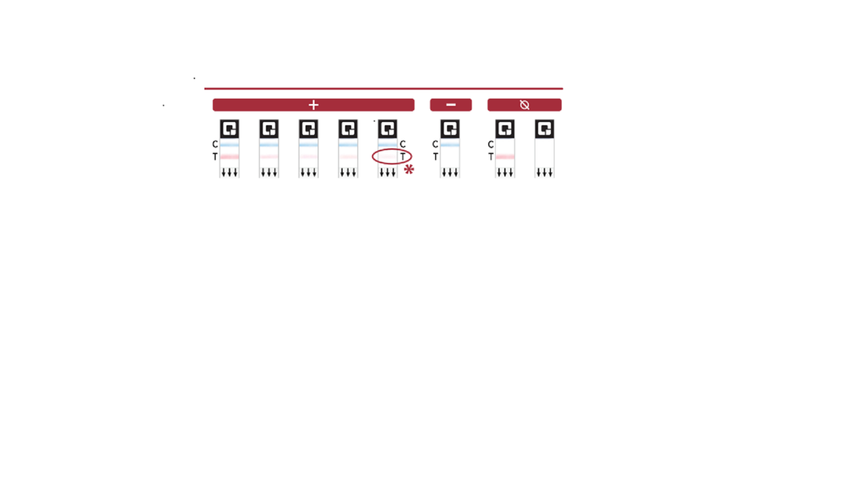
Reading Results

Slide 13
Invalid results
If the control line is not visible do not accept the patient or control results.
If it is the patient sample, send the culture swab to main lab for throat culture.
Place an order for the throat culture.

Slide 14
Entering Results
Do you need a culture?
Once you have a results, enter the value in the glucometer under other tests. Results MUST be entered in a manner that captures them in the lab package. This test is tracked and workload credit is awarded for it. Results entered in notes in the chart are difficult to find and do not report to the National Office that tracks tests.
If the results is negative or invalid the culture swab must be sent to the main lab for a throat culture to meet FDA guidelines for rapid strep tests.
Please place an order for the throat culture if you need to send the culture swab.

