Slide 1
Pregnancy Screening
Using Sure-Vue kit

Slide 2
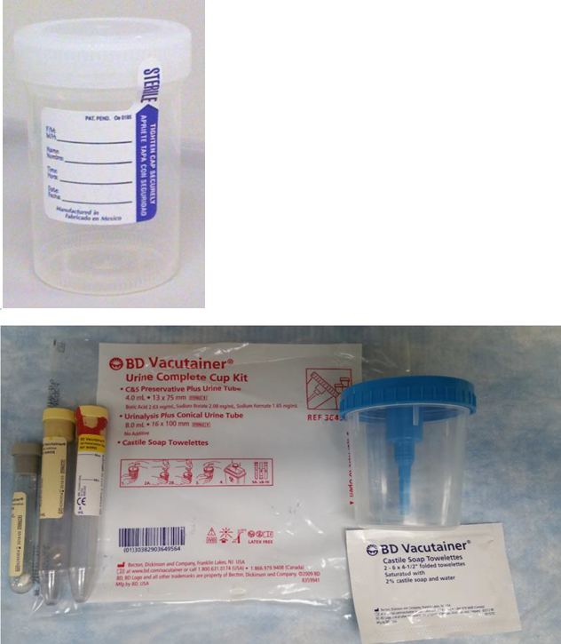
Waived testing for urine only
Be sure to label urine container.
Do not use containers with a preservative in them.
Do not use the Precision DX-12 drug screen cup.

Slide 3
Specimen Requirements
Preferred that 1st morning urine be used.
Allowed: random urine

Slide 4
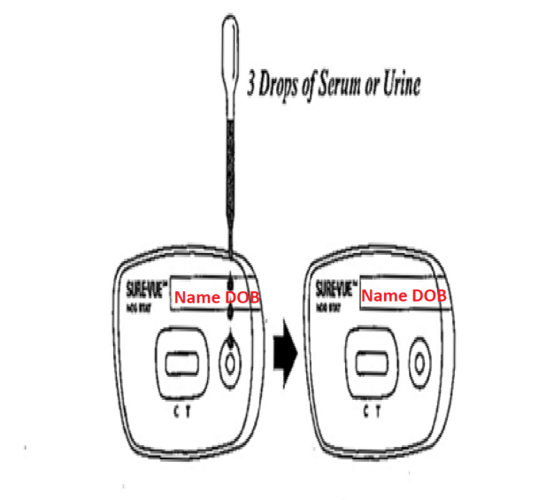
Label Cartrigde

Slide 5
Specimen Storage
While it is best to perform the test as soon as possible, the urine may be held in the refrigerator for up to 48 hours.
Samples should be clear before testing.
Samples can be cleared by centrifugation or allowing them to settle.

Slide 6
Perform the Test
Use standard precautions. Wear gloves.
Bring all items to room temperature if not already at room temperature.
Open the cartridge pack.
Label the cartridge with 2 identifiers.
Using the supplied pipets dispense 3 drops of urine into the specimen well.
Do not handle the cartridge during the incubation period.
Set a timer for 3 minutes
Read the results between 3 and 4 minutes.

Slide 7
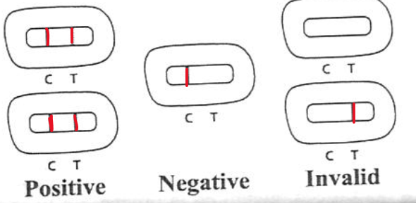
Test Interpretation
Both control line and test line are red

Slide 8
Enter the results in the AccuChek Inform II under other tests

Slide 9
External Controls
Controls should be run with each new shipment.
With each new lot
Every month
as part of training
Each operator should run controls yearly.
Do not use the droppers on the control bottle. Remove the dropped cap and use the kit droppers to ensure the correct amount is added.
Replace the dropper cap to prevent the control from leaking.

Slide 10
Internal controls
The red/pink control line should appear.
The background should clear

Slide 11
Reporting results
Report as:
Positive—2 red/pink lines
Negative- 1 red control line
Invalid- no control line even if a test line is present

Slide 12
Additional Testing
A positive result can be followed up with a blood draw for a Beta HcG. This can give an indication on how far along a pregnancy is.
An invalid result SHOULD be followed up with a blood draw for a Beta HcG.

Slide 13
This kit detects hCG but is licensed only for use in detecting pregnancy
Pregnancy is not the only source of hCG.
Other sources of hCG include:
Trophoblastic disease
Non-trophoblastic diseases including:
Testicular cancer
Prostate cancer
Breast cancer
And lung cancer
If these are present this kit cannot differentiate source.

