Slide 1
Multistix® 10SG
Waived testing urine dipsticks

Slide 3
Waived Test
This dipstick is a waived test per the FDA.
FDA oversees all commercial clinical lab tests in USA.
The requirement for colorblind screen is a separate regulatory issue.
The need for colorblind screen is based on the possibility of incorrect results being reported.
Each facility must determine which tests require a colorblind screen.
This test has multiple color changes and it has been determined that staff doing the test cannot be colorblind.

Slide 4
Normal Urine Color
Normal color is yellow. It will range from pale yellow to dark yellow.

Slide 5
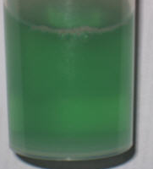
May be Normal or Abnormal Color continued
Colorless urine should be reported as colorless. It will often have a very low specific gravity. Seen often in people that have consumed too much water. May look like water.
Amber urine may be normal or abnormal depending on what is causing the color. Report as Amber.
Green is often dietary. However, some sources of infection may cause a green tint.

Slide 6
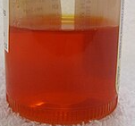
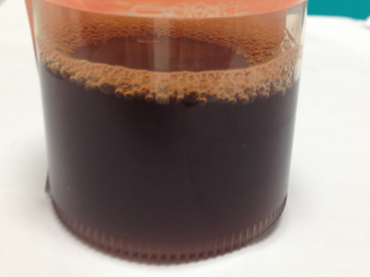
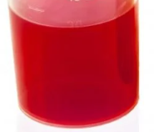
Abnormal Colors
Red, brown, orange, black or other. Colors falling under other may be the result of the intentional or accidental ingestion of a pH indicator. Do not assume that is what happened without a full investigation. This is mentioned because there is a university in the area. This has been a prank at more than one party by a chemistry student.

Slide 7
Color and Test Interpretation
Highly colored urines may make test interpretation difficult.
If the urine is highly colored and you suspect interference with a test pad add a comment “Abnormal color may be interfering with dipstick results.”
For example: Bloody urine and urine containing Azo (orange) may show a false positive nitrite result.

Slide 8
Clarity
Clear—You can see through the urine with no sign of particles.
Sl. Turbid– Particles are present, but you can still see newsprint through the sample.
Turbid– You cannot see through the sample.
Causes may be crystals or cellular elements such as red cells, or white cells.

Slide 9
Handling the Sample
Strips contain chemicals and are not certified as sterile.
Do not dip the strip directly into the sample cup.
If the strip has been dipped into the sample cup do not send it to the main lab for culture or drug screens.
What affect the chemicals in the test pads have on drug screens is not known.
Strips may be contaminated with bacteria that will continue to multiply during transport to the main lab and interfere with culture results.

Slide 10
Handling the Strips
1. Remove a single strip.
2. Close the container tightly.
3. Proceed with testing that 1 strip.
Leaving the strips open a few minutes a day for several days can allow moisture to enter the container. This will react with the test pads and cause control failures and errors in patient testing.
If strips are left open for an extended time they should be discarded and another container opened and controls performed.

Slide 11
Performing the dipstick
1. Pour urine into a labeled test tube. Tubes will be provided by the main lab. This prevents the sample in the collection cup from being contaminated by the chemicals or bacteria on the strip.
2. Examine for color and clarity using the tube or the sample cup.
3. The tubes provided will need to be filled almost to the top. These are narrow tubes and will be the 3 inches deep that the procedure calls for.
4. Dip the strip into the urine covering all pads. Remove within 2-3 seconds.
5. Blot the side of the strip on a clean absorbent paper towel.
6. Start a 2 minute timer.

Slide 12
Testing continued
7. Read each pad at the required time.
8. Record your results on the log sheet.
9. Each sample (patient or control) will have its own log sheet.
10. Enter results in VISTA.
11. Scan the log sheets for the day and send to main lab by FAX.
Fax number is 432-264-4859. Using fax will ensure that someone sees the results the next day so they can be proofread per Joint Commission standards for manual entry tests.

Slide 13
Log Sheet
Each sample will be on a separate log sheet.
The sheet will need to have 2 identifiers on the sheet.
Date and time collected will be filled out.
For controls the 2 identifiers are the control name and the lot number.
You circle the result for each test.
Enter the results into VISTA. The person doing the test will enter the results.
Once the log sheet has been scanned and the scan saved the paper copy can be shredded. BE SURE THE SCAN HAS BEEN SAVED. These records must be held for 2 years.

Slide 14
Quality Control
Run both levels of controls at the beginning of each shift and with each bottle of strips used for that day.
Controls are in dropper bottles. Stored in the refrigerator controls are stable until the expiration date on the bottle.
Warm to room temperature.
Using the dropper make sure each pad is covered with the control.
Do not touch the dropper tip to the pads.
Blot the side of strip on clear absorbent material such as a paper towel.
Read at the required time limits.
Compare the results against the data sheet in the box for the controls.

Slide 15
Quality Control continued
Each lot of control material may have slightly different ranges.
Make sure you are comparing the controls to the current data sheet.
Accept the controls by initialing the control log sheet.
For the control to be acceptable all analytes must be in range.
If the control fails, make a note on the log sheet.
Repeat the control and fill out a new log sheet. If it is still failing, call the main lab for help in troubleshooting.

Slide 16
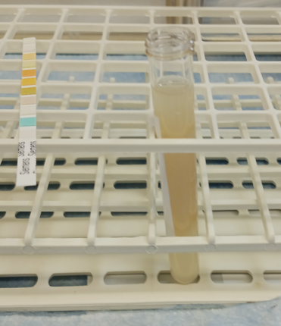
Urine has a label on it.
Color Yellow
Clarity Turbid

Slide 17
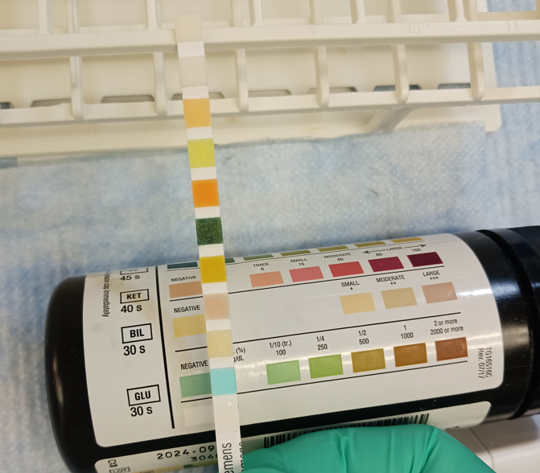
Read each pad against the proper chart section.
Glucose negative
Bilirubin negative

Slide 18
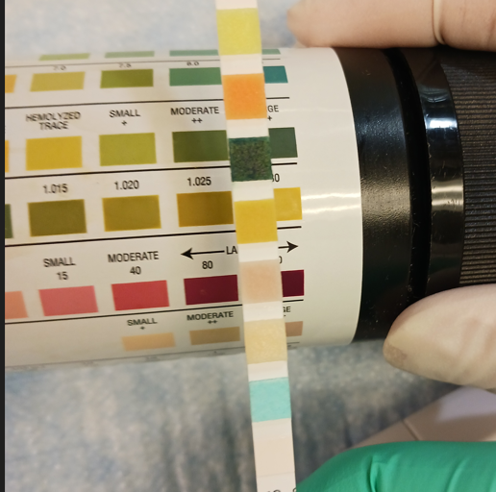
Ketone negative
Specific gravity 1.030
Blood 3+ (large)

Slide 19
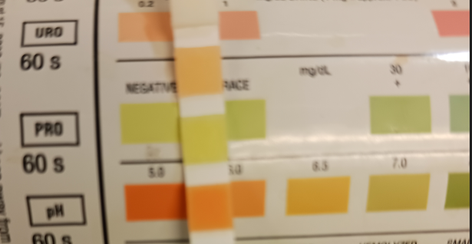
pH 6.0
Protein negative
Urobilinogen normal

Slide 20
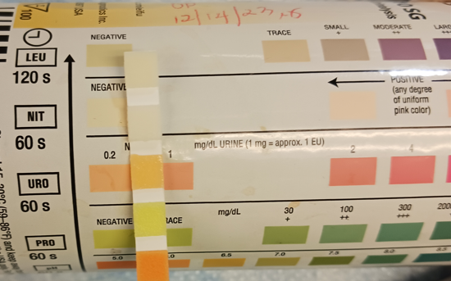
Nitrite negative
Leukocyte esterase negative

Slide 21
Example of log
Point of Care Manual Urinalysis Log
Sample ID: Place a patient label here with 2 identifiers or write what control this is.
Is this a control? Lot number_____________ Level___________
Date: _______________Time Collected:______________ May place small sticker from sample label that has this information
Circle the results obtained.
Glucose | Negative, 100, 250, 500, 1000, ≥2000
Bilirubin | Negative, small (1+), moderate(2+), large(3+)
Ketone | Negative, trace (5), 16, 40, 80, 100
Specific Gravity | 1.000, 1.005, 1.010, 1.015, 1.020, 1.025, 1.030
Blood | Negative, trace, 1+, 2+, 3+
pH | 5, 6, 6.5, 7, 7.5, 8, 8.5
Protein | Negative, trace, 30, 100, 300, ≥2000
Urobilinogen | Normal, 2, 4, 8
Nitrite | Negative, Positive
Leukocytes | Negative, trace, small (1+), moderate(2+), large(3+)
Color | Colorless, Yellow, Amber, other colors as seen__________ Is the color an abnormal color? Yes No If yes attach the comment “Abnormal color may be interfering with the dipstick results”.
Clarity | Clear, Slightly Turbid, Turbid
Initials of Person performing test_____________________________________
Printed Name of person performing test_______________________________
Date/time results were entered into VISTA_____________________________

