Slide 1

Principles of Microbiology, The Gram Stain as a Diagnostic Guide in Clinical Microbiology
2019 BootCamp
Donna M. Wolk, MHA, Ph.D., D(ABMM)
Geisinger, Diagnostic Medicine Institute (DMI)

Slide 2
Objectives
Assess Gram stains in a standard, logical manner
Apply concepts that improve interpretation to include indicators of infection
Identify ways to impact patient care
QA/competency/Quiz
Notes:
291. Introduce the concepts of core measures for sepsis and their impact on
hospitals
2. Review ways that Microbiology laboratories can support efforts to improve core
measures and sepsis outcomes.
3. Give examples of blood culture metrics and how they can support their
organization’s sepsis program.
4. Review simple statistics that support laboratory quality initiatives for blood
culture processes.
Summary: This session will frame the importance of blood cultures as they relate to the
Surviving Sepsis Campaign and to healthcare’s efforts to reduce mortality from sepsis. It
will also provide tips for laboratorians who seek to better characterize and report their
quality metrics and associated improvement in their metrics to provide evidence of the
laboratory contribution to sepsis programs.

Slide 3
GRAM’s STAIN Is ESSENTIAL to Guide Diagnosis and treatment
Efforts to standardize and improve performance and interpretation of Gram stains leads to improved management of infections and adds value to Microbiology results

Slide 4
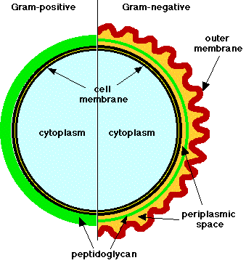
Bacterial Cell Wall: Key to Gram’s Stain
0
Gram positive (purple)
Thick peptidoglycan
Teichoic acid in cell wall
Gram negative (red)
Thin peptidoglycan
Outer membrane
  Lipid: asymmetric lipopolysaccharide-phosphic lipid bilayer interspersed with protein
  Endotoxin
Notes:
http://www.biologie.uni-hamburg.de/b-online/library/micro229/terry/images/micro/gramposneg.gif

Slide 5
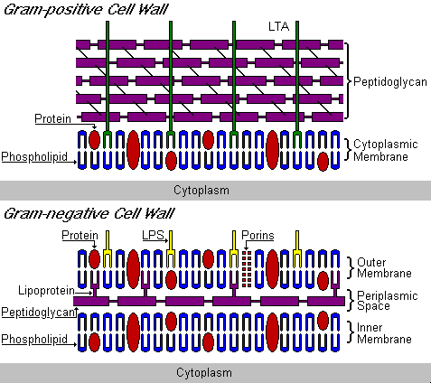
Close-up of Bacterial Cell Walls
Notes:
http://www.google.com/imgres?imgurl=http://www.cehs.siu.edu/fix/medmicro/pix/walls.gif&imgrefurl=http://www.cehs.siu.edu/fix/medmicro/genmicr.htm&usg=__h15aLQl-j-52GFgg85v0ovLy5CM=&h=424&w=477&sz=12&hl=en&start=18&um=1&itbs=1&tbnid=mYpdsxwvAzDaJM:&tbnh=115&tbnw=129&prev=/images%3Fq%3Dgram%2Bstain%2Bheat%2Bfixation%26um%3D1%26hl%3Den%26client%3Dfirefox-a%26rls%3Dorg.mozilla:en-US:official%26gbv%3D2%26tbs%3Disch:1

Slide 6
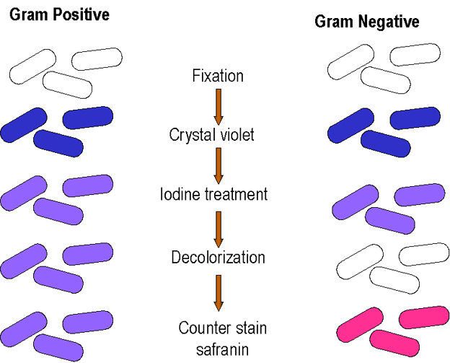
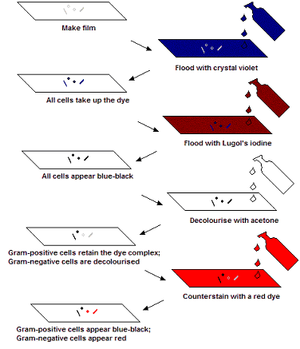
Gram’s Stain Procedure

Slide 7
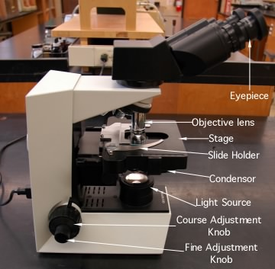
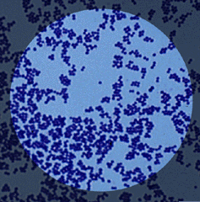
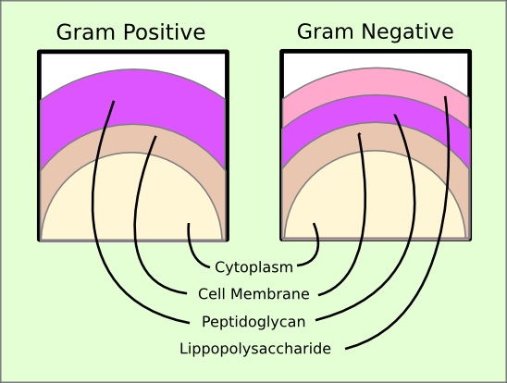
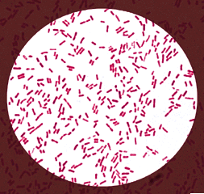
Gram’s Stain @1000X
Gram Positive Cocci
Gram Negative Bacilli
Notes:
http://biology.fullerton.edu/biol302/302labf99/GMSTPOS.gif
http://www.medschool.lsuhsc.edu/microbiology/DMIP/gramsta.gif
http://www.bact.wisc.edu/Microtextbook/images/book_3/chapter_3/3-1.jpg
http://www.meddean.luc.edu/lumen/DeptWebs/microbio/med/gram/gramstn.jpg
http://www.rlc.dcccd.edu/mathsci/reynolds/micro/lab_manual/gram_proc.jpg

Slide 8
Standard Approach
Low power (10X objective) examination
  Examine 10-20 fields at 100X magnificaion
  Assess the milieu and quantitate host cells:
  e.g. neutrophils, epithelial cells, ciliated columnar cells
Select area for high power (100X oil) examination
  20 - 40 fields at 1000X magnification
  describe specific organisms, intracellular location, etc.
  Go back and make sure no Gram negatives are missed
Report specific findings and interpretation
Notes:
Oil: Polymicrobial (lump)
Specifically: Intracellular or predominant organisms

Slide 9
Quantitation
(Organisms and Cells)
Report number
Rare (1+) <10 in all fields examined
Few (2+) 10- 24/field in all fields
Moderate (3+) 1-10 per 1000X field
Many (4+) >25 per 1000X field

Slide 10

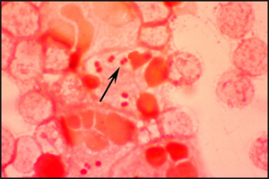
The need for speed…
Faster results mean faster access to targeted therapy
Notes:
Only your leadership will convey to people that they have to change. ; Now in IL, BC
is moving to a pay for performance. Mostly surgical and OB complications.

Slide 11
Common Morphology

Slide 12
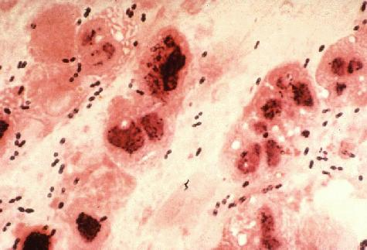
GPDC, lancet-shaped, S. pneumoniae
Gram-positive diplococci (GPDC)

Slide 13
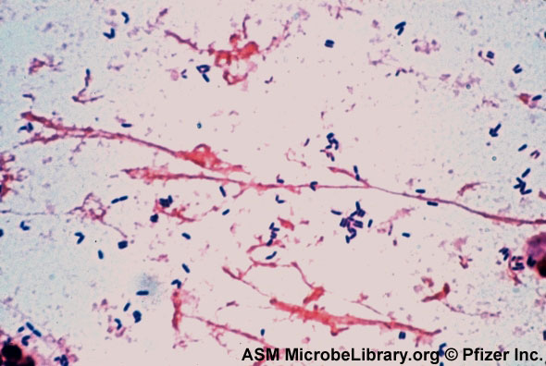
GPB palisades: Corynebacterium sp.
Gram-positive bacilli/rods (GPB/GPR)

Slide 14
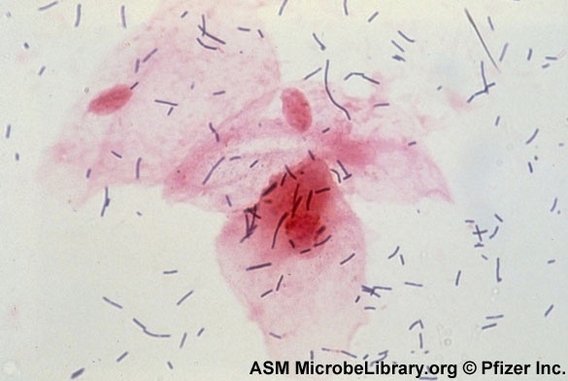
Thin GPBR, Lactobacillus sp.
Gram-positive bacilli/rods

Slide 15
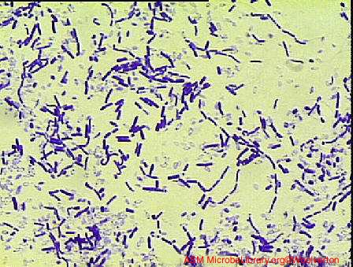
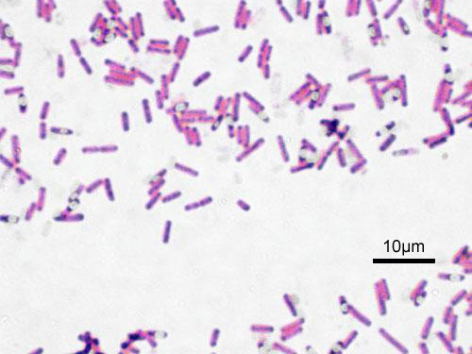
FAT GPB/GVR: Bacillus sp.
Gram-variable bacilli/rods (GVR)
Notes:
B. subtilis

Slide 16
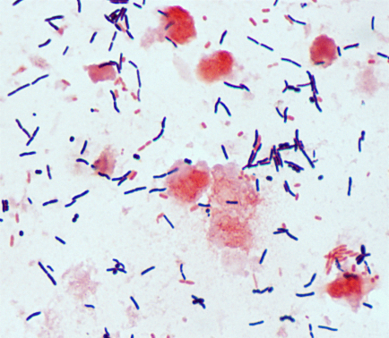
GPR/GVR: Clostridium spp. (anaerobe)

Slide 17
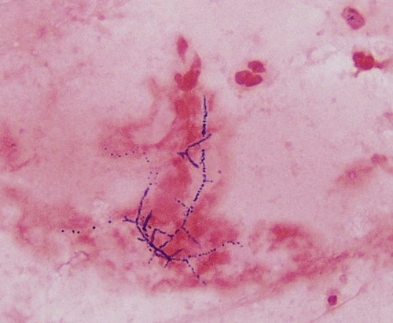
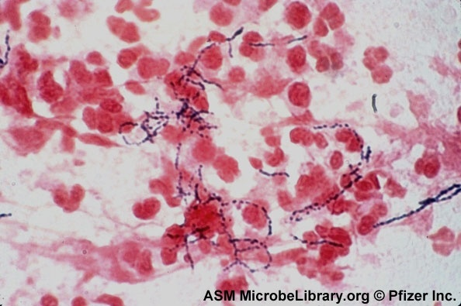
Branching GPR: Nocardia sp.
Notes:
N. asteroides

Slide 18
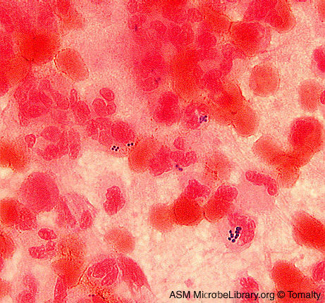
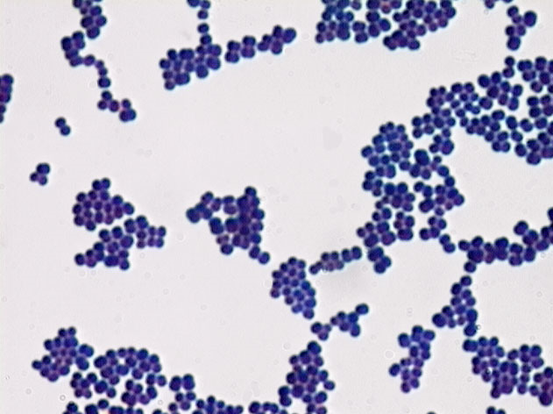
GPC CLUSTERS: Staphylococcus aureus
Gram-positive cocci CL
Notes:
wound

Slide 19
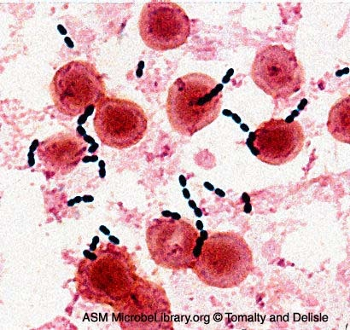
GPC CHAINS: Enterococcus faecalis
Gram-positive cocci CH
Notes:
In Blood cult

Slide 20
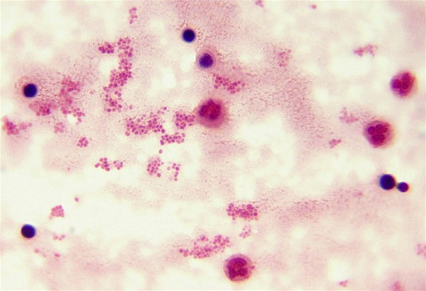
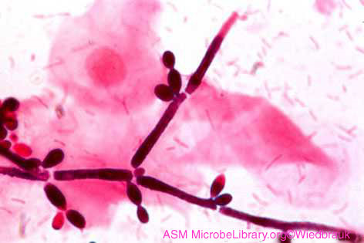
Budding Yeast

Slide 21
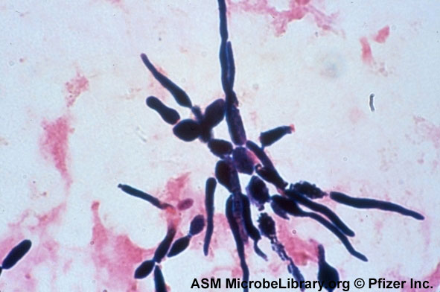
Yeast, pseudohyphae: Candida albicans

Slide 22
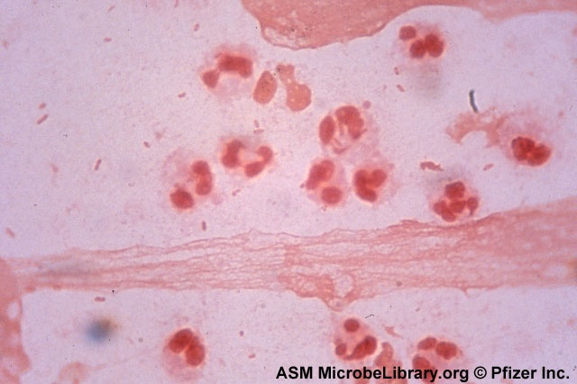
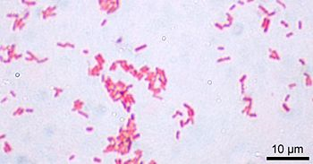
GNB: Escherichia coli
Gram-negative bacilli/rods (GNB)

Slide 23
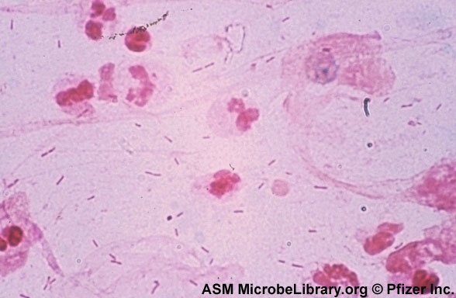
GNB: Pseudomonas aeruginosa
Thin Gram-negative bacilli/rods (GNB)

Slide 24
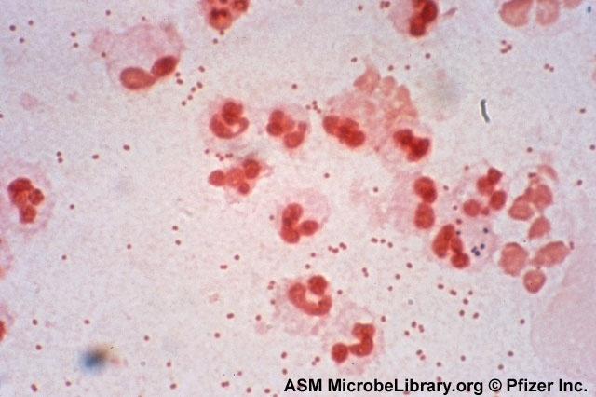
GNC: Moraxella catarrhalis
Gram-negative cocci (GNC)

Slide 25
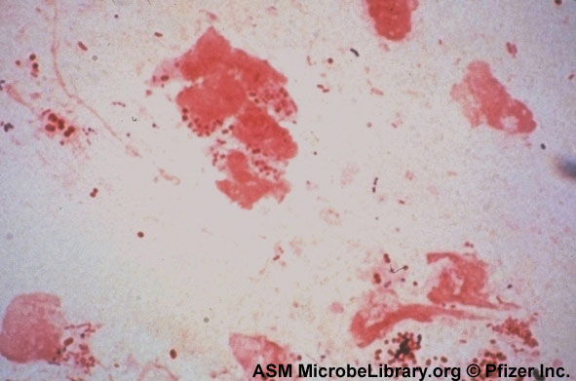
GNCB: Acinetobacter baumanii
Gram-negative coccobacilli/rods (GNCB)

Slide 26
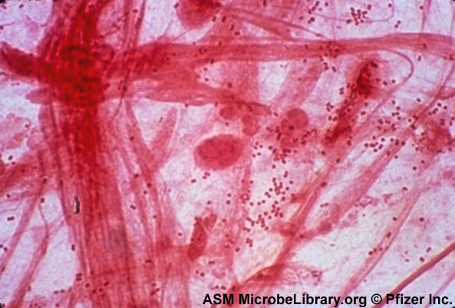
GNDC: Neiserria meningitidis
Gram-negative diplococci (GNDC)

Slide 27
Common Morphology Review
Gram Positive Cocci or Diplococci
  GPC in pairs, chains or clusters; GPDC
Gram Positive Bacilli (Rods)
  GPR or GPB, ± palisades, ± branching
Gram Negative cocci or diplococci
  GNC or GNDC
Gram Negative Bacilli (Rods) or coccobailli
  GNR, fat, thins, pleomorphic or GNCB
Yeast: YST or budding yst
Notes:
Clinical Microbiology Procedures Handbook, 2004, 2nd ed,Table 3.2.1-2-basic morphologies

Slide 28
Cautions

Slide 29
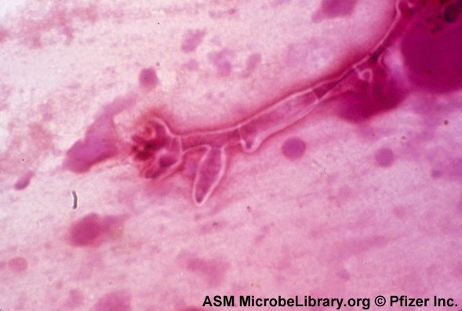
Mold may be seen as Ghosts:
Aspergillus fumigatus

Slide 30
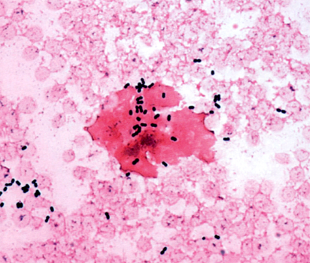
Acinetobacter: can stain Gram positive
Rand, K. and M. Tillan. Errors in interpretation of gram stains from positive blood cultures. AJCP 126:686-690, 2006
Notes:
Common error
Can be a bad mistake…
Morphology always wins over culture

Slide 31
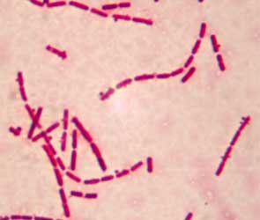
Bacillus and Clostridium spp/ can decolorize

Slide 32
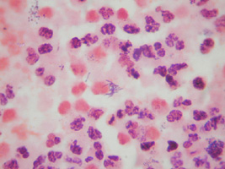
Mycobacteria tuberculosis: Ghost stain

Slide 33
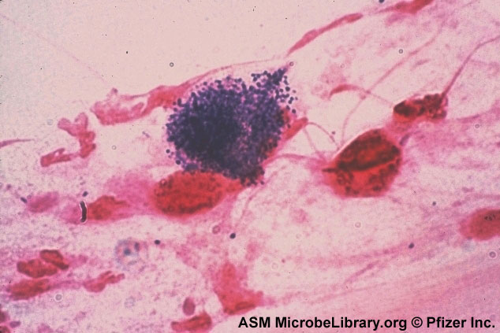
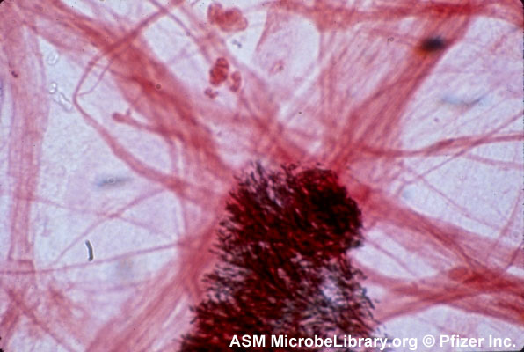
Artifacts: Stain precipitate

Slide 34
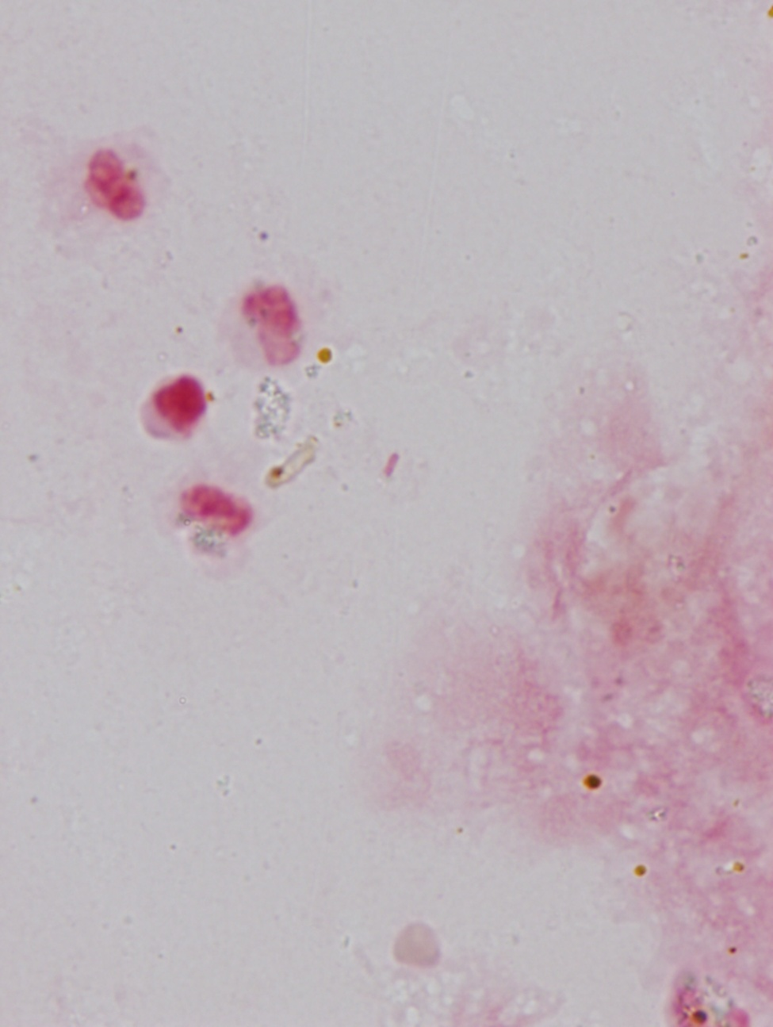
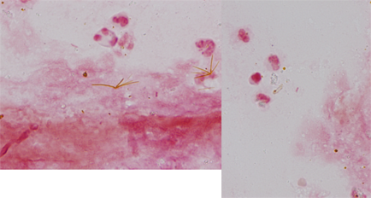
Bile Crystals
Photos from Dr. Thomson
Rounded crystal
Notes:
6-05 session
Pointy or rounded.
Maybve see in glla bladder fluid

Slide 35
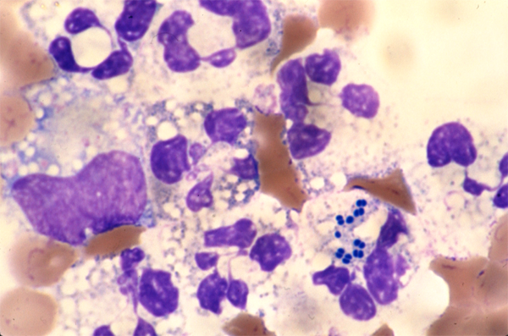
on Wright’s stain; can’t distinguish Gram neg and pos (actually a GNDC)

Slide 36
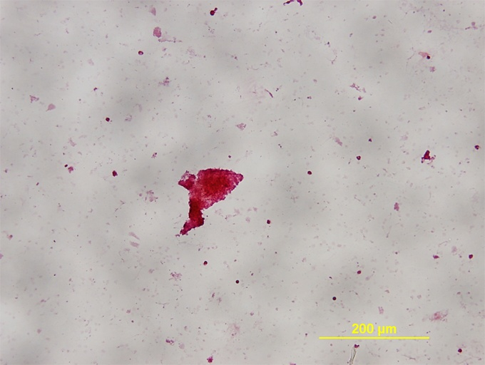
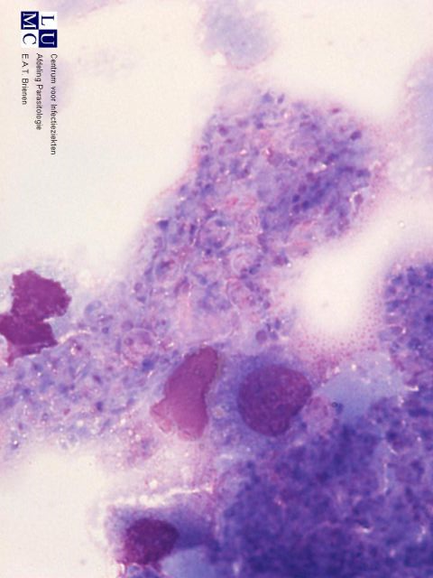
Pneumocystis jiroveci (carinii) Cast
Typical foamy aveolar exudate may break off and be visible in Gram stain
Low power Gram stain

Slide 37
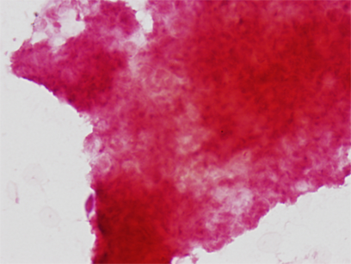
Pneumocystis jiroveci (carinii) Cast
Oil

Slide 38
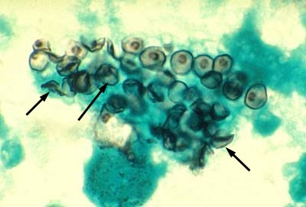
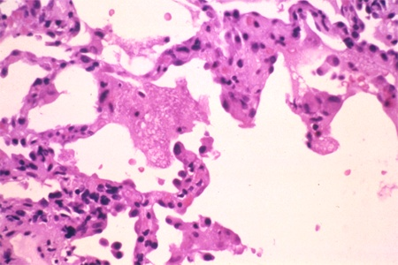
Pneumocystis jirovecci must do (Calcofluor, H&E, GMS: Typical foamy aveolar exudate

Slide 39
Variables
Slide preparation: method of cleaning
Inoculum size and smear preparation
Fixation of sample to slide
Reagents: Timing of various steps and decolorizer
Drying choice: paper or air
Organism: species, age,
Antibiotic therapy
Notes:
Organism variables:.
Smear preparation: inoculum, swab roll, liquid drop, thick/thin smears, cytospin; touch preparation, 2-slide thin smear, minced biopsy
Slide preparation: method of cleaning
Fixation
Decolorize with alcohol, acetone-alcohol or acetone
Variants with crystal violet or iodine reagents
Variants with counterstain reagents (usually attempting to stain Gram negatives like Helicobacter, Campylobacter, Fusobacterium, Bacteroides, Legionella, Brucella and anaerobes better) e.g. carbolfuchsin rather than safranin
Dry with paper or air
Timing of various steps
Organism variables: species, age, antibiotic therapy, etc.

Slide 40
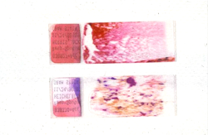
Thickness: Feather Edge Best
Bottom Slide - Too Thick
Notes:
Tom Thomson, ASM Workshop WS-14, 2008
2 nice slides used by rub method
Use second thinner slides to see orgs better

Slide 41
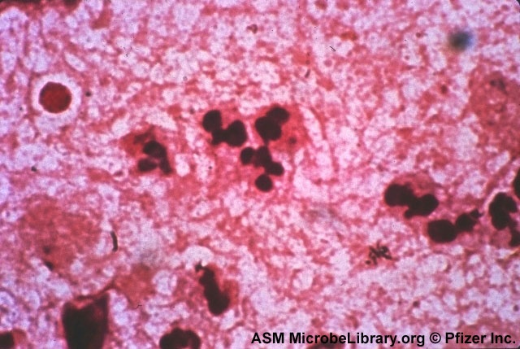
Proper stain: Neutrophils should be red

Slide 42
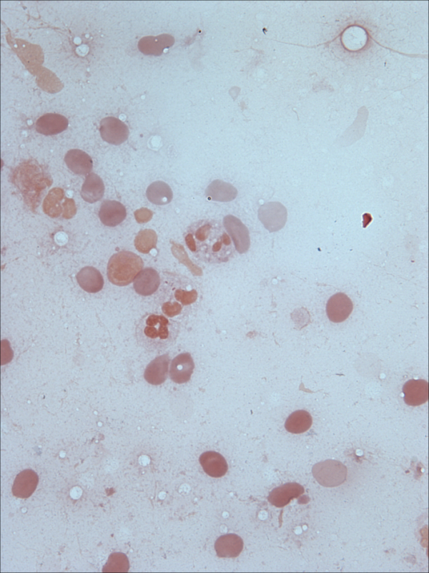
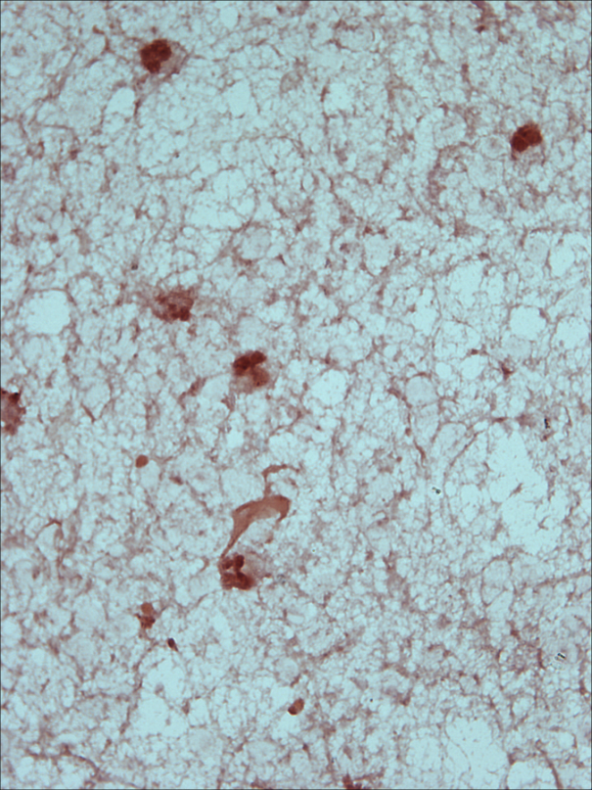
Fixation
Personal Preference
Methanol
  Preserves host cells bette
  Prevents liquids from washing off
  Cleaner background
Heat
  Bacti-Cinerator or flame
  Slide warmer
Notes:
42

Slide 43
Sample selection
Fluids and Tissues are BEST
SWABS are POOR specimens
Automatic for wounds, tissue, respiratory, normally sterile sites and fluids
Select pus or bloody areas
Not routine for urine, stool, throat, blood

Slide 44
Critical Gram Stains
Normally sterile body fluids/sites
Wound with suspected Clostridium
Eye with GPR (Bacillus) or thin GNR (Psedomonas)
STATs
When results differ from expected
  Aspiration pneumonia e.g. “Suggestive of aspiration pneumonia;” [critical call]
  Sputum w/ white cells and pathogen OTHER THAN the usual suspects), for example
    Nocardia in sputum
    Outpatients with atypical orgs. like Large gram positive rods

Slide 45
QC/QA
QC: Standard QC for stain and reagents
QA:
  Compare final culture results with Gram stain interpretation: Routine and competency testing
  Resolve discrepancies: review slide
  Correlate with clinical picture
  Assess speed of Gram stains from blood, sterile sites and STATS
Notes:
45
Munson et al. 2007. JCM 45: 3754-58. Mechanism to assess Gram stain interpretation proficiency.
Basic vs. Advanced , ASM Workshop 14, May 31, 2008

Slide 46
Challenges

Slide 47
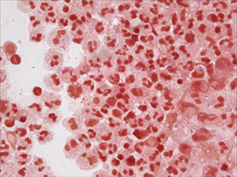
Pleural fluid with Gram positive cocci; nothing grew
Notes:
Plueral fl saw g+cocci small so CAD thought vir strep or peptostrep; pt treated night before with vanco and pip/tazo –nothing grew, incl anaerobically.
“Pleural fl G pos cocci NG”
Was gram fasle pos or culture a fasle neg…check if pt on antibiotics

Slide 48
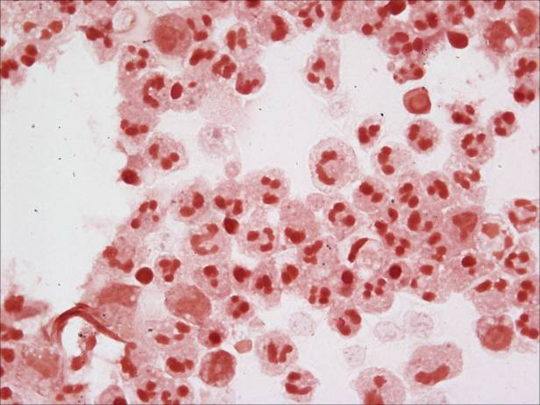
Pleural fluid
Correlate Gram stain with culture!
Review the slide; is Gram stain false positive?
Is the culture a false negative? Has the patient been on antibiotics which may account for the “no growth”? Anaerobes?
Get history/ contact the clinician to resolve the discrepancy. (This patient was previously on 2 antibiotics.) This is good practice PLUS it is good patient care/communication.

Slide 49
Indicators of Pathology
(Advanced Competency in Bold)
White blood cells (polymorphonuclear leukocytes)
Alveolar macrophages
Squamous/columnar epithelial cells
Elastin/collagen fibers
Curschmann’s spirals
Corpora amylacea
Intracellular bacteria/yeasts
Antibiotic effect
on bacteria
Crystals
Charcot-Leyden Crystals
Adapted from Dr. Thomson
Notes:
49

Slide 50
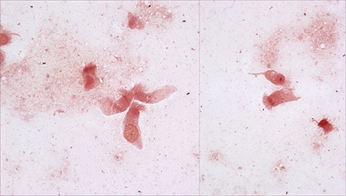
Ciliated Columnar Epithelial Cells
Good place to look for bacteria
Notes:
In gram stain…know this is a deep lunch specimen

Slide 51

Ciliated Columnar Epithelial Cells

Slide 52

Curshmann’s Spiral in Asthma Patient
Not relevant- do not report.
Slide from Dr. Thomson
Notes:
Drs. Cibas and Ducatman's Cytology (3rd ed., ISBN 978-1-4160-5329-3) says, "Curschmann spirals are coiled strands of mucus. With the Papanicolaou stain, they appear as distinctive purple helices. In the past they have been associated with chronic respiratory diseases, but they are, in fact, a nonspecific finding and not worth mentioning in the report. (Mentioning them might only cause puzzlement. Like some Hollywood celebrities, they are strikingly beautiful and equally irrelevant.)"
"Charcot-Leyden crystals are rhomboid-shaped, orangeophilic structures derived from degenerating eosinophils in patients with severe allergic disorders like asthma."
Attached is the picture of Charcot-Leyden crystals downloaded from the online version of this book (copyright protected).
Haiying

Slide 53

Corpora amylacea indicates tissue damage.
Slide from Dr. Thomson
Notes:
Ca= starch body
Damage can be seen in ling and prostate spec

Slide 54

Corpora amylacea: laminated starch bodies
Slide from Dr. Thomson

Slide 55
EXAMPLES

Slide 56
Body Fluid Gram’s Stains

Slide 57

CSF: Neisseria meningitidis

Slide 58

CSF: S. pneumoniae

Slide 59

CSF: Haemophilus influenzae

Slide 60
Genital Gram stains

Slide 61

Male Intracellular GNDC: Report to Dept. Health

Slide 62

Clue cells, Gram variable rods, Gardnerella vaginalis

Slide 63

Trichomonas vaginalis

Slide 64

Vaginal Gram Stain: Candida albicans

Slide 65

Sputum Gram Stains
Correlate with Culture

Slide 66
Many Screening Criteria for Routine Bacterial Culture of Sputum
Pick just ONE
Bartlett (1974): Quality scoring system
Murray/Washington: < 10 SEC/LPF
Van Scoy: >25 neutrophils/LPF
Geckler: <25 SEC/LPF
Kalin et. al. >5 neutrophils/SEC
Morris et. al. <10 SEC/LPF & bacteria present
etc……
Notes:
Nancy Cornish

Slide 67
Sputum Screening
CAP inspection guidelines support the use of a microscopic screening protocol
Impacts patient care by reporting only clinically useful information
Saves the patient and institution money
Conserves laboratory resources
Notes:
Nancy Cornish

Slide 68

Saliva: Reject Specimen

Slide 69
Sputum Gram Stain Reports
Keep report short—avoid line listing of all morphotypes present
  Inexperienced health care providers will treat everything listed OR
  Ignore the results
Notes:
Karen Carroll, ASM Symposium, May 25, 2004

Slide 70
Historic : “Line-listing” in Gram Stain Report
Moderate polymorphonuclear leukocytes
Moderate gram positive diplococci
Few gram negative diplococci
Few gram positive cocci in clusters
Few gram negative bacill
Lab Assumption: Health care providers will know how to interpret.
Reality: “I‘d just ignore this as meaningless garbage and treat empirically.” Anonymous medical resident
Notes:
Karen Carroll, ASM Symposium, May 25, 2004

Slide 71
Interpretive Gram Stain Report
Moderate polymorphonuclear leukocytes
Moderate gram positive diplococci suggestive of Streptococcus pneumoniae
Organisms suggestive of normal respiratory flora
Assumption: Health care provider will treat for Streptococcus pneumoniae
Notes:
Karen Carroll, ASM Symposium, May 25, 2004

Slide 72
Report “Suggestive of….”*
Gram negative small
cocco-bacilli
Gram positive lancet-
shaped diplococci
Gram positive cocci
in chains
Gram positive cocci in clusters
Gram negative diplococci
After adequate competency
Haemophilus influenzae
Streptoocccus pneumoniae
Streptocccus spp.
Staphylococcus spp.
Moraxella catarrhalis

Slide 73
Respiratory Gram Stain
What if you’re wrong?
Example:
Many white cells
Many intracellular and extracellular Gram negative diplococci suggestive of Moraxella catarrhalis

Slide 74

Acinetobacter
2
3
1
Moraxella
3
Moraxella
2
1
Notes:
Acinetobacter (~7th most common cause of nosocomial acquirted pneumonia) and Moraxella (~2-3rd most common cause of CAP
Acinetobacter is one of the more frequent causes on LATE onset VAP (occurs p 4 day) so, when have an I pt hosp’d > 4 day then consider comment that it looks like Moraxella/.Acinetobacter

Slide 75
If predicted incorrectly, fix it.
Notify physician.
Amend written report.
Educate technologist.
Even though this was incorrect, >99%
of the other predictions are correct.
Notes:
Acinetobacter is one of the more frequent causes on LATE onset VAP (occurs p 4 day) so, when have an I pt hosp’d > 4 day then consider comment that it looks like Moraxella/.Acinetobacter

Slide 76
Can we do even better?
Acinetobacter is an important cause of nosocomial infection but not community-acquired pneumonia.
When Moraxella-like morphotypes are seen on Gram stain AND the patient has been hospitalized > 3 days, consider using this comment:
“…bacteria morphologically
suggestive of Acinetobacter/Moraxella”
Notes:
Miller’s audiocon ASM Lab dx of pn 3/31/04

Slide 77
Can we do better?
Gram stain-directed cultures
Additional information to technologists
  Seek out organisms near WBC on Gram stain
  Culture workup based on a combination of Grams stain and cultures results
Reports for aspiration pneumonia Gram’s stain is highly suggestive of aspiration pneumonia. Antibiotic coverage for anaerobic bacteria should be considered (in addition to therapy for the standard pathogens). A variety of organisms (pleomorphic Gram negative rods and Gram positive cocci and rods) are present inside neutrophils.

Slide 78
Aspiration Pneumonia
<10 squamous epithelial cells per low power field
> 25 neutrophils per low power field
An increase in mixed flora to >50 organisms per oil immersion field with intracellular gram positive and gram negative organisms in at least one field
Cumitech 7B (2004)
Notes:
Just reporting this is unhelpful, but actually interpreting it (like in the [next] slide with comment) is

Slide 79

Aspiration Pneumonia: Tech Report (SUGA)

Slide 80
Other Respiratory Cases

Slide 81
Haemophilus influenzae Pneumonia
83 year old woman
Presented to ED with difficulty breathing and purulent sputum
First specimen had many Gram negative cocco-bacilli on Gram stain and grew many H. influenzae
What do you make of the second respiratory specimen? Why was there no growth?

Slide 82

(photograph compliments of Mike Sauboulle)
Sputum
Notes:
Dear Group: I thought I would share these two smears I photographed of Haemophilus influenzae under the influence.
The first slide was from a patient seen in ED around 4am (many, many years ago). Expectorated sputum showed many GN coccobacilli and grew almost pure culture of HI. The patient was then admitted. 4 hrs later (around 8 to 9 am) we received a bronchoscopy specimen with morphotypes seen in the second slide; culture of that specimen grew nothing. Note: don’t ask me why a bronchoscopy was performed—perhaps the pulmonologists did not read the results of the first smear. The patient had been give cefuroxime in the ED prior to admission. This illustrates the vast difference that even a few hours can make and certainly what therapy can do to microbiology results. The interpretations would have been totally different if we had not had the first slide to go by. We have also had many E. coli, Klebs, and Acinetobacters with really bizarre forms.
Best,
Mike Saubolle
Medical Director, Infectious Diseases Division
Laboratory Sciences of Arizona, and
Clinical Associate Professor of Medicine
University of Arizona, College of Medicine
Good Samaritan Regional Medical Center,
1111 E. McDowell Rd
Phoenix, AZ 85006
Tel: 602 239-3485

Slide 83

After cefuroxime
Second specimen (bronch); antibiotic effect
No growth (compliments of Mike Sauboulle)

Slide 84
Wound Gram’s Stains
Correlate with Culture

Slide 85
Gram Stain of Wound
Gram stain should guide workup of culture
Specimen: note on report if swab or tissue/aspirate
Cells in Gram Stain: PMNs, macrophages, epithelial cells – quantitate
  numerous epithelial cells indicate
  surface contamination – limit work up
  numerous PMNs – more extensive
  work up

Slide 86

Gram stain
guided workup
swab
quants
epithelial
cells
Gram stain
AST
contaminants
Fungal or AFB
Notes:
Numerous epis indicate surface contamination
Gram stain should guid culture wkup on potentially contam cultures

Slide 87





Surgical Specimens: Red swabs don't do
the job… to avoid an issue, send us a tissue
FOR SURGICAL SPECIMENS, SEND TISSUE, FLUIDS, OR E-SWAB MEDIA TO MICROBIOLOGY LAB FOR CULTURE
Red Swabs are inadequate for culture of surgical specimens
Out of every 100 bacteria absorbed on a red swab, only 3 make it to grow in culture
Anaerobes on swabs die when exposed to air, but will survive in tissue, fluids, and E-swabs
Thanks from your patients and Division of Microbiology

Slide 88

Group A streptococcus
Notes:
Gas

Slide 89
Which pathogen is real? Is it pathogenic?
The EXPERT considers the following
Is it a good specimen? Or a swab?
Rough quantitation correlated with Gram stain; epithelial cells, white cells, elastin or collagen in Gram stain
Normal flora vs. pathogen
Quantity of potential pathogen in Gram stain and culture

Slide 90
Wound Gram Stain Comments
Gram Stain results suggest commensal flora:
or
If physician demands results for inappropriate specimen as indicated by stain:
“These results are reported by special request of the attending physician and may or may not reflect an accurate etiology of infection.”
Miller, J. M. Guide to Specimen Management in Clinical Microbiology, 2nd ed
Notes:
. Nancy Cornish

Slide 91
Elastin and Collagen in Normal Tissue
Both seen in Gram stains with infection or other tissue damage/disruption
Elastin: breakdown fibers with ribbon-like strands, parallel walls and punched out holes
Collagen: similar to elastin but without holes; does not stain well with Gram stain
Notes:
Seen in gram stain, indicates some type of tissue damage

Slide 92

Elastin (low power)
Notes:
Elastin from our 6- 05 session

Slide 93

Elastin high power
Slide from Dr. Thomson
Notes:
Low power

Slide 94

Elastin
Notes:
Elastin from our 6- 05 session
High power

Slide 95

Punched out holes characteristic of elastin rather than collagen
Notes:
Elastin from our 6- 05 session

Slide 96

Collagen fibers
Slide from Dr. Thomson
Notes:
Collagen, no punched out areas…have almost same signif as elastine

Slide 97
Anaerobes

Slide 98

Mixed infection: Peritoneal fluid
Notes:
Gpos gneg potentaill anaerobes

Slide 99

Bacteroides from Hip Joint
Supplement your setup to optimize recovery of anaerobes and Haemophilus.
Notes:
Septic arthritis Saur, Grp a strep, strep pneumo
Bacteriodes not usually a casue of septica arthirits….so consider set up in this case for anaerobes cuz you see collagen
Let gram guide micr to add anaer plates

Slide 100

Fusobacterium in Pleural Fluid
(missed initially because smear too thick)
Thick
Thin
Notes:
Thinner slide shows thin gnr…better to have a thinner slide

Slide 101
Stool Gram Stains
Rarely useful:
Some excpetions

Slide 102

Campylobacter jejuni: Gull wings

Slide 103
Blood Culture Gram Stains

Slide 104
Issues in Grams Stains in Blood Cultures
Verbage for reporting Gram stain
--Interpret with “suggestive of…”?
Should every positive culture be called? No - but
--Every time a Gram negative rod is found
in a new blood culture within 24 hr?
--What about 48 hr?
--What about Gram positive cocci?

Slide 105
Gram Stain Accuracy of Blood Cultures
Sensitivity 91.3-99.7%
  Most frequent species. GNR and Staph: 91.3-100%
  Non-hemolytic streptococci the lowest: 86.2 to 94.9%
Specificity 98.9-100%
PPV 94.6-100%
NPV 99.0-100%
First notification of positive blood cultures shows high accuracy of the Gram stain
2007 JCM 45 (4) Søgaard, Nørgaard, Schønheyder
Notes:
First notification of positive blood cultures: high accuracy of the Gram stain report
Mette Søgaard1,2,*, Mette Nørgaard2, Henrik C. Schønheyder1

Slide 106
Interpretation Errors from Grams Stains in Blood Cultures
0.7% misread
Acinetobacter read as Gram positive
Bacillius and Clostridium read as Gram negative
Mixed cultures (missed one morphotype)
~half missed Gram negative bacilli;
~half missed Gram positive organisms
Rand, AJCP 126:686-690, 2006

Slide 107

Salmonella and Staphylococcus from blood culture; only Staph seen on Gram stain
How long should we examine a slide?
Notes:
Salmonella and Staph grew…20 min of blood read still missed the gnr on gram stain from a pos BC bottle…no curretn std for this bc gram

Slide 108

Penicillium marneffii in Blood Culture
(from S. Poutanen, M.D., Mt. Sinai Hospital, Toronto, Canada)
Notes:
Penicillium marneffii BC)

Slide 109


Anthrax: Bacillus anthracis
Notes:
K. Todar on right U Wisc

Slide 110
Expertise in Direct Stains:
Added Value
What you see
What you do NOT see
THINK about a Diagnosis

Slide 111

#1: History of
diabetes
Notes:
Keep this arrangement for HIPPA reasons., eye nosr, brain, conj

Slide 112

NOS until Silver stain performed
Gomori-methenamine silver revealed Mucro sp. (fungus)

Slide 113
#2: History
56 year old man
Specimen labeled only as “arm” (from surgery)
Technologist’s initial impression: no white cells, moderate Gram negative rods
Should you do more than enter the results into the computer?

Slide 114


RE-stained
Photograph supplied by Dr. Steven Milner
Gas gangrene of the arm; clostridia showing spores
Notes:
No clinically signif gram neg orgs have spores !!!!
Clostridium lecithinase will lyse WBC, insert shows gram pos from BC…
Gas gangrene of arm on left…clsotridia can decolorize

Slide 115
#3: History
75 year old woman
  Rheumatoid arthritis with chronic steroid Rx
  Coronary Artery Bypass Surgery 2 mo ago
  Failure to thrive
  GI bleed and failure to thrive
  No eosinoplhilia
  No diarrhea
  Sputum submitted for culture but did not meet criteria; rejected because too many squamous epithelial cells
BUT 10X magnification revealed object

Slide 116

oil
low power on edges of slide
Rare Strongyloides seen….on outer edges because they crawl away from the slide
Notes:
Rare strongyloides seesn….on outer edges because they crawl away from the slide

Slide 117

Serpinuinous tracks on sputum culture
Notes:
What are these tracks?????? Maggots or stongyloiseds???
Gram st showed rejected
White blood cells
1+ (rare, <1 per low powered field)
2+ (few, 1-9 per low powered field)
3+ (moderate, 10-25 per low powered field)
4+ (many, >25 per low powered field)
Organisms
1+ (rare, <1 per oil immersion field)
2+ (few, 1-5 per oil immersion field)
3+ (moderate, 6-30 per oil immersion field)
4+ (many, >30 per oil immersion field)
Clinical Microbiology Procedures Handbook, 2004, 2nd ed

Slide 118
#4: History
54 year old male
  3 years post cardiac transplant
“Large” intracellular staphylococci ? In BAL

Slide 119


Slide 120
Summary
Strengths, weaknesses, and caveats of Gram stain
Examples in teaching/competence testing/QA issues
Gram stain can drive culture
Think about patient and diagnosis – do more if suspicious

Slide 121
Questions
dwolk@email.arizona.edu

Slide 122
Question #1
Which condition is NOT associated with over-decolorization of a Gram’s stain?
A) patient has been treated with antibiotic
B) organisms growing in blood culture broth
C) acetone is used for too long of a time period
D) specimen is too thick on smear

Slide 123
Question #2
Which component of the cell wall is stained and fixed with crystal violet and iodine?
A) peptidoglycan component of cell wall
B) peptidoglycan component of nuclear membrane
C) lipopolysachharide (LPS)
D) protein ligands

Slide 124
Questions #3
For a gram stain to be properly reported
A) all neutrophil nuclei must be dark purple
B) the specimen must be screened on low power (100X) and high power 1,000X
C) the reader must observe ciliated epithelial cells
D) the reader must observe evidence of tissue breakdown

Slide 125
Infectious Disease
Case Examples

Slide 126

Epidemiology Case Example:
“Walk the Line”
A Clone of Methicillin-Resistant Staphylococcus aureus among Professional Football Players, Kazakova et.al NEJM, February 2005

Slide 127

Observational Study of Football Players by CDC Epidemiologists

Slide 128
Results: MRSA Transmission “On the Line”

Slide 129
Differential Dx.
Staphylococcus
Streptococcus
Fungi

Slide 130

Emerging Infections with Community-Acquired MRSA
(methicillin-resistant Stapylococcus aureus)
Gram Positive Cocci

Slide 131
Community-Acquired MRSA
CA-MRSA
  Dx made in outpatient setting or culture positive within 48h of admission
  No history of hospitalizations within the past year
  No history of medical procedure
  No permanent indwelling device that passes through the skin

Slide 132



Other Presentations of CA-MRSA
May resemble spider bite

Slide 133

Laboratory Investigation
Culture: S. aureus
Antibiotic susceptibility
  Resistance to macrolides and oxacillin
  Susceptible to ciprofloxacin, clindamycin, tetracycline, bactrim & vancomycin

Slide 134

Epidemiology / Genotyping

Slide 135
MRSA: USA Genotypes
USA PFT
USA 100 | HA-MRSA Most common, (44% of MRSA) Multi drug resistance
USA 200 USA 500 USA 600 | Multi drug resistance
USA 300 and USA 400 | CA-MRSA, skin and soft tissue infections β-Lactam & Macrolide resistance, other antibiotics are usually sensitive PVL toxin is common, multiple toxins found
  McDougal et.al., Jnl of Clinical Microbiology, Nov.2003

Slide 136

Genotype
USA 300-114 from Culture
  Demonstrated Panton-Valentine leukocidin (PVL); Aggressive infections associated with PVL
  Demontrated SCCmec type IVa (Staphylococcal chromosome cassette) antibiotic resistance
    Small, highly mobile genetic element
    Gene encodes a penicillin binding protein with reduced affinity for β-lactam antibiotics

Slide 137

Case Review
Host: Lineman pre-disposed by antibiotics, and skin injury
Agent: emerging MRSA clone
  Clone is indistinguishable from other US clusters of CA-MRSA infections for genotype and virulence factors
Environment: Primary source of MRSA was not identified, assume nasal or skin colonization via human to human transmission
Prevention: Cleaning hot tubs and exercise rooms

Slide 138

Epidemiology Case Example:
Saturday Night Fever

Slide 139
Case Example: “Saturday Night Fever”
35 yr. old golfer w/ 4 weeks of cough, one week of increasing cough, fever, night sweats, decreased appetite
3 days small nodule in neck
Rash
2 months after golf circuit trips to Kentucky, Arizona, California, Florida

Slide 140

X-ray: Nodular foci

Slide 141


Erythema nodosum, a rash that commonly accompanies early infection

Slide 142
Differential?
Blastomycosis
Coccidiomycosis
Allergic reaction
Cancer

Slide 143
Valley Fever
Clinical Microbiology Laboratory Scientists Identify a Dimorphic Fungi

Slide 144

Wet Prep of Exudate
Spherules
Notes:
144
Smear of exudate showing spherules of Coccidioides immitis. Experimental infection of mouse with soil sample.

Slide 145

Periodic Acid Schiff (PAS) Stain
Notes:
145
Histopathology of coccidioidomycosis. Spherule with endospores of Coccidioides immitis. PAS stain.

Slide 146

Sputum Culture
Glen Roberts, Mayo Clinic

Slide 147

LPCB stain
Glen Roberts, Mayo Clinic

Slide 148

Arthroconida
Glen Roberts, Mayo Clinic
Notes:
148
Septate hyphae
Raquet hyphae produced in young cultures
Alternate arthroconidia produced from hyphae that are smaller in size
Barrel, rectangular or rounded in shape
Spherules containing endospores are not usually found on culture media
Gen-Probe molecular identification, both species combined

Slide 149
Valley Fever
Fungal disease, coccidioidomycosis
Endemic to the southwestern US and parts of Central and South America.
Acquired by inhaling the arthroconidia present in the soil
Coccidioides immitis (CA)
C. posadasii (AZ)

Slide 150

Valley Fever Life Cycle Dimorphic

Slide 151

Valley Fever
The reported number of cases of Valley Fever in Arizona has been increasing since 1997.
The highest rates of infection occur in Maricopa, Pima and Pinal counties,
Peak seasons June - August and October- November.
Standard medical practice in Arizona fails to diagnose ~90% of illness due to Coccidioides spp.

Slide 152

Case Review
Host: outdoorsman/golfer
Agent: Coccidioides sp.
Environment: Soil and airborne microbe are the only known source of Coccidioides sp.; NO human to human transmission ever documented
Prevention: avoid outdoor exposure in wind

Slide 153

Epidemiology Case Example:
“May the spores be with you.”

Slide 154
Case Example:
“May the spores be with you.”
Healthy 49 yr old man with LASIK in both eyes
Travel to S. America (swimming in rainforest)
2 month history of irritation in left eye
Slit lamp biomicroscopy reveals well-healed LASIK flap
Superficial epithelial opacities in corneal epithelial cells
Corneal scrapings and tissue analysis revealed pathology

Slide 155
Differential?
Adenovirus
HSV, VZ
Microsporidia?
Notes:
155
Neisseria
Adenovirus esp. 8, 19, HSZ?, VZ?

Slide 156


Eye Tissue
PAS Stain
Hematoxylin & Eosin Stain
Also stain with Geimsa, Gram’s , Calcofluor, etc.
Notes:
156
FIG. 10. PAS staining of eye tissue (note PAS-positive granule at the end of each spore).
FIG. 9. Hematoxylin-eosin staining of eye tissue (note clear spores).

Slide 157
Case Example: Microsporidiosis
Clinician and Clinical Microbiologist work together to identify a disease of the immunocompromised or rare cause of eye infections

Slide 158

Microsporidia
Encephalitozoon sp. in eyes (LASIK and contact lenses)
Ubiquitous parasite NOW a fungi
Usually w/ HIV, transplants, or tropical climates
Notes:
158
CONNERS MS , Gibler TS, Van Gelder RN
Diagnosis of microsporidia keratitis by polymerase chain reaction.
Arch Ophthalmol 2004;122:283-4.
PubMed Related articles

Slide 159

Light Microscopy:
Special Stains required
Small size (1-4 μm)
Stains
  Chromotrope 2R
  difficult to interpret
  non-specific
10 μm

Slide 160


Fluorescent Microscopy
Polyclonal/ Monoclonal Abs
PCR of 16S rRNA gene
10 μ m
SSU

Slide 161
Case Review
Host: immunocompetant contact lens wearer
Agent: parasite, microsporidia
Environment: common parasite requires injury or immunosuppression to gain host access from water and soil
Prevention: unknown, limited epidemiology

Slide 162
Lecture I Review
The Microbes
  Viruses
  Bacteria
  Fungi
  Parasites
  Other Misc.
Diseases & Associated Epidemiology
Pathogenesis…to follow

Slide 163

Acknowledgements
Clinical Laboratory Innovations and Outcomes: Hosam Farag, MD, MSPH, Ann Marie Tice, B.S., MT(ASCP), CIC, MPH
Center for Infectious Disease Diagnostics and Research
Microbial Diagnostics: Raquel Martinez, Ph.D., D(ABMM); Patti Fidelman, M.S. (MT(ASCP)
Data Analytics Partners: Dhruv Mathrawala,
Suchitra Bhavanam, Niraj Vishwakarma, Uday Mandava
System Microbiology Operations
Microbiology Best Practice Team
Quality Program
Healthcare IT/LIS
Pharmacy
Infectious Disease
Financial Services

Slide 164
Questions
      Advancing diagnostics….saving lives©
Notes:
2001. Policy statement on consolidation of clinical microbiology laboratories. Clin.Infect.Dis. 32:604. doi:CID001358 [pii];10.1086/318726 [doi].
Barletta, G., M. Zaninotto, D. Faggian, and M. Plebani. 2013. Shop for quality or quantity? Volumes and costs in clinical laboratories. Clin.Chem.Lab Med 51:295-301. doi:10.1515/cclm-2012-0415 [doi];/j/cclm.ahead-of-print/cclm-2012-0415/cclm-2012-0415.xml [pii].
Caroland, C. R., III. 1982. Consolidation in the clinical laboratory industry. Pathologist. 36:579-582.
Carter, E., J. R. Stubbs, and B. Bennett. 2004. A model for consolidation of clinical microbiology laboratory services within a multihospital health-care system. Clin.Leadersh.Manag.Rev 18:211-215.
Farwell, D. C. 1995. Hospital laboratory consolidation. Reduce costs, improve service, enhance the workplace. Clin.Lab Manage.Rev 9:411-420.
Hoke, P. J. 1991. Laboratory consolidation, coalescence and coalition. Comput.Healthc. 12:44-46.
Plebani, M. 2014. Clinical laboratories: production industry or medical services? Clin.Chem.Lab Med. doi:10.1515/cclm-2014-1007 [doi];/j/cclm.ahead-of-print/cclm-2014-1007/cclm-2014-1007.xml [pii].
Sautter, R. L. and R. B. Thomson, Jr. 2015. Consolidated clinical microbiology laboratories. J Clin.Microbiol. 53:1467-1472. doi:JCM.02569-14 [pii];10.1128/JCM.02569-14 [doi].
Staneck, J. L. 1995. Impact of technological developments and organizational strategies on clinical laboratory cost reduction. Diagn.Microbiol.Infect.Dis. 23:61-73.
Takemura, Y. and J. R. Beck. 2001. Laboratory testing under managed care dominance in the USA. J Clin.Pathol. 54:89-95.
Ward-Cook, K. 2002. Medical laboratory workforce trends and projections: what is past is prologue. Clin.Leadersh.Manag.Rev 16:364-369.
Zaninotto, M. and M. Plebani. 2010. The "hospital central laboratory": automation, integration and clinical usefulness. Clin.Chem.Lab Med 48:911-917. doi:10.1515/CCLM.2010.192 [doi].
Zaninotto, M., A. Tasinato, A. Padoan, G. Vecchiato, A. Pinato, L. Sciacovelli, and M. Plebani. 2012. An integrated system for monitoring the quality of sample transportation. Clin.Biochem. 45:688-690. doi:S0009-9120(12)00090-2 [pii];10.1016/j.clinbiochem.2012.02.013 [doi].

