Slide 1
PROVIDER PERFORMED MICROSCOPY
HEALTH CARE PROVIDER TRAINING

Slide 2
POLICY
HHC Providers will use direct microscopy of wet mount and KOH slide smears at the point of care for the detection of causes of vaginitis and vaginal discharge.
HHC Providers will use determination of the pH of vaginal secretions as an adjunct in the diagnosis of bacterial vaginosis.

Slide 3
PURPOSE
To determine the presence or absence of Trichomonas, Candida and Clue Cells

Slide 4
INTENDED USE
Only authorized trained healthcare professionals should perform this test (Physicians, Physician Assistants, and Advanced Practice Nurses).

Slide 5
PRINCIPLE
A wet preparation of vaginal fluid is evaluated microscopically for characteristic features.
The specimen’s PH, odor and the nature of the discharge are also considered in the evaluation process.
A saline wet mount identifies clue cells, yeast/fungi and trichomonas.
A KOH mount will destroy all other cells except yeast and fungi.

Slide 6
YEAST/FUNGI (CANDIDA)
Candida Albicans is a saprophytic yeast that exists as part of the endogenous flora of the vagina which sometimes become an opportunistic pathogen especially in the immunocompromised host or when a woman has taken antibiotics. Candida Albicans is the second most common cause of vaginitis.
The clinical manifestations include pruritus, burning, dysuria, and dyspareunia. Excoriation with secondary infection may occur. The vaginal discharge is frequently thick, white, and curd or cottage cheese-like.
Yeast cells are larger than bacteria and smaller than vaginal epithelial cells. They often approximate the size of red blood cells. Unlike biconcave red blood cells, yeasts are spherical to ovoid. Yeasts have thick refractile cell walls. When present, small budding daughter cells clearly distinguish yeasts. Yeast cells are not destroyed by 10% KOH unlike all human cells.

Slide 7
TRICHOMONAS
Trichomonas vaginalis is primarily a cause of vaginal infection but is also capable of infecting the urethra, periuretheral glands, bladder and prostate.
T. vaginalis is a pear-shaped single celled protozoan with a single nucleus. An additional important morphologic feature is an undulating membrane that originates anteriorly and extends posteriorly into a long flagellum. Several smaller flagella are present as well, but usually not seen well in unstained preparations.
Trichomonas vaginitis is characterized by a pruritis, a thin grey or greenish discharge with an unpleasant odor and sometimes dysuria.
A wet mount demonstrates the small organism moving chaotically with a rapid, jerky, rotating, nondirectional leaf-like motion. Rippling of the undulating membrane may be seen for several hours after cessation of organism motility.

Slide 8
BACTERIAL VAGINOSIS
Clue cells are epithelial cells of vaginal origin that are covered with bacteria. Clue cells have shaggy or beaded cell borders due to the adherence of coccobacilli. Most of the cell surface should be covered by bacteria for it to be identified as a clue cell. The presence of occasional irregular granules in the cytoplasm of squamous cells should be distinguished from adherent bacteria.
Nitrazine paper can be used to test the pH of vaginal secretions.
A pH greater than 4.5 is supportive of the diagnosis of BV.
The discharge may have an amine or “fishy” odor which is accentuated by the addition of 10% KOH solution. This is the so-called “whiff test”.
BV has been associated with an increased risk of pre-mature labor.

Slide 9
SPECIMEN COLLECTION
Vaginal secretions are collected from the posterior vaginal pool obtained by a speculum that has not been lubricated with petroleum jelly (water based Lubricants are O.K. – “Surgilube, and K-Y”).
Saturate a cotton tipped swab with the Specimen

Slide 10
REAGENT
1. 10% Potassium hydroxide (KOH)
2. 0.85% Sodium chloride (SALINE)
Make sure the opened dates and the expiration dates are written on the reagent vials.

Slide 11
KOH MOUNT PROCEDURE
Specimen Collection: Collect a sampling of vaginal material with a sterile swab passed through and along the area of concern. Place the swab in a test tube containing approximately 0.5 ml sterile saline and twirl it vigorously in the saline to dislodge any particulates.
Testing Procedure
Place one drop of specimen to a clean glass slide
Add 1 drop of KOH solution to the specimen
Check smear immediately for a “fishy” amine odor and note presence or absence. (The odor indicates anaerobic bacteria growth.)
Allow smeared glass to rest for 5 to 7 minutes.
Drop a cover-slip over the smear.
Examine the slide under low power (10 x) for budding yeast and pseudohyphae and under 40X (High power) to look for smaller fungal elements.

Slide 12
CANDIDA ALBICANS ON KOH PREP

Slide 13
PSEUDOHYPHAE ON KOH PREP

Slide 14
WET MOUNT PROCEDURE
Specimen Collection: Collect a sampling of vaginal material with a sterile cotton swab passed through and along the area of concern. Place the swab in a test tube containing approximately 0.5 ml sterile saline and twirl it vigorously in the saline to dislodge any particulates.
Testing Procedure: Place 2 or 3 drops of the mixed solution on a clean glass slide.
Place a cover-slip over the slide preparation.
Examine the slide for the presence of clue cells, or mobile trichomonads

Slide 15
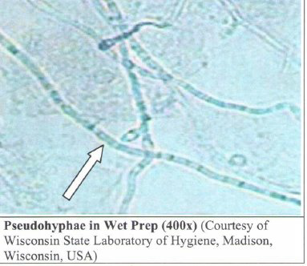
WET MOUNT
TRICHOMONAS

Slide 16
TRICHOMONAS-WET MOUNT

Slide 17
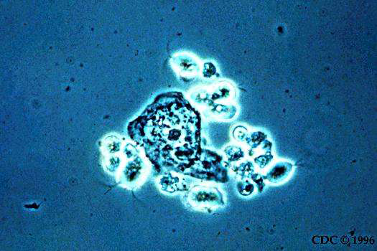
TRICHOMONAS

Slide 18
CLUE CELL

Slide 19
CLUE CELL – UNSTAINED SMEAR

Slide 20
PROCEDURE NITRAZINE PH PAPER (NP) TEST
Tear approximately 2 to 3 inch of NP
Either (a) dip the strip of NP into the speculum with the specimen or (b) saturate a cotton swab with the specimen and use it to moisten the NP strip.
Shake off any excess (fluid) specimen on NP strip onto gauze or paper towel.
Immediately place the NP strip against the NP color chart to compare the color change and read the matching pH color accordingly.
Document result in pH chart along with microscopic test result.

Slide 21
DOCUMENTATION
Record the result of the microscopic exam in the patient’s EHR as follows:
Under Genitourinary exam/pelvic/check off wet prep with KOH/PH test if done and in comments, document:
– KOH Prep: negative or positive for fungi
– Wet mount: identify clue cells or organisms seen or negative if none seen.

Slide 22
UNIVERSAL PRECAUTIONS
Always observe departmental universal precautions at all times.
Wear gloves and protective barriers as needed and if required.
Follow established protocols to properly dispose of contaminated wastes and materials.

Slide 23
MICROSCOPE MAINTENANCE
After each use, the clinician should use lens paper to clean the lenses.
Clean any residue from the objectives with an alcohol prep pad.
Clean the eyepiece and objectives with lens paper or lint free tissue. Do not use facial tissue or toilet paper.
Clean the arm, table and base with recommended alcohol wipes, or germicidal disinfectant.
Maintain the cleaning record at the unit with the initials of the person performing the cleaning.

Slide 24
NEXT STEP
Take AND PASS the test.
Your learning file on Medtraining.org will have a record of your on-line training permanently. This can be accessed by your Department as proof of training.
Thank you

