Slide 1
Refrigerator/Portable, Freezer and Platelet Incubator
QC/Maintenance

Slide 2
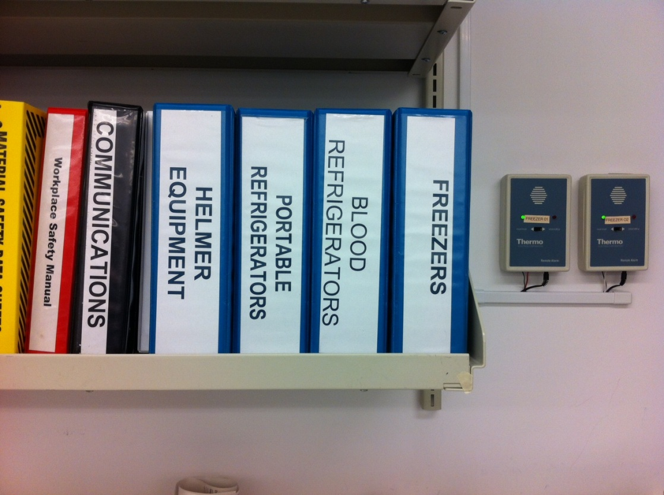
Daily-
Record temperatures for each piece of equipment with corresponding form located in teal binders on the shelf next to freezers.

Slide 3
Daily-
Recording daily temperatures should include digital temperature, chart reading, and two internal temperatures, with the exception of portables (one internal) and platelet (control temperature).

Slide 4
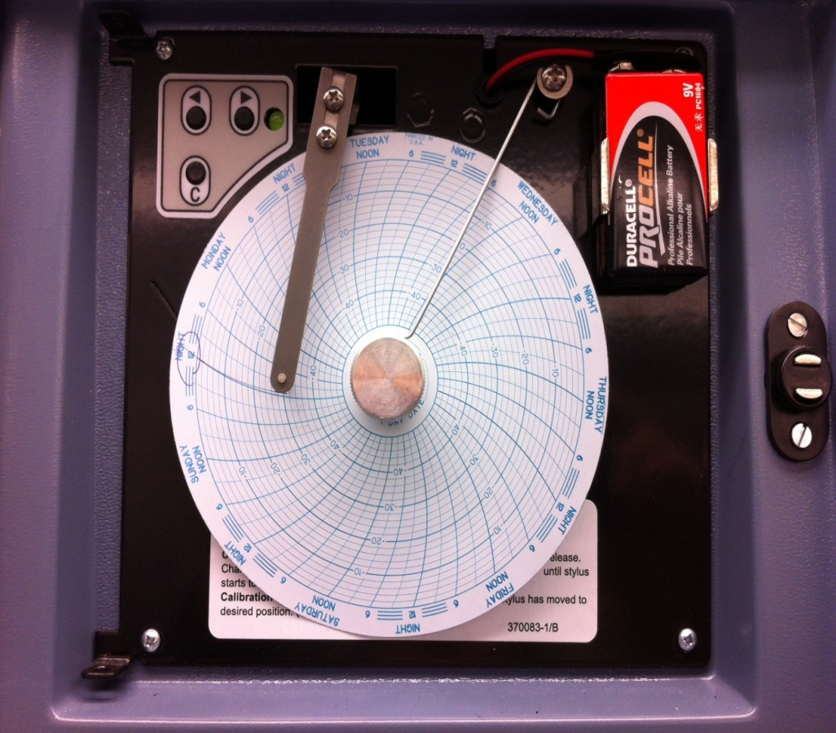
Prior to recording temperatures, ensure chart recorder is working by verifying date and time on the chart; LED green light should be steadily lit.
After documenting temperatures, test the alarm and record, with the exception of the platelet incubator and ultra low freezers.

Slide 5
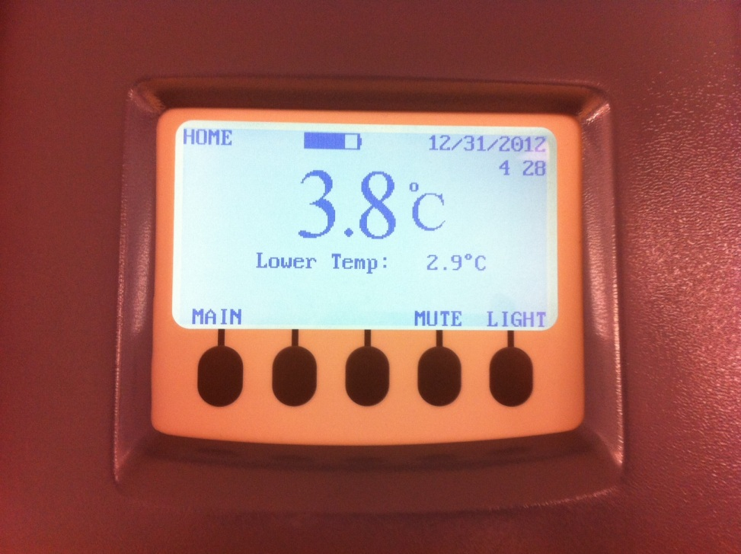
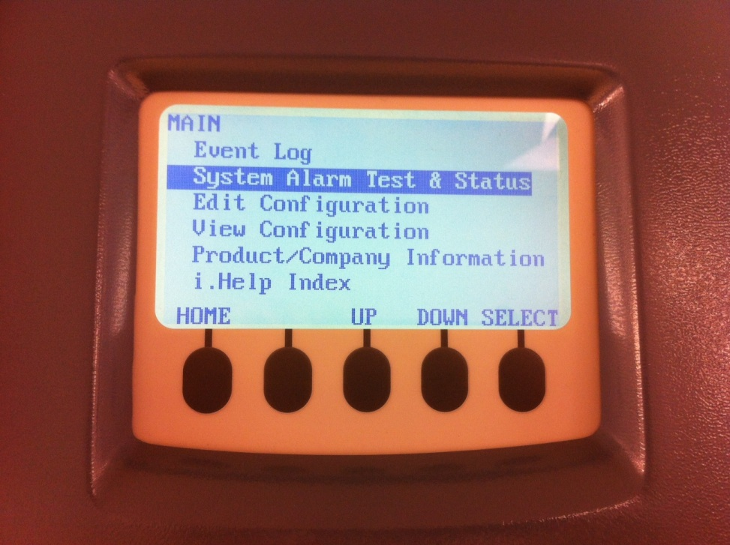
New Freezers and Refrigerators
Press the Down button to highlight the System Alarm Test & Status, press select.
Press the Main button on the far left.

Slide 6
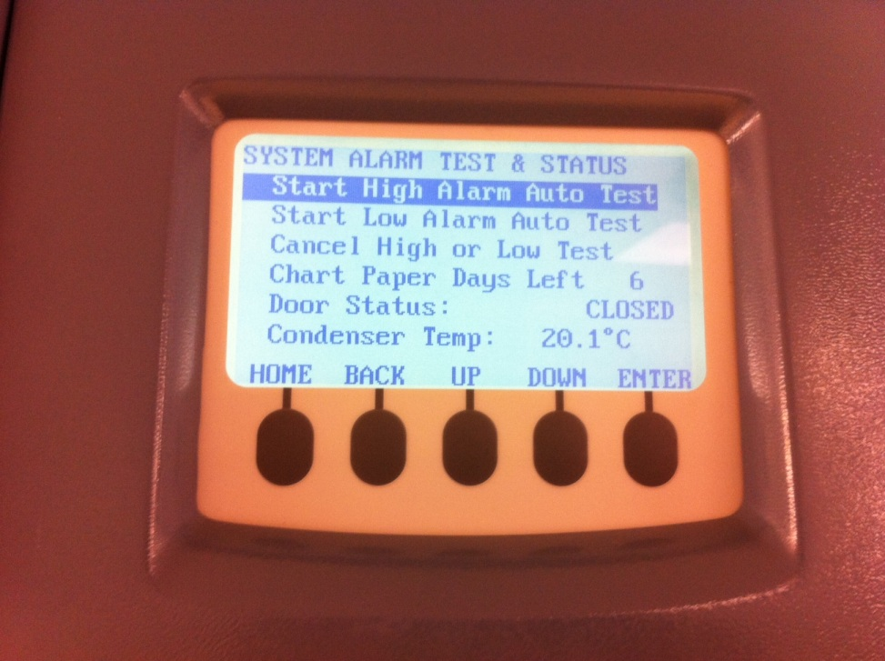
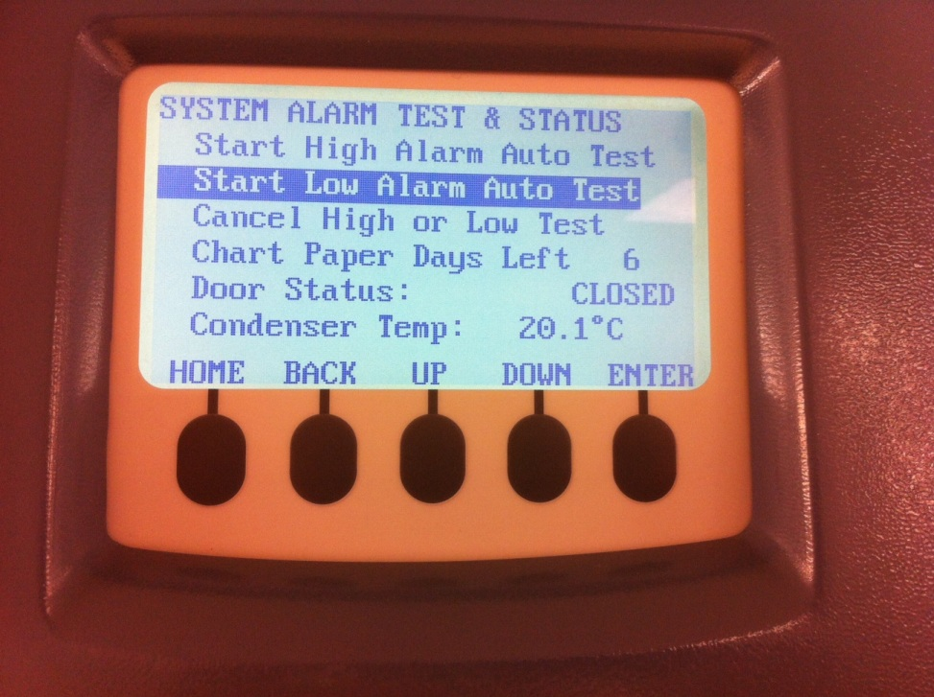
New Freezers and Refrigerators
The Start High Alarm Auto Test will be highlighted, press the Enter key and allow the unit to perform test. Alarm will sound when finished.
Perform functions 1-3 and highlight Start Low Alarm Auto Test instead of high to complete.

Slide 7
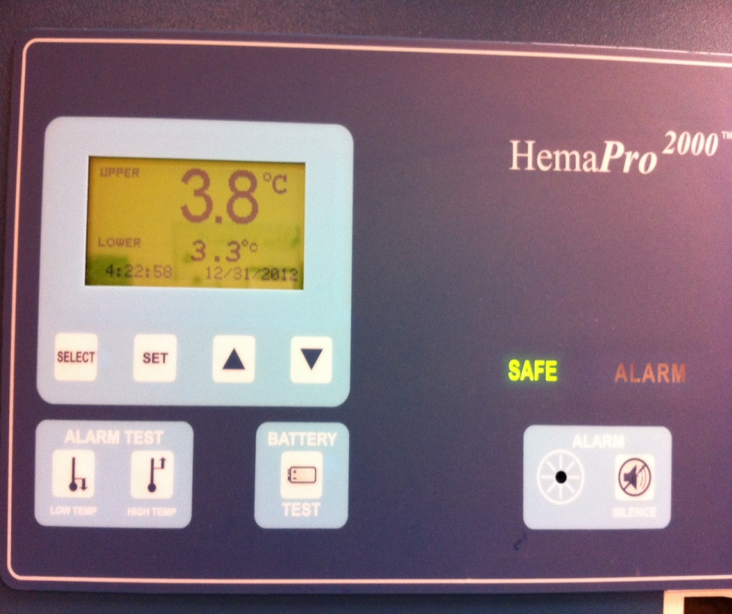
Old Refrigerators
Press the Battery Test button located underneath the digital temperature.
Once the Alarm sounds and the Alarm lights in red press the silence button.

Slide 8
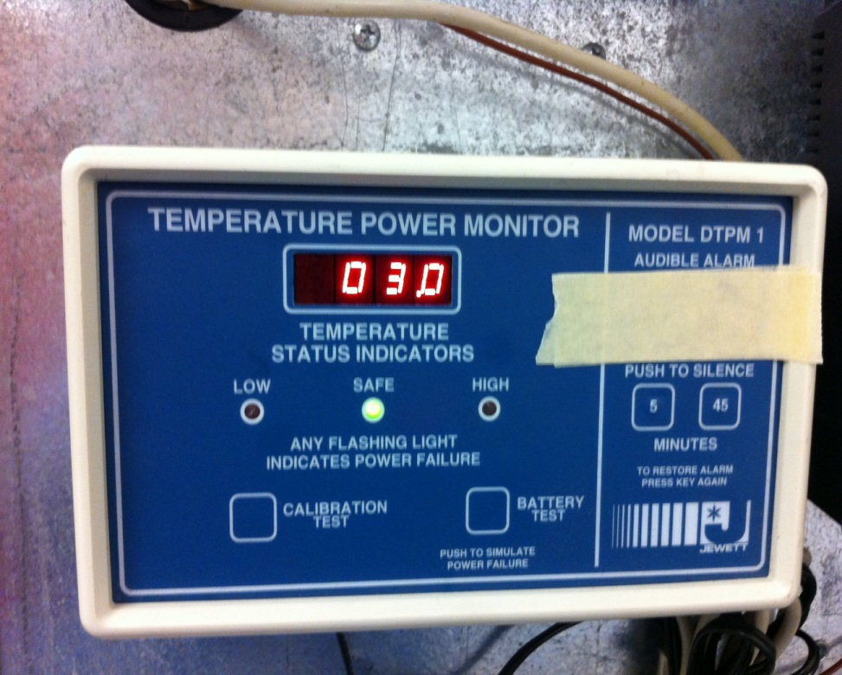
Portable Refrigerators
Press Battery Test button located underneath digital temperature to ensure the alarm sounds.
Press the 5 button to silence the Alarm.

Slide 9
Temperature Ranges
Refrigerators/Portables 1-6 C +/- 2 C
Freezers below -18 C
Tissue Freezers below -65 C
Platelet Incubator 20-24 C +/- 2 C

Slide 10
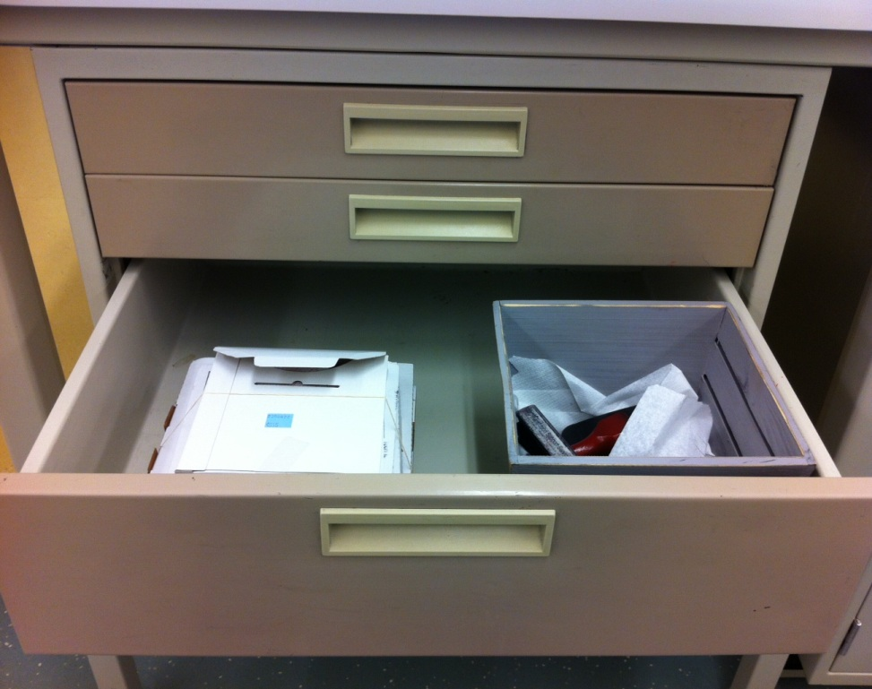
Weekly-
Change Charts every Sunday at Midnight-
Before changing charts locate new charts in 3rd drawer down on right hand side of read back table.

Slide 11
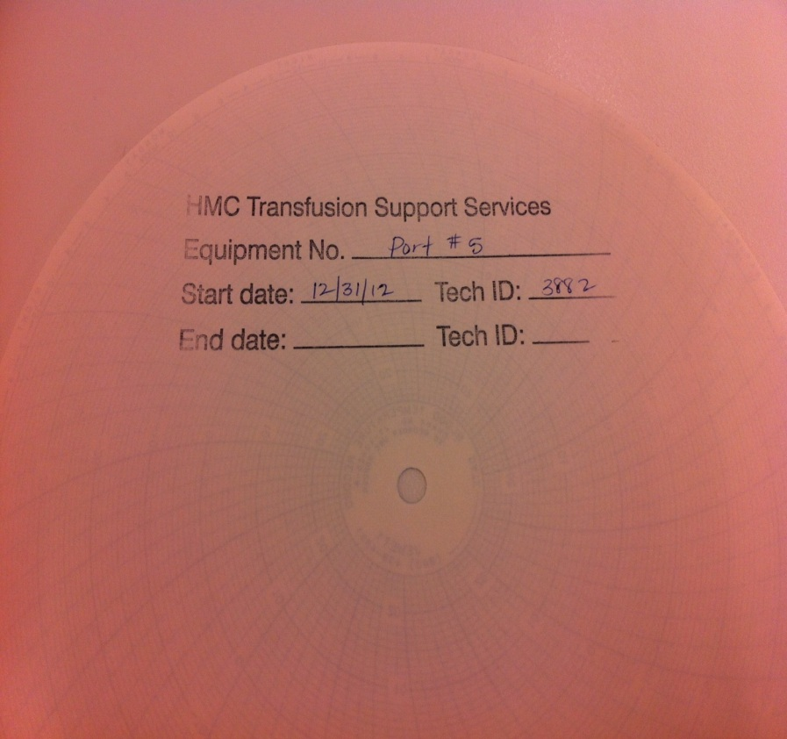

Obtain corresponding charts for each piece of equipment and stamp the back filling out the unit, start date, and tech ID.
Push number 3 or C to retract marking pen.
Unscrew chart if applicable.

Slide 12
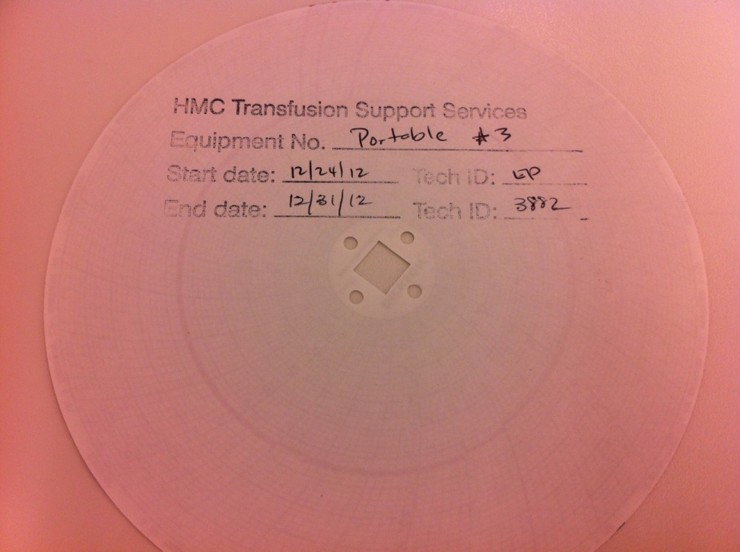
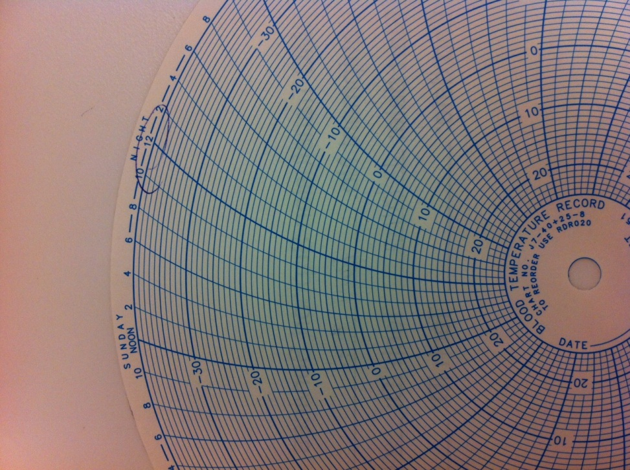
Remove chart, place stop date and tech ID on back (insert chart in teal binder with corresponding unit).
Before placing new chart, circle Sunday night, 12 and align with groove (set point) before tightening bolt, finger tight only.

Slide 13
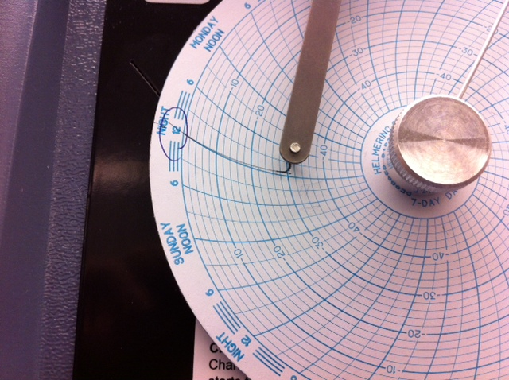
Press number 3 or C to reset marking pen, making sure the temperature coincides with the digital.
After 2-4 hours check to ensure chart is moving and pens are recording, while recording temperatures.

