Slide 1
Reagent and Supply Receipt
Quality, Practicality, QC, and Package Inserts

Slide 2
Reagents
Gotta have ‘em
Need them to be in date
Need sufficient quantity without outdating
Need the manufacturer’s package insert
SOPs, QC, and Test Performance need to match the Manufacturer’s instructions
Must keep a record of lot number receipt

Slide 3
Reagent and Supply Quality Plan
SOPs pertaining to Reagents and Supplies
1400-1: Management of Services and Supplies
1704-1: Inspection and Evaluation of Critical Supplies, Services, and Products
1706-1: Supplier Recall of Nonconforming Products

Slide 4
Additional SOPs
Critical Supplies and Services – Reagents and Supplies list
Specific reagents, supplies and their sources
4001-2: Reagent Receipt Process
4002-1: Package Insert Review

Slide 5
Lot Numbers and Package Insert Versions
The Reagent Receipt Record

Slide 6
Lot Number Tracking
Supplies: Tubes, Saline, Pipets, Alcohol Swabs
Do not track lot numbers on receipt records
Saline cube lots are recorded on Cell Washer QC form
Other Supplies: lot number recorded if used for component processing
Quantity received recorded on Blanket/Standing Order sheets
Testing Reagents
Tracked on
Receipt Record form
Manual QC records
TANGO QC printout

Slide 7
Quality Plan and Reagent Receipt Record
Plan says TSL will:
Track lot numbers
Identify lot numbers to be recalled
Review Package inserts and make revisions as indicated
Reagent Receipt Record
Lot numbers recorded
Package insert numbers recorded and reviewed

Slide 8
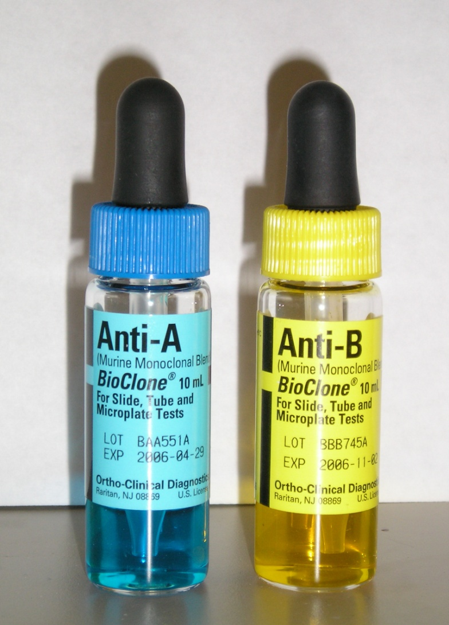
But Package Inserts are…
Not Lot Specific
So…
How do you connect …
Package Insert
For
Anti-A
Ortho Clinical Diagnostics
e631222758
?

Slide 9
Match Lot Number to Package Insert
Reagent Receipt Record
Lot number
Package Insert number
Package insert in page protector
Reagent Box
Package Insert in box
SOPs
Reagent use described in SOP
Reviewed and revised when new insert version received

Slide 10
What if…
Reagent is no longer in the original box with its package insert and there is no SOP covering testing method?
Trust your memory for incubation time, temperature, and phase of testing
Not Recommended especially if you haven’t used the antisera recently so you…
Hope the package insert number is written on the Reagent Receipt Record

Slide 11
And if it isn’t???
But there is a package insert in the page protector
Check receipt date against package insert version date
Packing Lists in the filing cabinet by supplier have receipt date if it isn’t on the box
Receipt later than revision date – OK to use
Receipt earlier than revision date – Quarantine reagent
Complete a QIM
Follow up with manufacturer’s Tech Support

Slide 12
Purpose of Reagent Receipt Record
Record of lot numbers in case of manufacturer recall.
Connect lot number to package insert.
Record of new version review prior to putting reagent into use.
Record of entry into RCAid, if applicable.

Slide 13
Annual Reagent Review
Every January 1st
Start new Reagent Receipt Records
All lot numbers currently in the lab are recorded
Write “In Use” for receipt date
Package insert numbers are recorded
Old package inserts removed and sent to Archive
Missing package inserts located
Current package inserts are in the page protector
Do we have to do this on 1/1?
No, but an annual audit is part of a Quality Plan

Slide 14
Inventory Ordering and Receipt Basics
Part of a Quality Plan for Patient Safety

Slide 15
Inventory and Storage
Ordering Happens…
Write it on the whiteboard
Weekly Count – 1st shift
Check for outdated reagents
Called in on blanket orders
Place order in Purchase Path
Jimmy, Roxann, Gie, Brenda
Borrow from PSBC in the worse case scenario
Storage Upon Arrival…
Fresh in the back
Oldest in the front
Stored per manufacturer’s instructions
Avoid prolonged periods out of temp range

Slide 16
Receipt
Time stamp and add Tech ID to packing list
Copy of packing list goes in Purchasing envelope (Mail organizer)
Count number received and match to packing list
Add Date Received and Tech ID to each container
Inspect packaging and a random number of reagent bottles
Quarantine unacceptable reagents or reagents waiting for a new package insert version to be reviewed

Slide 17
Standing Orders
Reagent Red Cells are on standing order – Manufacturer only makes what they pre-sell
Delivery schedule in Order Notebook
New Lots
Screening cells, Reverse Typing cells, Control Cells, QC Kit:
Separate as New Lot Do Not Use
Place Screening Cell antigram in Antigram Notebook
Panels:
Go directly into service
Antigram is placed in Antigram notebook

Slide 18
Supplies
Items on Standing Order
Pipets
Culture Tubes
Saline
Type Segments
Receipt is recorded on Standing Order form
Saline lot number recorded as used on the Cell Washer QC form
CAP requirement: each container has received date

Slide 19
How do we decide to record and track Lot Numbers?
Reagents used for testing must be tracked
Supplies used for processing where functionality cannot be assessed must be tracked
YES
Alcohol swabs if used for a sterile process
Saline used in cell washers and squirt bottles
NO - Transfer Pipets – you assess function with every drop
________________________________________________
Question: If we used sterile transfer pipets, would we need to record the lot number in use? YES because sterility cannot be assessed

Slide 20
Quality Control
A Few Reminders

Slide 21
FDA has their say…
Day of Use is the minimum
Some reagents require controls run in parallel
Sickledex Kit
Positive: heterozygous antigen or weak antibody best, if possible
Negative: antigen negative or inert solution like albumin or Seraclone control

Slide 22
Reagents NOT QCed Automatically Each Day
QC required if reagent is used that day
A2 cells
Anti-C3b, -C3d
C3 coated control cells
PEG
How would you QC A2 cells?
Confidence Antibody and Seraclone Control

Slide 23
Reagent Limitations and Expectations
Package Insert Details

Slide 24
Limitations
Every Reagent has them
FDA requires Limitations be listed in the Package Insert
Quality Assurance requires that YOU:
Know the limitations which are not in the SOP
Know the difference between manufacturers
Respect them in your testing and interpretation of test results

Slide 25
Example: anti-D reagents
BioRad
Any delay in reading and recording may result in weakened / false negative reactions
Clot tube: test within 10 days
IAT phase of testing required to detect weak D and D category VI antigen
Not validated for use with enzyme treated cells
Ortho
May stand up to 15 minutes at RT prior to centrifugation
Clot tube: test within 14 days
Weakened expressions of D antigen may show varied reactivity as compared to other anti-D reagents

Slide 26
Example: BioRad anti-S
Stability
Should be read immediately and results interpreted without delay.
Delay may result in false negative or more often weak positive reactions
Limitations
False negative may occur with
TSEN+, S+ red cells
Cells exposed to bleach
False Positive may occur with
Antibodies to antibiotics
Autoantibodies
Cold antibodies

Slide 27
Example: Anti-Jka
BioRad
RT incubation for 15 minutes
Centrifuge 1 minute
Immucor
IAT test method
15 to 30 minutes at 37ºC

Slide 28
Example: Anti-M
Quotient
Washed at least 1 time
Resuspended in UNBUFFERED Saline
Located at the TANGO
Do not use the bench saline
Why UNBUFFERED?
Optimal pH is 8.5
Extremely sensitive to pH
Other Limitations
Higher incubation temperatures yield weaker results
Test fresh samples. Antigen strength may decrease with storage of EDTA and clot samples (donors are in CPD)

Slide 29
Summary
Reagents are open to use and abuse
Review how you use and, possibly, abuse them
Apply our Quality Plan to reagents and supplies
Improve Patient Safety every day through your knowledge of reagents

