Slide 1
Transfusion-associated Graft versus Host Disease (TA-GvHD)
Nancy Chong

Slide 2
What is TA-GvHD?
Is a rare complication of blood transfusion
Donor T lymphocytes attack the recipient’s lymphoid tissue.
Normally, Donor lymphocytes are identified as foreign and destroyed by the recipient’s immune system.
However, in this situation where the recipient is immunocompromised, the recipient’s immune system is not able to destroy the donor lymphocytes.

Slide 3
Risk Factors
Immunocompromised individuals:
Bone marrow transplant patients
Chemotherapy patients
Radiation therapy patients
Fetuses and newborns
Heart, lung and liver transplant patients
Non-immunocompromised individuals:
Recipients with same haplotype as the donor (genetically similar)
Blood relatives of the donor
Did you know that 100% of WBC containing blood components in Japan are irradiated?

Slide 4
Facts
TA-GVHD follows 0.1–1.0% of transfusions in susceptible recipients
However, the mortality rate of TA-GVHD is 87–100%
The most common causes of death in TA-GvHD are infections and hemorrhages secondary to pancytopenia (reduction in RBC, WBC, and PLT) and liver dysfunction

Slide 5
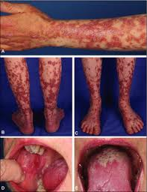
Symptoms
Fever
Rash
Toxic epidermal necrolysis
Cough
Abdominal pain
Vomiting
Profuse diarrhea

Slide 6
Diagnosis
May be difficult due to rarity in occurrence and overlapping clinical features with various infections and drug reactions
Laboratory manifestations:
-Pancytopenia, abnormal liver enzymes, electrolyte imbalance (when diarrhea is present)
Biopsy of the affected skin
HLA analysis of the circulating lymphocytes

Slide 7
Treatment
No cure ☹ Only supportive care

Slide 8
TA-GvHD Prophylaxis
Irradiate the White Blood Cells!
Blood irradiation prevents donor lymphocyte replication by:
Atomic ionization
Free radical formation
DNA damage that is severe enough to stop cellular division

Slide 9
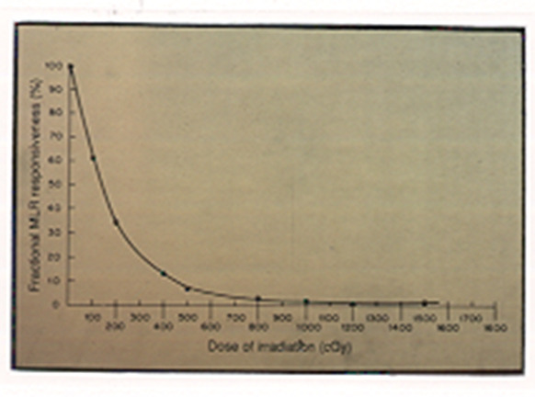
Radiation Effects on Lymphocytes
5 Gy:
Inhibit in-vitro proliferation in MLC
15 Gy:
In-vitro response to mitogens decreased 90%
25 Gy:
Clonal expansion is abolished
50 Gy:
In-vitro response to mitogens decreased 98%
FDA and AABB standard

Slide 10
Blood Product Inspection
http://www.ashland.com/products/rad-sure-blood-irradiation-indicators
Product Description
RAD-SURE sticker

Slide 11
Effects on the other blood cells
RBCs:
Intracellular potassium loss
Increased free Hgb levels in supernatant (Hemolysis)
Cell viability shortened
28 days
OR
Original Expiration, if less than 28 days
Platelets:
No qualitative or quantitative changes up for doses up to 50 Gy

Slide 12
Questions
Why don’t we irradiate plasma and cryo?
Why doesn’t leukoreduction take care of the problem?
Why aren’t the Pediatric Trauma RBCs irradiated?
Is it bad to give the short dated irradiated RBCs to any patient (inventory control)?

Slide 13
Let’s discuss!
How can we improve our process to “not miss” the LKR, IRR attributes?

Slide 14
Answers
Why don’t we irradiate plasma and cryo? These are acellular products – no white blood cells
Why doesn’t leukoreduction take care of the problem? There are sufficient remaining lymphocytes to cause TAGVHD.
Why aren’t the Pediatric Trauma RBCs irradiated? High potassium in irradiated units can cause cardiac arrhythmias. Physicians would rather deal with the rare chance of TAGVHD than a heart stopping. We can order FRESH irradiated RBCs if needed.
Is it bad to give the short dated irradiated RBCs to any patient (inventory control)? No. Adult patients can deal with the high potassium.

