Slide 1
Recap
Anti-A | Anti-B | Anti-D | Control | Ac | Bc
4+ | 0 | 0 | 0 | 0 | 2+
Anti-A | Anti-B | Anti-D | Control | Ac | Bc
0 | 0 | 3+ | 0 | 4+ | 3+
Anti-A | Anti-B | Anti-D | Control | Ac | Bc
0 | 4+ | 3+ | 0 | 4+ | 0
Anti-A | Anti-B | Anti-D | Control | Ac | Bc
4+ | 4+ | 4+ | 4+ | 0 | 0

Slide 2
Agglutination Testing and Antibody Detection
Max Louzon, MLS(ASCP)^{CM}

Slide 3
Objectives
Describe the indirect antiglobulin test and its role in unexpected red cell antibody detection
Describe the process of performing an antibody screen using tube, gel and solid phase techniques
Outline the steps for producing antihuman globulin
Define the terms unexpected antibody and clinically significant antibody.

Slide 4
Objectives (cont.)
List causes of red cell alloimmunization
Identify potentiators used in antibody detection testing
Define prozone, equivalence, postzone
Discuss the purpose of IgG coated red cells in antiglobulin testing
List limitations of antibody detection techniques
Differentiate the stages of agglutination
Recognize the differences between a direct antiglobulin test and an indirect antiglobulin test

Slide 5
History
Notes:
Early research based on IgM and immediately visible agglutination. 1908 Moreschi first described the principle. 1945 Robin Coombs, Race, and Mourant outlined the procedure. Test is occasionally referred to as the Coombs test. AHG is made by injecting rabbits with human IgG

Slide 6
Expected Antibodies
Clinically Significant Antibodies
Notes:
IATs detect unexpected IgG antibodies. These can lead to hemolysis and reduced RBC survival. These originate through antigen exposure (transfusion, pregnancy) disease state, drugs, chemcials or parasites

Slide 7
IgM, IgG and RBCs
Harmening DM
Modern blood Banking and
Transfusion Medicine, 5th ed

Slide 8
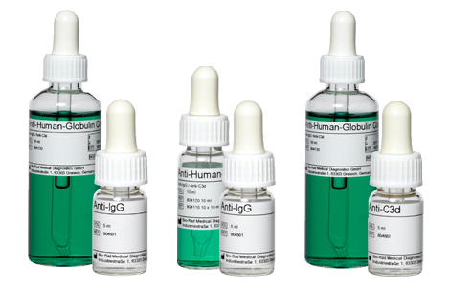
AHG Antisera
Picture from bio-rad.com
Notes:
AHG can be monoclonal or polyclonal. Directed towards immunoglobulins or complement system. Originally produced from animals; labs made their own. Now commercially made and purchased

Slide 9
AHG Reaction

Slide 10
Potentiators
Temperature
Time
Medium
Concentration
pH
Enzymes (?)

Slide 11
Prozone, Equivalence, Postzone

Slide 12
Zeta Potential

Slide 13
Enhancement
Standard saline incubation 37C – 30-60 min
LISS – Low Ionic Strength Saline
0.2% saline
Decreases negative repulsion (Zeta Potential)
Decreases incubation time to 5-15 min
22% Albumin
Also decreases zeta potential
Incubation time 15-60 min

Slide 14
Enhancement (cont.)
PEG – Polyethylene Glycol
Decreases water between RBCs
Decreased hydrophobic repulsive force
Brings cells closer together
Incubation time at 37C is 10-30 min

Slide 15
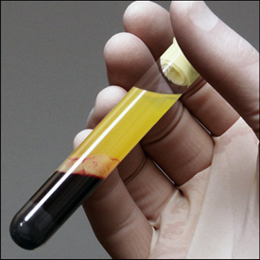
Indirect Antiglobulin Test Principle
Central question for IATs: does this patient have antibodies to antigens present on red blood cells?
Notes:
Patient sample is the unknown while the screening cells are the known. If antibodies are present, cells will be sensitized. This is an in vitro test and does not reflect patient status.

Slide 16
Tube Method
Patient plasma is incubated with screening cells in an enhancement media
Cells are than washed to removed excess IgG
AHG is added and sample is centrifuged
Test is positive if cells agglutinate
If no agglutination is seen, check cells are added and should agglutinate upon centrifugation
Check cells are sensitized RBCs

Slide 17
Was this a good wash?

Slide 18
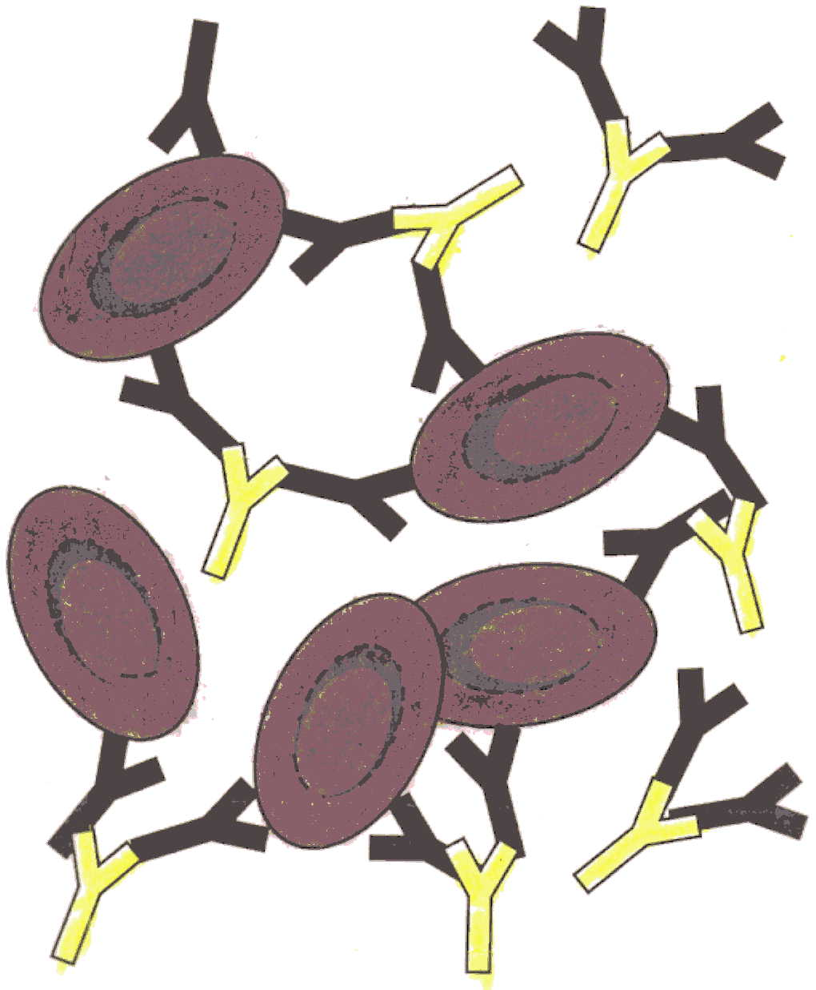

Slide 19
Check Cells
Also known as control cells, Coombs cells
RBCs coated with IgG antibody
Usually Rh pos RBC coated with anti-D
Also available in RBCs coated with C3
They are added to every AHG reaction tube with a negative result
They are a guard against false negatives
Bad washing, no AHG added

Slide 20
Check Cells (cont.)
Mixed field appearance
Checks will agglutinate, screening cells will not
Two different cell populations
Test is valid if CC agglutinate
If CC do not agglutinate
Bad washing
No AHG added
Test is invalid and must be repeated

Slide 21
Tube Grading

Slide 22
Tube Method Pros and Cons
Pro
Gold standard
Inexpensive
Flexible
Con
Labor intensive
Not stable

Slide 23
Gel
Patient plasma, LISS and screening cells are incubated in a microtube
Microtube is filled with gel which is laced with AHG
If cells are sensitized, red cells will be held in gel, otherwise will form pellet at bottom

Slide 24
Ortho Clinical Diagnostics
Raritan, NJ 10/01

Slide 25
Gel Pros and Cons
Pro
Smaller sample size
No cell washing step
Clear, stable endpoint
Sensitivity comparable
Can be automated
Con
Expensive
More false positive

Slide 26
Solid Phase
Patient plasma, LISS and screening cells added to microtiter well lined with Protein A which has a high affinity for Fc portion of AHG and incubated.
Wash
AHG added
Centrifugation
Graded via computer system.
Positive will show as cells lining entire well

Slide 27
Solid Phase Grading
Immucor Gamma
Norcross, GA 5/02

Slide 28
Solid Phase Pros and Cons
Pro
Reduced volume needed
Increased sensitivity
Less technique needed
Con
Learning curve
Expensive
Reagent expiration

Slide 29
Situations

Slide 30
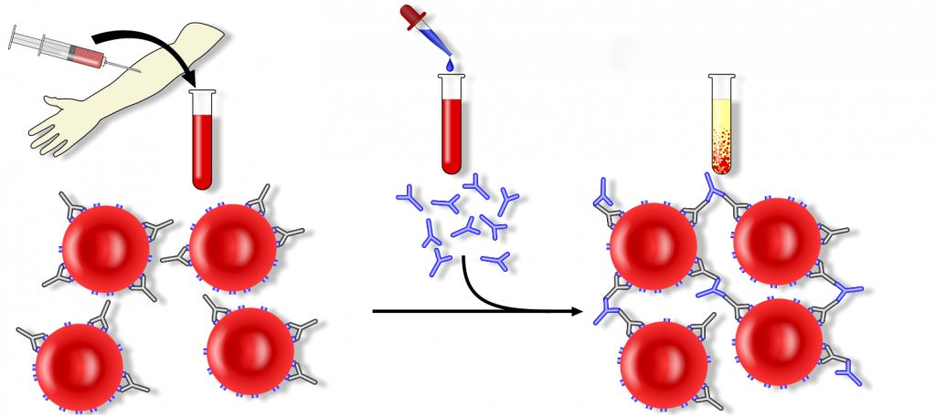
Direct Antiglobulin Test Principle
Central question for DATs : does this patient have antibodies or complement already stuck to their red cells?
Test Procedure: Washed patient red blood cells + AHG
http://www.pathologystudent.com/?p=1003
Notes:
Historically known as a direct Coombs test. When would this be positive?

