Slide 1
Immunohematology is all about…
Antigen: Known or Unknown?
Antibody(ies): Known or Unknown?
Where are they?
How did they get there?

Slide 2
ABO SYSTEM
ISBT 001
HISTORY, STRUCTURE & CLINICAL SIGNIFICANCE
Notes:
Our theoretical knowledge of Transfusion Medicine needs to begin with an understanding of the ABO Blood Group System. Its ISBT number is 001. The importance of A and B antigens and antibodies in transfusion cannot be overestimated.

Slide 3
Table of Reactions
KNOWN Antibody
Patient’s Red cells | Reaction with anti-A | Reaction with anti-B | Interpretation
1 | + | 0 | A
2 | 0 | + | B
3 | 0 | 0 | O
4 | + | + | AB
UNKNOWN Antigen
Notes:
Testing patient red cells for the presence of A and/or B antigen shows the above patterns. This is FORWARD TYPING; also known as CELL TYPING.

Slide 4
Table of Reactions
KNOWN Antigen
Patient’s Serum | Reaction with A cells | Reaction with B cells | Interpretation
1 | 0 | + | A
2 | + | 0 | B
3 | + | + | O
4 | 0 | 0 | AB
UNKNOWN Antibody
Notes:
Testing patient plasma or serum with reagent red blood cells with A or B antigen detects the presence of isoagglutinin – expected antibodies to antigens lacking on the patient’s red blood cells.
This is Landsteiner’s Rule: the reciprocal antibody is expected when the antigen is not present.

Slide 5
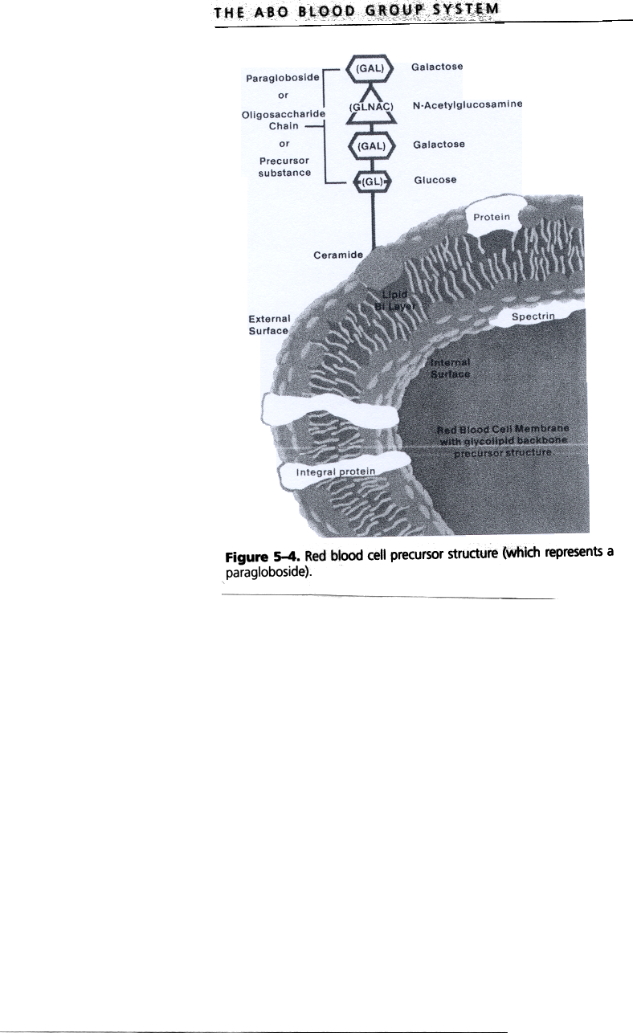
Structures – what are we detecting?

Slide 6
Amount of H Antigen
Reciprocal Relationship
Why do you care? People with more H have more RBC destruction in Cold Agglutinin Syndrome.
O > A₂ > B > A₂B > A₁ > A₁B
Greatest Least
Concentration Concentration
H H

Slide 7
A₁ and A₂ Phenotypes
Common Subgroups of A blood type
Both encode for same immunodominant sugar
A₁
  Sequence has proline at amino acid 156
  Produces an efficient transferase
  Converts almost all of H to A₁ antigen
  A₁ ≈ 1-2 million
  A antigen sites
  Agg. by anti-A, anti-A₁
A₂
  Sequence has leucine at amino acid 156
  Produces transferase with low substrate recognition
  Less efficient, less H converted
  A₂ ≈150,000- 500,000
  A antigen sites
  Agg. by Anti-A,
  Neg with Anti-A₁

Slide 8
A₁ and A₂
Both react strongly with Anti-A
  Routine testing does NOT differentiate
Distinguished by A₁ lectin (seed extract)
  Dolichos biflorus reagent (Anti-A₁)
  Agglutinates A₁ cells, neg with A₂ cells
  80% of A or AB persons are A₁ or A₁B
  20% are A₂ or A₂B
  Most to least H slide
    Who has more H antigen – A₂ or A₂B?
A₂ kidneys successful in group O recipient
Notes:
D. Biflorus = aka “Horse Grain” or “Poor Man’s Pulse.” The plant is a twining legume found in Africa and India.

Slide 9
Your Turn
Interpret these reactions:
  Anti-A = 0
  Anti-B = 0
  A₁ cell = 4+
  B cell = 4+
  Blood Group: ___________
Anti-A1 lectin = Not indicated
Anti-H lectin = 4+
A2 cells = 4+
O cells = 0

