Slide 1
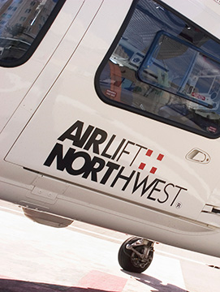
Airlift Northwest
Blood Coolers for ALNW -Boeing

Slide 2
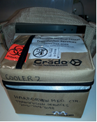
Blood Cooler
Credo Cooler contains
2 units of RBC (O NEG)
2units of liquid plasma (AB or low titer A)
Data logger- tracks temperature of blood products inside the cooler
Each cooler can carry up to 4 units maximum
Cooler with blood must be stored at 1-6C when not taken on flight

Slide 3
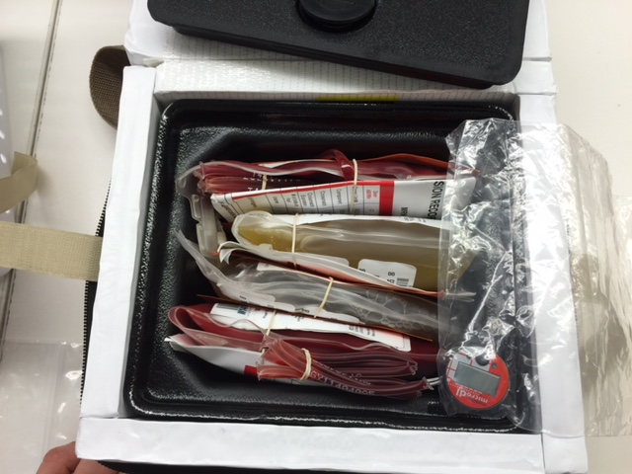
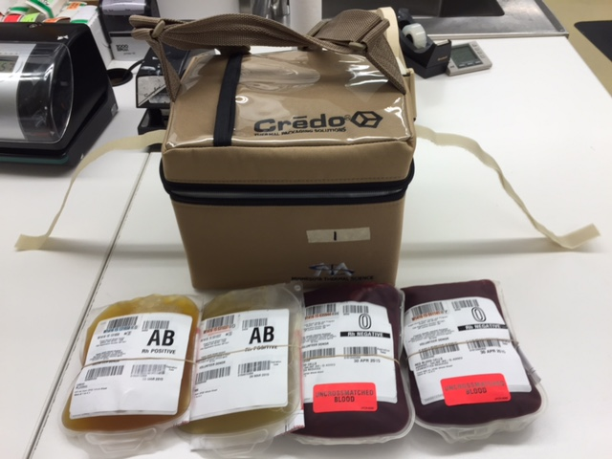
Contents and Packaging
Data Logger
Recording temperature in the Credo Cooler
Data downloaded at HMC TSL
Verifies storage within acceptable range
Allows return of units to inventory (or discard if out of range)

Slide 4
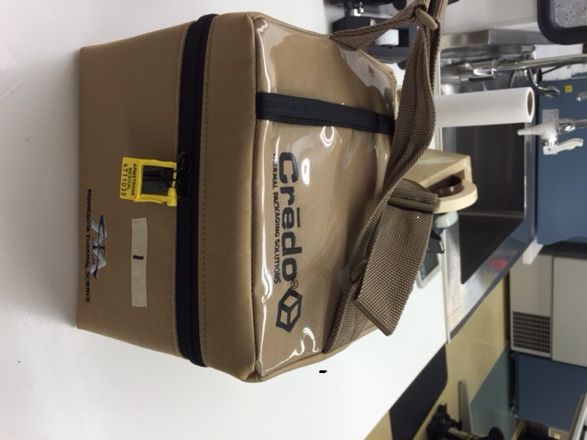
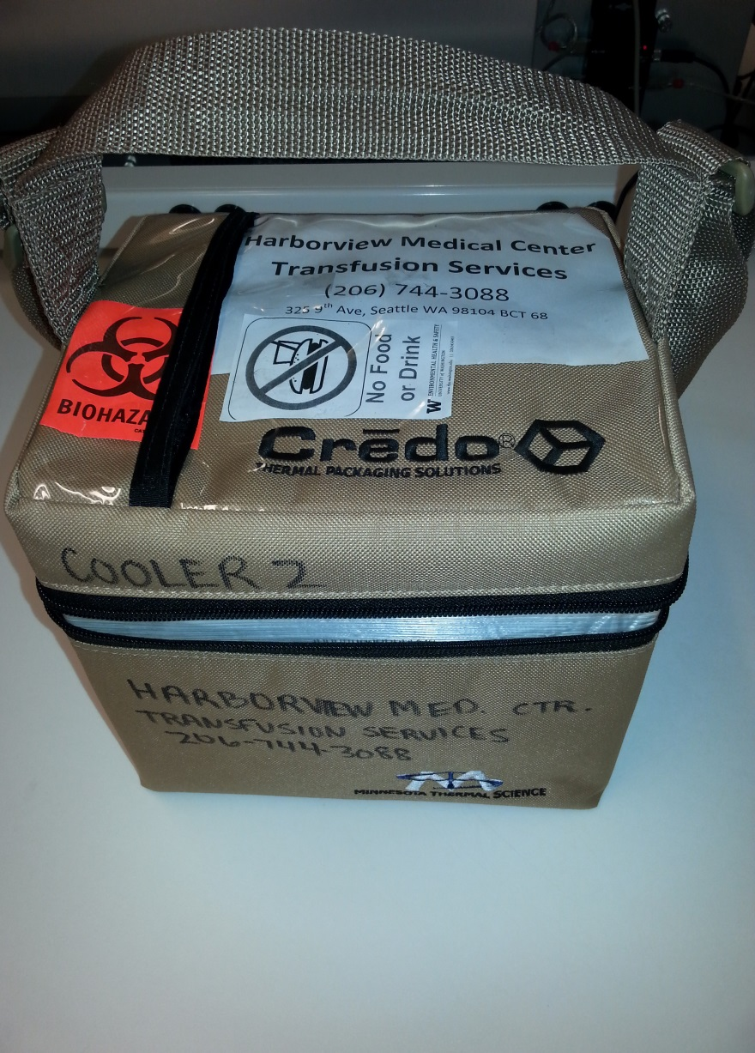
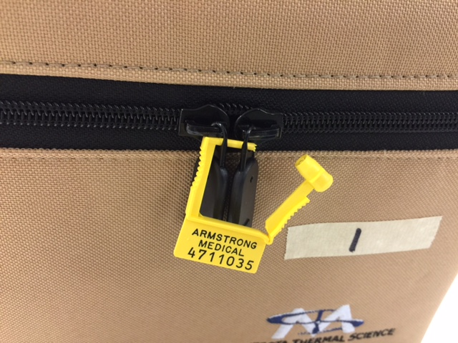
Loaded
and Locked!

Slide 5
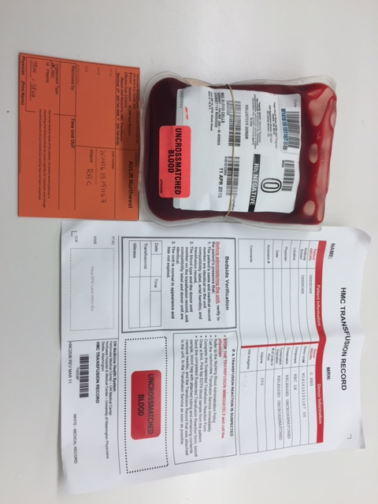
Each unit will have:
HMC Transfusion Record
ALNW Unit Record (orange)

Slide 6
HMC Transfusion Record
Will need patient medical record # and name
Unit information:
Donor ABO/Rh
Component- RBC or Plasma
Crossmatch- Released Uncrossmatched
Crossmatch Expiration- Released Uncrossmatched
Volume- 350 or plasma volume

Slide 7
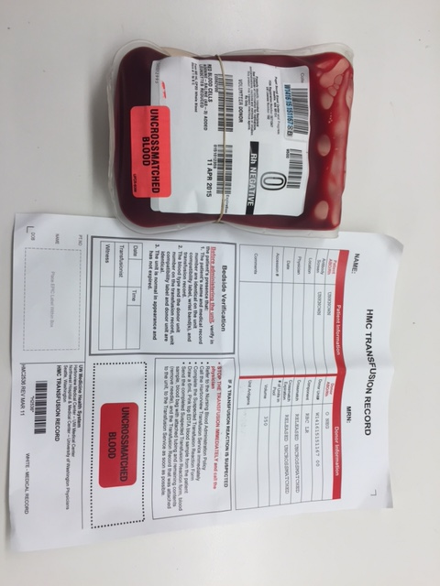

Slide 8
ALNW Unit Record
Needed for Transfusion Services to reconcile inventory and update patient records
ALNW staff must complete the following:
Record patient information
Removed by
Time unit removed from cooler
Physician name

Slide 10
Used Cooler Return to HMC TSL
Leave in the Credo Cooler
Unused units
Transfusion Records
Unit Cards
Data Logger
HMC TSL will process paperwork and units

Slide 11
Cooler Replacement
Routine schedule- Every Wednesday
If cooler is taken on a life flight and lock on cooler opened, call HMC Transfusion Services for pickup and delivery of next set
For patients coming to HMC, blood coolers can be delivered to Transfusion Services or call for pickup from emergency department

Slide 12
HMC TSL
Harborview Medical Center
Transfusion Services Lab- BCT 67
325 9th Ave. Seattle WA 98104
Phone: 206-744-3088
Fax: 206-744-6530
Contacts
Dr. John Hess (Medical Director)
Nina Sen (Manager)
Lead Technologist

