Slide 1
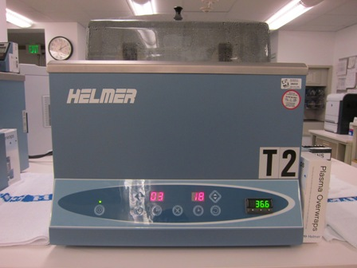
Plasma Thawer Maintenance and QC
Will add picture

Slide 2
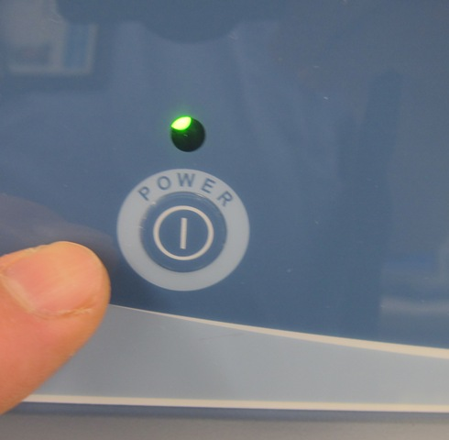
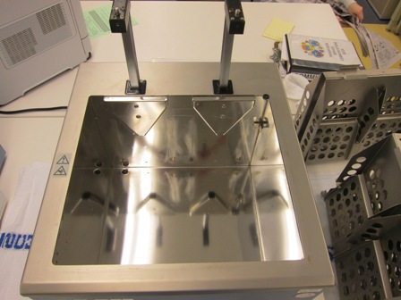
Weekly Maintenance
1.1 Clean the Chamber
1. Turn the power switch Off and Unplug the power cable before draining the chamber
2. Fully drain the existing water from the chamber bath.
CAUTION: It is a safe practice to wear PPE whenever cleaning blood bank equipment. Follow established laboratory procedures.

Slide 3
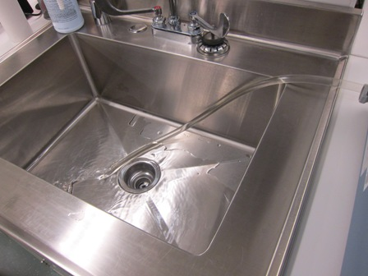
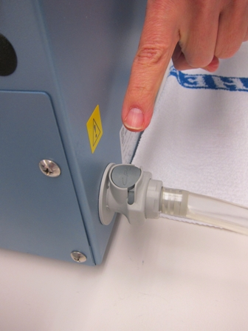
Drain the existing water from the chamber bath.
b. Push the other end of the drain hose with the coupling valve into the drain plug that is located on the left side of the unit towards the back, until it “clicks” securely in place. The chamber water immediately begins to flow out of the chamber until it is empty.
a. Place the open end of the drain hose securely into a sink or drain.

Slide 4
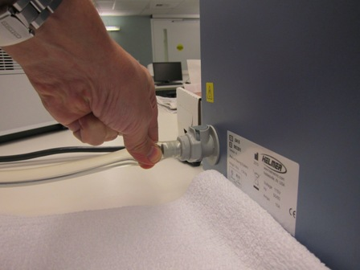
Weekly Maintenance
c. Squeeze the tubing just after the coupling and release to remove any air pockets, improving the speed of draining.
d. After the chamber bath has fully drained, press down on the button located on the top of the drain plug to disconnect the drain hose.

Slide 5
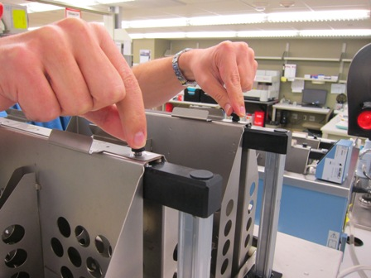
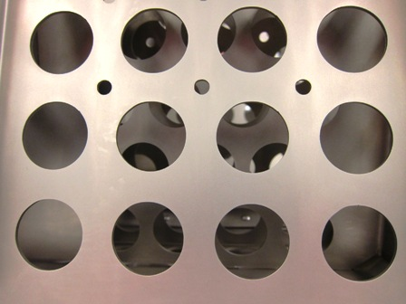
Remove the basket assemblies from the unit.
The two V-shaped stainless steel brackets located on the back wall of the chamber bath are held in place by two screws and may also be removed for cleaning when necessary
NOTE: Since the unit is an open water bath system, staining, discoloration and rust spots can occur as a result of various factors. These factors include quality of water used, regularity of cleaning, environment,
Using a soft cloth or sponge and a disinfectant compatible with stainless steel, thoroughly clean the chamber
bath walls and basket assemblies.
Note: If stains or discoloration remain after general
cleaning then use a general purpose stain, scale or rust remover compatible with stainless steel.

Slide 6
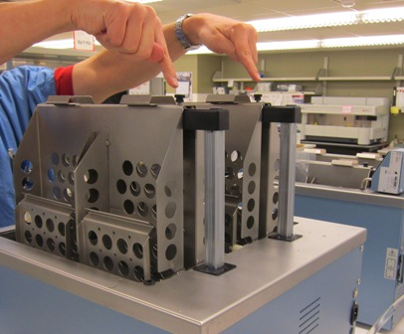
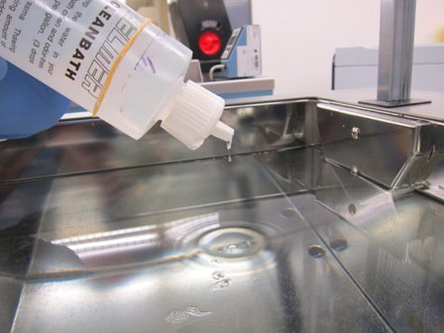
Installing the basket assemblies
Install the V-brackets previously removed.
Refill the chamber with warm water between the 2 lines and add the clean bath solution (96 drops).Mix the solution by running a thaw cycle for 10 minutes.

Slide 7

Quality Control

Slide 8
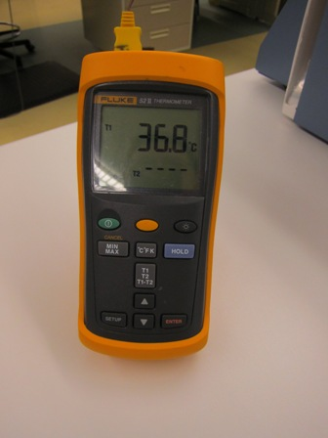
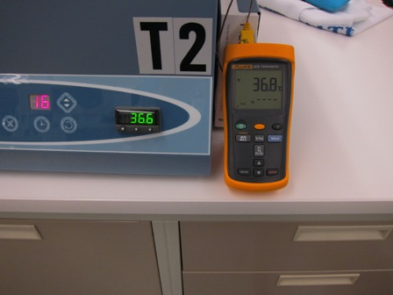
Monthly Temperature QC
Compare the thermometer reading against the display on the Temperature Controller. The Temperature
Controller needs to be calibrated if there is a temperature difference. A “difference” is defined as a
temperature variance greater than allowed by your department or facility policy.
Place a NIST traceable calibrated independent thermometer in the chamber and allow the temperature to
stabilize for at least 30 minutes.
NOTE: For example, if the “set” temperature is 36.5°C, the Temperature Controller reads 36.9°C, and the independent thermometer reads 36.6°C, a -.3 adjustment is necessary.(Fig 3-1)

Slide 9
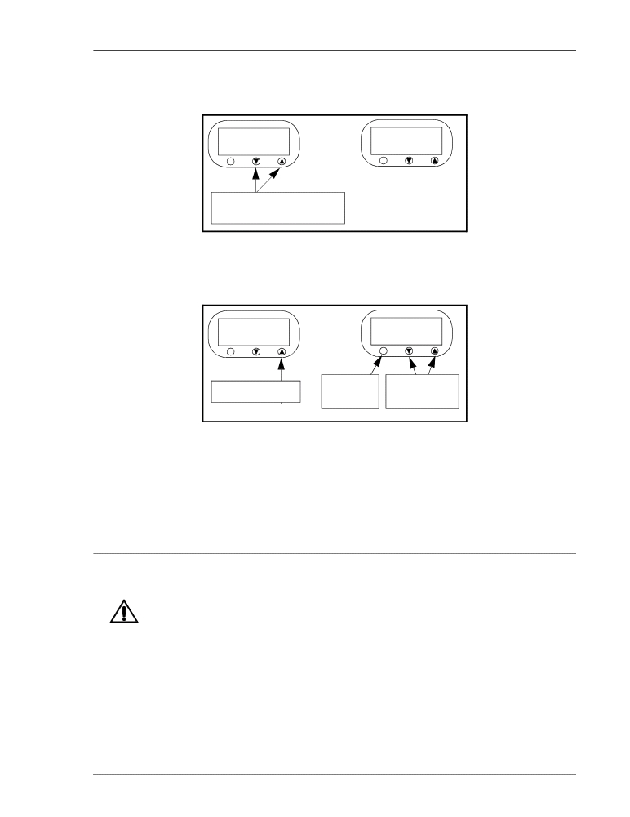
1.
Press and hold and ▲ at▼ the same time for 3 seconds. The display alternates between tunE and oFF.
This indicates you are in the program menu.
36.5
tunE
*
*
Hold together for 3
seconds
Figure 3-1. Accessing the Program Menu on the Temperature Controller
2.
At the tunE prompt, press ▲ until the display reads AL.HI. While holding *, use ▼and ▲ to set the desired
value.
AL.Hi
37.6
*
*
Press repeatedly
Press and
Use either to
hold set new value
Figure 3-2. Setting a New Temperature Alarm Setpoint
3.
If you wish to set a low alarm value, press the * button then press ▲ to display AL.Lo. While holding the *
button use the ▼and ▲ to set the desired low alarm setpoint value.
4.
To exit back to the main menu, release the * button and press and hold uand t simultaneously until the
operating temperature appears on the digital display.

Slide 10
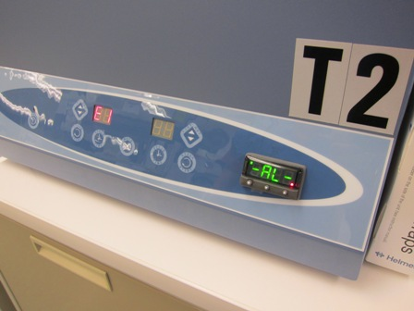
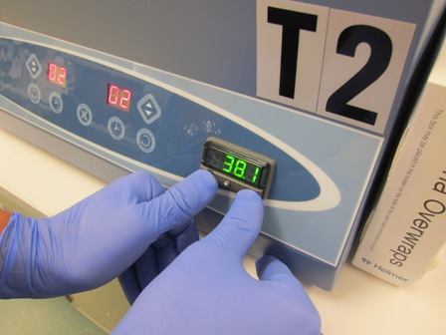
QUARTERLY HIGH ALARM TEST
Follow the procedure outlined in Fig 3.2, Temperature Alarm, to access
the AL.HI. menu.

Slide 11
1.
Press and hold and ▲ at▼ the same time for 3 seconds. The display alternates between tunE and oFF.
This indicates you are in the program menu.
36.5
tunE
*
*
Hold together for 3
seconds
Figure 3-1. Accessing the Program Menu on the Temperature Controller
2.
At the tunE prompt, press ▲ until the display reads AL.HI. While holding *, use ▼and ▲ to set the desired
value.
AL.Hi
37.6
*
*
Press repeatedly
Press and
Use either to
hold set new value
Figure 3-2. Setting a New Temperature Alarm Setpoint
3.
If you wish to set a low alarm value, press the * button then press ▲ to display AL.Lo. While holding the *
button use the ▼and ▲ to set the desired low alarm setpoint value.
4.
To exit back to the main menu, release the * button and press and hold uand t simultaneously until the
operating temperature appears on the digital display.

