Slide 1
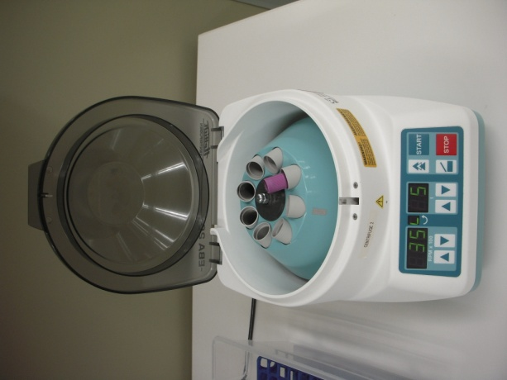
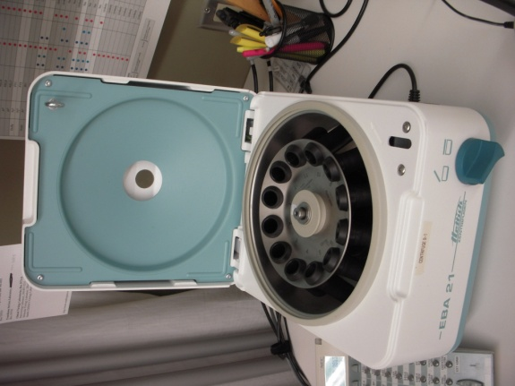
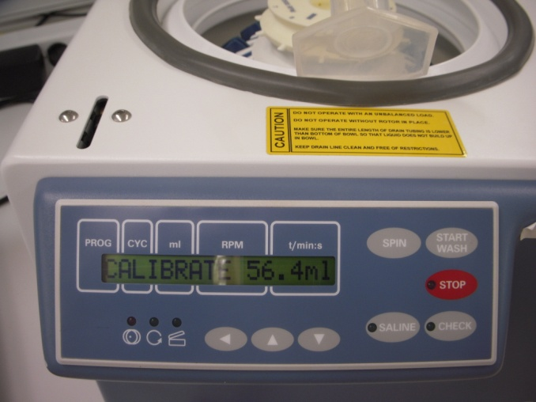
Serofuge and Cell Washer Operation and Maintenance

Slide 2
Basics
Centrifuges must be balanced before operation. NOTE: Balance tubes should be used for a limited time due to stress breakage.
Tach and Timer QC is performed by Scientific Instruments
Programmed settings must be checked prior to each operation cycle
Blood spills must be cleaned immediately

Slide 3
For All TSL Staff Let’s Get Started
EBA 20 Sample Centrifuge

Slide 4
EBA 20 Sample Centrifuge
Power Switch is on the back
START
Time
Speed
Red Stop Key
Open Lid button

Slide 5
Programming
Up/Down buttons allow changes in speed and time
TANGO samples
SOFT Spin to standardize robotic sampling
Setting is 35 RPM for 5 minutes
Manual Bench Testing
Any time and speed will do

Slide 6
EBA-20 Cleaning and Maintenance
Daily
Clean housing and surface
Mild (pH 5-8) soap and water
Green Top Sani-Wipes OK
Clean obvious blood spots immediately
Do Not use Purple Top Sani-Cloth wipes
Destroy plastics
Harm porous surfaces

Slide 7
EBA 20 Cleaning and Maintenance
As Needed
Remove rotor head
Wrench is stored in Fellowes black tool kit under Helmer Thawers
Clean with mild detergent.
Rinse with water
Check parts for wear and corrosion.

Slide 8
For MLS Staff Testing Bench Equipment
EBA 21 Sample Centrifuge
Ultra CW Cell Washers
Stat Spins

Slide 9
EBA 21 Testing Serofuge
Clean daily with mild soap and water or Green Top Sani-Wipes

Slide 10
Programmable
Serofuge Programs: Press UP/Down buttons
Program 1 Routine tube testing 2900 rpm / 20 seconds
Program 2 Buffered eluate 3400 rpm / 1 minutes
Program 3 anti-Jka (BioRad) recommends 1 min spin
2900 rpm / 1 minute

Slide 11
EBA 21 Serofuge
Head lifts out easily for rapid cleaning of spills

Slide 12
Emergency Lid Release – EBA 21
Lid May Fail to Open following a Power Failure:
Turn off Power.
Make sure rotor has stopped.
Turn off Power

Slide 13
EBA 21 Parts and Manual
Locate the pin driver in the equipment drawer under the SOP binders
Bright Orange Handle

Slide 14
Emergency Lid Release – EBA 21
Move the serofuge to the front of the counter and locate the emergency release hole.
(Not wise to tip the serofuge back this far except for illustration!)
Insert the pin driver, pushing upwards and at the same time rotate the lid-lock handle.
Open the lid.

Slide 15
Helmer Ultra CW Cell Washer
Programmable Serofuge and Cell Washer

Slide 16
Programmable
Serofuge Programs
SPIN 2900 20 seconds
Cell Washer Programs
Program 1 4 cycle wash
CLEAN program Weekly Decontamination
Other Programs
Program 2 - 5 Used for calibrations and for 10mm tubes

Slide 17
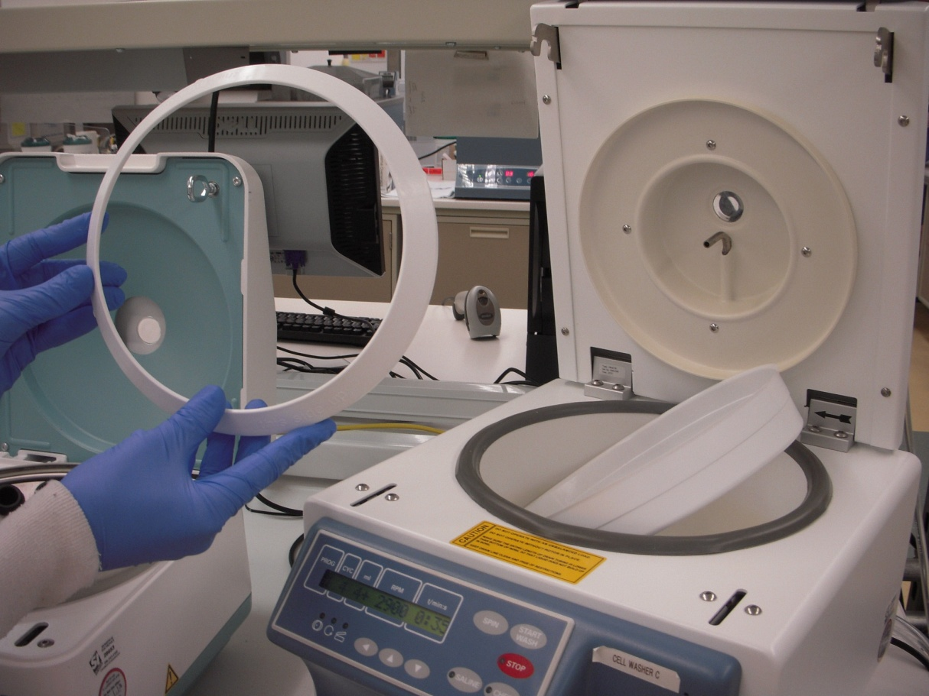
Daily QC
Inspect tubing and drain. Clear obstructions.
At Bench C and D, empty waste daily
Inspect tubing connections and secure
Clean and Dry interior after normal usage
Check Saline Volume Delivery

Slide 18
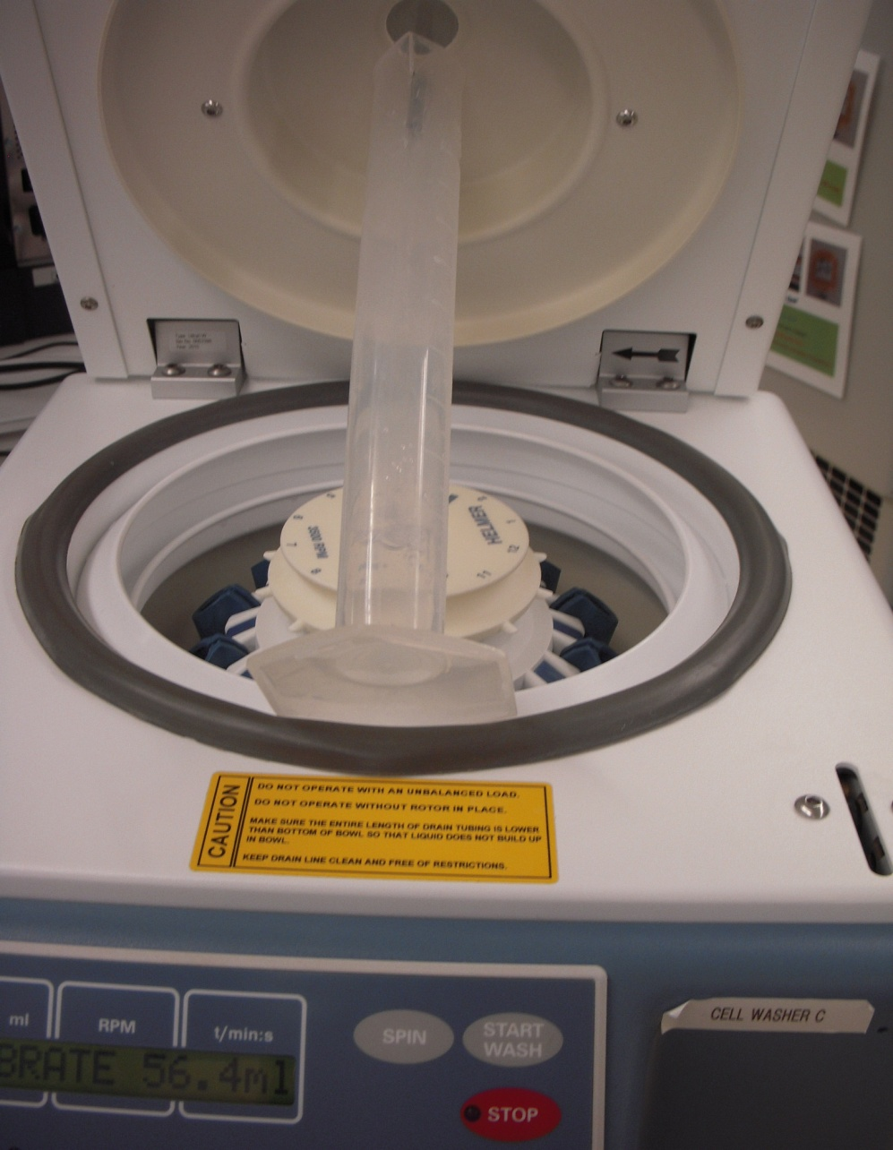
Saline Volume Delivery
Place volumetric cylinder under the saline spout.
Hold Saline button until CALIBRATE appears
Press CHECK until pump starts and saline is entering the cylinder

Slide 19
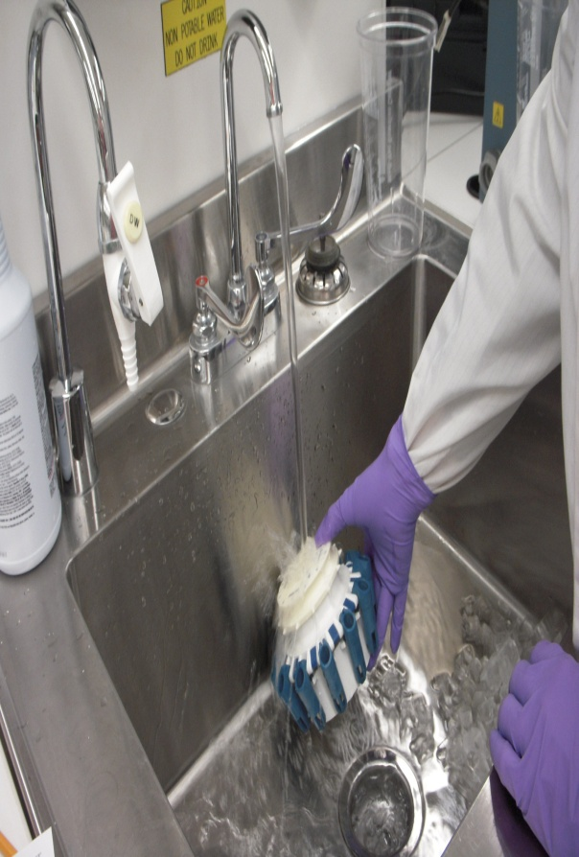
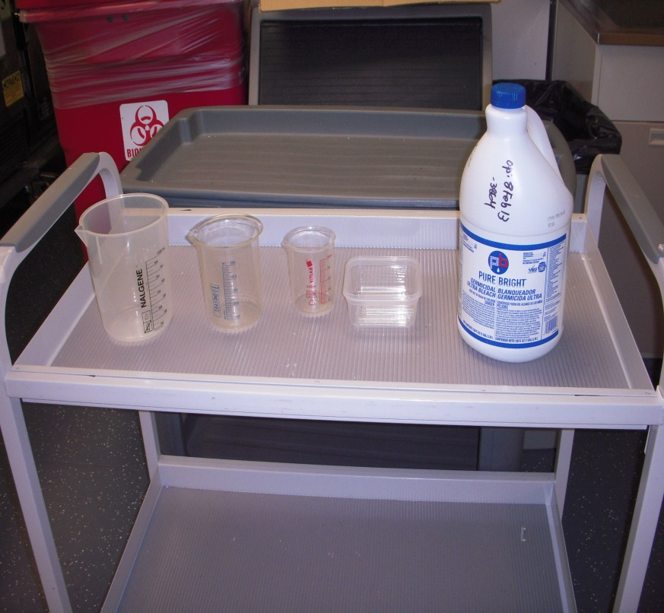
Weekly QC
Flush the system with 10% bleach
Clean the fill ports on the rotor
Why does the procedure call for
Tubes in every other tube holder during
CLEAN program?

Slide 20
Why are tubes required during Clean?
Tube contents are flunge out and up, cleaning the upper part of the bowl and lid with bleach solution.

Slide 21
Monthly QC
Inspect rotor for wear, corrosion and damage
Replace if indicated or at 5 years
Inspect tube holders for wear and damage
Replace if indicated or at 2 years
Clean the exterior

Slide 22
Annual QC
Replace supply and drain tubing.
Replace pump tubing

Slide 23
STATSpin Express 3
Speed is NOT adjustable
Used primarily for STAT Manual Testing orders
Not used for Eluates
Not Programmable
Buttons for 2, 3 or 5 minutes spin

Slide 24
Removing the Bowl
Large Hex required

Slide 25
Remove all Tube Holders 1st
Center ring screws off
After removal, head will lift out.

