Slide 1
Extracorporeal Life Support (ECLS) at HMC

Slide 2
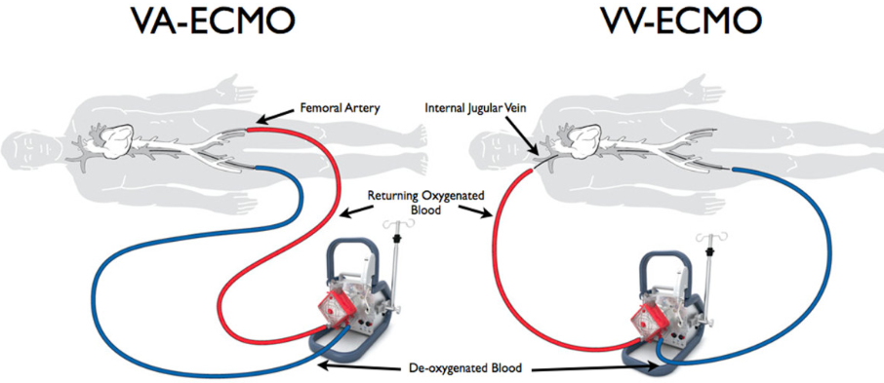
Extra-Corporeal Life Support (ECLS)
Allows provision of either cardiac & pulmonary (VA) or pulmonary (VV) support in patients with severe cardio-pulmonary failure

Slide 3
ECLS Technology
Veno-Arterial (VA) ECMO
Provides both cardiac and pulmonary support
Indications:
Severe cardiac failure/refractory cardiogenic shock/septic shock
Post cardiac surgery support
Full arrest support (E-CPR)
Massive pulmonary embolism
Hypothermic cardiac arrest (exposure)

Slide 4
ECLS Technology
Veno-Venous (VV) ECMO
Emerging mode providing only pulmonary support
Indications:
Severe/refractory hypoxemia or pulmonary failure (P/F < 80-100)
ARDS secondary to sepsis, trauma or burns
Severe pulmonary infection (bacterial or viral)
Smoke inhalation
Severe pulmonary injury/broncho-pleural fistulas

Slide 5
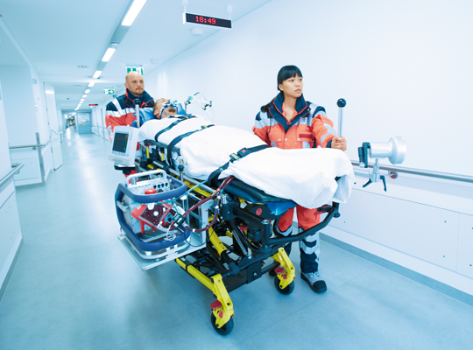
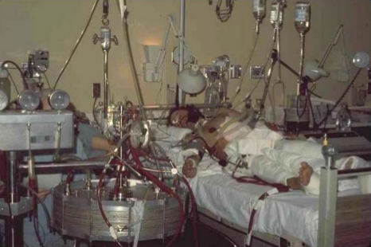
ECLS Technology
Changes in catheter access and pump technology are expanding the indications for this therapy
Pumps are now manageable by specially trained ICU Nurses or Respiratory therapists

Slide 6
ECLS
Treatment Strategy for all ECLS is allow time for healing or bridge to a device
VV Pump times for respiratory failure are some of the longest

Slide 7
Current State of UW Medicine ECLS
UW Medical Center Currently Operates an ECMO Program
Primarily VA as a rescue following cardiac surgery with some VV as a bridge to lung transplantation
Perfusionist managed making expansion difficult
Plan to transition to a nursing model and then expand for additional cardiac indications

Slide 8
Evidence in adults
Increasing evidence of efficacy in adult respiratory failure from a variety of etiologies
RCT from the UK (CESAR) comparing conventional ventilator management to transfer to ECMO center
6 month survival 63% vs 47%
Recent experience with H1N1 epidemic in young adults with critical respiratory failure
76% survival ECMO vs 45% survival matched controls

Slide 9
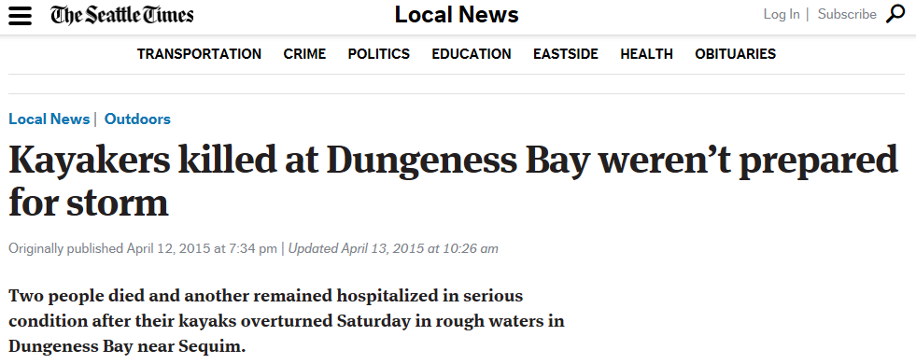
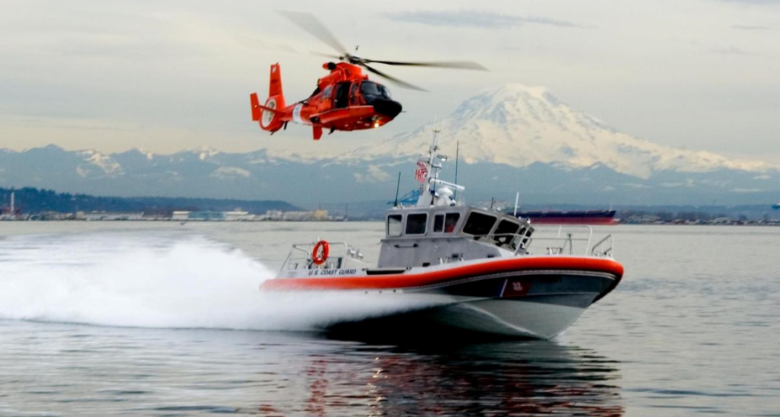
Growing community need

Slide 10
New ECLS programs in Western WA
St. Joseph, Bellingham
St. Joseph, Tacoma
St. Peter’s, Olympia
Harrison Hospital, Bremerton
Swedish Hospital, Seattle
Overlake Medical Center, Bellevue (in development)

Slide 11
HMC Proposal
Harborview program to support severe pulmonary failure (VV) with a limited VA ECMO program for HMC specific patients
VV Support for severe respiratory failure (P/F<80-100 despite max. vent support)
ARDS secondary to sepsis, trauma and burns
Severe pulmonary contusion/Broncho-pleural fistulas
Severe pulmonary infection (bacterial or viral)
VA Support for “Harborview Patients” requiring complete cardio-pulmonary rescue
Near-drowning
Hypothermic arrest secondary to exposure
Major pulmonary embolus with cardiovascular collapse
Trauma-pneumonectomy

Slide 12
New Protocol Development
Refractory Hypoxemia
Management of Severe Pulmonary Embolus
Management of Hypothermia
“ECMO Response Team” emergency page
Notify in-house operators of an emergency procedure
Responders include Code blue operations and recorder

Slide 13
Staffing of ECLS
Identified a Team of ECLS Operators from ICU and Respiratory Therapy Staff
Four Operators in House on all shifts
1 bedside RN and 1 ECLS Operator per patient
Pump must be staffed without interruption (break relief)
Cannulation and emergency procedures will require 2 operators
2nd ECLS Operator located physically adjacent with a light assignment

Slide 14
Staffing of ECLS
New Service Created for Management
“HMC ECLS Service”
Attendings will consist of General Surgery Intensivists
All day to day management will be at attending and fellow level

Slide 15
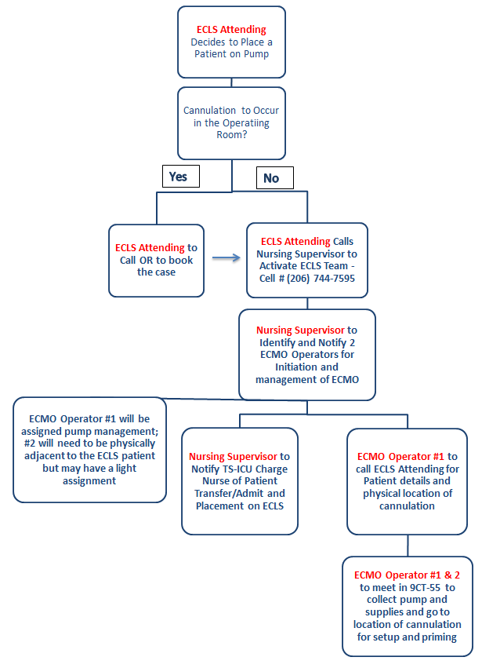
Communication Tree

Slide 16
NAS Concerns
Identification of ECLS Operators In-House
Kronos Skill Codes
Patients will be located in TS-ICU while on pump
2 ECLS Operators will need to be adjacent to each other
Break relief
Emergency Procedures

Slide 17
Program Readiness
ECLS Operator and Faculty Training near complete
Equipment purchased and being stocked
Notifications to departments and councils happening now
Finalizing workflows
Procedural Simulations in March
Go-Live potentially week 3 or 4 of March

Slide 18
References
Guirand DM, Okoye OT, Schmidt B, et al; Venovenous extracorporeal life support improves survival in adult trauma patients with hypoxemic respiratory failure: A multicenter retrospective cohort study. J Trauma Acute Care Surg 76: 1275-1281, 2014
Peek GH, Mugford M, Tiruviopati R, et al; Efficacy and economic assessment of conventional ventilator support versus extracorporeal membrane oxygenation for severe adult respiratory failure (CESAR): a multicenter randomized controlled trial. Lancet 374: 1351-1363, 2009
Sauer CM, Yuh D, Bonde P; Extracoporeal membrane Oxygenation Use Has Increased by 433% in Adults in the United States from 2006-2011. ASAIO Journal 2015 Jan-Feb; 61(1): 31-6
Noah et al, JAMA, 2011; 306 (15): 1659-1668

Slide 19
HMC TSL
Responsibility
Provide blood transfusion support to the team
TSL Medical Directors will be contacted for coagulation and transfusion issues

Slide 20
HMC TSL
Process
Once notified by ECMO team; write on whiteboard name and HID of ECMO patient. Update BAD file in SQ; under comments ECMO; date time and tech ID
Emergency trauma packs or crossmatched blood will be provided based on urgency
Patients on ECMO may or may not bleed therefore the team may call an MTP but no blood will be used
TSL should respond STAT to all testing and blood requests on ECMO patients
Locations- OR, TSICU

