Slide 1
HMC Laboratory Medicine Highly Pathogenic Infection Update
3/2016
Notes:
Thanks for coming, everyone. If you don’t know me… AIDET.

Slide 2
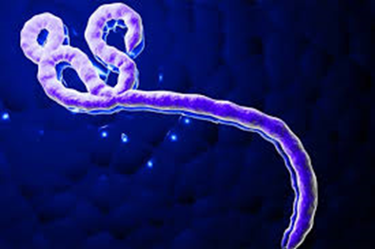
Agenda
Overview
Highly Pathogenic Infection (HPI) Plan
HMC Home Assessment Teams
Practice with PPE
Ebola Viral Particle
Notes:
In the next hour we’re going to spend 30 minutes talking what we’re now calling the HPI plan – essentially a melding of our existing Bioalert protocols with the Ebola protocols. I’m also going to tell you about a new process that Harborview is instituting, where rather than activate a full containment for patients in the hospital when they’re possibly infected with something nasty, but they’re not sick enough to need hospital care. And finally, we’ll spend the last 30 minutes donning & doffing the extra PPE required in an Ebola-level activation, just so we don’t forget all we learned a year or so ago.

Slide 3
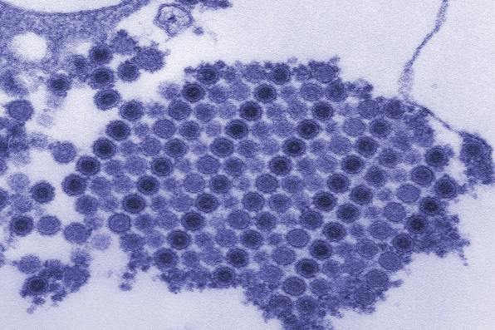
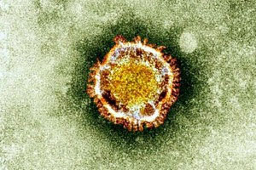
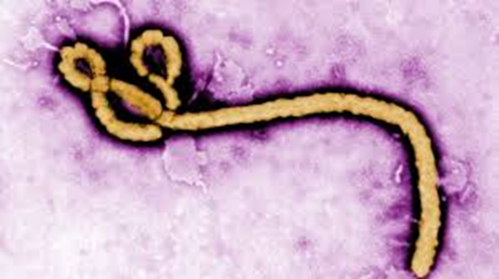
Why the change to ‘HPI’?
Ebola epidemic over for now
Other emerging infectious diseases
MERS
Zika
Next one???
Patient Care Providers also transitioning
Use the same terminology
Chikungunya Viral Particles
Zika Virus
Ebola Virus
Notes:
Any of you NOT here 1 – 2 years ago when we had to come up with a laboratory response to the Ebola epidemic?
History: We had a Bioalert plan for many years, but when ebola hit, it was clear we’d never imagined dealing with a pathogen that virulent in a general clinical lab – had to come up with whole new way to be sure any lab person handling the specimen was protected. Long & painful process, I’m very proud that we are one of very few labs who figured it out and made it work. HMC had 4 activations, carried off admirably.
Labs & PCP now take what we learned from Ebola and create plans that covers the spectrum – like emergency preparedness & ‘all hazards’ plan – one plan that covers all the hazards you can imagine happening. So, even though Ebola over for now, you never know when the next epidemic will happen – could be Ebola, could be Lassa or Marlberg or other known nasty viruses out there, or it could be one of the emerging infectious diseases (Zika or MERS) or even bioterrorist attack. So – the new ‘Highly Pathogenic Infection’ term was created – HPI. Doesn’t exactly roll off the tongue, but want to use the same terminology as the PCP’s, so we all understand what we’re dealing with.

Slide 4
‘Highly Pathogenic Infection’ Plan
Definition: “Infections requiring enhanced precautions due to a high potential to cause fatal human disease via respiratory, airborne or contact transmission.”
Hospital Process
Screen patients for history of travel or HPI symptoms
If positive, place in isolation: droplet, contact and/or respiratory as needed
Infection Control will notify impacted departments (Lab, EVS, Dietary, etc.)
Infection Control will monitor access to room
Notes:
From a hospital level, the HPI plan goes into effect when there’s concern for infections that fit this definition. Screen for disease, isolate patient – may or may not build out the special isolation room that we saw during Ebola activations. IC will make sure people don’t inadvertently wander into the room or space, and also charged with notifying everyone who needs to know – includes the LMR on call.

Slide 5
Laboratory HPI Plan
Tiered system based on transmission risk
LMR integral part of activation, notification and risk assessment
Do risk assessment
Do Lab Medicine notification
Work with patient care team regarding testing
Deactivate plan
Notes:
Once the LMR gets notified, they need to figure out what type of risk does this particular issue hold for those of us in the lab. One of the new things in the HPI lab plan was creation of tiers of risk, with different levels of activation based on that risk. Some things may be hazardous to those working up close to the patient, but no excessive risk to anyone removed from the patient. Recent example is MERS – extra precautions while working with patient, but standard precautions in the lab.
Once LMR determines level of activation, starts the notification process, works with patient’s docs as needed, and deactivates the plan – much like they did for Ebola process. So let’s talk about the tiers…

Slide 6
Lab Protection Levels
Lab Protection Level | Infection Route | Laboratory Precautions
Level A | Respiratory or Mosquito-borne (MERS, SARS) | Enhanced precautions for Phlebotomy & other direct patient care. Use BSC for respiratory & stool samples. Standard PPE and normal laboratory precautions in lab. Precautions when culturing pathogen.
Level B | Direct Contact (Ebola & other VHF) | Phlebotomy will not draw patients. Enhanced PPE for specimen handling & testing, limited test menu, special waste & specimen discard process.
Level C | Airborne & Contact (??) | If respirator required, testing not performed in central lab.
Notes:
Made up a new term to help us (LPL)
A = highest risk near patient – phlebotomy wear PPE (like Flu). While with these diseases you can get pathogen in blood, highest titer in respiratory secretions (sputum, BAL) and many high in stool, so want these specimens handled in BSC. Other testing okay using standard precautions & PPE. Virology shouldn’t culture, so need to know. Also would apply to diseases spread by mosquito, where need an infected mosquito.
B = Ebola level. Enhanced PPE – staff monitoring likely
C = can’t think of what pathogen would fit here, but wanted a category for things that the CDC says we need to use a respirator even for the limited no-manipulation basic lab testing. Faculty have decided that we won’t go that far – we’d possibly offer near-patient testing wearing same PPE as patient care providers, but not bring samples into the lab.

Slide 7
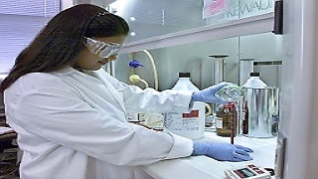
Standard Laboratory Precautions
Wear standard PPE (gloves, lab coat, eye protection)
Avoid aerosol generation
Perform hand hygiene after removing gloves
Clean benches regularly
No eating or drinking in lab
Avoid touching face
Notes:
Lab Protection Level A - Obviously, a disease that is transmitted by respiratory route can be caught by lab worker handling sample containing organism if they don’t follow good lab procedures – this is also true of blood borne pathogens we know we handle every day. Aerosol generation comes to mind – how do you avoid aerosols?
Seeing too many people handling a tube of blood without gloves lately! Also, scratching face, fluffing hair, etc. all bad habits.
During Ebola outbreak, resident did a study to see if could find virus around the lab, specifically on the chem automation line – while mostly none in areas not directly near specimen handling/pipetting/discard areas, there were some positive findings on just regular automation line surfaces – treat the lab testing areas as a contaminated areas!

Slide 8
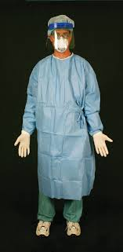
Lab Protection Level B
“Ebola” level response
Limited test menu
Teams of 2 – handler and helper
Laboratory Site Manager
Enhanced PPE – impermeable gown, double gloves, face shield, face mask (surgical hoods & leg covering available but not required)
Use BSC for sample manipulation, can open tubes behind a shield
Special attention to cleaning/ disinfection/discard
Notes:
This plan will apply to any VHF (Ebola, Lassa, Marburg, and Crimean-Congo hemorrhagic fevers have person-to-person transmission).
Take standard precautions and stepped it up a notch with additional PPE & safety processes
Respirator not required
Test Manu - Automated instrument or POC/other stuff in BSC (biological safety cabinet, or hood), only thing done on open bench is carefully remove tube top

Slide 9
Limited Test Menu (others require LMR approval)
Division/Bench | Testing Available
Hematology | CBC/Differential/Retic, Malaria Screen
Coagulation | PT, PTT, FIB, TT, DDI
Chemistry | Chem tests on automated line– only lime green or orange tops accepted (no aliquoting)
Urinalysis | UA, yellow-top tube only (no urine cups, no manual microscopic exam)
Blood Gas | ABG
Microbiology | Blood Cultures Rapid Strep
Transfusion | Universal Donor – no testing without faculty approval
Virology | Requires approval or inactivating media
Send-Outs | To State Lab if approved
Notes:
Only limited lab testing, things necessary for patient care. They can send additional tubes and order whatever they like but unless on this list we won’t perform unless get LMR approval. Do need to save the samples for awhile in case of addons or if patient shown to not have the suspected pathogen.

Slide 10
Divisional Plans
Work as a team:
Specimen HANDLER works with sample
Helper provide safety monitoring and perform ‘clean’ tasks if helpful
Lab Site Manager ensures process goes smoothly & doffing PPE done correctly
Other employees stay clear of area to minimize distraction
Block access to non-lab staff
No manual manipulations or verification steps
Decontaminate area/instrument prior to resuming regular testing
Notes:
Not going to review in detail (do so if you haven’t reviewed it in awhile) – Other employees stay at least 6 feet away – okay to work at other benches. Block access to lab for non-lab employees (delivery, couriers, sales reps, etc.)

Slide 11
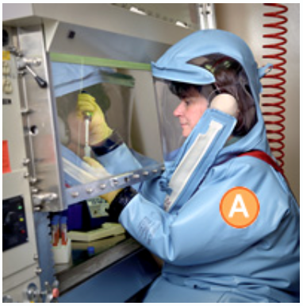
Lab Protection Level C
If transmitted by airborne & contact or
If CDC requires respirator for GENERAL laboratory testing
NO TESTING IN LAB – would set up near-patient testing, wearing same PPE as patient care providers
Notes:
If “miasma of badness” or if CDC clearly recommending respirators for standard lab testing (automated), then avoid bringing into the clinical lab.

Slide 12
HPI Summary
Tiered system based on transmission risk
Lab Protection Level A
Lab Protection Level B
Won’t go above this
Activated when hospital activates
LMR responsible for communication & risk assessment
Notes:
Any Questions?

Slide 13
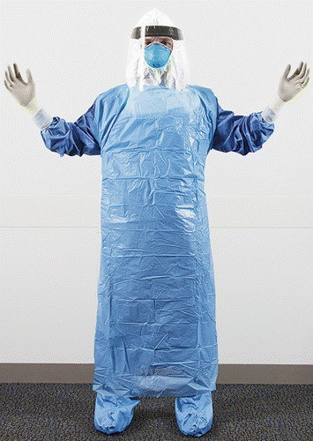
HMC ‘Home Assessment Team’
For mildly ill patient – day shift
Lab supplies container with sample collection supplies
Team will go to patient’s home, assess and collect samples
Samples come to HMC lab
Lab may activate HPI plan (depending on pathogen and specimens received)
1918 influenza – virology specimen in inactivating media
Notes:
HMC learned that it’s very expensive to have nurses & doctors all suited up watching a slightly ill patient sleep! In self defense, they have created a process to take ambulance to patients home, suit up, talk to patient and take samples. Goal is to rule out serious pathogen before bringing them into hospital. Patient pre-logged as Inf Disease clinic visit – they will call LMR to notify they are activating. Lab has agreed to supply them with box containing sample collection tubes & supplies – no one else willing to monitor for expiration dates. Box will be labeled and serve as transport back to the lab. Depending on the pathogen and samples, we may need to activate – no different than patient in house for us! But rest of hospital no impact, other than lab TAT.
Would be activated perhaps by Public Health, say another ebola or VHD outbreak, or if researcher on UW Campus comes down with symptoms. Upcoming new research for 1918 strain of influenza – one of the last big pandemics, so don’t want to take any chances if someone from that lab starts running a fever…

Slide 14
Donning / Doffing PPE
Critical to do correctly
Helper or Lab Site Manager talk people through removing PPE
Provide Sani-wipe to disinfect gloves prior to removal
Read steps from Poster - do not get ahead of reader
Helper can assist in removal if needed
If potential exposure, clean immediately

Slide 15
Putting on PPE
Isolation gown over lab coat, head through loop, tighten neck, tie at waist in back
Mask – adjust to fit at nose
Hair/head/neck protection (if using)
Face shield
First glove – under isolation gown cuff
Put gown thumb loop over gloved thumb
Extended cuff glove - pull over cuff of gown
Team members check each other

Slide 16
How to take off PPE
Disinfect & remove outer gloves & discard
Pull gown at waist to break back tie
Pull at shoulders– roll gown inside out – discard
Disinfect inner gloves & remove
Perform hand hygiene, put on clean gloves
Remove face shield, grasping by headband
Remove head/neck/hair protection (if using)
Remove mask/eye protection by the side and/or ties - discard
Remove gloves - discard
Perform hand hygiene again immediately
Notes:
Extremely important – this is where most HCP’s get ill, don’t realize contaminated self.
Two parts – body, then face.
Keep gown away from you and off floor

