Slide 1
Laboratory Medicine Highly Pathogenic Infection Training
6/2016

Slide 2
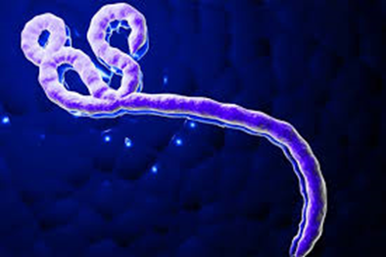
Overview
Lab Medicine has recently combined the lab’s ‘Bioalert’ and ‘Ebola’ plans into a ‘Highly Pathogenic Infection (HPI) Plan’.
This training will describe the new HPI plan.
The actual HPI plan and division-specific plans can be found in the Workplace Safety Manual.
Ebola Viral Particle

Slide 3
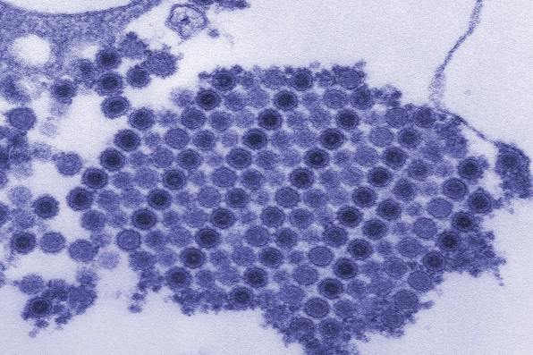
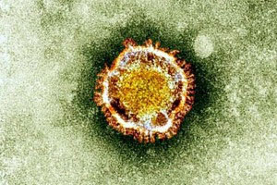
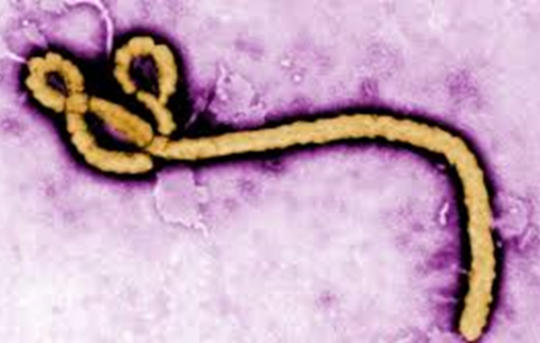
Why the change to ‘HPI’?
The Ebola epidemic over for now.
Want to maintain lessons learned from Ebola, and be able to apply them to any high risk pathogen.
The hospitals and patient care providers are also transitioning to a more generic plan based on risk.
Want to use the same terminology
Chikungunya Viral Particles
Zika Virus
Ebola Virus

Slide 4
‘Highly Pathogenic Infection’ Plan
HPI Definition: “Infections requiring enhanced precautions due to a high potential to cause fatal human disease via respiratory, airborne or contact transmission.”
Hospital Process
Screen patients for history of travel or HPI symptoms
If positive, place patient in isolation: droplet, contact and/or respiratory as needed
Infection Control will notify impacted departments (Lab, EVS, Dietary, etc.) and activate plan
Infection Control will monitor & limit access to patient room

Slide 5
Laboratory HPI Plan
Lab Protection Levels: Created new tiered system based on lab transmission risk
Lab Med Resident responsible for the following:
Do risk assessment of the pathogen – how is it transmitted? What precautions does the lab need to take (i.e. what lab protection level to activate)?
Start Lab Medicine notification process
Work with patient care team regarding testing
Deactivate plan when appropriate

Slide 6
Lab Protection Levels (A thru C)
Lab Protection Level | Infection Route (examples) | Laboratory Precautions
Level A | Respiratory or Mosquito-borne (MERS, SARS) | Enhanced precautions for Phlebotomy & other direct patient care. Standard PPE and normal laboratory precautions in lab. Use BSC for respiratory & stool samples. Take precautions when culturing pathogen.
Level B | Direct Contact (Ebola & other VHF) | Phlebotomy will not draw patients. Enhanced PPE for specimen handling & testing, limited test menu, special waste & specimen discard process.
Level C | Airborne & Contact (??) | If CDC says a respirator required for general lab testing, testing will not be performed in central lab.

Slide 7
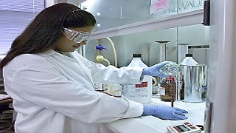
Level A: Standard Laboratory Precautions
Standard Precautions only protect you if you consistently follow them!
Wear standard PPE (gloves, lab coat, eye protection) whenever handling specimens or are working in an area that specimens are handled
Perform hand hygiene after removing gloves
Avoid aerosol generation
Clean benches regularly
No eating or drinking in lab
Avoid touching your face in lab

Slide 8
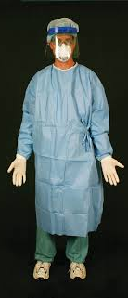
Lab Protection Level B
This is the “Ebola” level response
Limited test menu offered
Teams of 2 – handler and helper – suit up and perform the testing
A Laboratory Site Manager oversees activity
Enhanced PPE worn when performing testing – impermeable gown, double gloves, face shield & mask
Samples can only be manipulated in a hood or run on automated instrument (can open tubes behind a shield)
Special attention given to cleaning/ disinfection/ discard of samples

Slide 9
Limited Test Menu (all other testing requires LMR approval)
Division/Bench | Testing Available
Hematology | CBC/Differential/Retic
Coagulation | PT, PTT, FIB, TT, DDI
Chemistry | Chem tests on automated line– only lime green or orange tops accepted (no aliquoting)
Urinalysis | UA, yellow-top tube only (no urine cups, no manual microscopic exam)
Blood Gas | ABG
Microbiology | Blood Cultures, Malaria Screen, Rapid Strep
Transfusion | Universal Donor – no testing without faculty approval
Virology | Requires approval or inactivating media
Send-Outs | To State Lab if approved

Slide 10
Divisional Plans
Review your division’s plan in Workplace Safety Manual
Work as a team:
Specimen HANDLER works with sample
Helper provide safety monitoring and performs ‘clean’ tasks
Lab Site Manager ensures process goes smoothly & doffing PPE done correctly
Other employees stay clear of area to minimize distraction
Block access to non-lab staff
No manual manipulations or verification steps
Decontaminate area/instrument prior to resuming regular testing

Slide 11
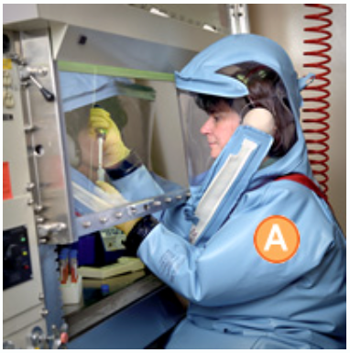
Lab Protection Level C
If CDC requires respirator for GENERAL laboratory testing
Then NO TESTING IN LAB – likely would set up near-patient testing, wearing same PPE as patient care providers
Not going here!

Slide 12
HPI Summary
Tiered system based on transmission risk
Lab Protection Level A – respiratory transmission, standard precautions for most lab testing
Lab Protection Level B – contact transmission, requires enhanced PPE, only limited testing offered
Won’t go above this
Activated when hospital activates
LMR responsible for communication & risk assessment

Slide 13
Questions?
HPI plan and divisional plans are located in the Workplace Safety Manual
OR
Ask your Supervisor
OR
Contact Sara Trimble, Laboratory Safety Officer

