Slide 1
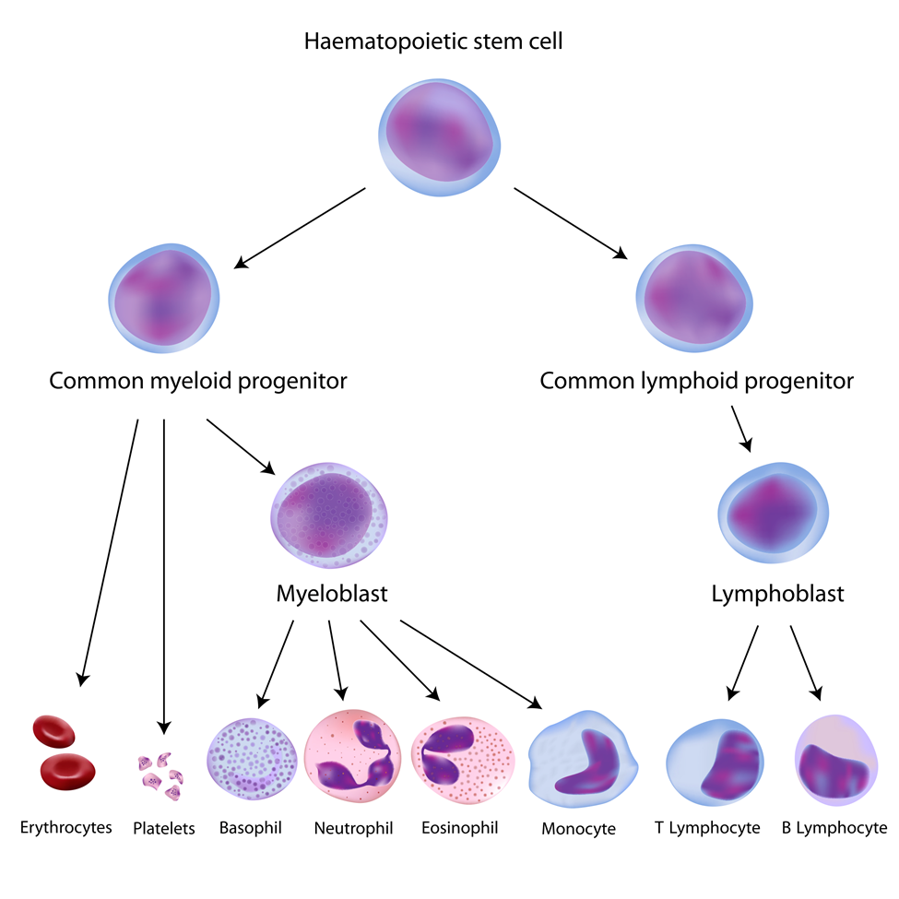
Hematopoietic Stem Cell Transplantation
Madalina Badiu
Medical Laboratory Science Student
Immunohematology Rotation,
July 7th, 2016

Slide 2
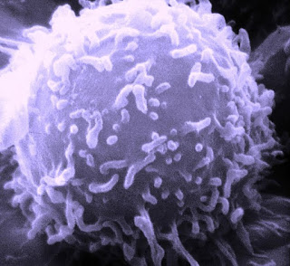
Objectives
Categories of hematopoietic stem cell transplantation (HSCT):
Autologous HSCT (the graft is collected from the patient before the transplant)
Syngeneic HSCT (donor-recipient are identical twins)
Allogeneic HSCT (the graft is collected from a healthy donor)
Sources of SC
HLA matching
ABO mismatches
Transfusion support
Graft versus Host disease

Slide 3
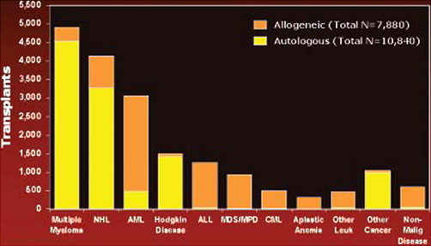
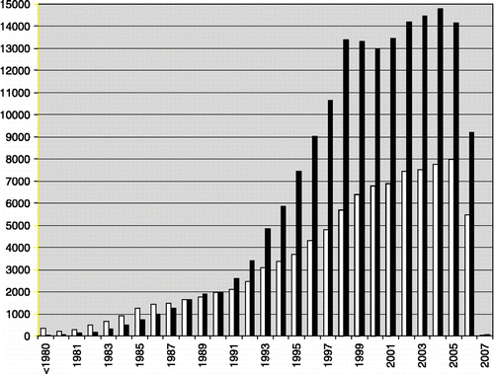
HSCT
HSCT has been used for many years for the treatment of a variety of malignant and non-malignant hematologic disorders, solid tumors, and autoimmune disorders
Kim Schmit-Pokorny
Fig.1 Indications for HSCT in North America – 2005
R. Saccardi & F. Gualandi
Fig.2: Bars indicate the number of HSCT transplants/year reported to the European Blood and Marrow Transplantation Group (EBMT) registry in the period 1980–2006, according to the source of SCs and irrespective of diagnosis. Data of 2006/7 are incomplete.
White bars allogeneic
Black bars autologous

Slide 4
HSCT – Sources of Stem Cells
Bone marrow - obtained by repeated aspiration of the posterior iliac crests (was the first source of hematopoietic stem cells)
Peripheral blood - because marrow stem cells detach continuously, enter the circulation, and return to the marrow, peripheral blood is a convenient source of hematopoietic stem cells
As compared with marrow, peripheral-blood stem cells obtained with currently used techniques produce more rapid hematopoietic reconstitution
Umbilical Cord Blood
can be used if transplantation is urgent or if suitable donors are not found
blood from the umbilical cord is rich in hematopoietic stem cells but is limited in volume

Slide 5
HSCT-Mobilization Strategies
The number of CD34+ cells in blood can be increased by mobilizing them from the bone marrow
Mobilization using FDA approved cytokines alone
generally well tolerated
yields are often suboptimal
Mobilization with chemotherapy in addition to cytokine
increases stem cell yields at the time of collection
increased complications: (cytopenias requiring transfusion support and febrile neutropenia requiring hospitalization and intravenous antibiotics)
Mobilization using granulocyte-colony stimulating factor (G-CSF) alone
good efficacy in most patients (most frequently used)
The mobilization of CD34+ cells is increased when G-CSF is given after chemotherapy.

Slide 6
Autologous HSCT
Auto-HSCT is recommended for patients with either relapsed lymphoma or those in first remission as consolidative therapy
The success of auto-HSCT is influenced by:
dose of reinfused stem cells: higher stem cell doses are associated with faster platelet and neutrophil engraftment and reduction in the need for supportive measures
patient age and gender
exposure to previous irradiation and chemotherapy
previous mobilization attempts
disease characteristics (such as the involvement of bone marrow)
http://www.msra.org.au/HSCT

Slide 7
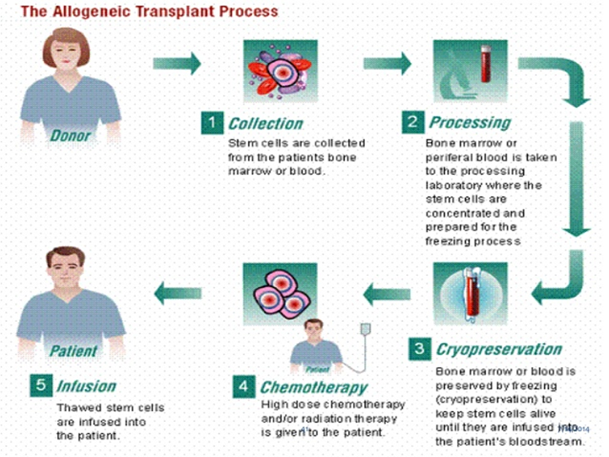
Allogeneic HSCT
Allo-HSCT has been used as salvage therapy in relapsed lymphoma after previous auto-HSCT
Success of allo-HSCT can be impaired by:
HLA/ABO patient/donor incompatibility
graft-versus-host disease (GVHD)
disease relapse
infections favored by the delayed immune reconstitution
http://www.slideshare.net/BhargavKaptan/HSCT

Slide 8
Allogeneic HSCT
HLA genotypically identical sibling donors are the gold standard for transplantation purposes (only 30% patients have such a donor)
For the remaining 70% patients alternative sources of stem cells are a matched unrelated adult volunteer donor, a haploidentical donor or a cord blood unit
If multiple donors are available, choice is based upon:
Blood group
Age
Transfusion history
CMV status
Parity in case of women donors
Notes:
The probability of identifying an HLA-identical sibling donor depends only on the number of siblings and is 25% for patients with one sibling, 44% for those with two, 58% for those with three, 68% for those with four, and up to 90% for patients with eight siblings.
On the other hand the probability of identifying a highly matched unrelated donor depends on the frequency of the patient’s HLA haplotypes.

Slide 9
Allogeneic HSCT- HLA Matching
HLA matching depends on the level of resolution and on which loci are tested
The gold standard is high resolution typing at the HLA-A, -B, -C, -DRB1 and -DQB1 loci (10/10 match)
Single disparities for HLA-A, -B, - C, or -DRB1 are associated with increased risk of post-transplant complications
HLA-DQB1 mismatches seem to be better tolerated
Some HLA-C, -DRB1 and -DPB1 disparities are potentially less immunogenic
Notes:
The development of HLA molecular typing technologies and the availability of more than 27 million donors in the international database has greatly facilitated unrelated donor searches.
Many patients will still not have a fully matched donor because of the extremely great diversity of HLA alleles and haplotypes.

Slide 10
Allogeneic HSCT – Preparatory Regimen
Patient receives high dose chemotherapy and/or total body irradiation to:
Eradicate malignant or abnormal cells
Create space within bone marrow microenvironment to allow engraftment of stem cells
Provide immunosuppression to prevent rejection
Prophylactic antimicrobials
Acute GVHD prophylaxis with methotrexate and cyclosporine

Slide 11
Stem Cells Infusion
The genes for RBCs are not located on the same chromosome as those for HLA type, therefore allogeneic transplant recipients may receive stem cells from ABO–incompatible donors
Crossing the ABO barrier raises the issues of:
Major ABO mismatch - occurring when the recipient has isoagglutinins against donor’s RBCs
Minor ABO mismatch - when plasma from the donor contains isoagglutinins against recipient’s RBCs

Slide 12
Major ABO Mismatch
Immediate Hemolysis
commonly seen when the HSCT is derived from bone marrow because more RBCs are present
RBC depletion techniques have helped eliminate this complication
HSCTs derived from peripheral blood typically contain a minimal volume of RBCs (8–15 mL), so clinically significant immediate hemolysis is rare
Delayed Hemolysis
preformed antibodies against non-ABO RBC antigens may remain in a recipient’s peripheral circulation for many weeks following transplantation
these antibodies may cause lysis when engrafted cells begin to produce new RBCs
in addition, chimeric patients may develop antibodies against ABO or non-ABO RBC antigens, thus resulting in delayed hemolysis

Slide 13
Major ABO Mismatch
Pure Red Cell Aplasia (PRCA)
seen frequently with group O patients receiving a group A transplantation
occurs when antibodies against newly engrafted RBCs destroy erythrocyte progenitor cells in the bone marrow
this intramedullary destruction leads to severe anemia without leukocytes or platelets involvement
because PRCA is associated with high levels of isohemagglutinins, a reduction of patient’s IgM or IgG titers (to ≤16) by plasma exchange or apheresis may be effective

Slide 14
Minor ABO Mismatch
Passenger Lymphocyte Syndrome (PLS)
Donor B lymphocytes produce antibodies against host’s red cells
PLS is the highest risk factor for early onset Graft Versus Host Disease
It is usually a self limited process
Risks for PLS include:
Highly lymphoid grafts
High donor antibody titers (donor Ab titers ≥256)
Donor lymphocytes capable of escape from host immune clearance

Slide 15
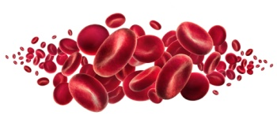
Transfusion Support in HSCT
Frequently leukocytes appear first, then platelets and erythrocytes
Platelet transfusions are administered to keep platelet counts >10,000/mm³
Patients receive RBCs to maintain a hemoglobin level >8.0 g/dl or a Hct >26%
Patient’s ABO Ab titer at transplant time is measured and if greater than 16, less than 20ml RBC are required in the stem cell bags at transplant
The need for plasma and cryoprecipitate transfusions is less frequent because HSCT does not typically interfere with the production of coagulation factors
ACKNOWLEDGEMENTS
I thank Bruce Ballard, RN, Manager Transfusion Services SCCA

Slide 16
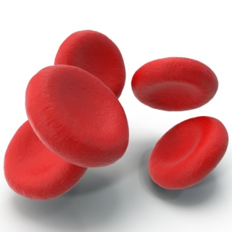
RBC Transfusion
ABO of both the patient and the stem cell donor are important considerations in RBC Tx of the HSC recipient
Recipients of ABO-mismatched SC will be transfused with group O RBCs
Post transplant RBC (and Platelet) support will be the Rh type of the donor (unless the patient has anti-D, in which case Rh neg components will be used)
In the case of double cord transplants, if either of the donors is Rh neg, support components will be Rh neg, since it is not known which donor cells will eventually engraft
RBCs attributes:
Irradiated (to inactivate lymphocytes and prevent TAGVHD)
Leukoreduced (to prevent HLA alloimmunization and reduce risk of CMV transmission)
Washed/resuspended (to reduce risk of allergic reactions for patients with severe IgA deficiency)
ACKNOWLEDGEMENTS
I thank Bruce Ballard, RN, Manager Transfusion Services SCCA

Slide 17
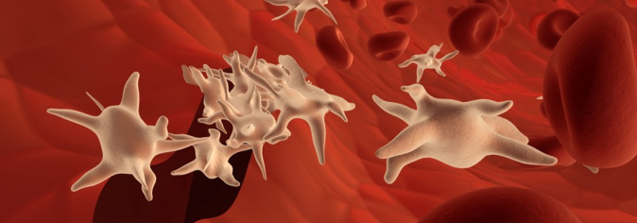
Platelets Transfusion
Because ABO antigens are only weakly present on the surface of platelets, and PLT components contain only small numbers of RBCs, ABO incompatible PLT may be transfused
PLT with ABO-incompatible plasma will be volume reduced to minimize the transfusion of isoagglutinines
Recipient’s ABO Ab titer must also be monitored:
For ex. if type O patient who receives SC from a type A donor has a titer of >256 ABO Ab then should not receive type A platelets unless they are volume reduced
Special requirements: irradiated, leukoreduced, HLA-selected, volume reduced, washed
ACKNOWLEDGEMENTS
I thank Bruce Ballard, RN, Manager Transfusion Services SCCA

Slide 18
Component Selection – transition period
Type of mismatch | Transplantation |  | Transfusion
 | Donor Type | Recipient Type | Red Blood Cell | Full Volume Platelets/ Plasma
Major | A | O | O | A AB
 | B | O | O | B AB
 | AB | O | O | AB
 | AB | A | A O | AB
 | AB | B | B O | AB
Minor | O | A | O | A AB
 | O | B | O | B AB
 | O | AB | O | AB
 | A | AB | A O | AB
 | B | AB | B O | AB
Bidirectional | A | B | O | AB
 | B | A | O | AB
Table 1: Component Type Selection for RBC and Platelet/Plasma Support of Patients Undergoing HSCT.

Slide 19
Component Selection - after conversion to donor’s ABO type
At about 100 days after HSCT, RBC’s for transfusion may be changed to donor ABO type when:
Patient has a stable graft and produces donor group ABO RBC (complete conversion to the new type, so no mixed fields in ABO forward and reverse typing)
RBC transfusion independence for at least one month
Two consecutive titers of both IgM and IgG, drawn at least one week apart, are negative
If measurable titers persist, we continue support with type O RBCs
ACKNOWLEDGEMENTS
I thank Bruce Ballard, RN, Manager Transfusion Services SCCA

Slide 20
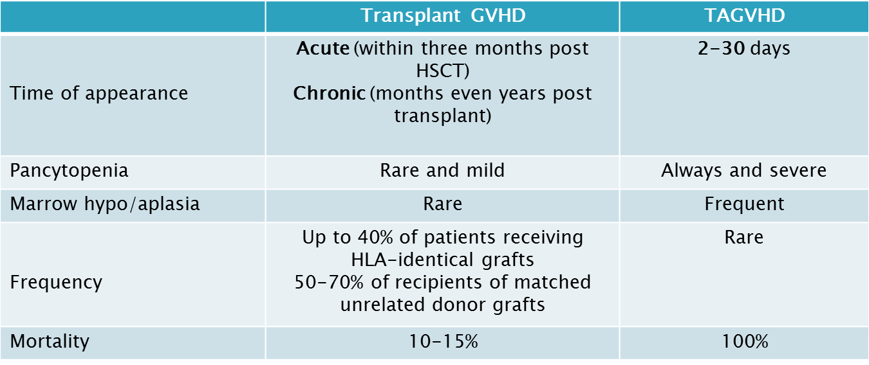
GVHD
Leukocytes from the donor graft attack recipient’s cells
Target organs:
skin – rash
intestine – gastrointestinal bleeding
liver – altered hepatic function
Table 2: A comparison between transplant versus transfusion associated graft versus host disease

Slide 21
Conclusions
HSCT is used to treat a variety of hematological diseases
HLA matching is important for a successful HSCT
Crossing the ABO barrier is not an impediment for the SC transplantation itself, however, it is very important and complex in transfusion support of the chimera patients
Patients undergoing HSCT remain dependent on RBCs and platelet transfusions until these cell lines engraft
All transfused components must be irradiated to prevent TAGVHD

Slide 22
References
Güner ŞI, Yanmaz MT, Selvi A, Usul C. The High Effect of Chemomobilization with High-Dose Etopside + Granulocyte-Colony Stimulating Factor in Autologous Hematopoietic Peripheral Blood Stem Cell Transplantation: A Single Center Experience. Hematology Reports. 2016;8(1):6319.
Tiercy, JM. How to select the best available related or unrelated donor of hematopoietic stem cells? Haematologica June 2016 101: 680-687
Vacca P, Montaldo E, Croxatto D, et al. NK Cells and Other Innate Lymphoid Cells in Hematopoietic Stem Cell Transplantation. Frontiers in Immunology. 2016;7:188.
Fonseca-Hial AMR, Parisio K, Oliveira JSR. Allogeneic hematopoietic stem cell transplantation in patients with advanced indolent lymphoproliferative disorders. Revista Brasileira de Hematologia e Hemoterapia. 2016;38(2):99-105.
Espinoza M, Perelli J, Olmos R, et al. Nutritional assessment as predictor of complications after hematopoietic stem cell transplantation. Revista Brasileira de Hematologia e Hemoterapia. 2016;38(1):7-14.
Lee HG, Kim S-Y, Kim I, et al. Prediction of survival by applying current prognostic models in diffuse large B-cell lymphoma treated with R-CHOP followed by autologous transplantation. Blood research. 2015;50(3):160-166.
Blumberg N, Refaai M, Heal J. ABO matching of platelet transfusions - "Start Making Sense As we get older, and stop making sense…" - The Talking Heads (1984). Department of Pathology and Laboratory Medicine, University of Rochester Medical Center, Rochester, NY. Blood Transfus 2015; 13; 347-50.
Platelet Transfusion. Standard Practice Manual, Fred Hutchinson Cancer Research Center, Seattle, WA. Revised by the Standard Practice Committee, December 17, 2014, finalized June 03, 2015.
Red Blood Cells Transfusion. Standard Practice Manual, Fred Hutchinson Cancer Research Center, Seattle, WA. Revised by the Standard Practice Committee, April 16, 2014.
Cohn C. Transfusion support issues in hematopoietic stem cell transplantation. Cancer Control. January 2015, 22 (1):52-59
http://www.slideshare.net/BhargavKaptan/HSCT
http://www.transfusionmedicine.ca/

