Slide 1
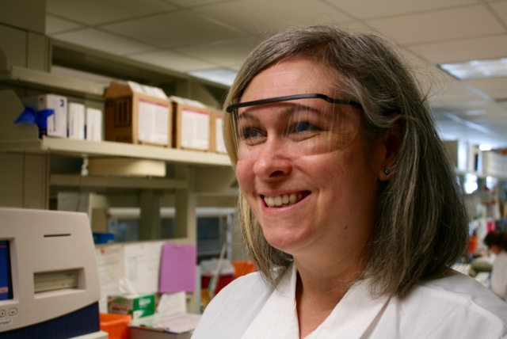
Eye Protection
Using Safety Glasses in Laboratory Medicine

Slide 2
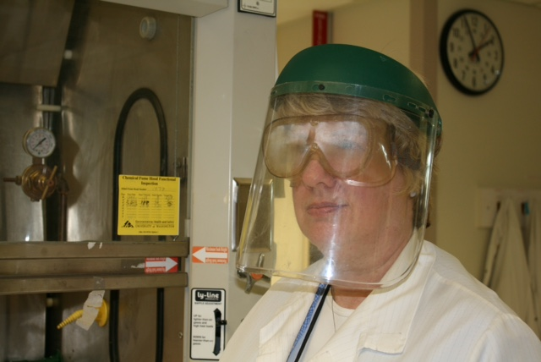
You Will Learn About:
Why, Where, and When Eye Protection is Needed
Different Types of Eye Protection
How to Select the Best Fit
Eye Protection Care and Safe Handling Tips

Slide 3
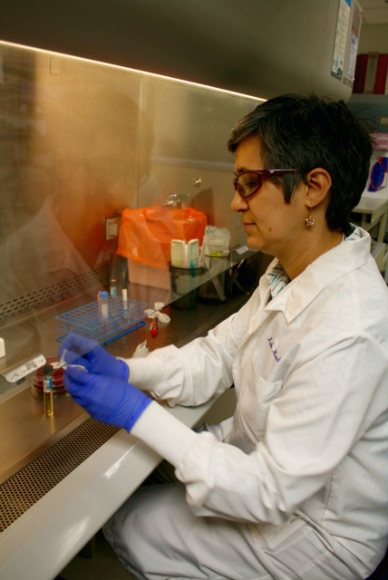
Why Wear Eye Protection?
Lab Medicine staff work with chemicals and biologicals
Splashes to eyes can result in blindness or transmit disease
Working behind shields proved insufficient in protecting staff from splashes
As of April 2009 Lab Medicine requires the use of eye protection in laboratories.

Slide 4
Blood Gas Testing
Centrifuging
Phlebotomy
Labeling Specimen or Chemical Containers
Performing Maintenance, Repair or Troubleshooting on Instruments
Activities Where Exposure Can Occur
Moving or Transporting Specimens or Chemicals
Cleaning Spills or Washing Items or Surfaces
Opening or Closing Specimen or Chemical Containers
Mixing or Pouring Specimens or Chemicals
Pipetting or Aliquoting Specimens or Chemicals

Slide 5
OSHA/WISHA Regulations
Be Reasonably Comfortable
Fit Securely & Not Interfere with Vision or Movement
Be Durable
Be Kept Clean and in Good Condition
Provide Adequate Protection
Per OSHA:
“Employers must provide suitable eye and face protection for employees exposed to … chemicals or blood splash or splatter.”
Per Washington State Labor & Industries:
“Minimum protection in laboratories is safety glasses.”
Eye Protection Must:

Slide 6
Protection Goals
A chemical splash to eyes can result in blindness – but our laboratory hazards are both chemical and biological
A biological exposure to nose or mouth is just as dangerous as to the eye
Full face protection may be needed at times to avoid splashes to the face
Alkali burn to eye resulting in blindness

Slide 7
Who Must Wear Eye Protection?
Personnel working in lab areas where infectious materials or chemicals are being manipulated or handled
Staff entering these lab areas (including supervisors, residents, students, faculty, etc.)
Visitors to these lab areas (guests, vendors, service engineers, etc.)

Slide 8
When is Eye Protection Optional?
When in computer or clerical work areas where no specimens or chemicals are present
Lab benches or desks where no specimens or chemicals handled or stored
or are at least 3 feet away from area where hazards are handled
or have divider or other clear separation from hazards
When walking through “main” aisles of a laboratory without entry into areas where hazards are being handled
When looking through a microscope
When in areas where chemicals and non-fixed specimens have been removed

Slide 9
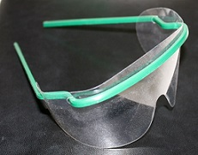
Acceptable Eye Protection
For general lab activities
Commercially available safety glasses with solid side shields
Prescription glasses with the addition of side shields
Disposable eye or face shields

Slide 10
Higher Risk Activities May Require Additional Eye & Face Protection
When handling corrosive or especially hazardous chemicals
During heat treatment of flammable, solvent, or corrosive chemicals
When performing chemical reactions involving vacuum, pressure or cryogenic apparatus
When working with lasers or ultraviolet light

Slide 11
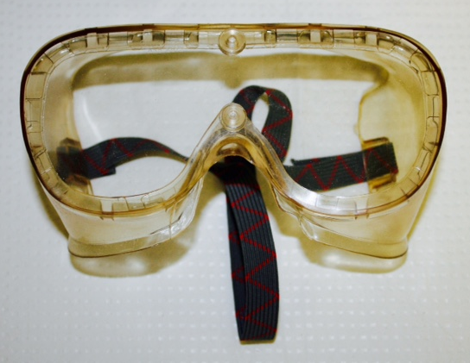
When Are Goggles Required?
Working with large volumes of hazardous chemicals (1 gallon or more)
Pouring very hazardous chemicals (solvents, corrosives, etc.) in addition to a face shield
Working with vacuum or pressure
Working with hot liquids

Slide 12
Obtaining Eye Protection
Lab Medicine will provide protection options:
Staff may purchase their own eye protection
if desired:
Safety Glasses (including options that fit over glasses or that have reader/magnification included)
Disposable Eye and Face Shields
Attachable Side Shields
Must have solid side shields that come to the edge of your eye socket
No requirements regarding size of lenses
Must be capable of disinfection

Slide 13
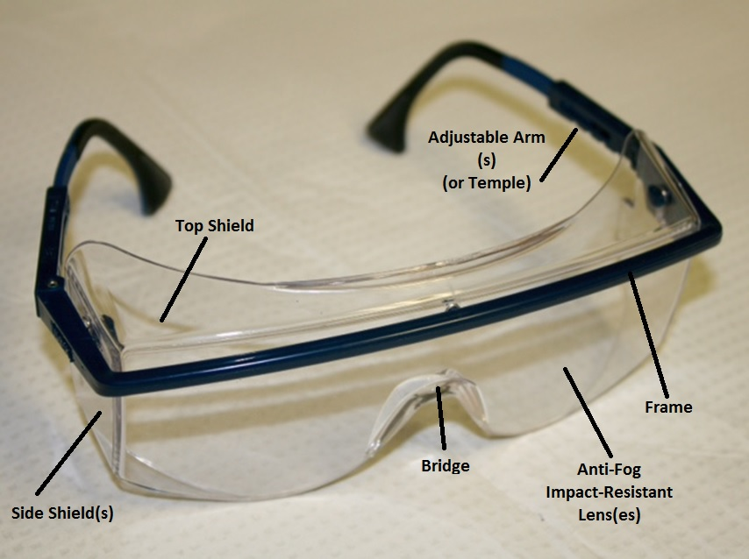
Selecting Your Safety Glasses
Most glasses are adjustable – temple length and position can be changed
Should fit snug on face without excessive gaps in protection
Select for fit and comfort

Slide 14
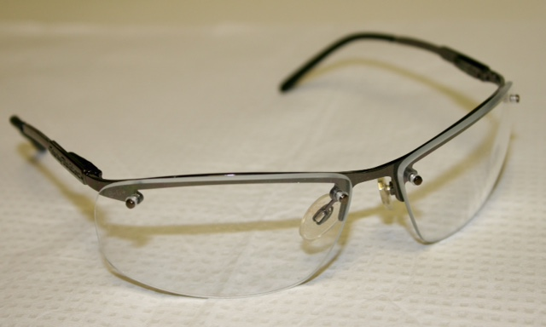
Taking Care of Safety Glasses
Clean your safety glasses regularly using mild cleanser or lens cleaner.
Avoid rough handling in order to avoid scratching lenses.
Store your safety glasses in a clean, dry place.
Request replacement of scratched, pitted, broken, bent, or ill-fitting glasses.

Slide 15
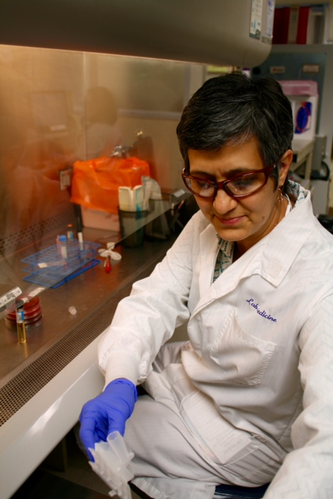
Safe Handling of Safety Glasses
Treat safety glasses as “clean” items
Put on before donning gloves
Remove with clean hands (don’t contaminate your face)
Can be worn outside the lab

Slide 16
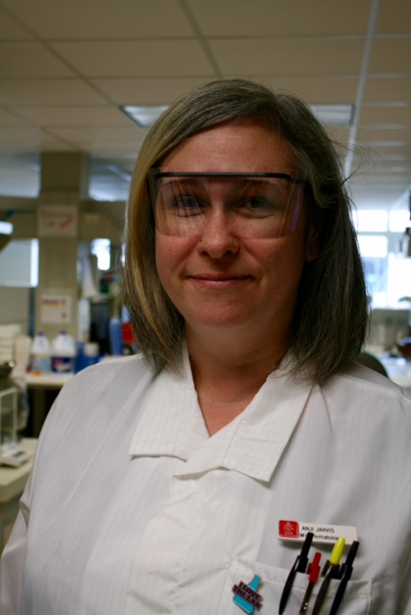
Questions?
Please check with your supervisor if you have questions about eye protection. This can include where eye protection is required vs. optional in your lab.
Thank you!

