Slide 1

BloodHub Returns

Slide 2
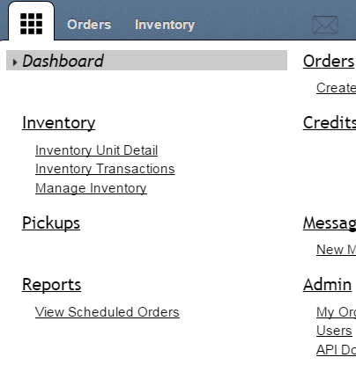
Returns Process in BloodHub
Click on 3x3 square to access Dashboard

Slide 3
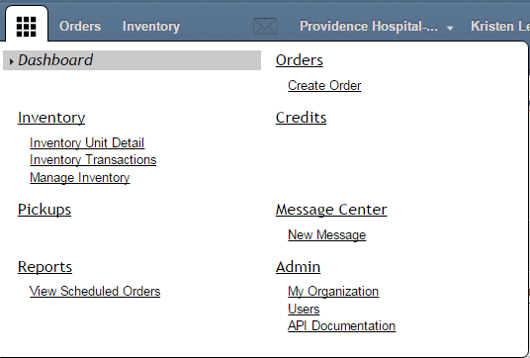
Returns Process in BloodHub
Click on “Manage Inventory” to return blood products.

Slide 4
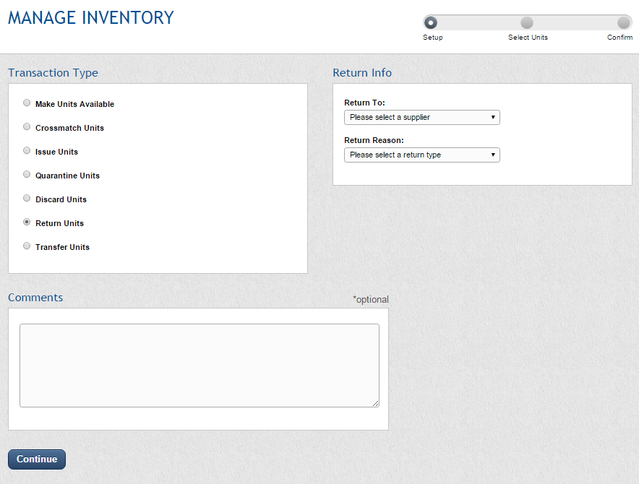
Choose a location to return to.
Note: Currently only the location your hospital orders from is available.
Choose “Return Units”
Select a return reason (see next slide)

Slide 5
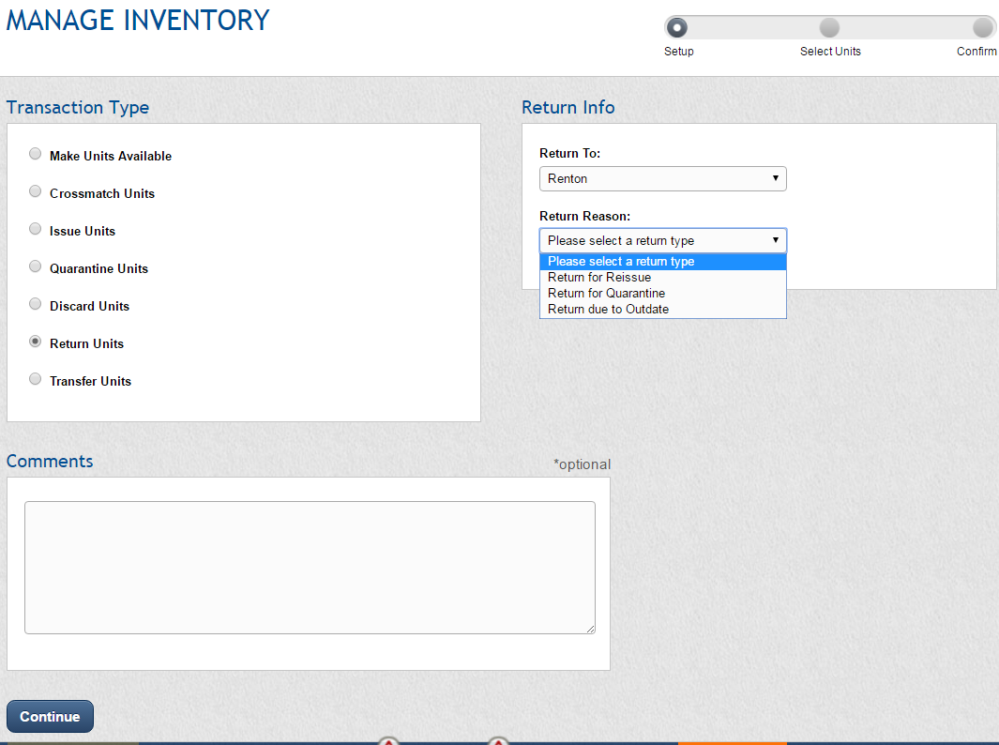
Choose either “Return for Reissue” or “Return due to Outdate” and a secondary menu will appear.
Note: The “Return for Quarantine” option is only available with a direct hospital interface system, but there are options for returning quarantined units reason under the “Return for Reissue” option

Slide 6
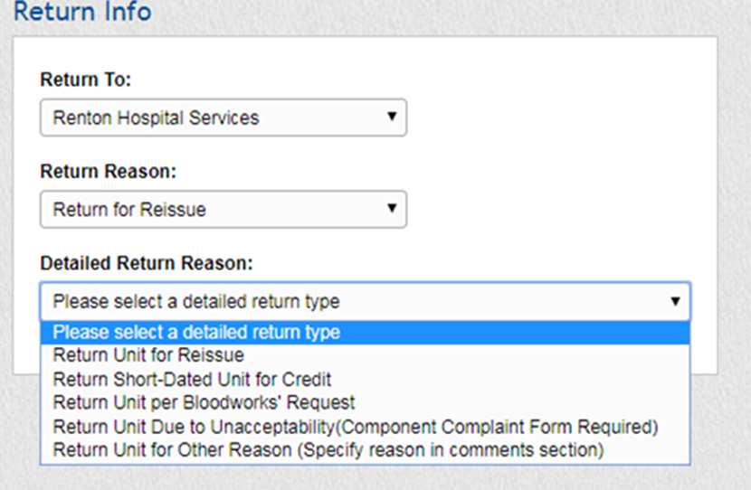
Return for Reissue Option Sub-Reasons
Return Unit for Reissue
Use for in-date viable units returned within the time limits specified in contract
Return Short-Dated Unit for Credit
Use for returning units that were sent as short-dated and were pre-approved for credit if not used
Return Unit per Bloodworks’ Request
Use for units recalled by Bloodworks
Return Unit Due to Unacceptability
Use for units found not suitable for transfusion or that did not meet order requirements
A Component Complaint Form must accompany returned units with this option
Return Unit for Other Reason
Use for units returned for a reason not specified above
Please specify reason for return in comments section

Slide 7
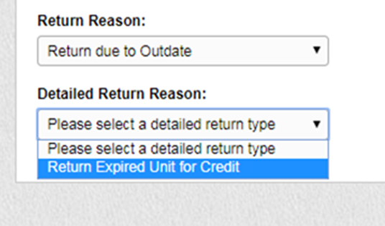
Return due to Outdate Option
Return Unit for Reissue
Use for returning expired AB RBC for credit
Use for returning expired platelets if pre-arranged in contract

Slide 8
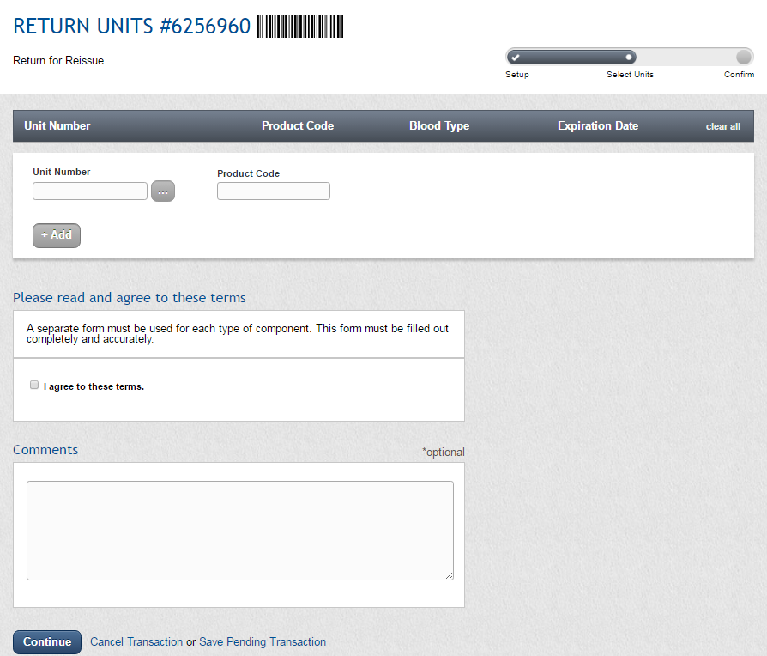
Scan unit number and product code for units you are returning or click on the “…” button to select the units from a list of units currently in your inventory.
As long as BloodHub recognizes the unit you are returning, “Blood Type,” and “Expiration Date” will automatically update, otherwise these fields will need to be manually entered.
Important Note: A separate form must be used for each type of component and a separate form must be completed for each shipping container

Slide 9
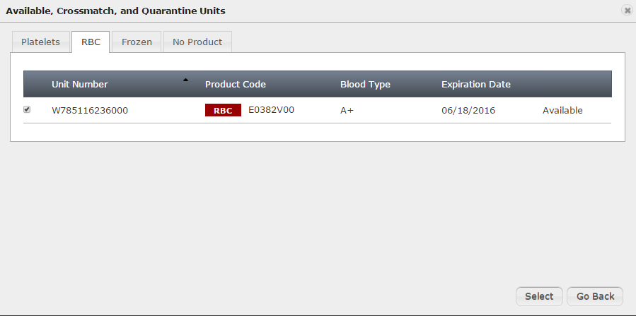
Note: Units will require unit number and product code to be manually scanned if:
They have been transferred to your location from a different hospital
Secondary processing has been completed at your location and the product code has changed
They are antigen negative units
If you click the “…” button on the previous screen, the inventory screen will look like this. You select the units by clicking in the check box, then clicking “Select.”

Slide 10
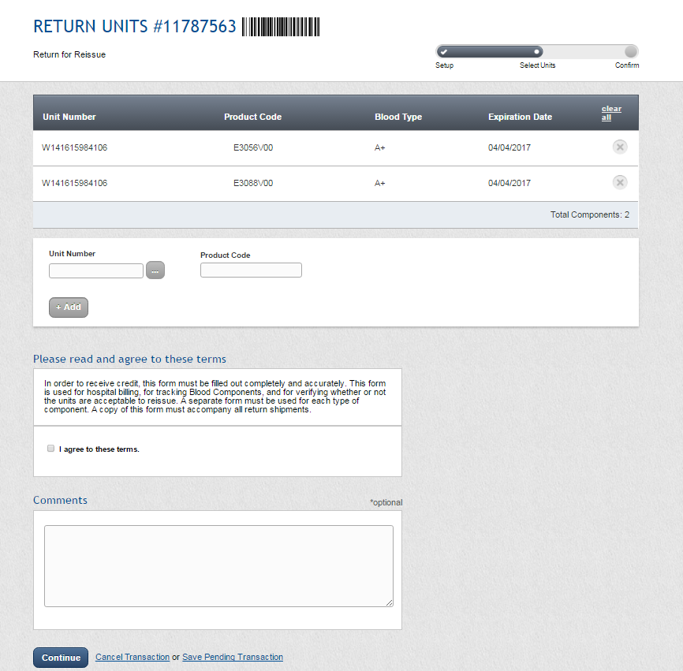
Read the terms and click the check box to agree to the terms.
This is a required field and the return will not proceed without this box being checked.
Then click on “Continue”

Slide 11
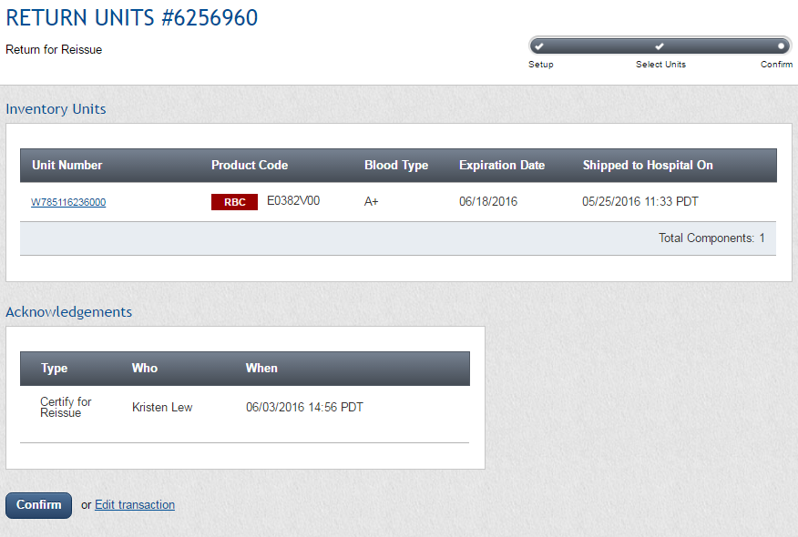
This screen is for reviewing your return before getting the final paperwork to print. When you have finished reviewing, click “Confirm.”

Slide 12
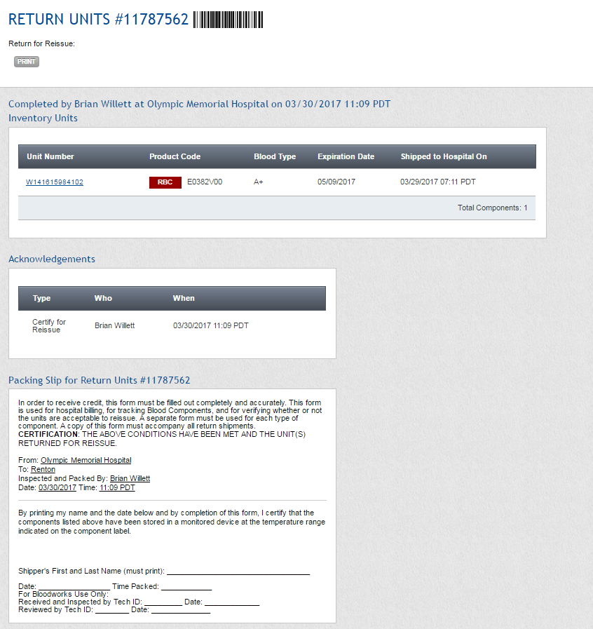

This is the final paperwork that needs to go in the shipment back to Bloodworks
Shipper must print first and last name to certify the storage conditions were met and the date and time units were placed in shipping container
IMPORTANT NOTE: Bloodworks will use this date and time as the time packed for the return shipment

Slide 13
Cancelling Returns
In BloodHub

Slide 14
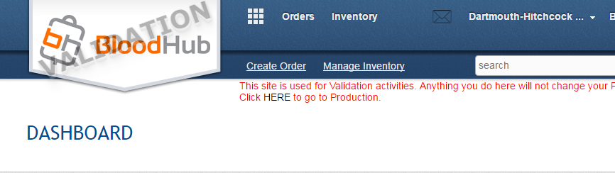
Click on 3x3 square to access Dashboard

Slide 15
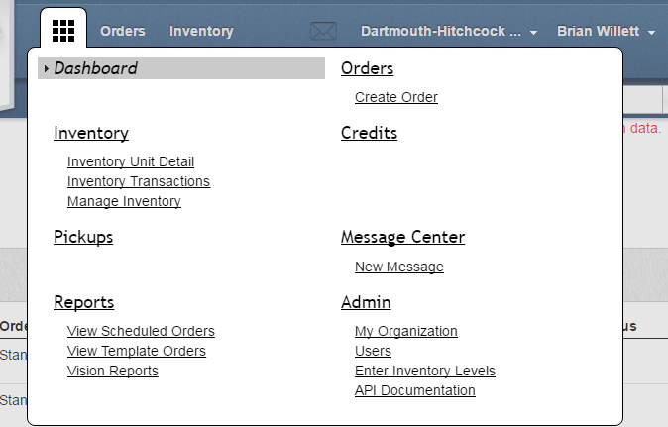
Select Inventory Transactions

Slide 16
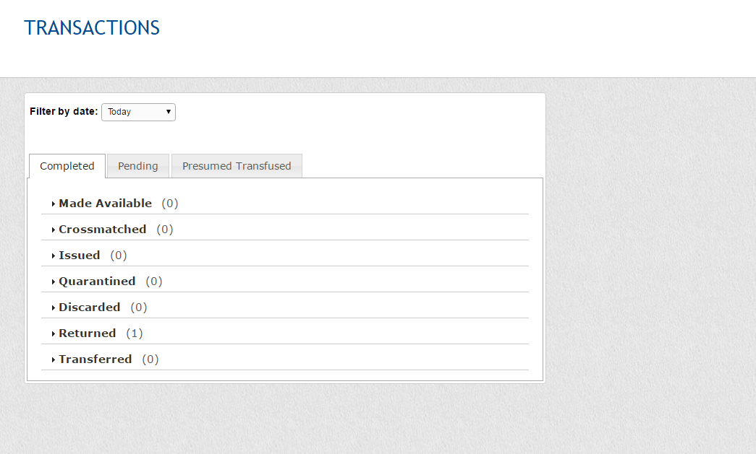
Click“Returned” to display returns for day and then select return transaction to be cancelled.

Slide 17
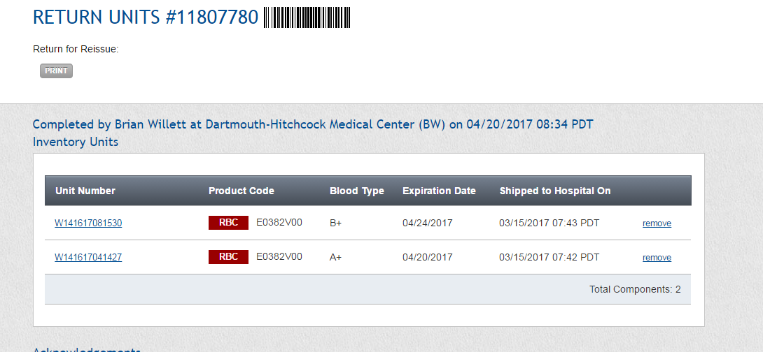
Click “Remove” to remove a unit from return

Slide 18
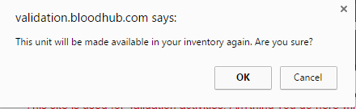
Click “OK”

Slide 19
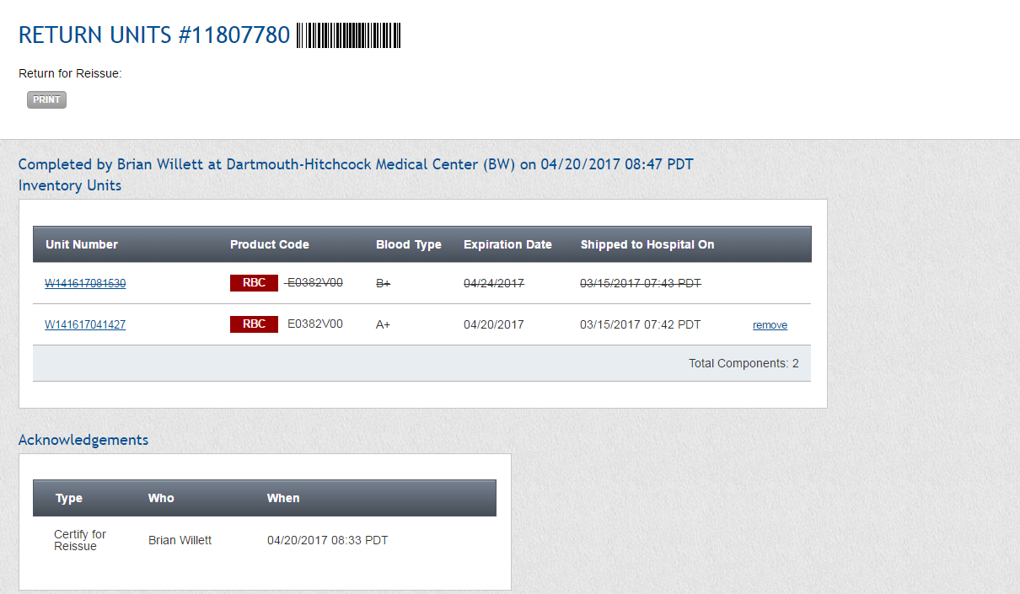
Reprint Packing List to show that unit has been removed

Slide 20
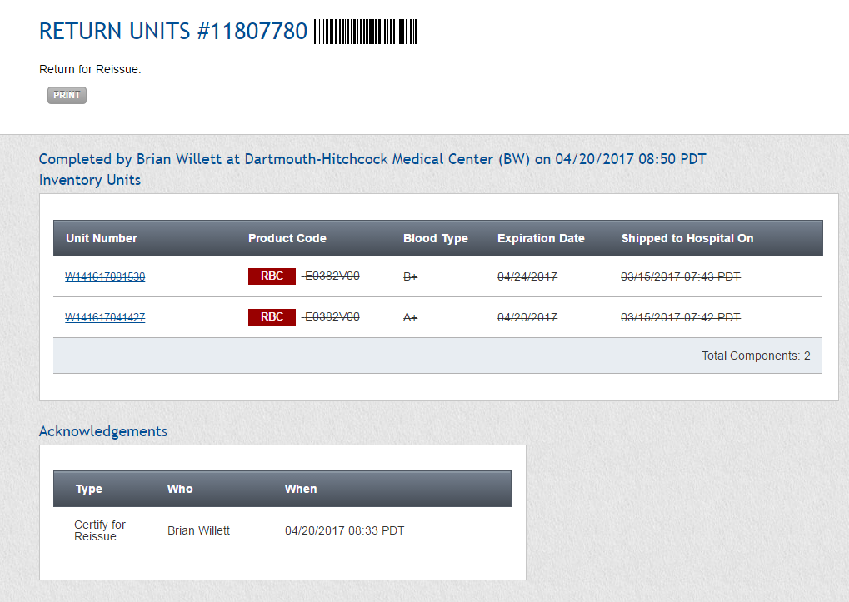
To cancel entire return, remove all units from transaction

