Slide 1
ORCA –SQ Blood Orders Interface
Go Live: August 14th, 2018

Slide 2
Project
UWMC and HMC have individual transfusion service lab with full testing abilities. Orders in ORCA needed to be cleaned up and updated to meet current services
Interface blood product orders from ORCA (CPOE) to Sunquest (Lab LIS) similar to test orders
In Scope- Inpatient areas using ORCA to order testing and blood products
Out of Scope- OR, ER, any areas that order in EPIC
SCCA outpatient orders- future orders same as current process, but when the RN activate the order to transfuse, the attribute and order will interface, and TSL will ignore the order in Gen Lab

Slide 3
Project timeline
Nov 2017- August 2018
Teams involved- clinical services with representation from physicians, nurses, PA, Laboratory IT, TSL managers, TSL Medical Directors, UW IT, SCCA IT and TSO
Build is complete and pending validation
Training will begin in July including relevant procedure updates for all impacted areas

Slide 4
Impact to TSL
Orders for blood products will interface to SQ through Gen Lab as test orders currently do
Attributes (irradiation) included in orders will interface with SQ and automatically update the SQ BAD file
Special requirements (volume reduction, HLA-matched) will print on the requisition as they do currently
2 requisition printers will be located in the front of the lab
one for interfaced orders
one for SCCA outpatient orders
Pending Order Monitor will be installed in the front of lab near the specimen receiving area
Blood Product Release Forms – will be electronically generated by RN and print in the lab for interfaced orders

Slide 5
ORCA Powerplans
ORCA orders are placed by provider using Powerplans. UW Powerplans consist of:
Adult Blood Powerplan
Neonate Blood Powerplan
MTP Powerplan
Red Cell Exchange
Plasma Exchange
Adult Hem/Onc Powerplan (irradiated)

Slide 6
Component Order Details
Component | ORCA order | SQ interface to order
RBC | Priority-Emergency uncrossmatched, STAT (60mins), Planned Transfusion, Routine Number of Units- 1-6 Attributes- Irradiated, Washed, Hb S neg Special Instructions- free text | PRIOR %UO ATT Not interfaced
Plasma | Priority- Emergency, STAT (60mins), Planned Transfusion, Routine Number of Units- 1-6 Special Instructions-free text | PRIOR %UO Not interfaced
Platelets | Priority- Emergency, STAT (60mins), Planned Transfusion, Routine Number of Units- 1-6 Attributes- Irradiated, Washed, Volume reduced Special Requirements- Apheresis, Pooled, HLA Matched Special Instructions- free text | PRIOR %UO ATT (volume reduction does not populate the attribute field) SPC? Not interfaced
Granulocytes | Priority- Emergency uncrossmatched, STAT (60mins), Planned Transfusion, Routine Number of Units- 1-6 Attributes- Irradiated, Washed, Hb S neg Special Instructions- free text | PRIOR %UO ATT Not interfaced
Notes:
Add cryo

Slide 7
Information in ORCA
Product Order- Interface with SQ and print in the lab
Transfuse Order- Instructions for nurse to transfuse blood product – not seen by the lab
Product and transfuse orders are linked- physician will need to unlink if placing a product order without a transfuse
EXAMPLE: Provider orders 4 RBCs
1 order for 4 RBCs interfaces with SQ
1 paper requisition for 4RBCs prints in the lab
4 transfuse orders are initiated for nursing (transfuse orders do not print in lab)

Slide 8
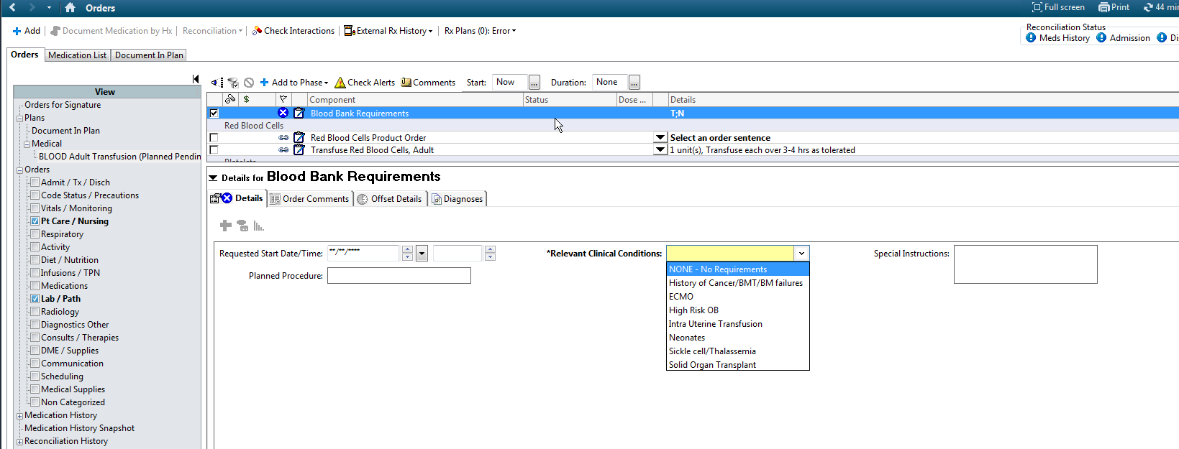
Blood Bank Requirements
New build in ORCA allows physician to alert the lab of special product requirements or relevant clinical conditions such as sickle cell or IUT
This will print individually or part of the product order
Information to alert lab staff that attribute, additional preparation or testing of blood products may be needed. If attribute such as irradiation is not listed in the patient’s BAD file, the attribute should be added at the time of receipt. Staff who do do not have SQ permission to add an attribute, should notify a MLS lead/MLS2 or manager to add the attribute at the time of receipt.
New clinical conditions (ECMO, IUT, High Risk OB, Solid Organ Transplant) should also be communicated to TSL management for appropriate review.
Sickle cell/Thalassemia should prompt adding a comments for needed Rh/K matching and communication with BB MD for review

Slide 9
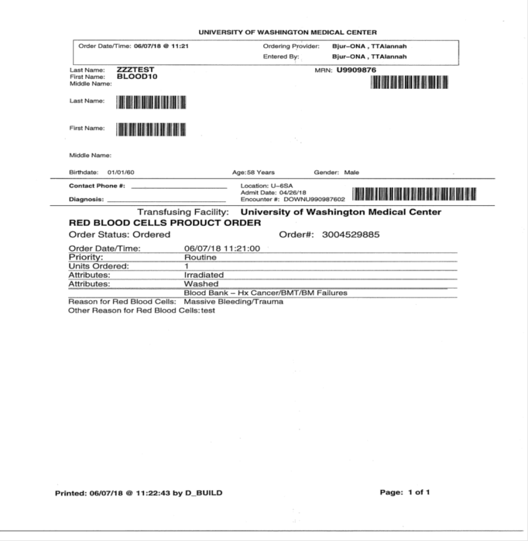
Projected Workflow for TSL
Provider places blood product order in ORCA
Order prints in the lab and interfaces with SQ

Slide 10
Projected Workflow for TSL (cont)
Open General Laboratory
Scan patient MRN
Select appropriate order to receive
TPLT, TFFP, TCRY interface directly with SQ meaning no more order entry for these products
TRBC (RBC order), TGRAN (granulocyte order) need to be received similar to platelet/plasma orders
Add the RBC or Granulocyte to current in date type and screen – this is the same as current process
Attributes automatically populate the patient SQ BAD file for Irradiation, Washed and Hb S. Volume reduction does not populated the attribute field
Special requirements such as Pooled/HLA matched/apheresis will not interface in BAD file but will print on the requisition and display under %PI in SQ

Slide 11
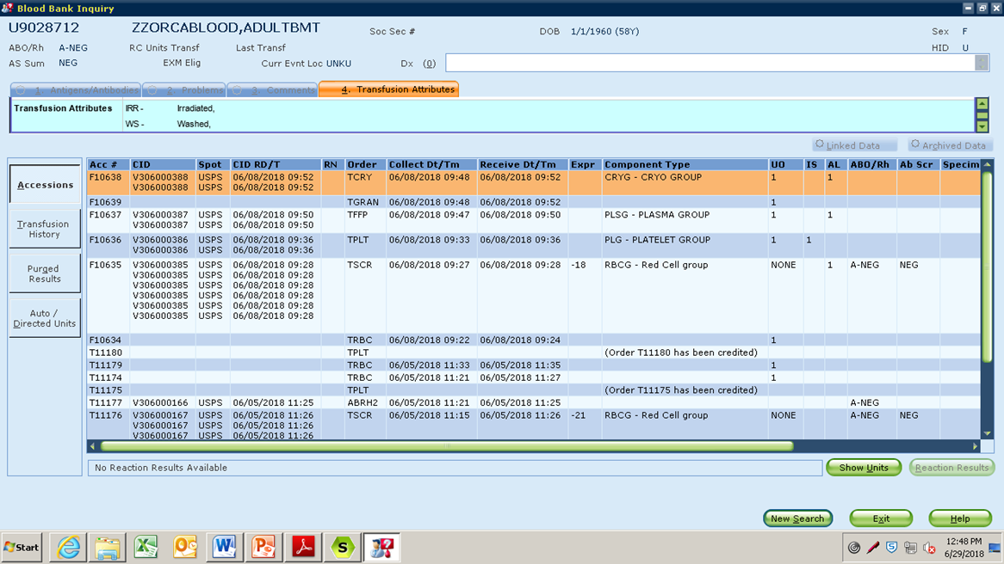
Projected Workflow for TSL (cont)
TRBC (RBC orders) and TGRAN(granulocyte orders) now appear in BBI similar to cryo, plt, and plasma orders
Attributes automatically interface to the attribute field

Slide 12
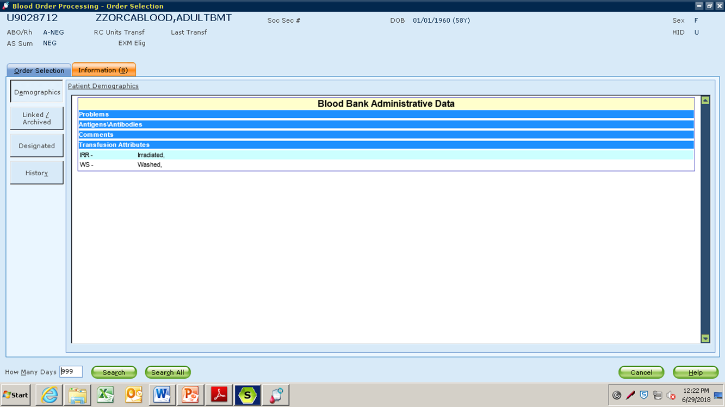
Projected Workflow for TSL (cont)
In SQ BOP (Blood Order Processing), attributes display the same as they do now on the first screen you see
Attributes that display in this field: Washed, Irradiated, HbS
No change to process for entering test results or allocating blood components

Slide 13
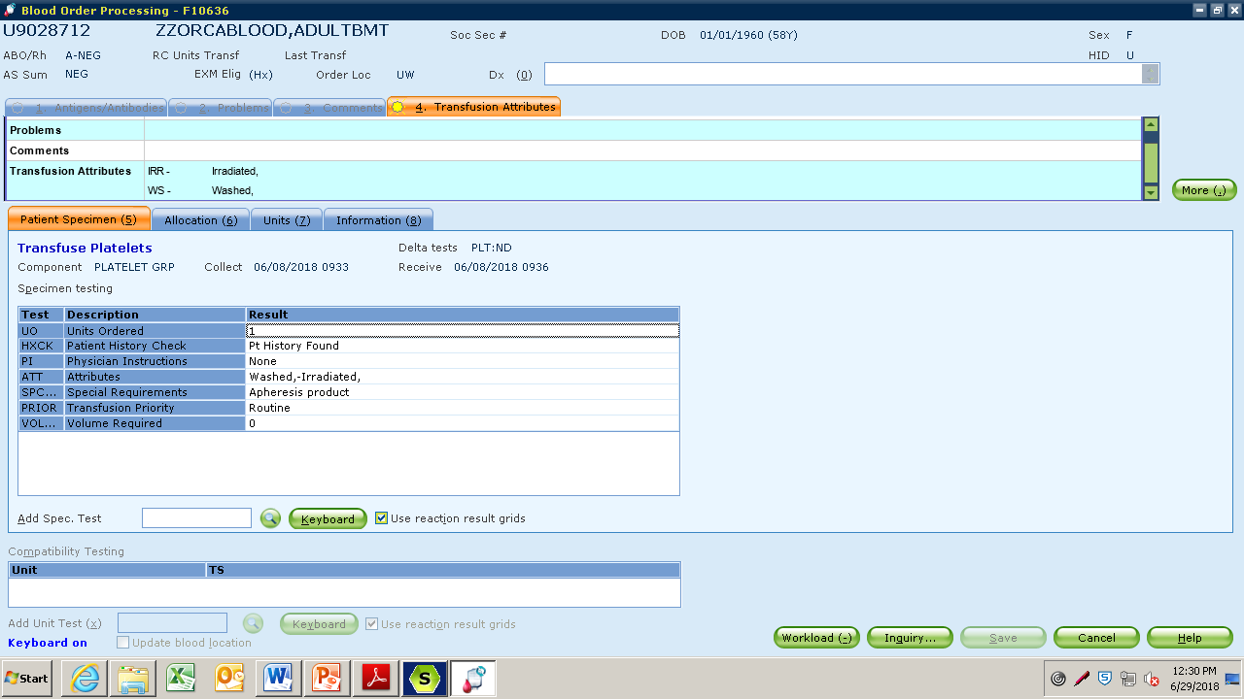
Projected Workflow for TSL (cont)
Platelet Orders: Attributes (washed, irradiated) and special requirements (apheresis) display as part of the order in BOP
Special requirements- must be reviewed in the order. Unlike attributes, special requirements do not interface to update BAD file. If order indicates apheresis, provide apheresis until review by TSL MDs is complete. Other examples are HLA or Pooled.

Slide 14
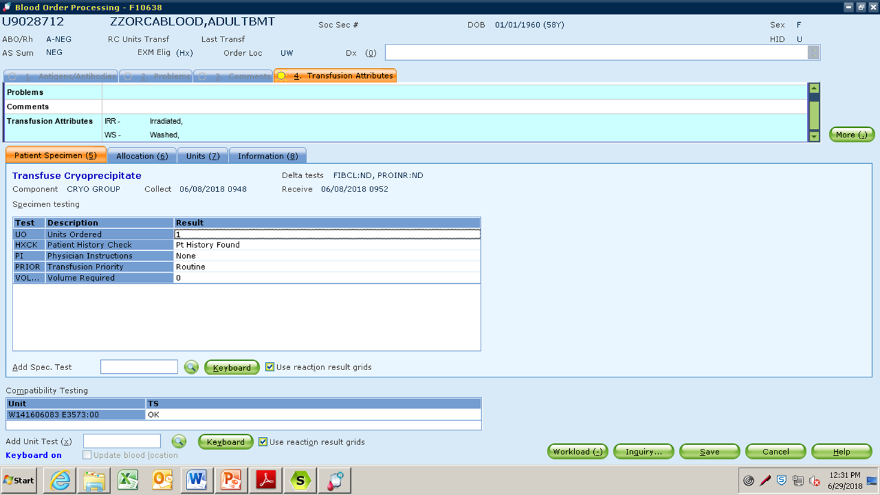
Projected Workflow for TSL (cont)
Cryoprecipiate Order:

Slide 15
Projected Workflow for TSL (cont)
Plasma Order:
Volume Required- neonate and plasma exchanges (ml)

Slide 16
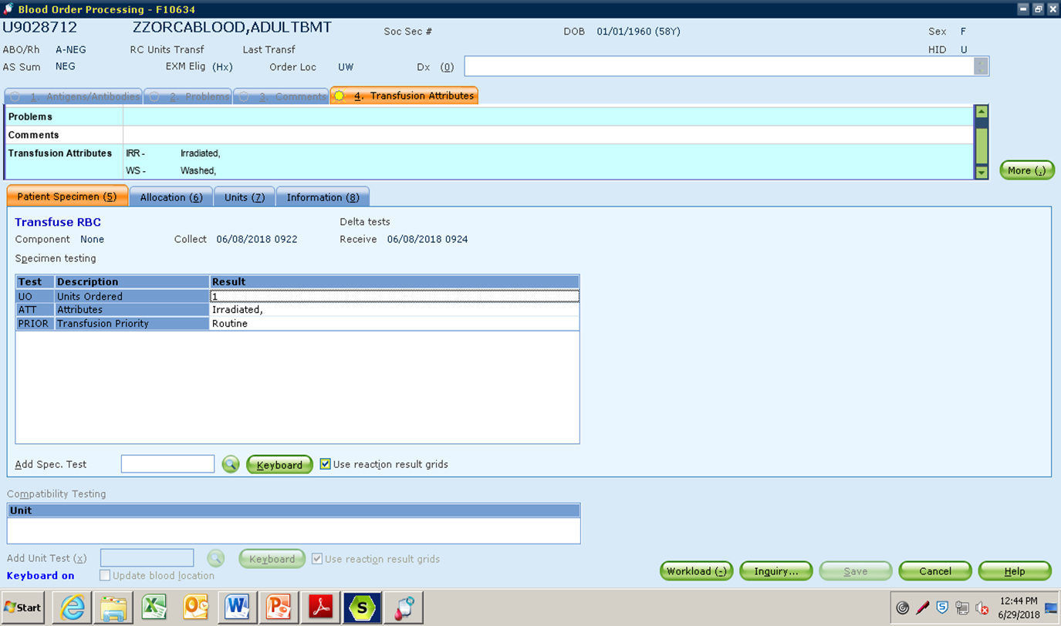
Projected Workflow for TSL (cont)
New RBC Order (TRBC):Displays date/time the order was placed (collected) and received along with attributes. RBCs CANNOT be allocated on this accession. The number of RBCs ordered must be added to the current TSCR order SQ (same as the current process)

Slide 17
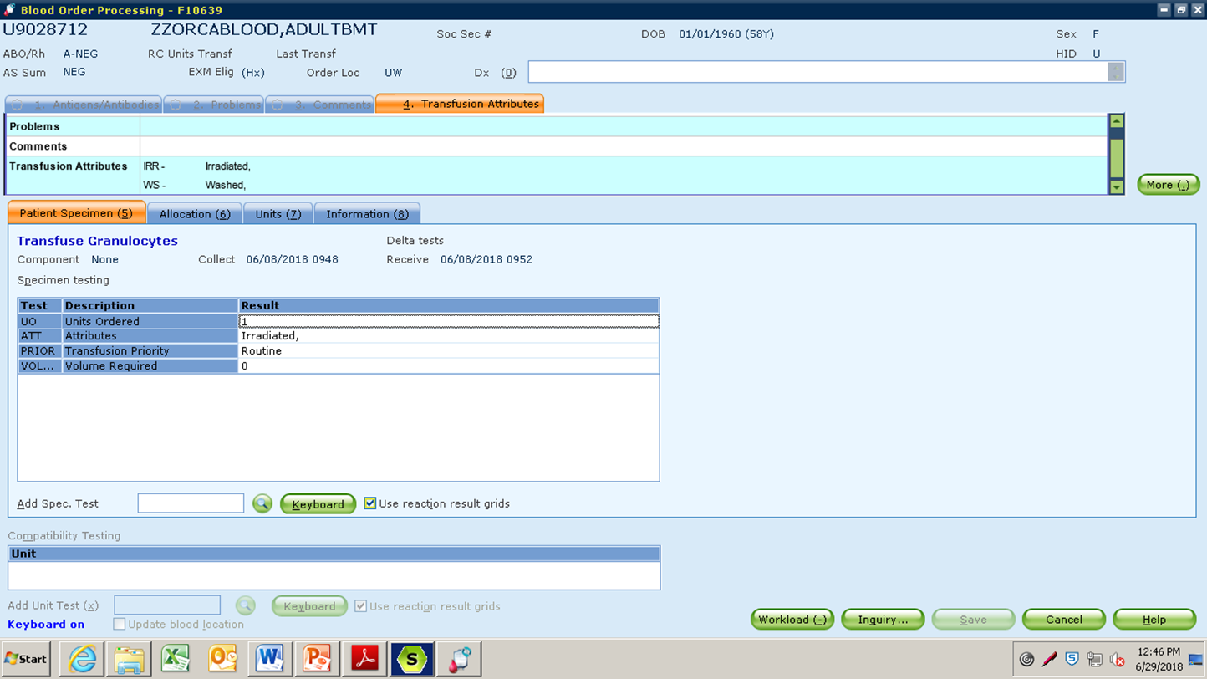
Projected Workflow for TSL (cont)
New granulocyte order (TGRAN):Displays date and time the order was placed and received and attributes. Granulocytes CANNOT be allocated on this accession. The number of granulocytes ordered must be added to the current TSCR order SQ (same as the current process)

Slide 18
Projected Workflow for TSL (cont)
After receiving order in SQ
Fill the order same as current workflow
Notify clinical team (RN) when the blood product(s) is available
RN will release the electronic Blood Product Release Form when ready to transfuse
Electronic Blood Product Release Form will print in the lab

Slide 19
New eBlood Product Release Form
This section is not used by UWMC BB

Slide 20
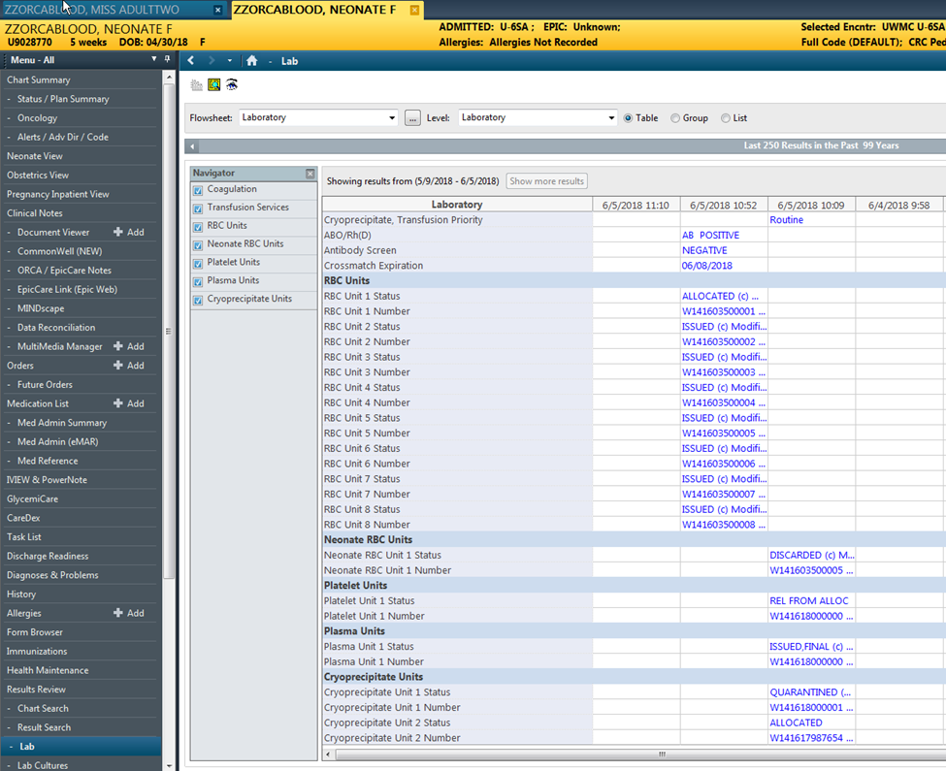
ORCA results display
Unit numbers and status of blood product are visible in ORCA

Slide 21
SCCA outpatient orders
SCCA Outpatient Product Orders will not be interfaced to SQ but the requisition will look very similar
Why? SCCA places orders for the future that cannot be interfaced at time of order.
SCCA orders are placed in future state, but not activated
When the order is activated,
Product order will display in general lab and can be received if the future order has not been filled or ordered.
Attributes requested will interface to the BAD file therefore at issue if a unit should be irradiated and is not, there will be a QA failure in SQ
These orders will print in TSL on a printer dedicated to SCCA outpatient orders
TSL workflow for processing SCCA outpatient orders will not change from the current workflow
Notes:
Orders cleaned up after14days in gen lab.

Slide 22
SCCA Outpatient Orders
No change from current status

Slide 23
Orders not Received
SCCA outpatient orders- When activated the order will display in SQ General Laboratory. If nurse/clinician cancels order in ORCA, the order will automatically be deleted form SQ.
SQ performs an auto cleanup in 14 days deleting any pending product orders
Inpatient duplicate orders- If nurse/clinician cancels order in ORCA, the order will automatically be deleted form SQ.
Once received in SQ Gen Lab by BB, orders canceled in ORCA do not delete from SQ.

Slide 24
Go Live- August 14th 8am
Support for clinicians and nurses will be through UW IT and the UWMC Clinical Nurse Educator
Support for laboratory staff will be through lab medicine IT, TSL Medical Directors and Managers

