Slide 1
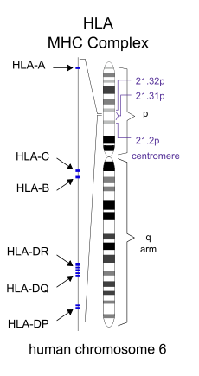
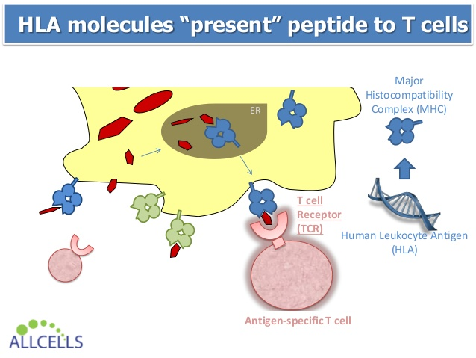
Human Leukocyte Antigen
Gene complex encodes major histocompatibility complex
Immune system identifies self from non-self
HLA I expressed on cells, including platelets
HLA I/II expressed in WBC
Notes:
What is HLA?
It is a highly variable gene complex which encodes MHC in humans
Immune sys id self
There are various different loci corresponding to different antigens on this Chr 6 and these constitute HLA A, B, C, DR, DQ, DP
HLA II on WBC is important because it is responsible for presenting HLA I antigens and HPA to immune system and causing more refractoriness.
The majority of clinically relevant HLA antibodies have been shown to be immunoglobulin G (IgG) and are directed against epitopes of class I HLA (A and B) (Yankee et al, 1969).
Although it has been reported that HLA-C is also expressed on platelets, its expression is lower and there are conflicting and limited data regarding the role of HLA-C antibodies in the outcome of platelet transfusion in alloimmunized patients (Legler et al, 1997; Meehan et al, 2000). Therefore, matching for HLA-C antigens is not regularly considered in the provision of HLA-selected platelets.

Slide 2
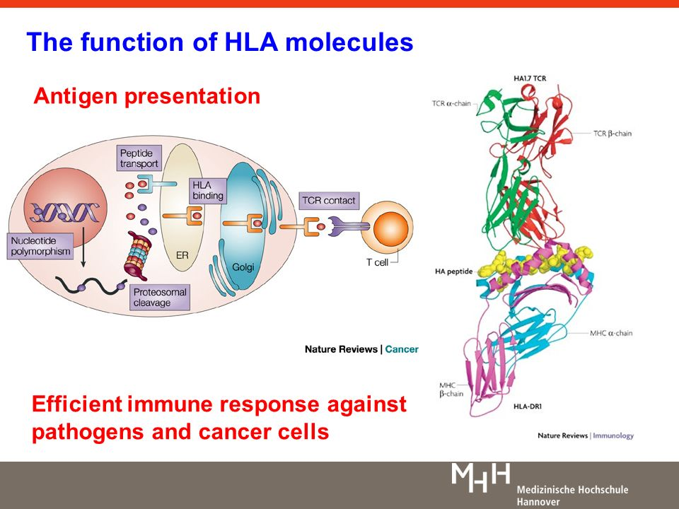

Slide 3
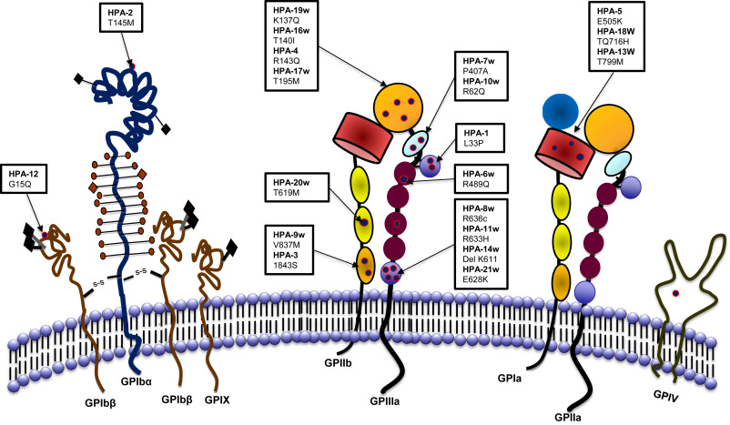

Slide 4
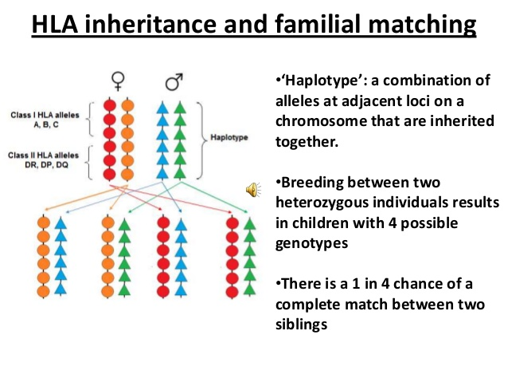
Notes:
I mentioned that HLA is genetically determined, so it is inherited from one’s parents and all of the ones on a single chromosome are passed on as a haplotype
Treatment of HLA Alloimmunization- Induced Refractoriness Platelet transfusions from HLA matched donors (Yankee et al. N Eng J Med 281:1208, 1969) Platelet transfusions from donors mismatched for cross-reacting HLA antigens (Duquesnoy et al. Amer J Hematol 2: 219, 1977)
Serological Cross-Reactivity Between HLA Antigens HLA antigens carry “private” and “public” epitopes Cross-Reacting Groups (CREGs) of HLA antigens share the same public epitope Rodey and Fuller: Crit Rev Immunol 7:229, 1987

Slide 5
Why are we interested in HLA in transfusion?
Platelet refractoriness
  HLA is expressed on Platelets
  Why we leukoreduce
Transfusion associated GvHD
  Why we irradiate blood products in directed donation, etc.
Notes:
Why are we interested in HLA in transfusion?
There are several reasons, including especially that HLA plays a role in platelet refractoriness and in Transplant because of its role in identifying self from nonself
As you can imagine from the familial inheritance, this is why family members are more likely to match in a transplant
This also plays a role in TAGVHD and why we irradiate all BP donated from family members

Slide 6
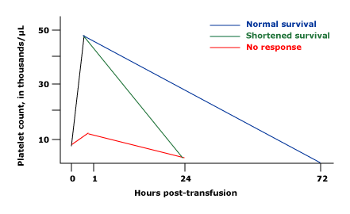

Platelet Refractoriness
Failure to achieve desired level of blood platelets in a patient following blood transfusion
Corrected count increment (CCI):
# PLT transfused ~300
CCI > 7500 considered sufficient
CCI < 7500 considered refractory
$$CCI=\frac{\left(PostCount −Pre\right)BSA }{\#PLT Transfused}$$
UptoDate, 2018
Notes:
I mentioned platelet refractoriness earlier
Patients may demonstrate refractoriness to platelet transfusions for a variety of reasons
The classic situation of alloimmunization is illustrated in the inset figure. A patient shows good responses to platelet transfusions initially, but these decline as the alloantibodies appear.
Later, provision of compatible units that lack the epitopes against which the antibodies are reacting result in a return of good increments and the desired clinical effect.
The alloantibodies are most commonly due to HLA antibodies or, less frequently, to antibodies against platelet-specific antigens.
In some patients with high titers of ABO antibodies, these isoagglutinins can also cause a blunted response to transfusions until platelets that do not bear ABO-incompatible antigens are transfused. Autoantibodies can, of course, cause similar platelet clearance, and this is a more difficult problem as compatible platelets are not to be found. Antibodies directed against drugs can also cause accelerated platelet clearance, either because the dugs or the immune complexes bind with platelets. Finally, non-immune causes of refractoriness need to be considered, including infection and sepsis, DIC and splenomegaly.
The TRAP study reported that in patients with acute myeloid leukaemia the incidence of HLA alloimmunization in patients receiving leucocyte-reduced blood components was 9% in patients who had never been pregnant and 32% in those with a history of pregnancy
Specific HPA antibodies occur at a frequency of 8% (The Trial to Reduce Alloimmunization to Platelets Study Group, 1997) to 20–25% (Murphy & Waters, 1985) in various studies of multi-transfused haematology patients and are usually found in combination with HLA antibodies (Kurz et al, 1996), although they may occur in isolation (Pavenski et al, 2012).
Two patterns can be seen in refractory patients. A normal increment at one hour following transfusion with return to the baseline count within 24 hours (green curve) is typical of the shortening of platelet survival seen with sepsis, hematopoietic cell transplantation, disseminated intravascular coagulation, and possibly in bleeding patients and those taking medications that interfere with platelet survival. The second pattern consists of little or no increment in platelet count, even within one hour of transfusion (red curve); this pattern is seen with alloimmunization.

Slide 7
Platelet Refractoriness
Failure to achieve desired level of blood platelets in a patient following blood transfusion
Corrected count increment (CCI):
# PLT transfused ~300
CCI > 7500 considered sufficient
CCI < 7500 considered refractory
CAUSES
Non-immune
• Infection/sepsis
• DIC
• Splenomegaly
Immune
Alloantibodies
  - HLA and/or HPA
  - ABO
Other antibodies
  - Autoantibodies
  - Drug-dependent abs
$$CCI=\frac{\left(PostCount −Pre\right)BSA }{\#PLT Transfused}$$
Stanworth et al, 2015
Notes:
I mentioned platelet refractoriness earlier
Patients may demonstrate refractoriness to platelet transfusions for a variety of reasons
The classic situation of alloimmunization is illustrated in the inset figure. A patient shows good responses to platelet transfusions initially, but these decline as the alloantibodies appear.
Later, provision of compatible units that lack the epitopes against which the antibodies are reacting result in a return of good increments and the desired clinical effect.
The alloantibodies are most commonly due to HLA antibodies or, less frequently, to antibodies against platelet-specific antigens.
In some patients with high titers of ABO antibodies, these isoagglutinins can also cause a blunted response to transfusions until platelets that do not bear ABO-incompatible antigens are transfused. Autoantibodies can, of course, cause similar platelet clearance, and this is a more difficult problem as compatible platelets are not to be found. Antibodies directed against drugs can also cause accelerated platelet clearance, either because the dugs or the immune complexes bind with platelets. Finally, non-immune causes of refractoriness need to be considered, including infection and sepsis, DIC and splenomegaly.
The TRAP study reported that in patients with acute myeloid leukaemia the incidence of HLA alloimmunization in patients receiving leucocyte-reduced blood components was 9% in patients who had never been pregnant and 32% in those with a history of pregnancy
Specific HPA antibodies occur at a frequency of 8% (The Trial to Reduce Alloimmunization to Platelets Study Group, 1997) to 20–25% (Murphy & Waters, 1985) in various studies of multi-transfused haematology patients and are usually found in combination with HLA antibodies (Kurz et al, 1996), although they may occur in isolation (Pavenski et al, 2012).
Two patterns can be seen in refractory patients. A normal increment at one hour following transfusion with return to the baseline count within 24 hours (green curve) is typical of the shortening of platelet survival seen with sepsis, hematopoietic cell transplantation, disseminated intravascular coagulation, and possibly in bleeding patients and those taking medications that interfere with platelet survival. The second pattern consists of little or no increment in platelet count, even within one hour of transfusion (red curve); this pattern is seen with alloimmunization.

Slide 8
Increased risk of refractoriness
An analysis of transfusion and clinical factors captured in the TRAP Study identiﬁed:
Fever (≥38 4°C)
Increasing number of platelet transfusions
Heparin administration
Bleeding
Increasing weight
History of at least two pregnancies
Male gender

Slide 9
Panel Reactive Antibodies (PRA)
Screen for HLA alloimmunization
Analogous to the “Screen” in a Type & Screen for Red Cell alloimmunization
Methodologies
  Complement‐Dependent Cytotoxicity (CDC) Assay
  FlowPRA
  Luminex‐based Bead assay

Slide 10
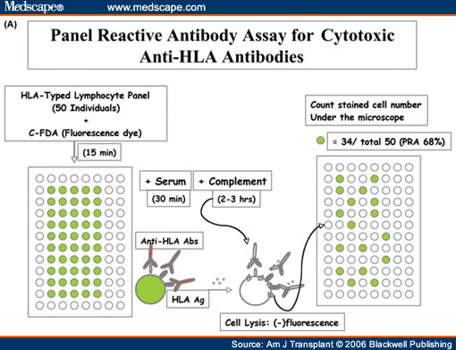

Slide 11
Platelet antibody screen
by solid-phase red cell adherence assay
Solid phase – tube wall
2. Test platelets stick to wall
3. Patient serum contributes
antibodies to platelets
4. Develop with anti-IgG and antibody-coated RBC
Positive – RBC
stick to wall
Negative – RBC
pool in bottom
Notes:
To detect platelet antibodies, one may use a PLT atb screen
This is on e example by solid pahse red cell adherence assy
This is similar to the solid phase assays that you would already be familiar with

Slide 12
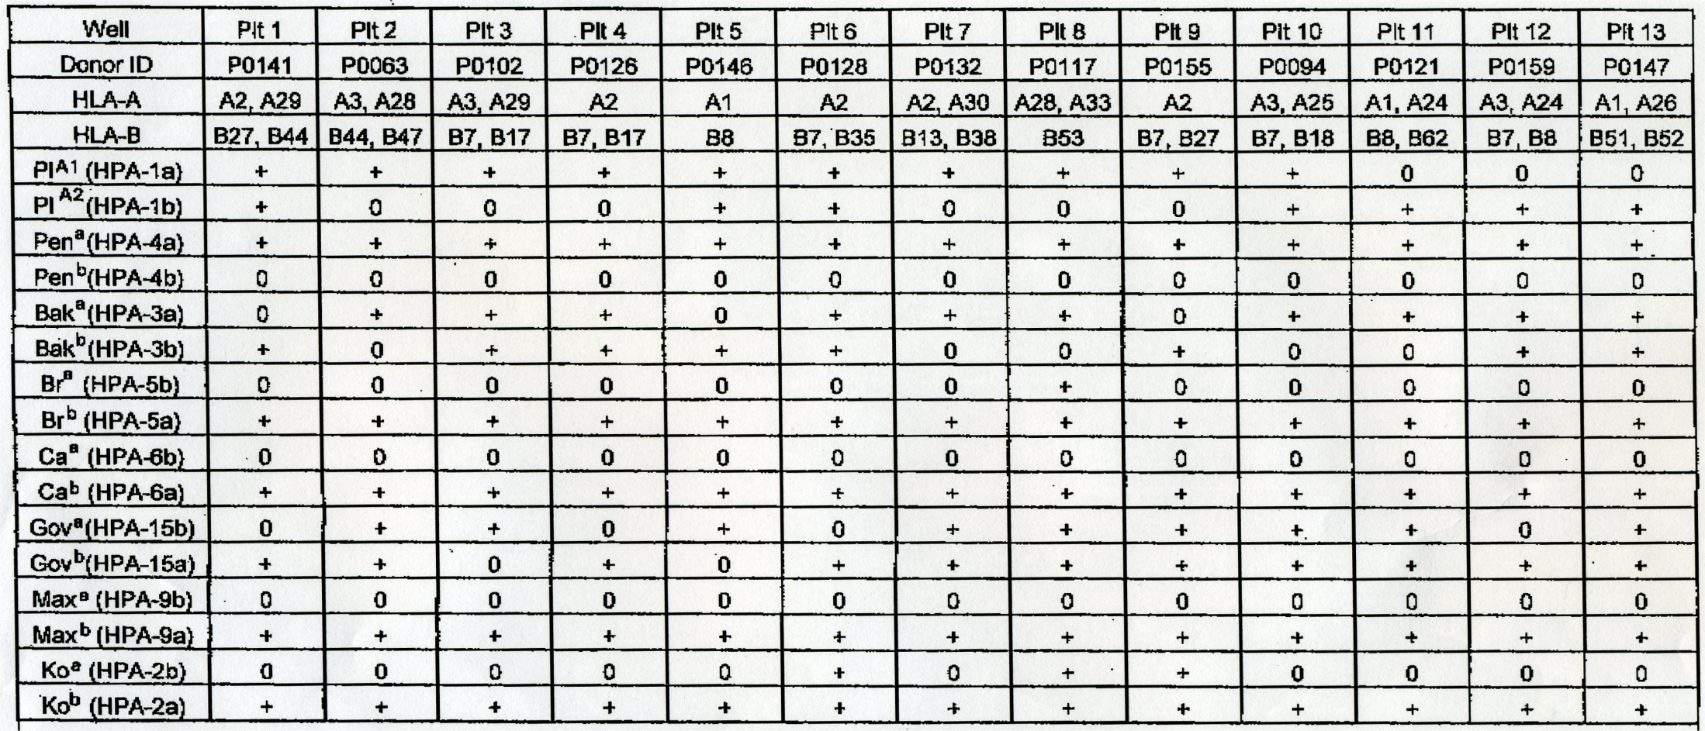
Platelet antibody screen
by solid-phase red cell adherence assay
Problem = so many possible
antibodies that it is hard to
sort them out
Notes:
The problem with this is that there are so many possible antibodies -> impossible to rule them out – imagine having to do antibody identification one this!
Therefore, it’s mostly just good for initial screening purposes. Are there antibodies or not.

Slide 13
CDC Assay
Advantages
  Relatively inexpensive assay
  Easy to perform
Disadvantages
  Dependent on cell viability
  Can be difficult to assign antibody specificity for highly sensitized patients

Slide 14
PRA Positivity
>20% commonly used as the cut‐off
Historically refers to CDC assay
BWNW uses a calculated PRA (cPRA) with the Luminex Analyzer

Slide 15
Platelet crossmatching
by solid-phase red cell adherence assay
Problems:
Blind crossmatch -
Labor intensive and expensive
Platelet inventory is limited, even in a regional center, and turns over rapidly
Notes:
There’s something called platelet xmatching, not going to go into this in detail, done at NYBC, not done at BWNW

Slide 16
HLA Class I panel reactive antibody (PRA)
Polypeptide HLA epitope, 1 of 300
Fluorescent bead
Flurorescent bead with all 300 epitopes
Fluorescent bead with all 300 epitopes dipped in patient serum and developed with a second anti-IgG antibody with a fluor. Relative brightness is a measure of the number of different HLA antibodies
Notes:
To actually identit
Screen patient sera with HLA typed panel –Complement-dependent methods: direct and/or antiglobulin-augmented lymphocytotoxicity –Antigen-binding assays such as Luminex, Flow Cytometry and ELISA preferably with single HLA class I alleles –HLAMatchmaker-based analysis of serum reactivity pattern to identify acceptable mismatches
HLAMatchmaker-Defined Triplet Matching for Patients with Class I HLA Allele Mismatched Hematopoietic Cell Transplants from Unrelated Donors Duquesnoy et al. Biol. Blood Marrow Transplant. 14: 1064-1071, 2008 National Marrow Donor Program (NMDP) Study 2431 cases including ALL (N=581), AML (N=676), CML (N=954) and MDS (N=223) Compare 10/10 allele matches with 9/10 allele matches with different numbers of mismatched triplets Analyze engraftment, GVHD incidence and patient survival

Slide 17
HLA Class I antibody identification
Flurorescent bead with 1 epitope
Different fluorescent bead
with a second epitope
Determine which fluorescent beads and their epitopes are associated with antibodies 100 different beads at a time.
Notes:
To actually identify the HLA antibodies, one modern method is that a fluorescence bead is covered in a single epitope with an array or panel of many many different beads and the antibodies are reacted against this, then the fluorescene of each bead with the single epitope is measured to determine reactivity against HLA A1,2,3,4, and so on.
Screen patient sera with HLA typed panel –Complement-dependent methods: direct and/or antiglobulin-augmented lymphocytotoxicity –Antigen-binding assays such as Luminex, Flow Cytometry and ELISA preferably with single HLA class I alleles –HLAMatchmaker-based analysis of serum reactivity pattern to identify acceptable mismatches
HLAMatchmaker-Defined Triplet Matching for Patients with Class I HLA Allele Mismatched Hematopoietic Cell Transplants from Unrelated Donors Duquesnoy et al. Biol. Blood Marrow Transplant. 14: 1064-1071, 2008 National Marrow Donor Program (NMDP) Study 2431 cases including ALL (N=581), AML (N=676), CML (N=954) and MDS (N=223) Compare 10/10 allele matches with 9/10 allele matches with different numbers of mismatched triplets Analyze engraftment, GVHD incidence and patient survival

Slide 18
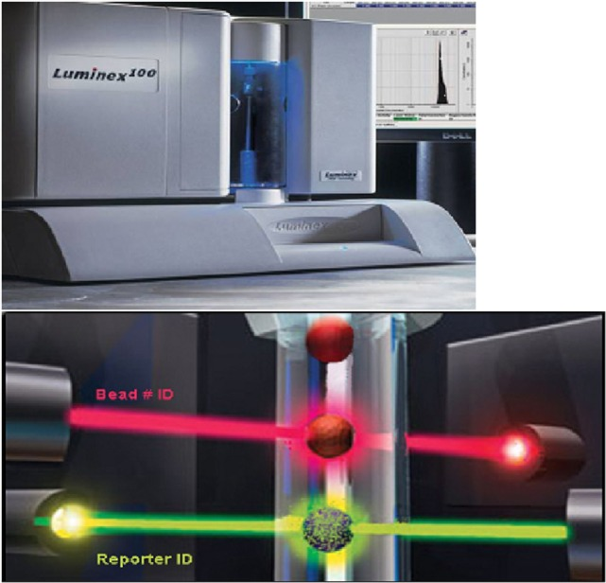
Tait, 2015
Notes:
The top panel shows the Luminex instrument. There are two lasers in the Luminex instrument (bottom panel). The red laser excites the fluorophore in the bead which provides a unique signal thereby identifying the HLA molecule attached. The green laser excites the phycoerythrin bound to the second anti-human IgG antibody indicating IgG antibody in the test serum has bound to the appropriate HLA molecule attached to the bead. (Modified from a figure provided by Serologicals Corporation.)
The degree of fluorescence is expressed as a mean fluorescence intensity (MFI), which is normalized by taking into account the degree of fluorescence observed with an antibody negative serum and with beads to which no HLA molecule is attached. A positive control consists of beads bound with PE-labeled human IgG.
https://www.ncbi.nlm.nih.gov/pmc/articles/PMC5146910/

Slide 19
Each bead has multiple copies of a single HLA antigen

Slide 20
Dual‐colored Beads
Each bead has a particular ratio of green:red
The luminex can identify each bead
Adapted from Barroso, PBSC

Slide 21
38 Beads Separated in 2‐D

Slide 22
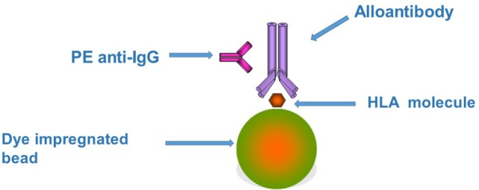
Luminex Single Antigen Assay
Beads are incubated with patient serum and a PE‐tagged anti‐IgG antibody
The sample is washed and analyzed using a Luminex Analyzer
The Luminex Analyzer can identify which individual beads are positive
Tait, 2015
Notes:
The figure represents the principles underlying the Luminex bead assay. Each bead has one or more different types of human leukocyte antigen (HLA) molecules attached depending on the level of testing being performed. If the test serum contains an HLA antibody it will bind to the appropriate HLA molecule. This binding can be detected by the use of a second phycoerythrin (PE)-labeled anti-human IgG. Each bead gives a specific signal when excited by one of the lasers built into the Luminex instrument due to the unique intensity of fluorophore embedded in the bead. A second laser detects the fluorescent excitation produced by the PE on the second antibody. The combination of the two signals indicates first the presence (PE fluorescence) and second the specificity (bead fluorescence) of the HLA antibody in the test serum.
https://www.ncbi.nlm.nih.gov/pmc/articles/PMC5146910/

Slide 23
Sensitized to One Antigen
Adapted from Barroso, PBSC

Slide 24
Highly Sensitized
Adapted from Barroso, PBSC

Slide 25
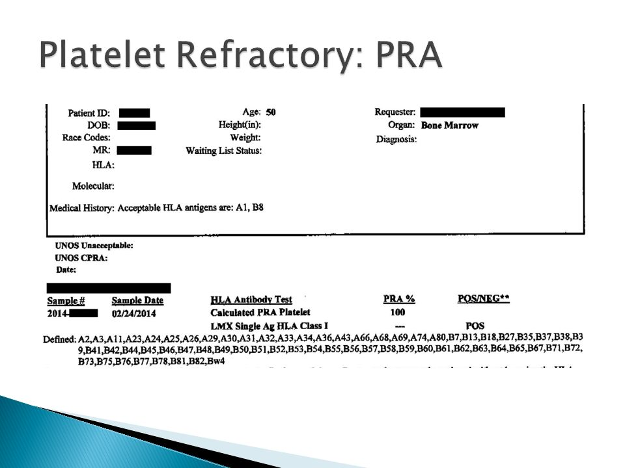
Notes:
The PRA measured the incompatibility of serum from a person or patient against a panel of non-self white blood cells. The test was done one of several ways, but the PRA was designed to detect the presence of antibodies against HLA antigens. The percentage of the test cells against which the serum reacted was also called the “PRA” (technically, the PRA “score,” but pretty much everyone just said “PRA”), and generally represented the percentage of the general population against which the patient was incompatible (e.g., a PRA of 75 means that the person had antibodies against 75% of the population).
The antibody specificities can then be used to generate a “calculated PRA” (cPRA), which has the same basic meaning as the old PRA score. The cPRA may be useful to blood bankers in the management of patients with platelet refractoriness (a situation where platelet transfusions lead to an insufficient response in the patient), because it helps to predict the percentage of random donors who are expected to be incompatible with the patient’s anti-HLA antibodies.

Slide 27
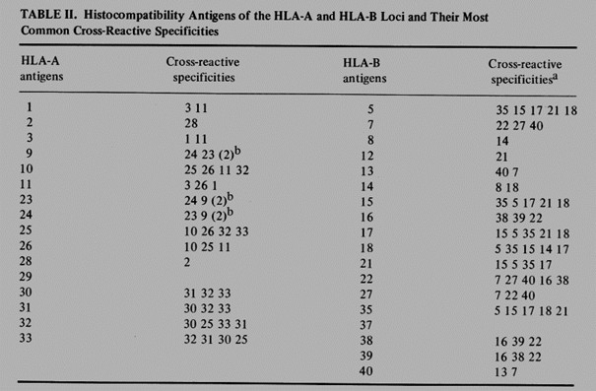
Duquesnoy et al. American Journal of Hematology. 2:219-226, 1977
Notes:
With the realization that the majority of HLA antibodies are directed against public epitopes (Rodey et al, 1994), ‘permissive’ mismatches in HLA-A and -B antigens were organized into cross-reactive groups (CREGs) on the basis of shared public epitopes. With CREG matching, platelets with one or two mismatches could be used as long as these antigens fell within the same CREG (Vassalo, 2007).
One such system used the match grade ‘A’ to signify full antigen match at all four HLA-A and B antigens, ‘BU’ to indicate a donor with homozygous antigens at HLA-A and/or B but who nevertheless had no HLA antigens not present in the patient,
‘BX’ to indicate a donor with one or more HLA antigen mismatches with the patient where the mismatches are all in the same CREG’s as the patient antigens and ‘C’ to indicate a donor with one or more mismatches where the mismatches are not in the same CREG’s as the patient antigens (Brown & Navarrete, 2011; Kopko et al, 2015).

Slide 28
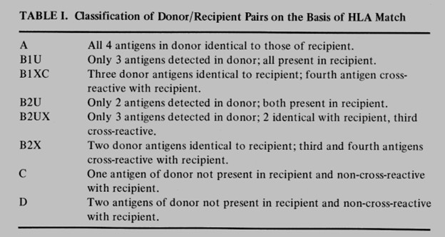
Duquesnoy et al. American Journal of Hematology. 2:219-226, 1977
Notes:
A (all 4 antigens HLA-A/-B in donor identical to recipient).
B (all donor antigens are present in the recipient phenotype but the donor lacks one (B-1) or two (B-2) of the recipient antigens). These are mismatches within cross-reactive groups (CREGS), as explained below.
C (donor possesses 1 or more antigens not found in the recipient) (Tosato et al, 1978). These are mismatches outside CREGS.
Donors typed by molecular methods can be considered homozygous for an antigen rather than “unknown”, when only one HLA Class I A or B antigen has been identified

Slide 29
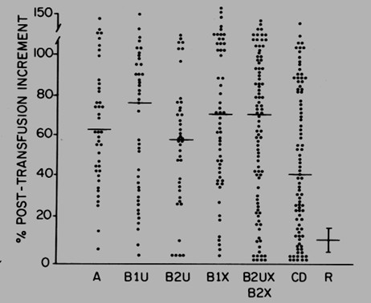
Responses to Platelet Transfusions with Different HLA Match Grades
Duquesnoy et al. American Journal of Hematology. 2:219-226, 1977
Notes:
Many BX Matches Have Incompatible Epitopes Cross-Reacting Matches and Bw4/Bw6 mismatches B Bw4/Bw6 epitopes are defined by residues in 79-83 sequence Effect of BW4/6 incompatibility on responses to BX matched platelet transfusions Patients 1-8: lower increments Patients 9-21: comparable increments McElligott et al Blood 59: 971, 1982
A and BU match groups may have incompatible epitopes revealed by 4-digit DNA typing
CREG matching considers only HLA-A and HLA-B; how important is HLA-C?

Slide 30
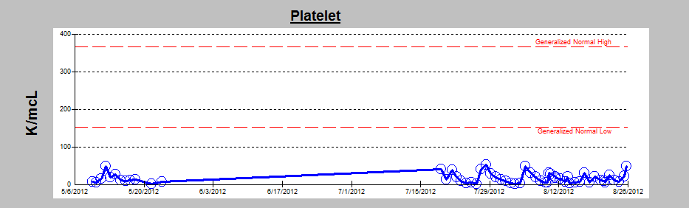
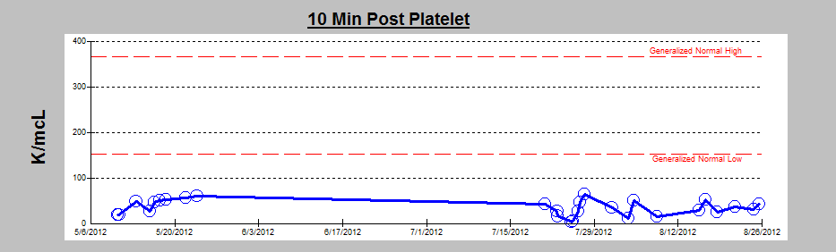
Managing patient with platelet antibodies
48 yo with breast cancer and aplastic anemia has had poor increments to platelets.
Antibody screen was 9/13 in May 2012
HLA Class I type is
A 2, 68; B 51, 60
She has antibodies against:
A:1 23 24 29 36
B:18 27 37 41 42 49 50 52 55 56 57 59 62 63 64 65 67 7 71 72 73 76 8 81 82

Slide 31
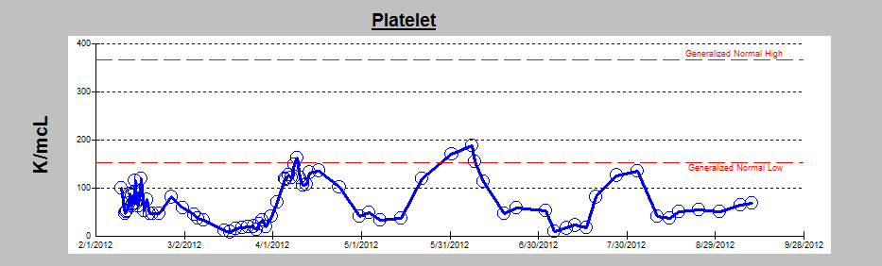
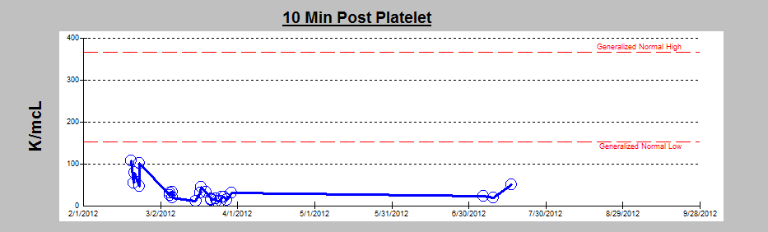
Managing patient with platelet antibodies
74 yo woman with MDS progressing to AML has had poor increments to platelets.
Antibody screen was 4/13 in March 2012
HLA Class I type is
A 1, 24; B 44, 44
She has antibodies against:
A:2 3 11 23 25 26 33 34 43 66 68 69
B:13 18 27 35 37 38 39 41 42 45 46 47 48 49 50 51 52 53 54 55 56 57 58 59 60 61 62 63 64 65 67 7 71 72 73 75 76 77 78 8 81 82

Slide 32
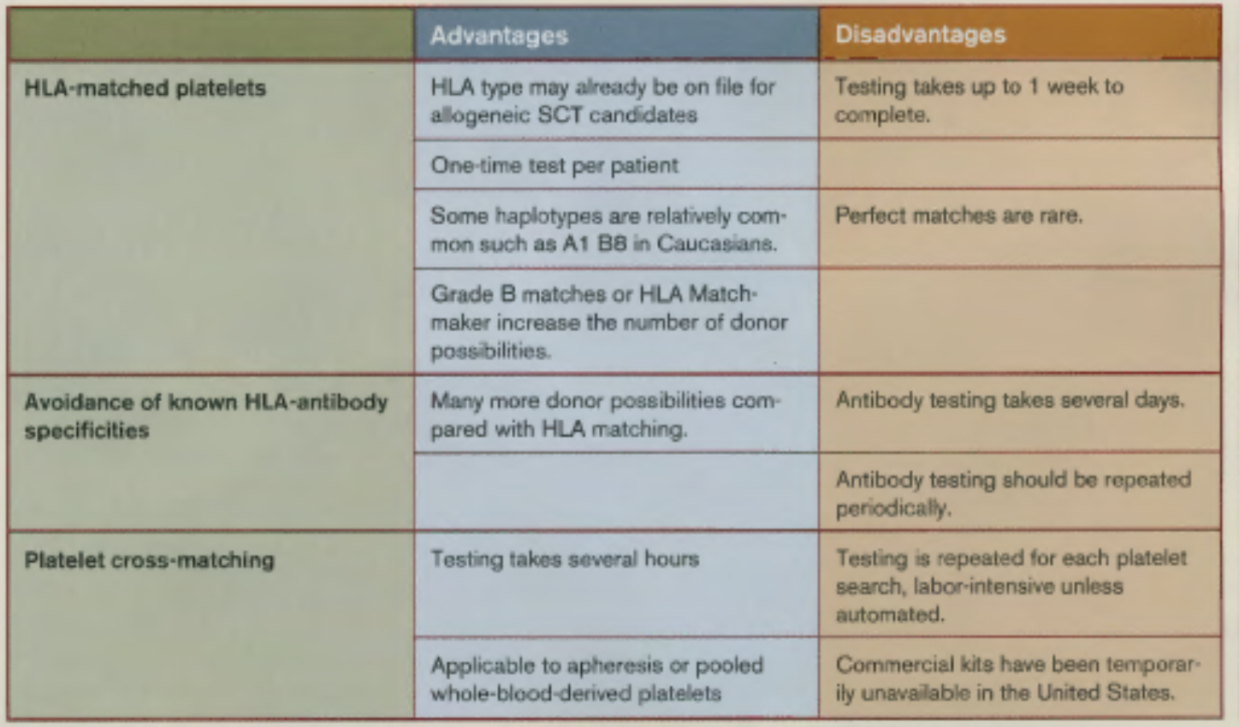
Finding Compatible Platelet
Problems:
Blind crossmatch -
Labor intensive and expensive
Platelet inventory is limited, even in a regional center, and turns over rapidly
Karen Quillen, The Hematologist, 2013 Dec; 10(6):4
Notes:
Donors typed by molecular methods can be considered homozygous for an antigen rather than “unknown”, when only one HLA Class I A or B antigen has been identified

Slide 33
HLA alloimmunization
40
RANDOM UNITS
COMPATIBLE UNITS
30
1 hr post-transfusion plt count
(10³/uL)
20
10
10
20
30
Treatment days

Slide 34
2015 Review
If refractoriness suspected, clinical assessment and treatment of potential contributory non-immune factors
Published guidelines: provision of fresh ABO-identical apheresis PLT with CCI
  (Hod & Schwartz, 2008; Nahirniak et al, 2015)
Screen for HLA antibodies
Monitor CCI to assess response
Some institutions and published guidance suggested PLT drips
Notes:
If there are improved responses, HLA-selected platelet transfusions should continue to be used for further transfusions. If there are poor responses to HLA-selected platelet transfusions, the reasons should be sought including poor HLA compatibility of the selected product, non-immune platelet consumption and HPA and ABO incompatibility.

Slide 35
Classic HLA matching
  Major limitation need for pt HLA type
  Large registries for identical matches
Antibody specificity avoidance
HLA-selected platelets based on the HLA type of the patient and their HLA antibody profile using a panel of HLA typed donors
Cross-matching of platelets
Notes:
Restricting use to only A-level or BU-level HLA-matched platelets often greatly limits potentially available platelet inventory and can lead to transfusion delays as the patient is HLA-typed and a matching platelet unit is obtained.9 Moreover, this
HLA-matching process does not account for any circulating HPA antibodies.

Slide 36
Classic HLA matching
Antibody specificity avoidance
  Useful for short term PLT support
  potential of further immunization
HLA-selected platelets based on the HLA type of the patient and their HLA antibody profile using a panel of HLA typed donors
Cross-matching of platelets

Slide 37
HLA-selected platelets based on the HLA type of the patient and their HLA antibody profile using a panel of HLA typed donors
  Most commonly used by Canadian and NHSBT
  When only mismatched donors are available, PLT expressing HLA atgs different from the antibody specificities identified in pt are selected
  NHSBT provides HLA-selected plt (grades A and B) for over 70% of patients
Notes:
method most commonly used by Canadian centres supported by Canadian Blood Services (S Nahirniak, Alberta Health Services Edmonton Divisional Director, Hematopathology and University of Alberta Faculty of Medicine, Canada, personal communication).

Slide 38
Cross-matching of platelets: Alt method
Solid-phase red cell adherence, modified antigen capture ELISA, or flow cytometry
  Don’t need large panel of HLA-typed donors
  Don’t need recipient HLA-typed
  Lower cost for short term support
  Need testing each time a PLT transfuse
  Poss increase in the alloimmunization

Slide 39
No compatible donors?
no evidence that alloimmunized pt benefit from prophylactic transfusions of incompatible PLT that do not increase the platelet count, and prophylactic PLT support should be discontinued
If bleeding, random PLT or best matched despite incompat, but may req large doses
Notes:
High dose IVIG, splenectomy and plasma exchange, have not been shown to be effective (Schiffer et al, 1984, 2001). Alternative approaches, such as massive transfusions of ABO identical platelets, intravenous immunoglobulin (IVIG) and plasma exchange, have been used, but with less success (Schiffer et al, 2001).

Slide 41
High res vs Low res HLA

Slide 42
UWMC TSL
Need PLT now
If pt HLA type available, check if Matched HLA of A to BU available
If only PRA available or no matched available, check inventory for HLA selected PLT (avoids)
Issue apheresis or pooled (ABO compat preferred.
  Inform team no HLA PLT. Ask next time team needs PLT. Call MD.

Slide 43
UWMC TSL
Need PLT in the future
If pt HLA type available, check if Matched HLA of A to BU available
If only PRA available or no matched available, check inventory for HLA selected PLT (avoids)
Call BWNW or ARC to see if HLA matched PLT available, preferred over selected for avoids.
None of above available. Inform team no HLA PLT. Ask next time team needs PLT. Call MD.

Slide 44
Systematic review efficacy of HLA-selected PLT in hypoproliferative TP
HLA-selected PLT led to better 1-h CCI but insufficient power for mortality or hemorrhage
Pavenski et al, 2013
Notes:
However, in this review, no data on high-resolution HLA antibody definition and HLA typing was considered and hence it is possible that, in some cases, the products were not truly HLA matched.

Slide 45
HLAMatchmaker
Predicts HLA compatibility by identifying immunogenic epitopes represented by AA triplets (eplets) in atb-accessible regions of HLA molecules (Nambiar et al, 2006)

Slide 46
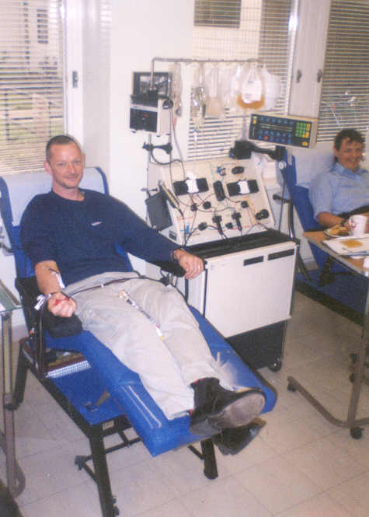
HLA Matched Platelet Components
-- from single donors
by apheresis
-- Registry search
-- Recruit
-- Collect
-- Test
-- Deliver
Takes a week!
Platelets being collected from a
single donor by apheresis
Notes:
Alternatively, the platelet unit can be created by apheresis. In this technique, the donor’s blood is anticoagulated with citrate as it leaves the arm, and platelets (and possibly other components) are separated in a centrifuge system through which the donor’s blood flows. The components that are not to be collected are returned to the donor. In 60-120 minutes, a therapeutic dose of platelets – usually containing the equivalent of a 6-unit pool of individual platelet units – is generated. This component is commonly referred to as “single donor platelets”.
The platelet storage bag is a specialised pack which is made from a gas permeable plastic. The pack has a larger surface area than for other products. Because platelets respire, O₂ and CO₂ exchange must be facilitated.
If adequate gas exchange cannot take place, the platelets revert to anaerobic respiration (glycolysis). This produces lactate and a build up of CO_{2.} These combine to overcome the buffering capacity of the plasma and lower the pH to the point that the platelets can no longer function and die.

Slide 47
Trial to Reduce Alloimmunization to Platelets said leukoreduced apheresis are best
Summary of results:
all treatment groups had significantly less HLA alloimmunization and refractoriness than the control group
no differences between study groups
low incidence of bleeding (0-1%) in all groups
filtered components recommended for AML patients
TRAP Trial Study Group. NEJM 1997;337:1861-9.
Notes:
All of the treatment groups showed reduced and similar reductions in HLA alloimmunization and refractoriness, and all patients avoided hemorrhagic complications at the same rate. Some patients developed HLA alloantibodies and refractoriness even though receiving leukoreduced platelets; these individuals may have been sensitized prior to the study even though they did not have demonstrable antibodies at its start. The study’s authors recommended the use of leukoreduced components for all AML patients as a means of avoiding or reducing the problem of refractoriness.

Slide 48
Reduce alloimmunization by reducing exposure
Give one platelet dose for prophylaxis when the first morning platelet count is 10K or less.
If patient bleeds raise the platelet transfusion trigger to 40K for 3 days then return to 10K if the bleeding has stopped.
Treat the patient, not the number. If they are not bleeding, one dose a day is enough.

