Slide 1
Transferring Components Between Hospitals in BloodHub

Slide 2
Should I Use BloodHub for Component Transfer?
Yes if
No if
The component will be transferred between your hospital and a hospital not in your hospital system
A credit for your hospital and a rebill to the recipient hospital is needed for the transferred component
A component is transferred between your hospital and a hospital within your hospital system and no credit or rebill is needed

Slide 3
Transferring Components
1
Click on “New Inventory Transaction”
2
Select “Transfer Units”

Slide 4
Transferring Components
3
Select a Transacted at Mode
Transfers can be completed at time of transfer or after the transaction has occurred
If “Now” is selected, Date/Time functions are frozen to current time
If “In the past” is selected, Date/Time functions must be selected from calendar and clock pop-ups

Slide 5
Transferring Components
Note: Transfers can be done to any hospital Bloodworks has a contract with. The transfer list for your hospital is based geographically. If you don’t see the receiving hospital listed, please call Bloodworks and we can add it to your list.
4
Begin typing in the name of the Transfer Destination and possible transfer destinations available from your facility will start auto-populating
Click on desired location
5
Click on Next Arrow

Slide 6
Transferring Components
Identify unit for transfer
There are two methods- By Scan or By Search
6A
Scan Method
Scan unit number barcode and product barcode
Unit will automatically be added to Transfer List

Slide 7
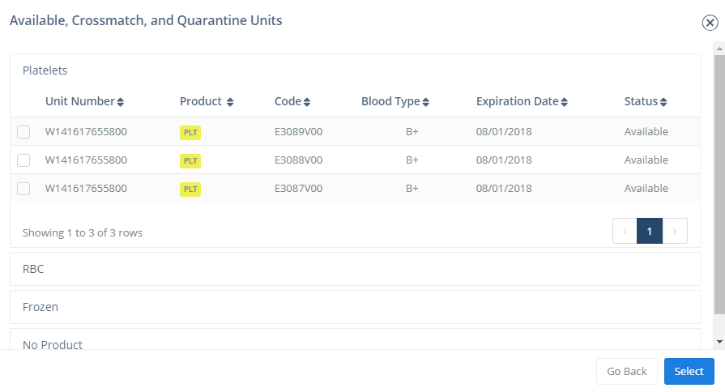
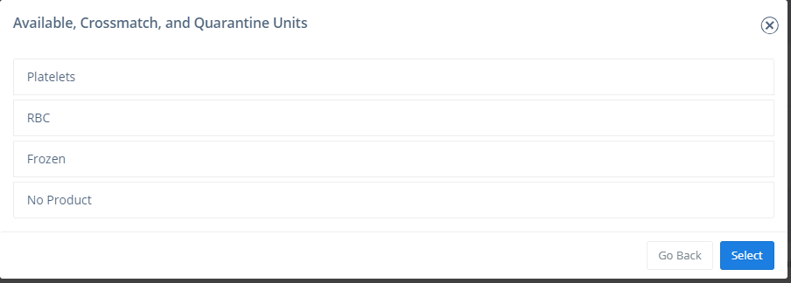
Transferring Components
6B-1
Search Method
A list of the products available that were shipped to you and are currently in-date will appear
Note: Not all units shipped will appear such as antigen negative units, so these will need to be entered via the scan method
Click on Product Type
Click on unit number
6B-2
6B-3
Click Select

Slide 8
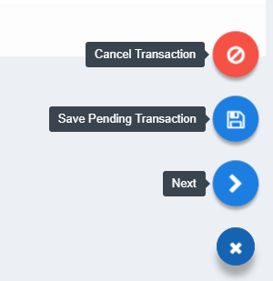
Transferring Components
7
Agree to terms
8
Click on Next

Slide 9
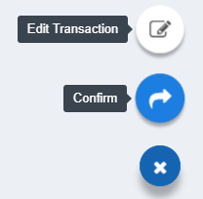
Transferring Components
9
Review transfer and click on “Confirm”

Slide 10
Transferring Components
Once the transfer has been confirmed, an electronic notification is sent to Bloodworks to notify of billing adjustments and location transfer.
Please do not print/send Transfer List to Bloodworks.
Transfer sheet can then be printed for hospital records or to send with transferred units if desired
Note: This does not take the place of transfer paperwork generated by a hospital’s BECS system
The name of the tech completing the transfer will appear on notification. The paperwork does not need to be signed.

Slide 11
Receiving Transferred Components
Upon receipt at hospital, transferred units may be uploaded in BloodHub. This is not required, but may be useful if hospital is using BloodHub for inventory reconciliations or metrics.
1
Click on “New Inventory Transaction”
2
Select “Make Units available”

Slide 12
Receiving Transferred Components
3
Scan unit barcode or and Product Code

Slide 13
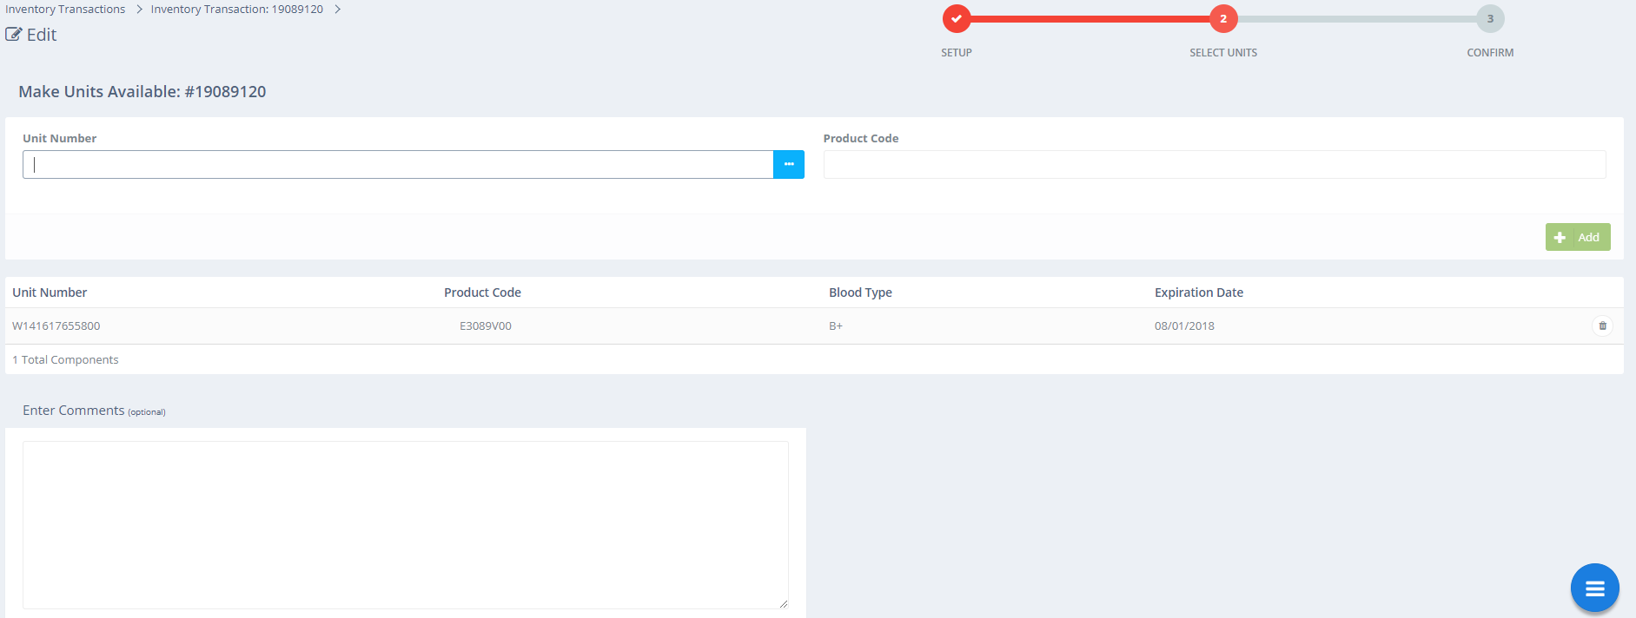
Receiving Transferred Components
4
Click on hamburger
5
Click on “Next”

Slide 14
Receiving Transferred Components
6
Verify info is correct and click on “Confirm”

Slide 15
Receiving Transferred Components
The component will now show available in BloodHub

