Slide 1
BloodHub Returns Hospital Customer Training

Slide 2
Index
Initiating a Return in BloodHub Page 3
Return Reasons Page 4
Return for Re-Issue Page 5
Return Due to Outdate Page 6
Adding Units Page 8
Submitting Return Page 12
Printing Return Form Page 14
Signing Return Form Page 15
Removing Units from a Completed Return Page 16

Slide 3
Initiating a Return in BloodHub
1
On the homepage, click on “New Inventory Transaction”
2
Select Transaction Type “Return Units”

Slide 4
Returning Components in BloodHub-Return Reasons
The “Return To” field will auto-populate to the Hospital Services location that supplies your facility
Select “Return Reason”
Choose “Return for Reissue or Return due to Outdate” and a secondary menu will appear.
See next page for descriptions
3
Note: The “Return for Quarantine” option is only available when a direct hospital interface system is set up with BloodHub. There are options for returning quarantined units under the “Return for Reissue” option

Slide 5
Returning Components- “Return for Reissue”
4A
Select “Return for Reissue” and then select from the detailed reasons below
Use for in-date viable units returned within the time limits specified in hospital contract
Use for returning units that were sent as short-dated and were pre-approved for credit from Bloodworks if not used
Use for units recalled by Bloodworks
Use for units found not suitable for transfusion or that did not meet order requirements
Use for units returned for a reason not specified above

Slide 6
Returning Components- “Return Due to Outdate”
4B
Select “Return due to Outdate” and then select from the detailed reasons below
Use for returning expired AB RBC for credit or for returning expired platelets if pre-arranged in contract

Slide 7
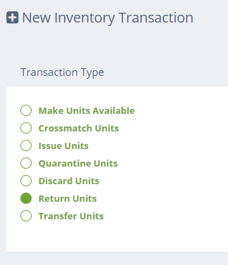
Returning Components
5
Once reason has been selected, click on next arrow
Enter comments as needed

Slide 8
Returning Components- “Adding Units”
There are two methods to add units to a return
6A
Recommended
6B
Scan unit number and product code
Or click on the “…” button to select the units from a list of units currently in your inventory (see an example of this on following slide)
As long as BloodHub recognizes the unit you are returning, “Blood Type,” and “Expiration Date” will automatically update, otherwise these fields will need to be manually entered

Slide 9
Returning Components- “Adding Units by scanning”
6A
Scan Unit Number and Product Code
As long as BloodHub recognizes the unit you are returning, “Blood Type,” and “Expiration Date” will automatically update, otherwise these fields will need to be manually entered
Manual Entry of Blood Type and Expiration Date is required in the following circumstances:
Secondary processing has been done to the unit at your facility and the product code has changed (i.e. irradiation or thawing)
Unit is antigen negative and was ordered from the Red Cell Reference Lab
Unit was transferred to your facility from another hospital and was not “made available” in BloodHub when received
See next page for example

Slide 10
Returning Components- “Adding Units by scanning”
6A
Select Blood Type from pull-down menu
Then select expiration date from pop-up calendar
Unit is added to return

Slide 11
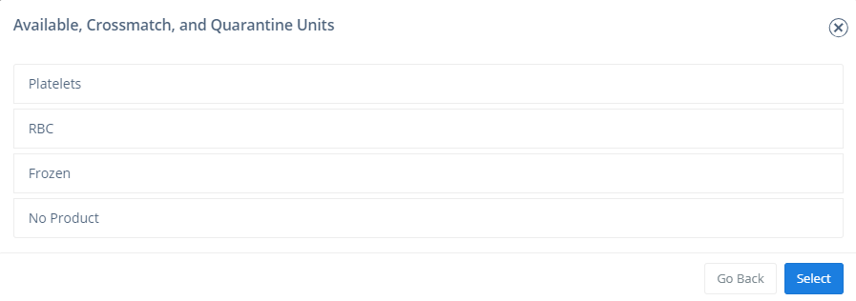
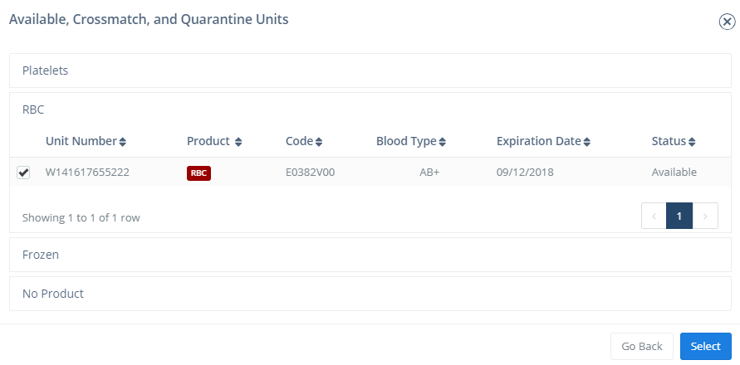
Returning Components- “Adding Units via BloodHub Inventory”
6B
Click on “…” to pull up BloodHub in-date inventory
Select product category from pop-up menu
Click on desired unit number
Click on “Select to add the unit to return

Slide 12
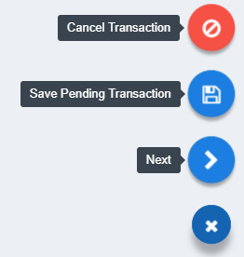
Returning Components- “Submitting Return”
7
Click to agree to terms
Note that separate returns must be completed for each type of component
8
Click on “Hamburger”
9
Click on “Next”

Slide 13
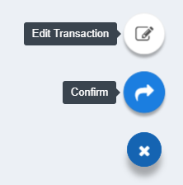
Returning Components- “Confirm Return”
10
Review return for accuracy and click on “Hamburger”
11
Click on confirm

Slide 14
Returning Components- “Printing Return Form”
12
Click on print icon to print return

Slide 15
Returning Components- “Signing Return Form”
The name of the staffer electronically completing the form is automatically recorded on the form as well as the timestamp.
When the units are physically packed for shipment, the shipper must complete the section below to certify that the storage conditions were met and the exact time units were packed.
Print
First & Last Name
13
Document Date & Time packed
Important Note:
Bloodworks will use this time as the time packed when calculating time in transit

Slide 16
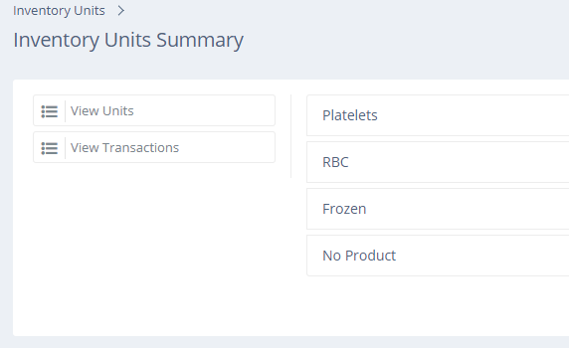
Removing Units from a Completed Return
Click “Inventory” at top of screen
1
2
Click
“View Transactions”
3
Select Product Type

Slide 17
Removing Units from a Completed Return
4
Select “Last Updated Today” from pull-down menu.
Click on “Completed Transaction Status”.
Click “Returned”.
5
Click on Transaction Number of desired return

Slide 18
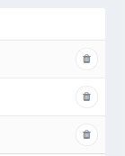
Removing Units from a Completed Return
6
Click on trashcan next to unit to be removed
Click “OK” on pop-up box
7

Slide 19
Removing Units from a Completed Return
The deleted unit will appear on the packing list with a line through it. This lets Bloodworks know that there is a change to the earlier electronic version.
8
Reprint Packing list and remove original from shipping container

Slide 20
Removing Units from a Completed Return
To cancel an entire return shipment, simply delete each unit on the return and call Bloodworks to inform of cancellation

