Slide 1
BloodHub Administration for Hospital Admins

Slide 2
Index
BloodHub Administrative Function Grid Page 3
Accessing Admin Functions Page 4
Managing Users-Adding a New User Page 10
Managing Users-Editing a User Account Page 11
Managing Users-Deactivating a User Account Page 12
Managing Users-Resetting User Passwords Page 13
Managing Organization-Editing Organization Info Page 14
Managing Organization-Editing Organization Address Page 15

Slide 3
BloodHub Administrative Function Grid
BloodHub Administrative Function Responsibility Grid Items in Green are sole responsibility of indicated group. Items in Purple can be performed by multiple groups.
Hospital Admins | Bloodworks | BloodHub Customer Support
Entry of new users once hospital is live on BloodHub Determining which BloodHub page each user sees when logging on to BloodHub Determining if user will be Hospital Admin or Hospital User For Swedish or Legacy Group, notifying Bloodworks of new users that need to be part of parent organization Editing user accounts Deactivating user accounts Resetting user passwords Editing hospital organization info | Initial entry of hospital users when hospital begins using BloodHub For Swedish or Legacy Group, adding new users to parent organization that need to be part of parent organization and notifying BloodHub if necessary Transferring an existing user from one hospital account to another hospital account Editing user accounts Deactivating user accounts Resetting user passwords Setting up Hospitals in BloodHub Editing hospital organization info Setting up hospital organization messages, alerts, redirects, and flags Creating product list | Setting up user accounts when user needs order access to multiple blood suppliers in BloodHub

Slide 4
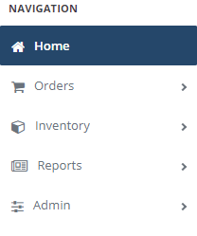
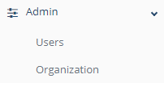
Accessing Admin Functions
All BloodHub Hospitals Users with account designation “Admin” have access to admin functions
Then click on “Admin” in the navigation window pop-up
Click on the “Hamburger on the toolbar
Users or Organization can then be selected

Slide 5
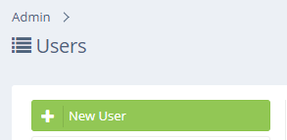
Managing Users-Adding A New User
Upload employee photo if desired
Click on “New User”
Enter First Name, Last Name, & Email Address

Slide 6
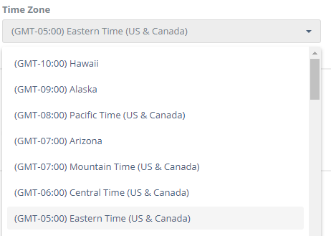
Managing Users-Adding A New User
Enter Phone Number (optional)
Enter Badge Number (Optional)
Choose Time Zone
Note: It is very important that correct time zone is shown so orders are forwarded to Bloodworks correctly

Slide 7
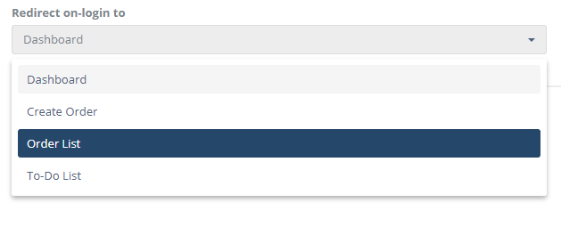
Managing Users-Adding A New User
Select the page user will see upon log in
Dashboard
Opens to Homepage
Displays Messages from Bloodworks
Recommended by Bloodworks
Create Order
Opens to New Order Screen
Order Template Appears
Good for Non-frequent Order Placers
Order List
Opens to Order Matrix
Shows Status of Orders within Specified Date
Good For Shift Supervisors
To-Do List
Do Not Use-Function Not Used by Bloodworks

Slide 8
Managing Users-Adding A New User
Your hospital will auto-populate in the organization field
Ignore these fields-they are just for Bloodworks Receiving
If the new employee will be working for one of these parent organizations at multiple locations
Enter the employee at their home hospital
Notify Bloodworks to have the employee added to the parent organization
Bloodworks will provide notification when access is available

Slide 9
Managing Users-Adding A New User
Choose employee access level by clicking on “Manage User Groups”
User’s access level prior to Re-skin will display here
2 Choices-Admin or User
Hospital Admin
Hospital User
Admins have access to create user accounts, reset passwords, delete user access, and modify audit trails. We recommend this access level for managers, supervisors, or shift leads and that each hospital have at least 2 admins.
Users have access to basic functions in BloodHub and can update their profile preferences. This is recommended for the majority of staff.

Slide 10
Managing Users-Adding A New User
Click “Save” and the employee account is created!
-Upon saving the account, a “Welcome to BloodHub” an email is generated and sent to the user.
-The email will contain a link to activate account.
-The user must activate the account within 3 weeks of generation.
Adding New Users-Frequently Asked Questions
1. My hospital receives blood from multiple blood suppliers that all require BloodHub for ordering, how should this type of user account be entered?
BloodHub Support will need to set up the dual ordering accounts for the user.
Email BloodHub Support at support@bloodhub.com .
2. The new user is transferring from another location within my hospital group and thus has their same email address and so the message “email address already exists” appears when I try to enter the new employee’s email address? What can be done?
Call Bloodworks to move the user to correct location.
3. If a new employee fails to activate their BloodHub account within 3 weeks, can the activation email be regenerated?
No, the email cannot be regenerated. Access the user’s account and manually change the user’s password. Have the user log in directly to the site using their email address and the new password.

Slide 11
Managing Users-Editing A User Account
2
1
Click on User’s name
Select “Users” from the Admin menu
3
Edit field
4
Click “Save”

Slide 12
Managing Users-Deactivating A User Account
2
1
Click on User’s name
Select “Users” from the Admin menu
3
4
Click “Save” button
Move the green “Active” button left so that it shows grey

Slide 13
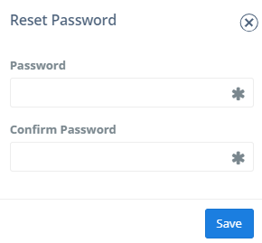
Managing Users-Resetting User Passwords
When a user needs password reset
Ask user to click on “password help” on the log-in page to reset password.
If that does not work (some users get caught in an email loop that doesn’t allow password reset due to firewalls), manually reset password for user following these steps:
1
2
Click on user’s name
Access “Users” menu from Admin function
3
4
Enter a new password
Click on “Reset Password”
If a user is having issues resetting passwords when an admin is not available, please call Bloodworks for password help
5
Notify user off new password

Slide 14
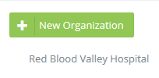
Managing Organization-Editing Organization Info
1
Select “Organization” from the Admin menu
2
Click on hospital name
4
Click “Save” button
3
*
Select “Info” tab.
Any of the these fields, indicated with “*”, can be edited.
*
*
*

Slide 15
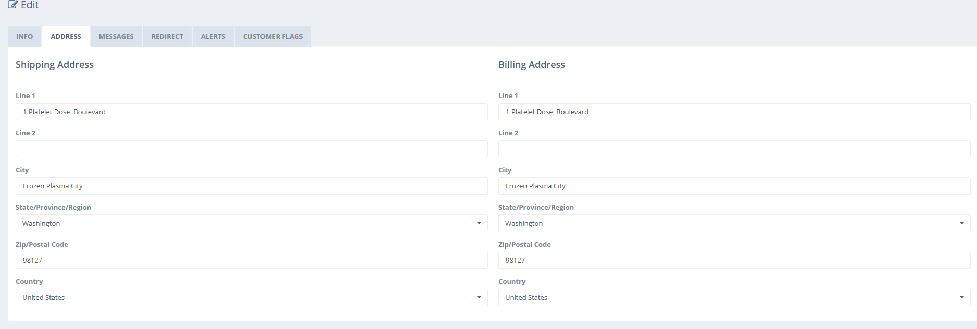
Managing Organization-Editing Organization Address
Note: These tabs are only for Bloodworks’ use. Please do not make any modifications within them!
Select “Address” tab.
Any of the these fields can be edited.
Click “Save” after changes are made

