Slide 1
Platelets Stored In Additive Solution (PAS) What is it and Why do we have it?

Slide 2
UWMC Platelet Inventory
4 different types of platelets are available on our shelf
PAS- apheresis platelet stored in additive solution instead of plasma; one donor
Apheresis in plasma; one donor
Pooled Platelets; 5-6 donors
Mirasol riboflavin-treated platelets - Miplate study ; one donor

Slide 3
Platelet transfusion, ABO considerations
Short shelf-life of 5 days, limited supply.
Difficult to provide ABO identical platelet transfusions and manage inventory
Pre and Post Bone Marrow Transplant (BMT) require platelets that are plasma compatible with
Pre transplant: Recipient
Post BMT: Recipient and Donor
ABO incompatible platelet transfusions:
Major incompatible: Recipient isoagglutinins (anti-A, anti-B) against ABO on platelets
Not a major concern when selecting a product
Example: Unit A, patient O
Minor incompatible: Donor isoagglutinins against recipient’s ABO antigens on RBC and tissues
Concerns for risk of hemolysis
Example: Unit O, patient A
Mair, Transfusion 1998
Larsson Transfusion 2000

Slide 4
Hemolysis Risks Risk of hemolysis depends on factors that can be classified as recipient or donor/unit factors
Recipient biological factors
Donor/Unit factors (antibody dose)
Body’s ability to dilute antibodies contained in a small amount of plasma
AB antigens on epithelium and soluble antigens that bind isoagglutinins (ABO antibodies) decreasing the risk of hemolysis
Antibody titer
Product volume
Garratty G. Am J Clin Pathol 1998

Slide 5
Populations with special consideration
Pediatric patients
Small patient relative to a large volume of plasma
BMT recipients.
Implications for engraftment and graft survival

Slide 6
Options to decrease the volume of ABO incompatible plasma contained in platelets
Monitor titers
No consensus of “safe” titer cut off.
Limit the number of doses of full volume incompatible plasma platelets transfused, in particular O units
Current strategy for non-BMT patients
Reduce volume of incompatible plasma, all ABO types
Current strategy for BMT patients
Combined solution?
Decrease the ABO antibody titer
Reduce the amount of plasma
Reduce the total ABO antibody dose
Notes:
Check mark 2 is the same as the title- what does this mean?
What about PAS?

Slide 7
Combined Strategy: Decrease Plasma and Antibody Titer
Titer 128
Volume reduction
Platelet
Additive
Solution
(PAS)
Titer 64 or 32
Plasma
Apheresis Platelet
300 ml plasma
Apheresis platelet
100 mL plasma
PAS Platelet
100 mL plasma
200 mL PAS
Same antibody dose
Notes:
1. Apheresis platelets contain about 300 ml of plasma. The isoagglutinin (ABO) antibody titer is variable among donors. In this example, the titer is 128.
2. When platelets are volume reduced, the antibody titer doesn’t change, but only 100 mL of plasma is transfused
3. PAS platelets are collected in platelet additive solution (200 mL) and contain a very small amount of plasma (~100 mL), which is equivalent to the VR unit. Titers are lower because the total volume of the unit is larger (300 mL)

Slide 8
PAS vs. Non PAS isoagglutinin titers
Group O, anti-A
Notes:
Most of the PAS platelets will have anti-A IgG titer of 32 (purple square)
Most of the apheresis platelets will have anti-A IgG titer of 128 (red square)
Anti-A IgM follows the same pattern but with lower titers.

Slide 9
Group A, anti-B
Group B, anti-A

Slide 10
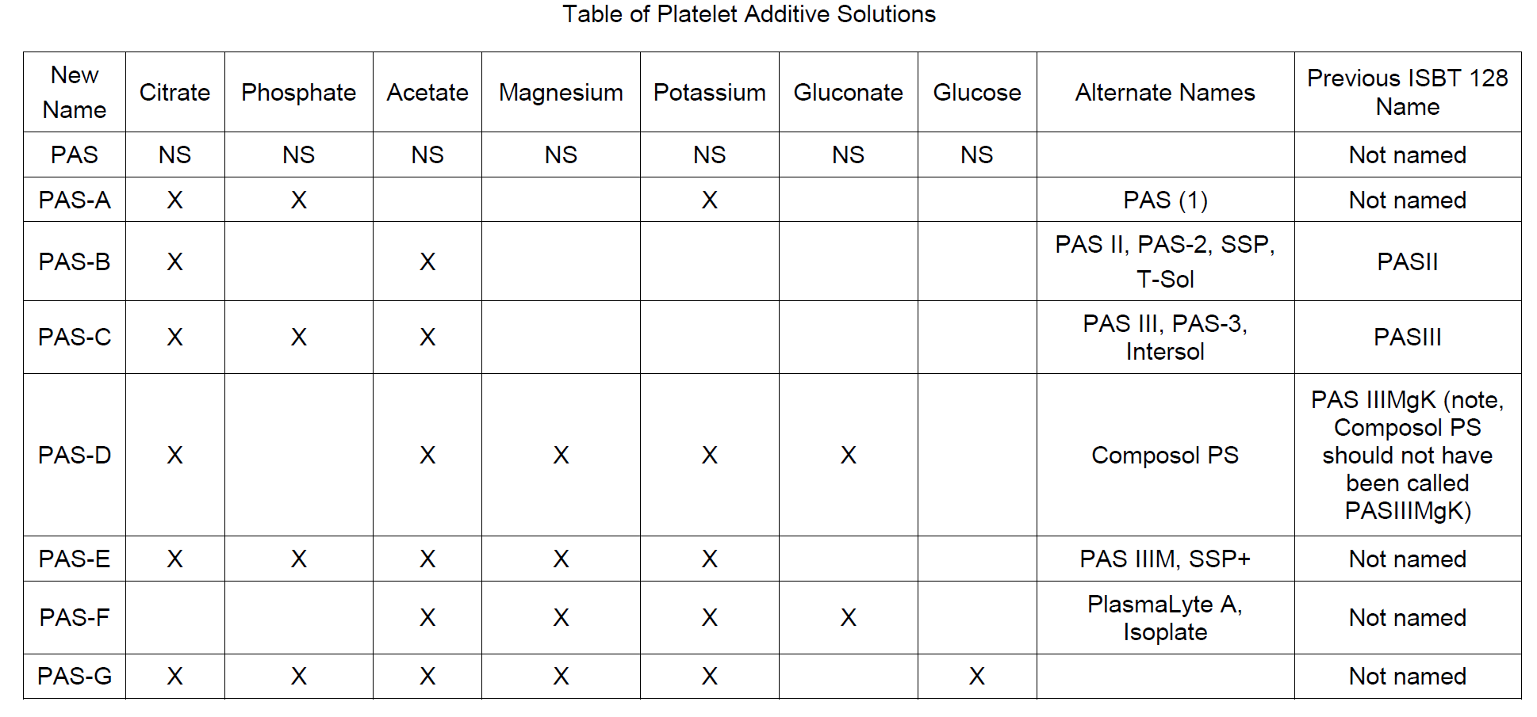
Platelet Additive Solution (PAS)
Balanced solution that replaces ~70% of the plasma volume of platelets
Allows for metabolic functions and optimal pH during storage
There are multiple solutions available – UWMC will stock PAS-C and PAS-F
Ringwald et al, Transf Med Rev 2006

Slide 11
PAS, Clinical Advantages
Contains small amount of plasma in platelet units (~100 ml, similar to the end volume of volume reduced platelets)
Contains lower isoagglutinin titers
Reduces the risk of allergic reactions (because of less plasma)
No need to VR for ABO incompatible platelet transfusions
Less need to VR for allergic reactions
Tobian et al, Transfusion 2014

