Slide 1
MIPLATE CLINICAL TRIAL
TERUMO BCT BIOTECHNOLOGIES, LLC
Study BACKGROUND AND Protocol TRAINING FOR CLINICIANS AND Blood Bankers
Version 4.0 30Jul2018

Slide 2
Training Topics
Mirasol Pathogen Reduction System (PRT) System for Platelets Overview
  MIPLATE Clinical Trial Intended Use
  Mode of Action
  System Components and Storage Conditions
  Treatment Process
Investigational Product Details
  Platelet Ordering
  Product Labeling
  Product Use Considerations
  Inventory Management
Clinical Investigational Plan Overview
  Study Design
  Eligibility Criteria
  Roles and Responsibilities
  Study Procedures

Slide 3
Mirasol® Pathogen Reduction Technology (PRT) System FOR PLATELETS
Overview of intended use, Mode of action, SYSTEM COMPONENTS and PROCESS

Slide 4
Intended Use
    The Mirasol Pathogen Reduction System for Platelets (PLTs) uses ultraviolet light energy and riboflavin to damage nucleic acids resulting in:
  Pathogen reduction of Apheresis (Aph) PLT components stored in 100% plasma
    Reduces risk of transfusion-transmitted infection (TTI)
  Inactivation of white blood cells (WBCs)
    Reduces the risk of transfusion-associated graft-versus-host disease (TA-GvHD)

Slide 5
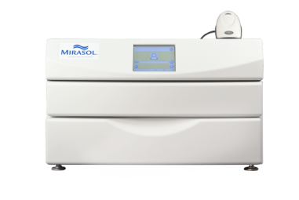


Primary Mode of Action
+
+
Blood product
Riboflavin
(vitamin B2)
solution
UV light
Reduction of viruses, bacteria, parasites
Inactivation of residual leukocytes
Notes:
The concept of the Mirasol PRT application for platelets and plasma is simple.
The process starts with a platelet or plasma product, either obtained by apheresis or Whole Blood-derived.
Riboflavin, or Vitamin B2, is added. The Riboflavin comes as a solution in a 35 mL bag.
The product is exposed to a specific dose of ultraviolet (UV) light, based on the volume and amount of Plasma in the product.
A photochemical reaction takes place, which inactivates pathogens and residual white cells that may be present in the blood product.
Refer to IB and Clinical Investigational Plan

Slide 6
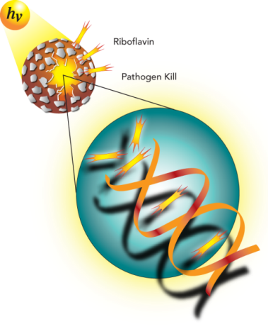
Primary Mode of Action
    The Mirasol system inactivates pathogens by altering their nucleic acids in 2 primary ways
1. UV light only: reversible inactivation
  UV light alone breaks chemical bonds in the
  nucleic acids of pathogens
2. UV light + riboflavin: irreversible inactivation
  Riboflavin molecules form complexes with nucleic acids
  UV light from the Mirasol Illuminator activates the
  riboflavin molecule in the complex
  Photoactivated riboflavin induces a chemical alteration
  to nucleic acids, making pathogens unable to replicate
Notes:
The Mirasol system utilizes the properties of UV light and riboflavin in the inactivation of pathogens as follows:
UV light alone will break chemical bonds in the nucleic acids of pathogens. This process can sometimes be reversed.
Riboflavin is a photosensitizer, and in the presence of UV light creates irreversible damage to nucleic acids. This occurs by electron transfer chemistry induced by the direct interaction of photoexcited riboflavin with nucleic acid base pairs (mostly guanine bases).
In essence, the presence of riboflavin in this system enhances the effect of UV light alone, creating a condition of greater pathogen sensitivity to UV light (the photosensitization effect). This results in more lesions or strand breaks in the DNA than UV light alone, and the lesions that occur are irreversible.

Slide 7
Why Riboflavin?
    Uses a non-toxic compound with known safety profile (riboflavin = vitamin B2)
    Effective against a broad range of pathogens
  Reduces pathogen load typically by ~3-6 log
    Effective white blood cell inactivation
  Non-clinical data shows reduction of immunological complications of transfusion, such as graft-versus-host disease (GvHD)
    Preserves PLT viability and function and plasma protein factors
    Easy to use and implement

Slide 8
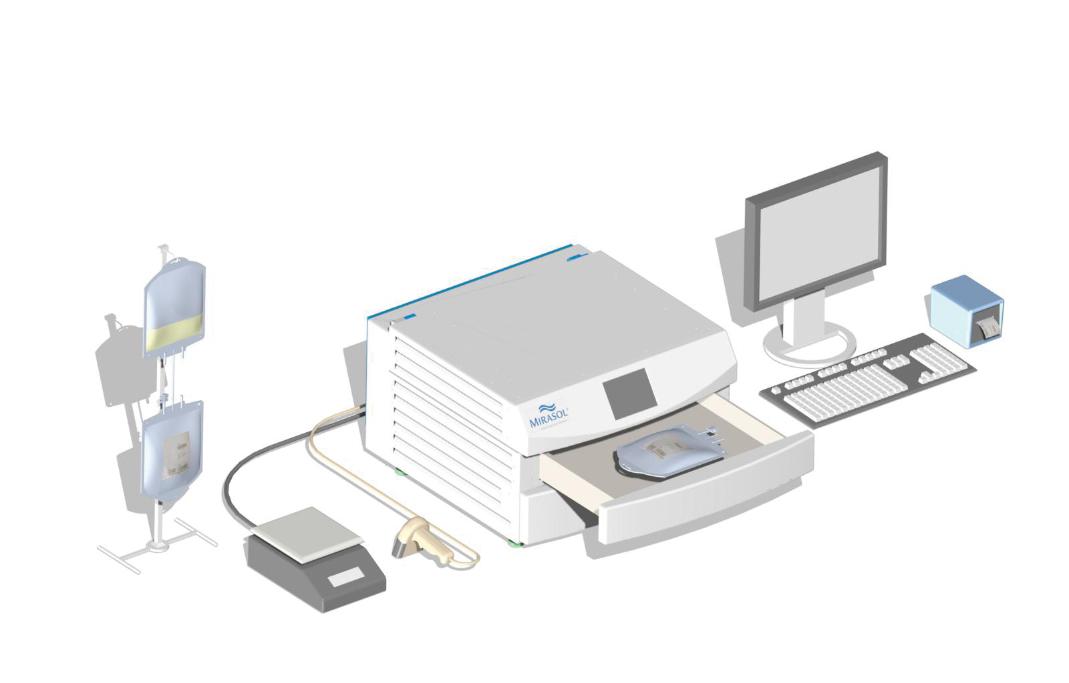
System Components
PLT product bag
Illuminator
Mirasol Process Label printer
Mirasol Manager computer
Disposable Kit (example): Illumination/Storage Bag and
Riboflavin Solution Bag
(not shown)
Barcode
scanner
Scale
Notes:
The Mirasol system consists of several main components.
The disposable kit includes the Illumination/Storage Bag or set and the Riboflavin Solution Bag.
Preparing the disposable kit is the first step in the process.
The PLT product bag and the Riboflavin Solution Bag are both sterile-connected and transferred to the Illumination Bag.
The Illuminator is where the treatment actually occurs.
The bag is placed in the product drawer.
The appropriate amount of UV light is applied during the treatment.
Ancillary devices include:
Scale (for obtaining the weight/volume of the product)
Barcode scanner (for easy and accurate data entry)
The Mirasol Manager enables:
Multiple Illuminator connections
Storage of data from all Illuminators in a comprehensive database
Mirasol Process Labels for easy identification of treatment outcome
A variety of reports for archiving and documentation

Slide 9
Overview of Mirasol Treatment Process
    Apheresis platelet collection in using Trima Accel ® System
  Platelets must rest for 2 hours post-collection
    Mirasol Treatment
  Treatment initiated 2-22 hours post-collection
  Treatment of one platelet unit requires 20-25 minutes
    Sterile docking and mixing of riboflavin with platelet product in the provided disposables set
    Disconnect original product collection bag and riboflavin bag
    Illuminate product for 4-10 minutes; actual time depends on product volume
    Break frangible connectors to spike ports on storage bag
    Final product labeling
  Mirasol-treated platelet unit is ready for transfusion or storage/distribution
  Bacterial testing required per institutional SOPs

Slide 10
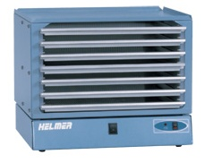
Mirasol Platelet Storage Requirements
Mirasol-treated PLTs are sensitive to light
  To ensure optimal PLT quality, it is important to adhere to the following recommendations for handling and storage of these products:
  Store for a maximum of 5 days at 22ºC ± 2ºC with gentle agitation.
  Avoid prolonged exposure to light. Store the PLT product on any intermediate shelf of a PLT agitator – NOT in direct ambient light
  (e.g. not on top shelf of an open PLT agitator).
  Be sure PLT incubators do NOT have internal lights on.
Brief diffused ambient light exposure during normal handling of products is not a concern.
Protective light shielding/covering of the PLT bag is not required.
Transfuse PLT product within 4 hours of removal from agitator.
No prolonged exposure to light
OK

Slide 11
Overview of Mirasol Treatment Process
    Apheresis platelet collection in using Trima Accel ® System
  Platelets must rest for 2 hours post-collection
    Mirasol Treatment
  Treatment initiated 2-22 hours post-collection
  Treatment of one platelet unit requires 20-25 minutes
    Sterile docking and mixing of riboflavin with platelet product in the provided disposables set
    Disconnect original product collection bag and riboflavin bag
    Illuminate product for 4-10 minutes; actual time depends on product volume
    Break frangible connectors to spike ports on storage bag
    Final product labeling
  Mirasol-treated platelet unit is ready for transfusion or storage/distribution
  Bacterial testing required per institutional SOPs

Slide 12
MIPLATE Investigational product details
PRODUCT ordering and inventory management

Slide 13
Platelet Product Details
    Product Specifications
  1 unit of PLTs ≥ 3.0 x 10¹¹/µL (standard therapeutic dose)
  Aph PLT, collected in ACD-A, stored in 100% plasma
  5-day expiration
  Irradiation not required but allowed at treating physician’s discretion
  No bedside leukoreduction (ensure accuracy of pre-/post-PLT counts)
  MIR PLTs
    Single-donor Aph PLTs collected on the Trima Accel ABC System
    Prepared/supplied by participating blood center
    No washing or volume reduction (not validated)
  REF PLTs
    Single-donor Aph PLTs collected on any machine
    Obtained from standard clinical supply

Slide 14
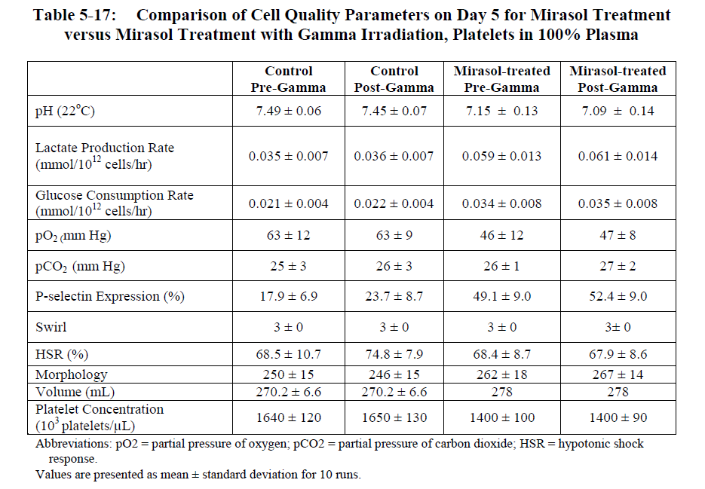
Irradiation with Mirasol-Treated Platelets
Mirasol® PRT System for Platelets Investigator’s Brochure Ed 5 : 28 SEP 2016

Slide 15
Mirasol Platelet Product Ordering
    Communication and ordering of MIR PLTs from the blood center
  MIR PLTs are considered investigational product and are “made to order”
  Platelets should be ordered with enough advance notice to support pre-defined production and shipping time requirements, while ensuring adequate inventory to meet each subject’s expected transfusion needs
  Ask your blood center for their MIR PLT production schedule/turnaround
  Routine and proactive phone communication by your point(s) of contact about patient screening status and supportive care requirements with your blood center is critical to timely delivery and minimization of off-protocol transfusions
  Ensure your blood center understands your patient-specific PLT requirements and post-manufacturing needs (e.g., irradiation)
  A completed order form must be submitted to the blood center for all MIR PLT requests

Slide 16
Mirasol Platelet ISBT Label
Affixed to the storage bag
Mirasol-specific ISBT product code (“E-code”)
Mirasol-specific description text (exact text may depend on the manufacturing/blood center)

Slide 17
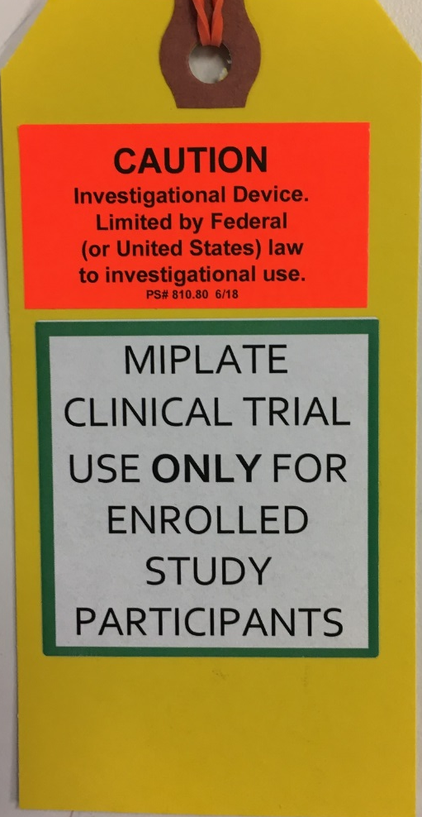
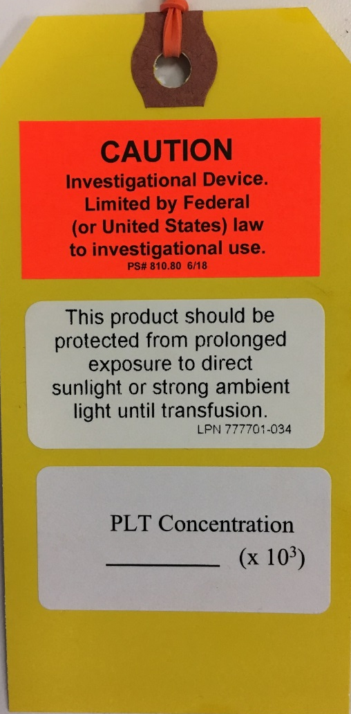
Mirasol Platelet/MIPLATE Study Tie-Tag
Attached to the top of the bag (opposite of ports)
SIDE 1
SIDE 2
To be completed by blood center
(required for all PLTs to calculate
CCIs)

Slide 18
Mirasol Platelet/MIPLATE Sample Packing List
Included with each shipment of Mirasol-treated platelet products
Shipment contents
MIPLATE-specific markings (location of text may depend on the manufacturing/blood center

Slide 19
Aliquoting for Pediatric Transfusions
    Mirasol-treated platelet products can be aliquoted to smaller volumes
  The Mirasol storage bag must be used as the “mother bag”
  A pedi-pack or other secondary bag can be used as the transfusion container
  Institutional standards for sterile connection/transfer must be followed
  Each transfusable dose must have a MIPLATE/investigational product tie-tag (same as what is affixed to the Mirasol bag) applied; extra tie-tags will be provided by Terumo BCT
  The Mirasol bag/contents must be transfused or discarded within 4 hours once the volume reaches less than 170 mL
    Terumo BCT recommends developing a MIPLATE/Mirasol-specific policy or procedure for pediatric aliquoting
    Documentation for pediatric aliquots
  Enter each transfusable dose on a new PLT Transfusion CRF and Hospital Platelet Product CRF; enter the calculated product concentration or yield based on the aliquoted volume.
  Ensure all of each Mirasol-treated platelet unit (including any unused/discarded portions) are documented on the Study Product Accountability Log

Slide 20
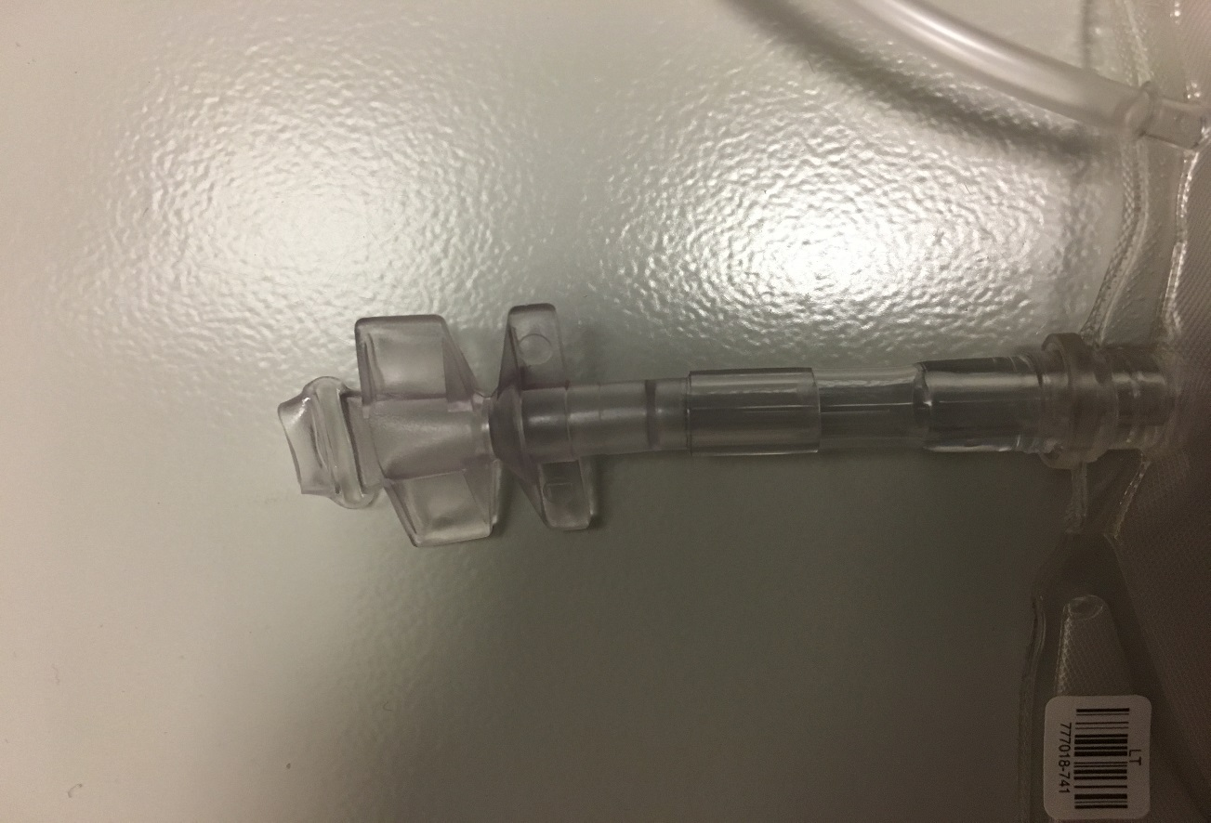
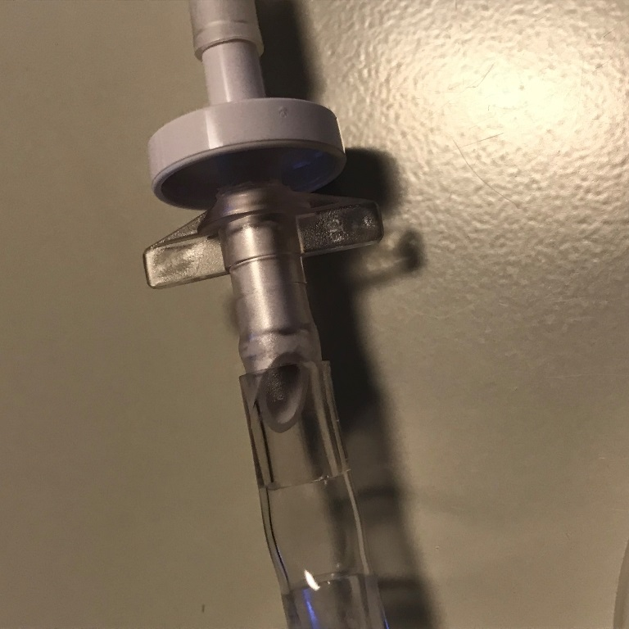
Connecting the Mirasol Bag
Twist and remove cap from receptor to expose the port
Successful connection
Do NOT cut or alter the bag!

Slide 21
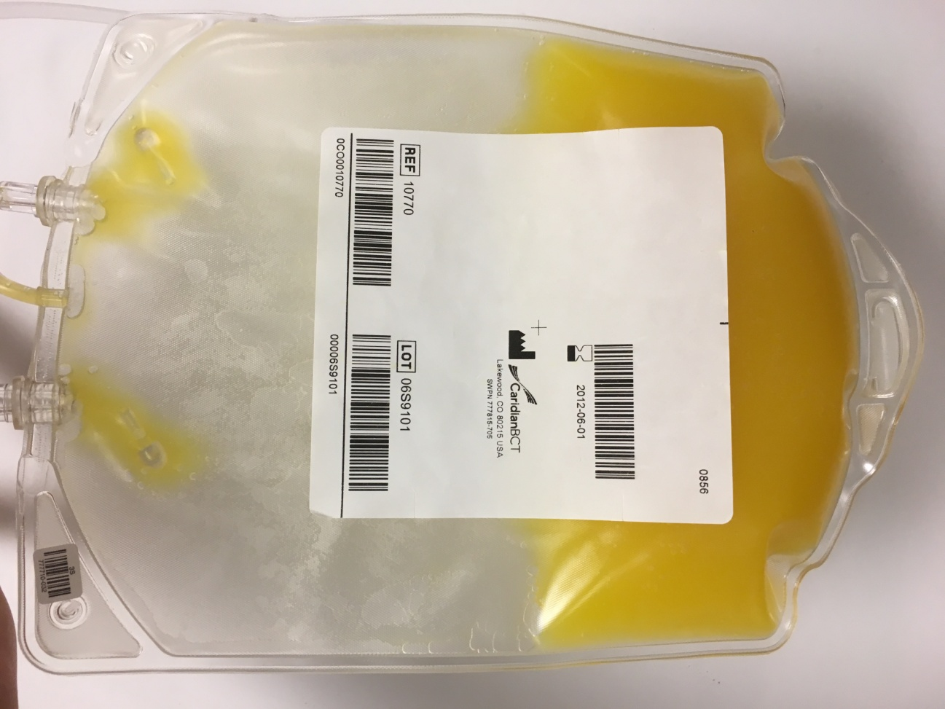
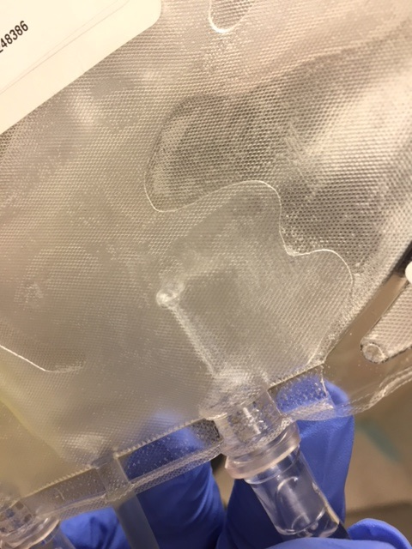
Frangibles
    Removed after illumination to allow platelet product flow through port
    Freely suspended in storage bag/may be visible
    Check for unbroken frangible; if product does not flow freely, break in-tact frangible (refer to Instructions for Use) and notify Terumo BCT
Broken (CORRECT)
Intact (INCORRECT)

Slide 22
Investigational Product Accountability
    Records of accountability must include the following to support chain of custody documentation requirements
  Record of the PLT order for each patient by a clinician; should be a reference to the patient’s participation in the MIPLATE study
  Completed study-specific order form for all MIR PLTs that were ordered from the blood center (REF PLTs follow standard ordering process)
  Record of receipt (packing list) for each MIR PLT from the blood center
  Record of dispensation of each PLT to the applicable study subject including date/time of release for transfusion
  Record of final disposition for each MIR PL, including those that were not transfused (destruction per institutional procedures)

Slide 23
Device Deficiencies
    Definition
  The inadequacy of a medical device with respect to its identity, quality, durability, reliability, safety or performance; includes malfunctions, use errors, and inadequate labeling
    Examples
  Defect in the bag that causes unintentional leakage of product or difficulty/inability to connect the bag for transfusion
  Improper or deficient product labeling
  Positive bacterial culture result on a Mirasol-treated platelet unit

Slide 24
Device Deficiencies
    Reporting
  Complete a Device Deficiency Report Form and submit to the sponsor within 24 hours after the event.
  Do not provide any unblinding information (subject identifier) in your initial report.
  Retain product and administration set until contacted by sponsor.
  Blood center will report any positive bacteria culture results
  When completing a Report Form, obtain as much information about the incident as possible
    Obtain as much information as possible from nursing to describe any challenges with connecting or transfusing the product
    Did it result in a delay that affected the safety of the patient?

Slide 25
MIPLATE CLINICAL INVESTIGATIONAL PLAN OVERVIEW
Study design, Eligibility criteria, Roles and Responsibilities, STUDY PROCEDURES

Slide 26
Mirasol PRT System for Platelets Regulatory Status
Mirasol for Platelets CE Marked in 2007 in the EU
FDA Registered as Class III Device
  Support/sustain human life;
  Substantial importance in preventing impairment of human health; or
  Present a potential, unreasonable risk of illness or injury
Pre-market approval (PMA) required for marketing approval of Class III devices in US
  Valid scientific evidence to assure safety and effectiveness for intended use
MIPLATE trial is a pivotal trial intended to support a PMA for the Mirasol PRT System for Platelets

Slide 27
Study Overview
    Title
  Clinical Effectiveness of Standard Versus Mirasol-treated Apheresis Platelets in Patients With Hypoproliferative Thrombocytopenia
    Target Population
  Patients with hematologic malignancies with hypoproliferative thrombocytopenia who are expected to have a platelet (PLT) count ≤ 10,000/µL requiring ≥ 2 platelet transfusions
    Applicable Guidances/Regulations
  21 CFR 812 (FDA Investigational Device Exemptions Regulations)
  ISO14155 (Good Clinical Practices for Device Trials Guidance)
  ICH E6 (Good Clinical Practices Guidance)

Slide 28
Study Design
    Study Type/Treatment Arms
  Supportive care; two treatment arms
    Transfusions with Mirasol-treated, leukoreduced, Trima Accel® Apheresis platelets stored in plasma (MIR PLTs); OR
    Transfusions with conventional (non-pathogen reduced), leukoreduced, Apheresis platelets stored in plasma (REF PLTs)
    Target Enrollment
  500 subjects in the mITT population (received at least 1 per protocol PLT transfusion)
  Enrollment anticipated to last 3.5 years
    Randomization
  1:1, stratified by hospital/site and type of treatment
    Allogeneic transplant
    Autologous transplant
    Chemotherapy

Slide 29
Study Design
    Study Blinding
  Blinding is not possible
    Different platelet storage/transfusion bags and labeling
    For many institutions, MIR PLTs will be ordered from a different blood center than REF PLTs
    Subjects receiving MIR PLTs may have more pronounced yellow coloring of urine (riboflavin)

Slide 30
Study Objectives and Endpoints
    Primary Objective
  To determine if the hemostatic efficacy of MIR PLTs are non-inferior to REF PLTs in the target population of enrolled subjects
    Primary Efficacy Endpoint
  Number of days of grade 2 or higher bleeding recorded from the first post‑randomization PLT transfusion through 28 days following the first transfusion OR until transfusion independence (10 days without PLT transfusion)

Slide 31
Study Objectives and Endpoints
    Select Secondary/Exploratory Endpoints
  Human leukocyte antigen (HLA) alloimmunization rates
  Proportion of subjects with bleeding; time to first bleed
  Proportion of subjects with PLT refractoriness
  Corrected count increments (CCIs)
  Number of red blood cell (RBC) transfusions
    Select Safety Endpoints
  Adverse events (AEs) and serious adverse events (SAEs)
  Unanticipated adverse device effects (UADEs)
  Pulmonary events including subjects on assisted ventilation
  Death due to bleeding as the primary or contributory cause of mortality

Slide 32
Subjects
  Inclusion Criteria
Subject weight >10 kg
Hematologic malignancy with hypoproliferative thrombocytopenia and is expected to have PLT count(s) ≤10,000/µL requiring ≥ 2 PLT transfusions
Laboratory results within 5 days prior to anticipated initiation of the first post‑randomization PLT transfusion:
  PT and/or INR ≤ 1.3 × ULN
  aPTT ≤ 1.3 × ULN
  Fib ≥ 100 mg/dL
Women of childbearing potential with negative pregnancy test and agree to medically acceptable contraception
Provide informed consent and/or assent

Slide 33
Subjects
  Exclusion Criteria
Previous treatment with pathogen-reduced blood products
Previously been enrolled in this study with at least 1 per protocol PLT transfusion
Receiving anticoagulant (including aspirin), pro-coagulant or antithrombotic, antiplatelet agents, and/or PLT specific growth factors within 10 days prior to randomization
≥ grade 2 bleeding at the time of randomization
Planned administration of bedside LR PLT transfusion(s)
Anticipated need for PLT washing or volume reduction
History of acute promyelocytic leukemia (APML), idiopathic thrombocytopenic purpura (ITP), thrombotic thrombocytopenic purpura (TTP), or hemolytic uremic syndrome (HUS)
HLA and/or HPA alloimmunization and/or clinically relevant antibodies (clinician judgment if testing not part of care standard)

Slide 34
Subjects
  Exclusion Criteria (cont’d)
Splenomegaly (presence of a palpable spleen whose border could be felt more than 4 cm below the costal margin)
History or diagnosis of a disease affecting hemostasis
Currently taking, or participating in a clinical study involving PLT substitutes, PLT growth factors, or pharmacologic agents intended to enhance (ie, antifibrinolytic agents) or decrease PLT hemostatic function
Acute or chronic medical disorder that, in the opinion of the investigator, would impair the ability of the subject to receive protocol treatment
Subject is pregnant or lactating
Inability of the subject to comply with study procedures and/or follow-up

Slide 35
Treatment Plan
    Randomization to occur within 5 days prior to first anticipated per-protocol transfusion
  Targeted as initial prophylactic PLT transfusion initiated for PLT count ≤10,000/µL
  Actual day of first post-randomization PLT transfusion will become the start of the transfusion period (Day 0)
    PLT transfusions in accordance with assigned treatment group for 28 days after initial PLT transfusion OR transfusion independence (10 days without PLT transfusion)
  PLT transfusions ordered per investigator care standard (PLT-count-related prophylaxis, intervention-related prophylaxis, therapeutic/treatment for bleeding, etc.)

Slide 36
Treatment Plan
    Off-Protocol Transfusions
  Any PLT transfusion other than to which subject was randomized
  Includes transfusions that must be volume reduced or washed, or PLTs in additive solution
  Subject will continue to receive study transfusions as per the allocated treatment group until study completion or one of the reasons for study treatment discontinuation/termination occurs
  75% of transfusions must be per treatment assignment for patient’s data to be included in the Per Protocol analysis; it is therefore critical to minimize off-protocol transfusions whenever possible

Slide 37
Bleeding Assessments
    Conducted every calendar day during the transfusion period
    Assessed per the World Health Organization Grading Scale for Bleeding
    Assessment Components
  Interview (FTF when in patient/in-clinic, phone when outpatient)
  Physical inspection for bleeding (conducted by Assessor unless all aspects covered as part of SOC exam/inspection and can be abstracted from chart)
  Medical record review
    Assessor(s) must be delegated member(s) of the study team without explicit knowledge/access to subject randomization assignments

Slide 38
Maintaining Study Integrity with Treatment Assignments
    Though this is not a blinded study, it is critical that Bleeding Assessors and Investigators assessing AEs for causality do not have knowledge of treatment assignment
  What floor nurses can do:
    Request that all potentially unblinding items be removed from the subject’s room or blinded before applicable study team members have access to subjects:
      Remove platelet transfusion bag
      Ensure catheter bags out of sight
    No entries in the medical record specific to which platelet product was transfused
    Remind the subject not to discuss any changes in urine color (per the ICF) or information related to “look” of the platelet bag with the study team
  What blood bankers can do:
    Avoid communication of treatment assignment information with Bleeding Assessors and Investigators assessing AEs.
    Your site CRA will review your transfusion/platelet accountability records, so it is OK to communicate treatment assignment information with him/her

Slide 39
Mirasol Platelet Risks to Patients
    Riboflavin and Lumichrome (photoproduct of Riboflavin)
  Risk of toxic effects is minimal (naturally present in human diet and in human blood)
    MIR PLTs
  Possibility for lower corrected count increment (CCI), but no statistically significant increases in bleeding in previous studies
  No significant differences in the frequency and severity of AEs and SAEs compared to REF PLTs
  No AEs or SAEs have been reported as attributed to the infusion of MIR PLTs specifically by either investigators or DSMB members
  May require more frequent transfusions
    Refer to Investigator’s Brochure and Clinical Investigational Plan for further details/data

