Slide 1
NTD Pos, NTD Neg
Go Live: December 3rd , 2018
UWMC Blood Bank

Slide 2
Objective
Background
Understand the use of NTD Pos and NTD Neg in Sunquest (SQ) LIS system
Identify acceptable and compatible blood products that will be allocated and issued to recipients with permanent ABO NTD POS/NEG designation
QA Warnings
Examples in SQ and Transfusion Record

Slide 3
NTD
Current State
NTD- “No Type Determined” was built as an interpretation in SQ. This was built to accommodate the Bone Marrow Transplant (BMT) where recipient blood type is different from the donor
NTD
Allows issue of only O Neg RBC without a QA failure
O Pos RBC cannot be issued without override in SQ
Allows allocation of Rh Pos platelets to Rh neg patients
Does NOT restrict the allocation or issue of platelet based on ABO

Slide 4
NTD POS/NEG
NTD POS and NTD NEG was built for the following reasons
Reduce the amount of QA overrides when acceptable components are allocated and issued
Restrict the allocation of Rh POS platelets and RBCs to NTD NEG
Allow the allocation of Rh Neg/Pos platelets and RBCs to NTD POS
Does NOT restrict the allocation or issue of platelet based on ABO

Slide 5
Where does NTD Pos/Neg go?
UW TSL management will enter NTD POS or NTD NEG in Sunquest Blood bank Adminstrative Data File (BAD) when the patient receives an incompatible BMT.
However NTD POS/NEG is NOT valid to use for interpretation of an ABO discrepancy when performing %ABR testing. NTD should still be used in for interpretation of test results (specimen ABO)

Slide 6
What is acceptable to allocate and issue?
Blood Product | NTD POS | NTD NEG
RBC/Granulocyte | O Positive or O Negative | O Negative
Platelet | Rh Positive or Rh Negative* *See Selection of Platelet Components SOP for ABO compatibility | Rh Negative* *See Selection of Platelet Components SOP for ABO compatibility
Plasma | AB | AB
Cryoprecipitate | Adult: any type <4mos old: AB | Adult: any type <4mos old: AB

Slide 7
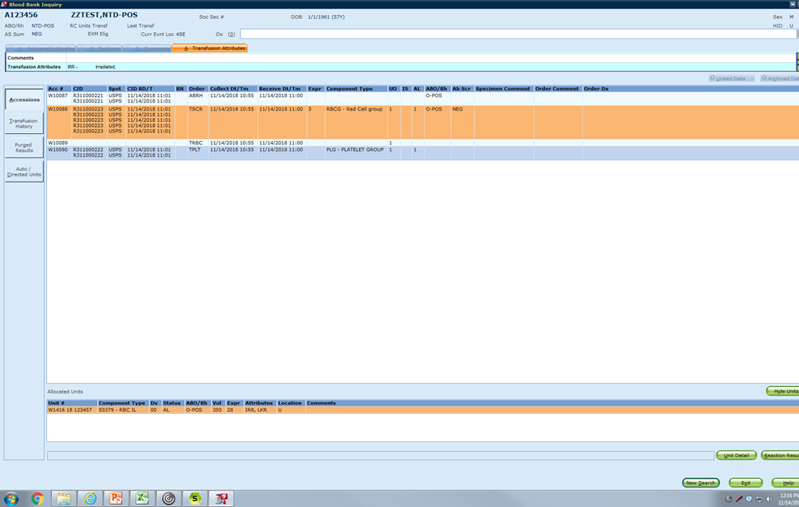
Example- RBC
Allocation of a O Pos RBC to a NTD POS type
This is acceptable to Allocate and Issue. No override

Slide 8
Example-RBC
Allocation of O Neg RBC to NTD NEG type
This is acceptable to allocate and issue. No override

Slide 9
Example-Platelet
Allocation of Rh Pos Platelet to a NTD POS
This is acceptable to allocate and issue. No override

Slide 10
Example-Platelet
Allocation of Rh Neg Platelet to a NTD NEG
This is acceptable to allocate and issue. No override

Slide 11
What is unacceptable to allocate and issue?
Blood Products | NTD POS | NTD NEG
RBC, Granulocyte | A, B, AB | A,B,AB, Rh positive
Platelet | None* *See Selection of Platelet Components SOP for ABO compatibility | Rh positive* *See Selection of Platelet Components SOP for ABO compatibility
Plasma | A,B,O | A,B,O
Cryoprecipitate | Adult: None <4mos old: A/B/O | Adult: None <4mos old: A/B/O

Slide 12
Example- RBC
O Pos RBC allocated to NTD Neg
Do Not Override without TSL MD approval

Slide 13
Example-RBC
B Pos RBC allocated to a NTD Neg
Do NOT Override

Slide 14
Example-Platelet
Rh Positive Platelet allocated to NTD NEG
Do NOT Override without TSL MD approval

Slide 15
SQ QA Warnings
Critical review of the QA warnings must be made at allocation and issue
Below are common examples of QA warnings that may pop up when units are allocated in SQ
1. QA warning: Selected unit's ABO does not match patient's permanent ABO -example BAD file is NTD Neg/Unit is B
2.QA warning: Selected unit's RH does not match patient's permanent RH -example BAD file is NTD Neg/Unit is Rh Pos
3. QA warning: Selected units' ABO does not match specimen's ABO -example specimen ABO is NTD/Unit is O Pos
4.QA warning: Selected unit's RH does not match specimen's RH -example specimen Rh is Neg /Unit is Rh Pos

Slide 16
SQ QA Warnings- RBCs
Below are some examples when the different QA warnings will pop up. Remember- not all are appropriate to override.
BAD file | Specimen blood type | Product ABO/Rh | QA warning | Allocate and issue
NTD Pos | B Pos | O Pos | None | Yes
NTD Pos | NTD | A Neg | 1. override: Selected unit's ABO does not match patient's permanent ABO 2. override: Selected units' ABO does not match specimen's ABO 3. override: Selected unit's RH does not match patient's permanent RH 4. override: Selected unit's RH does not match specimen's RH | No
NTD Pos | AB Neg | O Pos | 1. override: Selected units' ABO does not match specimen's ABO 2. override: Selected unit's RH does not match specimen's RH | Yes
NTD Neg | NTD | O Pos | 1. override: Selected unit's ABO does not match patient's permanent ABO 2. override: Selected units' ABO does not match specimen's ABO 3. override: Selected unit's RH does not match patient's permanent RH 4. override: Selected unit's RH does not match specimen's RH | No

Slide 17
SQ QA Warnings-Platelet
BAD File | Specimen blood type | Product ABO/Rh | QA warning | Allocate and Issue
NTD Neg | O Pos | O Pos | 1. override: Selected unit's ABO does not match patient's permanent ABO 2. override: Selected unit's RH does not match patient's permanent RH | No
NTD Neg | A Pos | B Neg | none | Yes
NTD Neg | AB Neg | B Pos | 1. override: Selected unit's ABO does not match patient's permanent ABO 2. override: Selected unit's RH does not match patient's permanent RH | No
NTD Pos | O neg | B Pos | None | Yes

Slide 18
SQ QA Warnings-Plasma
BAD File | Specimen Blood Type | Product ABO/Rh | QA warning | Allocate and Issue
NTD Pos | O Neg | AB Pos | None | Yes
NTD Pos | B Pos | A Pos | 1. override: Selected units ABO does not match patient's permanent ABO | No
NTD Neg | NTD | AB Pos | None | Yes
NTD Neg | NTD | B pos | 1. override: Selected units ABO does not match patient's permanent ABO 2. override: Selected units Rh does not match patient's permanent RH | No

Slide 19
Transfusion Record RBC/Granulocytes- Patient ABO/Rh will be the specimen ABO/Rh
O Positive listed as patient specimen ABO/Rh,
not historical BAD file ABO/Rh NTD Pos

Slide 20
Transfusion Record Platelet/Plasma/Cryo- Patient ABO/Rh will be the BAD file blood type
Historical BAD file NTD-Negative listed as Patient ABO/Rh

