Slide 1

BloodHub
Antigen Negative RBC Ordering
Hospital Customer Training

Slide 2
Index
Overview Page 3
Accessing BloodHub Page 4
Creating New Order Page 5
Delivery Type Page 6-7
Order Type and Entering Patient Data Page 8
Unit Type Page 9
Entering Antigens Page 10
Order Status and Fulfillment Page 11-14
Contacting IRL Page 15

Slide 3
Overview
Antigen unit ordering will now need to be done using the BloodHub ordering system
There will be a phased go live with each hospital going live on a negotiated date
Antibody ID requests will still need to be done by paper form and the current process

Slide 4
Accessing BloodHub
BloodHub runs best on Google Chrome, Safari, Edge or Firefox. Microsoft Internet Explorer is not recommended.
To access the BloodHub live production site, go to bloodworks.bloodhub.com
To access the BloodHub training site where you can practice creating orders, go to bloodworks.training.bloodhub.com
To access the newest version with new features prior to go-live, go to validation.bloodhub.com
(You can use your BloodHub username and password to access the validation and test systems. Please call Bloodworks if you have issues accessing sites)

Slide 5
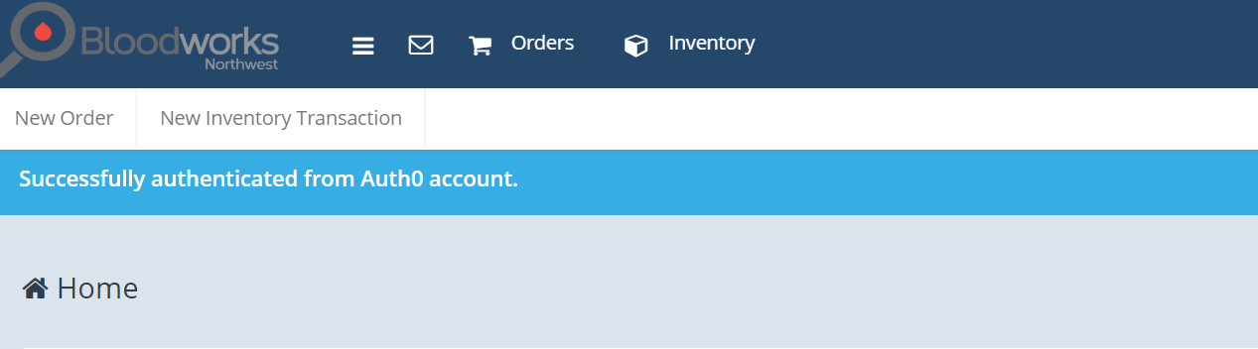
Creating New Orders
From the Home page, click on “New Order” to start order

Slide 6

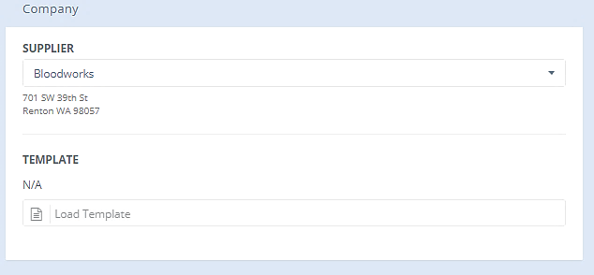
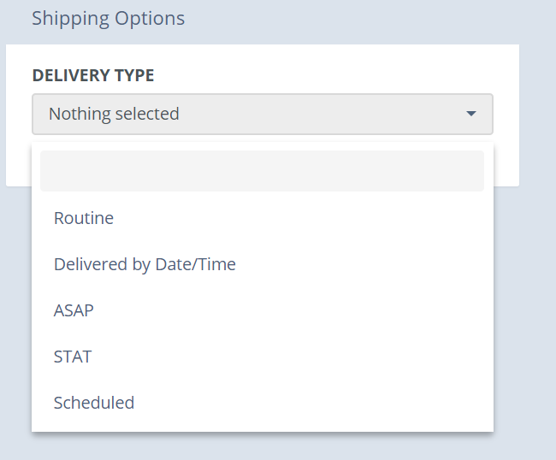
Selecting Delivery Type
The supplier field is initially auto-filled based on the Bloodworks location that supplies your hospital
Select “Delivery Type” from the pull-down menu
(See next page for description of delivery types)

Slide 7
Selecting Delivery Type
Delivery Type
When to Order
Routine
Delivered by Date/Time
ASAP
STAT
Scheduled
For Scheduled Deliveries
To have delivered by a specific Date/Time
(Not recommended due to time glitch in system-Consult Bloodworks if you would like to use this option)
For orders needed prior to next scheduled shipment, but not needed stat
For orders needed immediately
For reoccurring standing orders
(Do Not Use for Antigen Negative Orders)

Slide 8
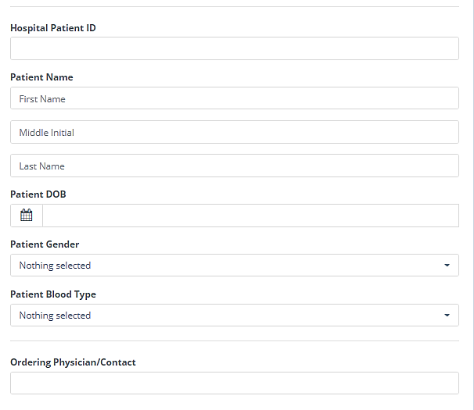
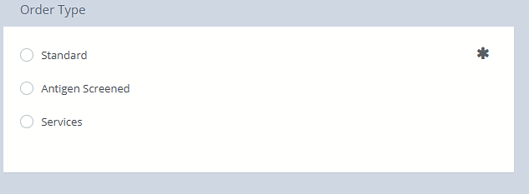
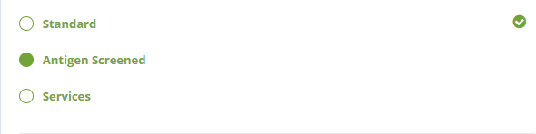

Selecting Order Type & Entering Patient Data
Fill in patient data in pop-up box.
Fields are optional, but please fill in as much info as possible.
Choose Antigen Screened order type
Units can be ordered as stock
or
Patient-specific
Then click on
next arrow

Slide 9
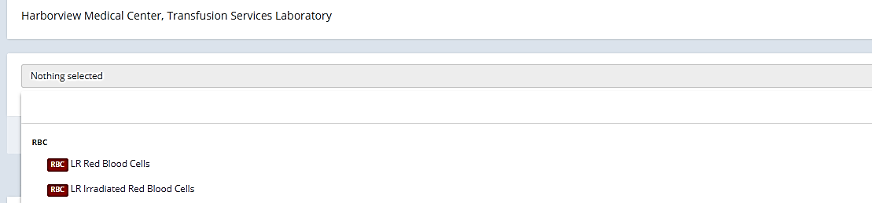
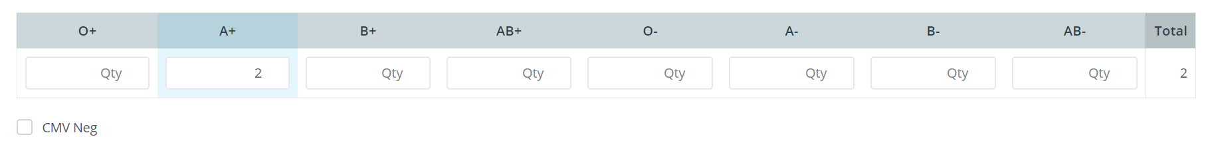

Selecting Unit Type
Select Regular RBC or Irradiated RBC from pull-down menu
Choose ABO/Rh and number of units
For patient orders, patient’s blood type will be highlighted
Check CMV box if CMV negative units required
Click Add to add units to order

Slide 10
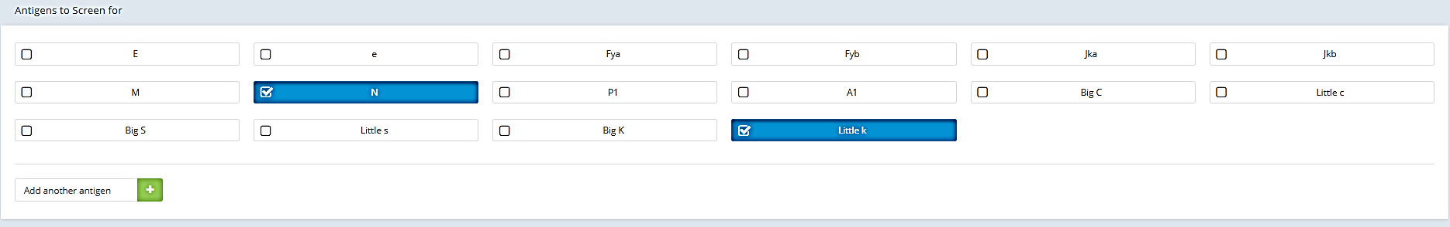
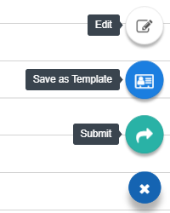

Selecting Antigens
Select desired antigens
If antigen does not appear in list above, type the desired antigen in the box and click the plus sign to add antigen to order
Click the next arrow
Then click on Submit

Slide 11
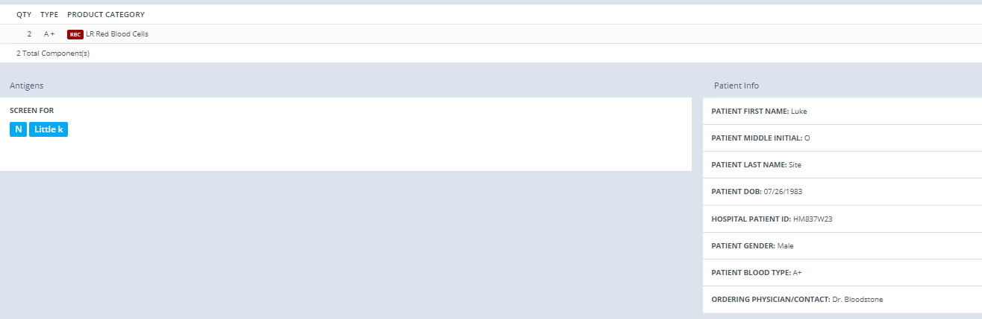
Order Status
Order will show units, requested antigens and patient info

Slide 12
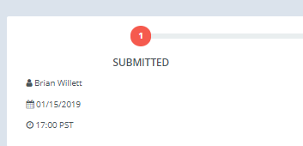
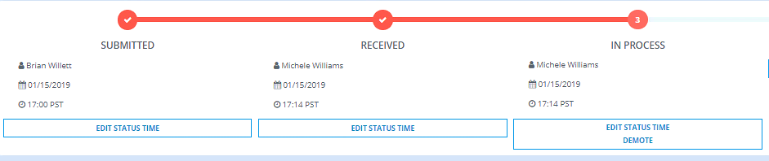
Order Status & Fulfillment
The order is now in Submitted status.
Hospital users can still make edits to the order while in this status.
IRL staff will acknowledge the order by promoting it to Received status.
Hospital users must call IRL at this point to make any changes to order.
Once IRL is ready to work on filling the order, it will be promoted
to In Process Status

Slide 13
Order Status & Fulfillment
Stat orders will be shipped directly from IRL in Central Seattle
ASAP orders may be shipped from Central Seattle or Your location distribution site
Routine orders will be shipped from your regular depot Renton, Portland or Eugene

Slide 14
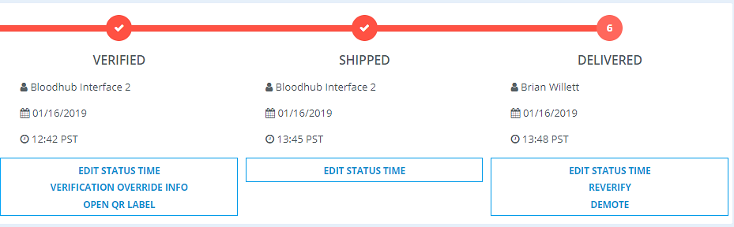
Order Status & Fulfillment
Once the order has been packed,
it will move to Verified status
When the order leaves Bloodworks,
it will show as Shipped status
When the order has been delivered,
it will change to delivered status

Slide 15
Contacting IRL
If you have questions regarding antigen negative blood products, call the Immunohematology Reference Department @ 206-689-6534
Staff are available 24/7 to help

