Slide 1
SCCA Hospital
Training on Upcoming Changes to Medical Record and Patient ID Bands
May/June 2019

Slide 2
The Seattle Cancer Care Alliance is a hospital providing inpatient and outpatient care
In order to best fulfill our regulatory obligations set by the U.S. Centers for Medicare and Medicaid Services (CMS) and the Washington State Department of Health (DOH), we will be making a few changes to our SCCA Hospital medical record.
This training will inform you of the changes to look out for.
Thank you for your participation!

Slide 3
Medical Record Overview
Changes will be made to the legal medical record and patient ID bands to clearly identify SCCA patients currently admitted to the SCCA Hospital. These changes will go into effect between May 30 – June 4, 2019.
The following items have an updated view:
Epic Patient Header
Patient ID Band
ORCA Patient Header
Patient Chart (effective January 7, 2019)

Slide 4
Epic Header
The Patient Header now displays the SCCA MRN for all patients in the SCCA Hospital.
Patient Header: Current State prior to May 30, 2019
Patient Header: Future State beginning May 30, 2019 at 9:30 AM
SCCA MRN
SCCA Hospital

Slide 5
Patient ID Bands
The patient ID band is now yellow, and clearly indicates that the patient has been admitted to the SCCA Hospital.
Patient ID Band: Current State prior to June 4, 2019
Patient ID Band: Future State beginning the morning of June 4, 2019

Slide 6
ORCA Header
The Patient Header will now display the SCCA MRN for all patients in the SCCA Hospital.
Patient Header: Current State prior to May 30, 2019
Patient Header: Future State beginning May 30, 2019 at 9:30 AM
SCCA MRN

Slide 7
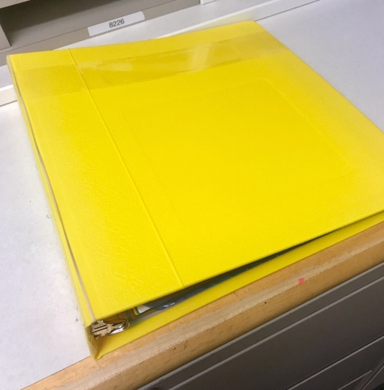
Patient Chart
As of June 4, 2019:
Yellow chart + yellow patient ID band = SCCA Hospital patient.
Yellow chart + white patient ID band = Former SCCA Hospital patient who has been discharged and readmitted to UWMC.
What does this mean for you?
The yellow chart follows a patient through a discharge from SCCA Hospital and readmit to UWMC until they are discharged to outpatient.
The yellow chart indicates that there are documents that must go to SCCA Health Information Management (HIM) aka “Medical Records” upon discharge from the inpatient setting.
The yellow chart should be delivered to 8NE/SCCA Hospital when a patient is discharged outpatient or after death.

Slide 8
What do these changes mean operationally?
Epic and ORCA
A way to easily identify a patient who is currently admitted to the SCCA Hospital
Chart Color
Action required for chart at discharge to outpatient or death
Patient ID Band
Visual cue for when a patient does or does not need discharge/readmit
Discharge and Readmit
Do not discharge/readmit patients who are no longer in SCCA Hospital (Yellow chart and white ID band)
Do discharge/readmit if an SCCA Hospital patient needs ICU post-procedure (Note: change in the level of care, which can be known pre-procedure or unexpected due to an unforeseen complication)
Discharge to Outpatient or Death
Send yellow charts to SCCA Hospital for processing

Slide 9
Discharge/Readmit Scenarios
Do not discharge/readmit patients:
If the patient is going to a procedural area from the SCCA Hospital and returning to the SCCA Hospital post-procedure
When moving a patient between UWMC departments if the patient has a yellow chart + white patient ID band
This indicates they were discharged from SCCA Hospital and readmitted to UWMC during this episode of inpatient care
Use Epic or Orca as confirmation of current hospital admission location
Do discharge/readmit a patient:
If the patient came from the SCCA Hospital and ICU is required post-procedure
Pre-planned or unplanned due to complication
For additional information, please refer to the policy on Discharging and Admitting Patients Between SCCA and UWMC Hospital Beds

Slide 10
Thank you!

