Slide 1
SUNQUEST UPDATES
Ortho Vision® Go Live 6/20/19

Slide 2
What happening 6/20/19?
With the implementation of ORTHO VISION® testing; the following tests have been created or revised
Blood Type (%ABR)
Donor confirmation (%ARC)
DAT Poly (%DBS)
DAT IgG (%DIG)
Cord Blood
Manual DAT Poly and DAT IgG grid changes

Slide 3
VISION TESTS
Blood type (%- ABR)- Vision has the capability to allow results to be sent across with interpretation and without interpretation
Patient testing results need to be resulted using Blood Order Processing as is current practice
Mixed field (MF) is only option to define mixed field in Gel. Do not grade (1+ etc)mixed fields on Vision and manual gel.

Slide 4
Example: Blood Type in BOP from Vision with interpretation
Interpretation: sent as O Neg from Vision to SQ

Slide 5
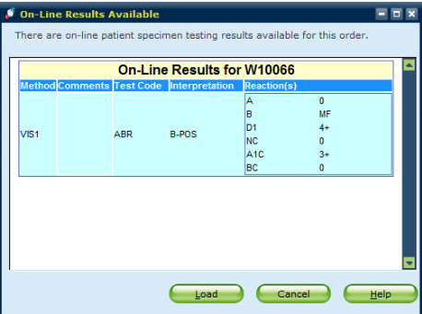
Example: Mixed field reaction with interpretation
Mixed field reactions on Vision can be called “MF” and sent across with appropriate interpretation. In this scenario this is a B Pos patient who received O pos RBC. Hence the interpretation of B Pos is appropriate to send from Vision.

Slide 6
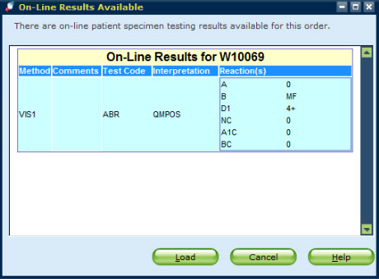
Example: Blood Type in BOP from Vision without interpretation
Results can be sent to SQ from Vision after review without interpretation. This would be valid to do in cases where the interpretation of NTD would be appropriate.
“QMPOS” under Interpretation-SQ has no defined code for this

Slide 7
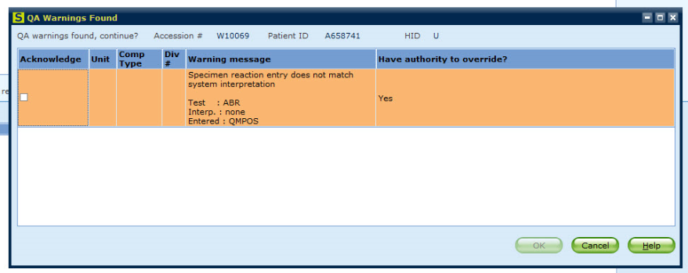
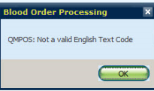
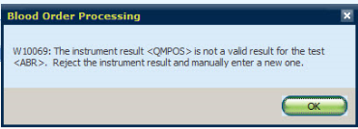
Example: Blood Type in BOP from Vision without interpretation
The following QA Warning will appear, followed by the BOP message, click ok
1
3
2

Slide 8
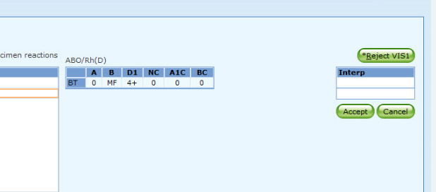
Example: Blood Type in BOP from Vision without interpretation
Enter interpretation such as NTD as appropriate.
NTD can be entered
Note: If results sent in error or incorrect; “Reject VIS 1” results

Slide 9
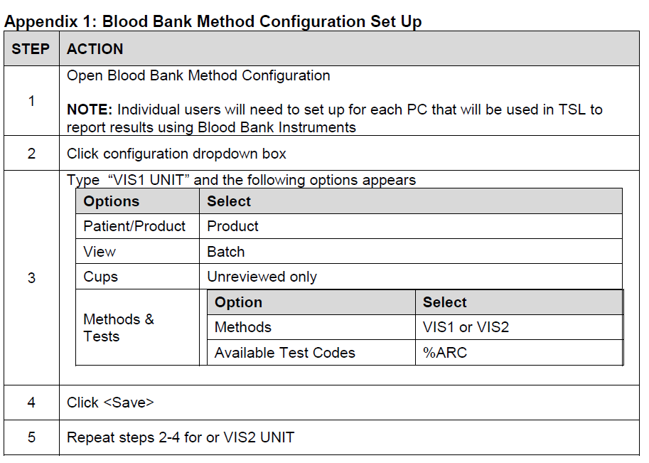
Donor type Confirmation
Donor type confirmation can be run on Vision
All users need to set up Blood Bank Instruments, follow instructions below

Slide 10
Donor type Confirmation
Do not run 1st/2nd container units on Vision. Results do not transmit to SQ. Results for donor type confirmation can be using batch specimen mode in Blood Bank Instruments. Select appropriate VIS 1 Unit or VIS 2 Unit
Unit flagged in red are discrepant results between Vision and SQ blood type. Do not release results that are discrepant.

Slide 11
Donor type Confirmation
Unit Blood Type in SQ
Interpretation sent by Vision

Slide 12
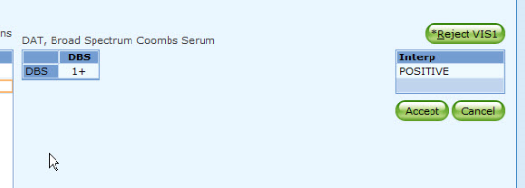
DAT Poly
If DAT Poly is positive, perform DAT IgG on Vision and DAT C3 by tube method. Control tube to be resulted with C3 tube testing grid (%DCD)

Slide 13
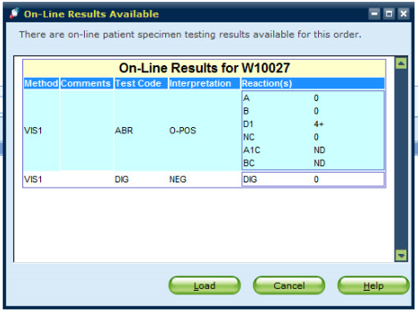
Cord Blood
Same ABD and reverse card as blood type used but reverse testing not performed. Vision will send “ND” for A1C and BC. DAT IgG same for cord blood and peripheral blood.

Slide 14
Manual DAT Poly
DGEL column added for DAT performed in gel method. Do not use DGEL column for tube method results.

Slide 15
Manual DAT IgG
DGEL column added for DAT IgG performed in gel method. Do not use DGEL column for tube method. No control tube results in gel.
DAT Complement (DCD) is performed in tube method only with control tube testing.

