Slide 1
O.R. Read back Training Transfusion Safety at the bedside
for Anesthesia and TSL Technicians
Melora Riveira, BSN, RN, CCRN
melorag@uw.edu
Teodora Monoski, Education Lead Transfusion Services
teodora2@uw.edu

Slide 2
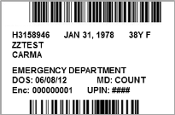
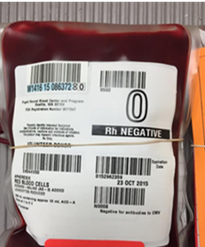
OBJECTIVE
Review the complex process to deliver blood safely to patients and important elements
Review the role of the Anesthesia and TSL Technicians in the O.R. in conjunction with other qualified clinicians
Sample Collection
Blood Product Verification

Slide 3
Anesthesia &
TSL Techs
What is our shared goal?
Deliver blood transfusions safely to our patients
Transfusion Safety
=
Patient Safety

Slide 4
TRANSFUSION SAFETY MANTRAS
The SAFEST transfusion is the ONE NOT GIVEN.
The right COMPONENT…
…to the right PATIENT…
…in the right DOSE…
…at the right RATE…
…for the right REASON.

Slide 5
Transfusion Cycle
Sample Collection
Two person verification of patient’s name and MRN
Draw sample and label at bedside
Sample and requisition form must indicate date & time of draw and persons collecting blood sample
Sample testing
Identify patient’s ABO and Rh blood type
Screen patient’s plasma for antibodies
If indicated, identify antibodies
COLLECT BLOOD SAMPLE
TEST
BLOOD SAMPLE
PATIENT’S BEDSIDE
TRANSFUSION SERVICES
TRANSFUSE DONOR BLOOD
SELECT & ISSUE
DONOR
BLOOD
Component Administration
Verify there is a valid order and consent to transfuse
Two person bedside verification to ensure right product to the right patient
Observe for complications
Component Selection and Issue
ABO/Rh compatibility
Special Needs
Two Person Verification
A breakdown at any point could lead to the wrong blood product being transfused to a patient.

Slide 6
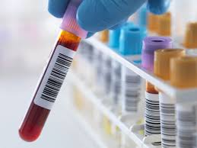
Anesthesia Techs
Sample Collection
What is so important about this task?
Type-specific or type-compatible blood requires a sample of blood to test for blood type and presence of antibodies (Type and Screen)
Timing is important, why?
Preserve universal products O RH Neg
Easier to type if less product diluted
Early antibody detection
TSL relies on the qualified clinicians to follow the policy of appropriate bedside verification to identify the right patient
2-person verification process with at least two patient identifiers

Slide 7
Patient
NOTE: Operating Room’s Anesthesia Information Management System (AIMS) may serve as the patient’s ID band ONLY AFTER performing, verifying and completing the surgical time-out.
What’s important to know…
Verify each area independently/separately

Slide 8
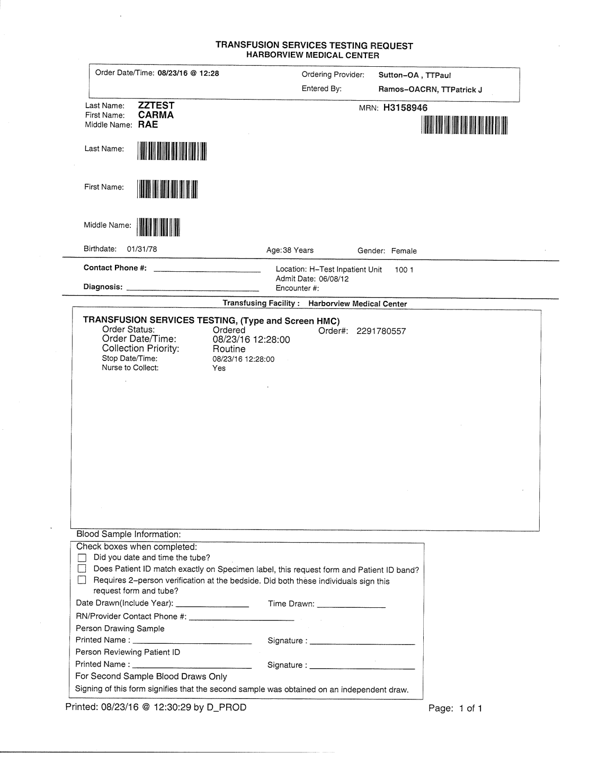
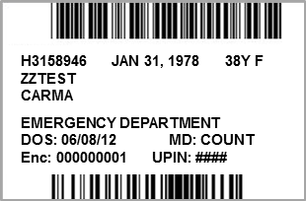
Blood Sample Attachment 1: Patient ID, Transfusion Services Requisition, Sample Label
II
I
PATIENT ID
TRANSFUSION SERVICES REQUISITION
54Y M
8/23/19
Hemorrhage
Frank
MRN: H9873828
III
In the presence of the recipient, the qualified clinician and one other qualified clinician shall verify at the bedside separately and independently: Patient’s name and MRN on (I)Patient’s ID band, (II)Transfusion Services Requisition, and (III)Sample Label correspond. Involve the patient when able to confirm name and DOB.
Step 1: Clinician A: Verifies patient information on (I) patient ID band aloud while Clinician B verifies information corresponds on the (II) Transfusion Services Requisition
Step 2: Clinician B: Verifies patient information on (II) Transfusion Services Requisition while Clinician A verifies information corresponds on (III) Sample Label to ensure all pieces of information match
Step 3: Using an EDTA blood collection tube, collect the blood sample from the patient per standard blood collection protocol, while the witness observes as the patient’s blood fills the tube.
Step 4: Date, time, and sign the requisition form and blood sample label.
Step 5: Have the witness sign the requisition form and blood sample label.
Step 6: Place the signed label on the blood collection tube in the presence of the patient.
Step 7: Place completed requisition form and properly labelled blood sample in a specimen bag and send to TSL.
Step 8: If confirmatory sample required, repeat process separately
SAMPLE LABEL
54 YEARS
12/20/1965
Male
H9873828
12/20/1965
54Y M
Ordered
8/23/19 12:28:00
Routine
8/23/19 12:28:00
Hemorrhage
Frank
Penny Plasma, RN
Emma Good, RN
Caveat: If Middle Name in one area, Matching middle initial on another area this is acceptable
DOS:8/23/19
Enc: 000
8/23/19
1300
PATIENT IDENTIFIERS MATCH on Patient ID band, Transfusion Services Requisition, and Sample Label
x
x
x
8/23/19
1300
Penny Plasma, RN
Penny Plasma, RN
Emma Good, RN
Emma Good, RN
DATE & TIME OF DRAW and SIGNATURES OF COLLECTOR & WITNESS MATCH on sample label and requisition form.
10/2019

Slide 9
PSN Themes and Criteria for
Rejection and
Inappropriate Sample Collection
Sending more samples than necessary
Check to ensure patient needs samples drawn
Mislabeled
Double labeled
Diluted with IV fluid/ contaminated with blood product
Mismatch or missing date and times on sample label and requisition or sample label
Clinician signatures missing (one or more)
Missing requisition
Printer cut off letters
Illegible

Slide 10
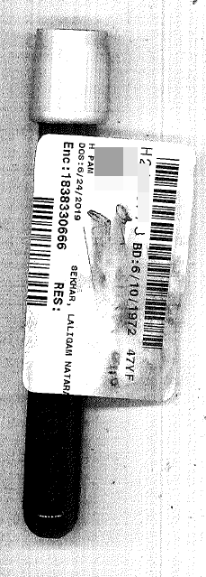
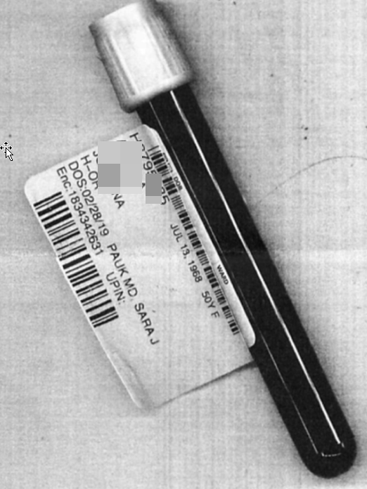
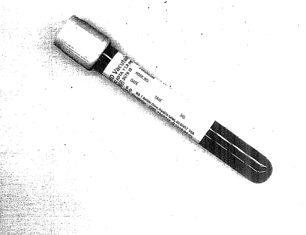
illegible
Missing signature
on form
Missing 2 signatures, date, time on sample
No patient label

Slide 11
PSN Themes and Criteria for
Sample Rejection
Why is this important
Clinician time
Delays
Resources/cost
Iatrogenic anemia
How can we prevent this:
Making transfusion related activities a time-out and understand the importance. Even in emergencies or busy
Communication with TSL on what is needed if unsure

Slide 12
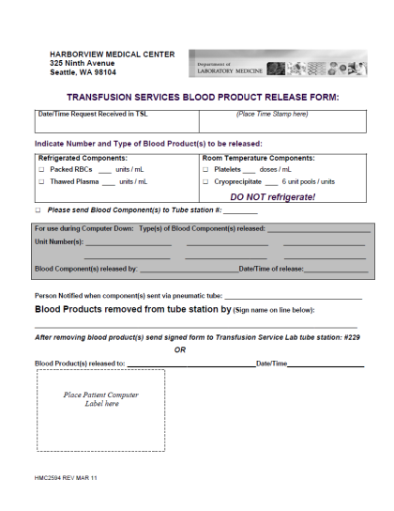
OBTAINING BLOOD FROM TSL
TSL will complete TRANSFUSION SERVICES BLOOD PRODUCT RELEASE FORM (HMC2594), aka “GREEN SHEET,” to fulfill request blood components for the OR.
TSL will prepare blood components based on the providers request:
Patient Identifiers
Blood component and dose
Modification Request
INSPECT blood component and
VERIFY you have the right component (with the requested attributes) to the right patient.
Once you receive the blood product, SIGN THIS SECTION and RETURN FORM TO TSL.

Slide 13
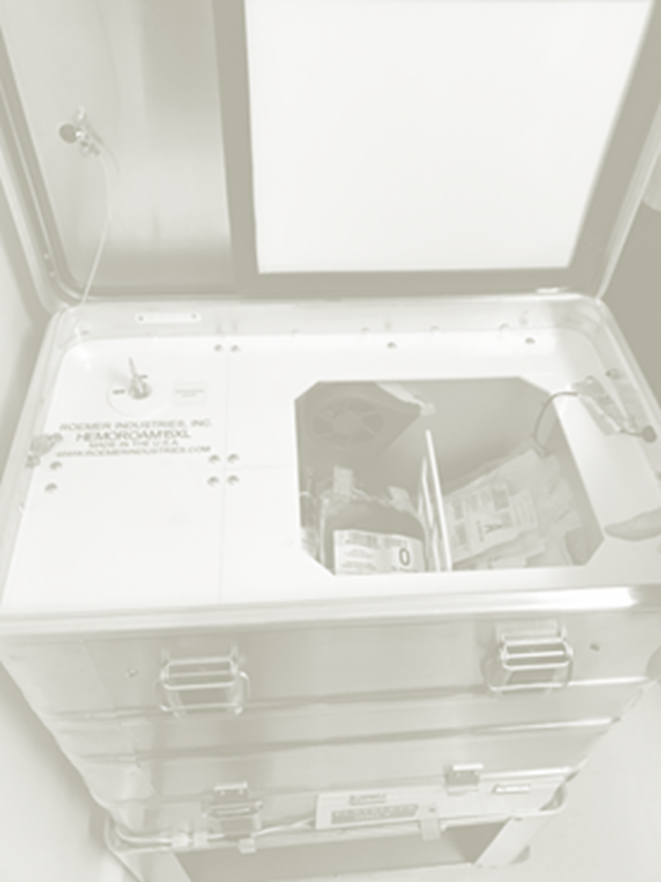
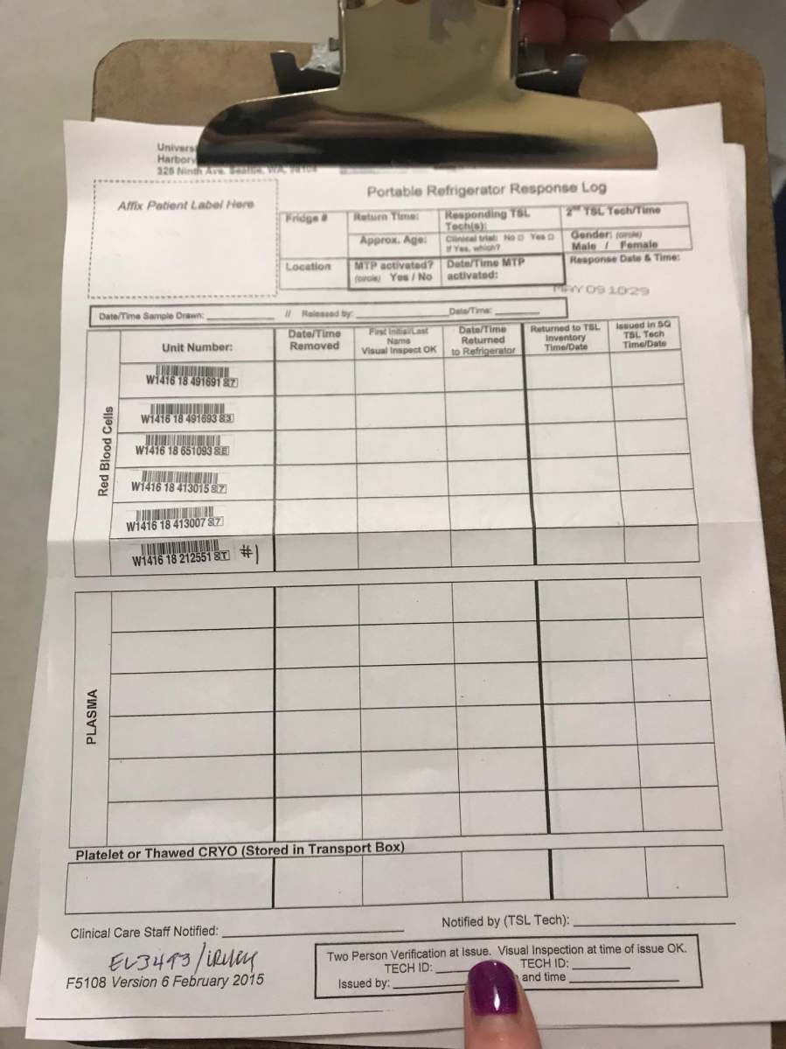
OBTAINING BLOOD FROM TSL
Jan/Feb 2019
Notes:
Why it this important?
PSN: both

Slide 14
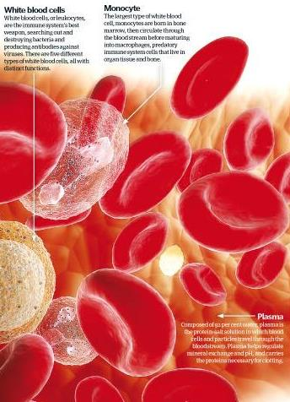
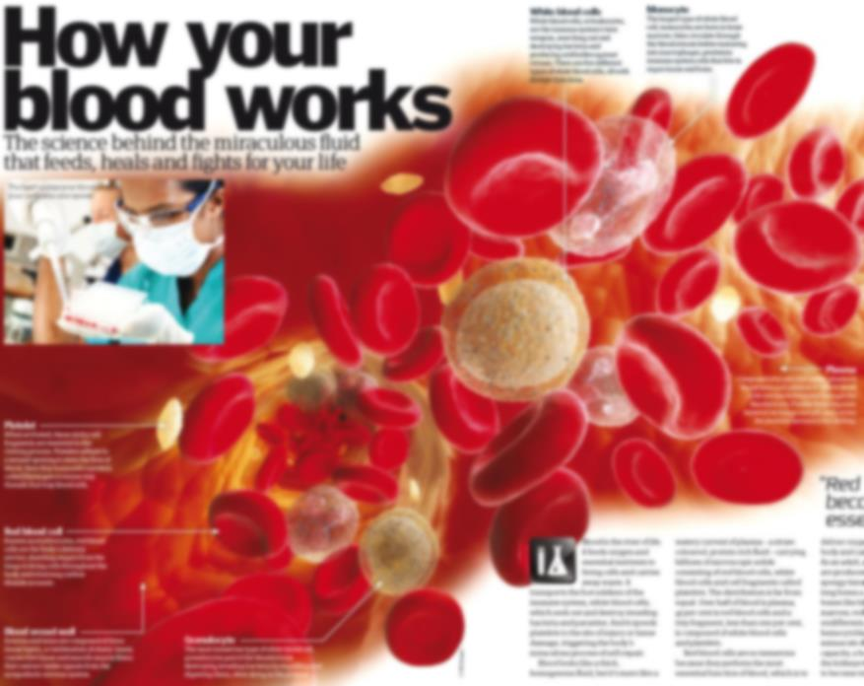
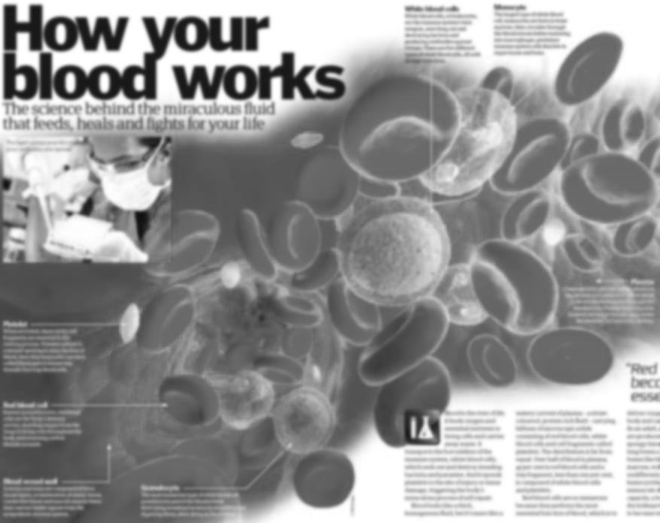
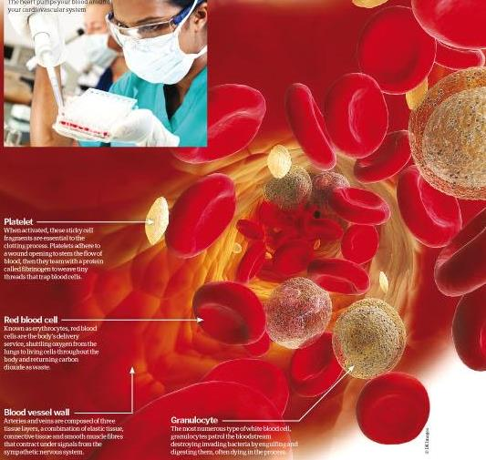
Blood Components at HMC
Red Blood Cells¹
Carry oxygen from the lungs to your body’s tissue and take carbon dioxide back to your lungs to be exhaled.
NEW:
Whole Blood!
Platelets¹
Colorless cell fragments in the blood whose main function is to interact with clotting proteins to stop or prevent bleeding.
Plasma¹
Fluid in which platelets, white blood cells, and red blood cells are suspended. It is made up of:
92% water
7% vital proteins such as albumin, gamma globulin, anti-hemophilic factor, and other clotting factors
1% mineral salts, sugars, fats, hormones, and vitamins
A blood transfusion is a procedure to replace blood or specific blood components
Blood components are collected from either whole blood donations or apheresis donations (i.e., donors donate a specific blood component)
Cryoprecipitate
Derived from plasma and contains a higher concentration of clotting factors than plasma alone.
Definitions taken from: 1) http://www.redcrossblood.org/learn-about-blood/blood-components or 2) http://kidshealth.org/parent/general/body_basics/immune.html
Background image taken from http://www.howitworksdaily.com/wp-content/uploads/2011/01/Blood.jpg
Plasma image taken from http://www.howitworksdaily.com/wp-content/uploads/2011/01/Blood.jpg

Slide 15
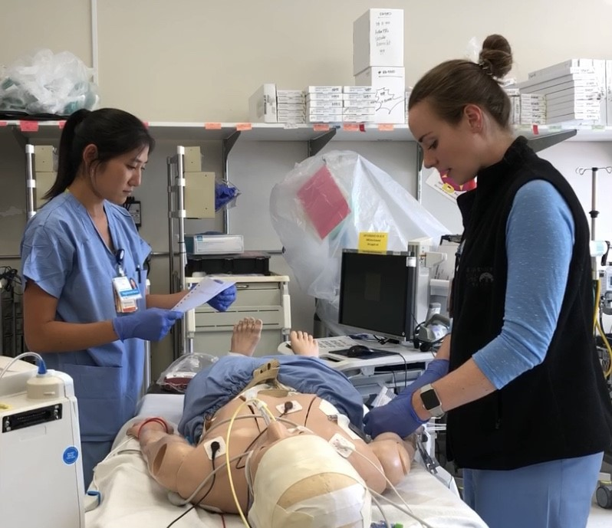
Blood Administration
Verify, verify, verify!
The right 2 person verification process
Right product
Right Patient
The right equipment, compatible IV solutions, IV access

Slide 16
Patient
NOTE: Operating Room’s Anesthesia Information Management System (AIMS) may serve as the patient’s ID band ONLY AFTER performing, verifying and completing the surgical time-out.
What’s important to know…
BEST PRACTICE:
Verify each area independently/separately

Slide 17
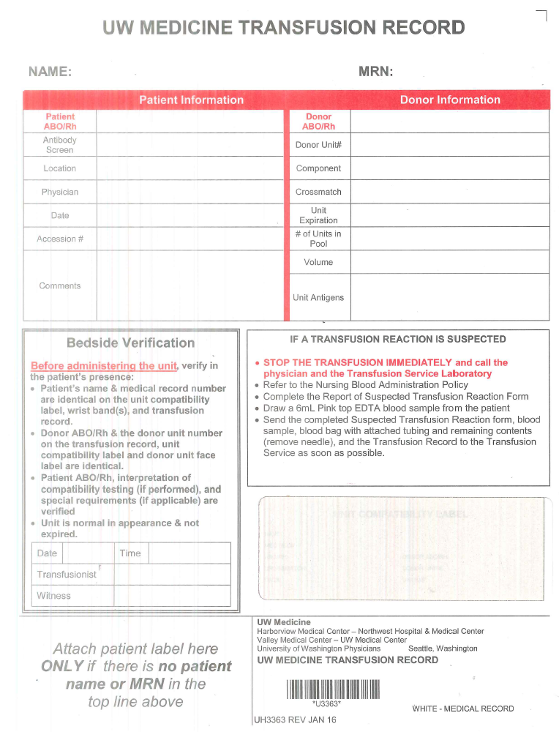
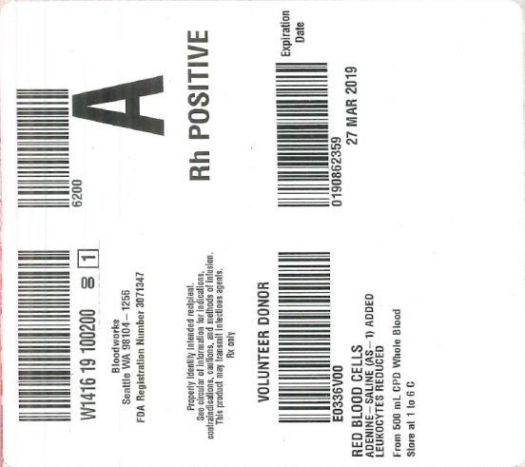
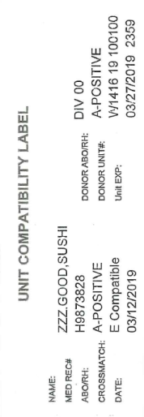
H9873828
Hemorrhage, Frank
12/20/1965
Blood Attachment 2: Patient Label, Unit Compatibility Label, Transfusion Record, and Container Label
II
TRANSFUSION RECORD
Special Requirements (Attributes):
-Will be on Transfusion record and container label
- Based on TSL inventory may substitute products with attributes even if patient does not need
I
PATIENT ID
Hemorrhage, Frank
H9873828
A-POSITIVE
A-POSITIVE
III
CONTAINER LABEL
NEGATIVE
W141619100100
9MB
RBCS L
Hart, MD
E COMPATIBLE
IV
UNIT COMPATIBILITY LABEL
03/27/2019 2359
350
Hemorrhage, Frank
Bedside Verification
In the presence of the recipient, the qualified clinician and one other qualified clinician shall verify at the bedside separately and independently: (I)Patient D Band (II) Transfusion Record (III)Container Label (IV) Unit Compatibility Label. Involve the patient when able to confirm name and DOB.
Step 1: Clinician A: Verifies patient information on (I) Patient ID band aloud while Clinician B verifies information verbalized on the (II) Transfusion record
Step 2: Clinician B: Verifies patient information aloud on (II) Transfusion Record while Clinician A verifies the information corresponds on the (III) Container Label and (IV) Unit Compatibility Label to ensure all pieces of information match
What exactly are we verifying per HMC Policy?
Patient’s name and MRN on Patient’s ID band, Transfusion Record, and Unit Compatibility Label.
Patient’s ABO & Rh blood type on Transfusion Record and Unit Compatibility Label.
Donor’s ABO & Rh blood type and donor unit number on Container Label, Transfusion Record, and Unit Compatibility Label.
Blood component type and division code on Container Label, Transfusion Record, and Unit Compatibility Label.
Crossmatch test interpretation (if performed) on Transfusion Record, and Unit Compatibility Label.
Expiration date & time has not elapsed on Container Label, Transfusion Record, and Unit Compatibility Label.
Rev 10/2019

Slide 18
H9873828
Hemorrhage, Frank
12/20/1965
Blood Appendix Transfusion G: Unit Compatibility Label, Transfusion Record, and Container Lab (Side I)
Hemorrhage, Frank
H9873828
A-POSITIVE
A-POSITIVE
W141619100100
350
RBCS L DIV 00
CONTAINER LABEL
(SIDE A)
Dr. Smith
E Compatible
3/27/2019
3/27/2019 2359
UNIT COMPATIBILITY LABEL (SIDE B)
H16760
350
Hemorrhage, Frank
In accordance with AABB standards and in the presence of the recipient, the transfusionist and one other trained individual shall verify:
Patient’s name and MRN on Patient’s ID band, Transfusion Record, and Unit Compatibility Label.
Patient’s ABO & Rh blood type on Transfusion Record and Unit Compatibility Label.
Donor’s ABO & Rh blood type and donor unit number on Container Label, Transfusion Record, and
Unit Compatibility Label.
Blood component type and division code on Container Label, Transfusion Record, and Unit Compatibility Label.
Crossmatch test interpretation (if performed) on Transfusion Record, and Unit Compatibility Label.
Expiration date & time has not elapsed on Container Label, Transfusion Record, and Unit Compatibility Label.
Rev 9/2019

Slide 19
H9873828
Hemorrhage, Frank
12/20/1965
Blood Appendix Transfusion G: Unit Compatibility Label, Transfusion Record, and Container Lab
Hemorrhage, Frank
H9873828
A-POSITIVE
A-POSITIVE
W141619100100
350
RBCS L DIV 00
CONTAINER LABEL
(SIDE A)
Dr. Smith
E Compatible
3/27/2019
3/27/2019 2359
UNIT COMPATIBILITY LABEL (SIDE B)
H16760
350
Hemorrhage, Frank
In accordance with AABB standards and in the presence of the recipient, the transfusionist and one other trained individual shall verify:
Patient’s name and MRN on Patient’s ID band, Transfusion Record, and Unit Compatibility Label.
Patient’s ABO & Rh blood type on Transfusion Record and Unit Compatibility Label.
Donor’s ABO & Rh blood type and donor unit number on Container Label, Transfusion Record, and
Unit Compatibility Label.
Blood component type and division code on Container Label, Transfusion Record, and Unit Compatibility Label.
Crossmatch test interpretation (if performed) on Transfusion Record, and Unit Compatibility Label.
Expiration date & time has not elapsed on Container Label, Transfusion Record, and Unit Compatibility Label.
Rev 9/2019

Slide 20
H9873828
Hemorrhage, Frank
12/20/1965
Blood Appendix Transfusion G: Unit Compatibility Label, Transfusion Record, and Container Lab
Hemorrhage, Frank
H9873828
A-POSITIVE
A-POSITIVE
W141619100100
350
RBCS L DIV 00
CONTAINER LABEL
(SIDE A)
Dr. Smith
E Compatible
3/27/2019
3/27/2019 2359
UNIT COMPATIBILITY LABEL (SIDE B)
H16760
350
Hemorrhage, Frank
In accordance with AABB standards and in the presence of the recipient, the transfusionist and one other trained individual shall verify:
Patient’s name and MRN on Patient’s ID band, Transfusion Record, and Unit Compatibility Label.
Patient’s ABO & Rh blood type on Transfusion Record and Unit Compatibility Label.
Donor’s ABO & Rh blood type and donor unit number on Container Label, Transfusion Record, and Unit Compatibility Label.
Blood component type and division code on Container Label, Transfusion Record, and Unit Compatibility Label.
Crossmatch test interpretation (if performed) on Transfusion Record, and Unit Compatibility Label.
Expiration date & time has not elapsed on Container Label, Transfusion Record, and Unit Compatibility Label.
Rev 9/2019

Slide 21
H9873828
Hemorrhage, Frank
12/20/1965
Blood Appendix Transfusion G: Unit Compatibility Label, Transfusion Record, and Container Lab
Hemorrhage, Frank
H9873828
A-POSITIVE
A-POSITIVE
W141619100100
350
RBCS L DIV 00
CONTAINER LABEL
(SIDE A)
Dr. Smith
E Compatible
3/27/2019
3/27/2019 2359
UNIT COMPATIBILITY LABEL (SIDE B)
H16760
350
Hemorrhage, Frank
In accordance with AABB standards and in the presence of the recipient, the transfusionist and one other trained individual shall verify:
Patient’s name and MRN on Patient’s ID band, Transfusion Record, and Unit Compatibility Label.
Patient’s ABO & Rh blood type on Transfusion Record and Unit Compatibility Label.
Donor’s ABO & Rh blood type and donor unit number on Container Label, Transfusion Record, and Unit Compatibility Label.
Blood component type and division code on Container Label, Transfusion Record, and Unit Compatibility Label.
Crossmatch test interpretation (if performed) on Transfusion Record, and Unit Compatibility Label.
Expiration date & time has not elapsed on Container Label, Transfusion Record, and Unit Compatibility Label.
Rev 9/2019

Slide 22
H9873828
Hemorrhage, Frank
12/20/1965
Blood Appendix Transfusion G: Unit Compatibility Label, Transfusion Record, and Container Lab
Hemorrhage, Frank
H9873828
A-POSITIVE
A-POSITIVE
W141619100100
350
RBCS L DIV 00
CONTAINER LABEL
(SIDE A)
Dr. Smith
E Compatible
3/27/2019
3/27/2019 2359
UNIT COMPATIBILITY LABEL (SIDE B)
H16760
350
Hemorrhage, Frank
In accordance with AABB standards and in the presence of the recipient, the transfusionist and one other trained individual shall verify:
Patient’s name and MRN on Patient’s ID band, Transfusion Record, and Unit Compatibility Label.
Patient’s ABO & Rh blood type on Transfusion Record and Unit Compatibility Label.
Donor’s ABO & Rh blood type and donor unit number on Container Label, Transfusion Record, and Unit Compatibility Label.
Blood component type and division code on Container Label, Transfusion Record, and Unit Compatibility Label.
Crossmatch test interpretation (if performed) on Transfusion Record, and Unit Compatibility Label.
Expiration date & time has not elapsed on Container Label, Transfusion Record, and Unit Compatibility Label.
Rev 9/2019

Slide 23
H9873828
Hemorrhage, Frank
12/20/1965
Blood Appendix Transfusion G: Unit Compatibility Label, Transfusion Record, and Container Lab
Hemorrhage, Frank
H9873828
A-POSITIVE
A-POSITIVE
W141619100100
350
RBCS L DIV 00
CONTAINER LABEL
(SIDE A)
Dr. Smith
E Compatible
3/27/2019
3/27/2019 2359
UNIT COMPATIBILITY LABEL (SIDE B)
H16760
350
Hemorrhage, Frank
In accordance with AABB standards and in the presence of the recipient, the transfusionist and one other trained individual shall verify:
Patient’s name and MRN on Patient’s ID band, Transfusion Record, and Unit Compatibility Label.
Patient’s ABO & Rh blood type on Transfusion Record and Unit Compatibility Label.
Donor’s ABO & Rh blood type and donor unit number on Container Label, Transfusion Record, and Unit Compatibility Label.
Blood component type and division code on Container Label, Transfusion Record, and Unit Compatibility Label.
Crossmatch test interpretation (if performed) on Transfusion Record, and Unit Compatibility Label.
Expiration date & time has not elapsed on Container Label, Transfusion Record, and Unit Compatibility Label.
Rev 9/2019

Slide 24
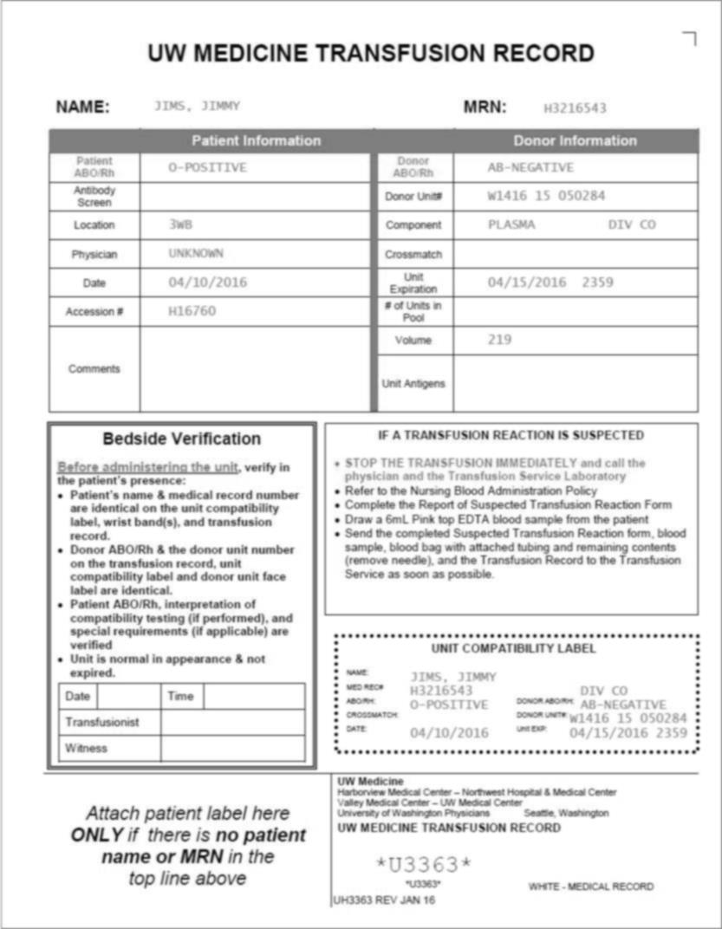
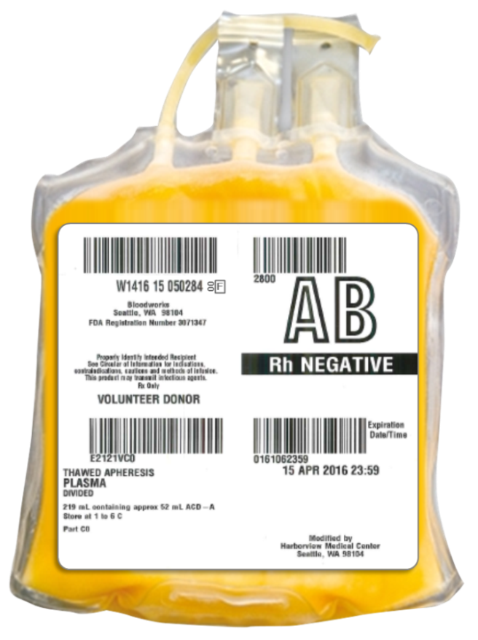
to Right Patient VERIFIED
Bedside Verification: Right Product to Right Patient VERIFIED
Bedside Verification: Right Product to Right Patient VERIFIED
In an emergency, when the second licensed clinician cannot sign the transfusion record, it is acceptable to PRINT the clinician’s name on the transfusion record and obtain signature at the end of the case.
Hemorrhage, Frank
H9873828
H9873828
Hemorrhage,
Frank
Upon COMPLETION of the verification process, DATE, TIME, and have both transfusionist and witness SIGN the transfusion record
FRONT
BACK
Hemorrhage, Frank
If there are any DISCREPANCIES, notify and return blood component to TSL.

Slide 25
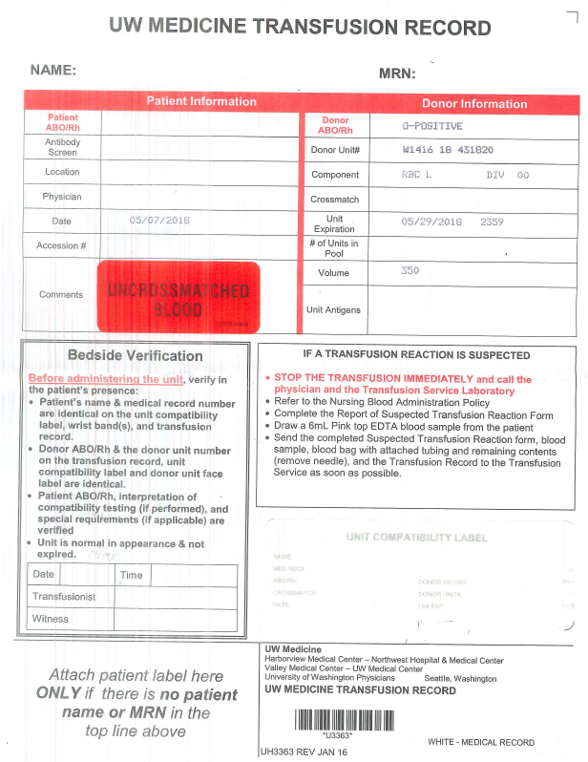
Quality improvement spotlight: Uncrossmatched labeling
Patient
Safety
Notes:
Why it is important

Slide 26
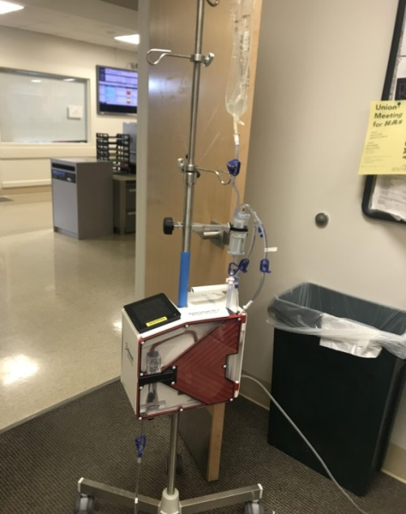
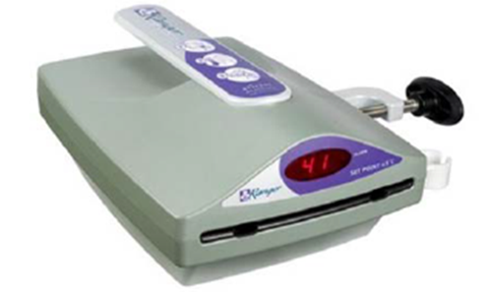
Observation and Monitoring
If getting large volumes:
Hyperkalemia
Hypocalcemia
Volume Overload
Hypothermia
Anyone receiving blood:
Transfusion Reactions
Blood products are generally safe but…
What should transfusionist do if they think the patient is having a transfusion reaction?
Stop the transfusion if you suspect a transfusion reaction, keep the IV access, treat the patient, notify TSL and save the product and anything attached. May need to send another pink-top tube.
Notes:
Transfusion Reactions
Hypocalcemia
Hypothermia
Hyperkalemia

Slide 27
Thank you
TRANSFUSION SERVICES LAB (TSL)
744-3088
BCT-67
Tube Station #229
Medical Directors:
JOHN HESS, MD
MONICA PAGANO, MD
HAMILITON TSANG,MD
Manager:
Erin Tuott
TSL Educator:
Te Monoski
Program Manager:
Melora Riveria

