Slide 1
All things Epic

Slide 2
Cutover Timeline
2300 – ORCA and Epic go down.
Orders placed will be on paper
Patients will be registered on downtime documents
0000 – Sunquest goes down
Downtime process for TSL
0015 – patients arm banded with U MRN
0300 – Sunquest back up (hopefully)
Paper orders received on patients registered on downtime documents must be created in SQ Administrative Data Entry
0400 – Epic comes up (hopefully)

Slide 3
Sunquest/TSL Changes
New test codes
New MRNs (remember, we are all on U MRNs now)
New component issue process (must SCAN the ecode)
New Whiteboard for OR cases
New sample requirements and inpatient areas using SQ for labels
MLS - New report for outpatient transfusion orders (DAR = Department Appointments Report)
BPAM in Epic – Blood Product Administration Module (how blood is charted at bedside)

Slide 4
Job aid for post reconciliation Ecode scanning
Red for RBC
Yellow for plasma and cryo
Blue for platelets
Three will be placed around TSL for ease of use.
Review ecode on trauma log then scan job aid at BPI

Slide 5
New order codes
TSCREX – preadmission Type and Screen
TFFPP, TPLTP, TCRYP, TGRANP – pediatric order sets, in mL but still give whole units (no aliquots)
TFFPN, TPLTN, TCRYN – neonate order sets, in mL but still give whole units (no aliquots)
TFFPX – plasma exchange, volume crosses into SQ. Update total number of units used after determining how many needed to get total volume
TWHBLD – whole blood, only orderable in MTPs
MLS - TRBC AND TGRAN – must result history check in BOP

Slide 6
Sample changes
All samples must have 2 signatures/initials plus date and time of collection. Year is optional but if indicated it MUST BE CORRECT
Requisitions are only required for non-Epic ordered samples (i.e. OR). They must come with the sample and can’t be sent later.
Inpatient areas and some clinics use Epic orders and SQ collect
Receive sample in ORM, update time of collection to what is on sample
If collected by phlebotomy, add the phlebotomy tech ID
Clinics use Epic orders and ADT labels
Receive sample in ORM, indicate time of collection to what is on sample
OR uses TSL Test & Blood Product Request form and ADT labels
Order using SQ OE function

Slide 7
Requisitions
Product orders will print in TSL. They are now called “prepare orders”
Test order requisitions will not print.
**Exception to the rule – TSCREX will print with sample collection and again on day of surgery when the question re transfusion or pregnancy is answered.
Requisition does not need 2 signatures, date and time of collection. They have been removed from paperwork completely

Slide 8
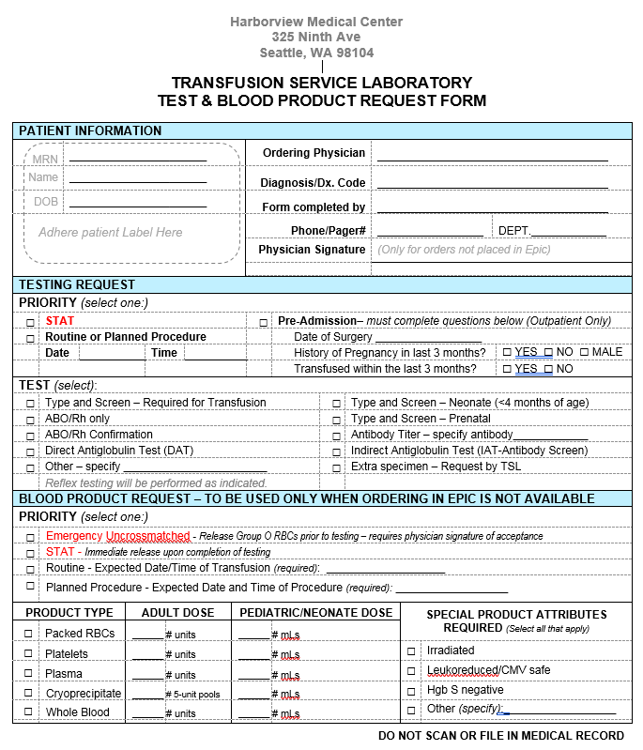
Requisitions
OR Requisition
Product orders will print in TSL. They are now called “prepare orders”
Test order requisitions will not print.
**Exception to the rule – TSCREX will print with sample collection and again on day of surgery when the question re transfusion or pregnancy is answered.
Requisition does not need 2 signatures, date and time of collection. They have been removed from paperwork completely

Slide 9
Nursing side of things
If they need assistance with Epic, direct them to their super user or “hit F1 in Epic” to get their help menu
Must have an order to be able to chart – no product/transfuse order then no flowsheet row
Sample collection – nurse will print SQ labels on the floor and use the 2D barcode to scan against pt armband. They will collect sample, enter date and time of collection and send with leftover labels to TSL.
BPAM – nurse will scan unit number and ecode and they will get a green thumbs up if the unit is correctly issued to patient or a red hand if it is not. They will also get an error if we do not SCAN the ecode at BPI and they cannot move past to transfuse the unit.

Slide 10
Initial OR Status Board set up step 1
Type OR/Procedure Status Board and select

Slide 11
Initial OR Status Board set up step 2
Select HMC
and start date of today, can change if reviewing future dates
Click “My default”, and Run

Slide 12
OR Status Board (don’t forget to log out of Epic when you leave for the day)

Slide 13
Screenshot – General Laboratory

Slide 14
Screenshot – General Laboratory (ORM)

Slide 15
prepare and release example
Irradiated RBC “prepare” (i.e., receive order in SQ)
Irradiated RBC “release” (i.e., ready to transfuse)

Slide 16
MLS – review history for LINK step 1 Click Review in Epic and enter patient MRN

Slide 17
MLS – review history for LINK step 2 Open Demographics tab and review Patient IDs

Slide 18
And finally (MLS Only) the anticipated DAR report for outpatient component orders Step 1 – type DAR in the search bar and “jump to” DAR – Dept Appts

Slide 19
(MLS Only) DAR Report Step 2
Select HMC TSL Transfusion Advanced Prep Report
Click box “my default”

Slide 20
(MLS Only) Final DAR view – unfortunately, don’t have any patients so stay tuned…

Slide 21
(MLS Only) DAR – the Epic Tip Sheet seems to indicate this view…

Slide 22
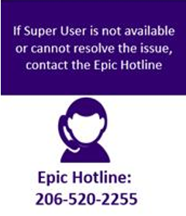
(who are you going to call?) D1 Go-live Information
This Station Login Location #
221150
Directing Providers to Resources after D1 Go-Live
Remember to be considerate and polite when speaking to Providers who have questions!
Issue Reporting to LMIT
Following links are found in:
SPS tools, Clinical Lab Links & HC1
Lab Med D1 Go-Live Issue Tracker
https://tracker.labmed.uw.edu/d1golive/issue?@template=item
Email: dlmpd1issues@uw.edu
For immediate assistance, page Labmed IT on-call through UW paging 206-598-6190 (HMC 744-3000)
The floor’s super user
Learning home dashboard in Epic
If none of the above helps, call the EPIC Hotline

