Slide 1
Sunquest Collect- Go Live 1/23/23
UW Inpatient Phlebotomy will be using the SQ Collect module to perform patient verification and bedside labeling process for all inpatient collections performed by Phlebotomy
Impacted Campuses: UWMC Montlake, HMC, NW campus- inpatient blood draw only
Who will be using this collection workflow: Inpatient Phlebotomy
Who will not be using this collection workflow: All Outpatient and Inpatient nursing blood collection

Slide 2
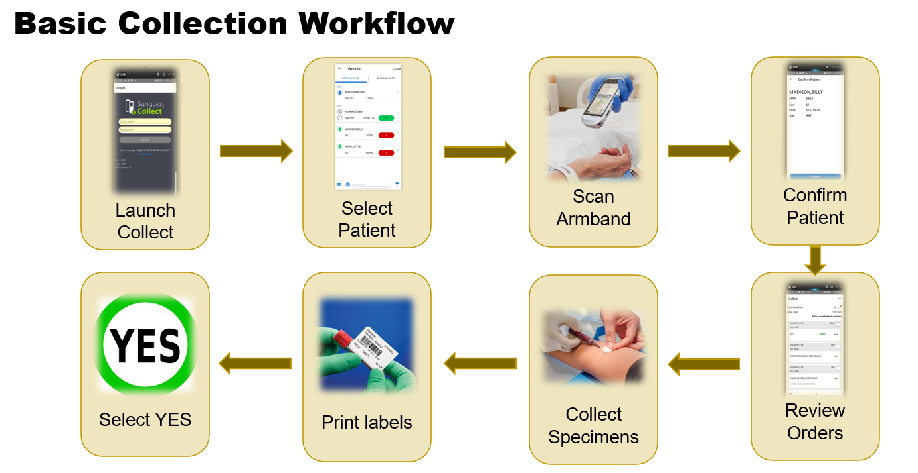
Sunquest Collect Workflow- Overview
Notes:
An overview of the process where phlebotomy will have handheld devices to perform verification, confirmation, collection and label specimens. The process uses Positive Patient ID to complete collection- only specific labels to complete the collection will print. No additional labels will print unlike current state where we see extra labels print for the Type and Screen

Slide 3
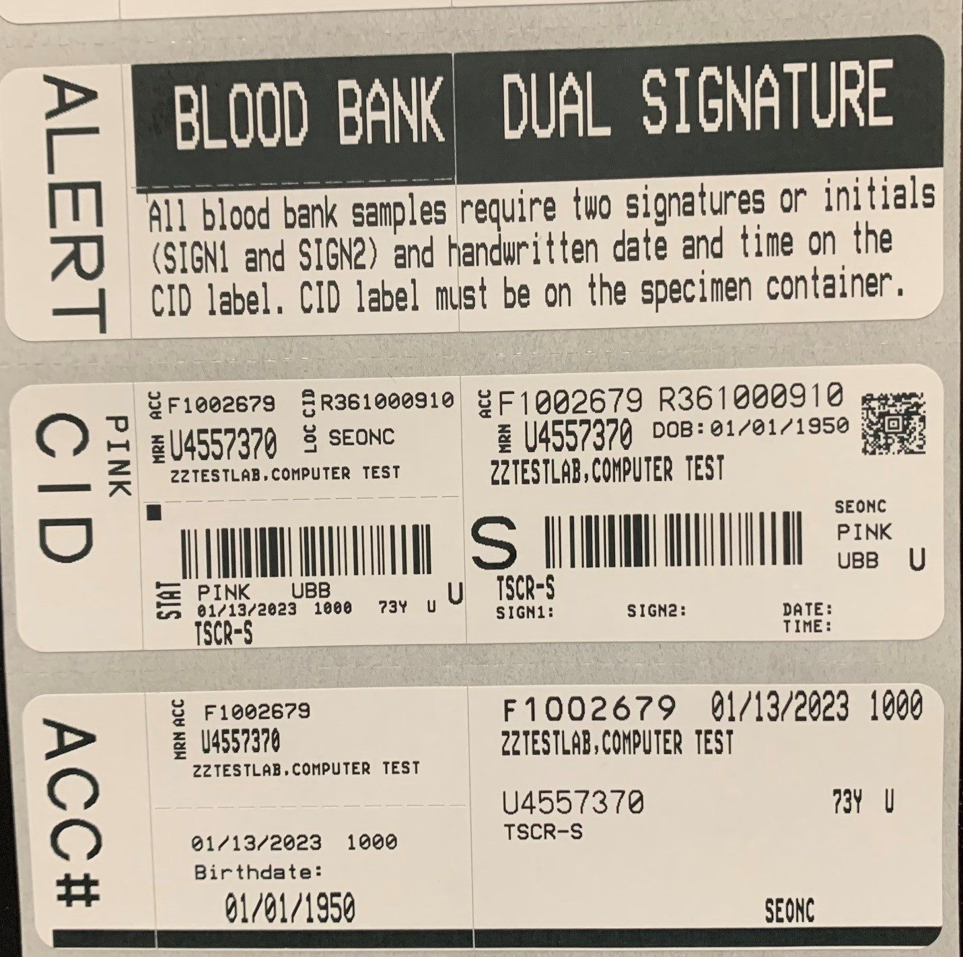
Current State SQ labels- this will remain in use for nurse and outpatient collections

Slide 4
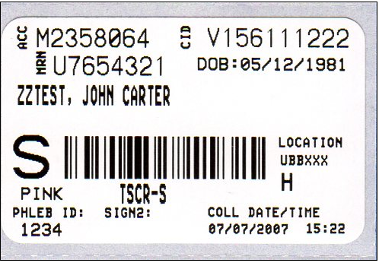
Sunquest Collect: this will be used by inpatient Phlebotomy
Notes:
The phlebotomist tech ID will print on the label (this is considered “sign 1” in comparison to our current SQ labels)
A second verifier is still required for acceptability
The collection date and time will print on the label instead of being handwritten. This is acceptable for SQ Collect labels.

