Slide 1
SQ v.11 Upgrade
Halie Borror, MLS(ASCP)^{CM}
Harborview Medical Center, Transfusion Services Lab

Slide 2
Objectives
Understand how to access SQ11
Understand updates made in
BAD File
BPE/Blood Inventory Search
BCP
BOP

Slide 3
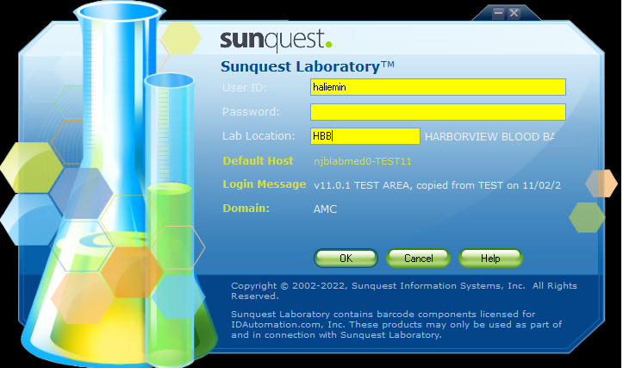
Logging in
AMC User+Pass
No more Tech ID!
Location MUST be HBB!

Slide 4
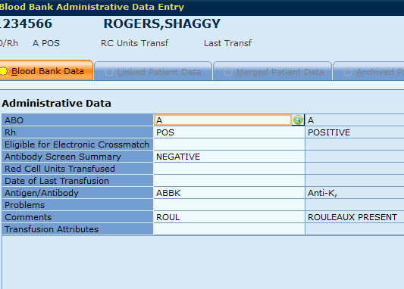
BAD File Permissions Lockdown
Leads/MLS2 can change:
ABO/Rh
Problem/Comments
RC Units Tranfs, Last Trans
EXM Elig, AS Sum fields
MLS1 can change:
Ag/Ab
Avoid mistakenly receiving samples (duplicates/rejected)!
Have to result as BBCAN...
No EXM
QA Overrides
Notes:
SUPER IMPORTANT: DO NOT RECEIVE DUPLICATES/REJECTED SAMPLES BY ACCIDENT
Only an MLS2 or Lead can change the blood type in the BAD File… BBCAN… if no one is scheduled to fix it… can’t electronic crossmatch and will encounter overrides not even an ABRH3 can fix

Slide 5
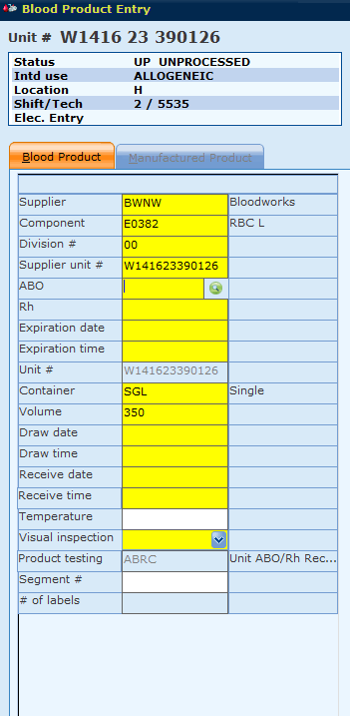
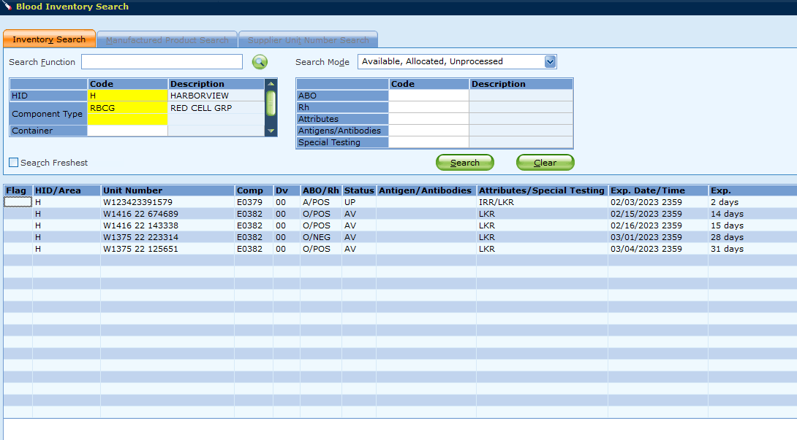
BPE/Blood Inv Search
BPE: ABO/Rh required upon scanning Blood supplier/product code
Blood inventory search will show expiration date and time

Slide 6
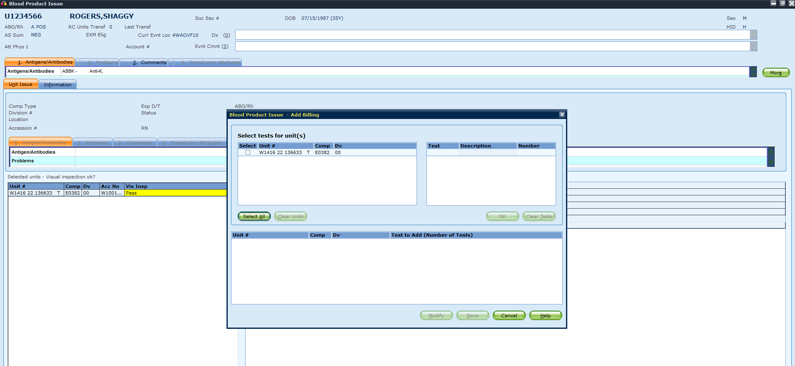
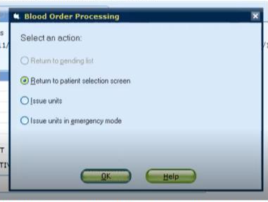
Issuing Updates
Issuing: Billing Pop Up window removed
After save in BOP: default is “return to patient selection screen”… issue? Select issue units

Slide 7
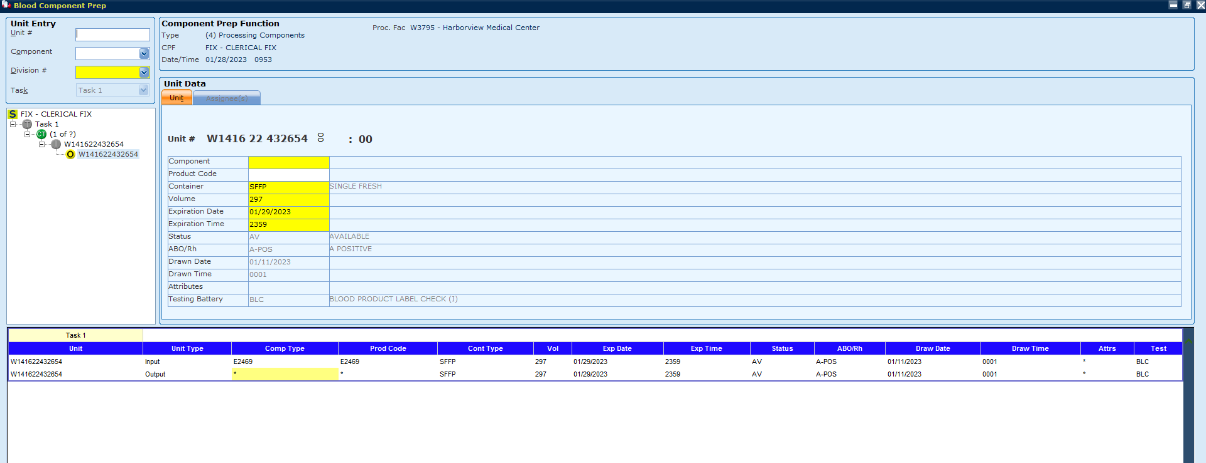
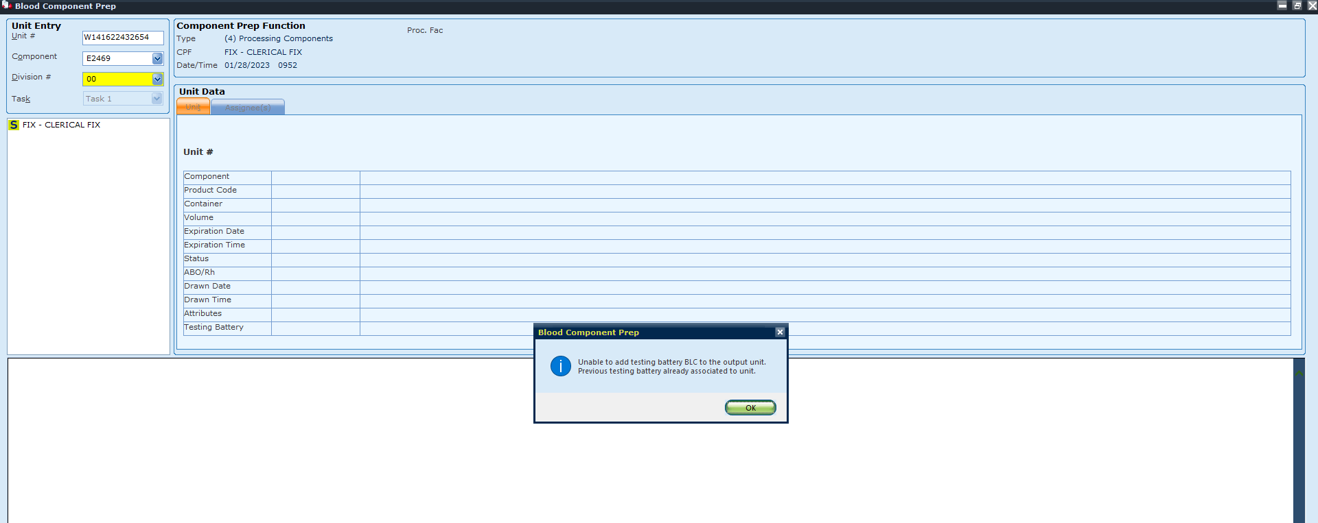
BCP FIX function for Expiration Date Modification – MLS2/Leads Only
BLC not applicable – still requires manual label verification
Fill with appropriate E code ie) E2469
Manually change back to original expiration date
Notes:
Still need MANUAL VERIF if LTP
IF BLC can be done again, and it overrides, no manual label verification

Slide 8
BOP Updates
Allocation, Crossmatch, Test results

Slide 9
Overview
Most changes are at the MLS level within BOP
EXM on Rh QA warnings, not on ABO
Updated compatibilities = less overrides
Reflex testing
Report locations
What’s relevant for CLTs? Less QA overrides encountered for issuing

Slide 10
List of QA Overrides
ATTRIBUTE INCOMPATIBILITY
67: Patient/unit attribute incompatibility
ie) SCCA patient with IRR requirements received EMR RBCs
96: Linked patient/unit attribute incompatibility
ie) Linked patient requires IRR, received EMR RBCS at HMC
RH INCOMPATIBILITY
71: Selected unit’s Rh doesn’t match patient’s permanent Rh
Rh UNKN –not EXM eligible
73: Selected unit’s ABO does not match specimen’s ABO
79: Specimen testing Rh does not match linked patient’s permanent Rh
Patient Rh NEG received Rh POS in a trauma not EXM eligible if MF present

Slide 11
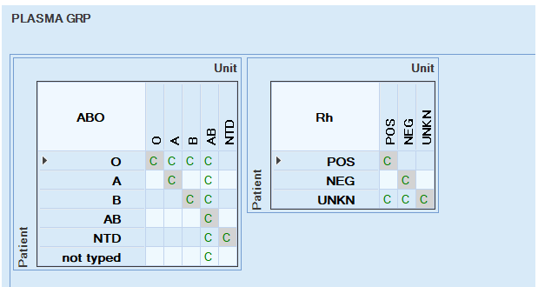
QA Override Updates: ABO/Rh and Allocation
No overrides for FFP, PLT, and CRYO due to Rh status
Will still have overrides for ABO
Does not consider Low Titer products
Notes:
No overrides for PLT, FFP, CRYO anymore

Slide 12
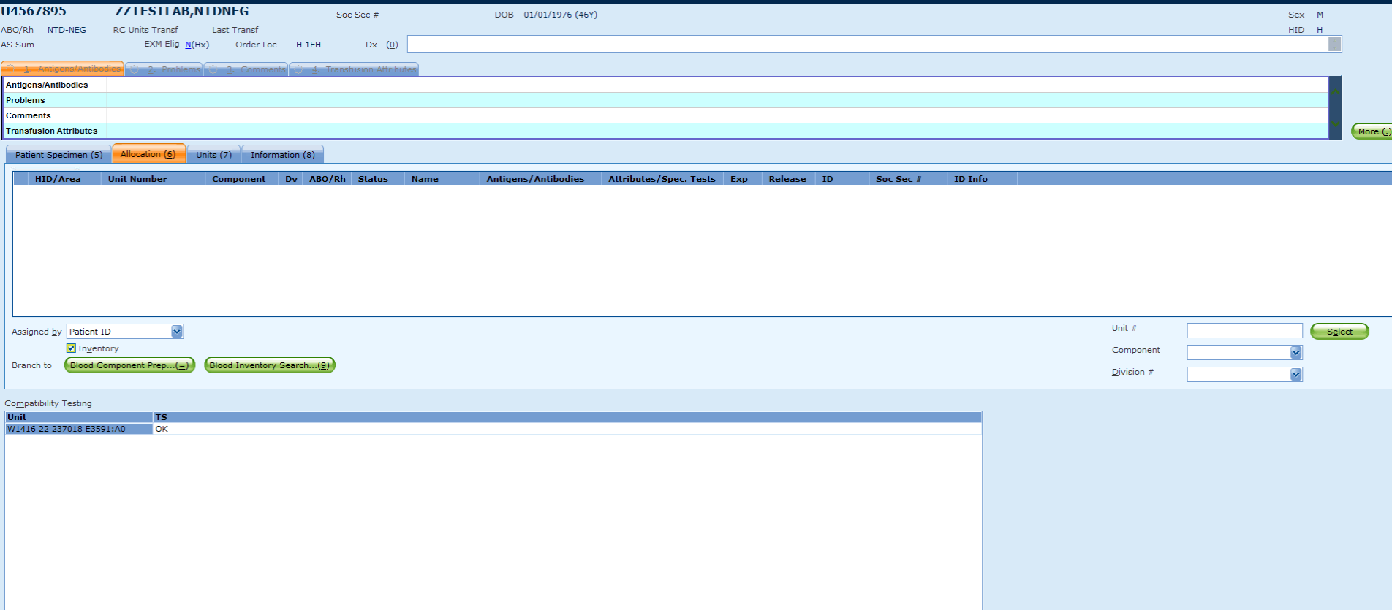
QA Override Examples: NTD-NEG allocated and issued A POS Cryo
No overrides!
Notes:
No overrides for PLT, FFP, CRYO anymore

Slide 13
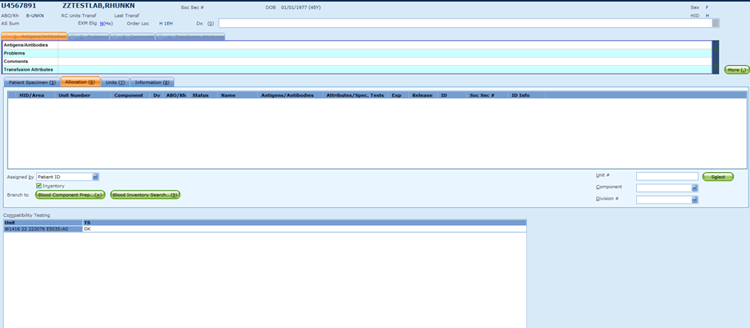
QA Override Examples: B-Unkn Allocated and Issued O POS PLT
No overrides!
Notes:
No overrides for PLT, FFP, CRYO anymore

Slide 14
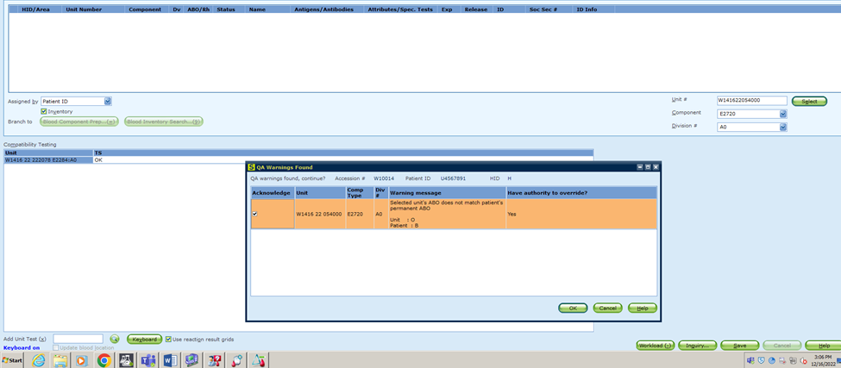
QA Override Examples: B-Unkn Allocated and Issued O NEG FFP
Overrides! Not an acceptable unit
Notes:
No overrides for PLT, FFP, CRYO anymore

Slide 15
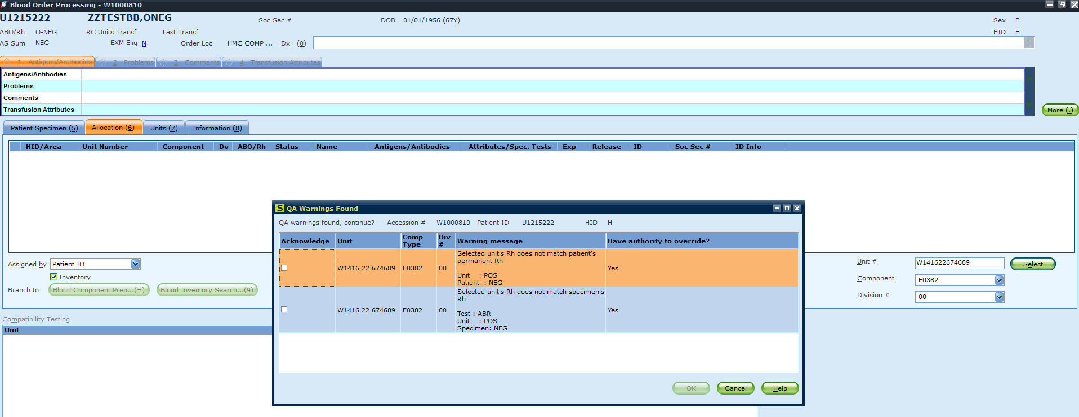
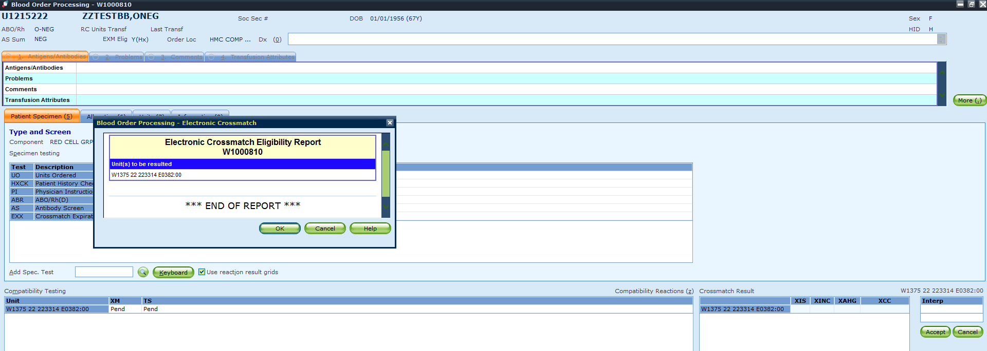
QA Override Examples: O-Neg patient with O-Pos RBC
1) Rh overrides
2) EXM eligible!
This does NOT apply if the patient has MF
Notes:
If patient has MF, the way SQ is built the grid results do not match the interpretation. It is seen as an ABO incompatibility and is not EXM eligible. This will be helpful for traumas using O POS RBCs, and allocating type specific Rh POS ie) A NEG adult male giving A POS, for inventory control purposes

Slide 16
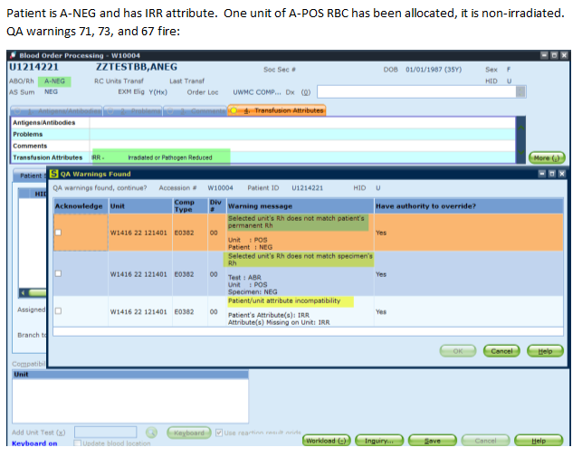
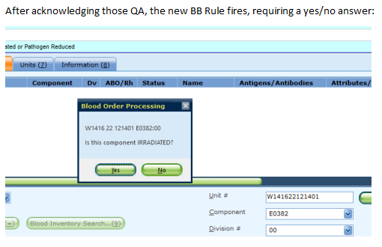
QA Override Example: EXM + Attributes
Notes:
For attribute incompatibilities, if you have overridden either of those and no other disqualifying QA failures are generated, it would allow you to EXM the unit.
For Rh incompatibility, if you override any of those and there are no other disqualifying QA failures, you would be able to EXM the unit, whether it was Rh-Neg to a Rh-Pos patient, or the other way around
Also helpful for ie) patient who is an MTP that requires IRR and we don’t have the inventory to give.

Slide 17
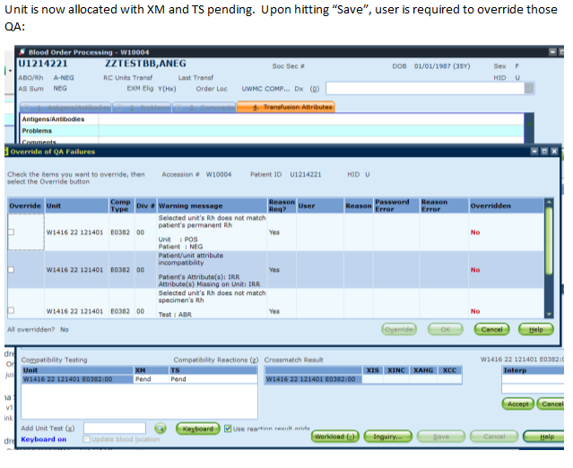
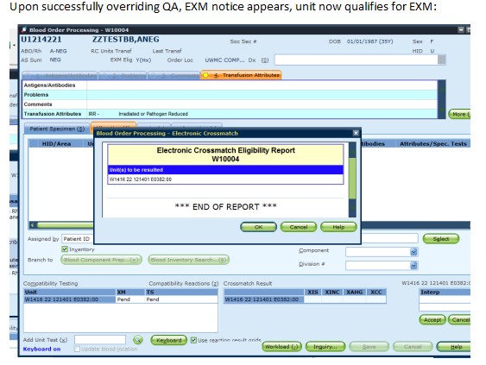
QA Override Example: EXM + Attributes
Notes:
For attribute incompatibilities, if you have overridden either of those and no other disqualifying QA failures are generated, it would allow you to EXM the unit.
For Rh incompatibility, if you override any of those and there are no other disqualifying QA failures, you would be able to EXM the unit, whether it was Rh-Neg to a Rh-Pos patient, or the other way around
Also helpful for ie) patient who is an MTP that requires IRR and we don’t have the inventory to give.

Slide 18
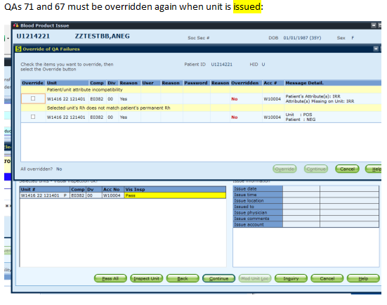
QA Override Example: EXM + Attributes
Notes:
For attribute incompatibilities, if you have overridden either of those and no other disqualifying QA failures are generated, it would allow you to EXM the unit.
For Rh incompatibility, if you override any of those and there are no other disqualifying QA failures, you would be able to EXM the unit, whether it was Rh-Neg to a Rh-Pos patient, or the other way around
Also helpful for ie) patient who is an MTP that requires IRR and we don’t have the inventory to give.

Slide 19
BMT guides
Mostly a UW thing
Relevant if issuing a unit for patients with linked BMT info
SQ will interpret the patient’s type as the BMT Donor’s type
If patient was originally O POS, BMT donor A NEG, SQ will default to A NEG compatibility rules
ie) O POS RBC for a BMT A NEG patient is NOT an acceptable product
Units are either compatible, suitable, or incompatible
Suitable = compatible, but not first choice
Pop up confirming that this choice is acceptable and confirming that you’d like to allocate
Not EXM eligible, must be IS
Notes:
if not careful, you could EXM a unit that shouldn't be given(?) Since per the GUI table this patient should only get Rh NEG units? Ex) O POS og, ANEG BMT, give an O POS unit, overrides come up, but you can still EXM.
we are allowing EXM for any Rh QA warning but NOT for the ABO warning (those would need IS XM)

Slide 20
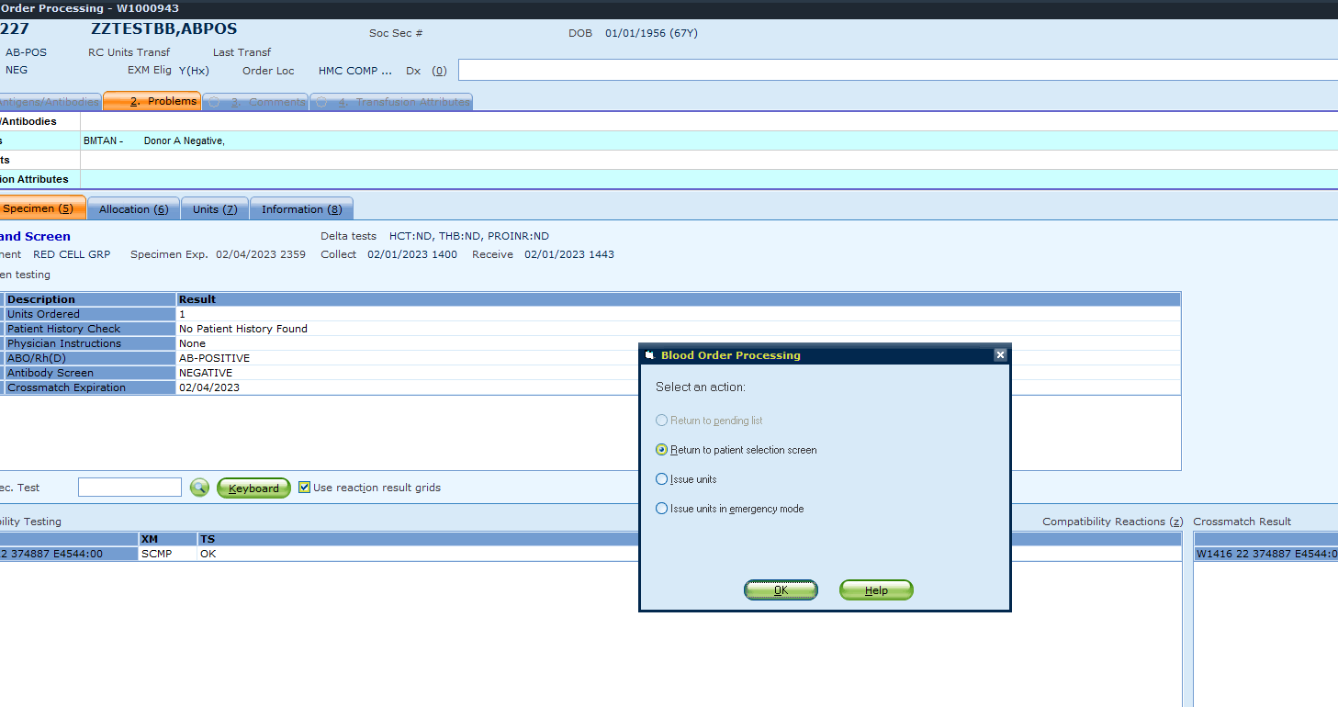
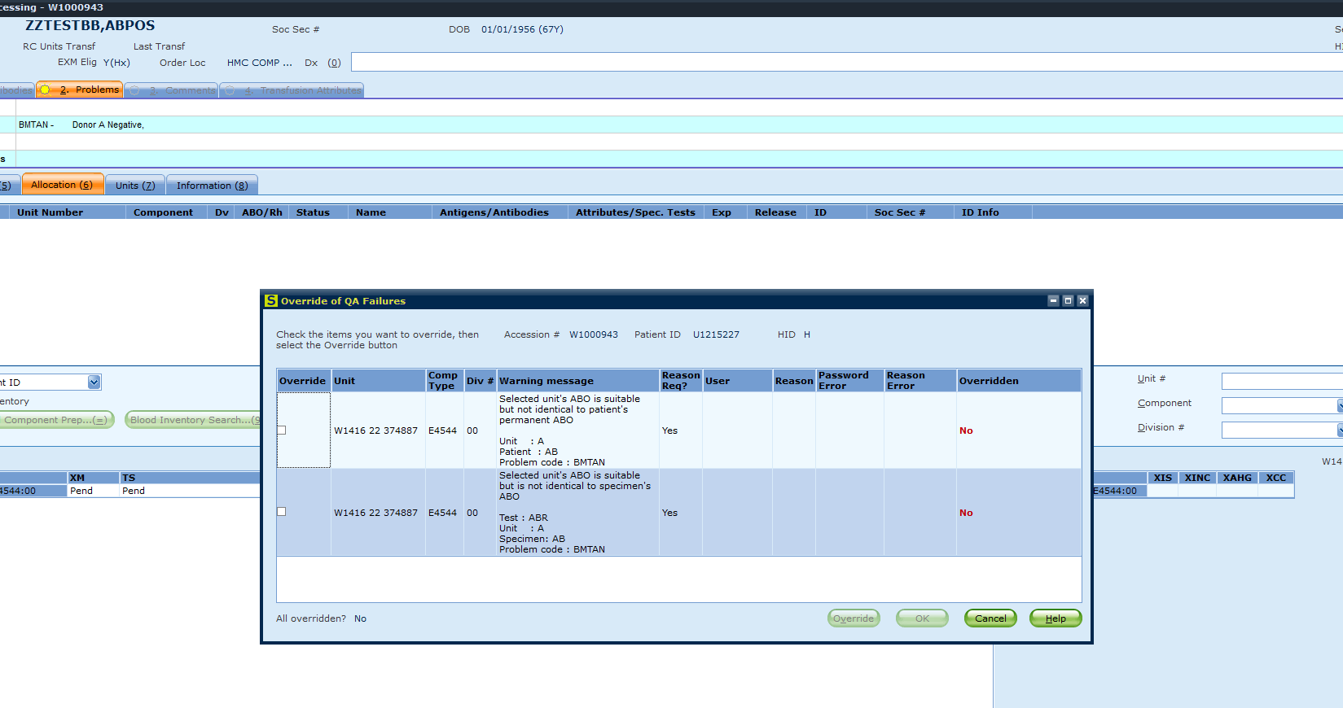
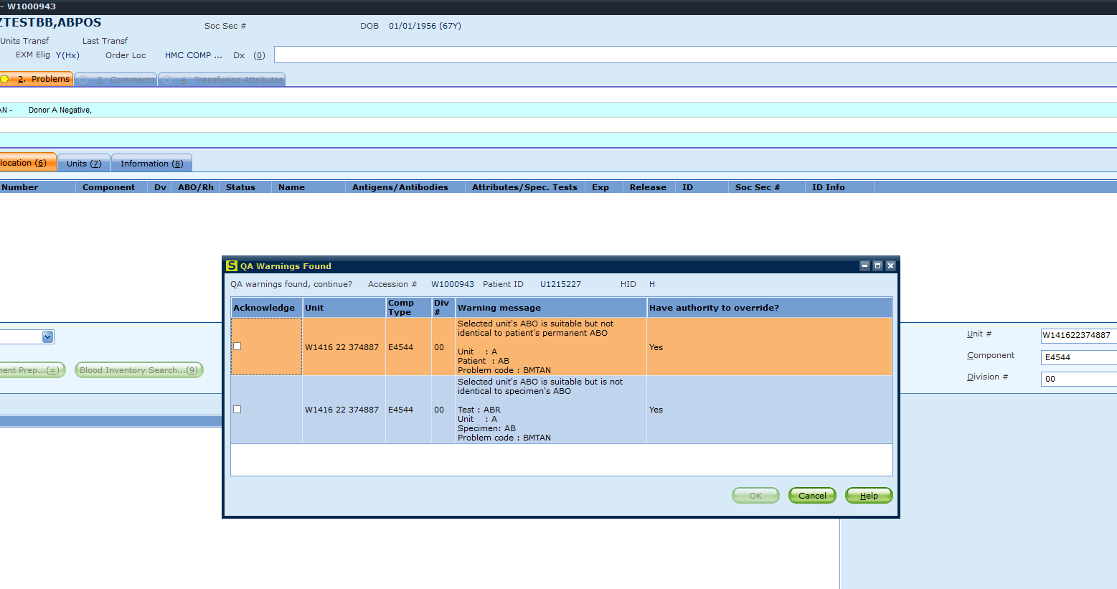
BMT Example: AB-POS patient, received A-NEG BMT, issue A-NEG RBC
Suitability acknowledgement/QA
Adding unit to order – no override, just acknowledge
Save to crossmatch/allocate/issue – override needed
Suitable must be IS

Slide 21
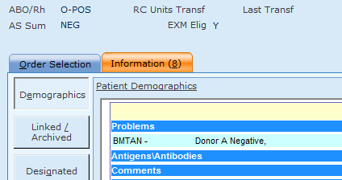
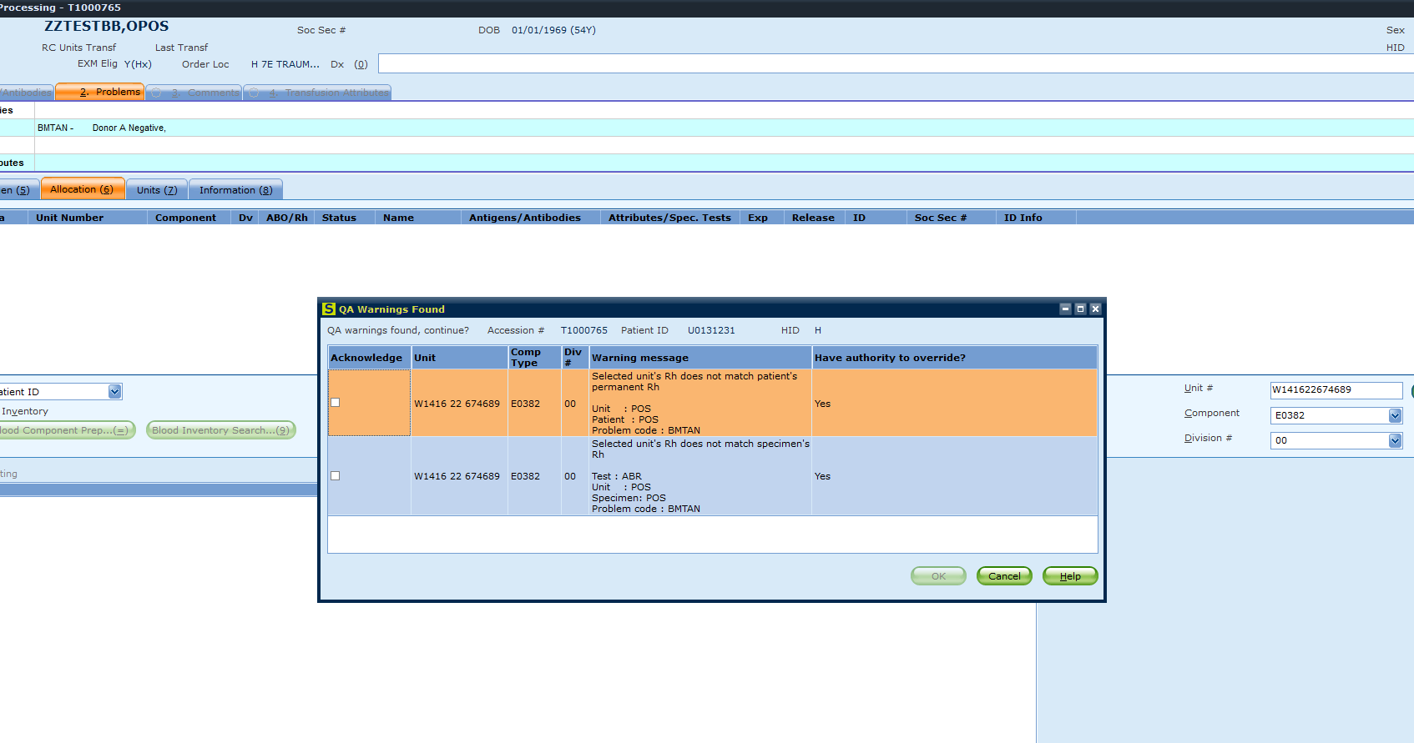
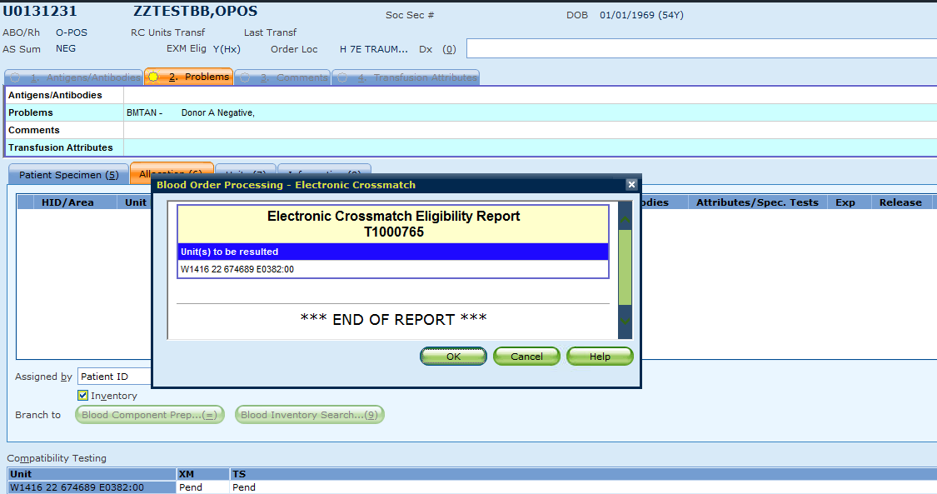
BMT Example: O-POS patient, received A-NEG BMT, issue O-POS RBC
O POS RBC is NOT an acceptable unit to choose for this patient
BMTAN: Give O NEG or A NEG
Overrides for Rh incompatibility… allows EXM
PAY ATTENTION TO YOUR OVERRIDES!
Notes:
If not careful, you could EXM a unit that shouldn't be given. Since per the GUI table this patient should only get Rh NEG units? Ex) O POS og, ANEG BMT, give an O POS unit, overrides come up, but you can still EXM.

Slide 22
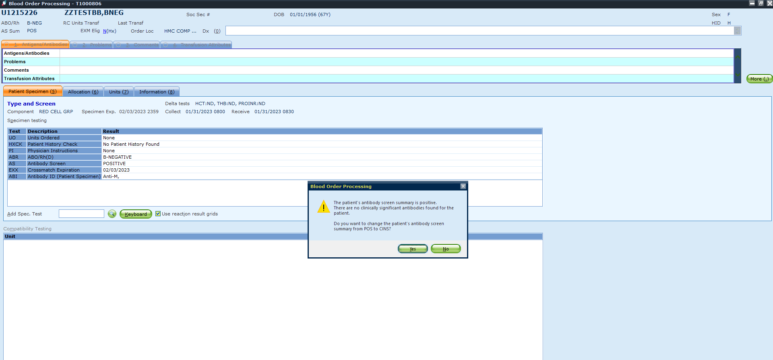
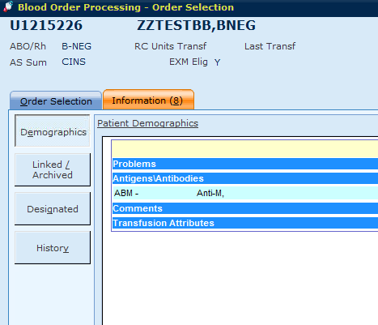
AB Sum POS → CINS
Unlikely to come across this feature but if you do, no need to fear
Updates POS status to CINS (clinically insignificant)
Has the ability to restore EXM eligibility (current NEG screen, clinically insignificant antibody)
Notes:
Unlikely to come across because it requires you to leave the ABI of the original AB POS screen unresulted. Then the second TSCR must be negative, and then after that if you result the ABI with a clinical insignificant antibody, it will prompt you with this pop up. Rarely if ever would we leave an ABI unresulted for long enough for the next TSCR to be negative.

Slide 23
Summary of EXM Updates
No Rh overrides for FFP, PLT, Cryo
If patient is Rh NEG (no MF) and given Rh POS RBCs → EXM eligible
Pay attention to your overrides!
Can EXM even if attribute requirements don’t match

Slide 24
BOP: Reflex testing overview
AS – PREN - DARA

Slide 25
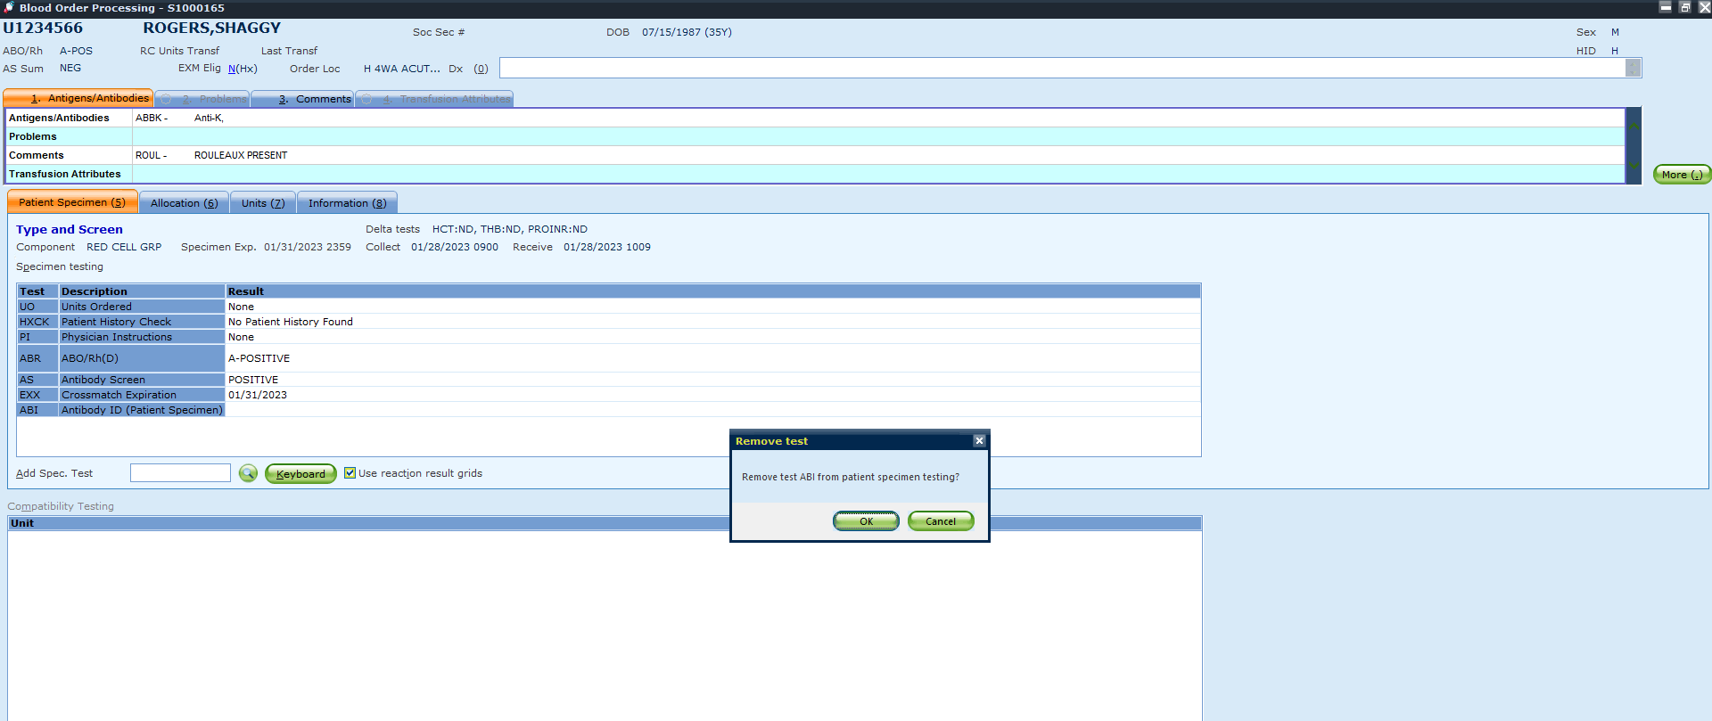
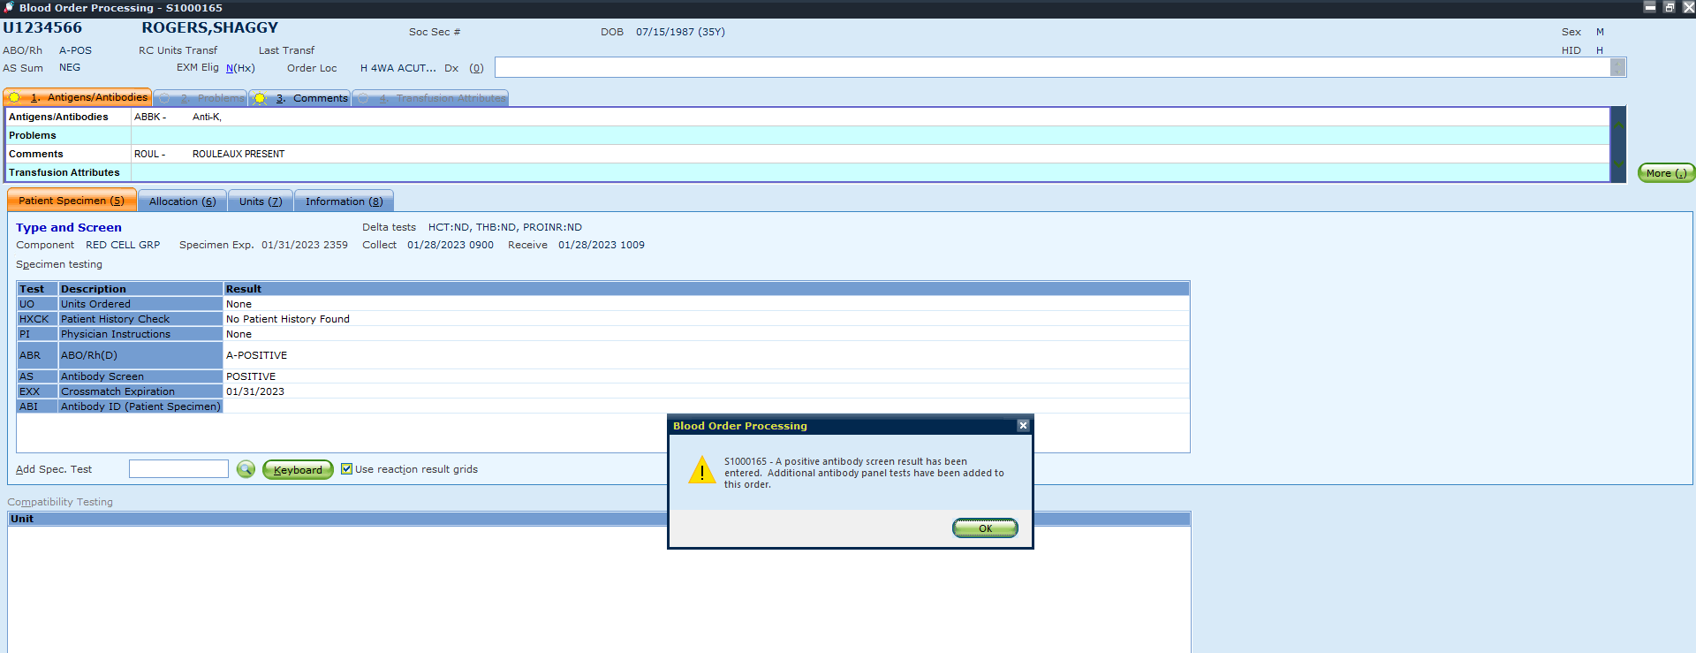
AS POS? Automatically adds ABI
Don’t need it?
SHIFT+DELETE BEFORE YOU HIT SAVE!
Notes:
When resulting from Tango… if you release results from BB Instruments, you cannot shift+delete the auto ABI added to the TSCR order. To work around that, if you want to delete the auto addition of ABI, release tango results via BOP, then shift and delete

Slide 26
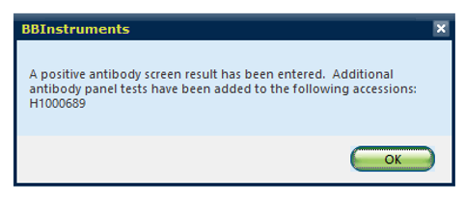
AS POS on Tango
If you release results from BB Instruments, you cannot shift + delete the ABI added to the TSCR order
If you don’t want ABI added, release Tango results via BOP, then shift + delete

Slide 27
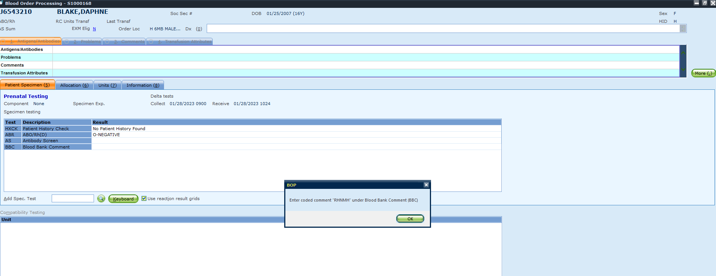
Prenatal reflex BBC
Notes:
If a patient with a PREN is Rh Neg, BBC will be automatically added and will instruct you to add “RHNMH”. This

Slide 28
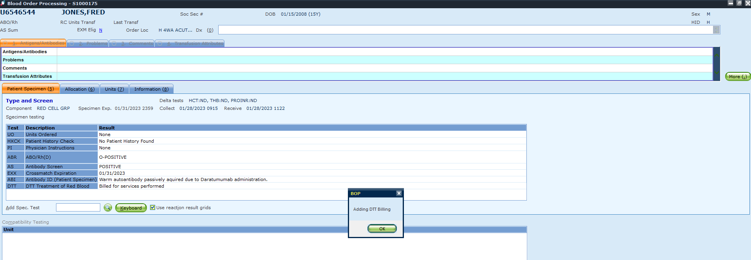
DARA Reflex DTT
Notes:
UW or HMC can result

Slide 29
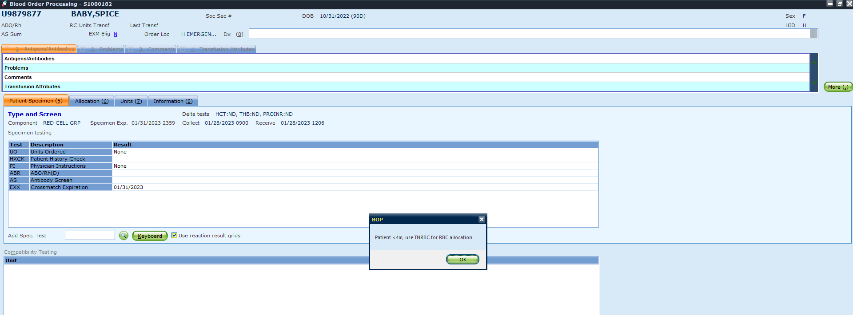
All things Neonates
If you attempt to allocate on a TSCR for a patient <4 mo/old, it will remind you to utilize TNRBC for allocate/issue
Notes:
If you attempt to hit allocate on a TSCR for a patient <4 mo/old, it will remind you to utilize TNRBC for allocate/issue

Slide 30
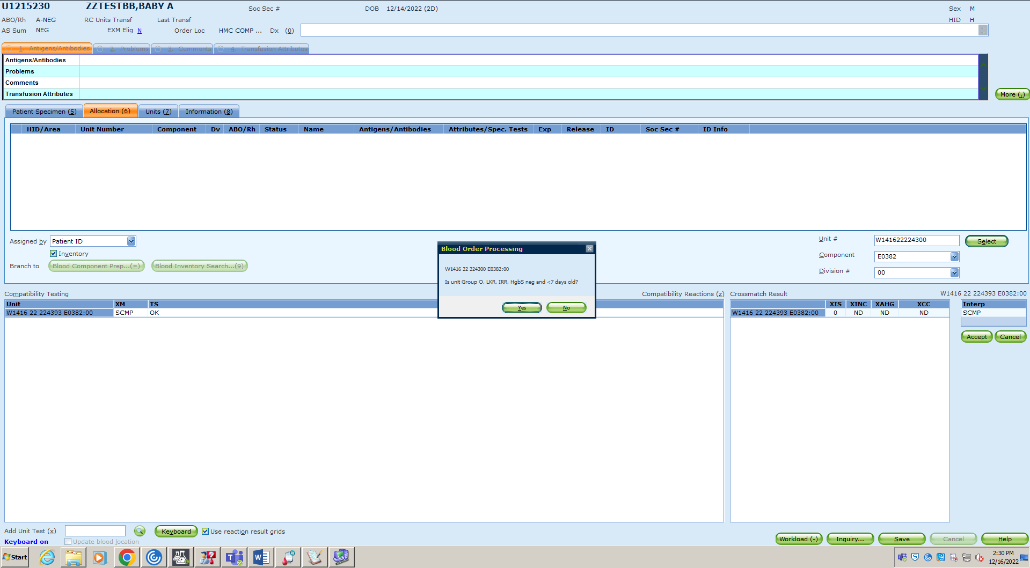
All things Neonates cont.
Example: A NEG Neonate with an O NEG RBC

Slide 31
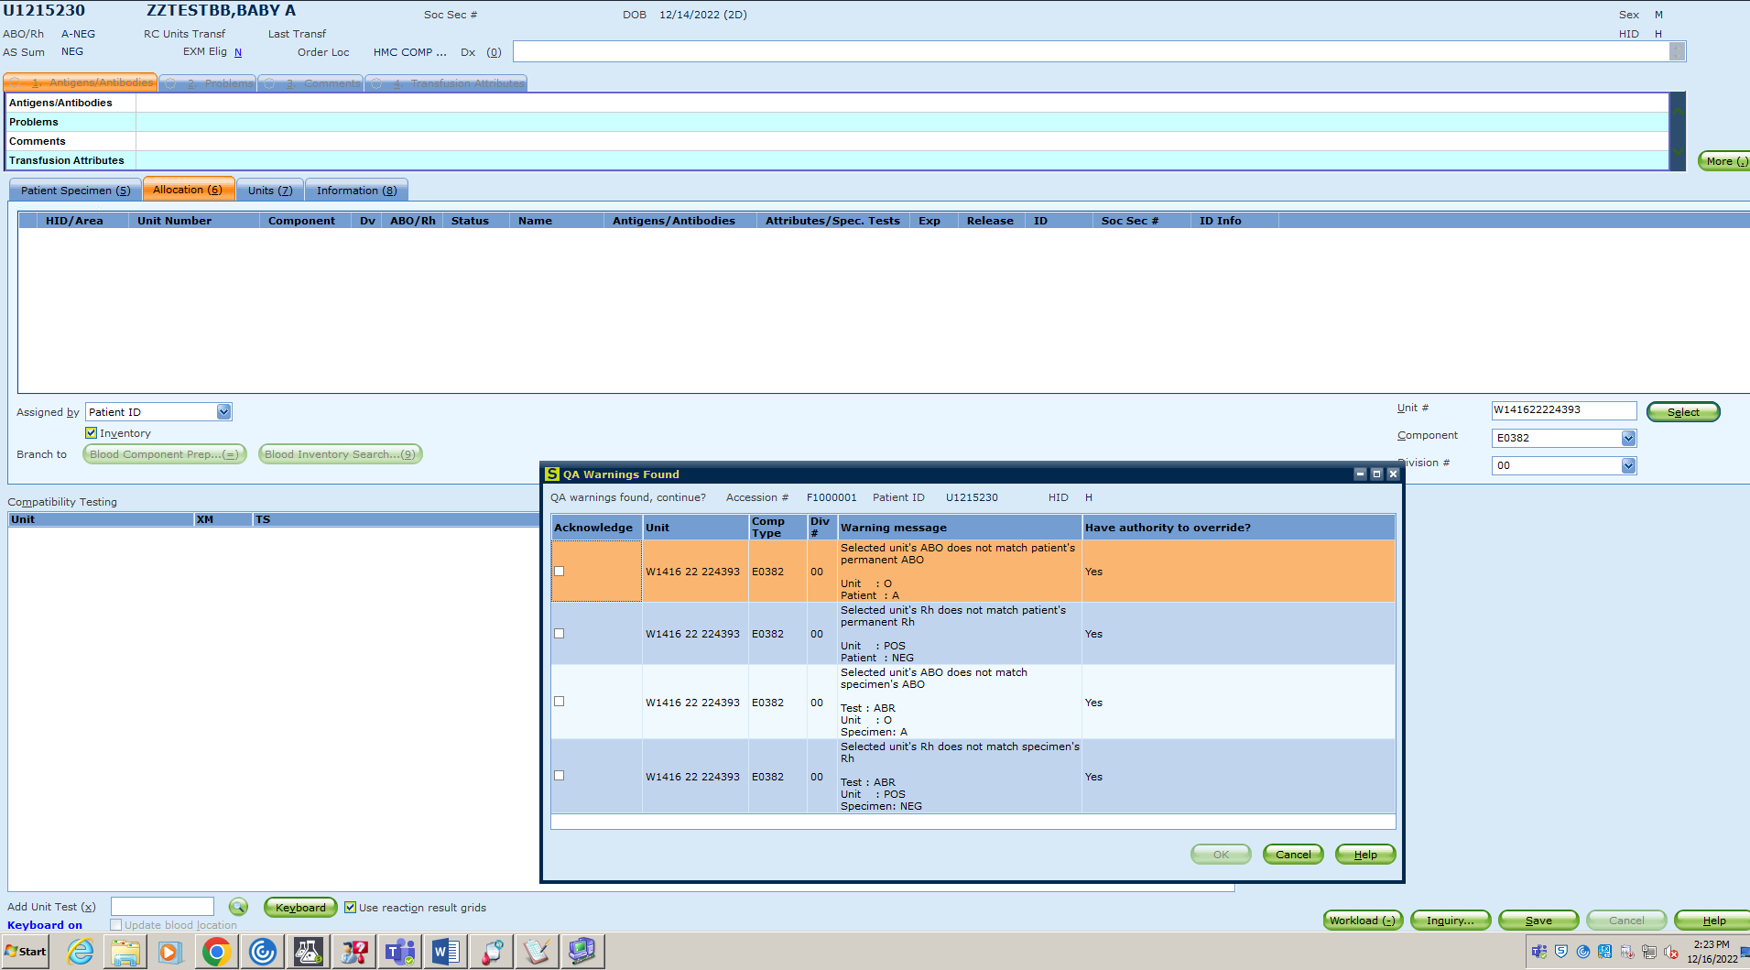
All things Neonates cont.
Example: A NEG Neonate with an O POS RBC

Slide 32
Reports
Certain reports will be moving from SmarTerm/Putty to GUI
BBR7 (will stay in Putty for the time being)
Utilization report; saves to workstation or a secure drive as .csv
Pending log and BBR14 via BOP
For now, print via Putty

Slide 33
Minor BOP Updates
BOP shows expiration date and time of specimen
Use ABUS instead of ABUNKN

Slide 34
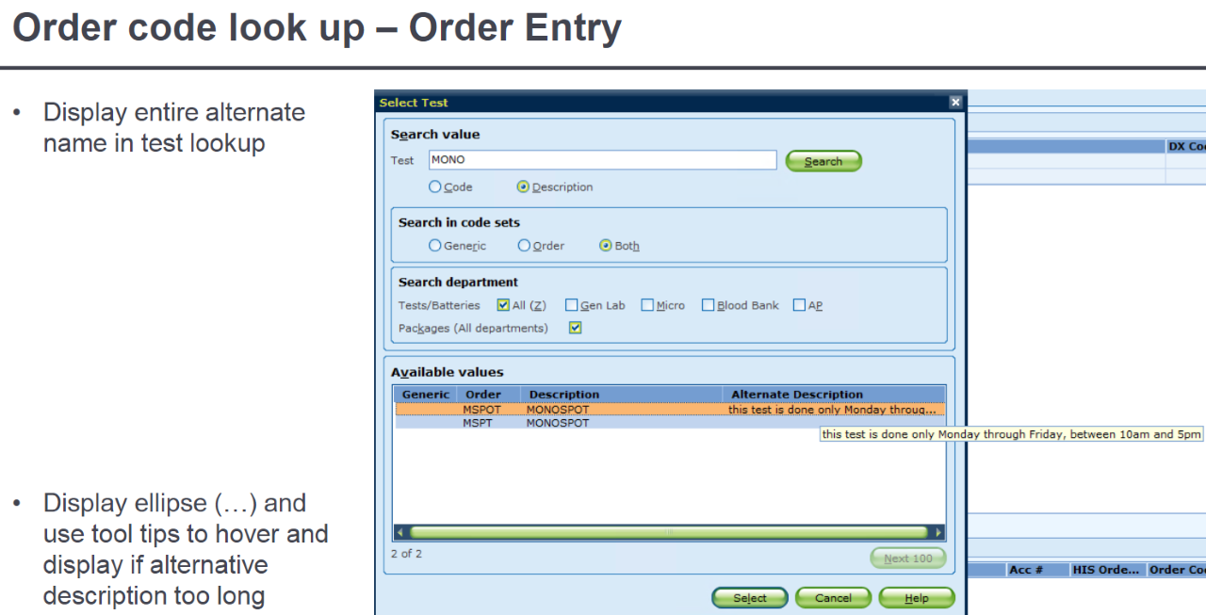
Miscellaneous
MERGE is no longer “final” -- IT can perform an unmerge
Function for CPW (where leads change passwords) will be blocked
AMC user+password
Hover over display if text is too long on Order Entry

