Slide 1
SQ v.11 Upgrade
Effective March 5^{th,} 2023

Slide 2
Objectives
SQ login access is same as AMC login
Understand updates made in
BAD File
BPE/Blood Inventory Search
BPI
BOP
Blood Bank Rules
Mother Child Link
Other minor updates

Slide 3
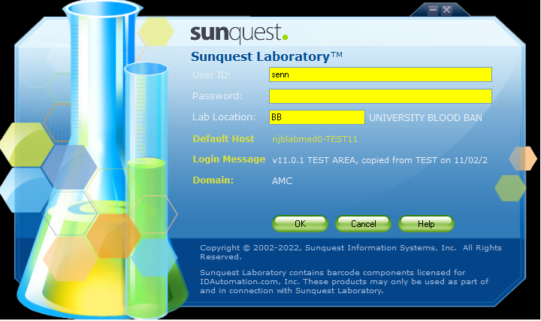
Logging in
Login
AMC username and password
Location remains same

Slide 4
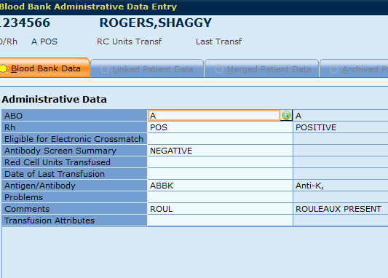
BAD File Permissions Lockdown
Manager, Lead/MLS2 can change:
ABO/Rh
Problem/Comments
RC Units Tranfs, Last Trans
EXM Elig, AS Sum fields
MLS1 can change:
Ag/Ab
Avoid mistakenly receiving samples (duplicates/rejected)!
Have to result as BBCAN...
No EXM
QA Overrides
Notes:
*SUPER IMPORTANT: DO NOT RECEIVE DUPLICATES/REJECTED SAMPLES BY ACCIDENT
Only an MLS2 or Lead can change the blood type in the BAD File… BBCAN… if no one is scheduled to fix it… can’t electronic crossmatch and will encounter overrides not even an ABRH3 can fix
* Comments to update BAD file can be added using %PB add on in Blood Order Processing if needed

Slide 5
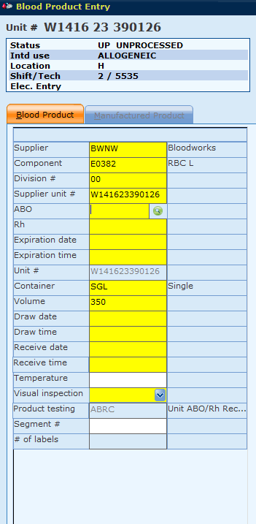
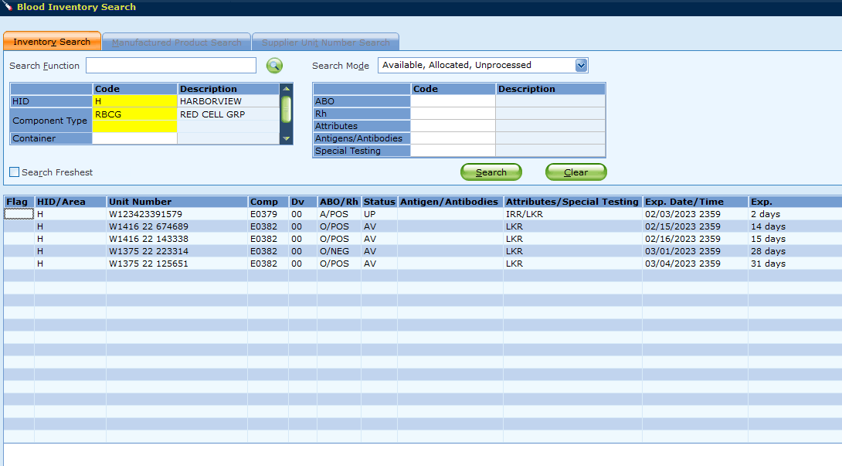
BPE/Blood Inv Search
BPE: ABO/Rh required upon scanning Blood supplier/product code
Blood inventory search will show expiration date and time
Notes:
Inventory expiration date and time listed in BIS function
ABO/Rh entry mandatory in BPE function

Slide 6
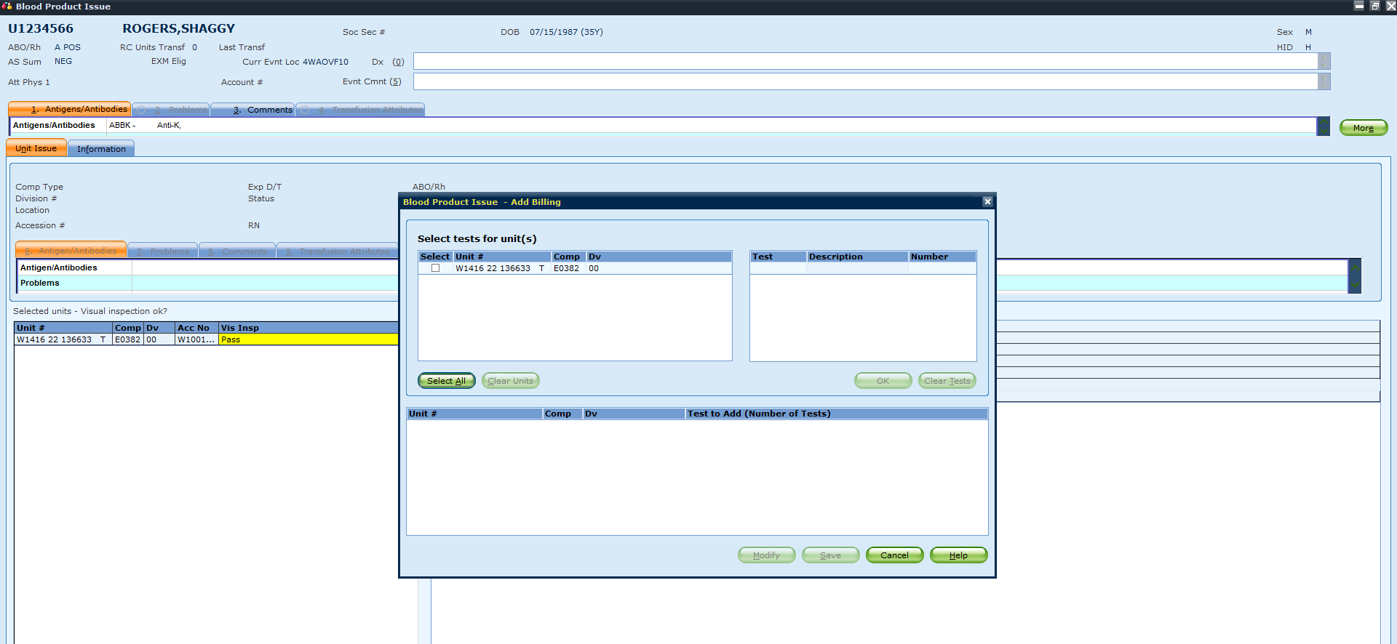
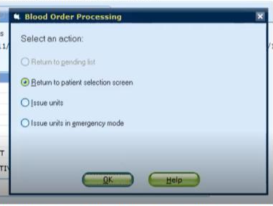
Issuing Updates
Issuing: Billing Pop Up window removed
After save in BOP: default is “return to patient selection screen”… issue? Select issue units

Slide 7
BOP Updates
Allocation, Crossmatch, Test results

Slide 8
Overview
Most changes are at the MLS level within BOP
EXM on Rh QA warnings, not on ABO
Updated compatibilities = less overrides
Reflex testing
Report locations
What’s relevant for CLTs? Less QA overrides encountered for issuing

Slide 9
Electronic Crossmatch Eligibility This functionality is now active in SQ 11.0
If patient qualifies for electronic XM- Y will be indicated in the BAD file
If patient does not qualify for electronic XM- N will be indicated in the BAD file

Slide 10
List of QA Overrides
ATTRIBUTE INCOMPATIBILITY
67: Patient/unit attribute incompatibility
ie) Patient with HgbS requirement receiving platelet
96: Linked patient/unit attribute incompatibility
RH INCOMPATIBILITY
71: Selected unit’s Rh doesn’t match patient’s permanent Rh
73: Selected unit’s ABO does not match specimen’s ABO
79: Specimen testing Rh does not match linked patient’s permanent Rh
Patient Rh NEG received Rh POS in a MTP. This will allow EXM if Rh incompatible is the only QA for RBCs

Slide 11
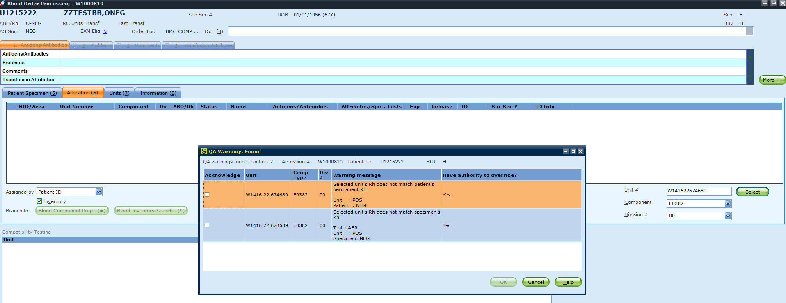
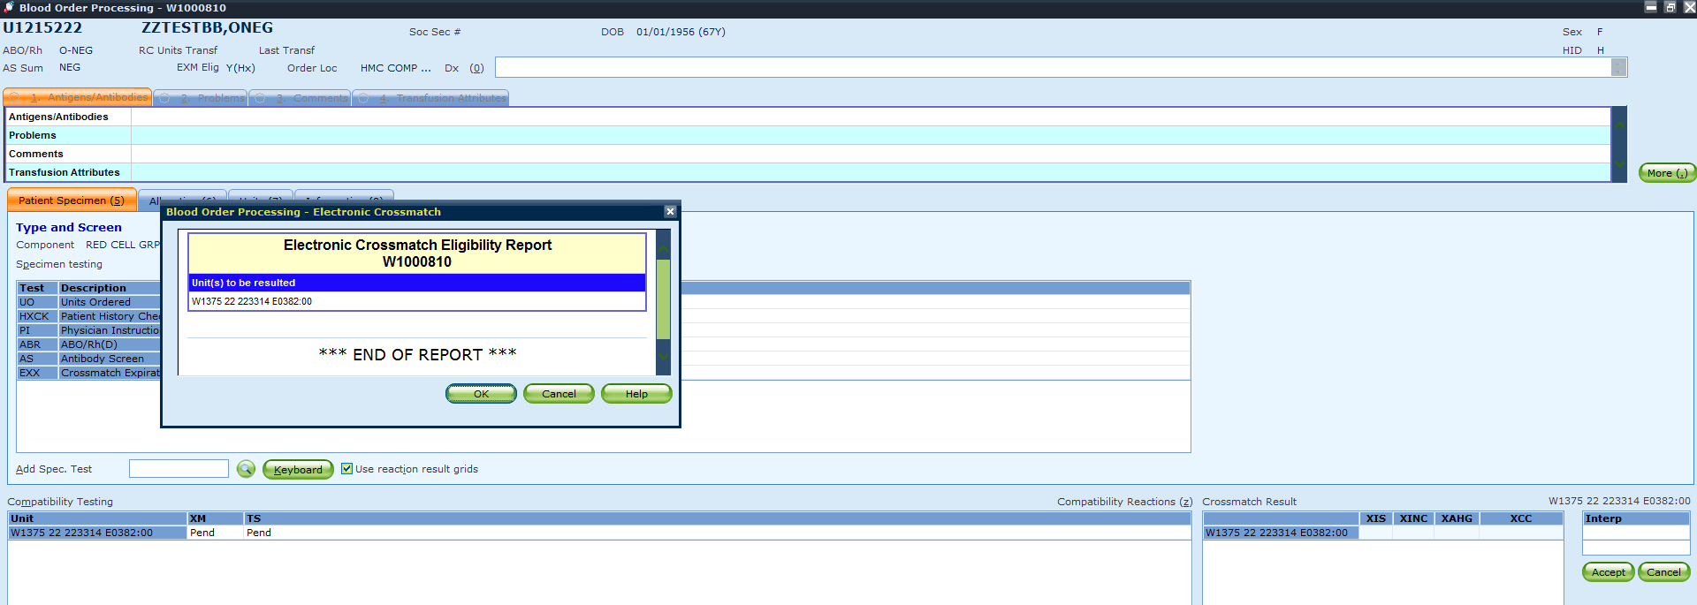
QA Override Examples: O-Neg patient with O-Pos RBC
1) Rh overrides
2) EXM eligible!
This does NOT apply if the patient has MF
Notes:
If patient has MF, the way SQ is built the grid results do not match the interpretation. It is seen as an ABO incompatibility and is not EXM eligible. This will be helpful for MTPs using O POS RBCs, and allocating type specific Rh POS ie) A NEG adult male giving A POS, for inventory control purposes

Slide 12
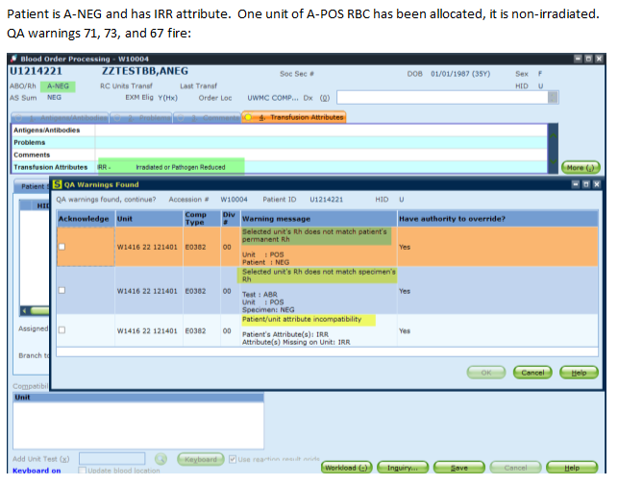
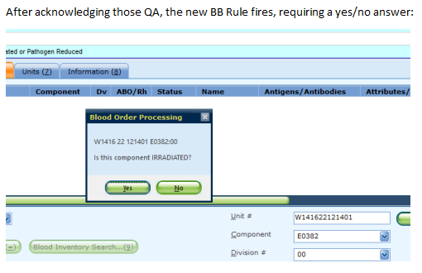
QA Override Example: EXM + Attributes
Notes:
For attribute incompatibilities, if you have overridden either of those and no other disqualifying QA failures are generated, it would allow you to EXM the unit.
For Rh incompatibility, if you override any of those and there are no other disqualifying QA failures, you would be able to EXM the unit, whether it was Rh-Neg to a Rh-Pos patient, or the other way around
Also helpful for ie) patient who is an MTP that requires IRR and we don’t have the inventory to give.

Slide 13
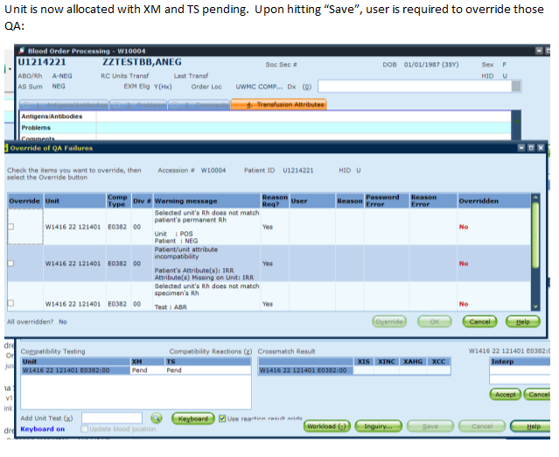
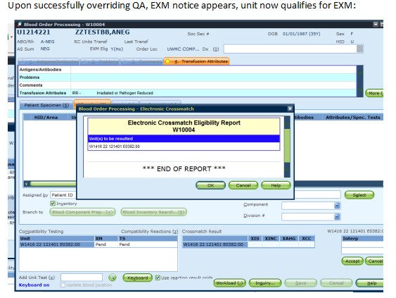
QA Override Example: EXM + Attributes
Notes:
For attribute incompatibilities, if you have overridden either of those and no other disqualifying QA failures are generated, it would allow you to EXM the unit.
For Rh incompatibility, if you override any of those and there are no other disqualifying QA failures, you would be able to EXM the unit, whether it was Rh-Neg to a Rh-Pos patient, or the other way around
Also helpful for ie) patient who is an MTP that requires IRR and we don’t have the inventory to give.

Slide 14
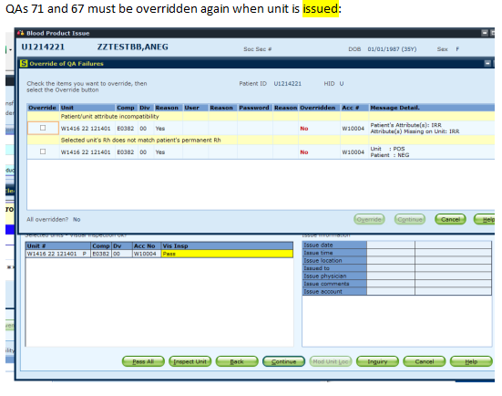
QA Override Example: EXM + Attributes
Notes:
For attribute incompatibilities, if you have overridden either of those and no other disqualifying QA failures are generated, it would allow you to EXM the unit.
For Rh incompatibility, if you override any of those and there are no other disqualifying QA failures, you would be able to EXM the unit, whether it was Rh-Neg to a Rh-Pos patient, or the other way around
Also helpful for ie) patient who is an MTP that requires IRR and we don’t have the inventory to give.

Slide 15
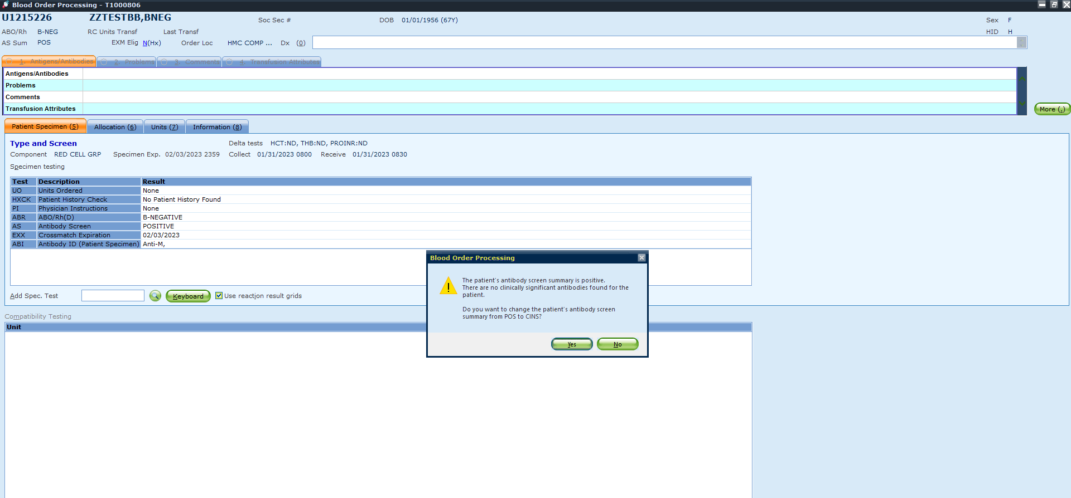
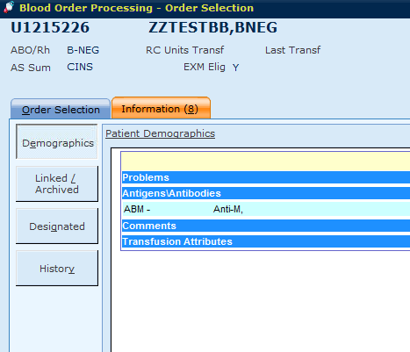
AB Sum POS → CINS
Unlikely to come across this feature but if you do, no need to fear
Updates POS status to CINS (clinically insignificant)
Has the ability to restore EXM eligibility (current NEG screen, clinically insignificant antibody)
Notes:
Unlikely to come across because it requires you to leave the ABI of the original AB POS screen unresulted. Then the second TSCR must be negative, and then after that if you result the ABI with a clinical insignificant antibody, it will prompt you with this pop up. Rarely if ever would we leave an ABI unresulted for long enough for the next TSCR to be negative.

Slide 16
Summary of EXM Updates
No Rh overrides for FFP, PLT, Cryo
If patient is Rh NEG (no MF) and given Rh POS RBCs → EXM eligible
Pay attention to your overrides! All overrides must be carefully reviewed before determining if it is appropriate to override
Can EXM even if attribute requirements don’t match

Slide 17
BOP: Reflex testing overview
%AS positive- Antibody Identificaiton (%ABI) added
ABI result as DARA- DTT test added
Rh negative on patient <3days old reported %ABR- weak D (%DU) added

Slide 18
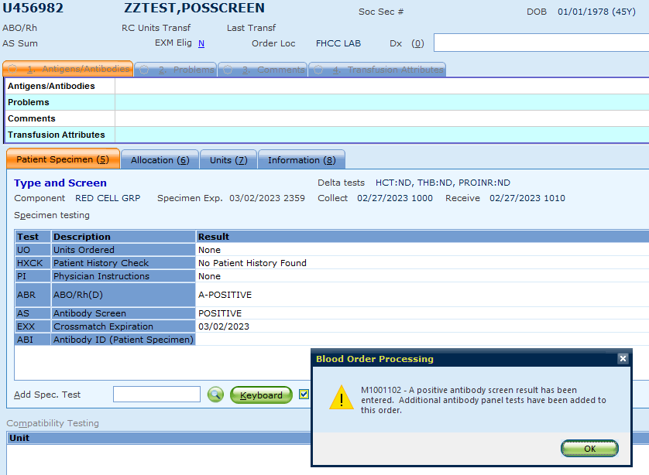
Antibody Screen (%AS) resulted as Positive
When antibody screen is resulted as positive, %ABI will be added as reflex

Slide 19
Cancelling ABI before saving To remove, select the test to be removed and hold Shift and Delete key the following message appears (must be done prior to saving, otherwise it must be credited)

Slide 20
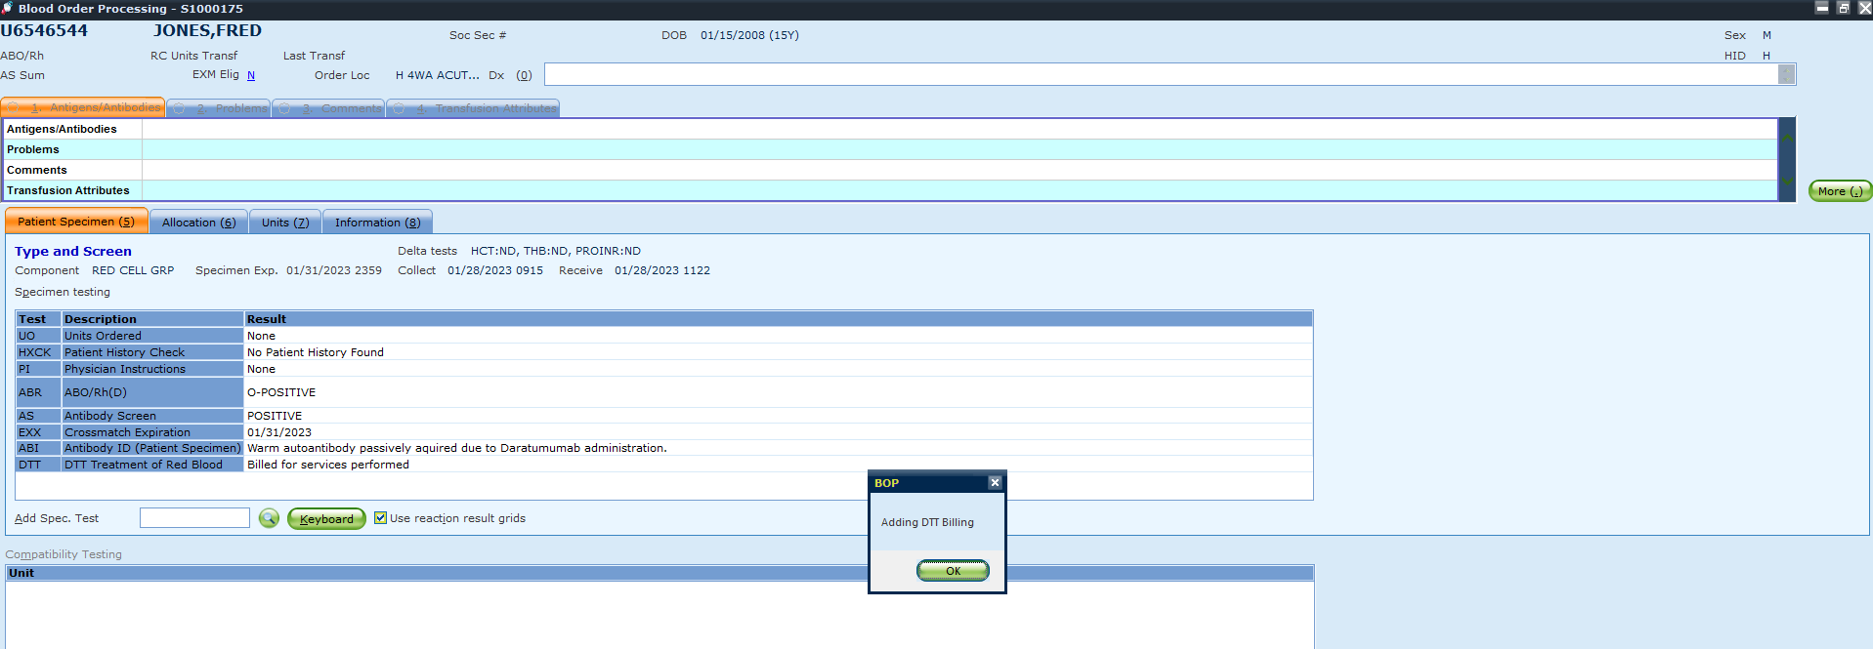
DARA Reflex DTT added to complete billing
Notes:
UW or HMC can result

Slide 21
Weak D (%DU) reflex on Rh negative result for neonates <3days old

Slide 22
Since this will apply to all Rh negative results on neonate <3days old- you will need to cancel the test before saving when it is not needed (Hold Shift and Delete Key to cancel test)
Notes:
To remove, select the test to be removed and hold Shift and Delete key the following message appears (must be done prior to saving, otherwise it must be credited). To credit use YBBCAN if unable to do Shift Delete. No credit needed for DU test

Slide 23
Blood Bank Rules
%ABI, %ELU, %AGI,%AO tests will be limited to the antibody codes in result field
Example: ABBK (Anti K) code entry in %AGI will not be valid. These tests have been restricted to the built codes, cancellation codes and free text. Erroneous entry errors will be eliminated.
If any codes found to be missing, notify TSL manager

Slide 24
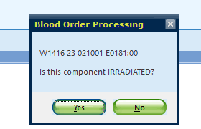
Blood Bank Rules Alert pop up to acknowledge
If a non irradiated RBC is allocated to an order the following appropriate message will appear
You will need to answer Yes or No. This does not prevent issue of non irradiated but to bring awareness that the unit being allocated has not been irradiated
TSL QA will monitor compliance via report

Slide 25
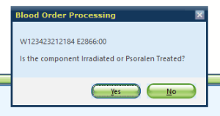
Blood Bank Rules Alert pop up to acknowledge
If a non irradiated or non psoralen treated Platelet is allocated to an order the following appropriate message will appear
You will need to answer Yes or No. This does not prevent issue of non irradiated but to bring awareness that the unit being allocated has not been irradiated or psoralen treated
TSL QA will monitor compliance via report

Slide 26
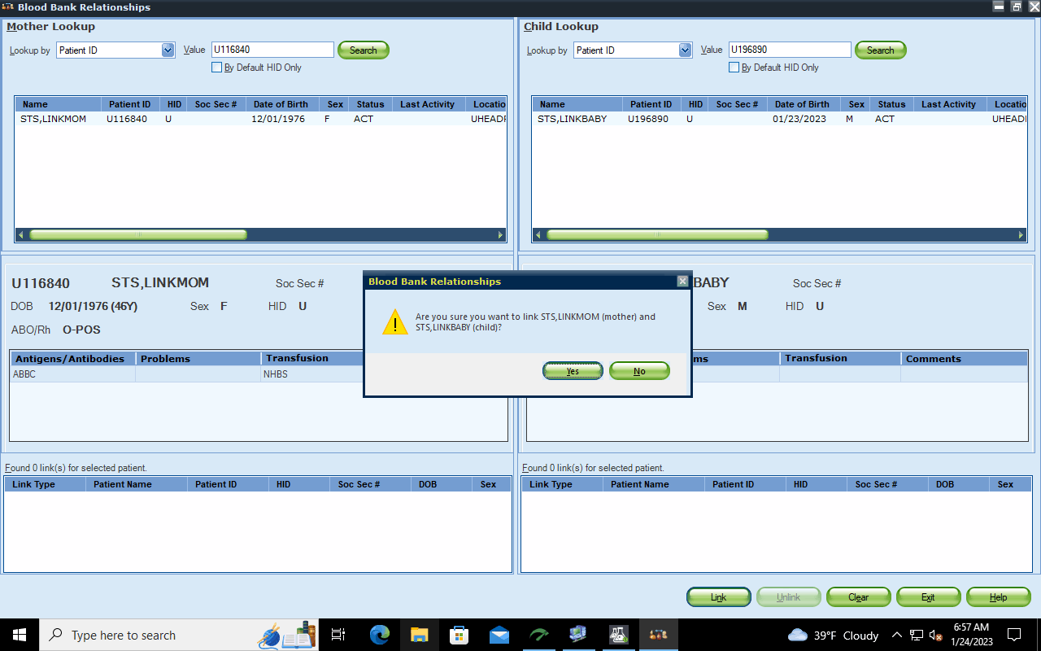
Mother and Child Link Function Now available in SQ 11.0 to link mother and child in SQ
A mother and child can be linked in SQ
This allows the antigen antibody attributes of on the mother to be required on the child as well
At this time link between mother and child will be done on a case by case basis. MLS 2, Leads and Manager will be performing link as needed
If you identify a mother with antibodies that need to be linked to a neonate- alert a lead or manager for further review and followup

Slide 27
Reports
Certain reports will be moving from SmarTerm/Putty to GUI
Smarterm no longer available. Use Putty and GUI for reports – impacts QA and management

Slide 28
Minor BOP Updates
BOP shows expiration date and time of specimen

Slide 29
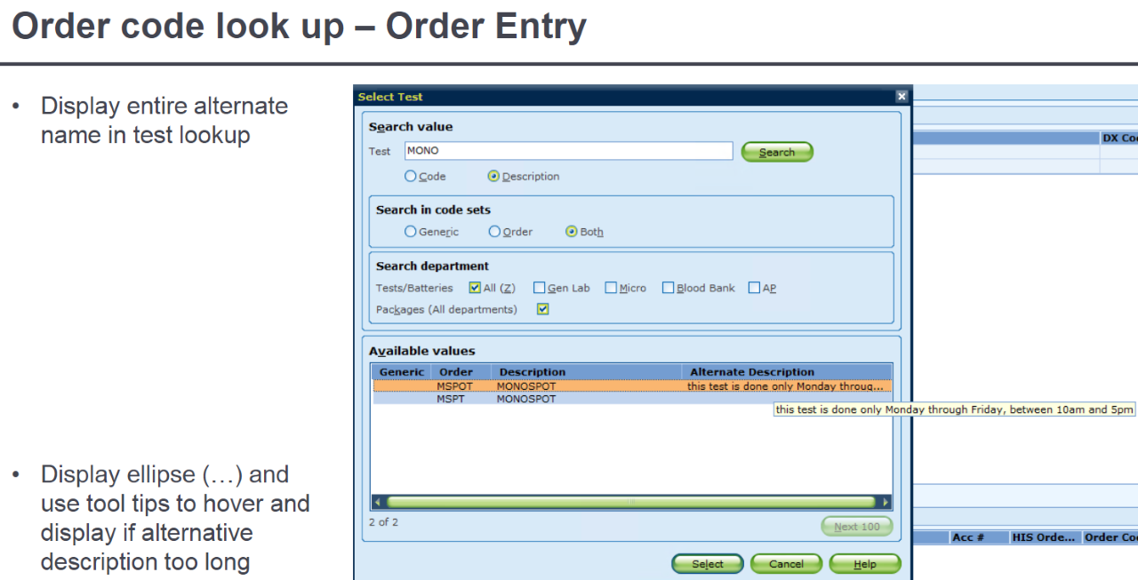
Miscellaneous
MERGE is no longer “final” -- IT can perform an unmerge
No longer need to update password in SQ. AMC password and login change process remains same and will apply to SQ as well
AMC user+password
Hover over display if text is too long on Order Entry

