Slide 1
Proficiency testing
Referral and Interlaboratory Communication

Slide 2
What is Proficiency Testing? Why is it important?
Proficiency testing, or PT, is the testing of unknown samples sent to a laboratory multiple times during the year. After testing, the laboratory reports its sample results back to their PT program. The results are graded using CLIA criteria which is routinely monitored by CMS.
PT is important because it is a tool the laboratory can use to verify the accuracy and reliability of its testing and can also be used to validate the entire testing process, including competency of the testing personnel.

Slide 3
How much PT is required?
PT participation is required for each laboratory with a CLIA certificate.
For large laboratories with multiple locations that each have their own CLIA certificate, PT surveys should be purchased for the analytes performed at each location.
Example: Montlake campus, Northwest campus, and HMC all perform Chem panels. Each site needs to order the associated PT.
PT specimens cannot be shared by locations with separate CLIA numbers.
Example: Montlake/Northwest/HMC labs can not order one survey and have each lab run the testing.
If a laboratory has multiple instruments that perform the same test, only one survey can be ordered.
Example: A lab has two Stagos for coag testing. Only one survey can be ordered.

Slide 4
How do I test PT specimens?
In general, PT specimens should be tested just like patient specimens.
The same number of times as you would a patient specimen.
At the same time as patient specimens.
By the same personnel that routinely test patient specimens. This should be rotated amongst staff.
Using the same test system that is routinely used for patient testing.

Slide 5
How do I test PT specimens? Cont.
PT specimens should not be tested:
in duplicate, unless that is what you normally do with patients.
on multiple instruments.
by only one person every time.
There are occasionally exceptions that will be spelled out in the Kit Instructions. These are usually handling instructions due to the nature of the PT specimen.
If patient specimens are reflexed to a test to go to another CLIA laboratory, NEVER send PT samples out of the laboratory.

Slide 6
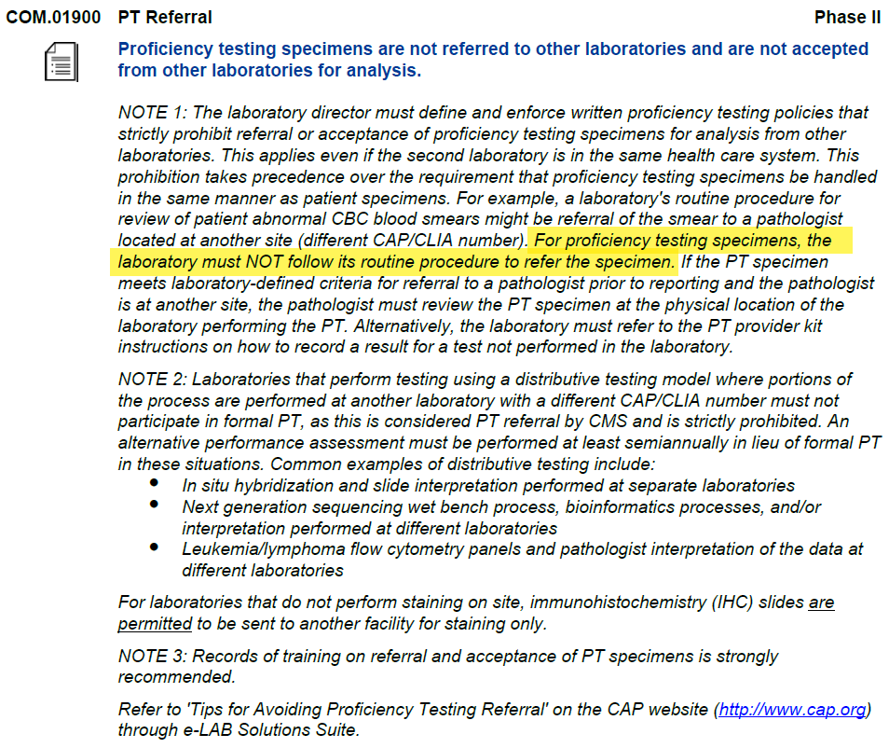
CAP Checklist Questions Relating to Proficiency Testing Referral

Slide 7
What is PT Referral?
Quite simply, PT referral is when Laboratory A sends its PT samples to another Laboratory B or multiple laboratories (Laboratories B, C, D, etc.) for any reason. Whether or not acts are authorized or even known by the laboratory’s management, a laboratory is responsible for the acts of its employees. Generally, PT referral is considered to be intentional. “Intentional” has been legally interpreted to mean the “intent to act”, regardless of motivation.

Slide 8
CAP Checklist Questions Relating to PT Interlaboratory Communication

Slide 9
What does this mean to us?
PT specimens can not be sent to another lab in our system
Data/Results for a PT specimen cannot be shared between labs in our system
Example: a Rapid HIV antigen/antibody testing is performed at Northwest for patients. The reflex HIV Antigen/Antibody confirmation goes to Harborview. The confirmation test cannot be ordered for PT specimens.
In instances where one lab would normally send a patient sample, they should result "Would refer" or "Test not performed“ for PT samples.
We cannot call another lab in the UW Medicine system or a friend at non-affiliated lab to see what they resulted prior to the PT event cut-off date.
We should not look in Sunquest to see if results are available for another lab until after the PT event cut-off date.

Slide 10
When is it okay to compare?
CAP sends out evaluations several weeks after the results are submitted. This information is useful to determine if our procedures and instruments are functioning properly.
Many of our labs at different sites look at the evaluations and compare results through our system as part of correlations. This is okay AFTER the PT event cut-off date.
A lab may repeat analysis of the PT specimen if they received unacceptable results. This duplication is okay as part of troubleshooting discordant results.
Labs may send old PT specimens (after a PT event cut-off) to other labs to correlate or help with troubleshooting.

Slide 11
Examples of PT referral/Interlaboratory Communication violations
A tech at Lab A orders a reflex test that goes to Lab B. A tech at Lab B sees the test on their worklist and enters results they obtained from the specimen already tested at their site. Staff at Lab A sees the results from Lab B. This is an example where the labs “shared” results, even if Lab B didn’t report them to CAP.
A tech at Lab A orders a smear review on a PT specimen since that is what they do for patients. The slide is sent to Lab B where all the pathologists look at slides from multiple labs. The Pathologist returns a result and the tech at Lab A enters that into the PT specimen accession. This is reported to CAP. This is ax example of a lab reporting results that were not theirs.
A tech at Lab A runs a test and enters the results. They are then chatting on Teams with friends at Lab B. They ask their friend, “Hey, what result did you get?” Regardless of whether anyone acts on the information, this is sharing data.

Slide 12
What are the consequences of PT referral or communication?
This will depend on what occurs and will be determined by CMS.
For minor violations, such as the PT specimen being sent to another lab during the event period, but results are not obtained until after the period, there may only be fines.
For major violations, such as multiple instances of Lab A reporting the results obtained by Lab B:
a laboratory could lose the ability to have a CLIA certificate (essentially shut down) or be limited on the testing they can perform.
a CLIA director might be restricted from directing a laboratory for 2 years.
the laboratory operator/owner may lose the rights to own or operator a laboratory for 2 years.
CMS may direct a Plan of Corrections and/or give a civil money penalty.

Slide 13
What should I do if I suspect PT referral or communication?
DO NOT test the specimen.
DO NOT enter any results.
If someone is showing you results or asking for results, refuse to discuss the PT specimen if the PT event cut-off has not passed. (If you aren’t sure, ask your manager whether the communication is okay).
Immediately notify your manager of any referred specimen, reflex test from another lab appearing on a worksheet, or request to compare results. They will work with the Quality management staff and CLIA director to review the scenario and report to CAP as needed.

Slide 14
Where can I find more information?
Proficiency Testing Policy (ADMIN_100-004) - Department of Laboratory Medicine and Pathology Policy
Read your department's procedure/job aid for handling Proficiency Testing specimens
Read the Centers for Medicare and Medicaid Services brochure: Proficiency Testing and PT Referral, Dos and Don’ts 9 (CLIA Proficiency Testing and PT Referral booklet (cms.gov))

Slide 15
Thank you

