Slide 1
ON TARGET 2015 Quality Assurance Training Series
VA Greater Los Angeles Healthcare System
Department of Pathology and Laboratory Medicine
Prepared by: Anton Estrada

Slide 2
Agenda: Laboratory Incident Reporting (LINC)
Purpose
Incident Types
How do I report?
What happens next?
Other avenues for employee concerns

Slide 3
SCOPE:
The VA GLA Laboratory System is comprised of the
West Los Angeles Medical Center and three Outpatient
Clinic Locations.
All GLA laboratory employees have the right to
voice their concerns. Incidents which may
impact the quality of patient care or safety,
or employee safety, will be investigated
equally using this mechanism regardless
of the individual reporting the
incident.

Slide 4
Purpose

Slide 5
Purpose
Identification
Incident types are observed for trends over time. Isolated events are distinguished from system issues.
Analysis
Data is gathered for each event and reviewed for root causes using a “big picture” approach.
Current and historic corrective actions are reviewed for completeness, appropriateness, and effectiveness.
Prevention
Modifications to policy or procedure, additional training and/or competency assessment, communication to employees and others in the supply chain, collaborative projects, and other mechanisms are used to prevent future occurrences.
Corrective actions are monitored through future LINC reporting for effectiveness.

Slide 6
Purpose
The reporting process is intended to prevent repeat future events.
Corrective actions are intended to improve
Customer service
Quality of product
Efficiency
Utilization of resources
Employee satisfaction

Slide 7
Incident types

Slide 8
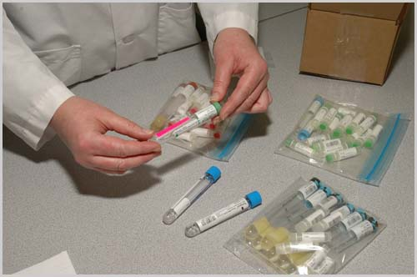
Specimen Mishandling
Incorrect storage or transport conditions
Not submitted to laboratory (left in box or at bedside)
Pouring specimen from one additive tube to another

Slide 9
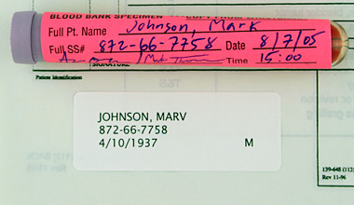
Specimen Mislabeling
Incorrect Name or SS#
Incomplete Name or SS#
Missing Name or SS#
Illegible information
Incomplete info other than ID
REMINDER
ZERO Tolerance Labeling Requirements:
FULL NAME
FULL SSN
LOCATION
DATE OF COLLECT
TIME OF COLLECT
INITIALS OF COLLECTOR
SOURCE

Slide 10
Transportation Issues
Testing delayed due to missed pick-up
Transportation failure to deliver boxes
Testing delayed due to transport delay
PTS “misses”
NOTE:
Transportation drivers are NOT responsible for creating manifests, packing, or ensuring prompt processing by receiving laboratory.

Slide 11
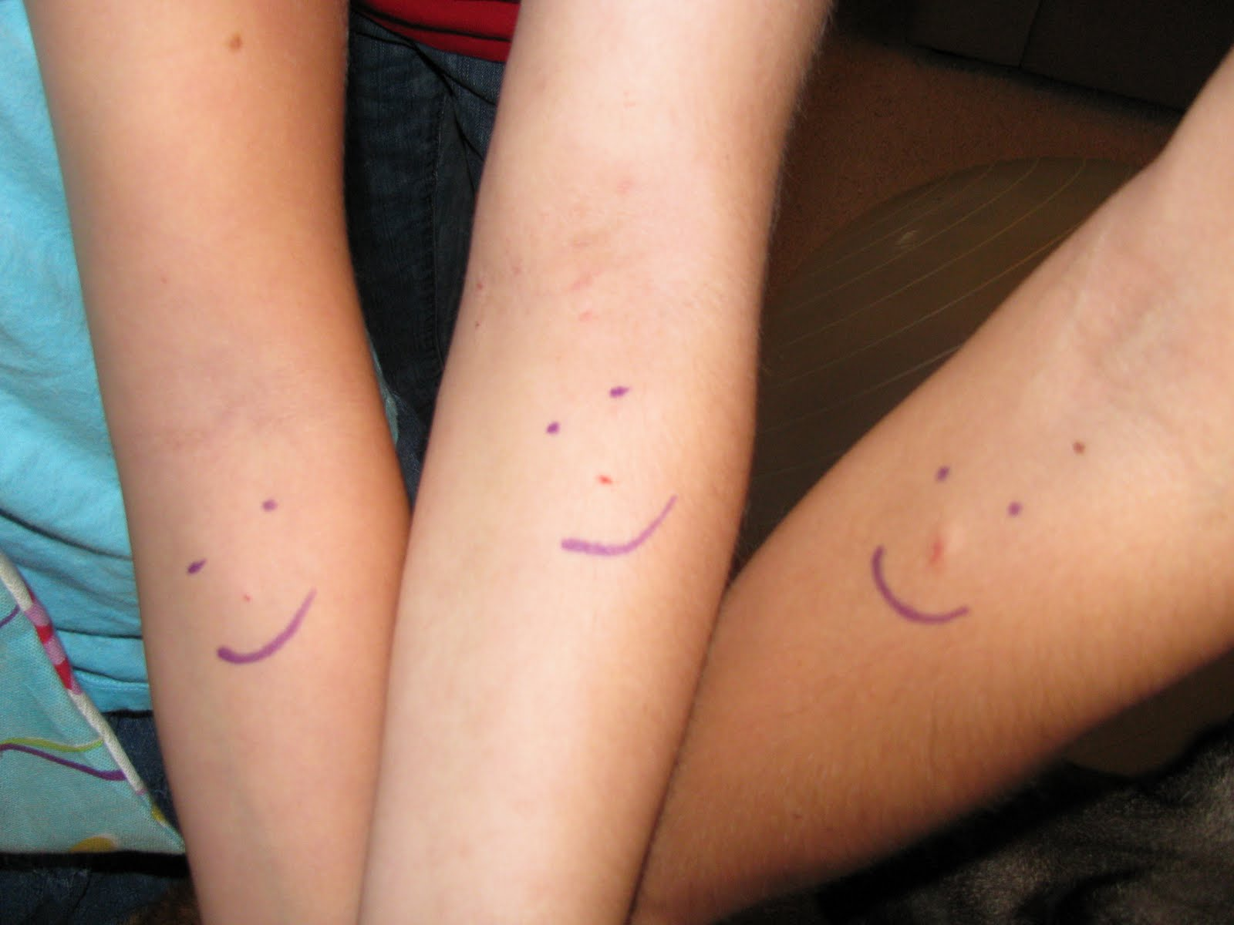
Customer Complaint
Long wait times
Excessive bleeding after venipuncture
Exceeding TATs
Poor customer service
Failure to use PPE

Slide 12
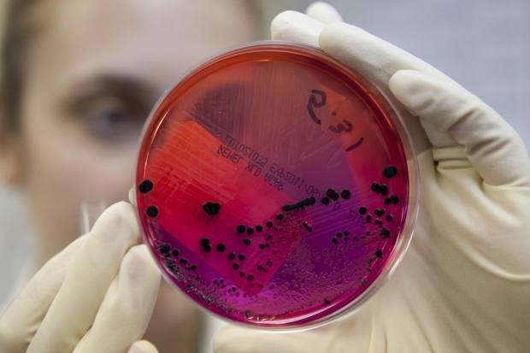
Reporting Failures: Critical Values
Unable to locate ANY provider within 30 mins
Provider refuses to accept CV
MT fails to notify physician of CV
Reporting Failures: Other
Incorrect result reported
Result reported on incorrect patient
Reported in error (performed in error)

Slide 13
Other
Consistent issues arising from another service
Consistent errors due to a single issue
????

Slide 15
How do I report?

Slide 16
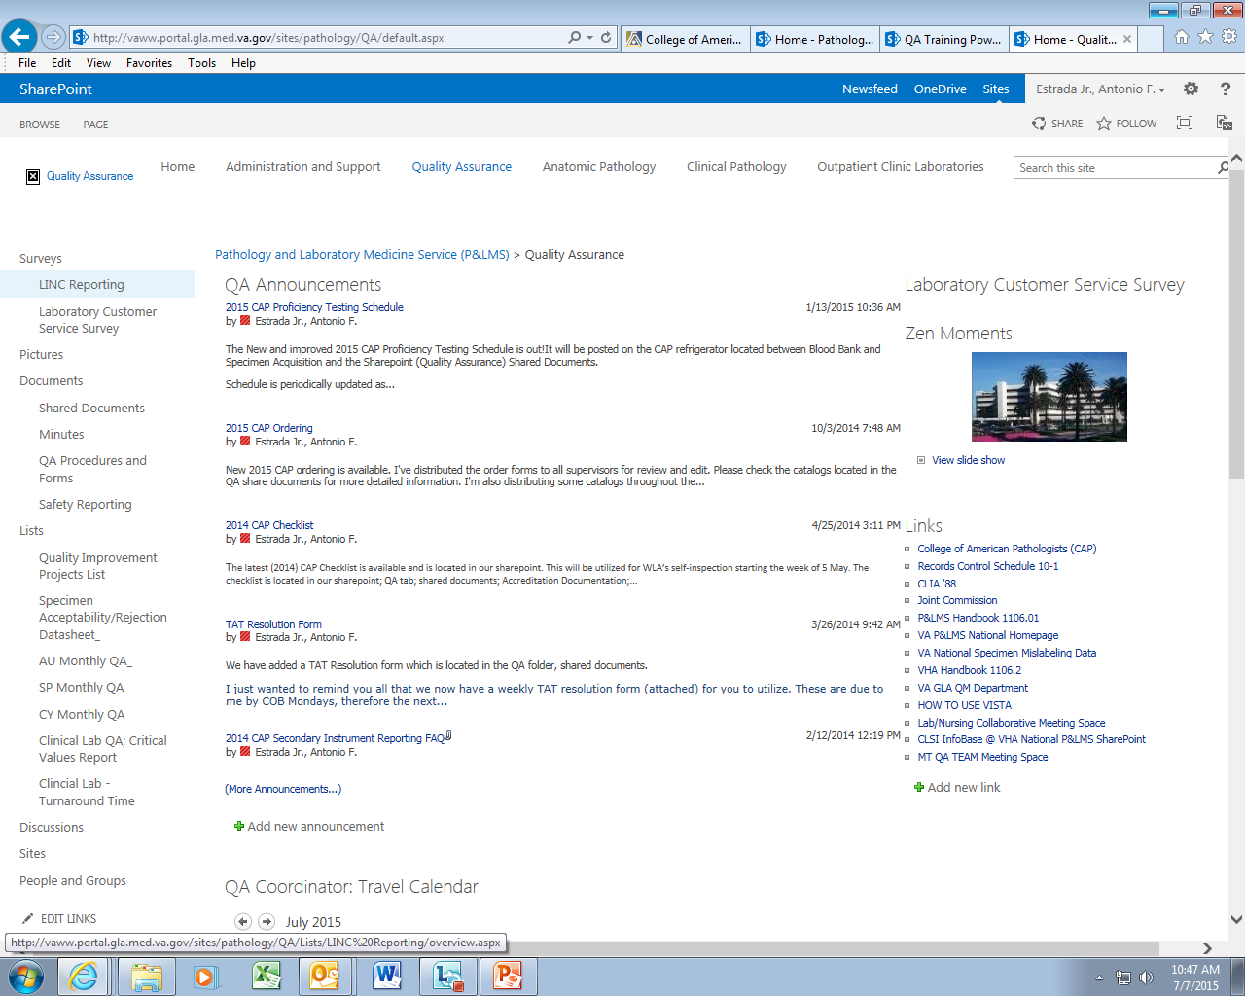

Slide 18
WHO
WHAT
WHERE
WHEN
WHY
HOW
???
Do not use
Patient IDs
in SharePoint
Not even last
name or last
four!!

Slide 20
What happens next?

Slide 21
What Happens Next?
Investigation
Presentation
Implementation
Periodic review of cases
Direct interaction with appropriate parties to implement actions
Discussion with Chief, LM, QM as appropriate
Coordination of activities
Follow Up
Basic questions to complete the picture.
Request for documentation.
Interviews.
Approval of plan to address
Ongoing communication with services
Self inspection
Note:
QA will not follow up with a LINC submitter if not appropriate.
If you are curious of the status of a LINC report and approved resolution, please contact the QA coordinator with the LINC case number.

Slide 22
Other Avenues for employee concerns

Slide 23
Other Avenues for Employee Concerns
GLA Internal:
Labor Union, Quality Management, Regional Commisioner
External:
CAP 866-236-7212
COLA 800-981-9883
OIG, OSHA
Lab Internal:
Chain of Command, LINC, ROC
All concerns and complaints are approached seriously; reporting and correction at the lowest level is preferred.
There is a fine line between quality issues and performance, conduct, and other work environment issues. Please report responsibly.

Slide 24
Recap: Laboratory Incident Reporting (LINC)
Purpose
Incident Types
How do I report?
What happens next?
Other avenues for employee concerns

Slide 25
Questions:
Quality Assurance:
Anton Estrada, QA Coordinator, 310.478.3711 ext. 40993
OTHER computer problems including Microsoft applications;
IT Help Desk

