Slide 1
Body Fluids and other irreplaceable samples
How we handle these specimens upon arrival to the laboratory.

Slide 2
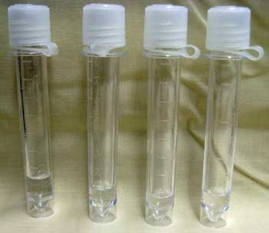
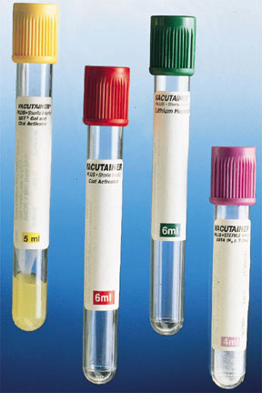
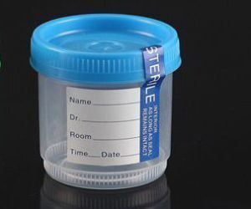
Specimen type
Irreplaceable samples:
Specimens that are difficult to obtain
Obtained by invasive procedures and cannot be recollected
Example’s: Tissues, spinal fluid, synovial fluid etc.
Replaceable samples:
Specimens which can be redrawn or recollected
Example’s: Peripheral blood and urine
CSF Blood GYN sample

Slide 3
Body Fluids
Body fluids received though pneumatic system:
Fill out Body Fluid Tracking form
Deliver to Hematology-specimen and form with specimen acquisition person’s signature
Body fluid brought in by clinical staff:
Assist clinical staff to fill out Body Fluid Tracking form, ensure signature(s) are entered
Escort clinical staff to Hematology where body fluid is triaged and submitted to testing labs
Note: Do not send body fluids via the pneumatic tube station between the lab departments. Always hand carry body fluids with tracking form.

Slide 4
Greater Los Angeles VA Medical Center Pathology and Laboratory Medicine Service | Page | 1 of 1
Document Title: | Document Number
BODY FLUID TRACKING FORM | Revision Date
 | Effective Date: 9/8/2014
1. Patient Name _________________________________________ Last 4 ____________
(Label)
­­­ ­___________________________________________________ _____________________________________
Signature of the person who delivered the specimen Date/Time Point of Contact
2. Received by: (Other than Hematology)
□ Specimen Acquisition: Date/Time Received_______________ Initials___________
□ Other: (i.e. AP) Date/Time Received_______________ Initials___________
3. Fluid Type: □ CSF □ Pleural □ Peritoneal □ Pericardial □ Synovial □ Other
Total # of Tubes/Containers Received: __________
□ Green □ Red □ CSF Tubes □ EDTA □ Sterile Container □ Other
Estimated Total Volume Received: ____________________________________________
4. Processed by Hematology: (call the MD to prioritize if fluid is insufficient)
Tech ID ___________ Date/Time Received ____________________
□ Verify all orders were accessioned in CPRS
□ Called all appropriate sections for pickup @ _____________
5. Received by:
Microbiology: Tech ID __________ Date/Time Received _____________________
□ Verify all orders were accessioned in CPRS
□ C&S □ Mycology □ AFB □ Other:
____________________________________________________
Chemistry: Tech ID _________ Date/Time Received ________________________
□ Verify all orders were accessioned in CPRS
Send Outs: Tech ID _________ Date/Time Received ________________________
□ Verify all orders were accessioned in CPRS
________________________________________________________________
Cytology: Tech ID ___________Date/Time Received ________________________
Note: If afterhours, place all remaining fluid and this flowsheet in Cytology refrigerator.
Placed in Cytology refrigerator (Date/Time/By) ______________________________
COMMENTS: ________________________________________________________________________________________
***ATTACH ORDER REQUISITION WITH FORM ***
PLACE COMPLETED FORM IN HEMATOLOGY BLACK FILE TRAY

Slide 5
Histology/Cytology Specimens
Clinical staff are required to fill out the delivery chain of custody form for each sample submitted
All entries in the log must be acknowledged by SA staff with their initial
After recording, the sample is placed in the Histology Locked bin by the SA Staff
Histology staff will pick up samples
Notify Histology Supervisor or Specimen Acquisition (SA) when problems arise
Off hours-specimen pickup will be the following working day
Refrigerated samples are placed in SA refrigerator container labeled AP container

Slide 6
Chain of Custody Log
Date | Time Delivered | Location where Specimen was Collected | Patient ID Last Name Initial and Last 4 SSN | Name of Person Delivering Please Print | Contact Telephone Number and ext. | # of Items delivered | SA Check In SA Tech Initials | # of Items Rec’d by SA Staff | AP Check In Tech Initials | # of items Rec’d by AP Staff
Individual delivering the specimen fills out YELLOW columns
Specimen Acquisition staff verify receipt of specimens in GREEN columns
Histology staff verify receipt of specimens in RED columns
At the end of each tour, open the lock box and review the contents. Ensure that all specimens are accounted for AND are correctly identified and distributed. Check for fluids or other samples that may have accidentally been placed in the locked bin.

Slide 7
Handling Problems
Irreplaceable specimens:
Providers will have an opportunity to correct misidentification errors
Providers will have to fill out form and sign it taking full responsibility
A copy of the form goes to the Section Supervisor and Path and Lab QA Office
A linc will be filed
Replaceable specimens
Sample(s) will be recollected
Phone calls regarding missing specimens
Immediately begin a search
Staff are required to search for misplaced specimens in the usual places (i.e. labs, refrigerators, freezers, trash cans, coolers)
Open the locked box and search for specimens
Notify Section/Shift Supervisor or designee if unable to locate
Linc to follow

Slide 8
CBOC Specimens
Body Fluids-Invasive procedures should not be collected at CBOCs, however in the event that they do:
Place the sample on the manifest sheet
Submit the specimen and the Body Fluid Tracking Form
Upon receipt at WLA, the SA tech will scan and deliver to Hematology with specimen acquisition person’s signature
Irreplaceable specimens
Submit specimens by entering them on the manifest sheet
Upon arrival at WLA, the SA tech will record the sample in the Chain of Custody Log sheet
Place the sample (s) in the Histology Locked bin

Slide 9
Specimen Misidentified/Irreplaceable Report Form
Date: | Time:
Specimen: | Problem:
Patient Name: | SSN:
Label/Re-Label Patient Name: | Label/Re-Label SSN:
Location (Department/Unit): | Provider:
Reporting Lab Section: | Reporting Personnel Name: (Please Print)
Copy to QA Coordinator: □ Yes Copy to Section Supervisor: □ Yes | Reporting Personnel signature:
CERTIFICATION
This Section of Form is Mandatory
By signing below I take full responsibility for labeling/re-labeling of the above listed patient samples/specimens.
Name: (Please Print) | Signature:
Title: | Date: Time:

Slide 10
Do’s and Don'ts
All patients must be identified with two legible patient identifiers
full name, full social security number or date of birth
Do not allow unauthorized personnel walk around unescorted in the lab
Do not leave samples unresolved. Always follow up with appropriate personnel so that sample gets addressed appropriately
If specimen issues cannot be resolved during your shift, verbally communicate to the next shift tech or supervisor to ensure that they follow up on the problem or document in the communication log

Slide 11
Questions?
If you have any questions or cannot resolve a problem notify any supervisor
Please take the competency in MTS that has been assigned to this training session

