Slide 1
Specimen Quality vs Quantity
Eva Archuleta, MT, Referral Lab Supervisor, PLMS Safety Officer
Sunday Dike, MT
Specimen Acquisition Supervisor
Ali Pashaeefar SH (ASCP)CM, Hematology Technical Specialist

Slide 2
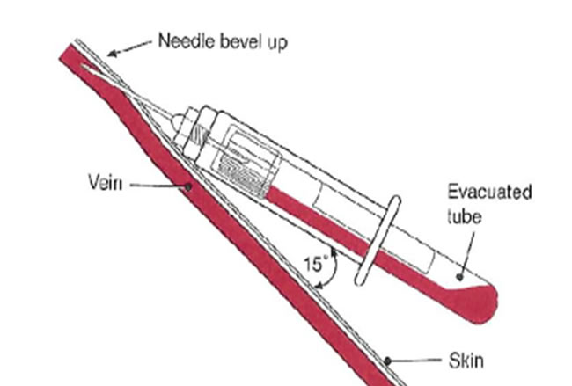
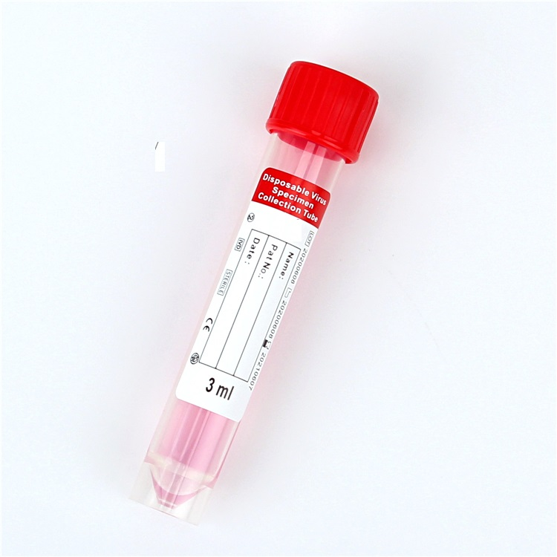
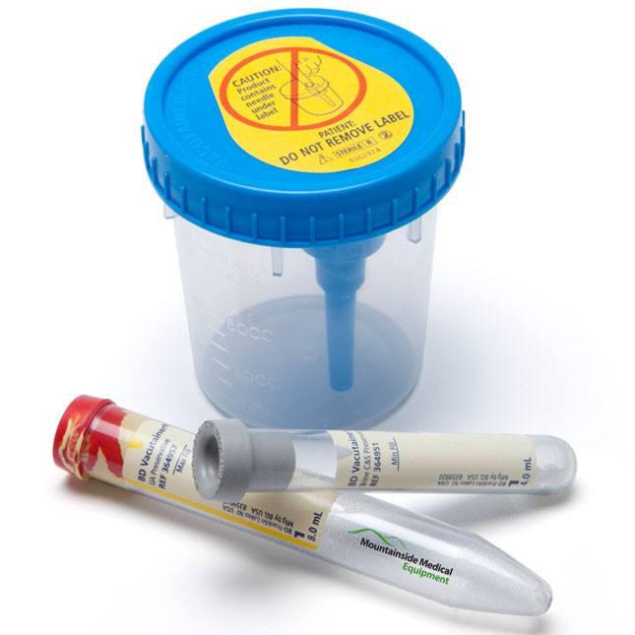
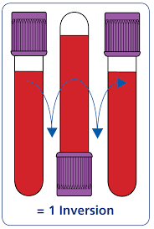
Agenda
Pre-analytical conditions that effect Sample Quality
Hemolysis
Clotting
Lipemia
Sample Volumes- Insufficient vs Overfilled
Mislabeled Specimens
Correct Specimen Container
Effects of Sample Quality

Slide 3
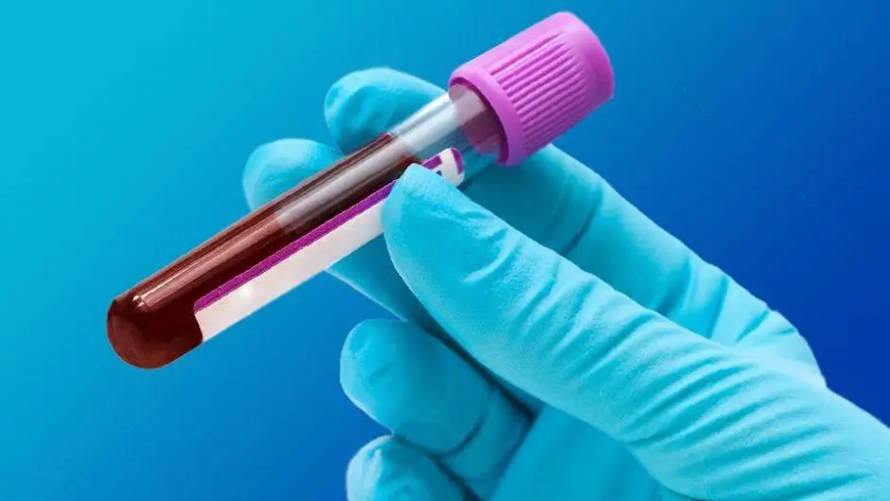
Introduction
Accurate and reliable laboratory results are critical to providing optimum patient care. The delivery of high-quality laboratory results relies not only on proper sample analysis and reporting but also on the integrity of the sample prior to analysis.
The preanalytical phase of testing refers to that period of time between patient identification and sample analysis. Errors in the preanalytical phase of testing represent the greatest source of inaccurate laboratory results in today's laboratory.

Slide 4
Phlebotomist’s Role
In order to prevent errors that affect specimen quality, the phlebotomist must pay close attention to detail during the entire venipuncture process.
All steps of the phlebotomy procedure must be included for every venipuncture. No shortcuts.
This will help to maintain specimen integrity during the collection, transport, and handling of blood specimens.

Slide 5
Preanalytical variables

Slide 6
Patient Identifiers
VA and Joint Commission requires two patient identifiers-Full Name, Full SSN
To identify patients:
Out-patient: ask veteran to state full name, full SNN. If unable to speak or identify him/herself, then ask the guardian/caregiver) to state the patient’s name and SSN. A picture ID, such as a driver's license, can also be used for positive patient identification.
In-patient: check and compare lab order sheet with wristband and/or ask veteran to state full name and full SSN. If unable to verify, then ask nurse to ID patient and have her date and initial lab order worksheet.
Do not say are you, Fred? Is this your SSN?

Slide 7
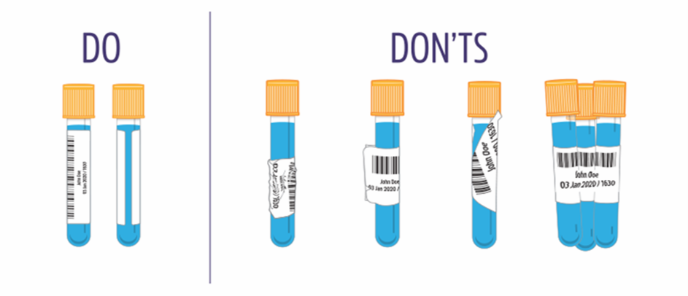
Labeling
Mislabeled Specimens
A mislabeled specimen is when a specimen from one patient is labeled with another patient's name.
Proper Labeling

Slide 8
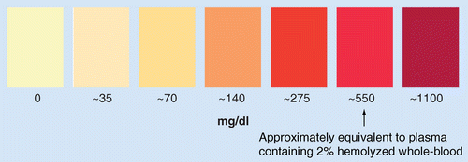
Hemolysis
Hemolysis is defined as an injury to blood cells, which is usually reflected by the presence of hemoglobin in serum or plasma.
Hemolysis can be attributable to either biological conditions leading to red blood cells (RBCs) breakdown
in vivo (i.e., intravascular hemolysis) or
In vitro, non-biological causes occurring during sample collection and handling (i.e. ,spurious hemolysis)
the most frequent of which include traumatic venipunctures,
sample collection with inappropriate devices (i.e., indwelling catheters or very small needles-25g),
inappropriate sample management (i.e., vigorous mixing or shaking of blood samples after collection),
inadequate storage conditions (sample freezing, long distance transportation under inappropriate conditions), sample re-spun after centrifugation, etc.

Slide 9
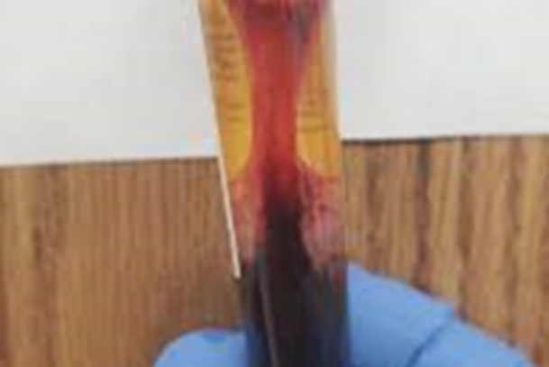
Clotting
A specimen clots when there is not adequate mixing of the anticoagulant in the tube.
An inappropriately clotted blood specimen is one in which clotting occurs in a tube containing an anticoagulant e.g., Purple top tube(EDTA), Blue top tube(Na-Citrate), Green top tube(Na-Heparin) etc.
Clotted samples for Hematology and Coagulation assays are rejected.
How do you mix a sample?

Slide 10
Lipemia
Lipemia is a turbidity of the sample caused by accumulation of lipoprotein particle caused by the presence of an excess of fats or lipids in the blood, specifically hypercholesterolemia.
Justification of lipemic sample to perform test or not is tech responsibility not phlebotomist.
Clearing lipemia can be done by ultracentrifugation.

Slide 11
Vacuum Tube Volume
Insufficient blood volume: the laboratory cannot perform tests requested because the amount of sample is insufficient. Laboratory instrumentation uses very little amounts of blood, serum or plasma (i.e. typically between 2 and 20 μL per test), yet a minimum volume is required for processing samples automatically.
Underfilled: underfilling in serum blood tubes or in those containing additives such as lithium-heparin, EDTA and procoagulant compounds (i.e. thrombin), may very rarely generate a clinically significant bias and only for a very limited number of analytes. Coagulation testing if 10% under filling will affect hemostasis testing such as PT, aPTT, fibrinogen.
Overfilling risks clotting, as the ratio of additive anticoagulant to whole blood may be insufficient. This occurs when applying pressure overfills tube. Removing the closure and needle then transferring through the syringe tip is also likely to cause overfilling.

Slide 12
How much to collect?
Review the Test Information menu for sample processing instructions.
Check the Quest website test directory menu for send out tests going to Quest.
Review other websites (Mayo, ARUP, etc.,) for sample collection, processing, storing, shipping instructions.
If our TI menu is not clear, missing information, or not up to date then let us know so that we can request a revision.
Follow the order of Draw.
What is the order of the draw?
Number of accessioned labels, doesn’t mean one sample per label. Best to submit full tubes and share, rather than ½ full tubes and not share.
When Sharing samples-place extra label on top of sample cap or rubber band label to original tube to signify a shared sample.
Additional labels on a tube will cause the tube to get stuck in the automated line puck and interfere with the robotic arm-causing the line to stop and requiring troubleshooting efforts to resolve problem.

Slide 13
Case Studies
Case study #1: Three tubes collected on a patient for a CBC, A1C and Hgb A2, quant, each tube was less than ½ full. The Send out test requires a minimum of 2mL. All three tests were cancelled as QNS.
Solution: collect ONE full tube and shared it 3 ways, or 2 full tubes rather than 3 short draws. The fullest tube should go to Send Out, in case reflex testing is required
Case study #2: Cryoglobulin Screen with Reflex was canceled as QNS. Another sample was canceled because tech failed to incubate sample. This test requires 10mL of serum, which means collection is 3 to 4 full red tops.
Solution: collect the proper number of tubes and keep warm. Question-what do you do if you don’t have a warm pack?
Case study #3: One ½ filled gold top collected for a Tree nut allergy panel and a Mold group allergy panel. After centrifugation, 1mL of serum was available for testing, tests had to be canceled. Each requires a minimum of 2 to 2.5mL serum more if it is a reflex test.
Solution: review sample volumes. Can you name other panels where this may occur?
Case Study #4: Factor VIII inhibitor Panel canceled. PPP not processed correctly. Some Coagulation assays cannot be shared samples, check website for instructions.
Solution: follow instructions on how to achieve PPP. In this case they are asking for 1mL x 3 so a total of 3mL of PPP is required.
Case Study #5: Specimen for an ERYTHROCYTE PROTOPORPHYRIN requires whole blood, specimen sent was plasma. No other lavender top tube was found, test canceled.
Solution: When processing samples, pay attention to detail, look at the TI menu for processing and shipping instructions.
Case Study #6: Several tube submitted for chemistry, immunochemistry, serology and send out. All were process except for SPL accession. Accessioner stated that sample was not received.
Solution: After researching sample, there was sufficient serum for SPL accession, staff retrieved sample and sent to Quest for testing. Always check to see if we can share specimens.
Case Study # 7: Two different 24-hour urine containers given to patient and told to collect sample for 24 hours and split the collection between the two.
Solution: The instructions for this situation requires patient to collect one container at a time. Collect the 1st 24-hour container then the next one.

Slide 14
Correct Specimen Containers
Samples collected in the correct container is necessary for accurate results of laboratory testing. Examples:
Stools and fluids are not collected in blue needle capped urine cups.
TBNK specimens are collected in Camo lavender tops not plain lavender tops
Sample aliquots will affect test results if not properly aliquoted.
Not all lavender or blue tops require whole blood, some tests use plasma and must be aliquoted.
Hemostasis assays require Platelet-Poor-Plasma (PPP).
How is PPP processed?
Not all aliquot tubes are the same. Make sure you are using the correct tube.
Plain-acid wash-acid free-false bottom
To avoid delays and/or cancelations, use the proper tube
Be aware of light sensitive specimens-if aliquot is required, place in light protected tube or wrap tube in aluminum foil if sample is not aliquoted.
Hard to collect specimens-body fluids, tissue, bone marrow ensure proper labeling, proper collection tubes and/or preservative media is correct, send immediately to testing lab.
NOTE: cells in fluids disintegrate 50% within ½ hour of collection causing bacterial growth, falsely low cell count.
Follow all specimen collection, incubation, and processing instructions.
QFTB tubes that are over-incubated invalidates test results. Thus, samples require recollection.

Slide 15
Sample Quality
Accession tests correctly-notice details
C.Tra/Neiss Gono RNA, TMA Throat and Rectal is not the same as urine. Ensure swab is in the vial
Some stool tests (electrolytes) require liquid stool and not formed
Hemolyzed specimens
Identify causes when too many samples are coming from a particular ward or employee and retrain
Insufficient volume
Share if there are other samples available
Specimens collected in anticoagulant tubes maybe overdiluted and cause interference or erroneous results
Wrong container or kit
Issue the correct kit t the patient- Semen Analysis kit is not the same as a Vasectomy kit.
Some tubes may be interchangeable, provided assays are validated (BD vs Greiner)
Undue clotting
Reject all samples for hematological or hemostasis assays even when fibrin clots are identified
Remove fibrin strands or clots from serum before use on automated systems
Specimen requirement
Review test information menu for tests that are not routinely performed
Do not process specimens that are unacceptable for testing. If unsure, seek assistance.
Remember-a good quality sample equals reliable results.
Some assays are (Potassium) are very sensitive to hemolysis

Slide 16
Summary
Unsuitable samples may be associated with diagnostic delay, missed or wrong diagnoses, additional workload for all staff involved, and also poses a considerable economic burden on the hospital and laboratory budgets.
Questions: Ask Eva or Sunday.

Slide 17
Thank you

