Slide 1
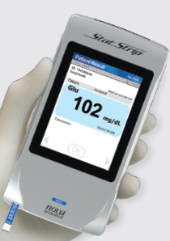

Point of Care Testing (POCT)
Glucose and Ketone
Nova Stat Strip Glucose Meter

Slide 2
Learning Outcomes
Present an overview of POCT.
Demonstrate sample collection procedure.
Explain pre-analytical errors and how to prevent them.
Demonstrate operational principles of POCT meters.
Demonstrate the maintenance, calibration and Quality Control procedure for the PHCC POCT meters..
Demonstrate ability to competently process a sample.

Slide 3
What is Point of Care Testing?
Point of Care Testing (POCT) as defined by the College of American Pathologists (CAP):
  tests designed to be used at or near the site where the patient is located
  do not require permanent dedicated space
  performed outside the physical facilities of the clinical laboratories
  performed by non-laboratory personnel.
The overall test management process is being supervised by the laboratory.​
​
Notes:
Near patient testing

Slide 4
Collection & Handling
Patient Preparation:
  Request should be done by the physician.
  Prepare the testing kit near the patient ( meter, strip, alcohol swab, etc )
  Introduce yourself and inform the patient ( If conscious ) that you are there to perform a blood collection procedure to measure the blood glucose level.
  Identify the patient.
  Wash hands and put on clean gloves when collecting blood sample.
  Massage the hand from the wrist to the fingertip 2 - 3 times or hang the arm down for 10-15 seconds to increase the blood flow before collection.
Sample type:
  Fresh whole blood (Capillary, Arterial, Venous whole blood samples)
Preferred Collection:
  Finger prick
  Samples from heel prick and venous samples can be used also for newborn babies.
Handling:
  Testing should be done immediately

Slide 5
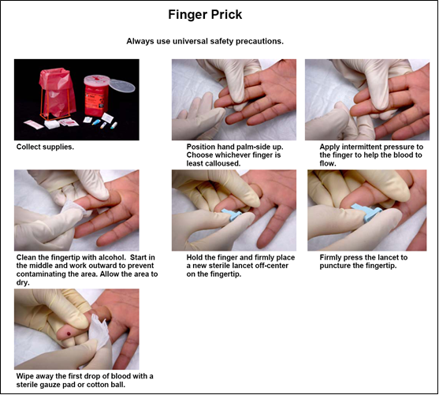
Sample Collection
Preferred site for heel-prick in newborns
Preferred site for finger prick
(6 months and above)

Slide 6
Pre-analytical Errors
Error | Effect | How to avoid
Contamination during the finger prick with alcohol | If Alcohol remains in the finger when the finger stick is performed, the test results may be affected and should not be reported. | Ensure that the puncture site is dried after wiping it with alcohol before collecting the sample
Excessive squeezing of fingertip | If the fingertip is squeezed excessively or "milked," allowing tissue fluid to contaminate the sample, it will cause false results | Obtain a free-flowing drop of blood. If necessary, warm the puncture site prior to skin puncture; do not elevate the puncture site; gently massage the puncture finger.
Puncture site contaminated with sugar | False high glucose result | Ensure the puncture site is cleaned prior to glucose testing.

Slide 7
Principles
The Test strip is designed with an electrode that measures glucose levels.
The glucose in blood sample mixes with reagent
( Modified Glucose dehydrogenase) on the
test strip that produces Electrical current.
?

Slide 8
Principles & Features
Nova StatStrip is a handheld analyzer for whole blood glucose monitoring.
  Nova StatStrip is a Multi-Well® system that measures & corrects for Hematocrit.
Eliminates interferences from Electrochemical Interferences such as: Paracetamol (Acetaminophen), Ascorbic Acid, Uric Acid, Cholesterol …..etc.
Nova enzyme on test strip does not measure & dose not affected by Supplemental Sugars- Maltose, Galactose, Xylose, and Lactose.
Not affected by sample’s Oxygen level.
No calibration codes required.
Glucose Test Strips: END fill test strip. Cannot be overdosed
Meter: Automatic transfer of results when meter is docked
Barcode scanning for operator ID, patient ID, and lot numbers ( strips & Control solution )
Result Reporting:
  Glucose results reported in 6 seconds.
Ketone results reported in 10 seconds.
Measurement Range:
  Glucose: 0.6 – 33.3 mmol/L 10 – 600 mg/dL
  Ketone: 0.0 – 8.0 mmol/L
Sample volume :
  Glucose: Uses only 1.2 µL of sample.
  Ketone: Uses only 0.8 µL of sample.

Slide 9
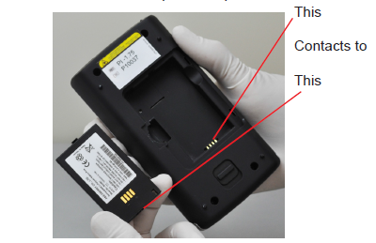
Memory & Battery Information
Data Storage:
    Patient tests: 1,000
    QC tests: 200
    Users: 8,000
Battery:
    Rechargeable lithium battery.
    Life: up to 8 hours in use or 40 Tests.
    Accessible at back of meter.
    Return meter to docking station when not using to Maintain life of battery.
    The light is amber when the battery is charging.
    The light is green when the battery is fully charged.
35

Slide 10
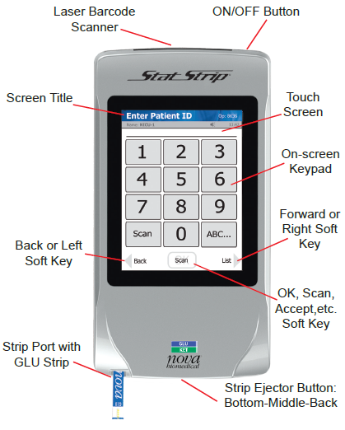
Major Compartments
35

Slide 11
Color Touch Screen Operation
“Welcome” or “Home” screen indicates:
  Name of Facility and Unit.
  Icons for Battery and Memory.
  Goes into “sleep mode” after 90 seconds if no data entered.
  Touch the screen to wake up.
  Do not touch screen with end of pen or hard nails,
  use soft pad of finger tips (prevents damage to screen).
  Blue dialogue box at top of screen will prompt
  user on next step.
35

Slide 12
Docking Station
When the meter is not in use,
place it into the Docking Station.
Enables the meter to stay
fully charged.
Connects the meter to a
data management system
(Upload & Download).
Charges spare batteries.
35

Slide 13
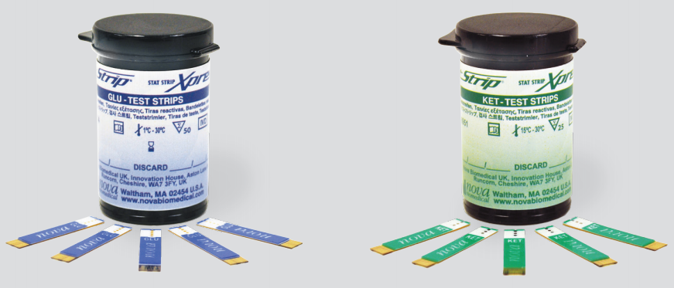
Consumables
StatStrip Strips
StatStrip Quality Control solutions
35

Slide 14


Glucose / Ketone Strips
Glucose: Two vials per box, 50 strips/vial
Ketone: Two Vials per box, 25 strips/vial
Gold colored side is bottom surface of strip.
Blue/Green colored side is top surface.
Gold metal end is inserted into meter well.
white tip is end of strip. Sample placed to tip of strip (End Fill).
Storage and handling:
Shelf-Life: up to manufacturer expiry.
Open vial stability is 6 months or 180 days.
Write opening and discard date on the vial.
Keep vial closed, strips affected by heat, light and
humidity.
Store at temperature below 30°C
Disposal:
  Dispose the used strips and lancets in the sharp box.
35

Slide 15
Quality Control Solutions
The Stat Strip glucose and - ketone control solution is used to make sure that the strips and the meter working together properly.
Storage and handling:
  Shelf-Life: up to manufacturer expiry.
  Open vial stability is 90 days from opening.
  Write open date on the vial.
  Store controls at room temperature (15-30 °C).
  Two levels of controls are required: L1 (LOW) & L3 (HIGH)
Disposal :
  Dispose Control solutions vials in yellow bag.
Calibration:
  Calibration Code is Not required for the meter.

Slide 16
When to Run The QC
  At least once a day before patient testing
  First time using the machine
  Opened new package of test strips
  Suspected abnormal test results
  Meter damage (dropped, wet..)
  New operator

Slide 17
Trouble shooting out of QC
If QC Result is not acceptable, do the following:
Repeat the QC test by following instruction carefully.
Check the QC solution for expiry / contamination.
Check the Strips for expiry / contamination.
Check the strip. If damaged, retest with new strip.
Check if meter is working properly.

Slide 18
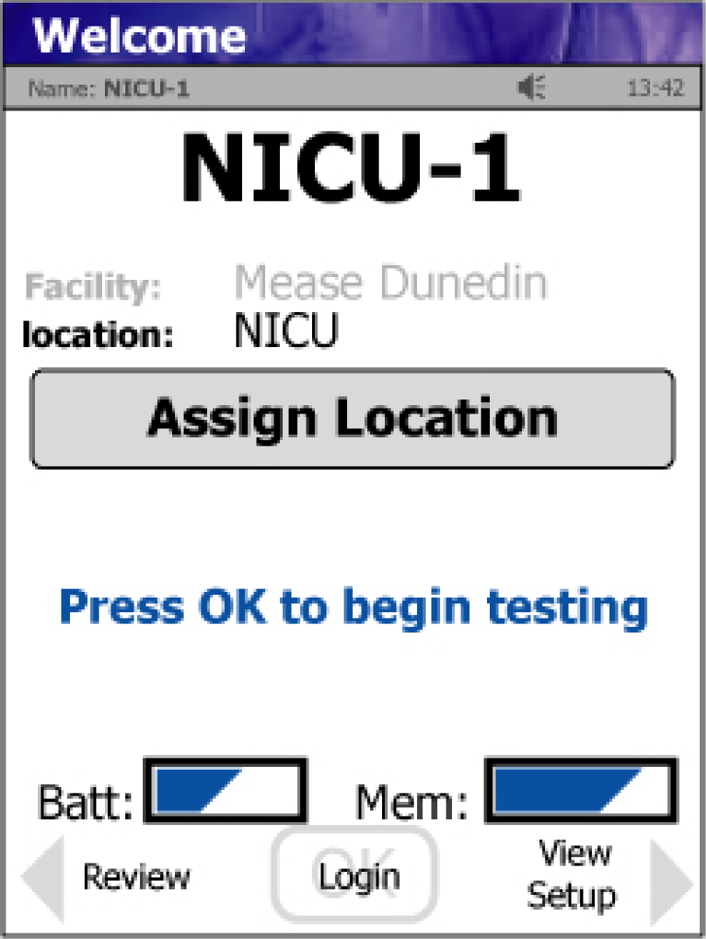
1st Step - Operator Login
TO START USING THE METER
Press the “ Login ” Soft key at the bottom middle of the Welcome screen.
The Enter Operator ID screen will then display….
If using Bar Codes for Operator ID’s:
Press the “ SCAN ” soft key.
Hold the barcode parallel to 4 – 6 inches (10-15 cm)
from The scanner.
When the information appears on the top of the
screen, the barcode has been successfully scanned.
Press the “ Accept ” Soft Key.

Slide 19
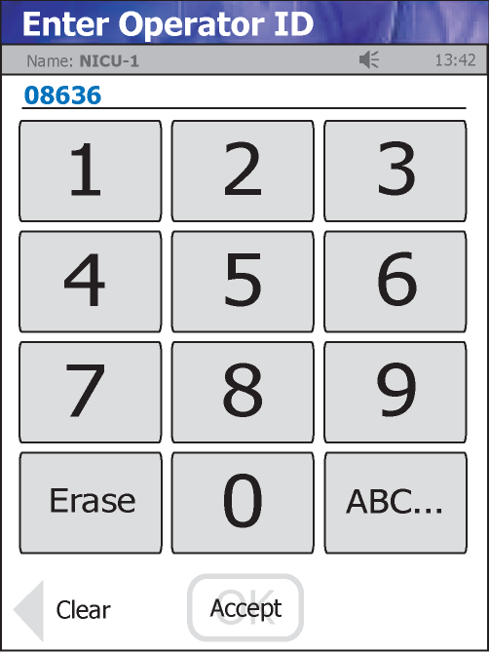
If only using manual Operator ID entry:
Enter your Operator ID using the keypad on the touch screen and press
“ Accept ”.
Once Operator ID has been accepted, The Patient Test screen displays.

Slide 20
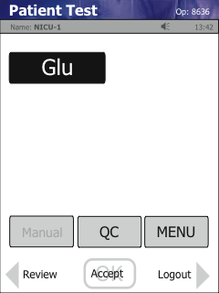
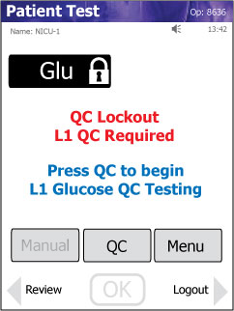
Patient Test Screen
Patient Test Screens-
Ready to Use vs Locked Meter
These meters are ready to perform patient and QC testing- No Lockout message shown…
This meter is locked out. QC must be performed (as indicated) before patient testing can be done.

Slide 21
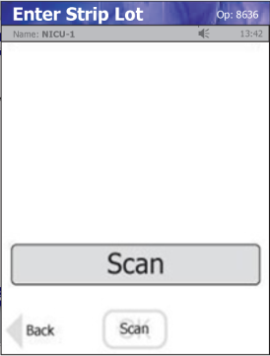
2nd Step – Quality Control Testing Procedure
Press “ Login ” from touch screen and then enter your operator ID using the keypad and press “ Accept ”.
From the Patient Test screen, Press the “ QC ” soft key
The Enter Strip Lot screen displays. Scan the barcode by pressing “ Scan ”.
NOTE : If the Strip Lot Number is invalid, the screen displays
"is not a valid Strip Lot Try again.“
Press the “ Accept ” soft key.

Slide 22
The Enter QC Lot screen displays.
Scan in the Barcode from the QC bottle to be tested.
Press “ Accept ” Soft Key to continue.
NOTE : If the QC Lot Number is invalid, the screen displays “ is not a valid QC Lot # Try again.”

Slide 23
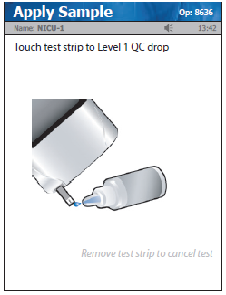
The Insert Strip screen displays.
Insert a Test Strip as shown on the meter screen.
With the test strip correctly inserted, the Apply Sample screen displays.
Gently mix the Control Solution before each use.
Place a drop of control solution to the end of the test strip
When enough sample has been drawn into the strip, the analysis countdown begins.
The Testing Sample screen displays.

Slide 24
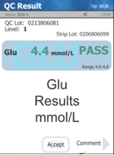
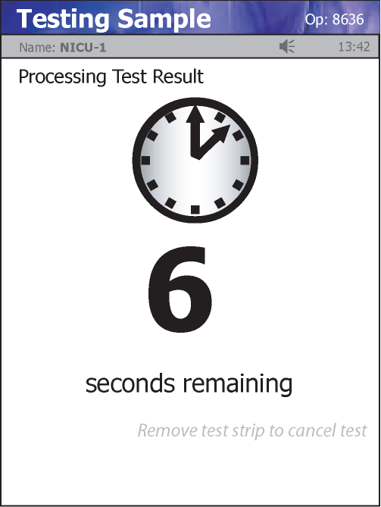
The QC result will display in 6 seconds for Glucose with either PASS or FAIL.
To add a comment to the result, press the “ Comment ” soft key.
To accept the result, Press the “ Accept ” Soft Key.
Note: Allowing liquid to run into the meter STRIP PORT may damage the meter!

Slide 25

3rd Step - Patient Sample Processing
“ Remove ” the meter from the docking station.
Press “ Login ” then enter your operator ID by using the keypad on the touch screen and press “ Accept ”.
From the Patient Test screen press “ Accept ”
From the Enter Strip Lot screen scan the strip lot number by pressing
“ Scan ” then Press “ Accept ”.

Slide 26

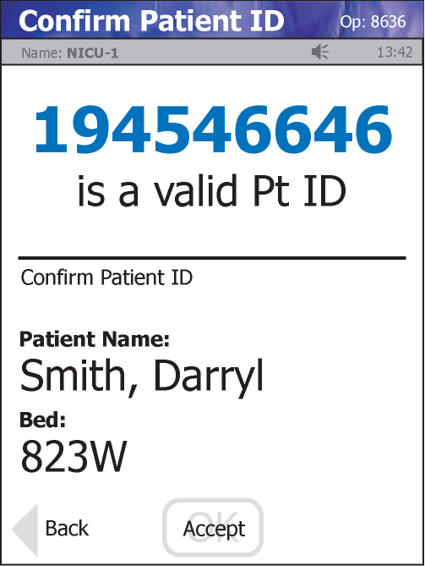
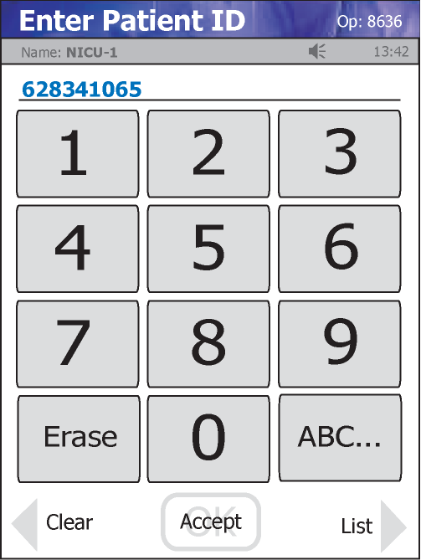
Enter the patient’s ID by scanning the label barcode or using the keypad on the touch screen. Press “ Accept ”.
The Insert Strip screen displays. Insert a Test Strip as shown on the screen.
Discard the first drop and add the 2nd drop to the strip.
Result will appear in 6 seconds for glucose and 10 seconds for Ketone.

Slide 27
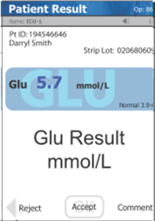
After result displays, remove the test strip and dispose of it in the sharp box..
To ACCEPT the result, Press the “ Accept ” soft key.
To REJECT the result, Press the “ Reject ” soft key.
To add a comment before accepting or rejecting the result, press the “ Comment ” key and choose from preset list. Accept your comment and accept or reject the result.
Record the result in patient file.
Return meter to the Docking Station

Slide 28
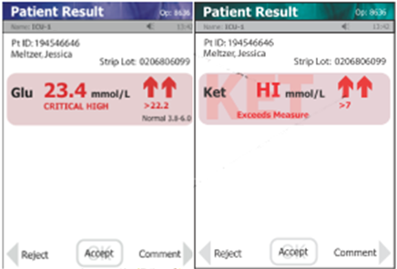
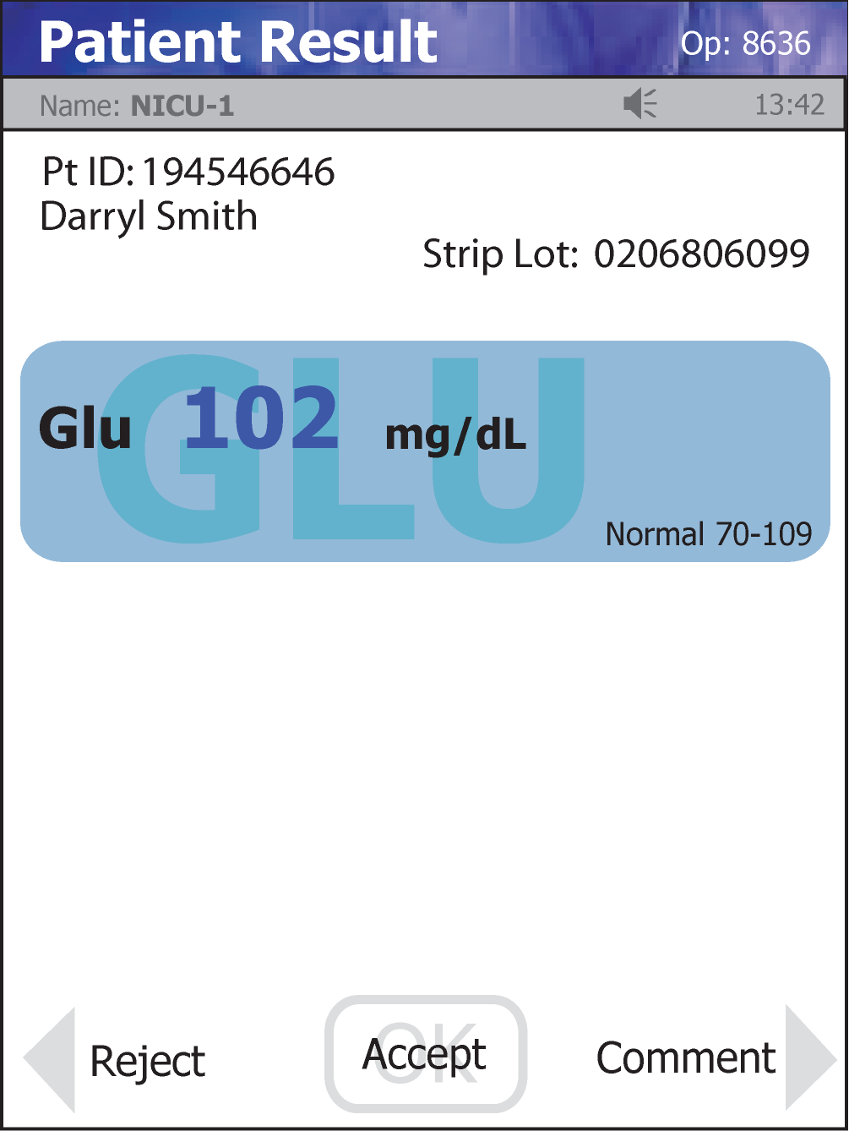
Results:
Normal range in BLUE.
displays Abnormal High results.
displays Abnormal Low results.
display Critical High results.
display Critical Low results.

Slide 29
Important Notes:
The test strip must fill completely upon touching the blood drop.
Testing will not begin until enough blood has been added to the strip.
  Do not touch the strip to the blood drop a second time.
  Discard the test strip and repeat the test with a new test strip.
Do not let blood run down into the meter.
Do not apply sample to the top of the strip.
Blood fills the strip from the End by capillary action.

Slide 30
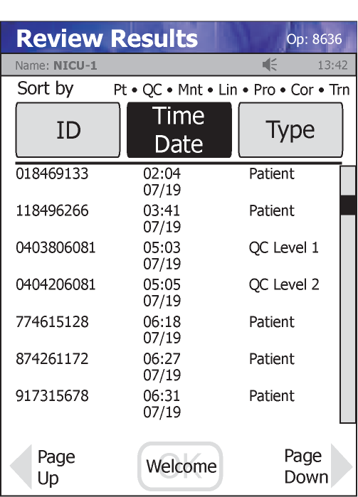
Review Results
Results can be recalled and reviewed.
From the Patient Test screen, touch the “ Review ” Soft Key.
The Review Results screen will display.
Previous results can be sorted by:
ID, Time/Date, or Type.
“ Touch ” any result on the screen.
Press the “ View ” Soft Key to view the result.

Slide 31
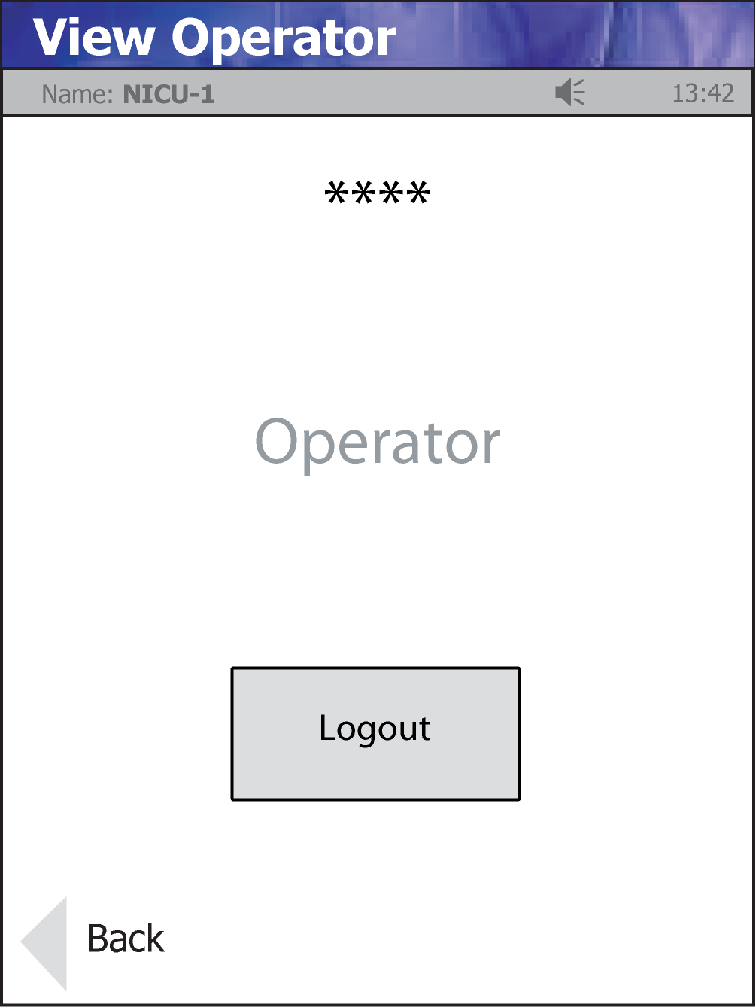
Operator Log Out
From the Patient Test screen, press “ Logout ” Soft Key.
The View Operator screen displays.
Press the “ Logout ” button on the touch screen to log off the meter.

Slide 32
Critical Results Reporting (Glucose)
Critical Range: less than “ ≤ 2.2 mmol/L ” or more than “ ≥ 28.0 mmol/L ”.
If the glucose result is critical for fasting repeat the test again.
Critical patient results are documented in the “Critical Result Log Sheet” and a copy should be forwarded to the laboratory.

Slide 33
Maintenance
Daily Maintenance:
Cleaning:
Clean the meter daily with 70% Alcohol .
Use soft cloth or lint-free tissue to wiped on the screen to remove all cleaning residue.
Caution:
DO NOT hold the meter under running water.
DO NOT spray any liquid into the STRIP PORT area.
Battery charge:
Check the meter charging and make sure it is in docking station.
NOTE: When you replace the battery, the meter will boot up in 20 seconds.

Slide 34
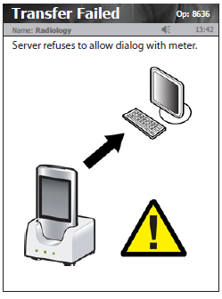
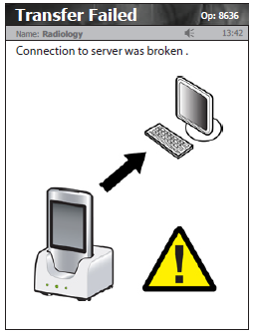
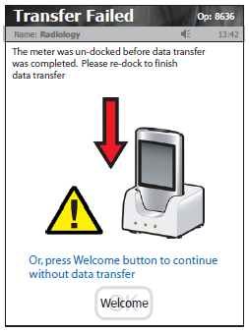
Troubleshooting
Transfer Failed Messages:
The yellow triangle is an indicator that the
meter transfer was incomplete.
The meter can still be used when these types
of communication errors appear on the screen.
The meter should always be
re-docked when it is not in use.

Slide 35
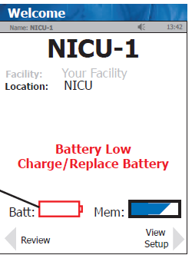
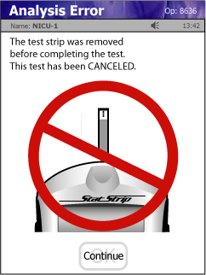
Battery Low:
Keep the meter into the Docking Station.
Analysis error:
The test strip was removed or lost electrical contact with the meter before completing the test.
Insert a new test strip and repeat the test.

